Slide 1
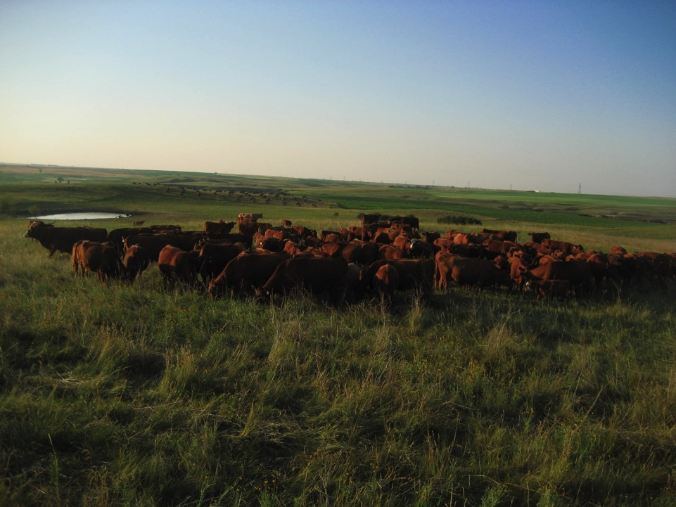

Developing a Mob Grazing System to Improve the Sustainability and Profitability of a Cattle Operation
in North Dakota
Jay & Krista Reiser
NCR-SARE’s Farmers Forum, 2015
Project Number: FNC10-796
Notes:
k

Slide 2
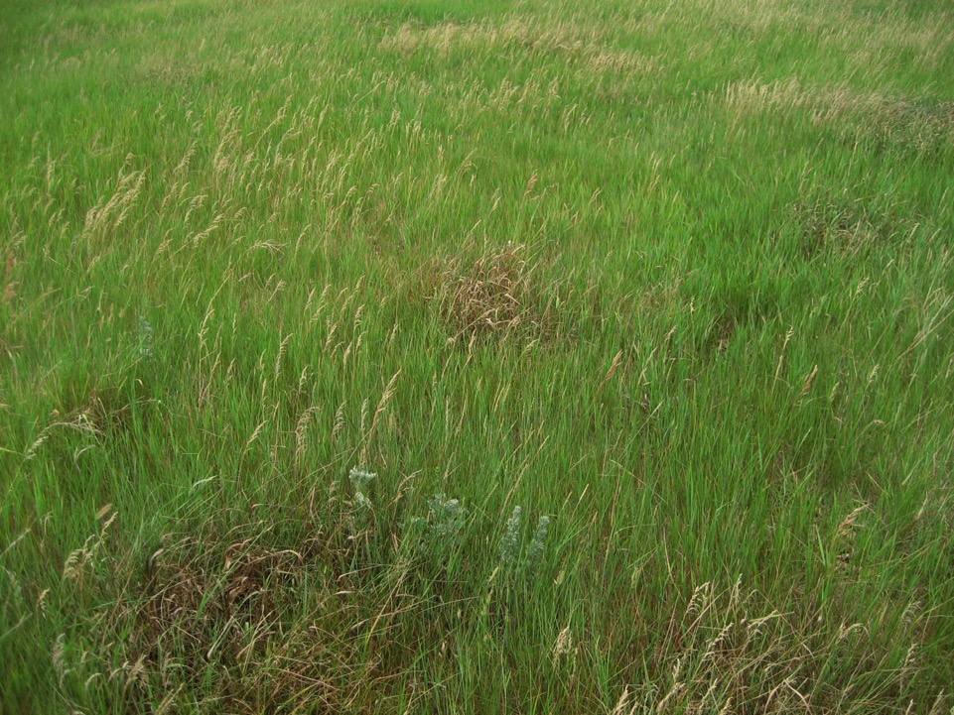
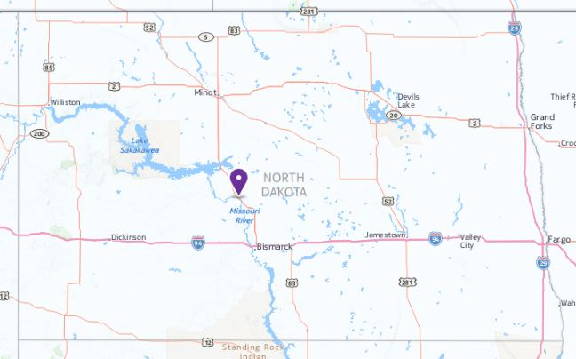
Reiser Ranch
Washburn, ND
Notes:
k

Slide 3
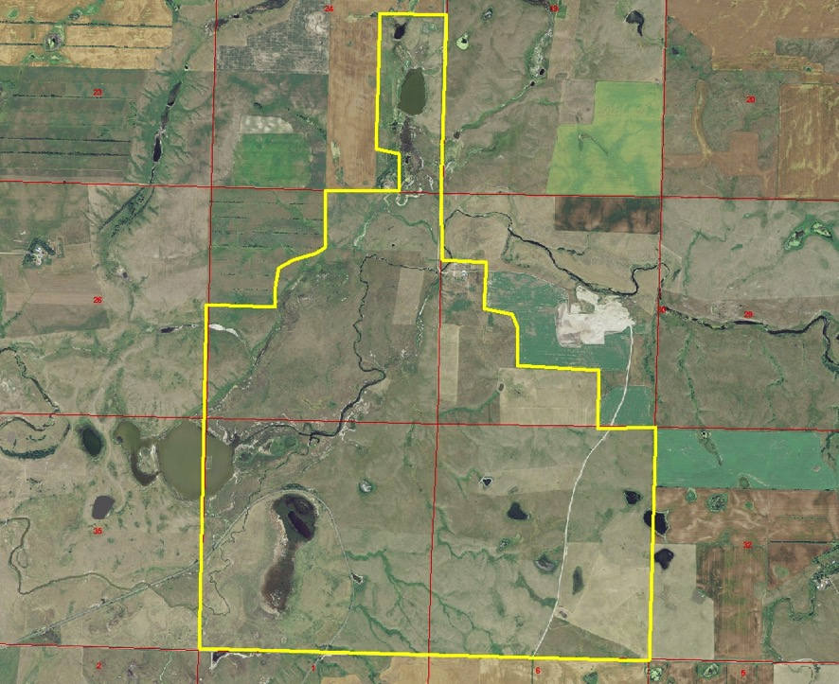
Notes:
k

Slide 4
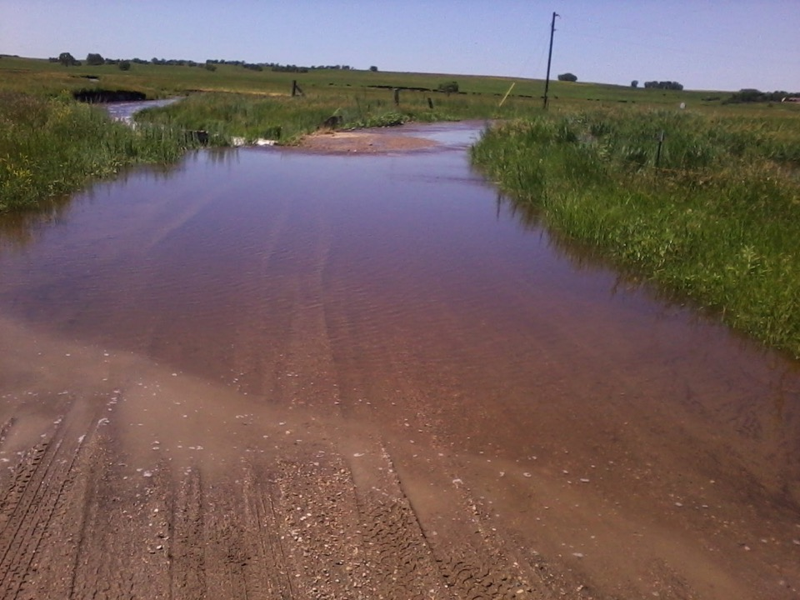
The Weather
2011 – rained a lot
Notes:
K Makes year to year comparison very difficult due to extremes, one test site was flooded

Slide 5
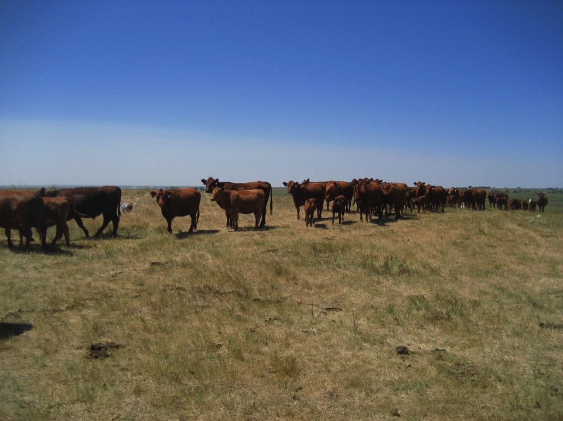
The Weather
2012 – very dry
Mixed results in grass production & clippings
Notes:
k

Slide 6
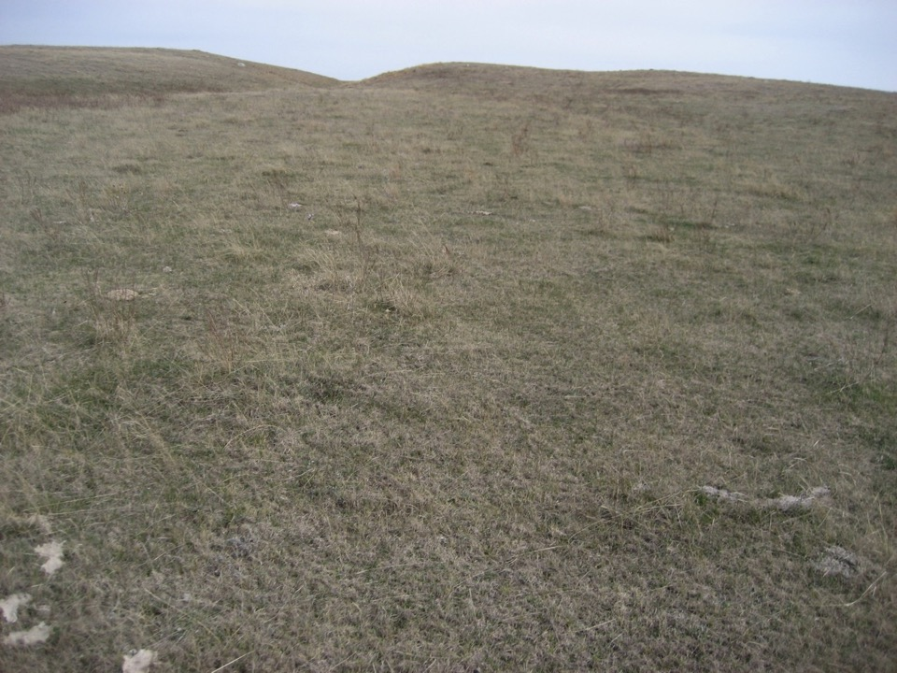
Why did we look into mob grazing?
Degraded rangeland every where we looked
    Selective grazing at a low stock density
    Continuous economic & ecologic deterioration
Notes:
k

Slide 7
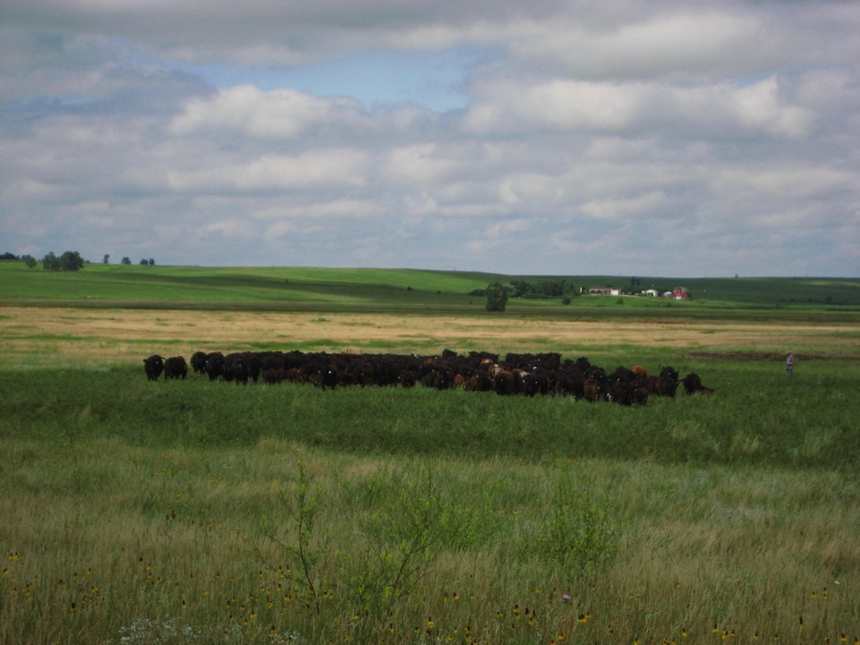
What we learned before mob grazing
Focus on Animal Performance
Increase Density BEFORE Stocking Rate
Notes:
k

Slide 8
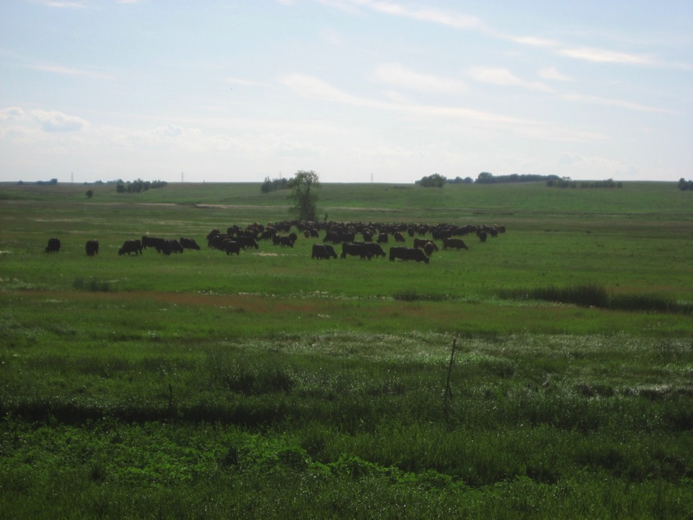
“Mob Grazing”
Stock density depends on your production
High Stock Density Grazing
Notes:
k

Slide 9
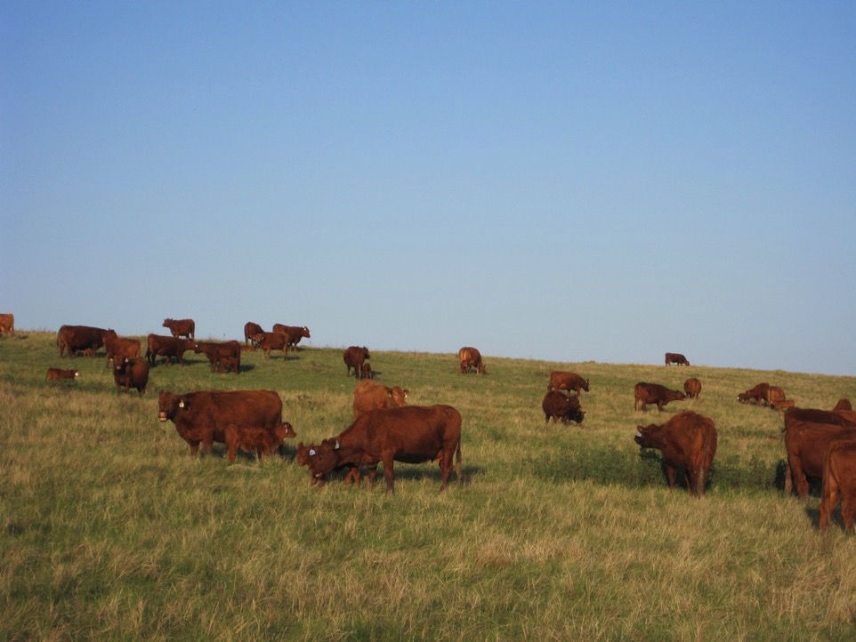
Terms
Cow Days an Acre (CDA)
Animal Unit Month (AUM)
Notes:
k

Slide 10
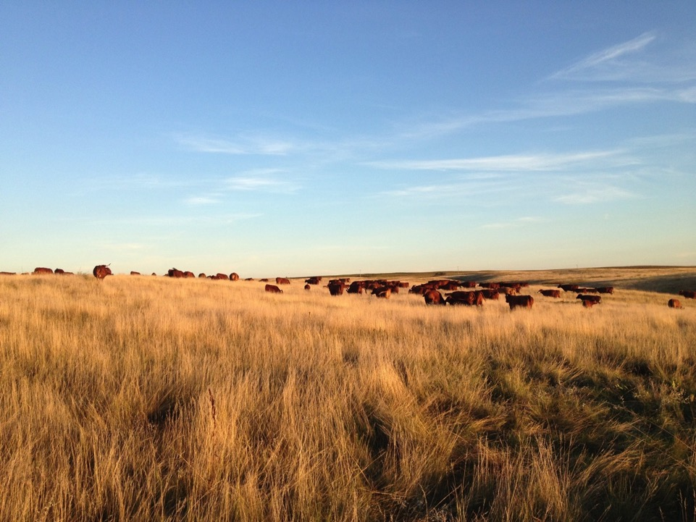
Cattle Classes Used in Mob Grazing
Pairs with calves that were > 1 month old
Fall Calving Cows
No mob grazing while calving
Notes:
k

Slide 11
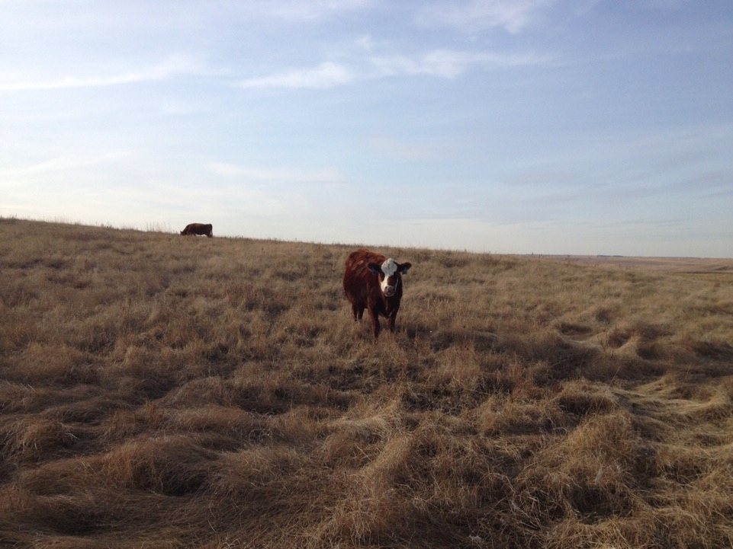
Misconception
Eating everything and leaving nothing
Notes:
K Need to perfect trample to graze ratio.

Slide 12
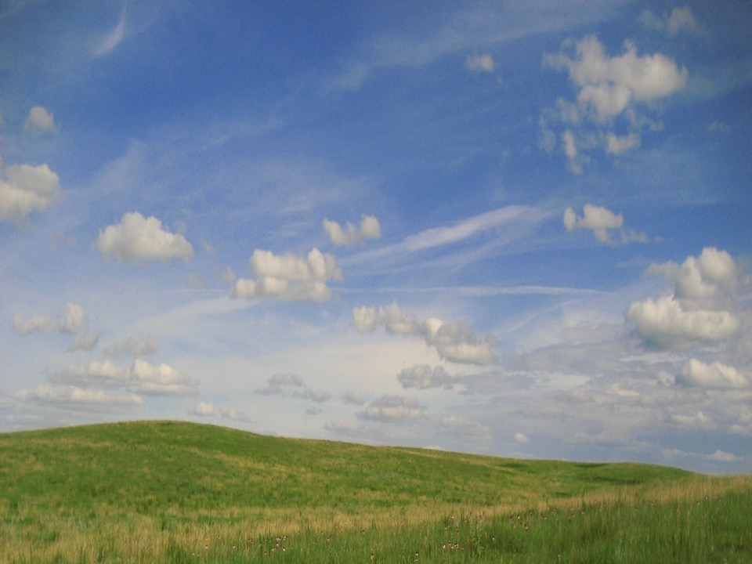
Stocking Rate Vs. Stock Density
Stocking Rate
  The number of acres needed to support one animal for the time you expect the herd to remain in the cell.
  Depends on plant production and size of the grazing animal.
Stock Density
  Concentration of animals in a cell.
Notes:
k

Slide 13
Low Stock Density
Over Grazing
Under grazing
Poor Nutrient Distribution
Notes:
k

Slide 14
Stock Density
Even Grazing
Better Manure/Urine Distribution
Notes:
k

Slide 15
High Stock Density
Very Even Grazing
Competiveness
Animal Impact
  Hoof Action
Improve Soil Health
Notes:
k

Slide 16
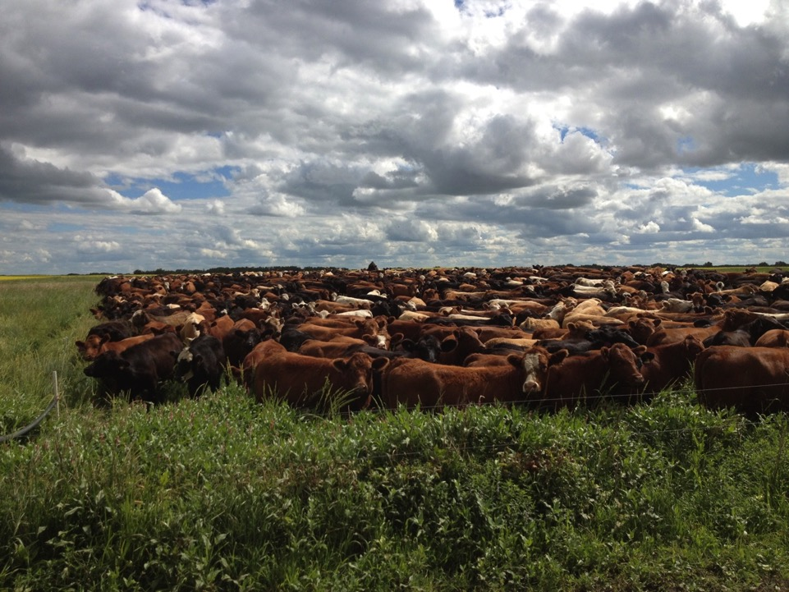
Pounds per acre
  Approx. 650,000#
Notes:
k

Slide 17
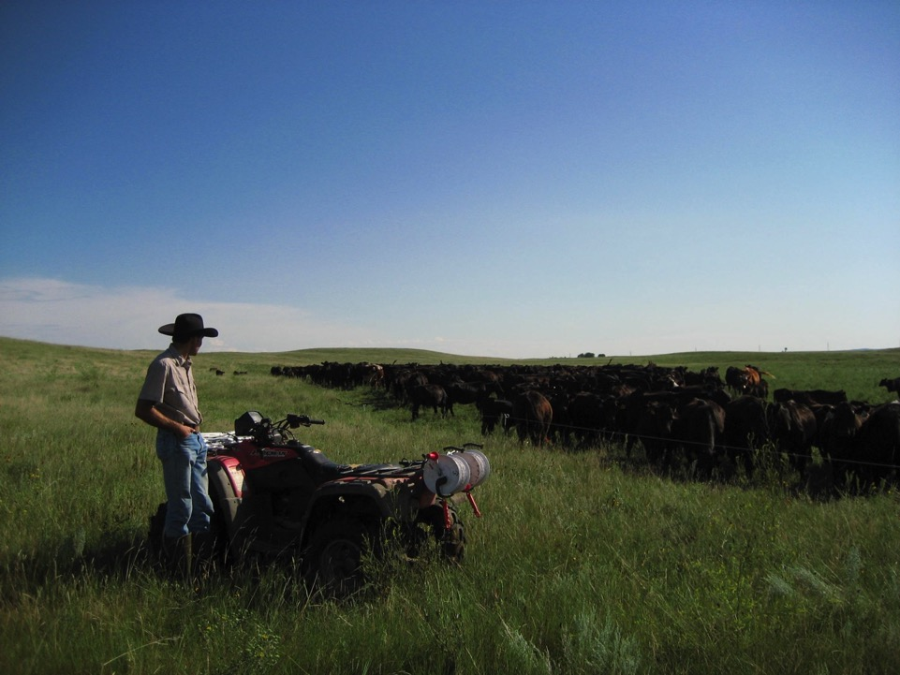
Top Two Conclusions
Mob grazing in our area should be used as a tool and not a whole ranch grazing system.
Rest associated with mob grazing is what made us successful.
Notes:
j

Slide 18
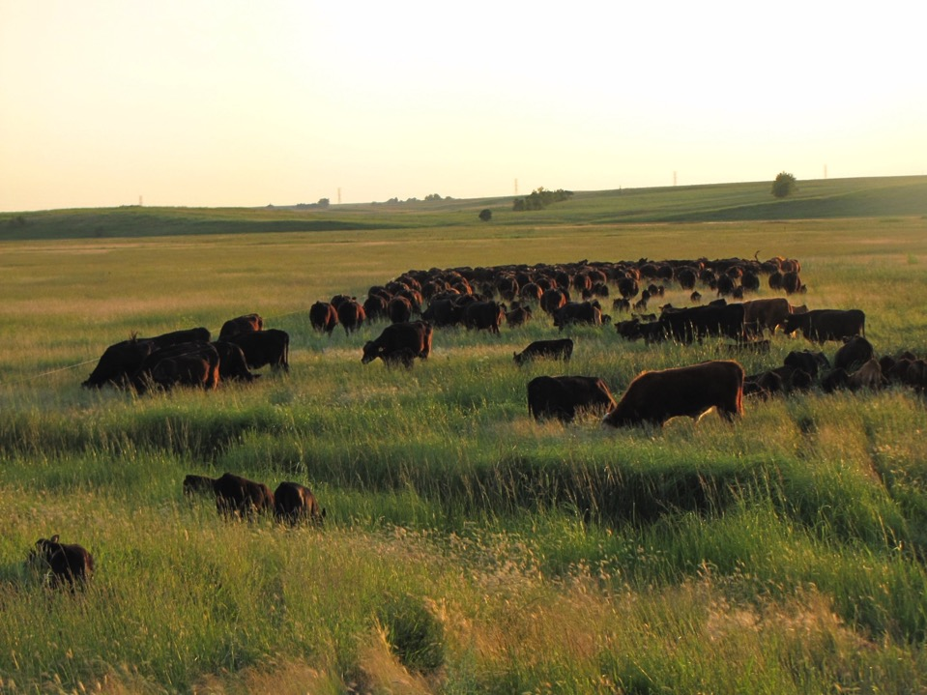
Our Tools – Need Good Equipment!
Temporary Fence
Movable Pipeline/Tanks for Water
Notes:
j

Slide 19
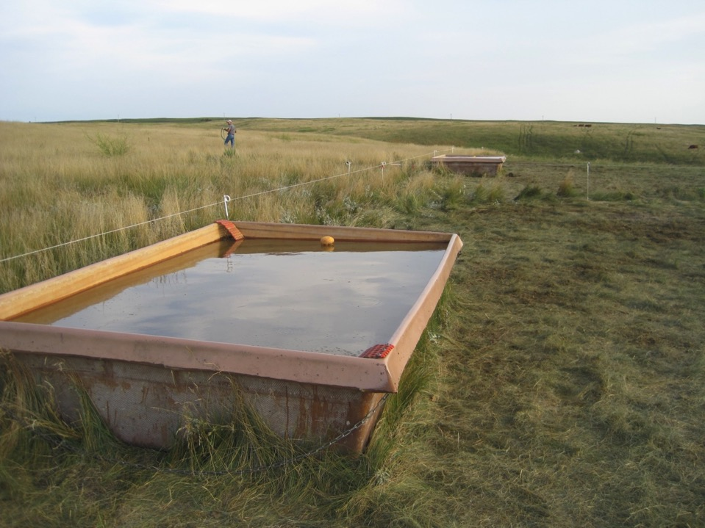

Slide 20
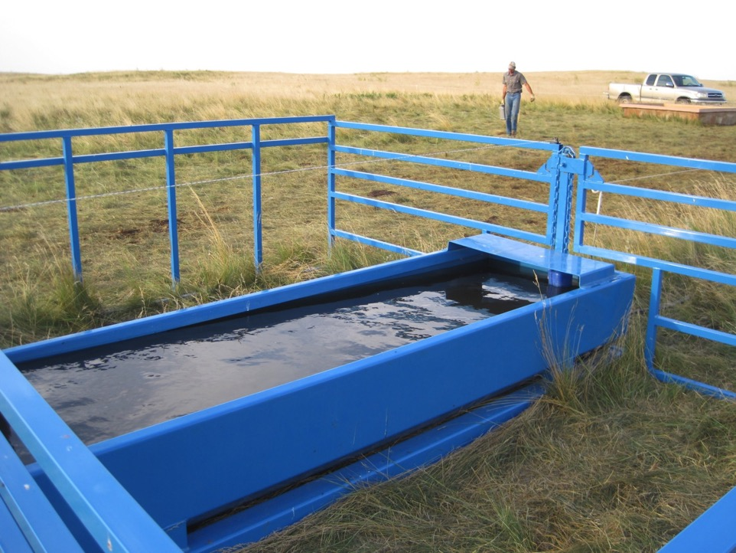

Slide 21
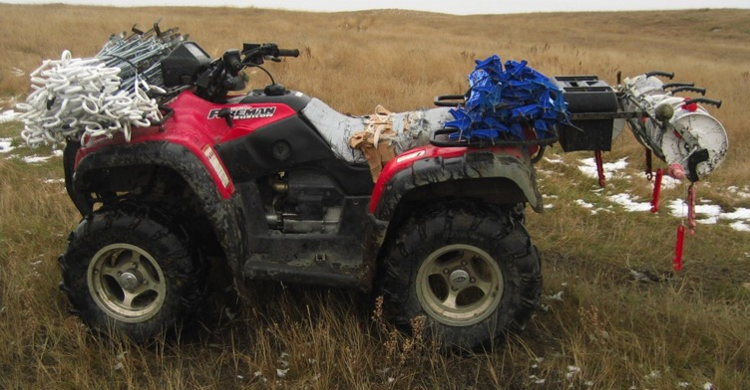
Simple Fence Materials
Polybraid on Geared Rollers
  (1/4 mile)
Treadline Step in Post
Pig Tail Step in Post
Jump Wires
Twine
Batt Latches
Notes:
J – no t posts, no metal wire, no heavy metal posts

Slide 22
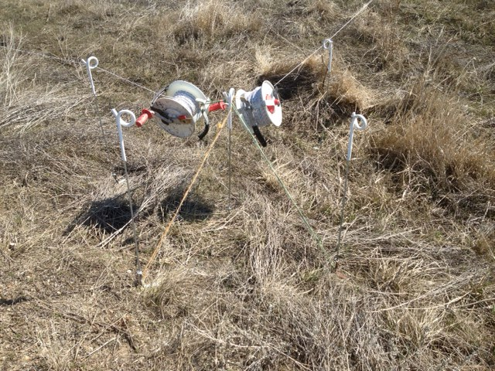

Slide 23
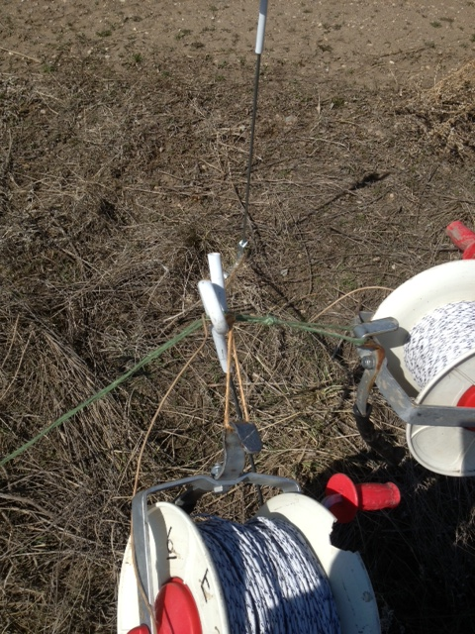

Slide 24
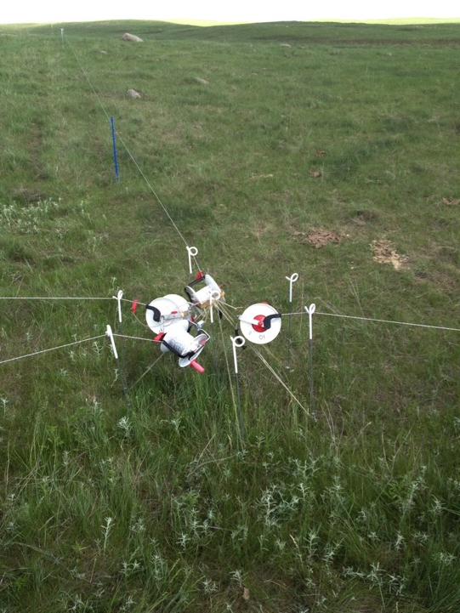

Slide 25
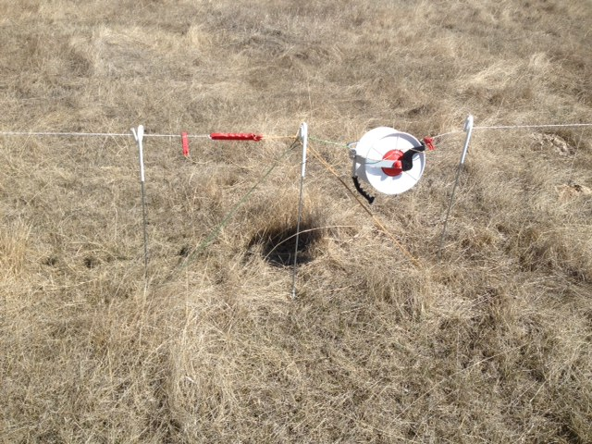

Slide 26
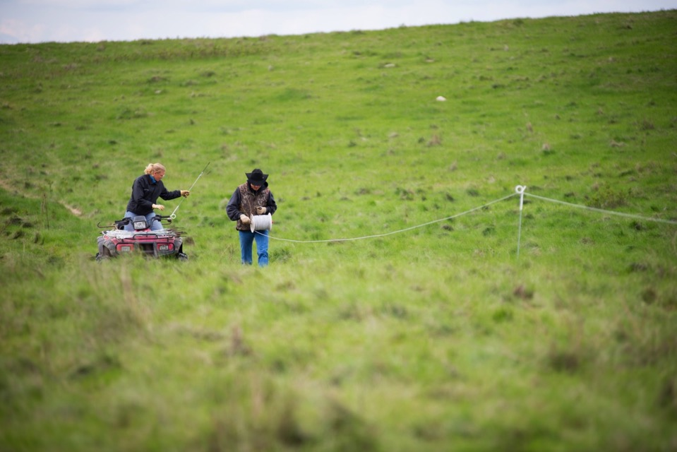
Single Wire Electric Fence
Photo Credit: LTP Images
Notes:
Time to put up

Slide 27
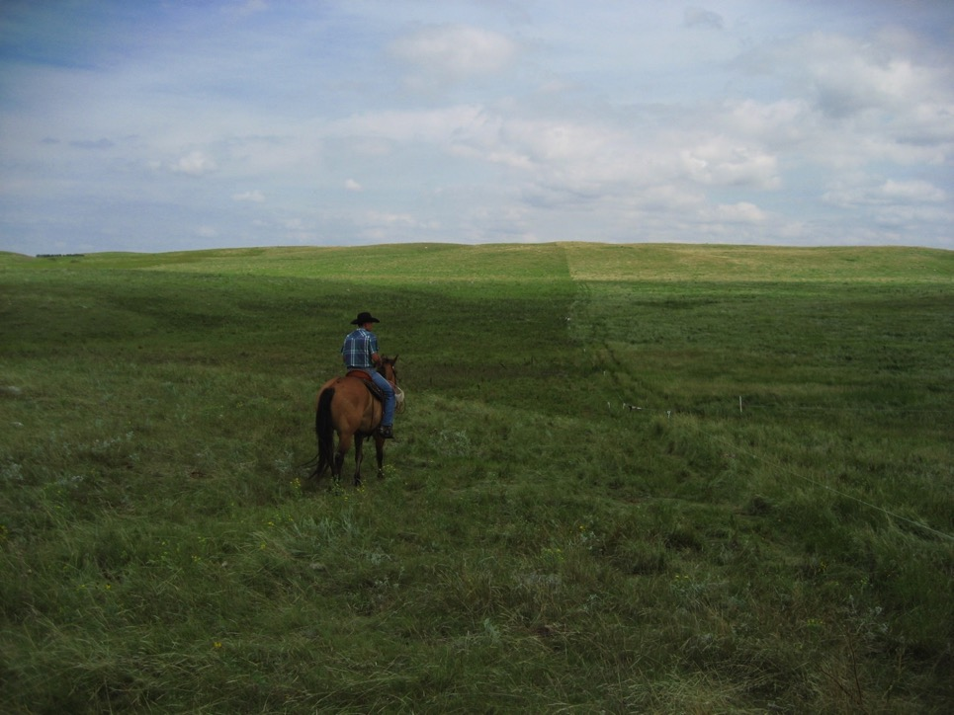
ATV
Tracks for tall forage
Cows can see fence better
Cows are trained to ATV track

Slide 28
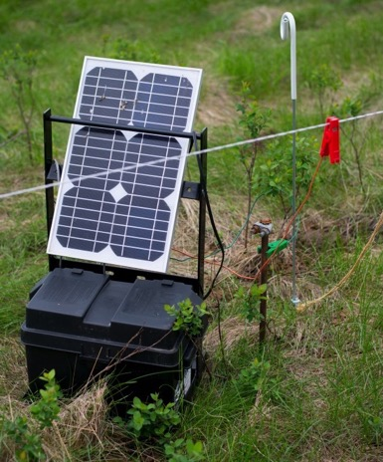
Energizer
Size
  Rule of thumb ½ to one joule
    per mile of temporary fence.
Battery Powered & Solar Panel
Always having a hot fence
Ground Rods
Photo Credit: LTP Images
Notes:
Ground rod w/ clamp

Slide 29
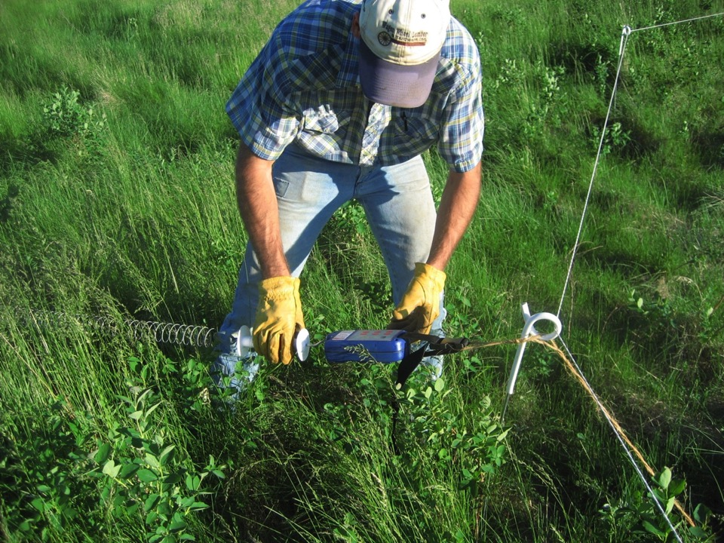
Notes:
J – A batt Latch is a automatic gate opener that is on a springs open when the timer goes off…just like an alarm clock. While mob grazing we would move our cows multiple times a day and they would not be coming back on the same ground, get a high animal impact, get a lot of cover on the ground and increase the rest in our system.

Slide 30
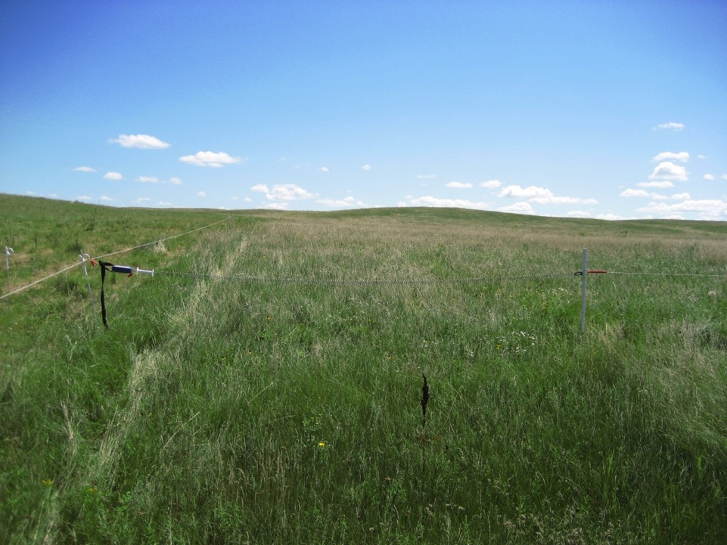

Slide 31
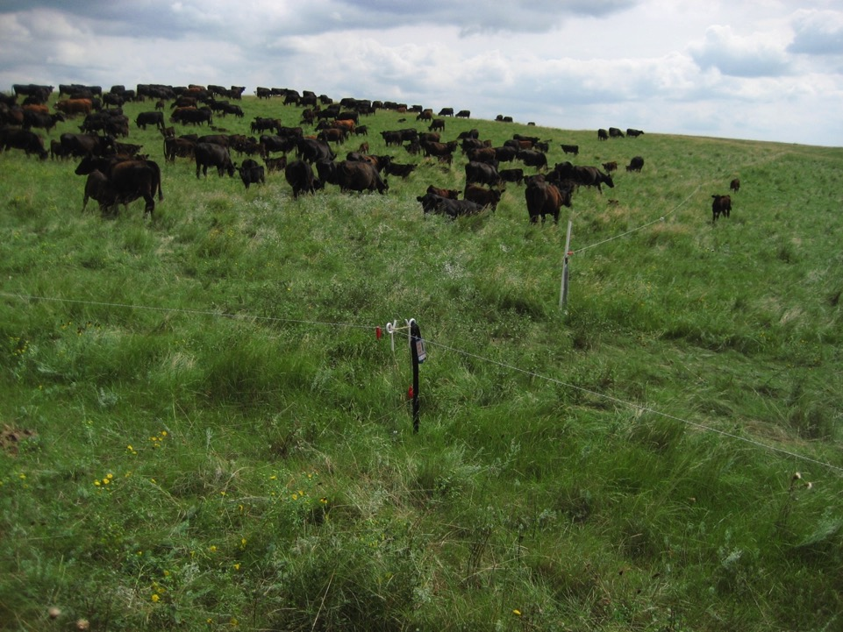

Slide 32
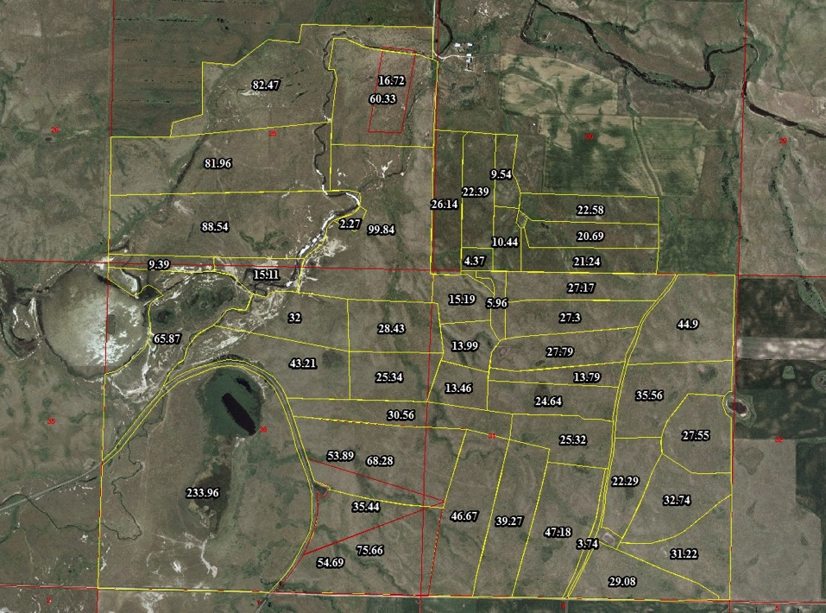
2012
Notes:
j

Slide 33
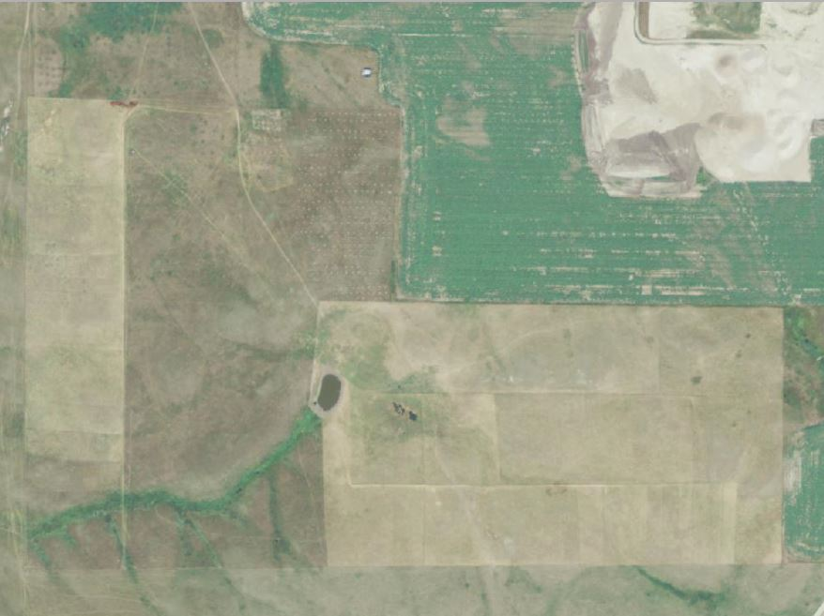
Notes:
j

Slide 34
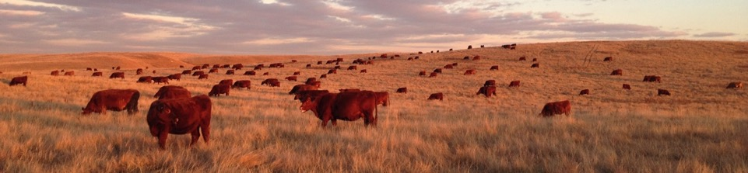
Cell Size
Long/Narrow vs. Wide
High Stock Density with no back fence
Notes:
j

Slide 35
Notes:
j

Slide 36
Notes:
j

Slide 37
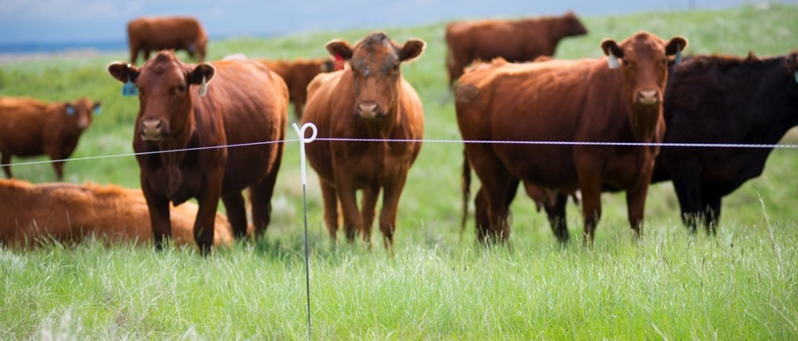
Training Cattle
Electric Fence
Knowing they will be moved
Learning to go around the corner
1 week adjustment
Photo Credit: LTP Images
Notes:
j

Slide 38
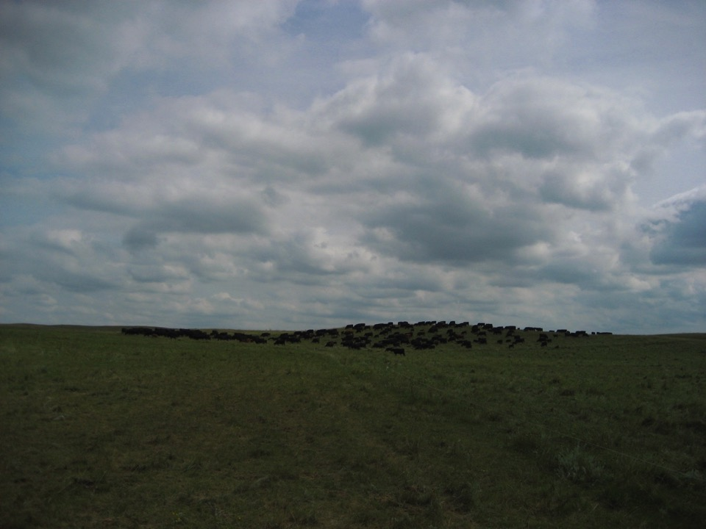
A Typical Day
4 moves
  Take down yesterday’s
  Set up first cell
  Let cows in
  Set up for today’s moves
  Go about the other projects you may have for the day!
Notes:
J Double check batt latches

Slide 39
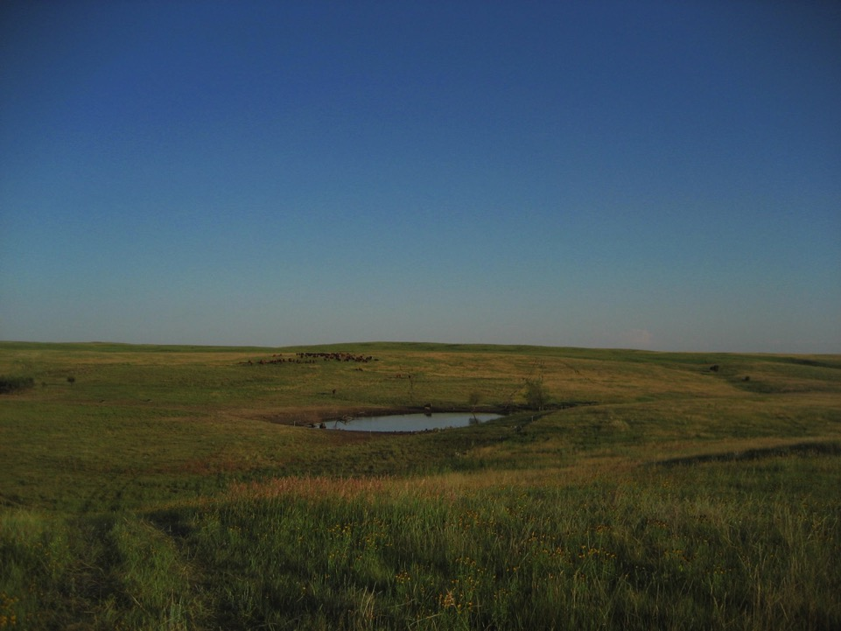
Planning Our Grazing System
Maps
Online Measuring Tools
  http://mapservice.swc.state.nd.us/
ATV odometer
Strides for measurement
Adapting and Changing
Notes:
j

Slide 40
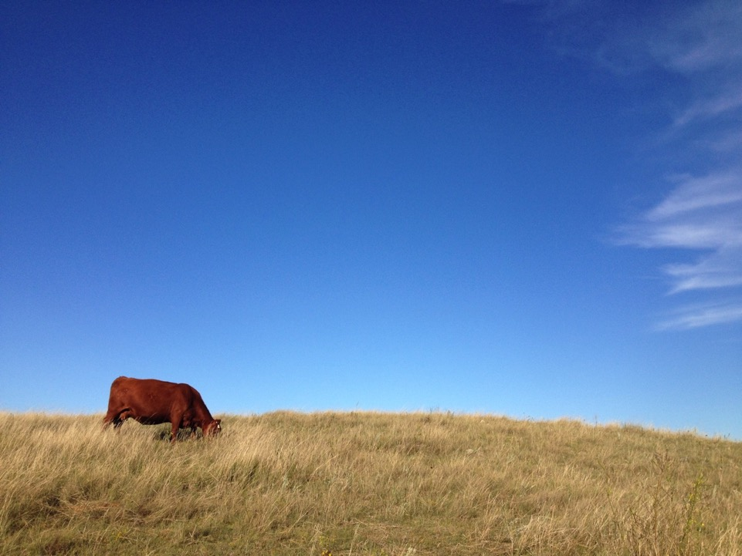
Determining the right amount of forage
Watch the animals
  Content vs. Bellering
Animal impact goal
Grass Quality
Grass Quantity

Slide 41
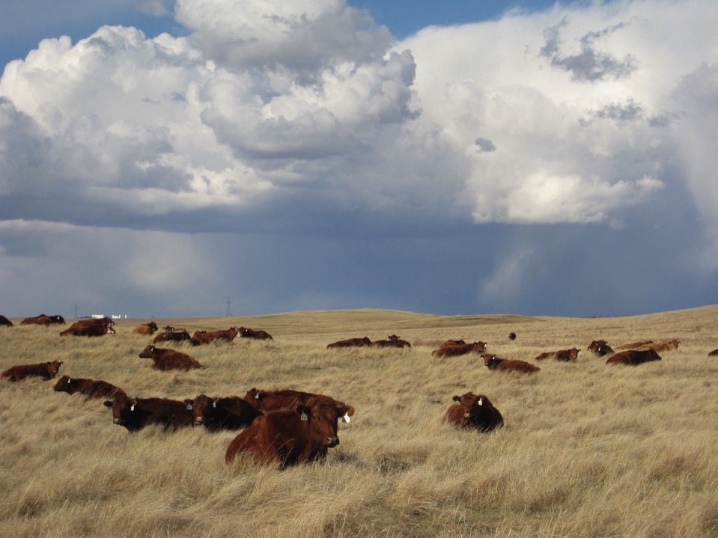
Determining the next move…
Brix
Hot temps
Bad weather
Manure composition
Gut fill
Notes:
j

Slide 42
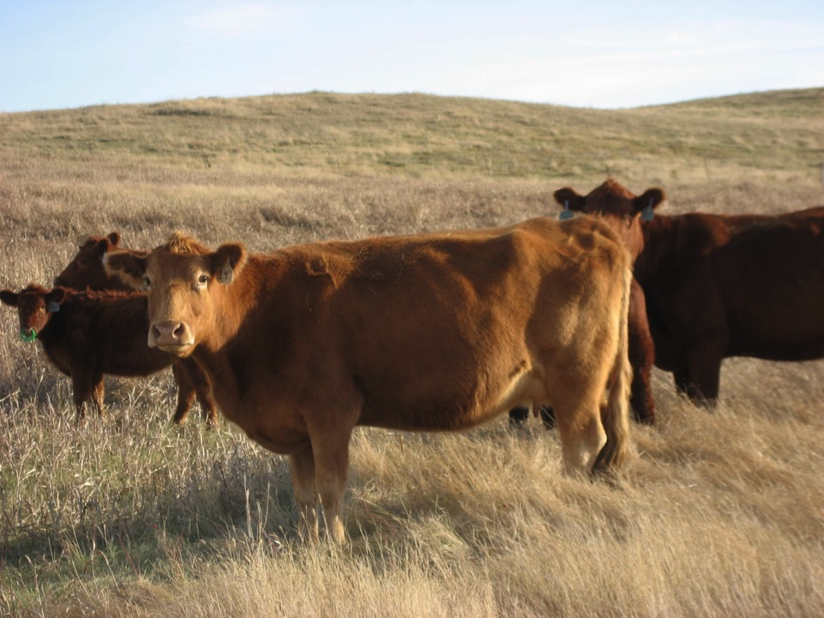
Gut fill

Slide 43
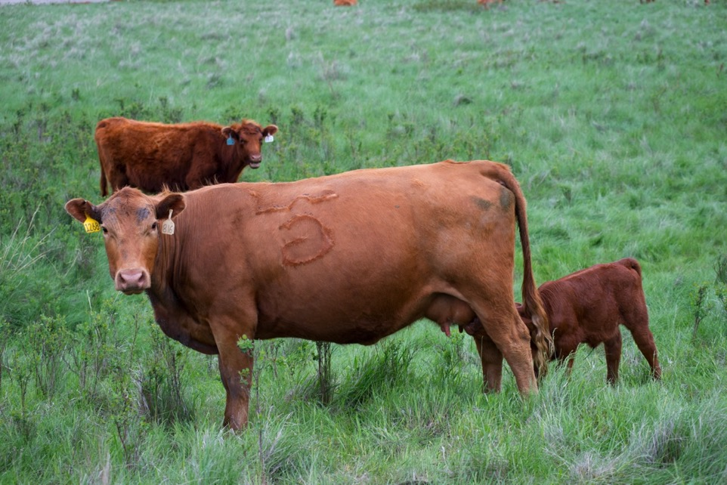
Gut fill
Photo Credit: LTP Images

Slide 44
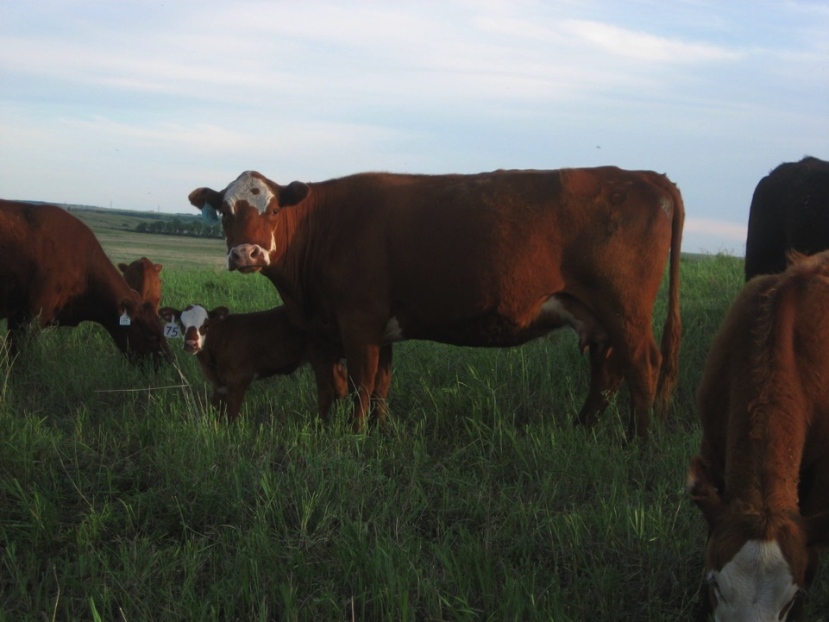
Gut fill

Slide 45
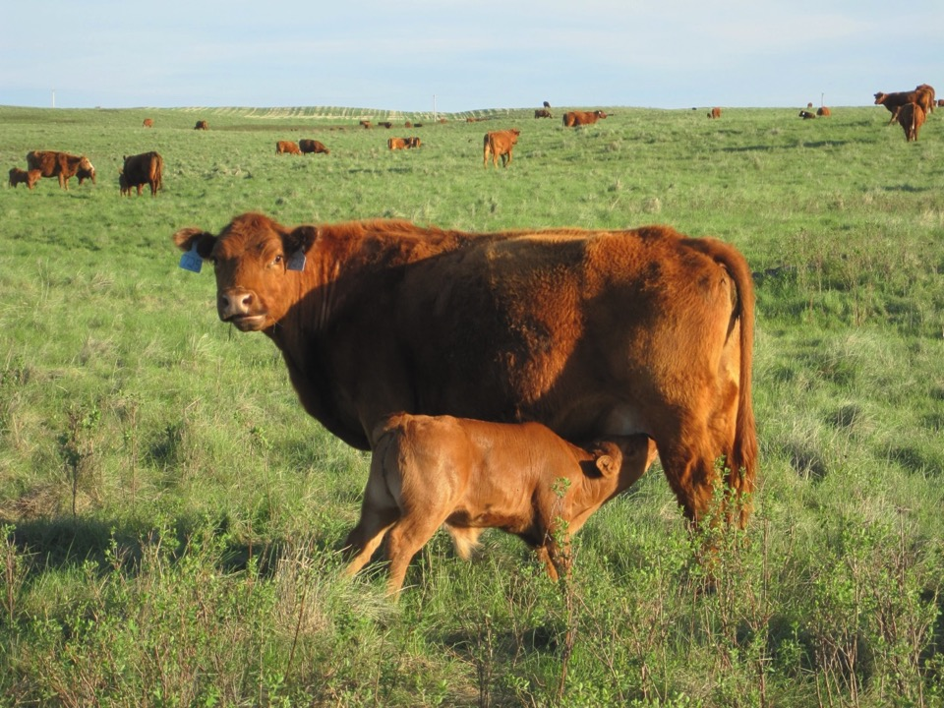
Gut fill
Gut fill

Slide 46
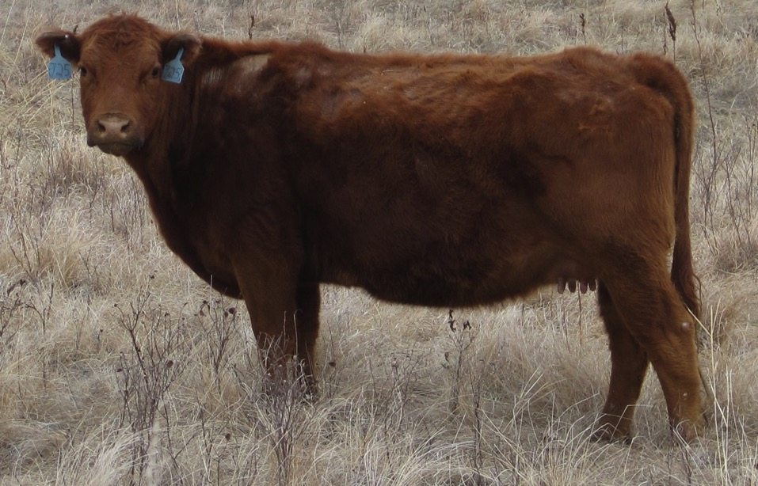
Gut fill

Slide 47
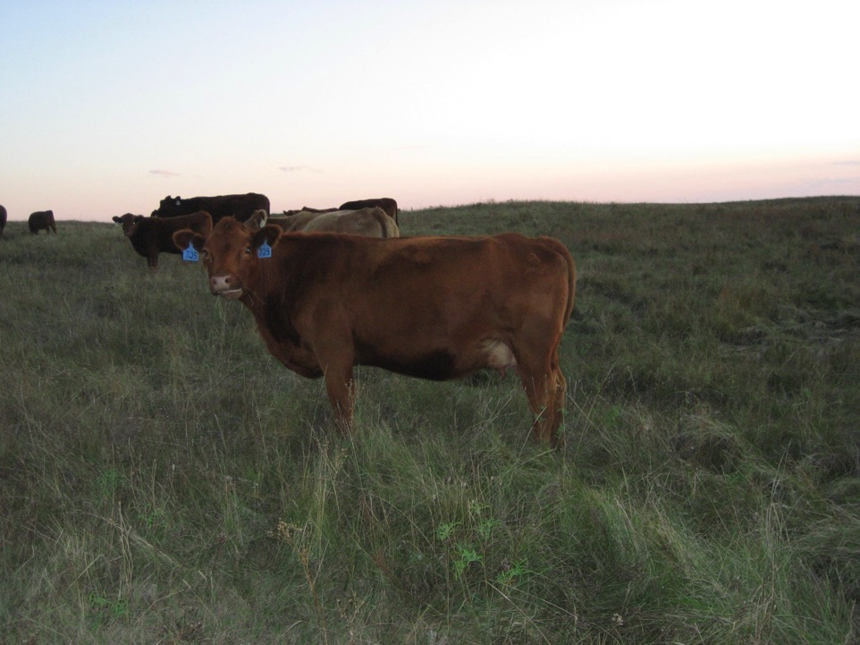
Gut fill

Slide 48
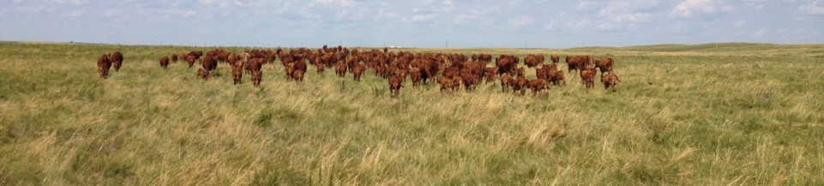
Manure Composition
Protein/Energy
“Washy Grass”
  Use straw bale to supplement
Brown Grass > Energy
Green Grass > Protein

Slide 49
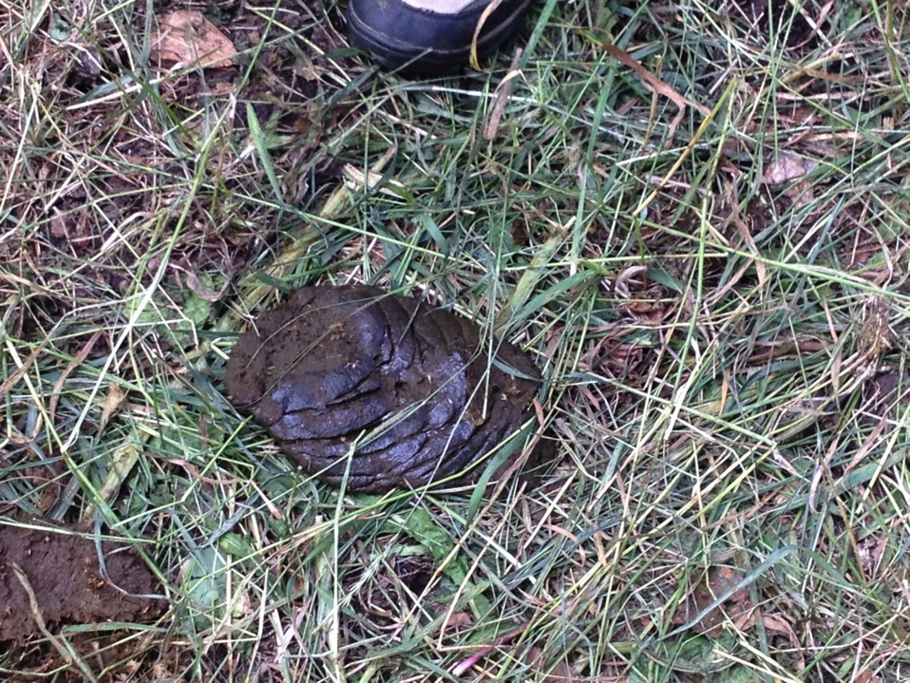

Slide 50
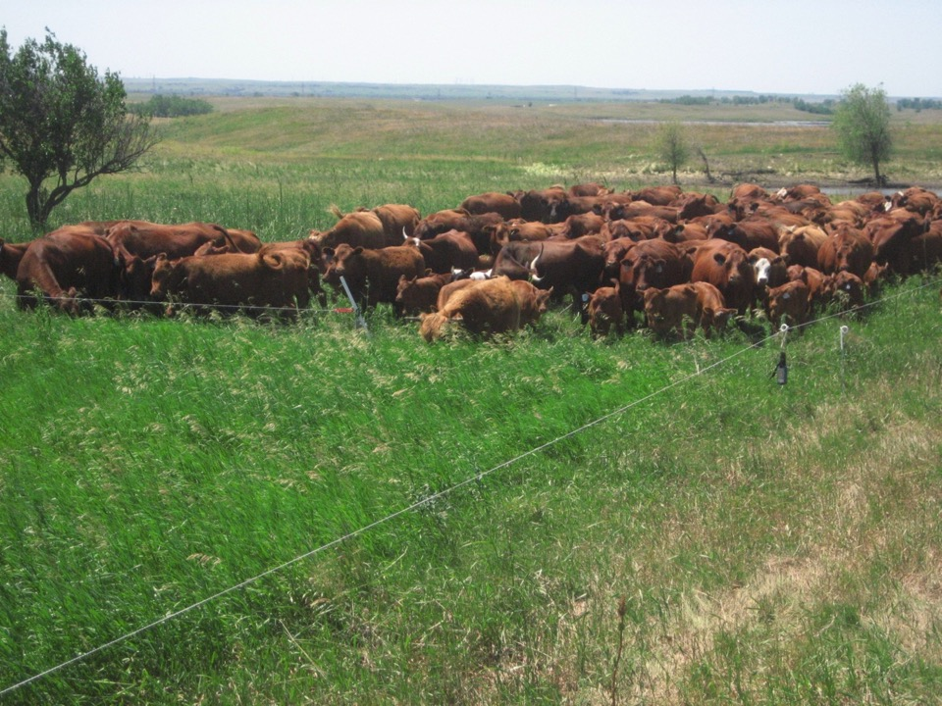
Notes:
K We use the batt latch as a time saving tool to help move our cattle while we are mob grazing. Here is our mob moving into a new cell. We are going to get into some of our grazing now, and show you what we are trying to do with the degraded rangeland.

Slide 51
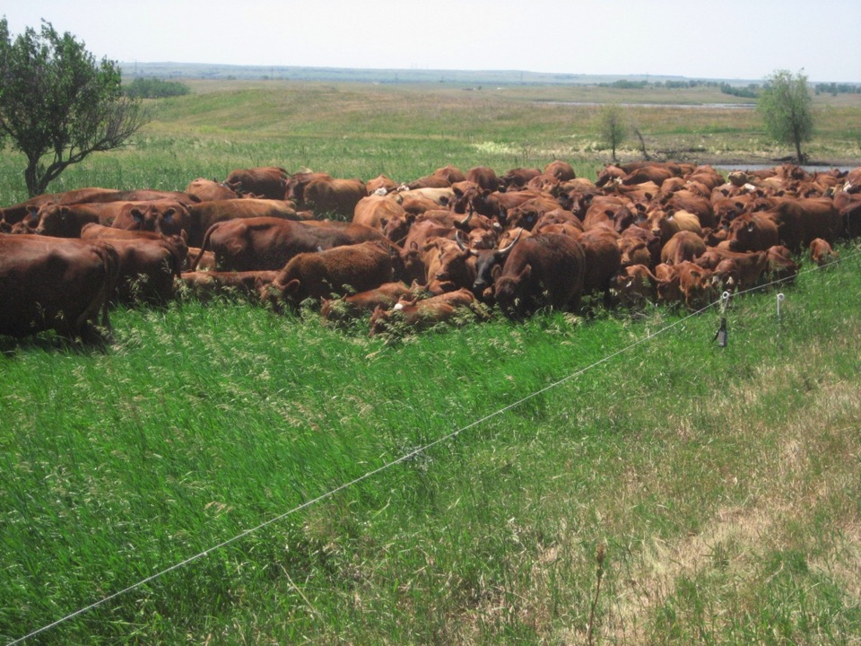

Slide 52
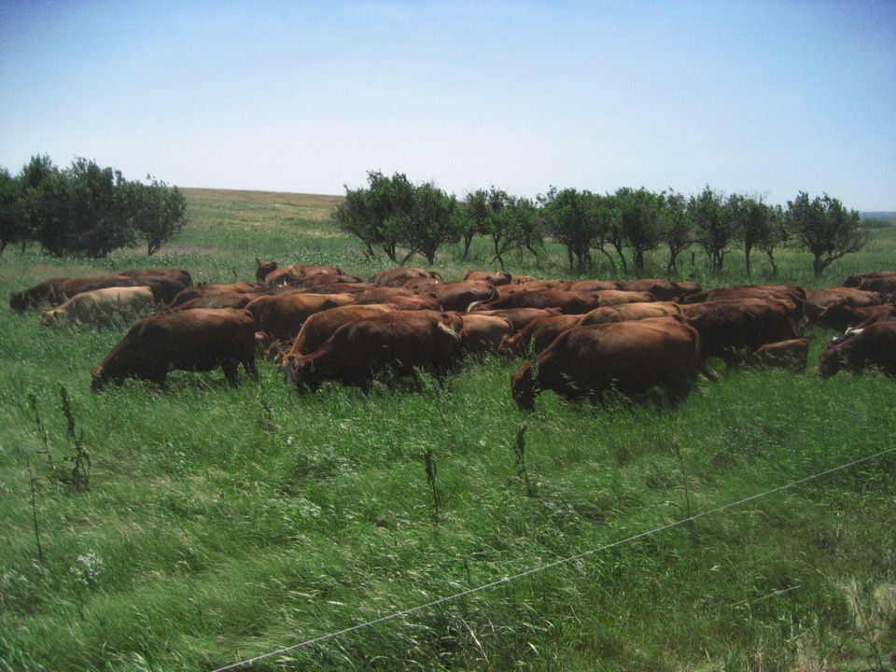

Slide 53
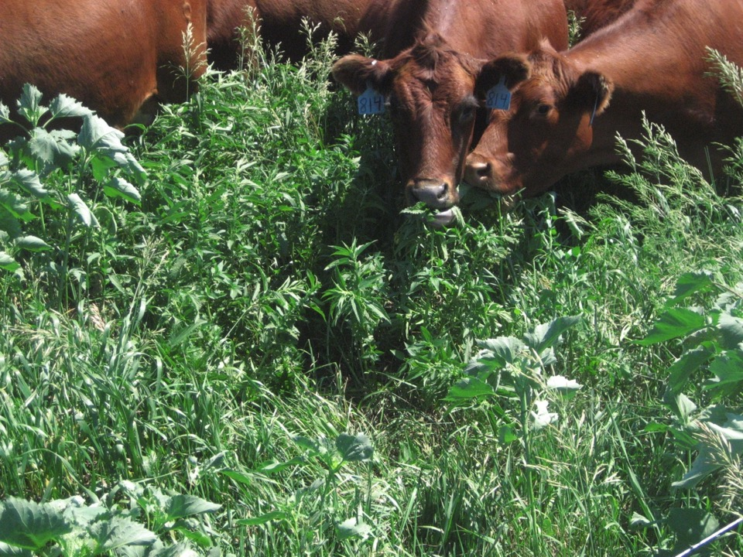
Notes:
J Cattle will actively seek out highly nutritious “weeds”

Slide 54
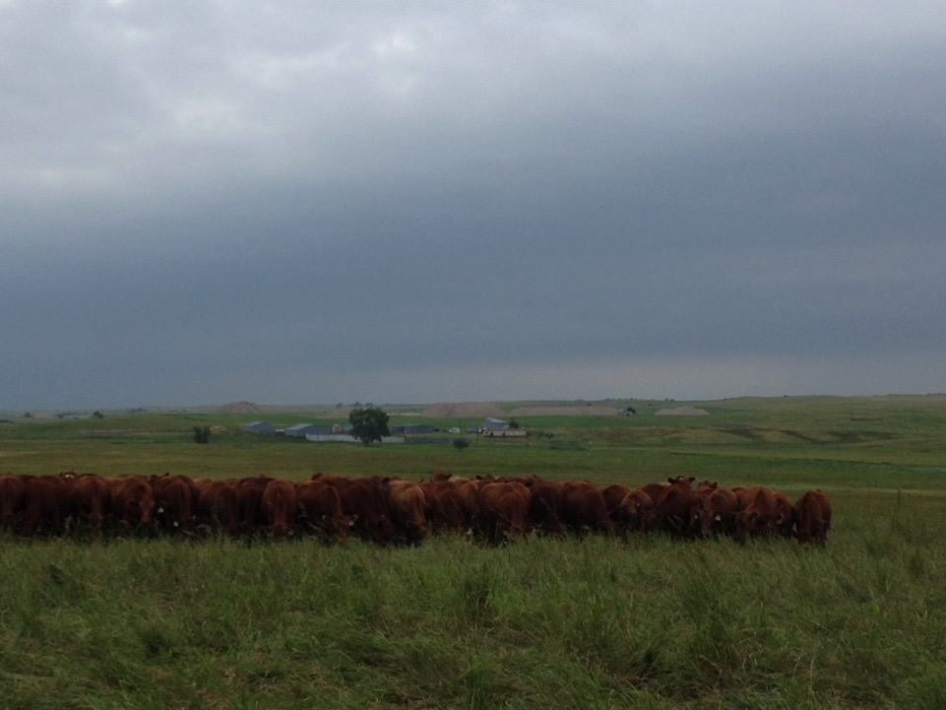
How Forage Tramples
Kentucky Bluegrass vs. Smooth Brome/Quack Grass
Wet vs Dry Forage
Morning Dew vs. Dry Afternoon
Changes in topography

Slide 55

Notes:
K Before the mob

Slide 56

Notes:
Lock in moisture and keep the ground covered – create a good seed bed, feed plants.

Slide 57

Notes:
Higher production area

Slide 58

Trample on a thin hillside
Notes:
Consume more of plant, so move them quicker and importance of hoof action

Slide 59

Really green Kentucky Bluegrass after the mob.
Notes:
Leave behind cover and try to let the cows take the best. Cover the ground.

Slide 60

Dry Kentucky Bluegrass after the mob.
Notes:
Trample in buckbrush patches – usually bare ground and where weeds start. Cattle tend to avoid
Side note our cattle LOVE buck brush.

Slide 61


Slide 62

Notes:
Point out sweet clover and previous management

Slide 63

Notes:
Rocks & cowpies

Slide 64

Notes:
Maybe nothing but kentucky bluegrass and sweet clover but at least we have something to keep the ground covered.

Slide 65

Rest – Our #1 Advantage
One weeks rest comparison
Notes:
This photo really speaks for itself. The easiest thing to do – is nothing! With no cross fences it requires a lot of labor. The plants are healthier, growing more forage, adding diversity from increasing recovery for the plants.

Slide 66

May 2014
Rested 2013
Grazed 2013 w/ 2014 regrowth

Slide 67

June 2014
Rested 2013, 2014
Grazed 2013 & 2014
Rested 2013 & Grazed 2014

Slide 68

New Western Wheatgrass growing in previously 100% Blue Grama
Notes:
Mob grazed in June and picture taking in the fall. Did the mob grazing open up the blue grama? Or did the mob grazing allow enough rest in the system for the western wheat to express itself? Everything is connected, so I don’t know if an answer is really necessary – we are just happy to see that diversity is coming into the landscape.

Slide 69

Knowing Production
Training Eyes for CDA
Know how many hours of grazing
Notes:
K – need to know what the land is producing – what is the trend? Don’t take the time to collect data you won’t use for management decisions.

Slide 70

Notes:
K Will our practices help cover the bare ground?

Slide 71

10 Point Frame
 | Before Mob Graze | 1 Year Mob Grazed | 2013
Taken | 8/21/2011 | 6/16/2012 | 8/4/2013
Bare Ground | 18.80% | 2.00% | 3.92%
Litter | 33.00% | 50.40% | 59.41%
Moss | 4.40% | 1.20% | 0.20%
Grasses | 35% | 40.4% | 32.36%
Forbs | 5% | *4.4% | **1.73%
Cow Pies & Rocks | 3.8% | 1.6% | 2.38%
*Dandelion & Curlycup Gum Weed
** Native Forbs
Notes:
Too many questions to make conclusions

Slide 72

Grass Production Increase?
Growing More Grass – Yes
Grazing More Cows – No
Not harvesting more grass because we are feeding the soil biology.
Notes:
Feeding soil biology for a long term gain, it won’t be immediate.

Slide 73
Frustrations/Learning Curve
Not finding the batt latch when it opens
Batt latch doesn’t open
Distance from water - decreases in utilization
Occasional time constraints or other emergencies
Standing by water on hot days and not grazing
Determining the right amount of daily forage allocation
Inconsistence stands of forage due to topography
“dumb” calves
Getting eaten by mosquitoes/gnat/horse flies
Too much rain causing pugging of soils
Notes:
k

Slide 74

Notes:
Wasn’t necessary damaged, but a person can do damage

Slide 75
Results/Benefits – Rangeland
Based on Visual Observations
The rest that was incorporated with mob grazing allowed our plants to increase in vigor and production.
Mob grazing allowed us to rest a area for an entire year.
The different types of grasses and forbs were able to better complement each other and form a fuller canopy.
Warm season plants were better able to express themselves since they were able to mature and go to seed on certain areas of our land base.
Significantly lengthen our grazing season.

Slide 76

Winter Grazing
February 2012
Stockpiled Forage
Saved $8,000 - $10,000 in hay
Notes:
K -

Slide 77

Results/Benefits - Cows
Increased harvest efficiency
Competition – less selective grazing
Quick to check cows, find problems right away
Fly control
Notes:
Jay - When mob grazing we noticed a lot of bird activity

Slide 78

Notes:
Cliff swallow

Slide 79

Notes:
Brown headed cowbird

Slide 80
Grant Conclusions
We wrote into our grant that we would mob graze 300 or more acres per year, but we realized that mob grazing works better as a tool on certain areas over others.
Into the future we will continue to use mob grazing but we will use it as more of a prescription treatment for the areas that it will benefit the most, rather than having a goal of a certain number of acres that we need to apply it to.
We would tell other ranchers to move into mob grazing slowly, and take the time to learn from others. Mob grazing takes a lot of time and you have to be willing to watch your cattle and make sure your evaluating their performance.
It is important to make the cells the right size to get the correct trample to graze ratio. Everything takes time as well as developing an experienced eye. Also don’t expect immediate results, nature doesn’t change as quickly as humans would like, everything takes time and patience.
Mob grazing can and cannot work – depends on how you use the tool
Notes:
j

Slide 81
Grant Conclusions
For our project we wanted to get some hard data for comparisons to conventional grazing systems. We think more data is needed to draw any conclusive results from our grant project.
We took cattle weights, soil samples, production samples and 10 point frame readings. We weighed our cattle and determined it was inconclusive. It was inconclusive because we would graze based on the weather, so mob grazing would not always occur as planned. Sometimes we needed to be gone and the cattle would not mob graze for a couple of days. It is nearly impossible to mob graze every day, so the cattle weights would not reflect just a mob grazing.
The grass production samples were the same but our weather extremes played a big role in grass production.
The goal of getting our bare ground covered with mob grazing was achieved.
The goal of lengthening our grazing season over a set stocked suggested stocking rate was achieved.
Notes:
j

Slide 82

Top Two Conclusions
Mob grazing in our area should be used as a tool and not a whole ranch grazing system.
Rest associated with mob grazing was what made us successful.
Notes:
j

Slide 83

Improving the Rangeland
Healthy Plants
  Nutrient Dense
  Deeper Roots
Improving Water Cycle
Build Drought Resistance
Increase Production
Feeding Soil Biology
Keeping the Ground Cover
Notes:
K

Slide 84

$
Soil Health
Plant Health
Animal Health
Notes:
Make sure every part of the system is properly feed for maximum performance

Slide 85
Our Grazing System
50% of land rested during peak plant growth
6% grazed
94% has no livestock
Always changing season of use
Notes:
Just some quick facts on our property. We don’t specifically manage for wildlife, but it is just an added benefit of managing holistically.

Slide 86

Our Grazing
Getting the cows to the right place at the right time for the right reasons
  Intense Rotation Graze
    Daily Moves
    Move every 3-6 days
  Winter Grazing
  Quality of Life Grazing (Vacation Grazing)
  Rest
  Mob Grazing Treatment
    Moving up to 4 times a day
Notes:
K- All of these have a focus of providing adequest rest and recovery. Rest was missing link in the management of this ground prior to us being here and rest is the missing link in a lot of grazing systems.

Slide 87

Mob Grazing as a Tool - 2014
Notes:
j

Slide 88


Slide 89


Slide 90


Slide 91


Slide 92


Slide 93


Slide 94


Slide 95


Slide 96


Slide 97

Questions?
Jay’s Cell: 701-400-1497
Krista’s Cell: 701-793-2021
Reiser_Ranch@yahoo.com
ND Grazing Lands Coalition
www.NDGLC.com
NCR-SARE’s Farmers Forum, 2015
Project Number: FNC10-796

