Slide 1
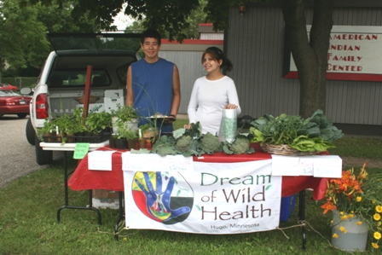
Mobile Farmers Market: Creating accessible markets for your customers and you.
NCR-SARE Project FNC10-803

Slide 2
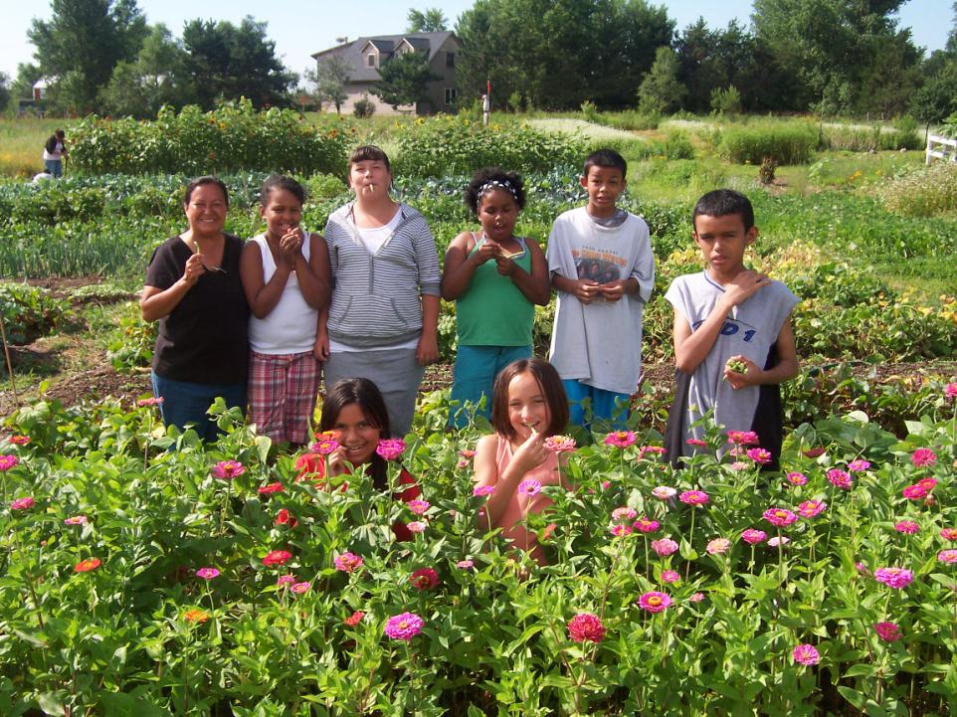
DREAM OF WILD HEALTH FARM

Slide 3
Why a mobile market?
In 2010, DWH operated two market stands in parking lots in food deserts in Mpls & St. Paul—averaged 5 customers/day.
Financial crash meant funding was scarce; with land as a resource, could we become self-sustaining?
Main markets saturated; we didn’t have funds to join, but we did have a network of organizations and offices that liked what we did.

Slide 4
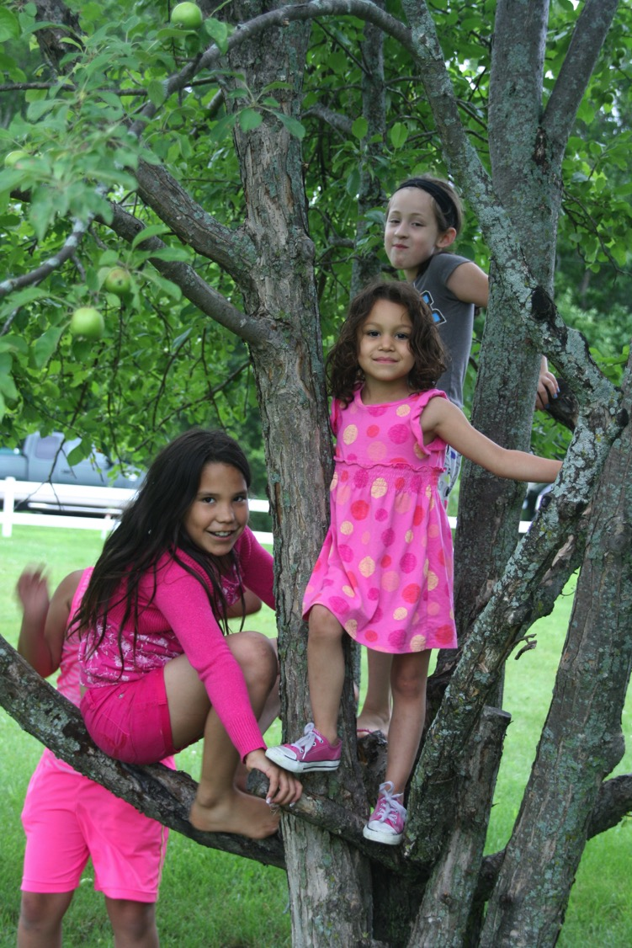
Community Needs:
Income
Familiarity
Knowledge
Location & Timing

Slide 5
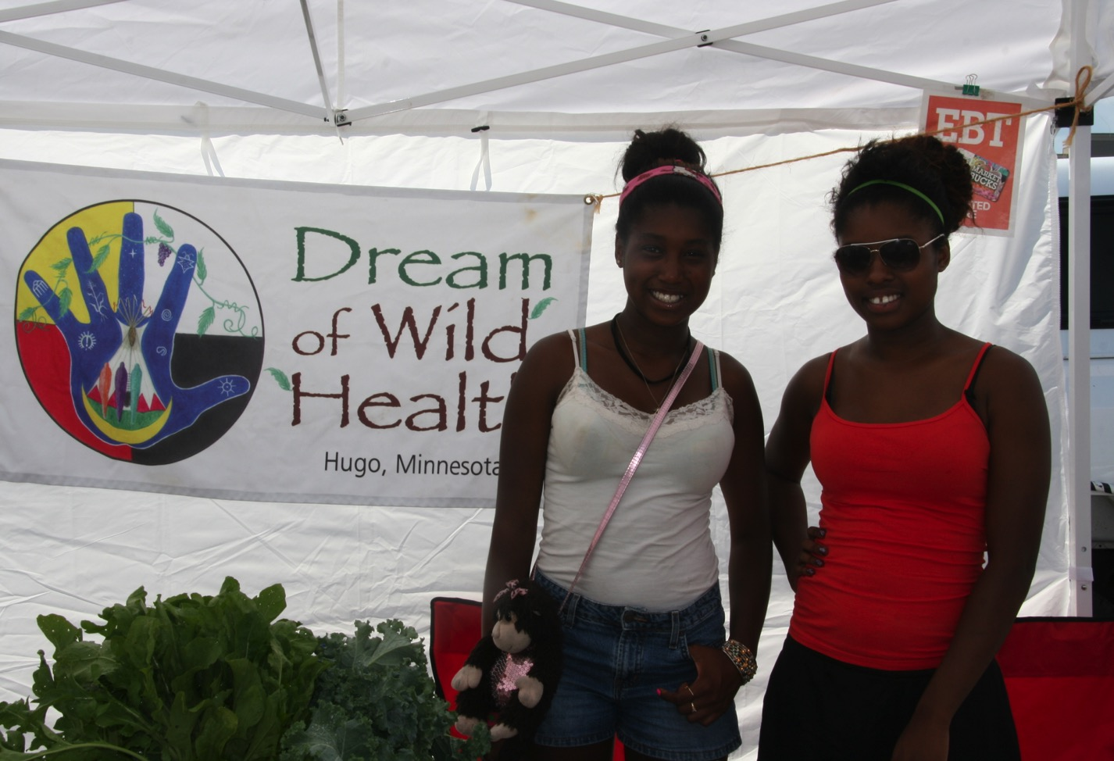
Community needs
17% of American Indians in the U.S. have Type 2 diabetes – the highest rate of any group
Last 20 years have seen a 68% increase in Native youth ages 15-19 with Type 2 Diabetes
Income
More than 40% of Native households in Minneapolis/ St. Paul have an income of $25,000 or less.
More than any other factor, zip code determines a child’s health.
Solution: we accept EBT and WIC at all our markets, started prices under supermarket levels, provide vouchers.

Slide 6
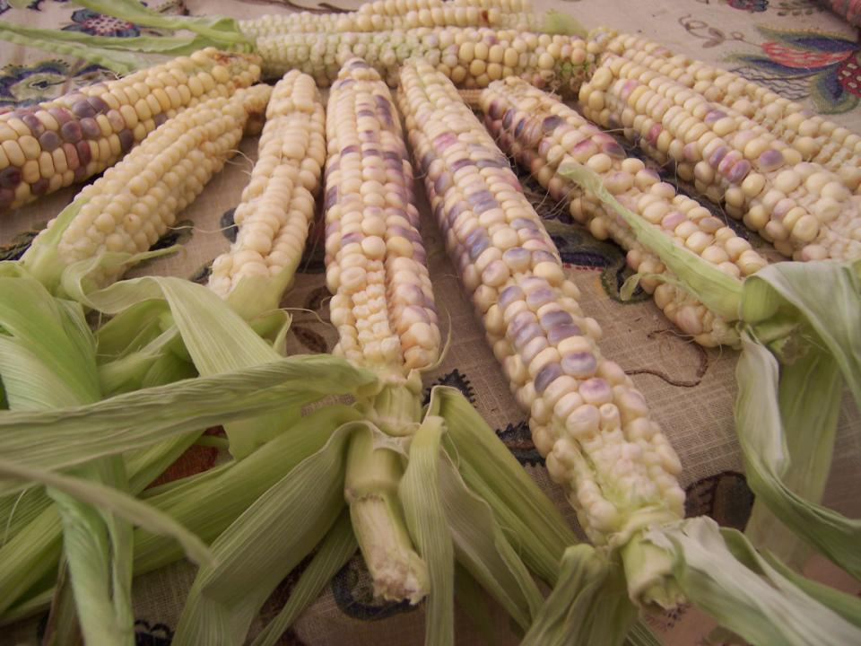
Familiarity
Top crops from survey:
Sweet Corn
Watermelon
Tomatoes
Cucumbers
Carrots
Onions
Broccoli
Green Peppers
Green Beans
Salad Greens
Cantaloupe
Sweet Potatoes
Spinach
Zucchini
Cabbage
Potatoes
Solution:
Have an abundance of these, but work on education around other crops.

Slide 7
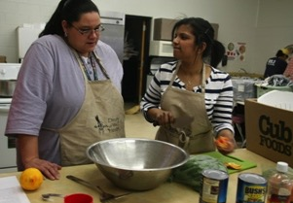
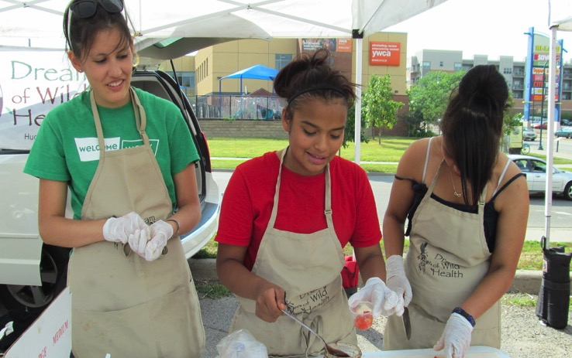
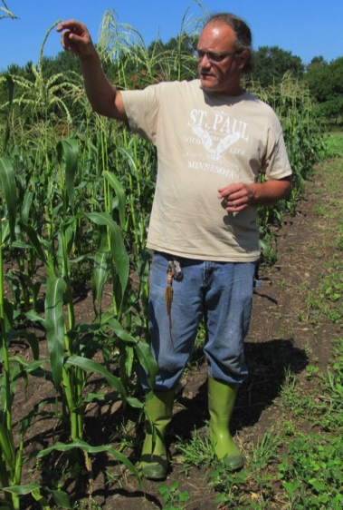
Knowledge
Cooking Classes
Demos at events
Farm Tours *Feature Veggies

Slide 8
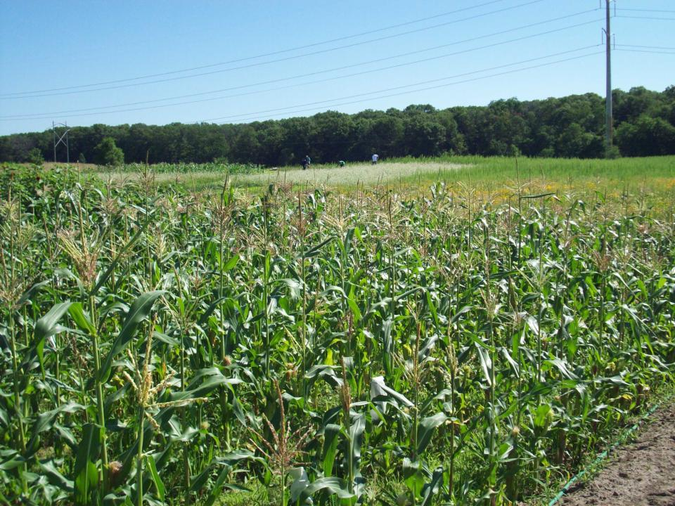
Marketing Plan
What crops to plant
Where & how to advertise
How many weeks/shares
Pricing…
What strategy will work best for YOU
For us, doing quick stops around the city
Tuesday & Thursday markets work for us because they’re program days
(just make sure it’s workable with the field plans too!)

Slide 9
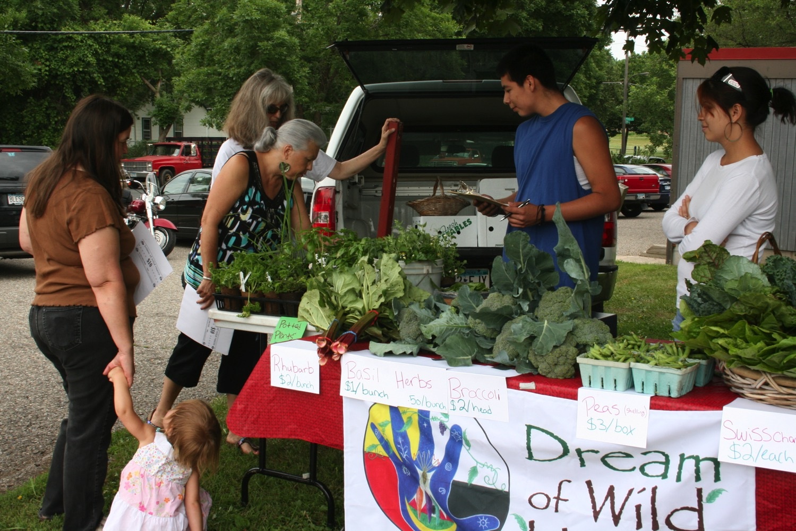

Slide 10
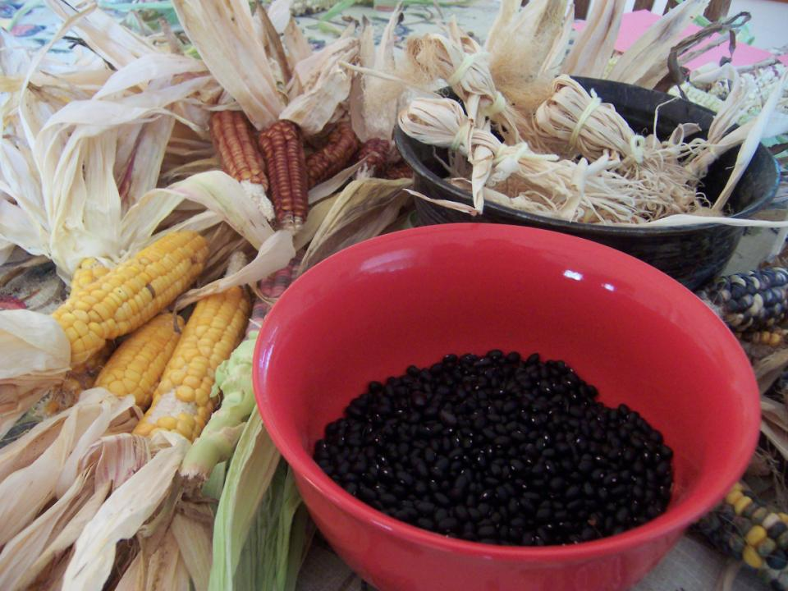
Stand Out from the Competition!
Work smarter, not harder
Quality over quantity
  Fresh, crisp greens; heirloom tomatoes;
Have the right equipment
  New van! Cooling system, EBT /credit card reader
Relationships
  Sometimes going the extra mile for a customer is worth it

Slide 11
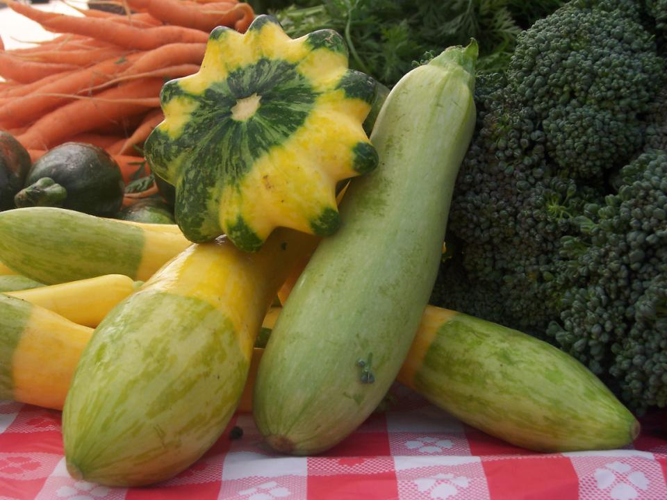
BE FLEXIBLE!
Listen to what the community needs
Don’t be afraid to change strategies, but always keep building relationships
    Give it time to grow.
    Diversify and/or Specialize

Slide 12
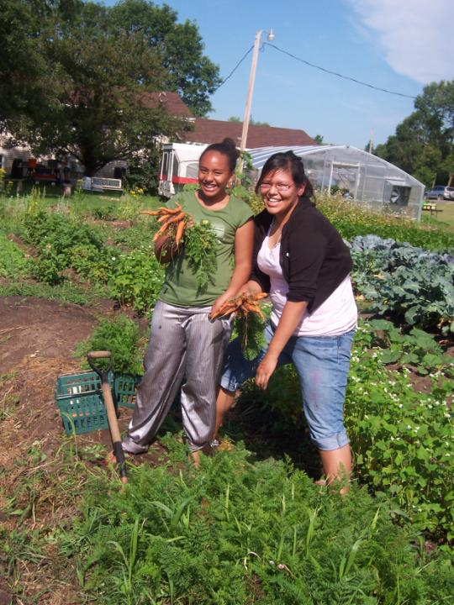
Looking forwards:
*Partnerships with ECFE for cooking classes
Market memberships
Outreach partners bring clients to market for first time
CSA/mission balance

Slide 13
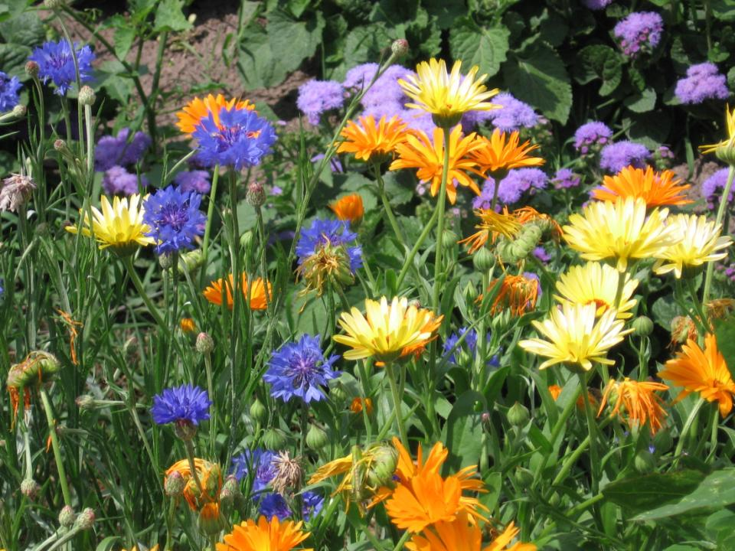
www.dreamofwildhealth.org

