Slide 1
Big Bluestem management using high density short duration grazing
Root Prairie Galloways
FNC10-842
NCR-SARE’s Farmers Forum, 2015

Slide 2
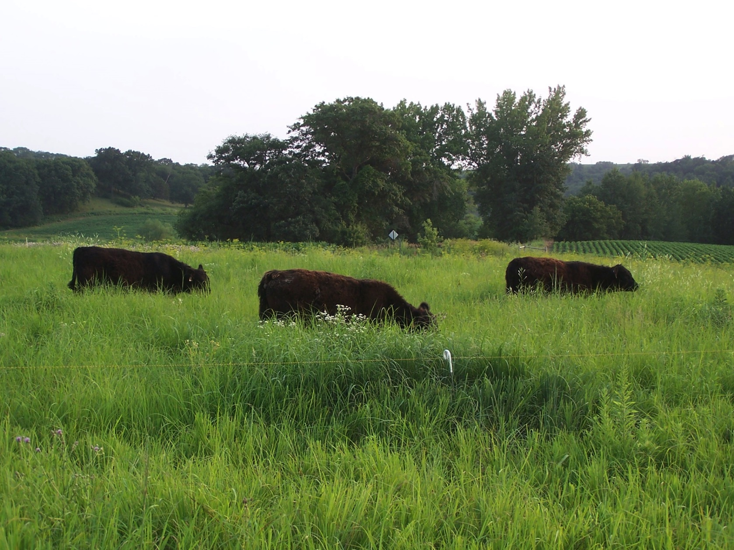
Root Prairie Galloways Brad & Leslea Hodgson Fountain, MN

Slide 3
Big Bluestem pastures established spring 2000
Truax No-till drill
Local Genotype seed
One seeding into former cornfield the other into bean stubble
Mowed the weeds yr. 1
Burned the fields a few years later
Hayed them a few times

Slide 4
Effects of a hard early graze on Big Bluestem pastures
We had an idea about grazing early in the spring ahead of the Bluestem breaking dormancy.
The idea was to graze early, but after the cool season species had started to grow. The plan was to graze them hard to put them at a disadvantage for when the Bluestem would break dormancy just after we finished grazing.
We received the Farmer & Rancher grant from SARE and began our 3 year experiment in the spring of 2011.
We grazed on the dormant Bluestem for three years 2011,’12 & ‘13 and then compiled the data.

Slide 6
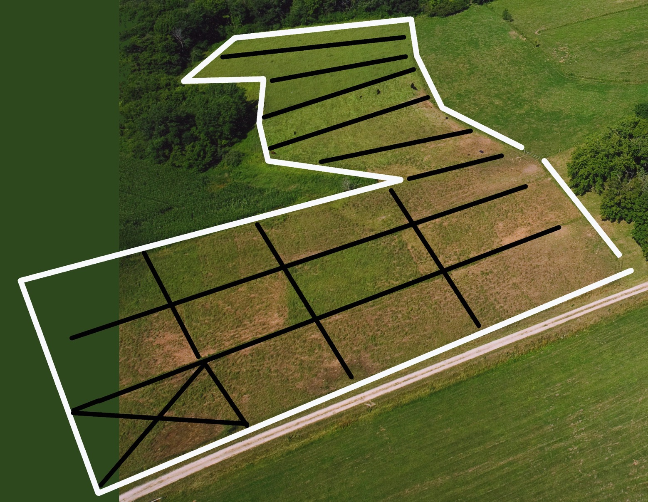
Subdivided into paddocks

Slide 7
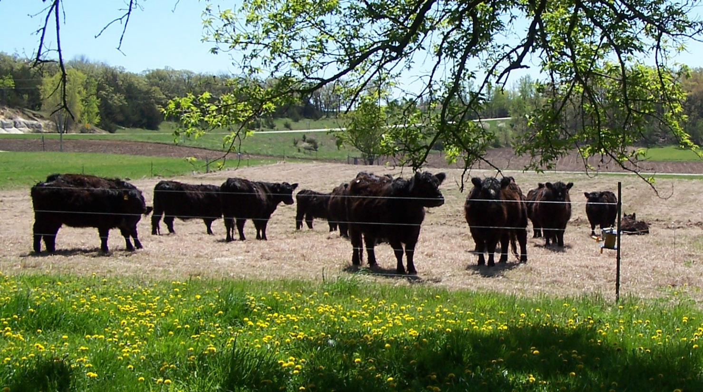

Slide 8
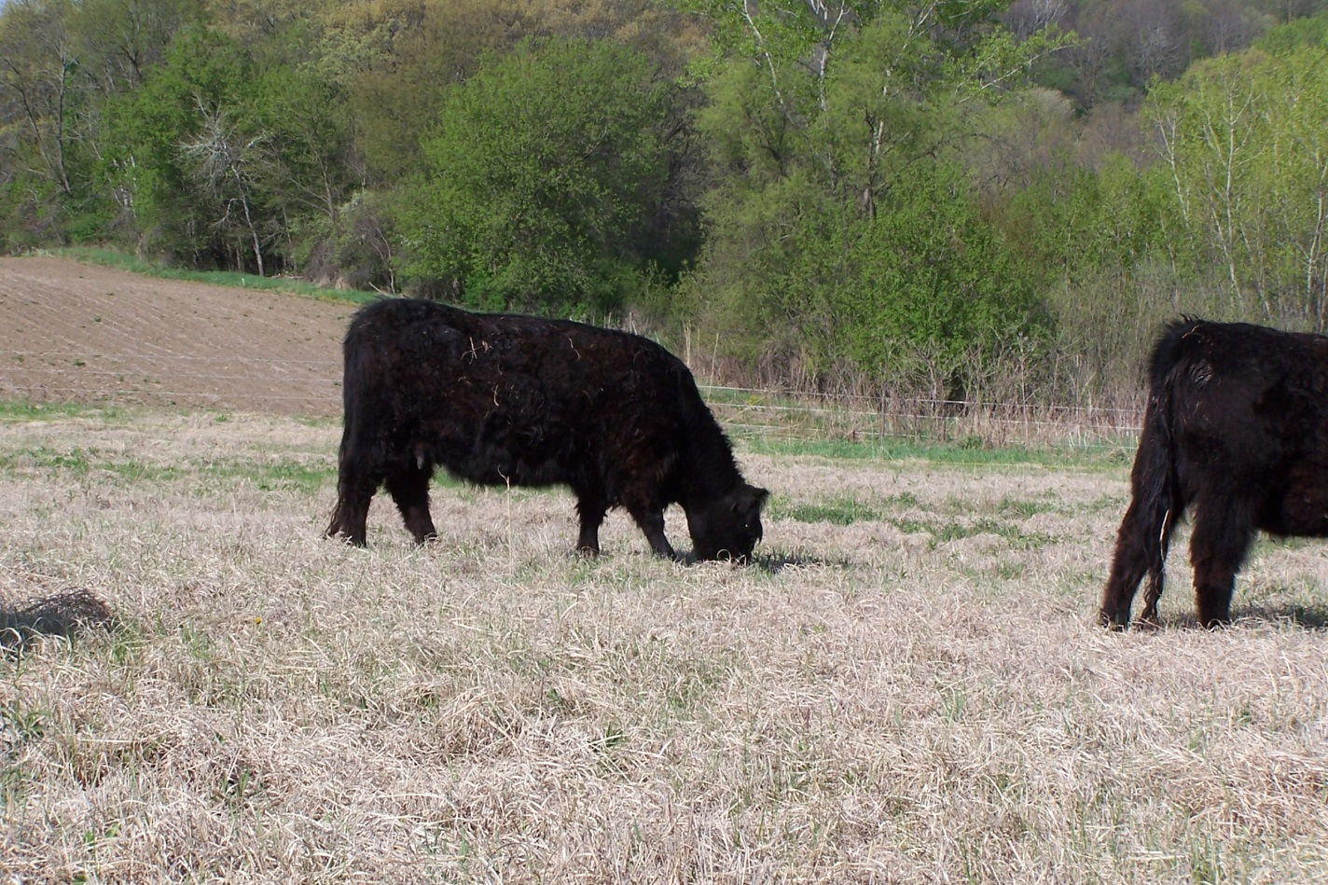
At first you wouldn’t think there was much out there.

Slide 9
Making the adjustment to getting a mouthful of dead grass along with the green material.

Slide 10
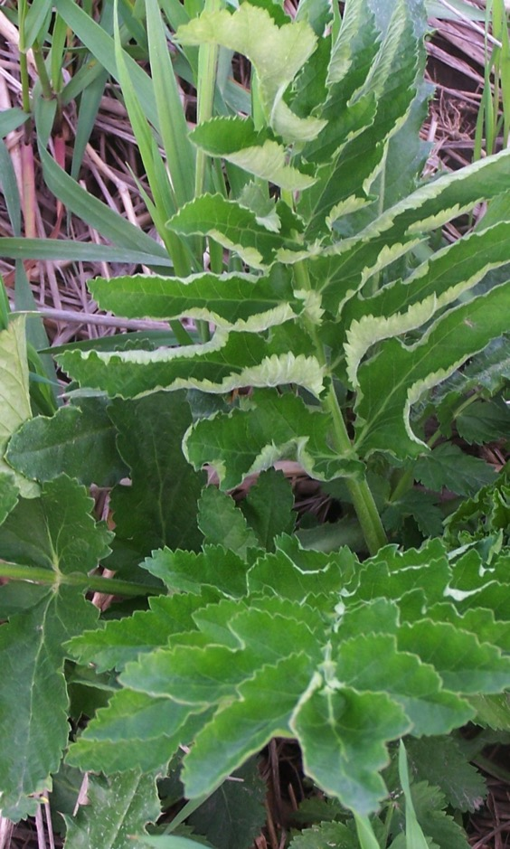
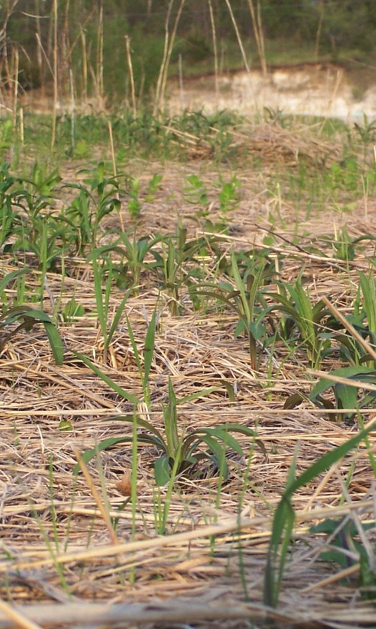
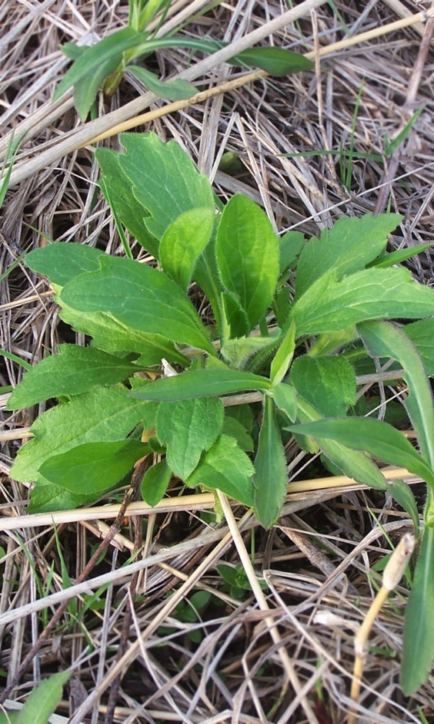
Available forages:
Wild Parsnip Canada goldenrod Asters

Slide 11
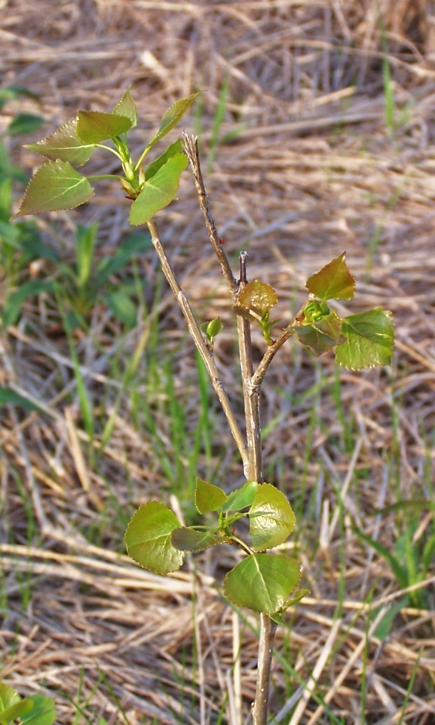
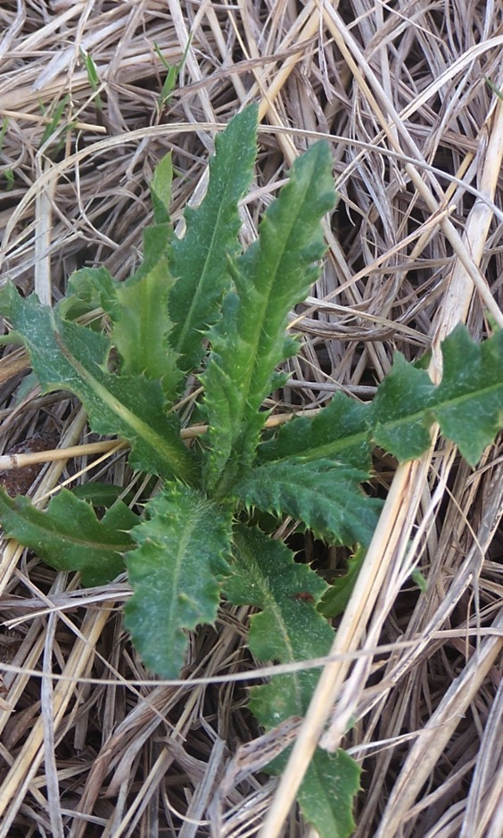
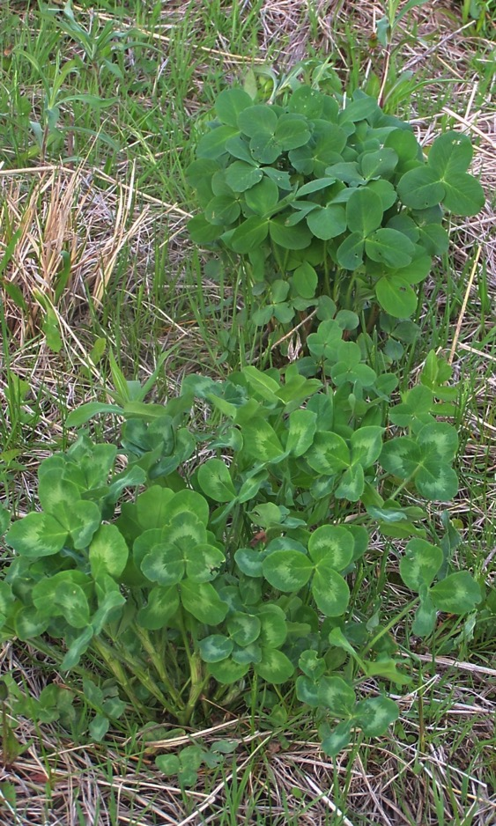
Aspen saplings Canadian Thistles Clovers

Slide 12
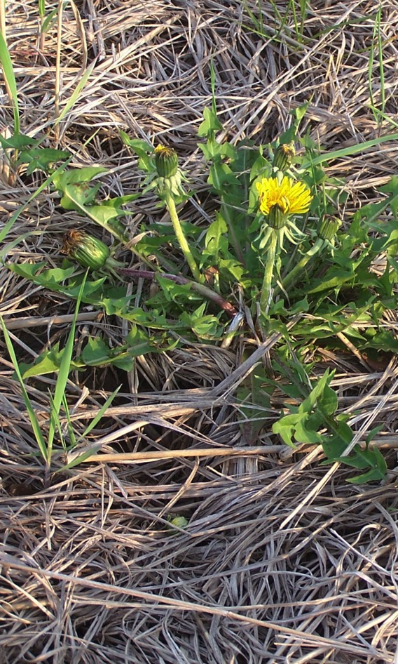
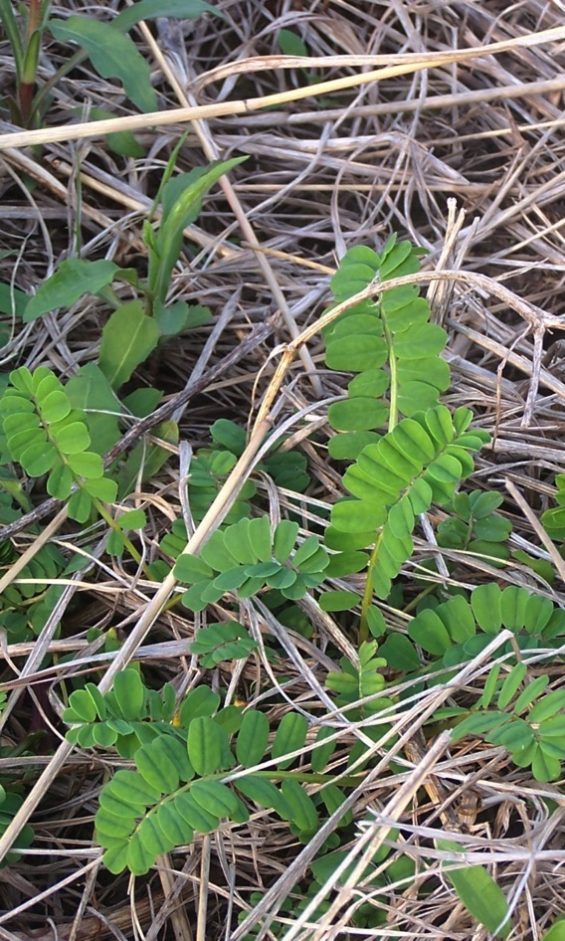
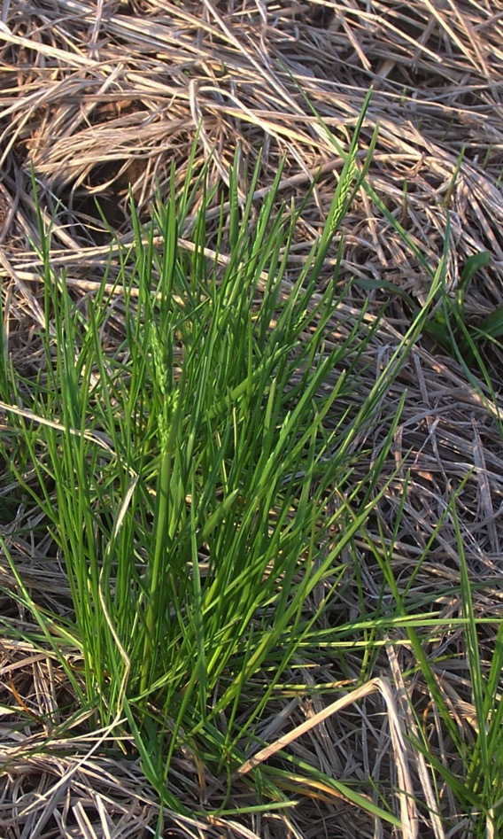
Dandelion Crown Vetch Kentucky Blue Grass

Slide 13
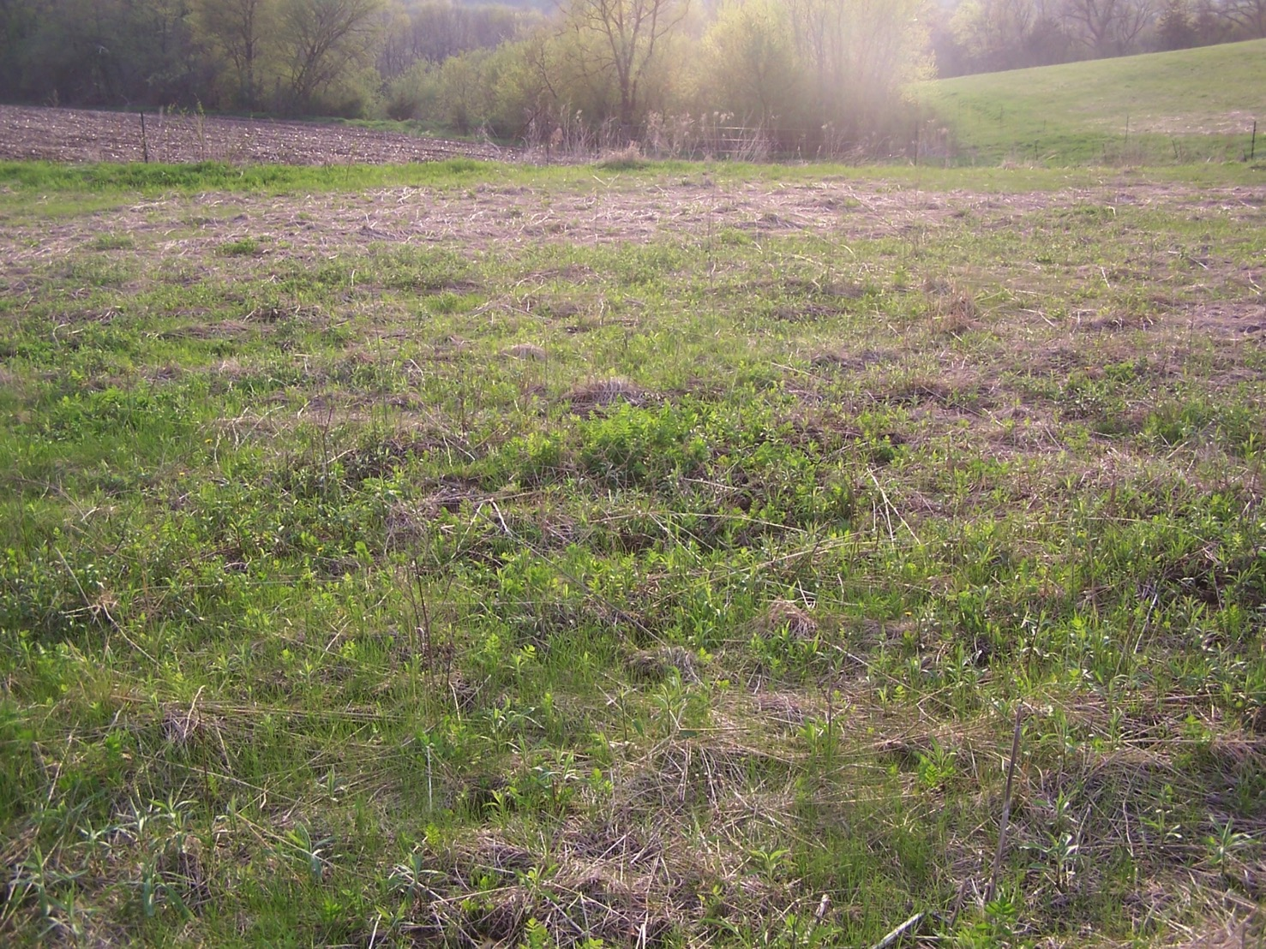
But mostly Canada Goldenrod & Kentucky Blue Grass

Slide 14
First graze through east field 5 ½ days, 16 cows on 2.5 acres

Slide 15
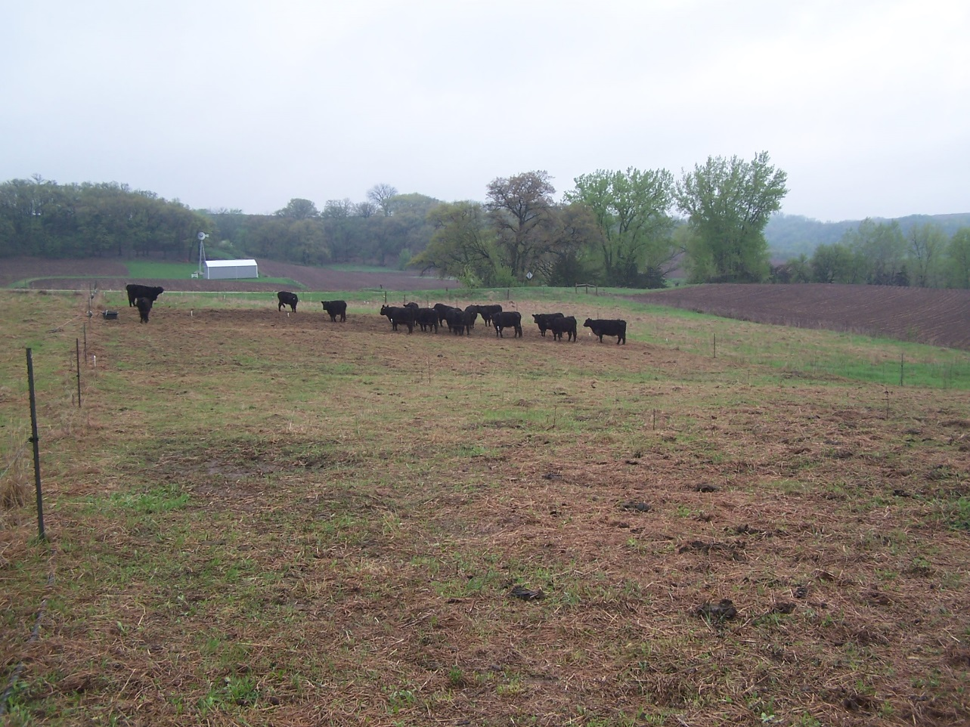
Same 16 cows on 1/5 acre for one half day with a rain

Slide 16
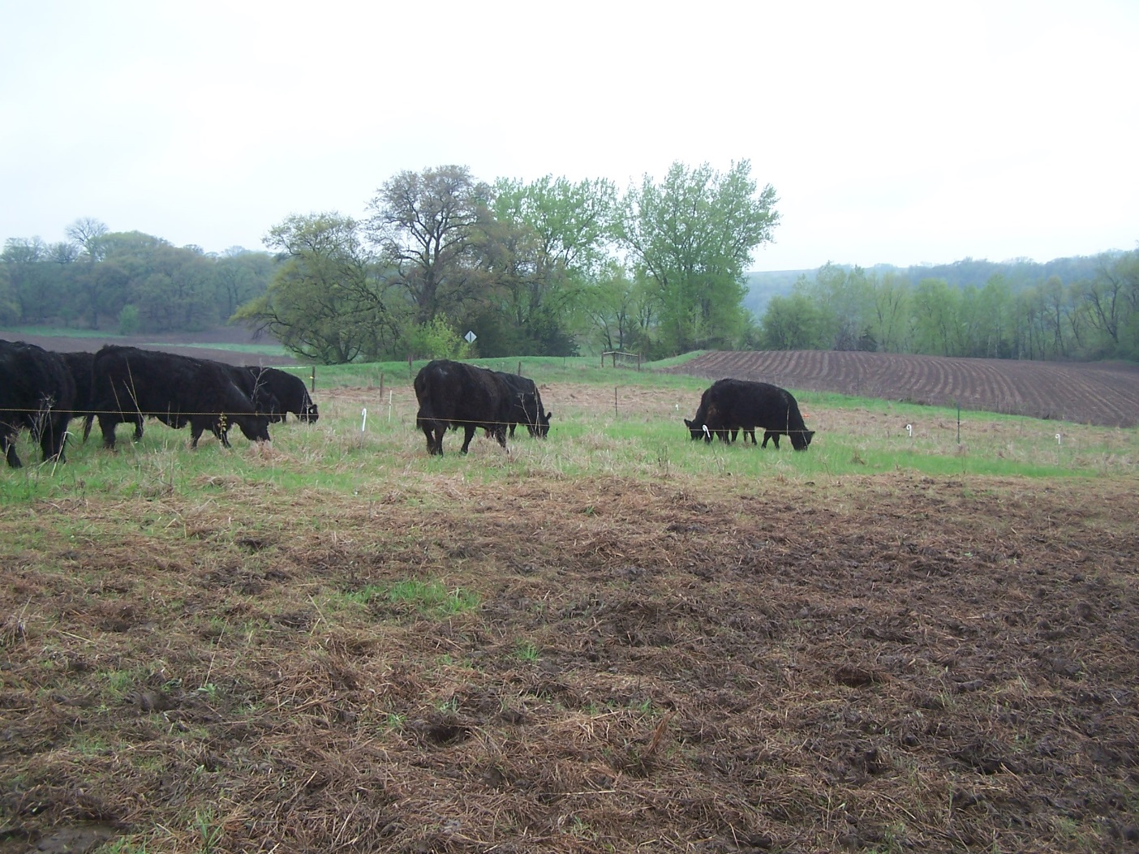
Good mixing of the old dried grass into the surface of the soil

Slide 18
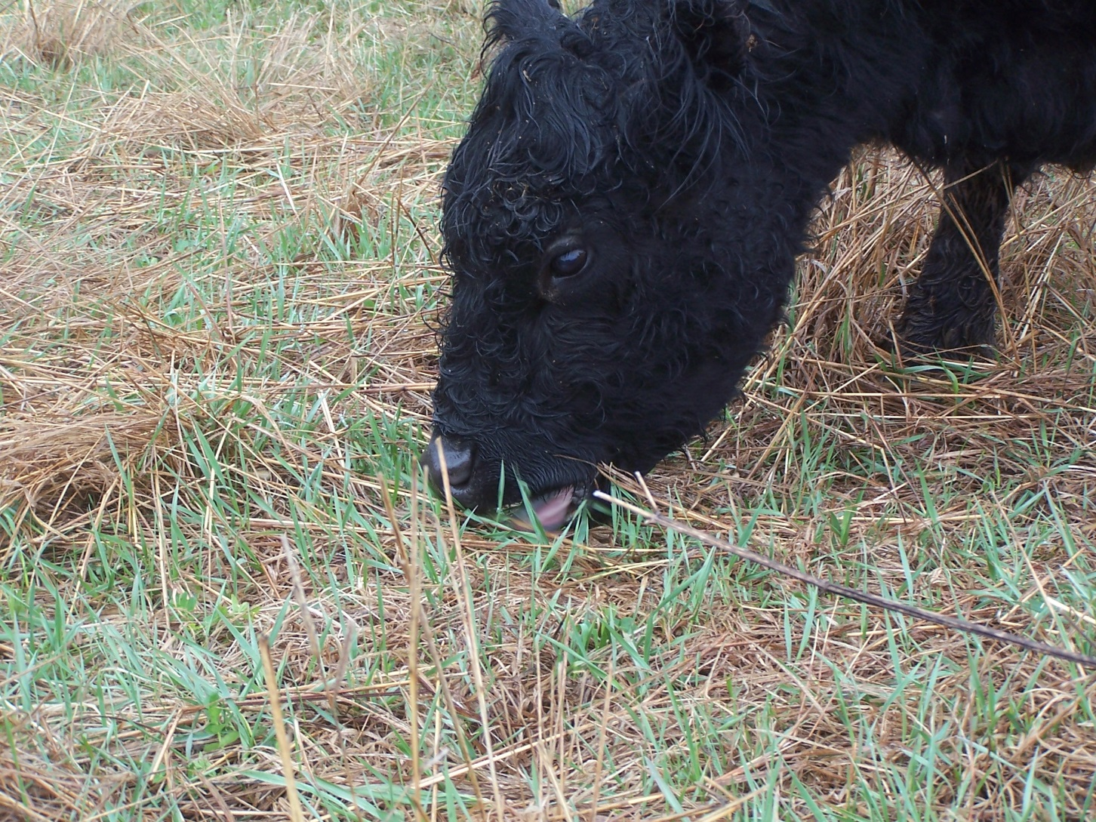

Slide 19
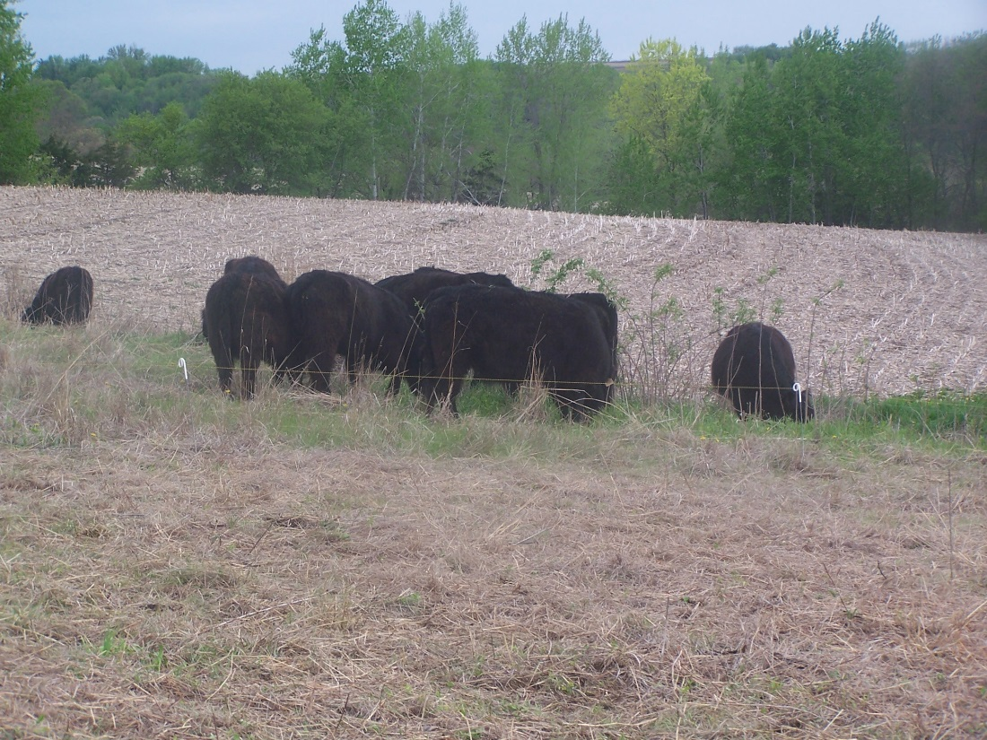

Slide 20
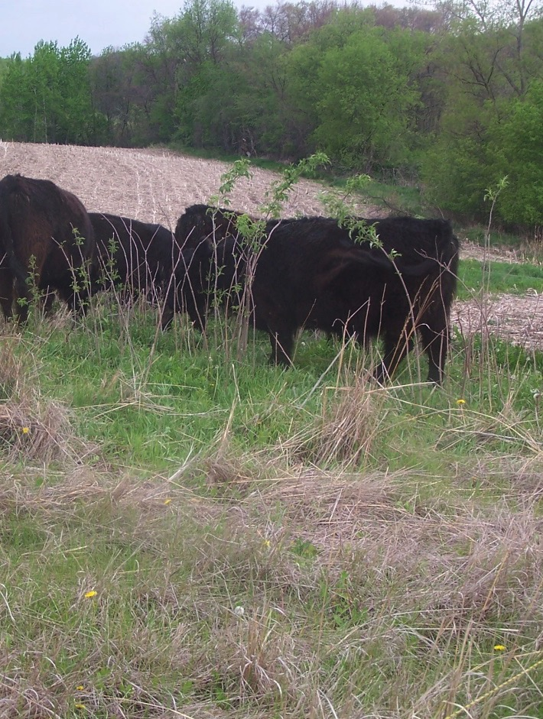
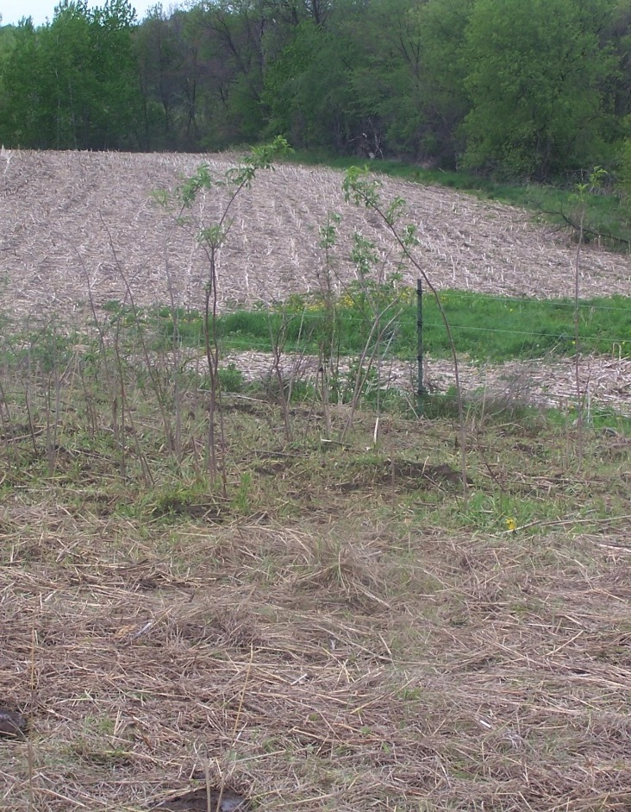
Before & After Elderberries
Elderberries
Before After

Slide 21
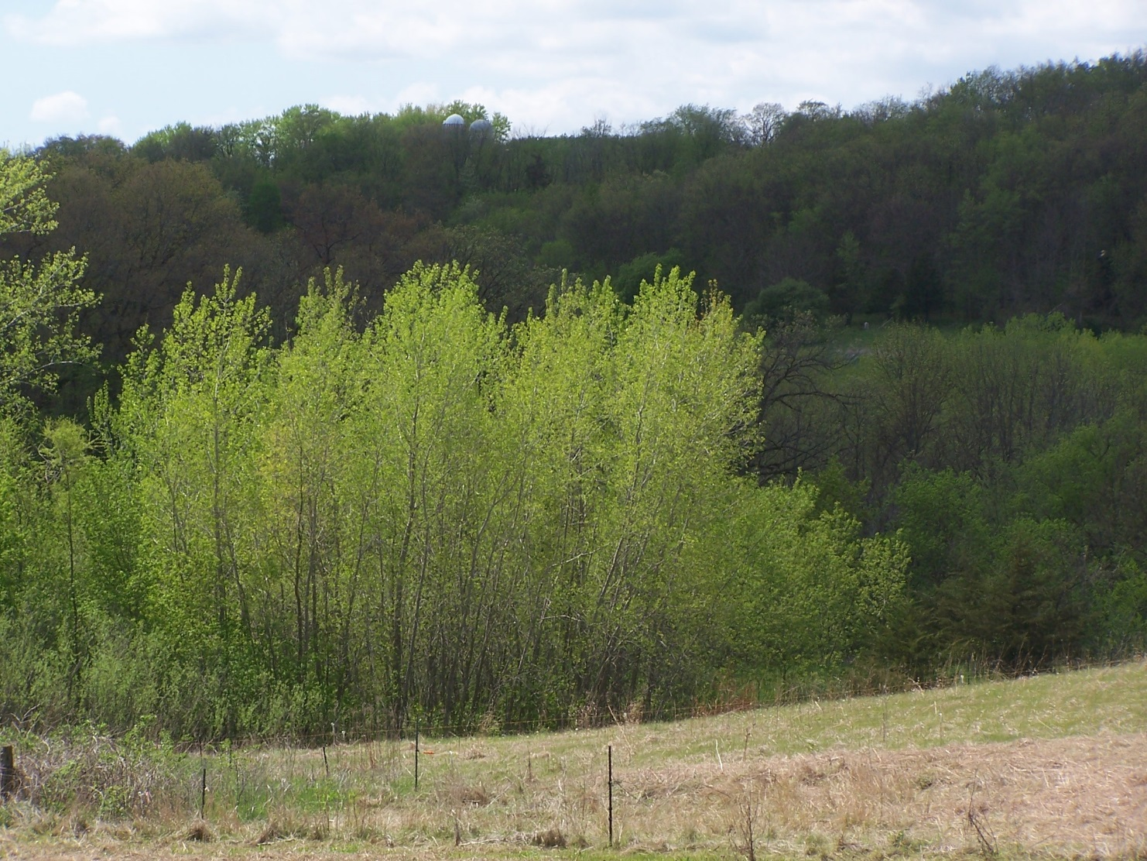
May 3rd

Slide 22
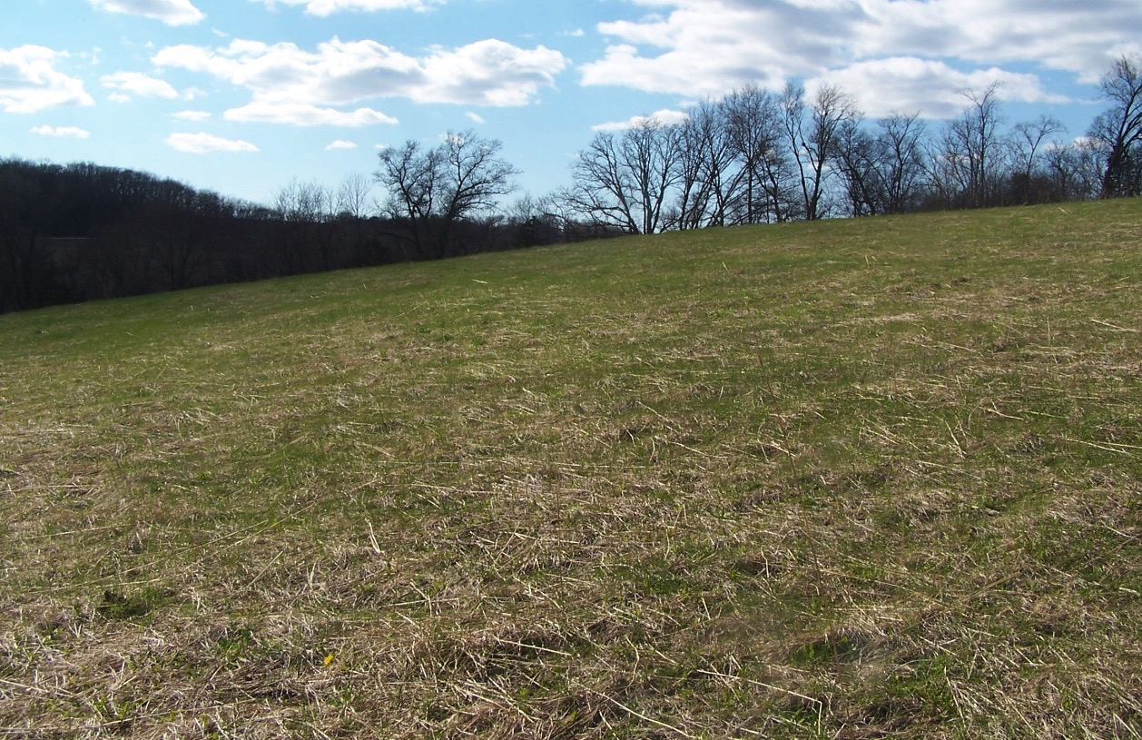
Now move on to the south slope

Slide 23
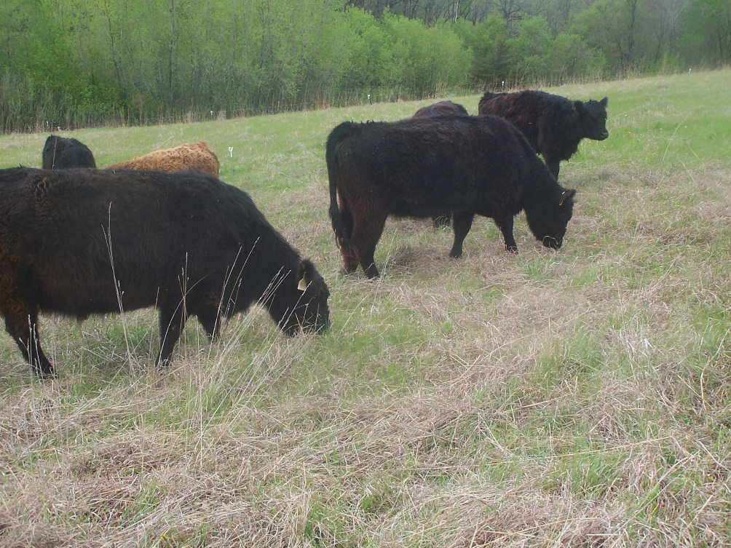
Starting up the south slope

Slide 24
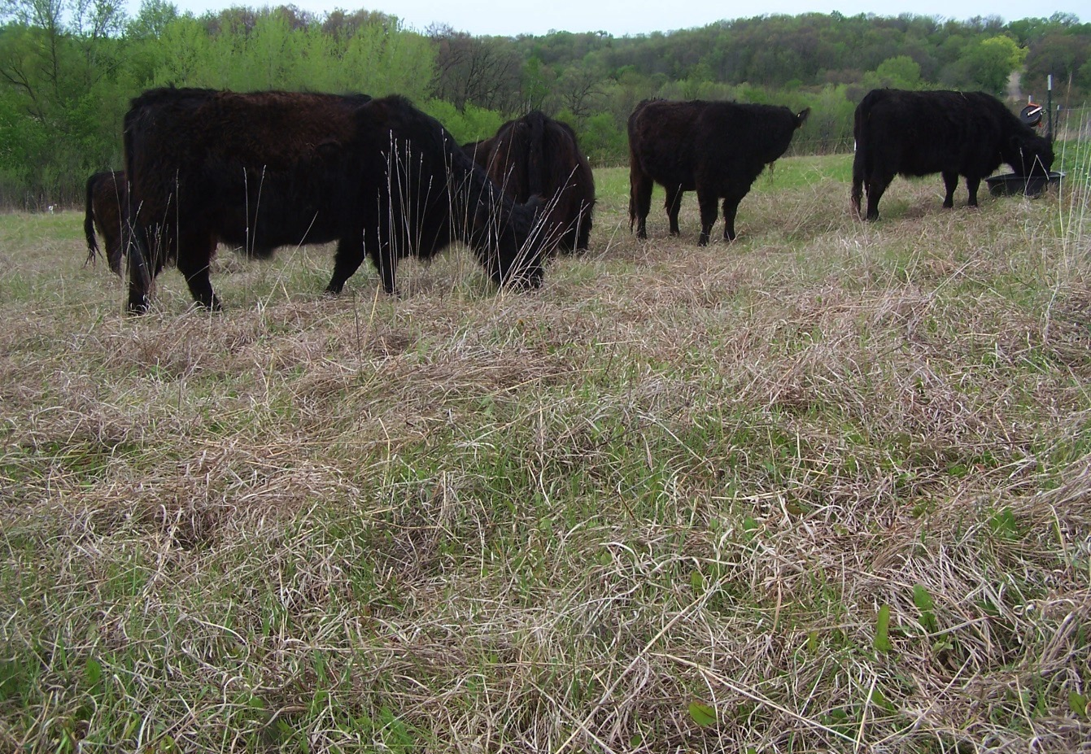
Actually quite content

Slide 25
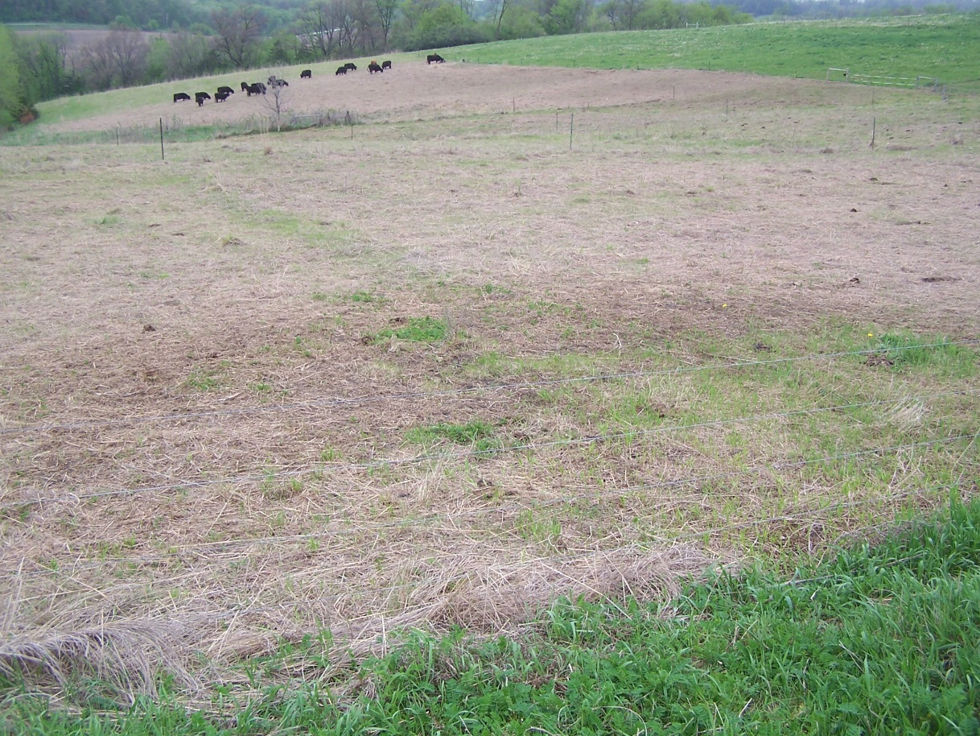
Halfway across the south slope

Slide 26
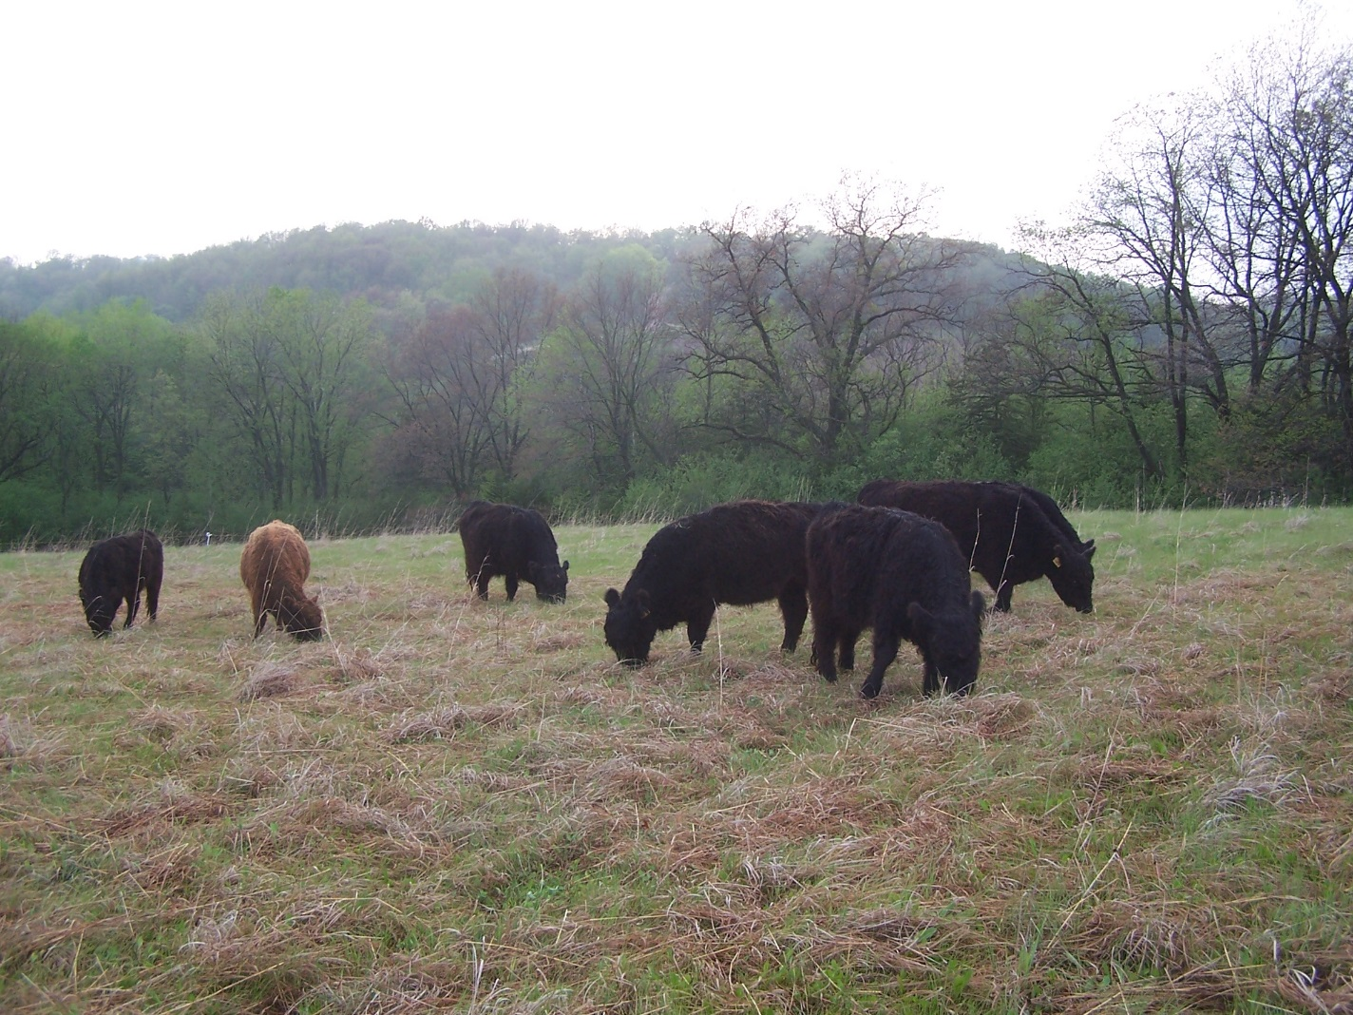
Just working away at getting the green stuff.

Slide 27
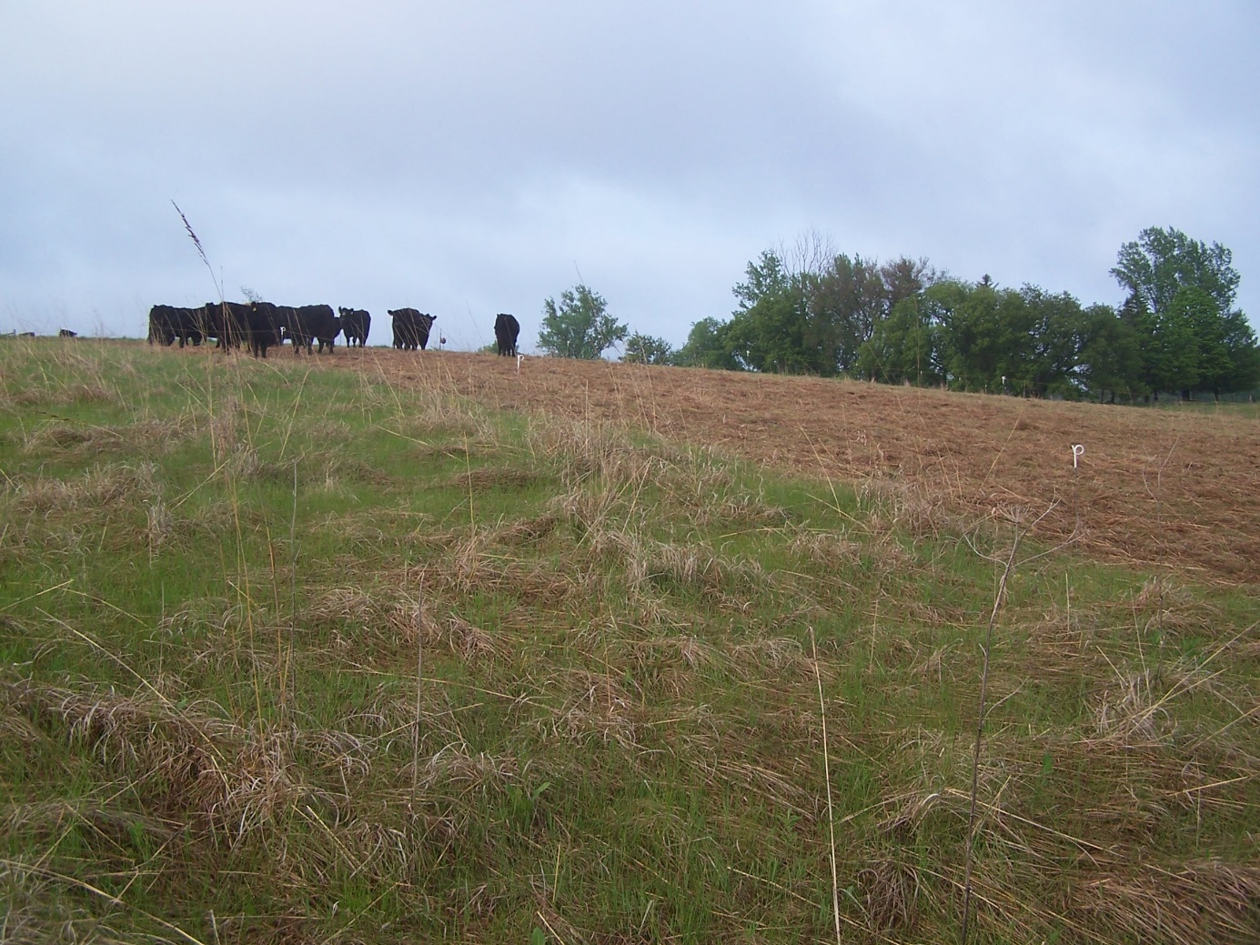

Slide 28
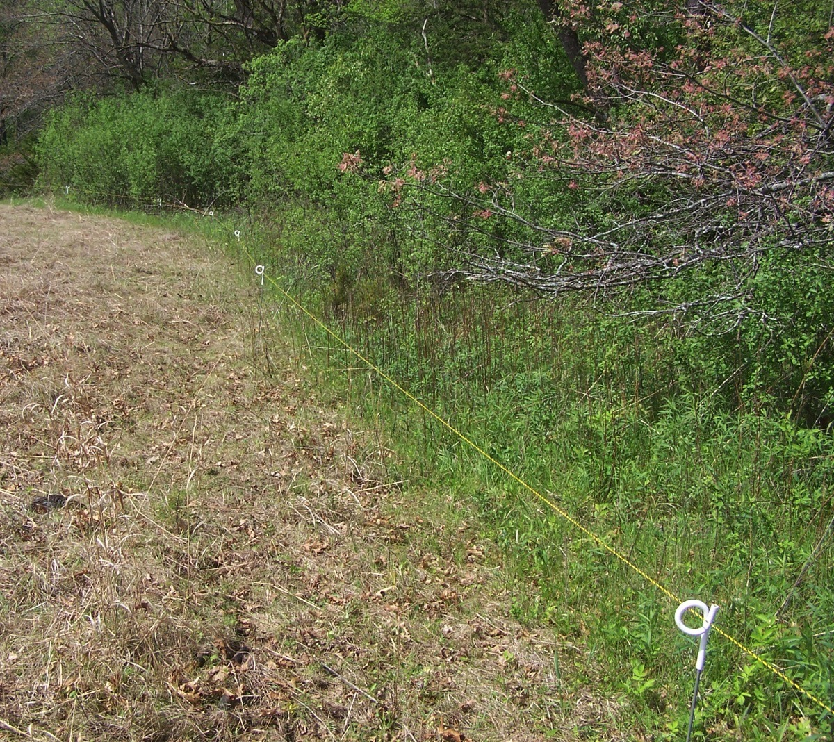
They cleaned up all Goldenrod along the edge of field

Slide 29
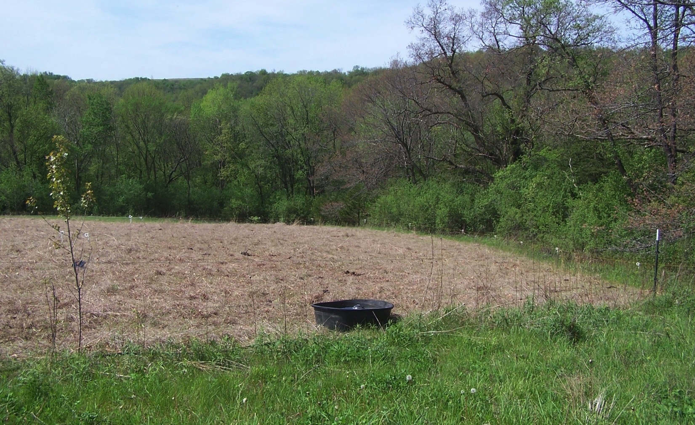
Finishing the south slope
Finished up weeding in the Bluestem for this season and now on to the cool season pastures.

Slide 30
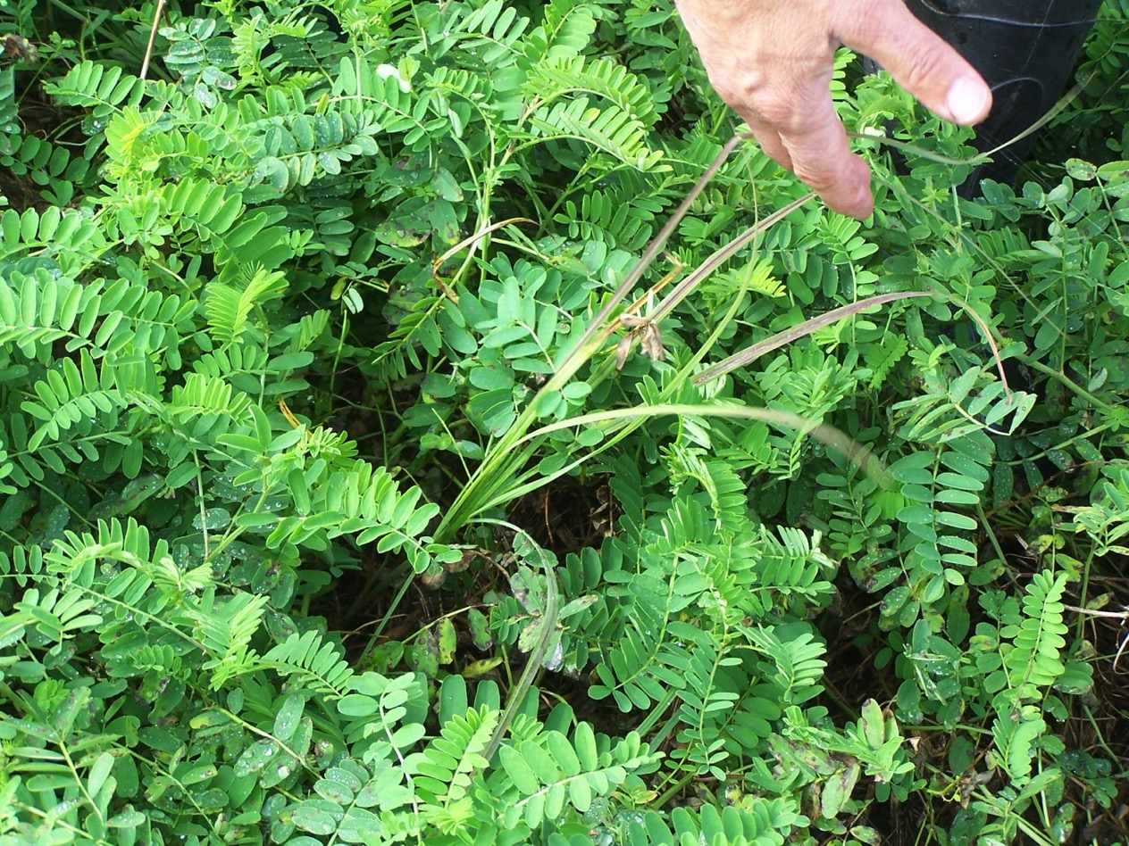
A problematic weed to note: Crown Vetch
Very early so it gets ahead of other plants
Very aggressive
Very leafy so it shades out competition easily
But it’s also
Very palatable

Slide 31
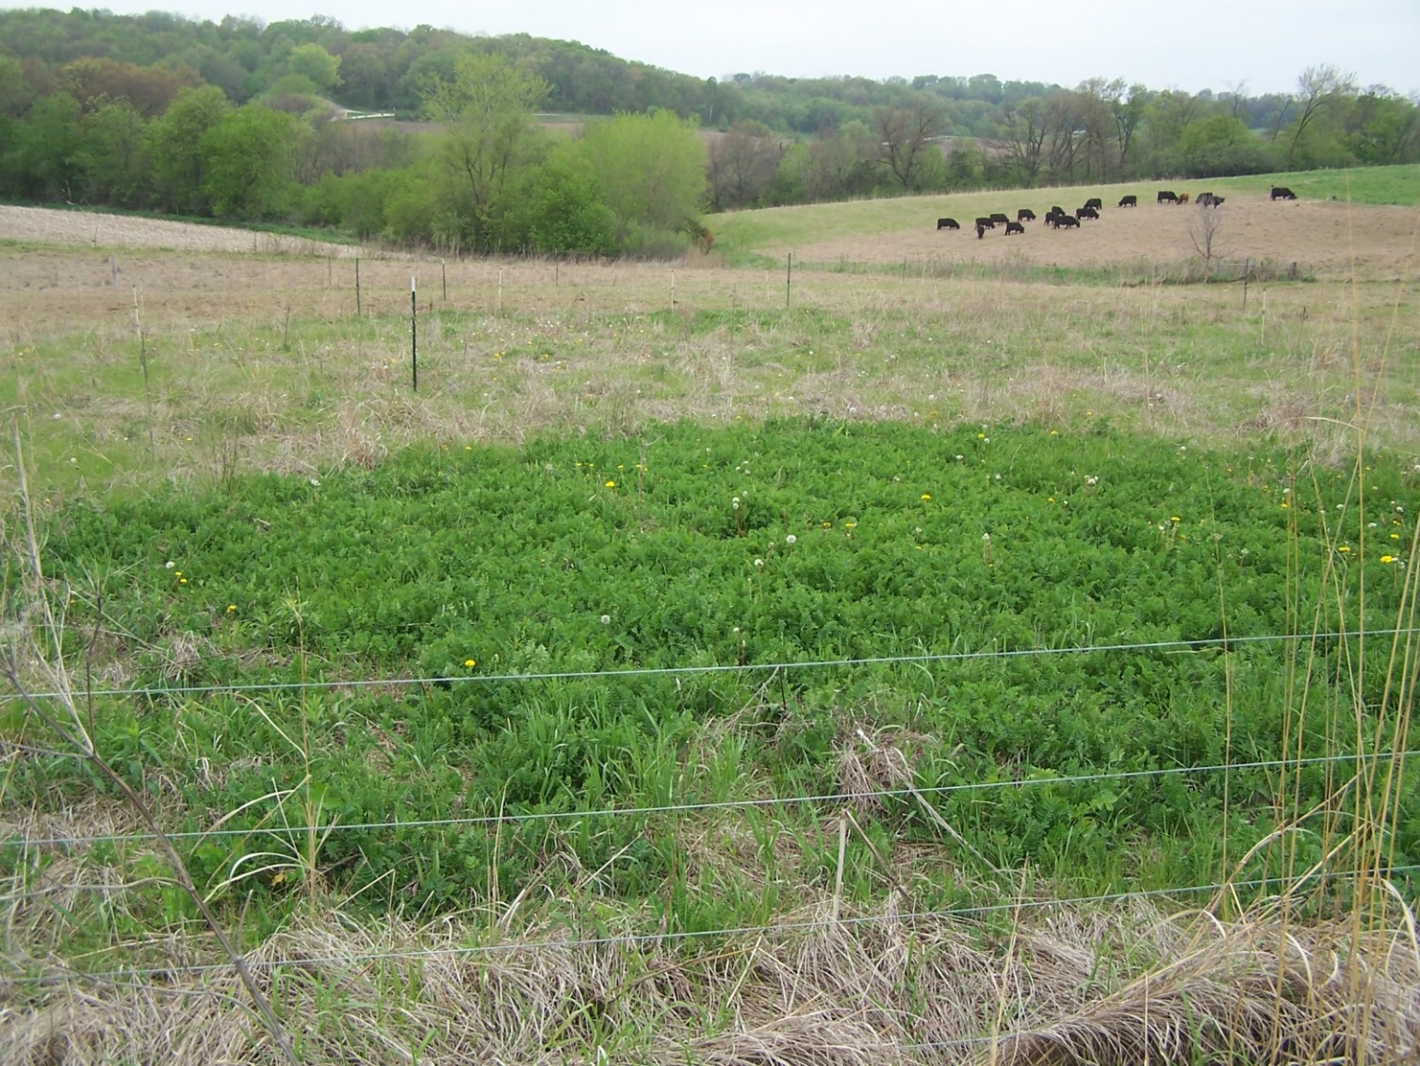
Crown vetch before…

Slide 32
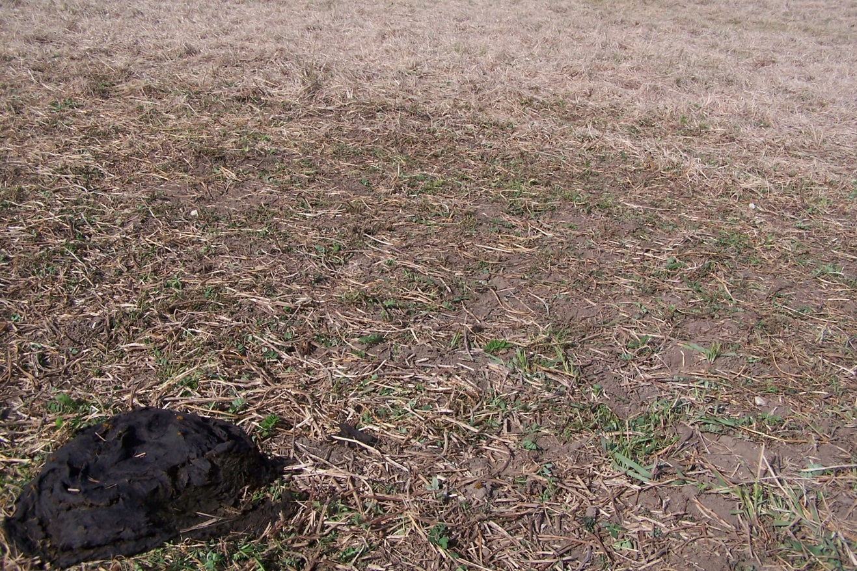
The vetch in the grazed paddock
Crown vetch after, reduced to one pile.

Slide 33
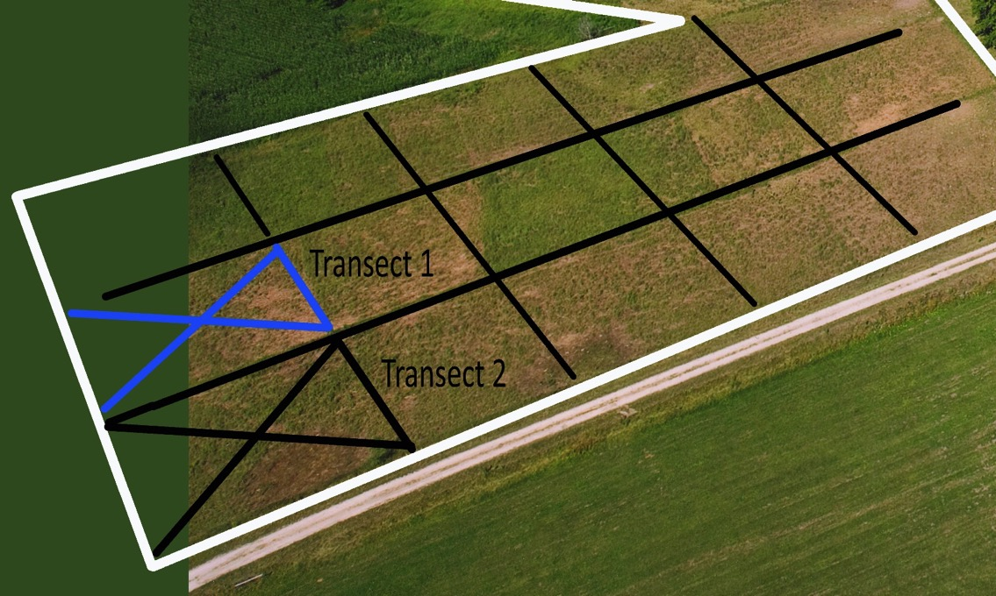
How the research was done.
Our collaborator Howard Moechnig had the experience with setting up an experiment of this type, and the plant identification skill which was necessary for good accurate information.
Howard came out and we walked the fields and chose two adjacent paddocks for the data collection. One paddock became the control which we would not graze and the other next to it would be grazed.

Slide 34
Transect system set up by Howard
Each transect was designed on the 8 points of the compass. One steel T post was set in the center of each and lighter weight fiberglass posts were used for the 8 points off of the center.
Plant identification was done at one foot intervals along a cloth tape pulled to each point from the center.

Slide 35
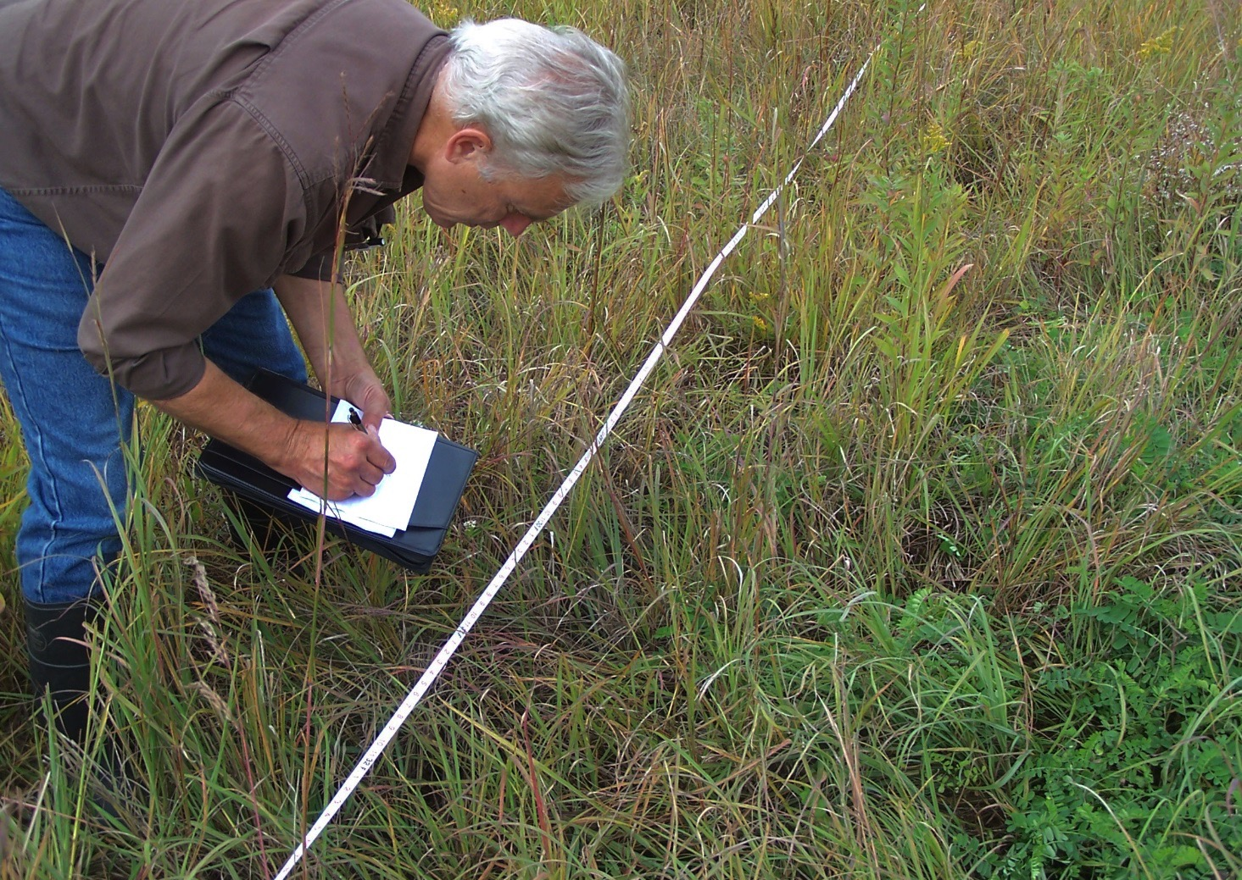
Howard making a record of each plant found at 1’ intervals along a line of the transect

Slide 36
Howard did the work of transferring the information to a spreadsheet for analysis
Two 3’x3’ sections were also clipped, dried, sorted, and weighed by species
Like doing an inventory of a pile of hay.
This gave Howard the yield data to look at

Slide 37
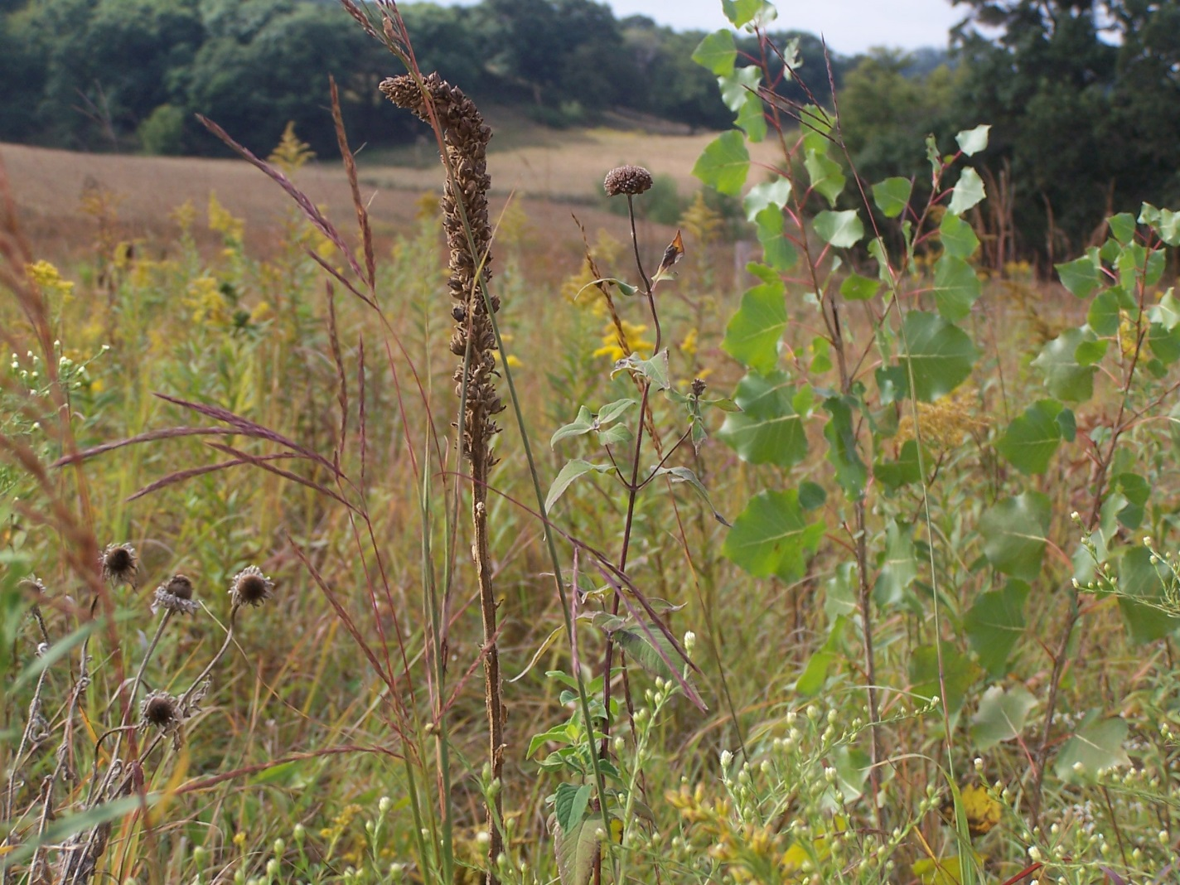

Slide 38
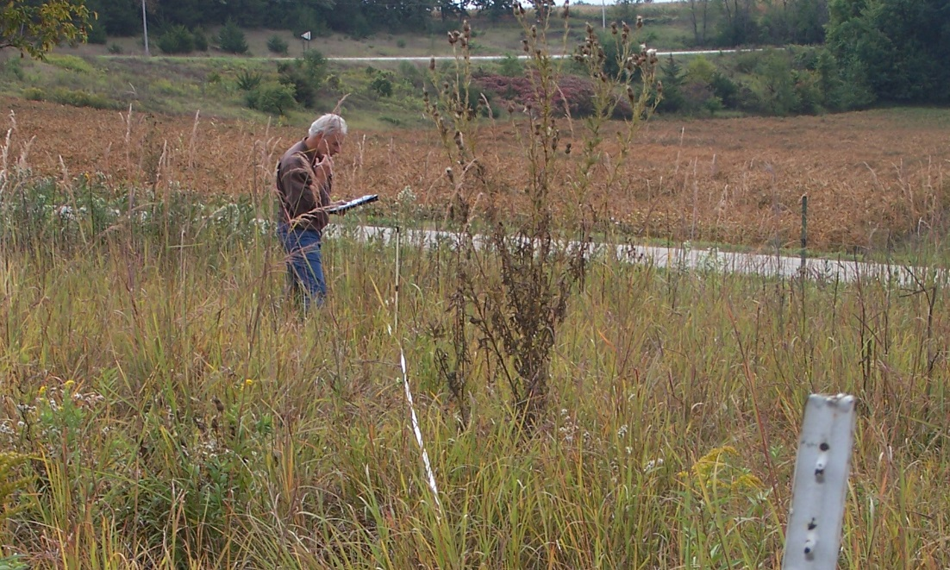
One big thistle. This must have been the Platte thistle?

Slide 39
Clipping & weighing data

Slide 40
Transect data

Slide 41
Our conclusions are
The grazing is thickening the stand of Big Bluestem and Indian Grass along with it.
Canada goldenrod declined In the grazed area vs. the control where it increase.
Kentucky Blue grass did well based on the clipping data.
No grazing pressure on the crown vetch was allowing it to continue it’s spread.
The broadcast seeding of the legumes did not work at all.

Slide 42
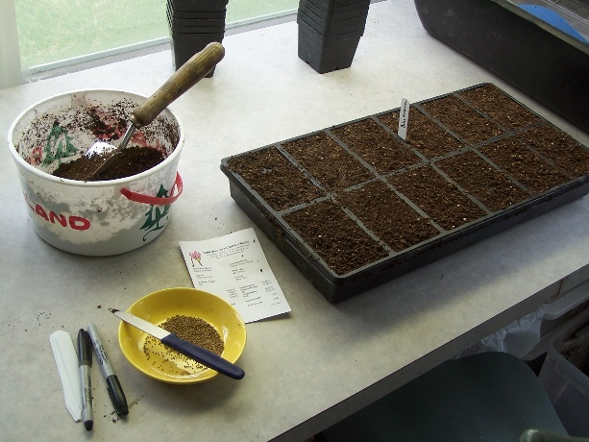
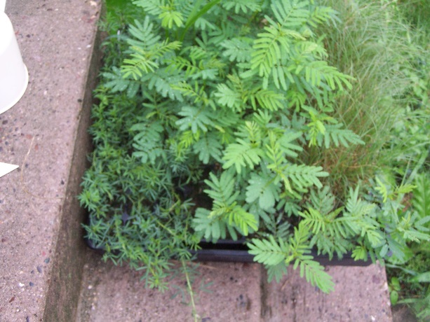
Testing germination of the native legumes
Purple Prairie Clover & Illinois Bundle Flower

Slide 43
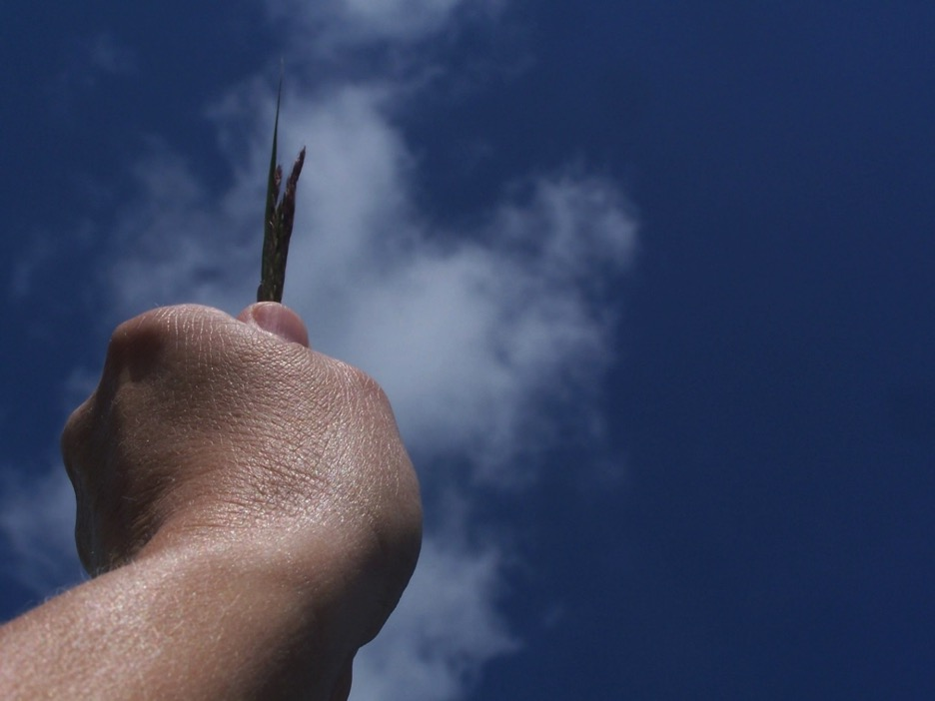
Tall Grass!

Slide 44
Heifers after summer grazing Big Bluestem

Slide 45
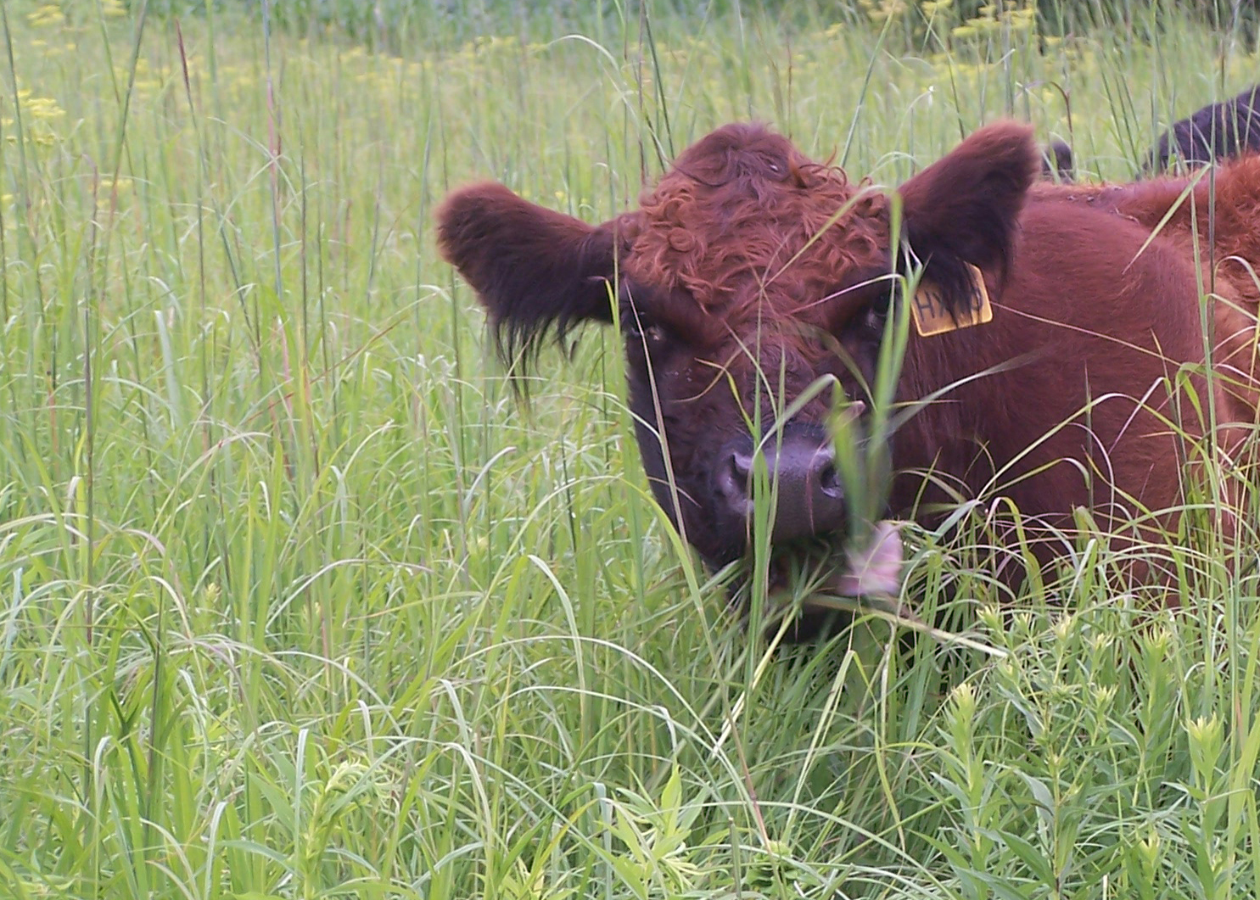
Regrowth in the heavily trampled area from spring graze

Slide 46
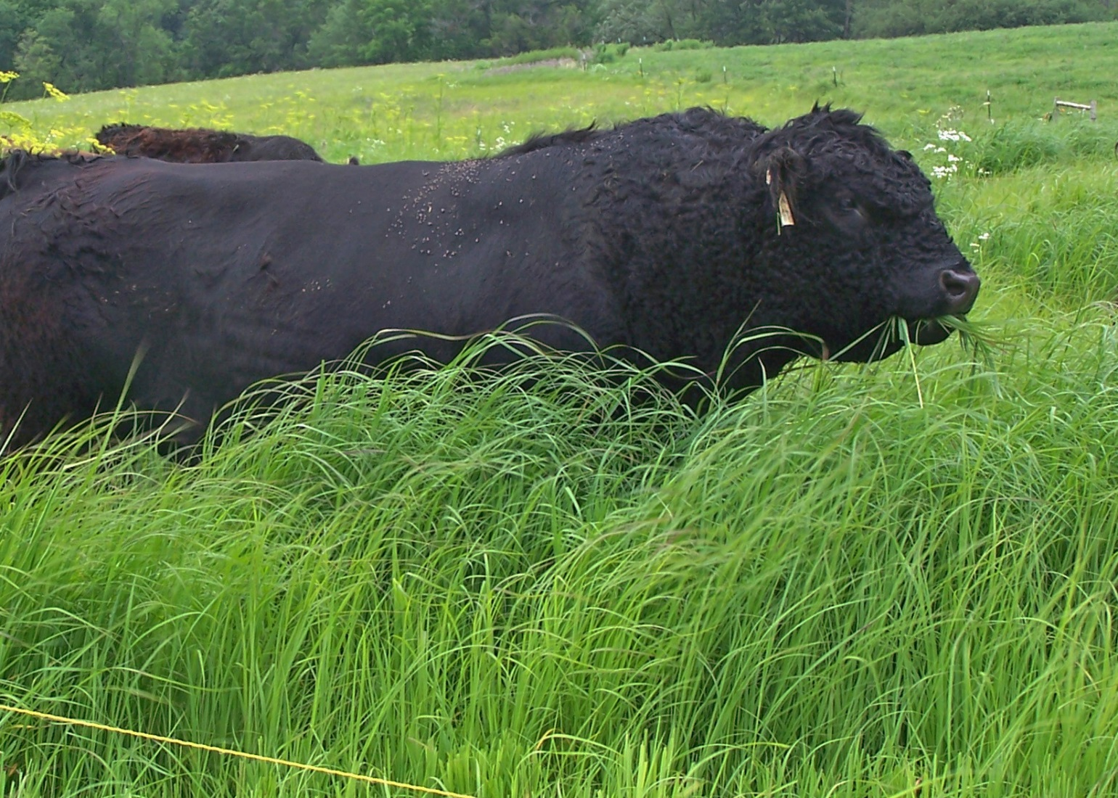
Blades of grass over 48” tall

Slide 47
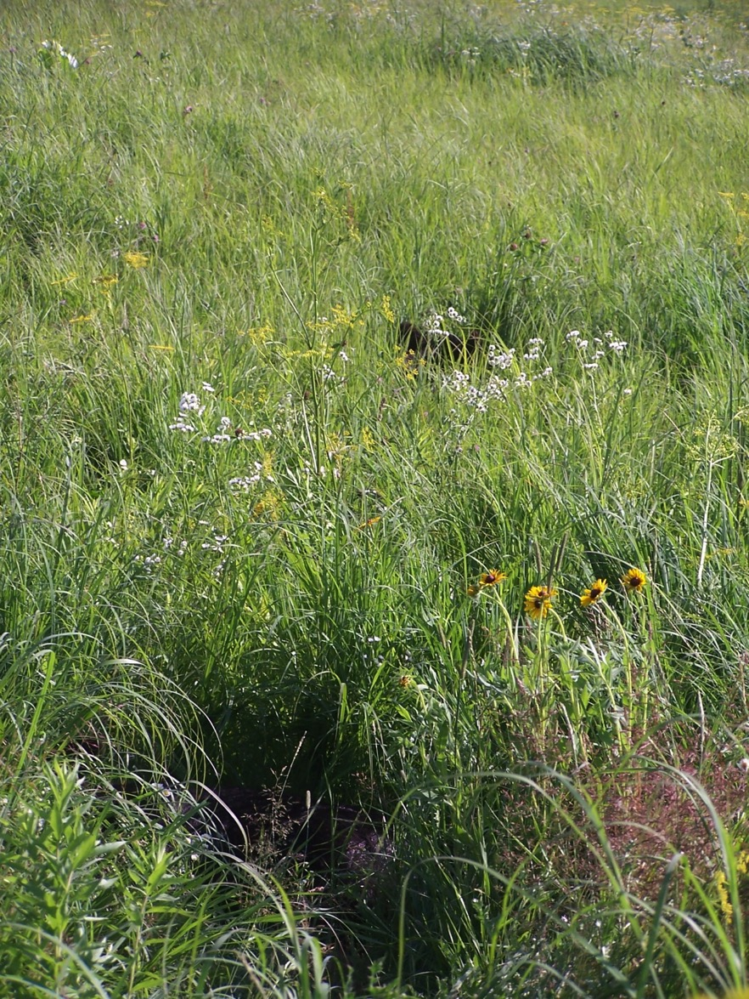
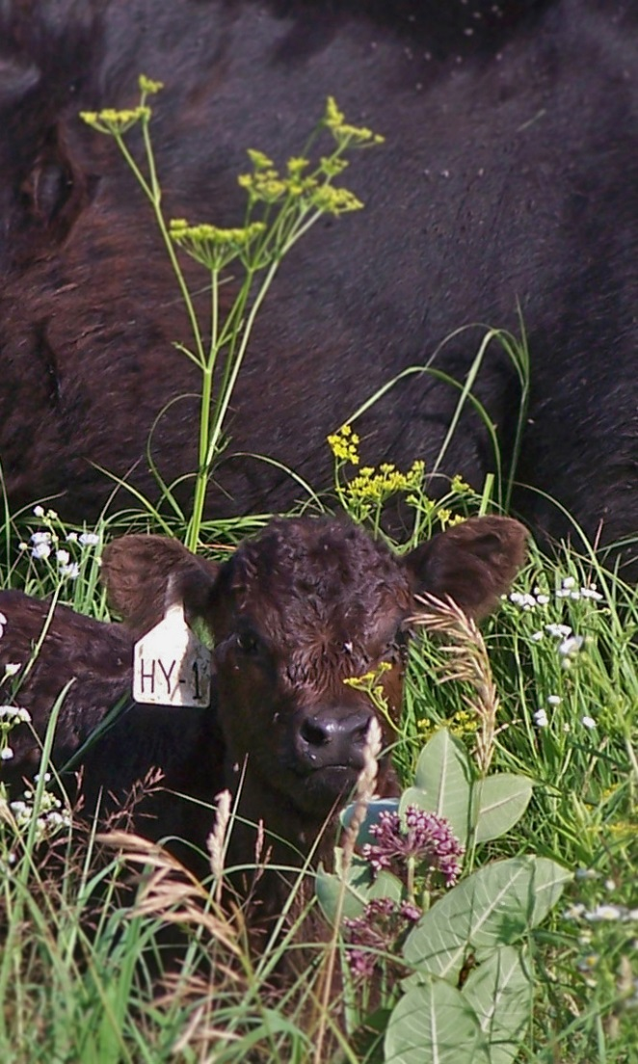
Calves like to hide in the tall cover it provides

