Slide 1
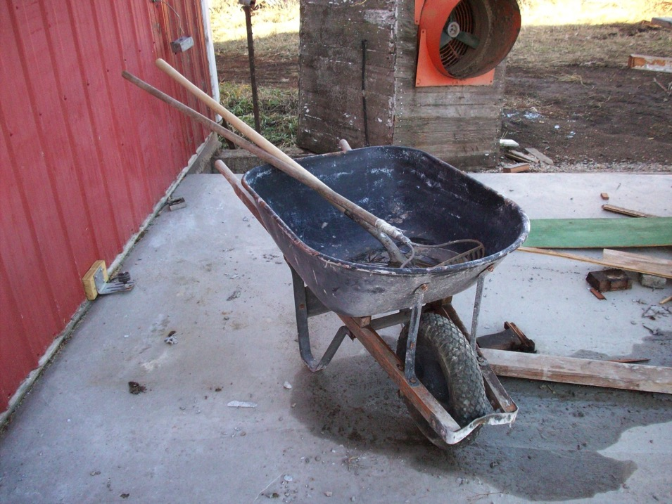
NCR-SARE Grant Remodeling Project 2012-2014

Slide 2
Sustainable Straw Based Animal Welfare Friendly Growing Unit For Hogs
Paul Sobocinski
Wabasso, MN

Slide 3
240 acre crop and livestock farm
LIVESTOCK:
• Farrow to finish hog operation. Sells finishers to Niman Ranch.
• Beef Cow/calf, using rotional grazing of pastures.
CROPS:
• corn, beans, alfalfa, grass hay, pasture,
• oats, wheat, and also have CRP

Slide 4
Farming Practices:
• Rotational grazing of cows.
• In the 5th year of a CSP contract for rotational grazing, pasture watering system that includes wildlife escape, nitrogen management, resource conservation crop rotation, and cover crops to scavenge nitrogen.
• Fenced in 160 acres and set up grazing paddocks on 40 acres and year-around watering system.
• Living snow fence on the farm in 1997.
•In 2001, I modified an existing pole barn into a deep bedded sow and piglet nursery.
•After the hog market collapse of 1998, I remodeled my existing raised crate farrowing barn into a deep straw farrowing barn.

Slide 5
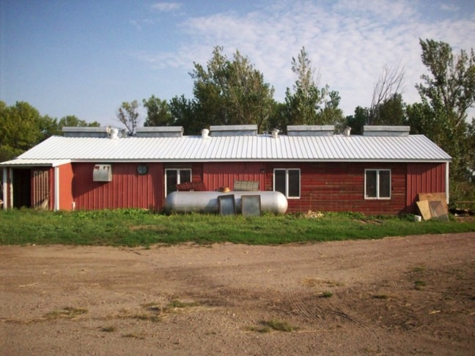
After becoming informed, I decided that raising hogs sustainably and having a specialized market through Niman Ranch was the approach that I wanted to take.
This presentation is about converting a nursery/ growing confinement building, with a pit, into a deep-bedded growing unit that meets Niman Ranch standards for improved animal welfare, while utilizing existing resources.

Slide 6
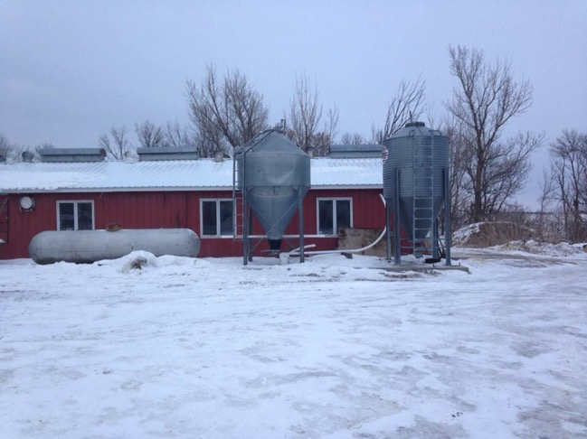
I was awarded this grant on the basis of demonstrating that a 24X64 confinement building with a partial pit could successfully be converted to an animal welfare-friendly
straw system that can
house pigs in a healthy
environment during their
initial growing phase.

Slide 7
Project Goals
(1) Renovate an existing 24 by 64 foot confinement building with a partial pit that would make the building suitable as a straw based animal welfare friendly growing unit.
(2) Look at pig performance and pig flow for the entire hog operation.
(3) Design the building to be easy for cleanout.
(4) Ensure good air quality in the building that exceeds its previous use as a confinement unit.
(5) Have a pleasant atmosphere to work in after the remodel.
(6) Have a space and pen(s) designed to address sick or injured pigs.

Slide 8
In addition…
I wanted to end up with a multifunctional building, one which was easy to clean, had less of an odor issue, and was not so labor-intensive.

Slide 9
The Outside (facing south and east)

Slide 10
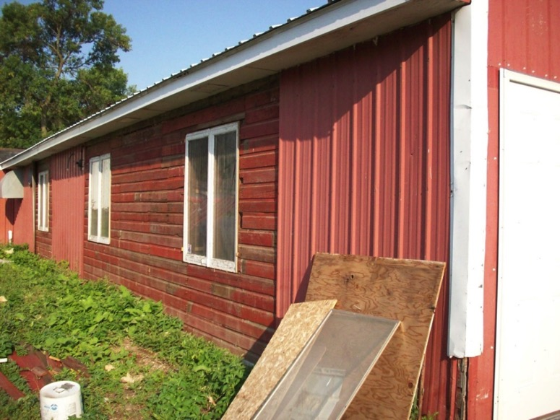
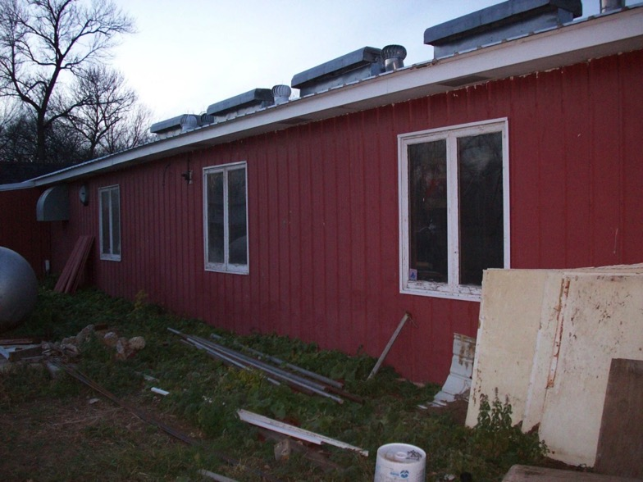
Sept 2012
Newly installed windows—natural lighting!
(note: old wooden siding being covered with tin)
Nov 1 2012

Slide 11
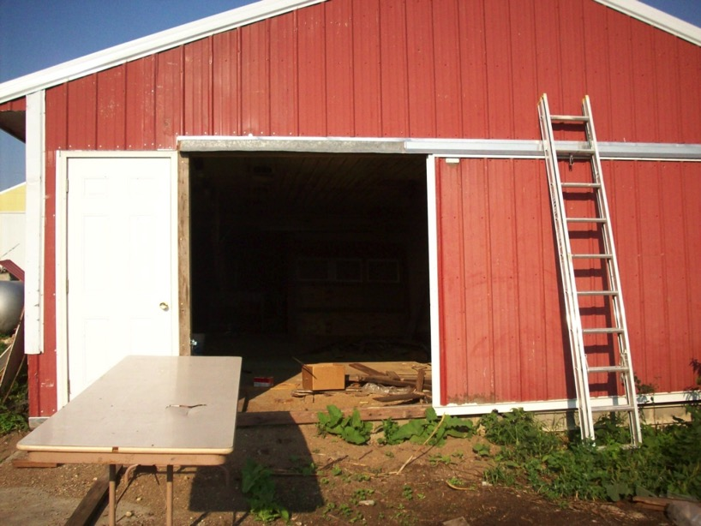
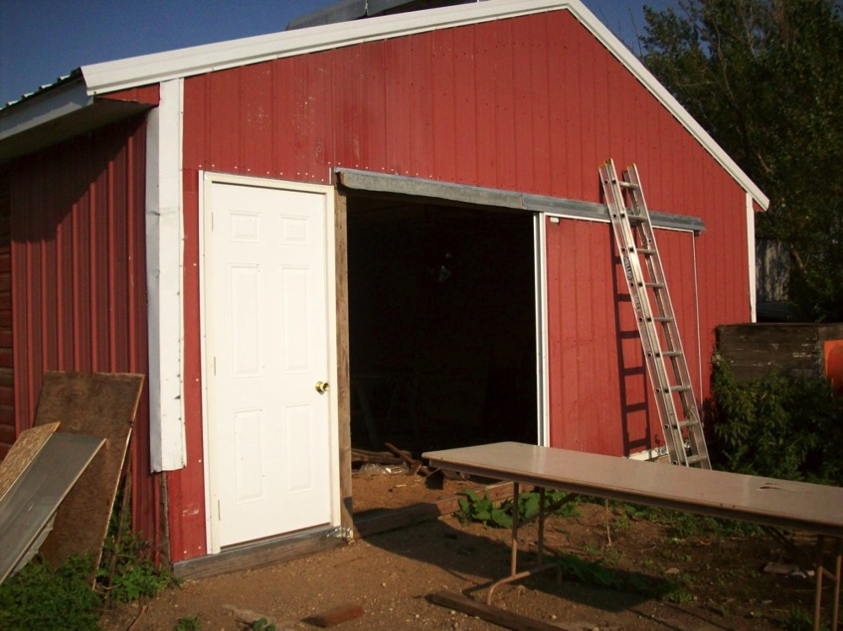
Sept 2012
New sliding
door in progress
(facing east)

Slide 12
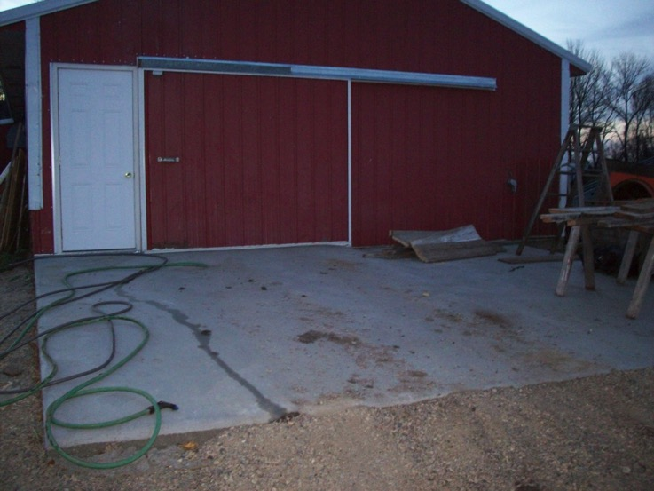
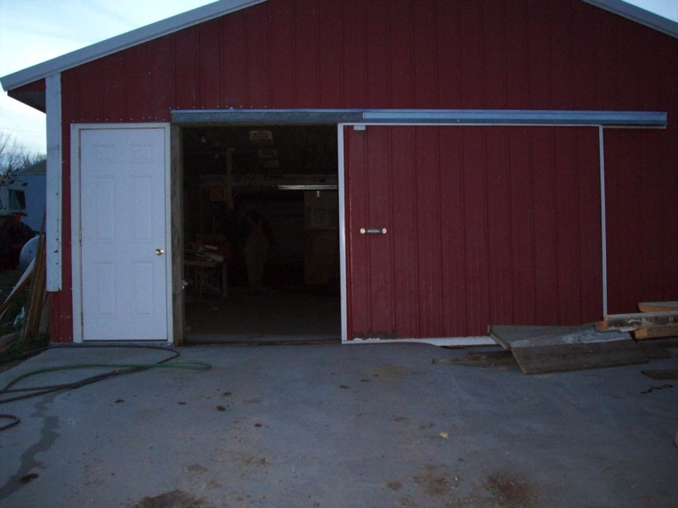
Nov 1 2012
New sliding door and
cement platform completed
(facing east)

Slide 13
Bulk bins (facing south)

Slide 14
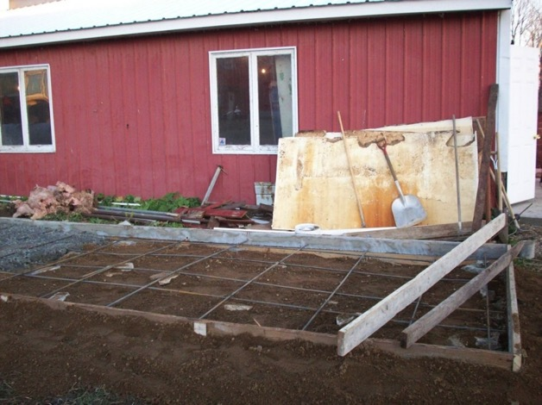
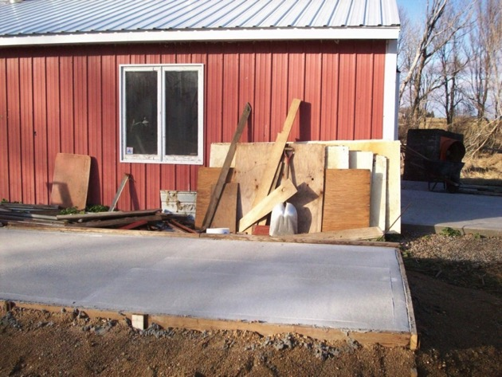
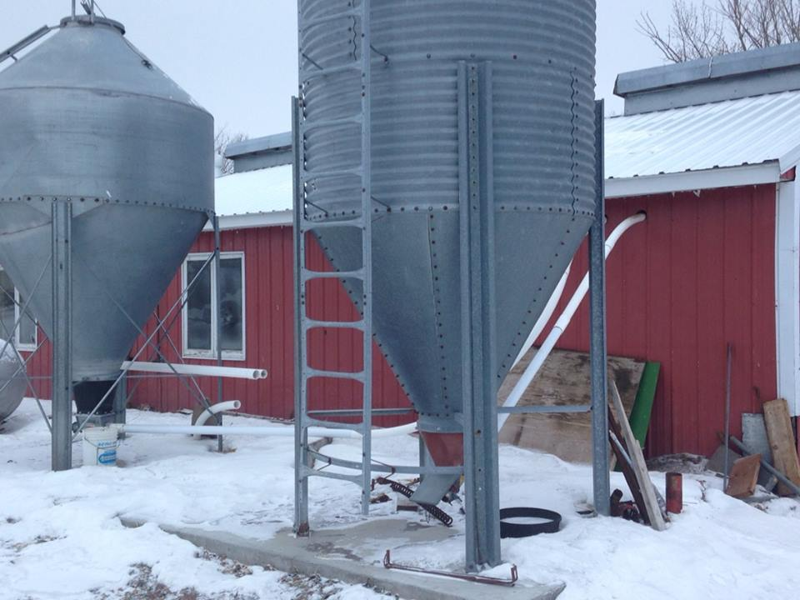
Nov 8, 2013
Nov 11, 2013
Jan, 2014

Slide 15
East side of nursery (inside)

Slide 16
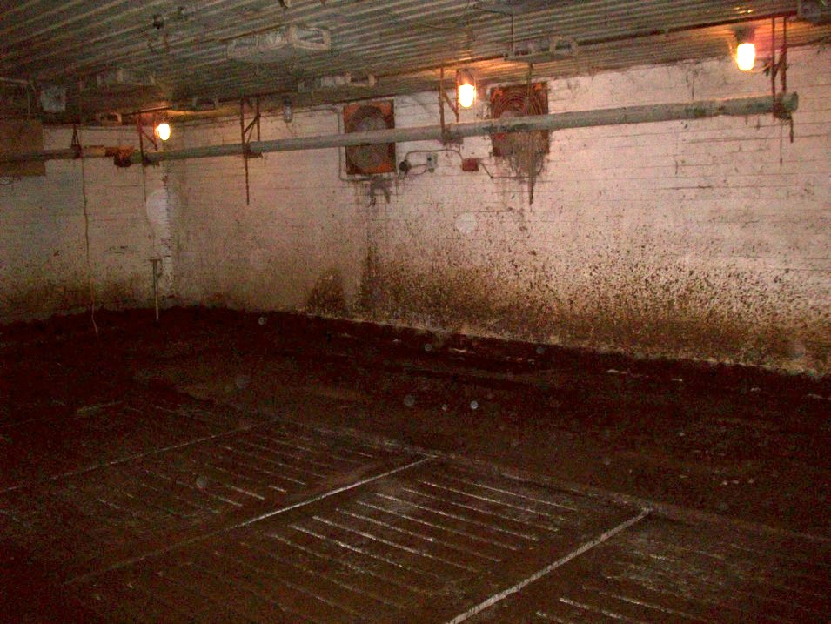
Sept 2012
(Picture of old interior)

Slide 17
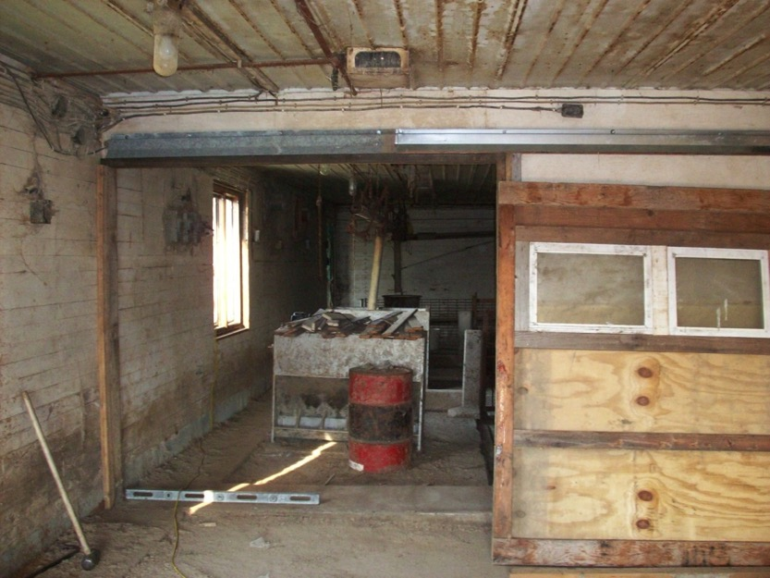
Sept 2012
Construction of dividing
wall between east and
west rooms

Slide 18
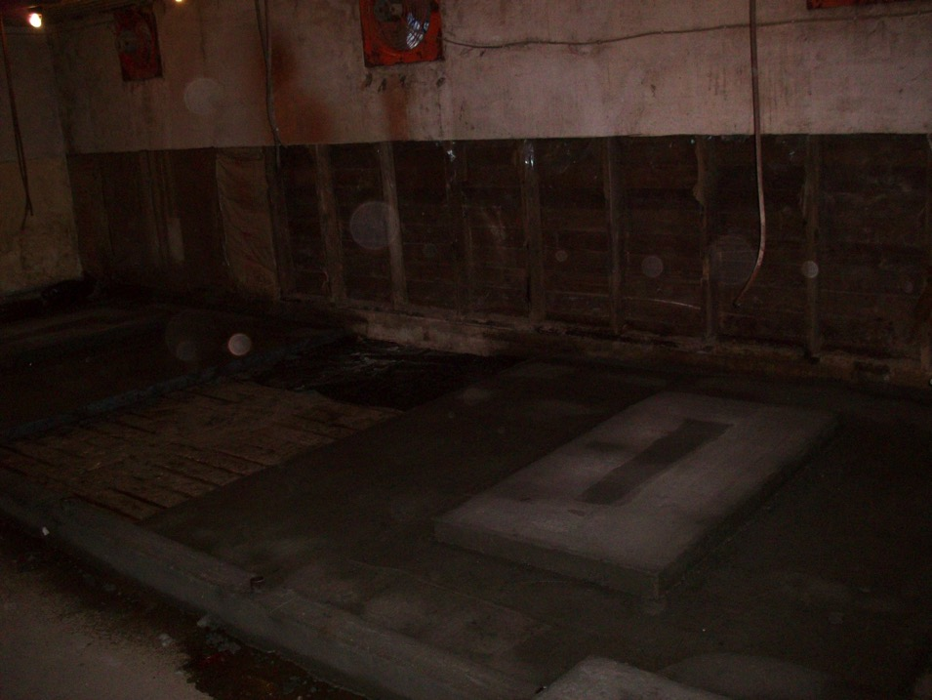
Nov 1 2012
New cement platforms for feeders
Having 2/3 of the
slats capped
improved air quality.
Capping slats with
2 in. of cement
(U of M consulted)

Slide 19
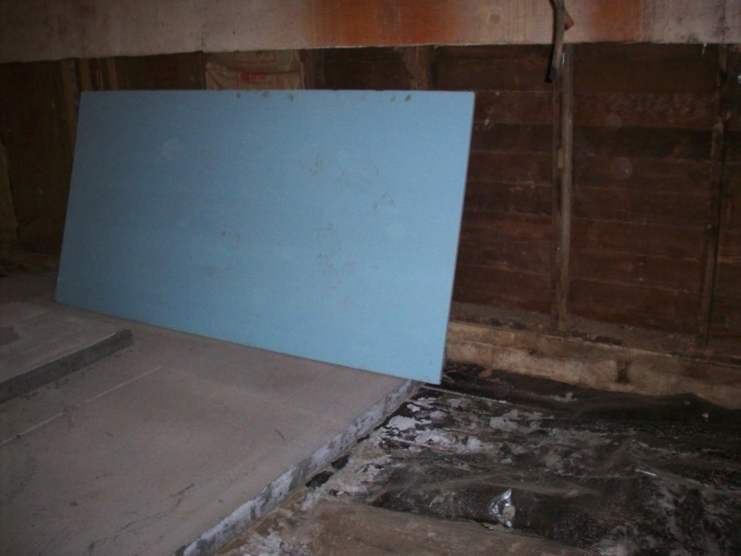
Nov 8, 2013
Insulation board beneath cement
Also reinsulated the
ceiling

Slide 20
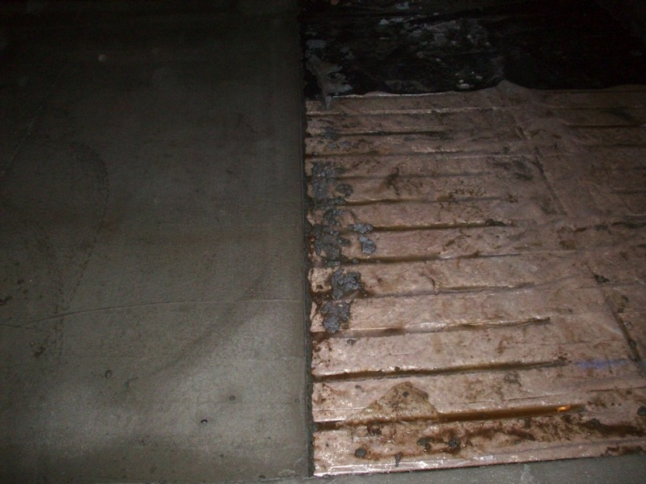
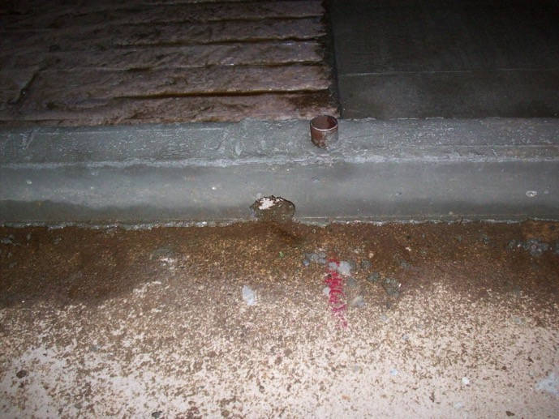
Nov 1 2012
East side slats for water drainage.

Slide 21
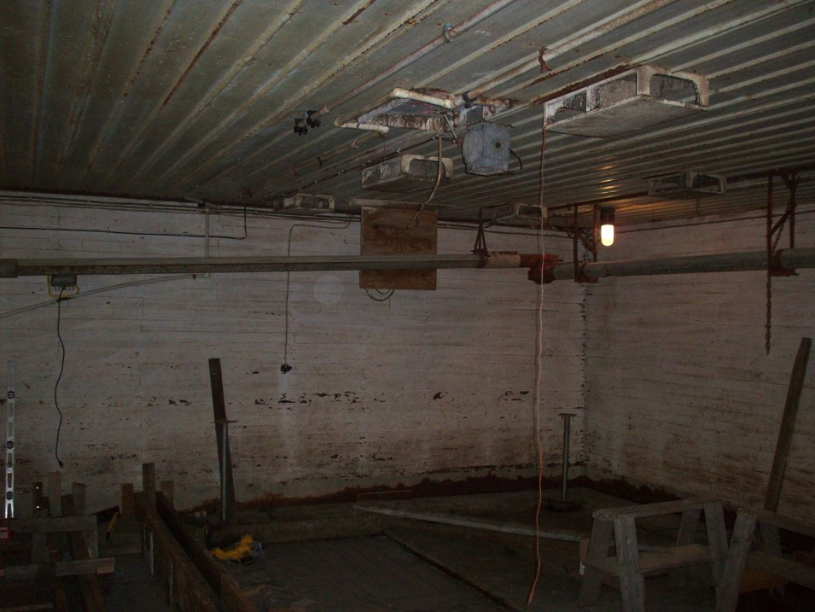
Nov 8, 2013
East side

Slide 22
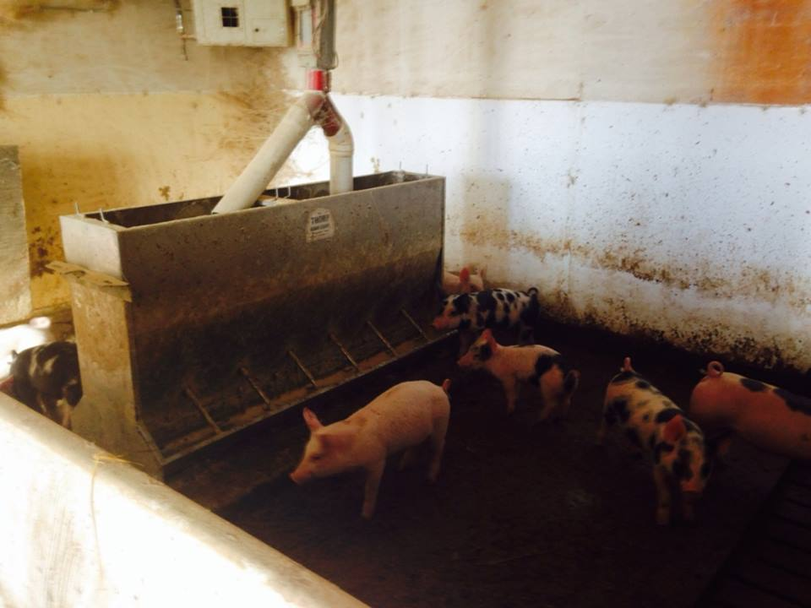
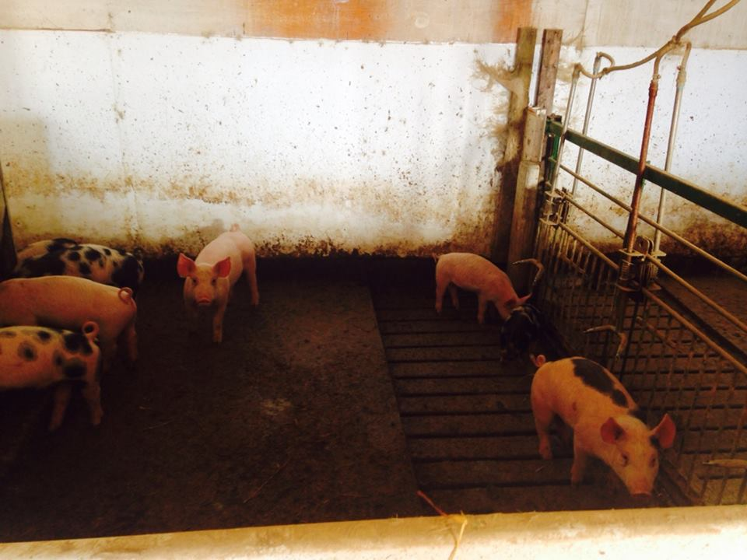
Jan 2, 2014
Note: 8X8 slatted area
(major dunging area)

Slide 23
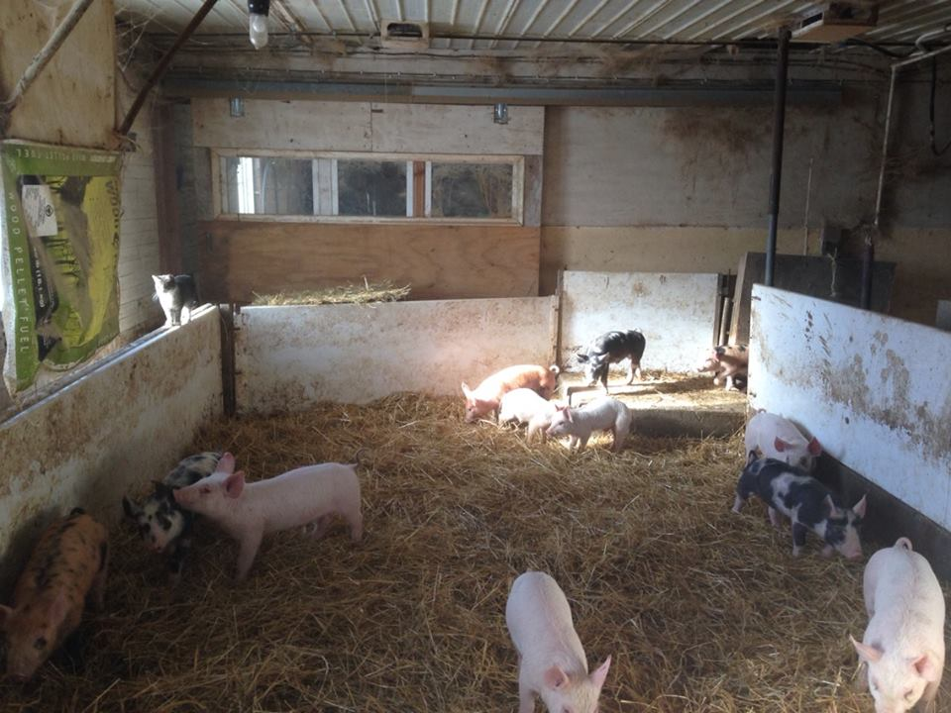
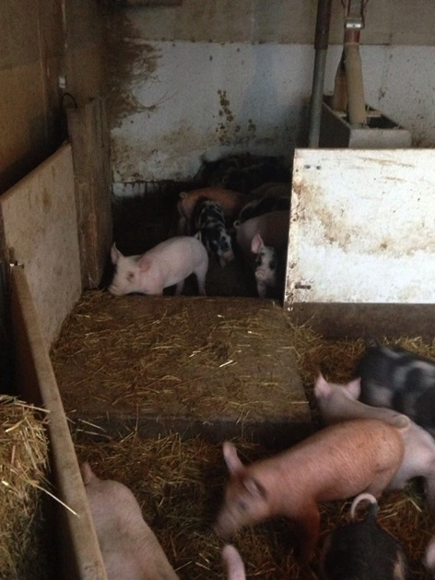
Jan 2, 2014
Note: light durable
gating

Slide 24
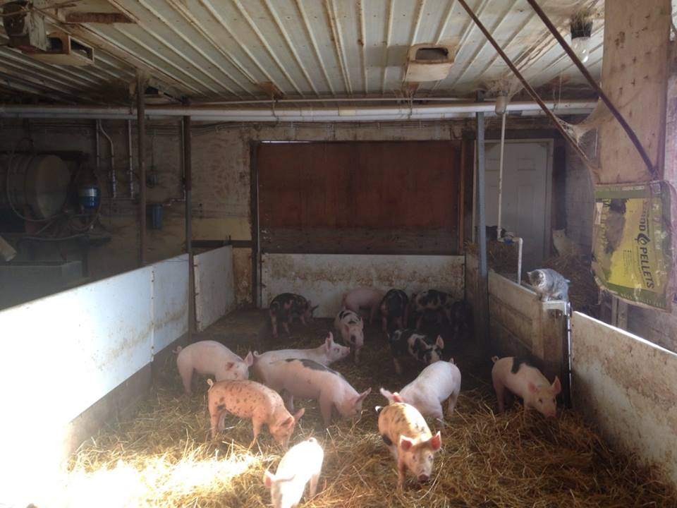
Jan 2, 2014

Slide 25
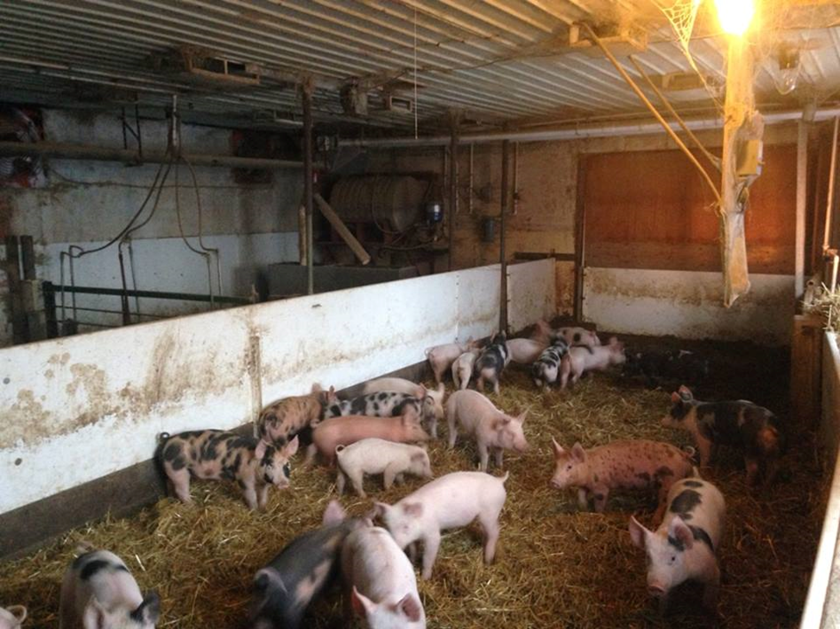

Slide 26
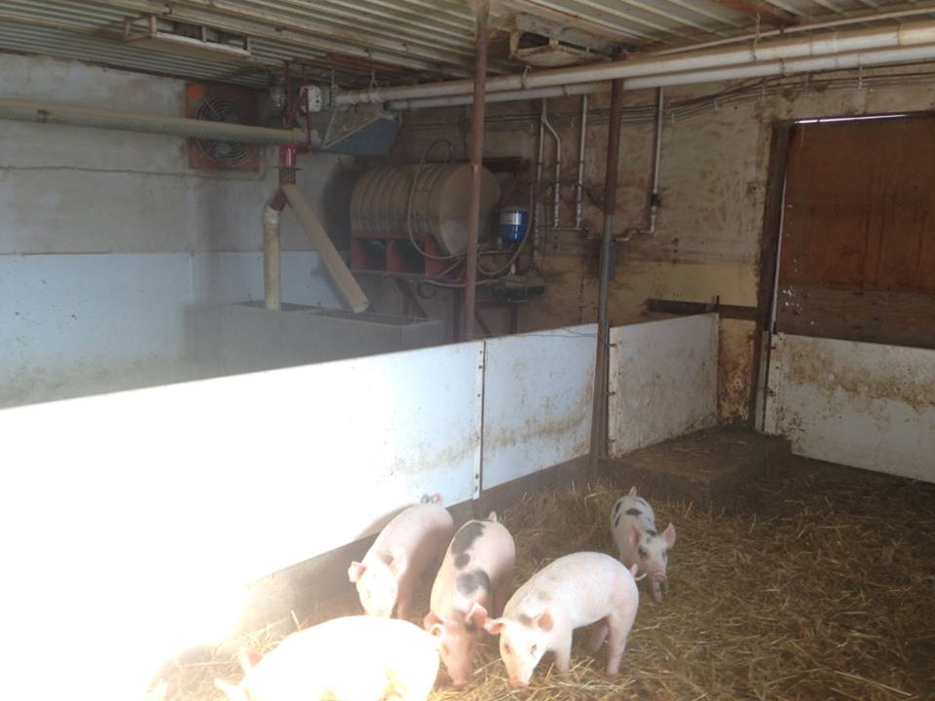
Jan 6, 2014
Note:
modified feed system

Slide 27
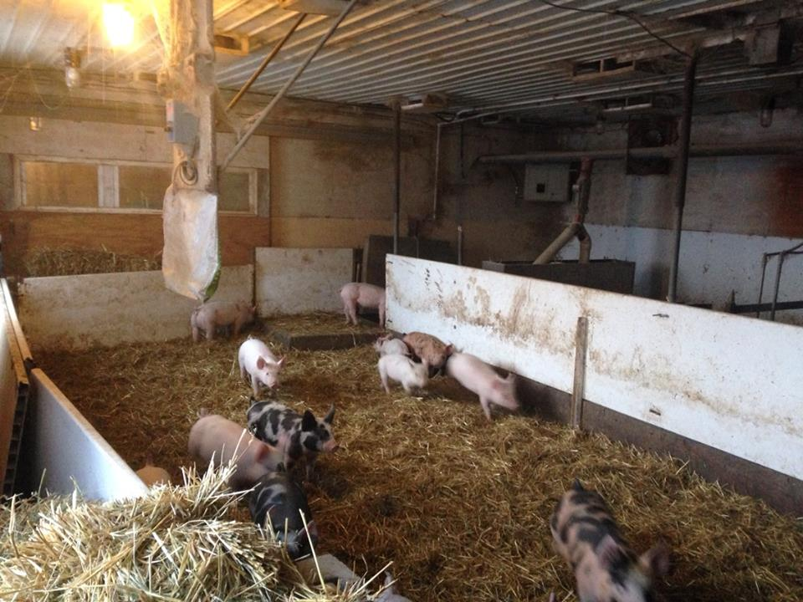
Jan 6, 2014
Note:
placement of
the heater

Slide 28
West side of nursery (inside)

Slide 29
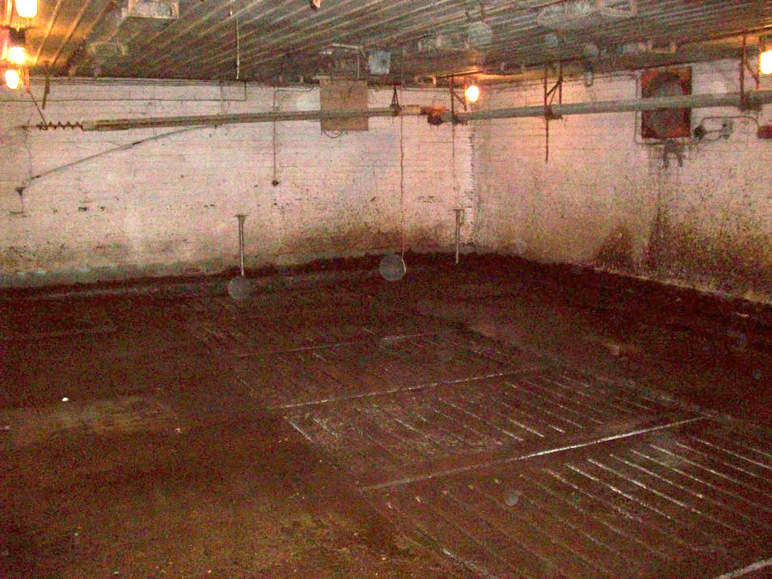
Nov 1 2012

Slide 30
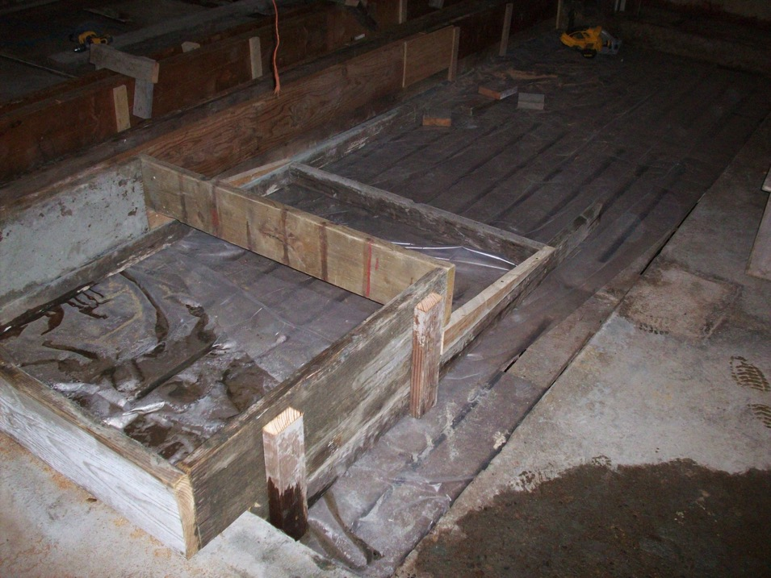
Nov 8, 2013
West side
Raised platform
with steps

Slide 31
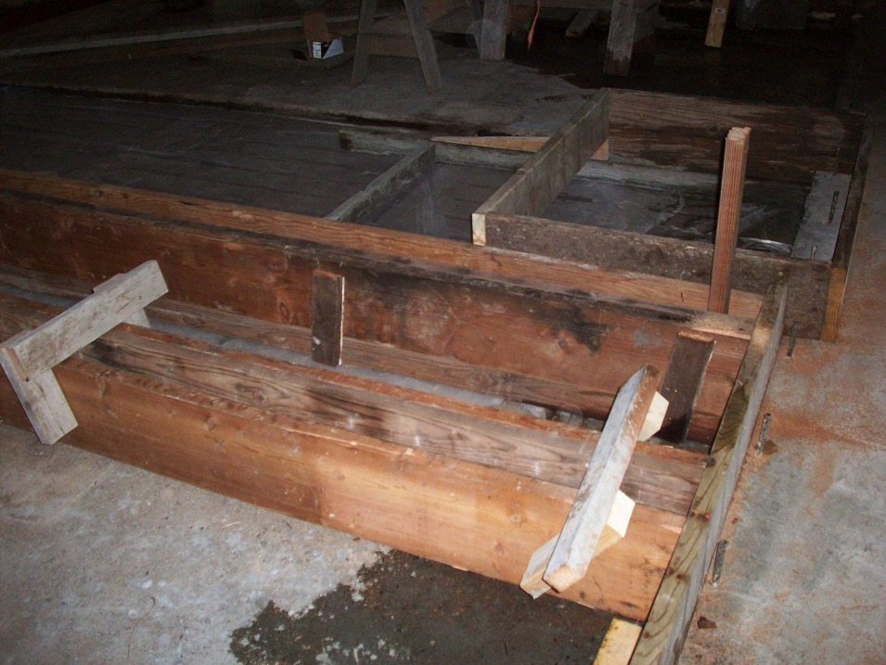
Nov 8, 2013
West side

Slide 32
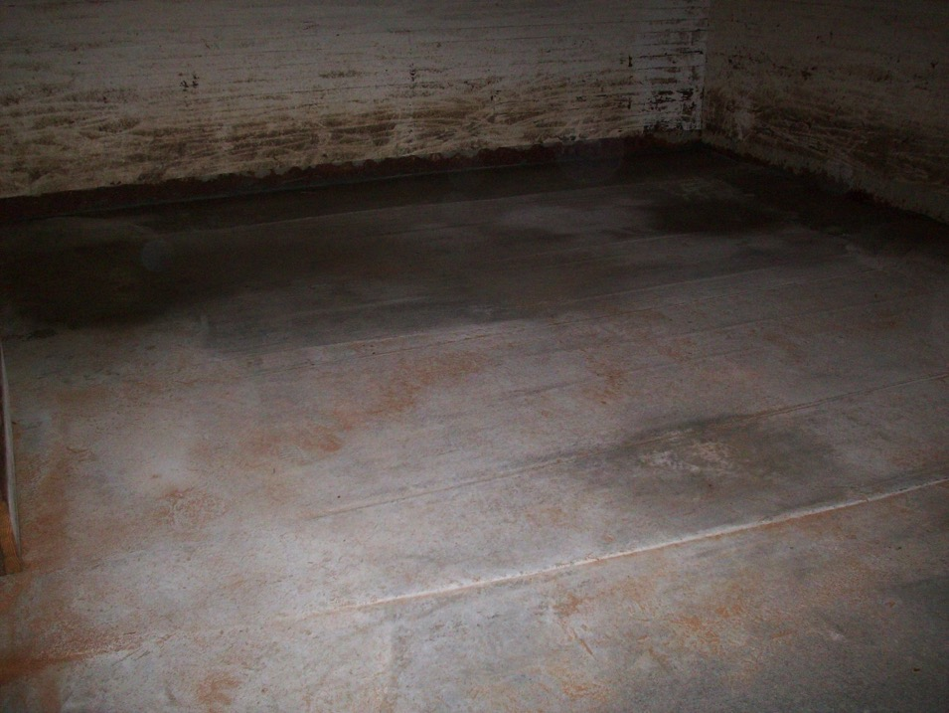
Nov 8, 2013
West side

Slide 33
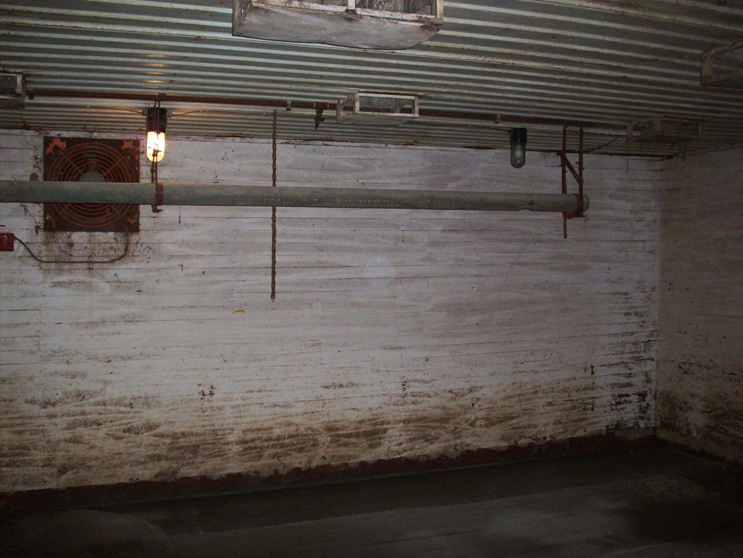
Nov 8, 2013
West side

Slide 34
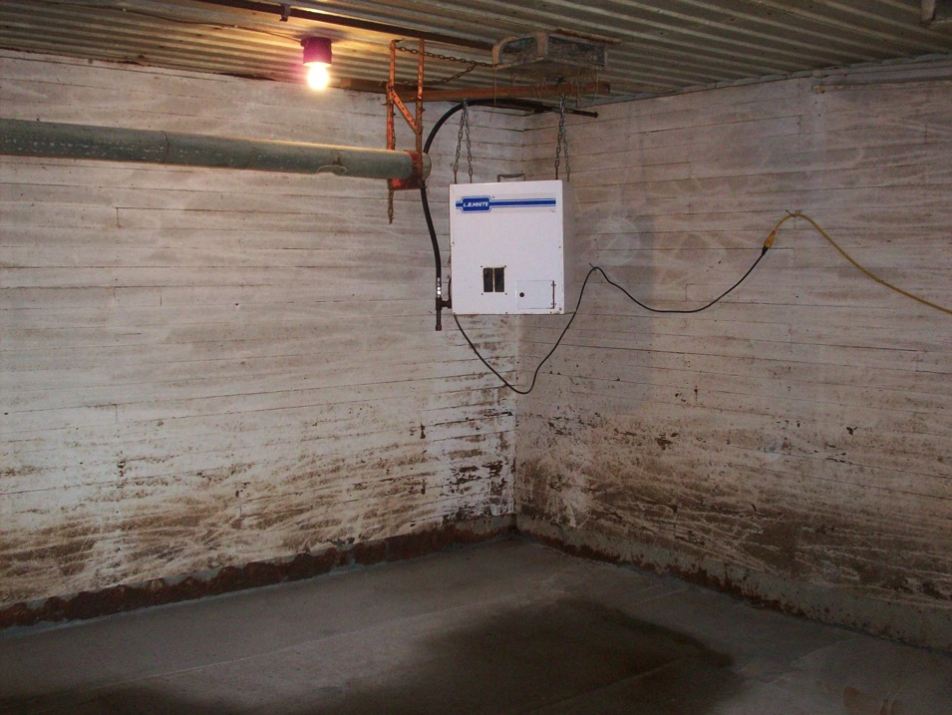
Nov 11, 2013
West side
Note:
placement
of the heater
(is wrong!)

Slide 35
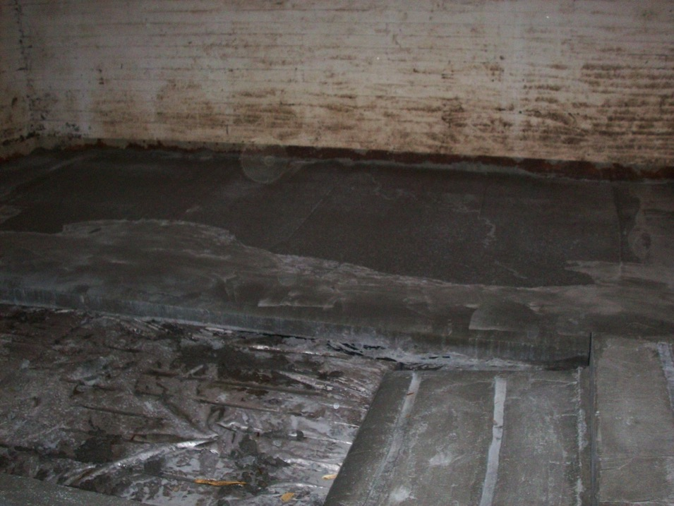
Nov 11, 2013
West side

Slide 36
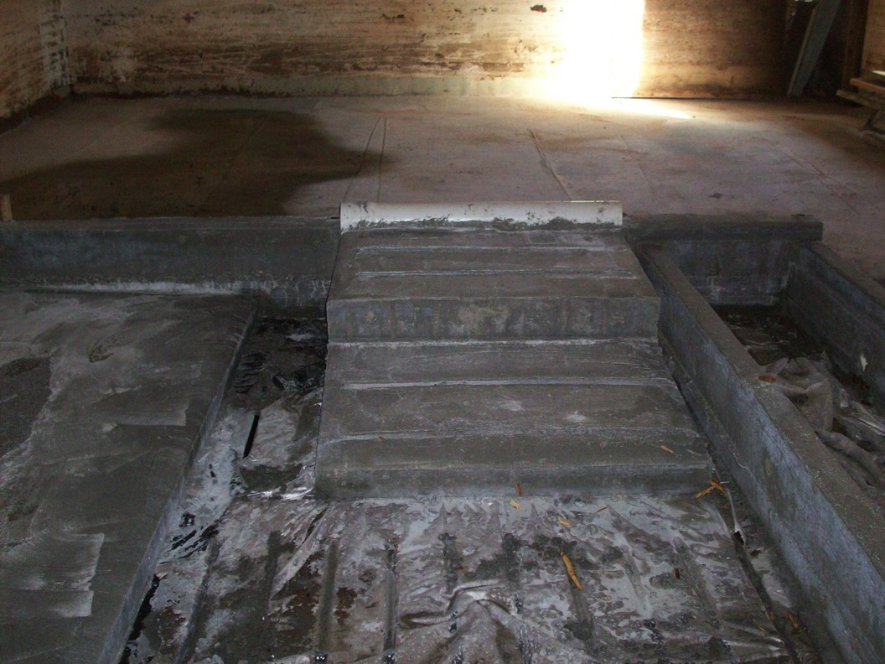
Nov 11, 2013
West side

Slide 37
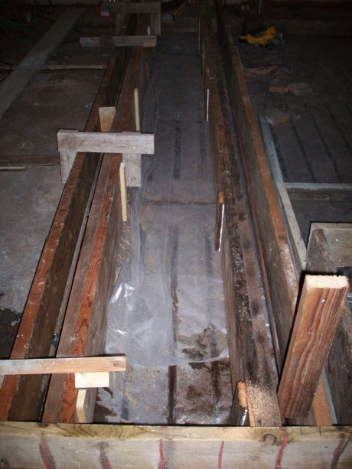
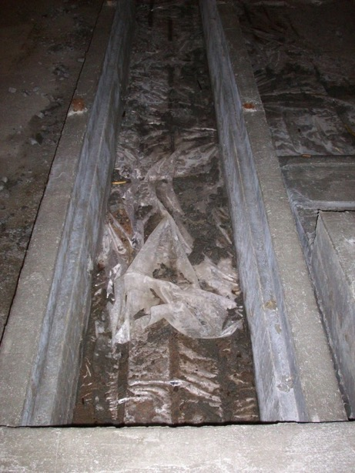
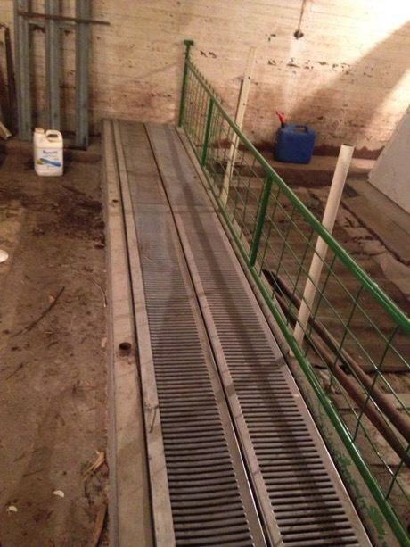
Nov 8 Nov 11 Jan 2014
West side
Water spill area

Slide 38
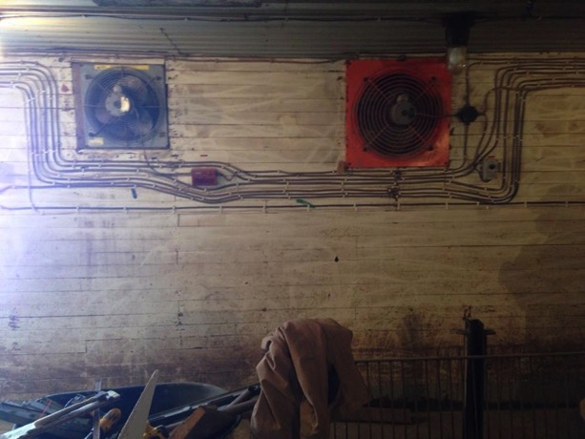
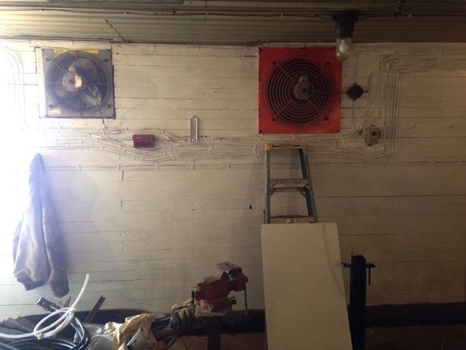
Painting!
West side

Slide 39
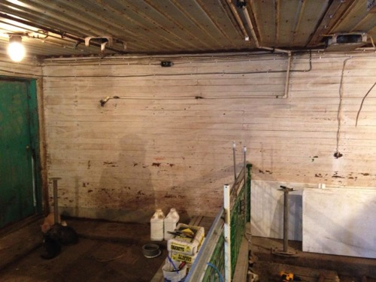
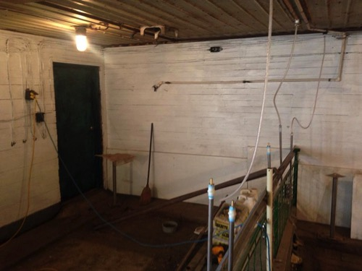
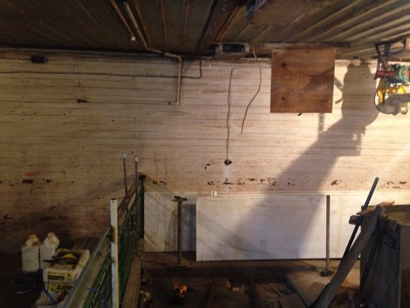
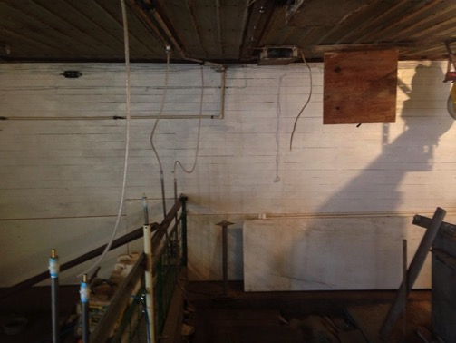
Feb 11 (More painting) Feb 13

Slide 40
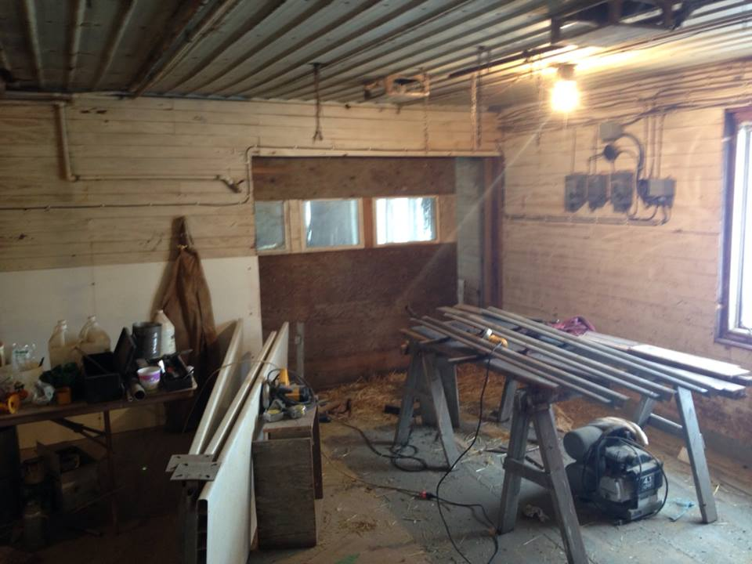
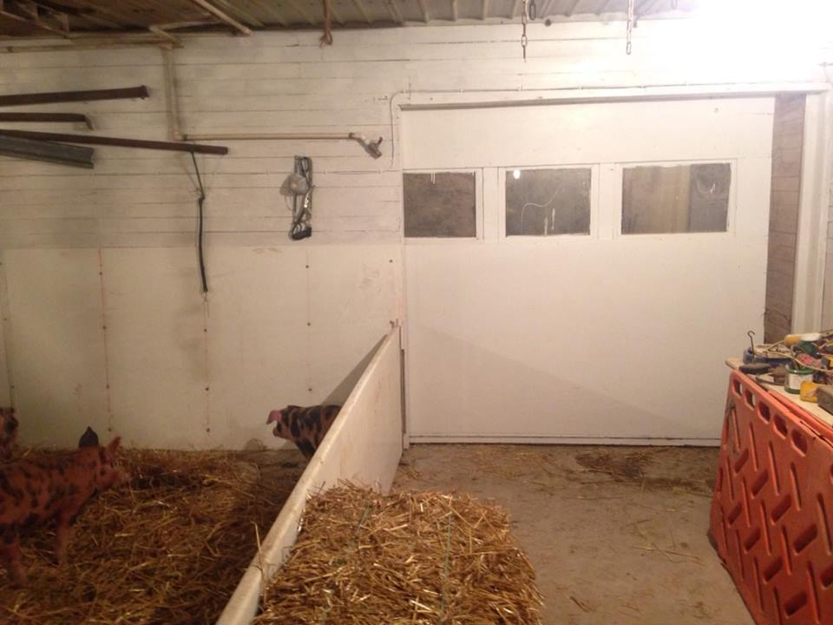

Slide 41
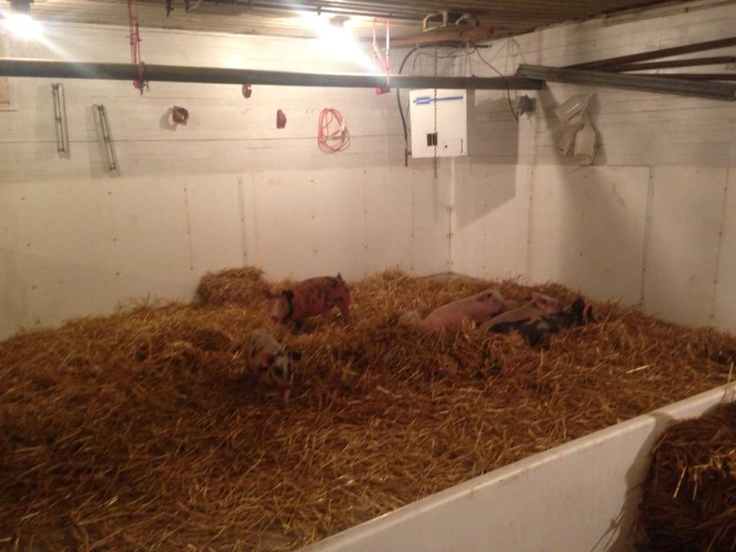
February 2014
West side

Slide 42
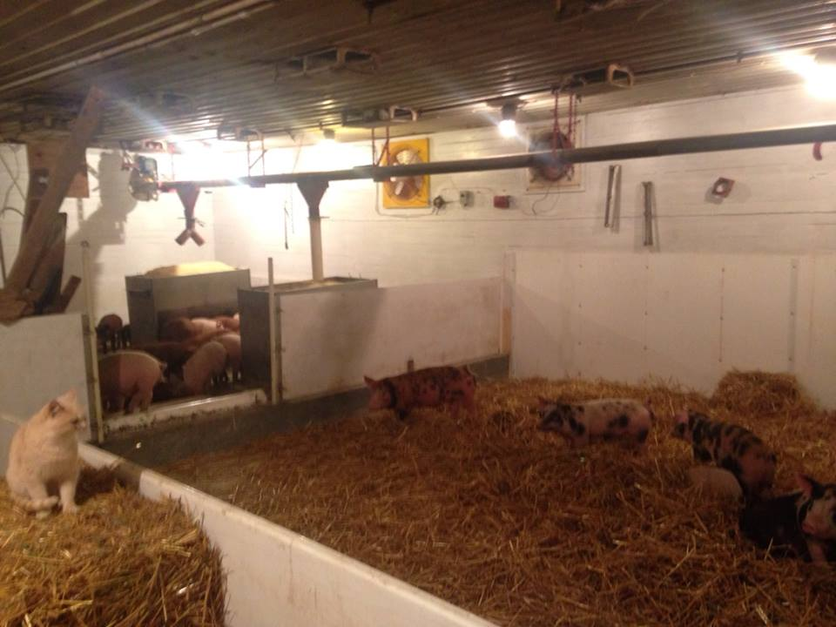
West side

Slide 43
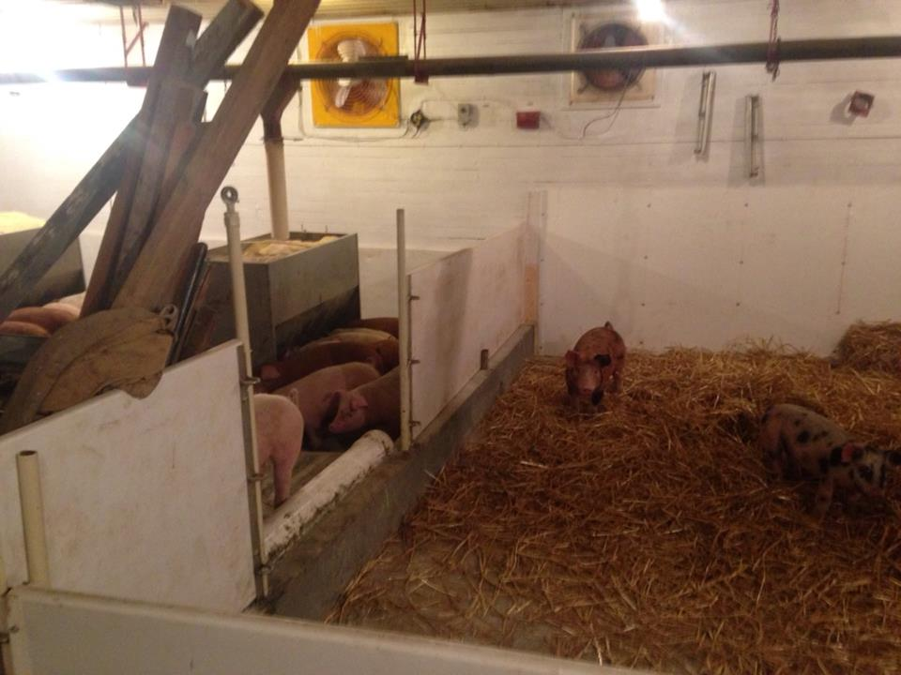
West side

Slide 44
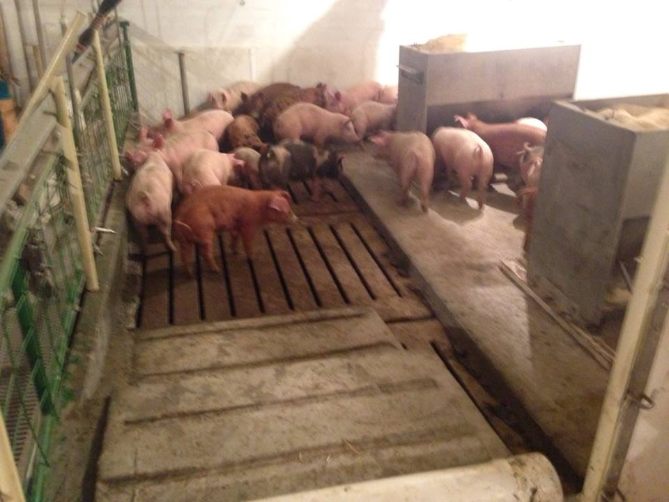
West side

Slide 46
West side

Slide 47
Building Issues and Response
(1)Wanted to use the pit in both rooms but didn’t want straw to end up in the pits, accomplished that with fencing and raised access pads to keep straw out of the pit.
(2)Wanted the major dunging to occur in the slatted area, accomplished that by water placement in the slatted areas kept.
(3)Wanted good air quality, accomplished that by capping 2/3 of the slats and good variable speed pit fans
(4)Wanted a pleasant atmosphere to work in, accomplished that by putting in windows and painting.
(5)Wanted easy clean out, accomplished that by making skid loader access for dry straw manure
(6)Wanted a treatment area for sick or injured pigs, accomplished that by special small pen designed for that.

Slide 48
Results
(1) Now suitable as a straw based animal welfare friendly unit.
(2) Two feed trials showed improved pig performance in the building, using 40% less feed per pound of gain compared to pigs in this weight category fed outside.
(3) Easy to clean because the pigs can be gated into the feeding area during clean out. The gating is portable, light, and easy to move.
(4) Air quality in the building is superior to when it was previously used as a pig confinement unit. The audit team for both Niman Ranch and Chipotle thought it was exceptional. Capping 2/3rds of the pit was a main factor in improving air quality.
(5) The atmosphere in the building after the remodel is pleasant, windows installation made an exceptional difference. The dungeon effect is gone.
(6) Having a sick and injured pen area makes the facility easy to deal with for those animals.

Slide 49
Any questions?

