Slide 1
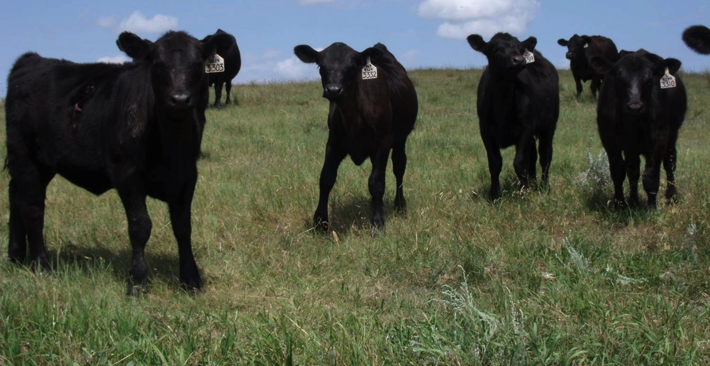
Utilizing Cover Crops to Increase Productivity, Health & Vigor on Tame Grass Pasture
Project #FNC13-908
Donnie & Trisha Feiring

Slide 2
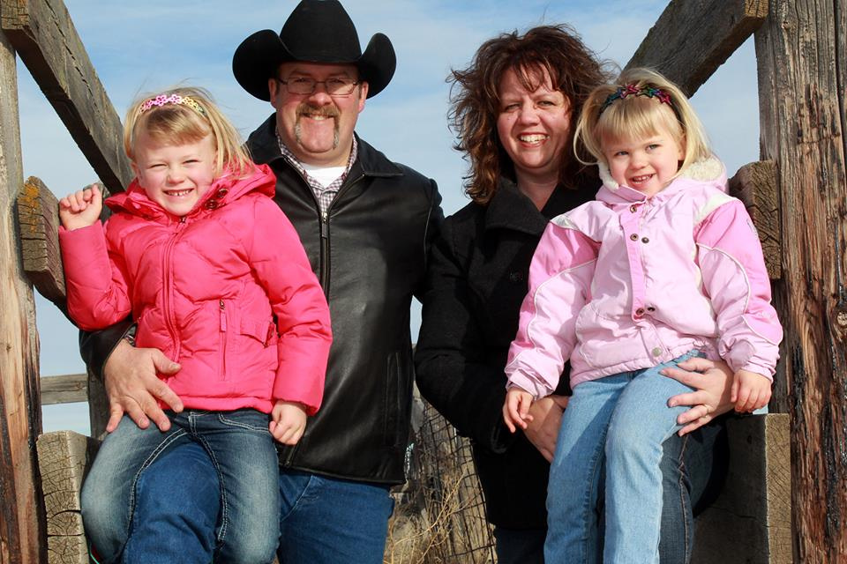

Slide 3
Description of SARE GrANT
Utilize cover crops to prove that a smooth brome grass dominated pasture can be rejuvenated without conventional tillage farming practices.

Slide 4
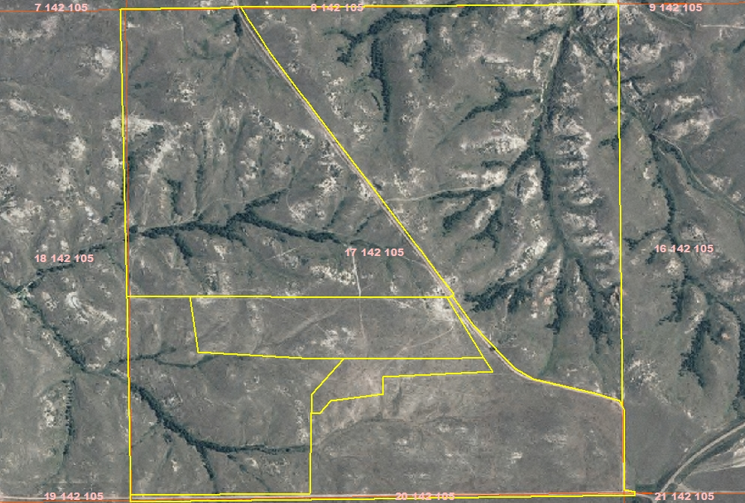
2004

Slide 5
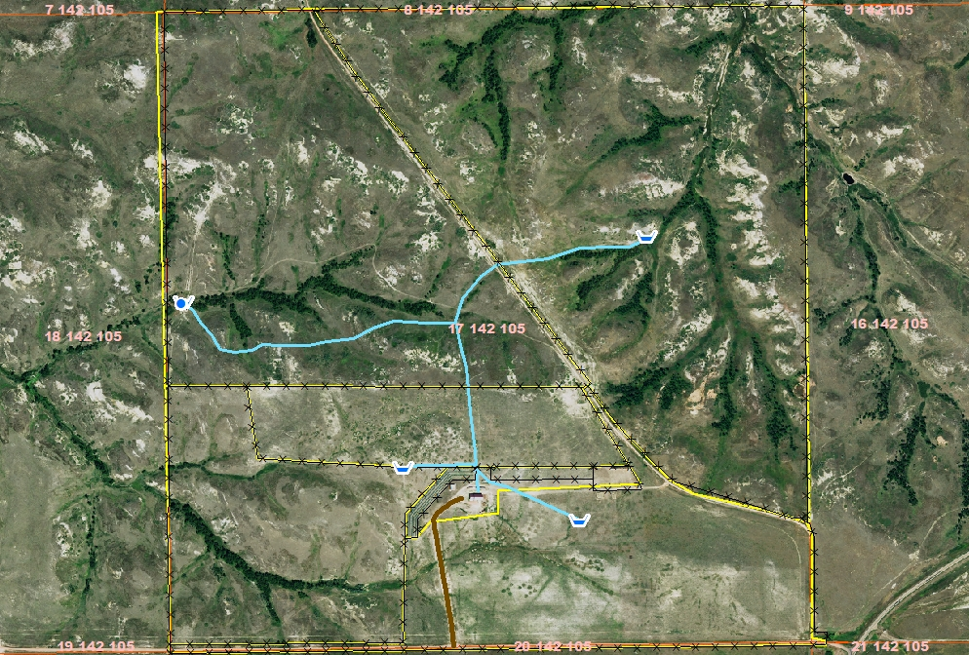
2014

Slide 6
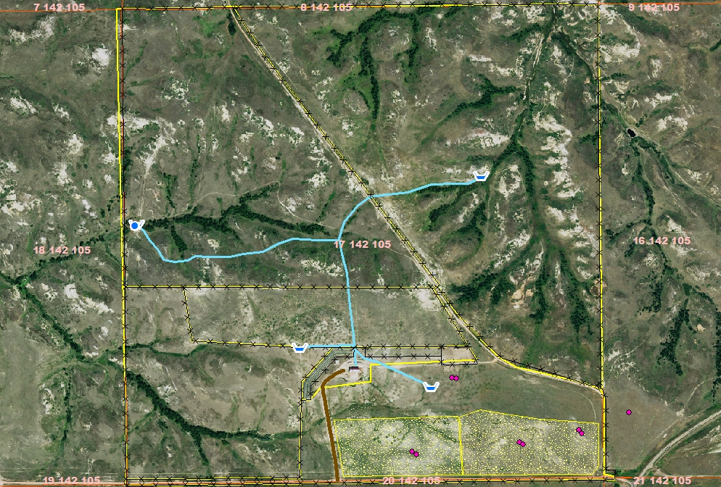
2014 with SARE Plots and Transects

Slide 7
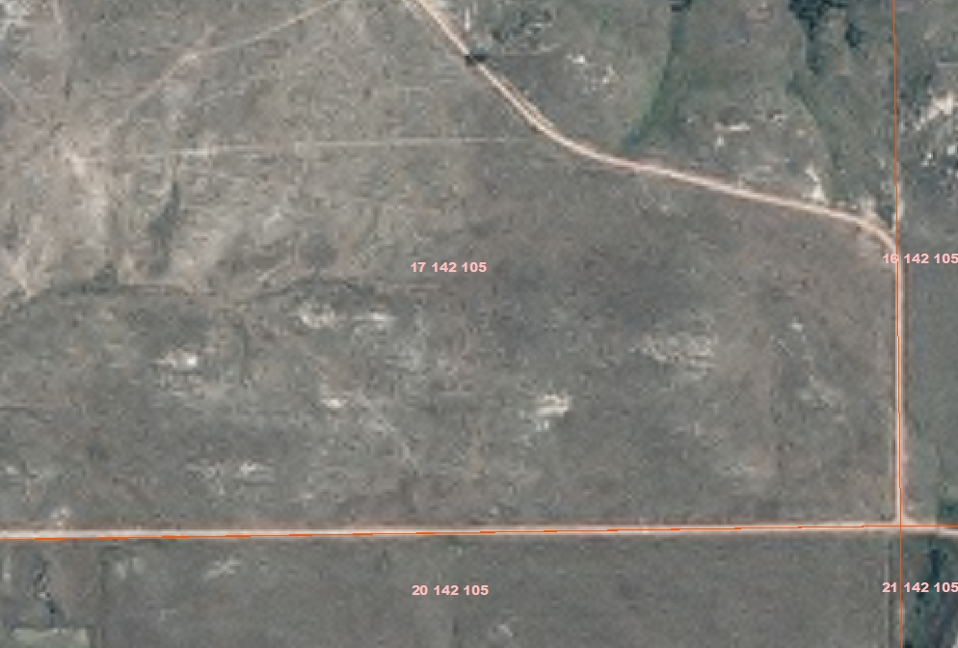
2004

Slide 8
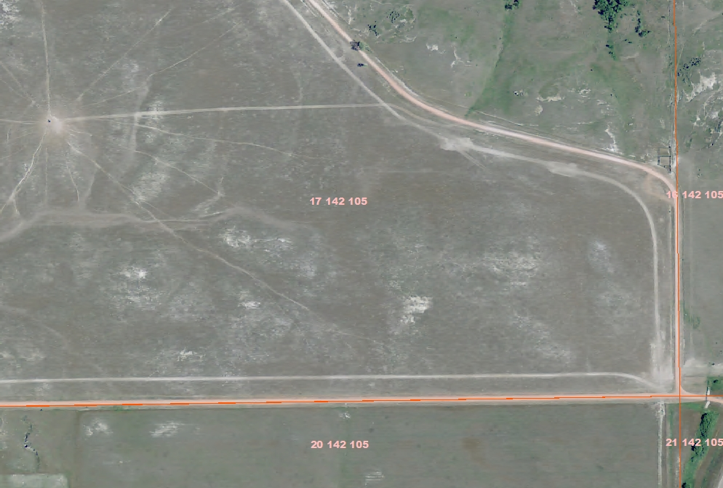
2009

Slide 9
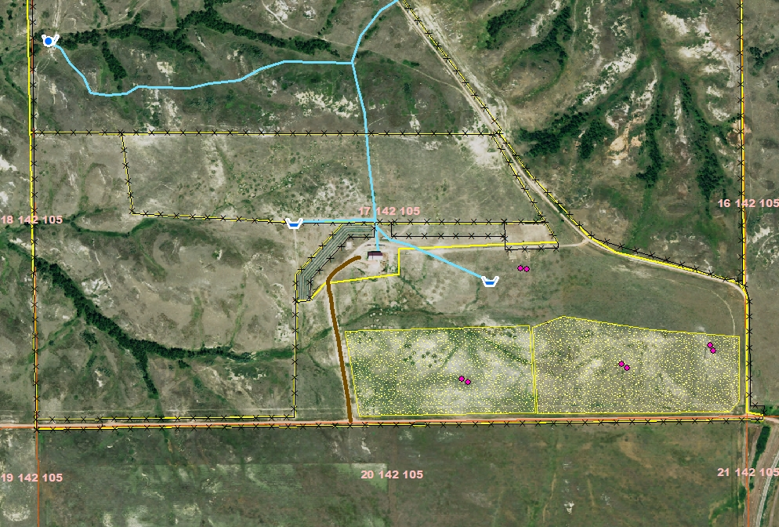
2014 with 20 acre SARE plots identified

Slide 10
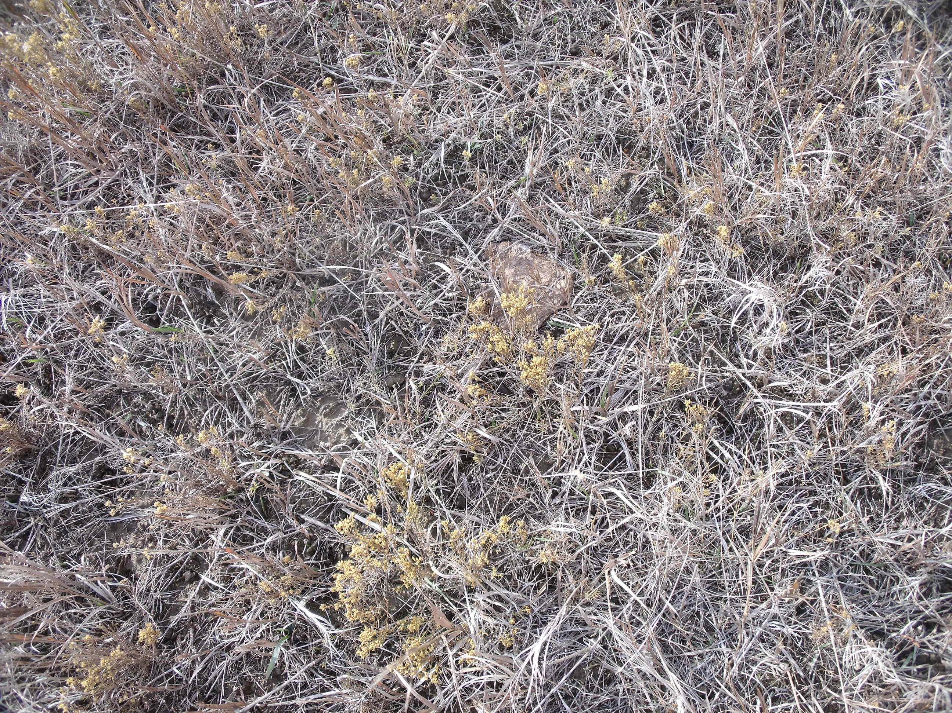
2012 CSP Photo Points

Slide 11
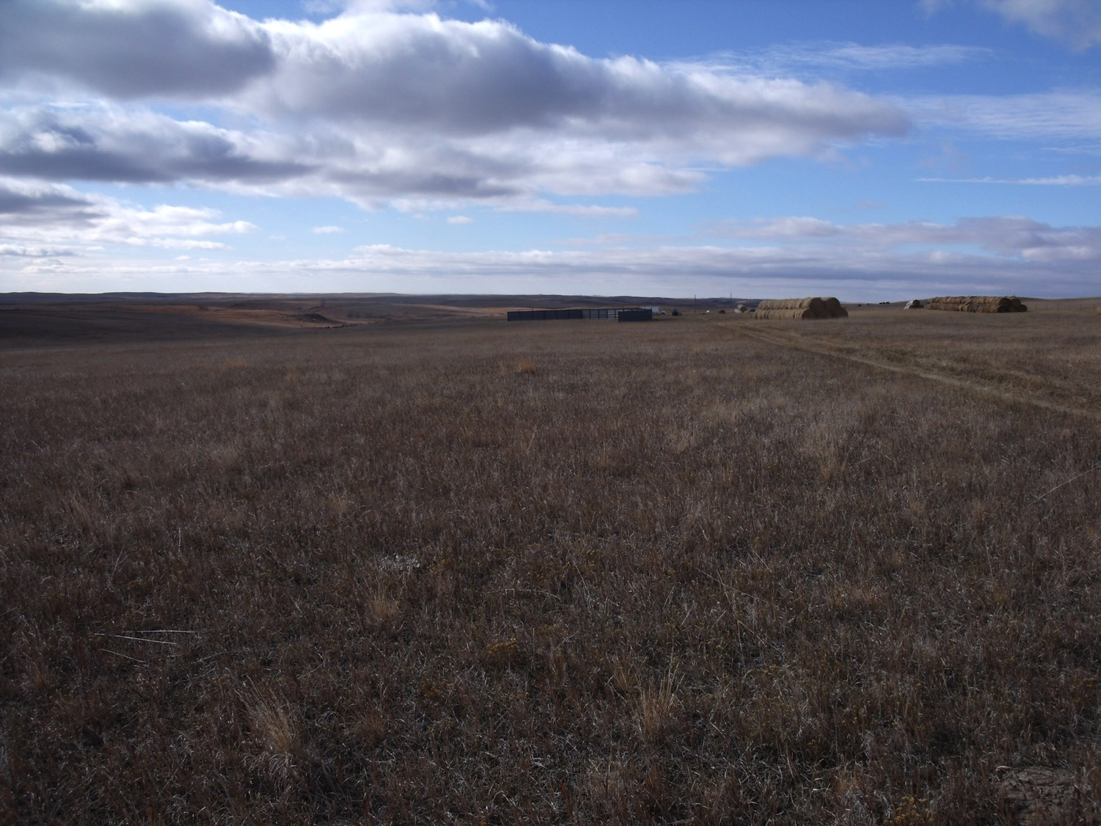
2012 CSP Photo Points

Slide 12
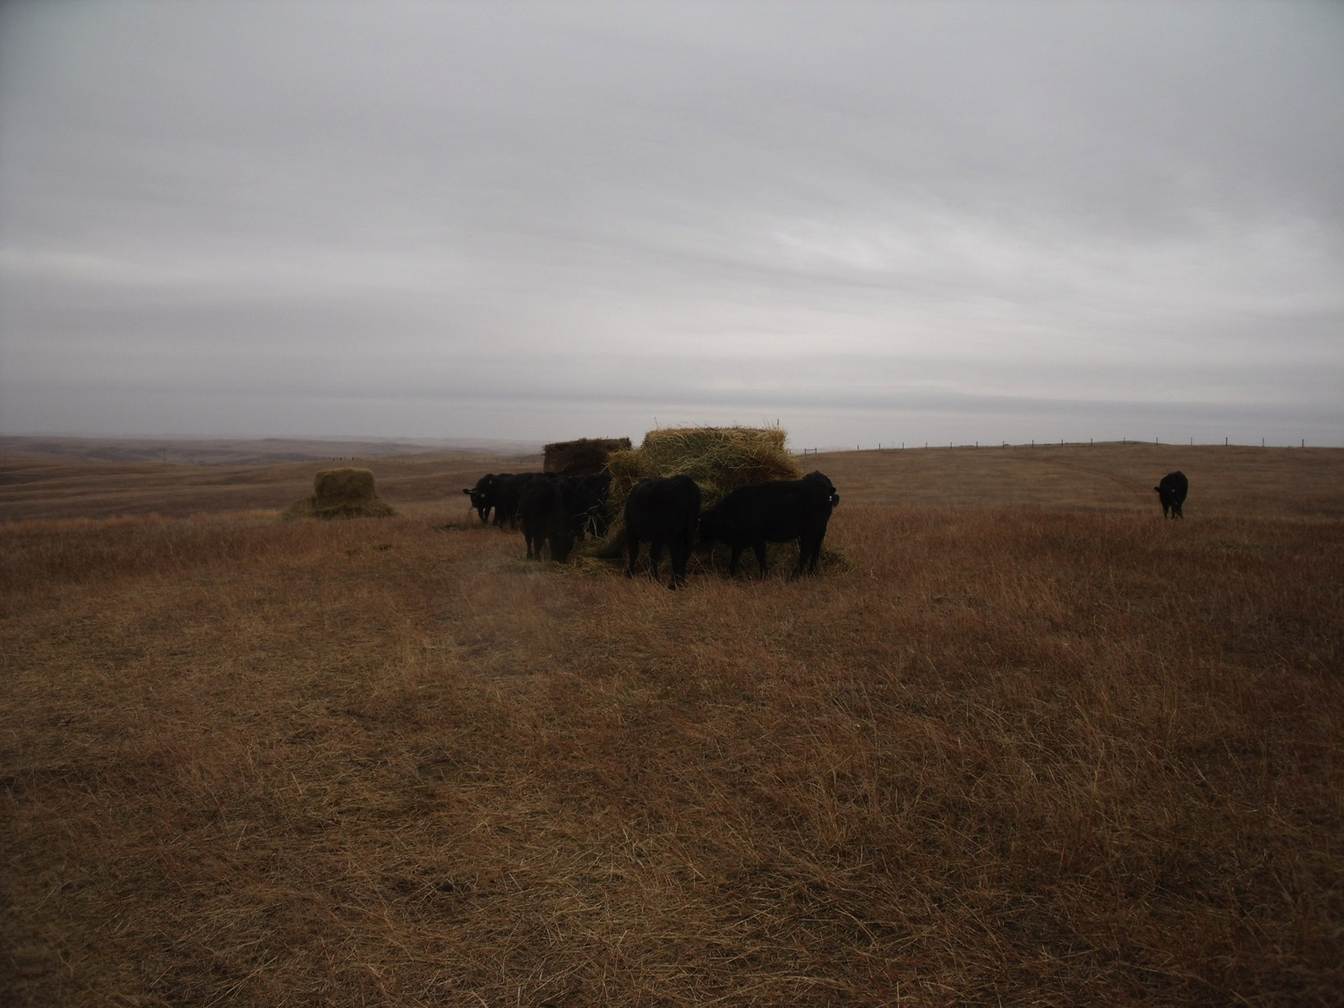
10-22-2012

Slide 13
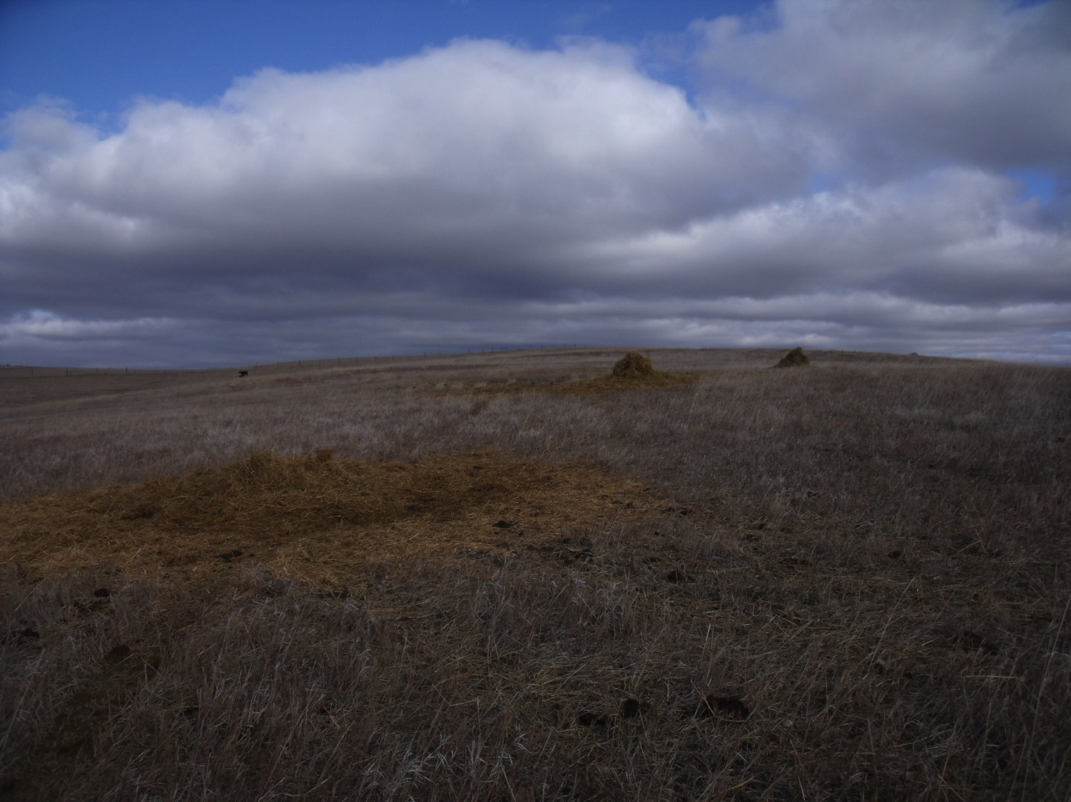

Slide 14
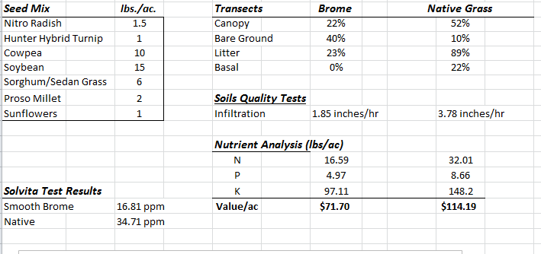
Spring of 2013

Slide 15
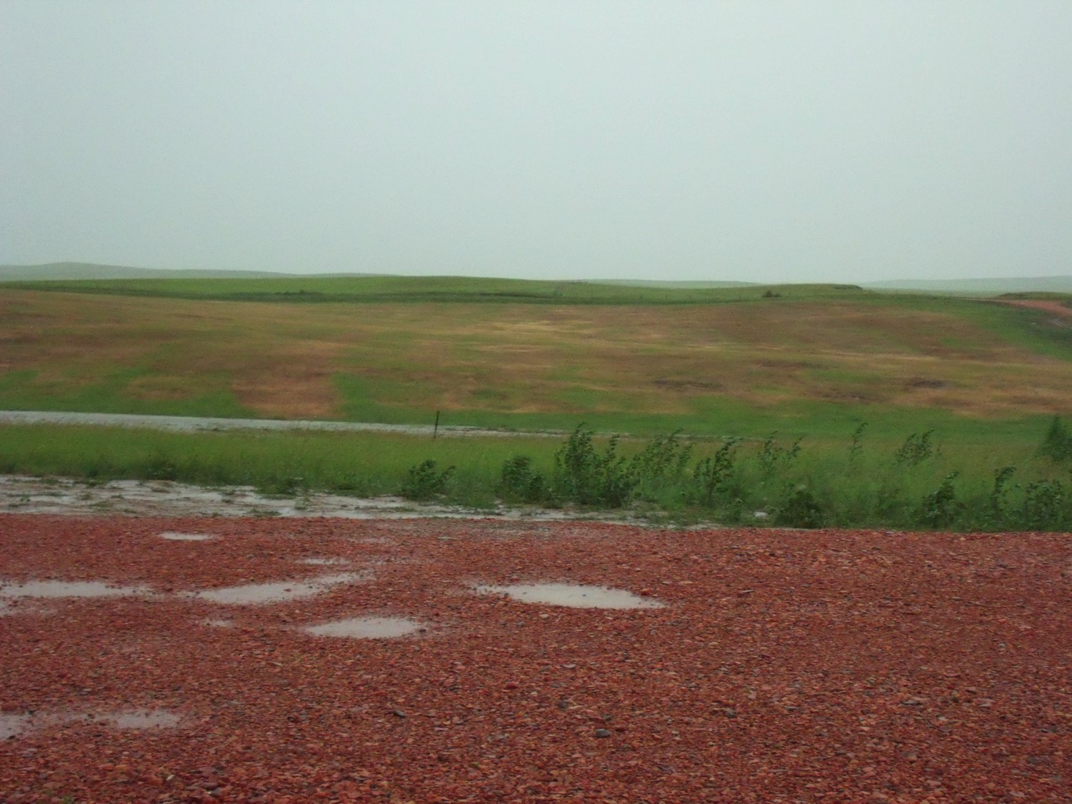
7-8-2013

Slide 16
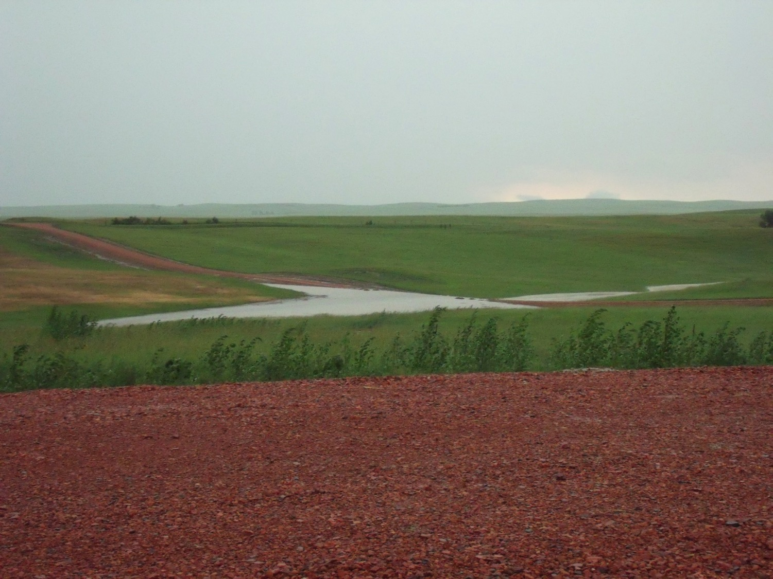
7-8-2013

Slide 17
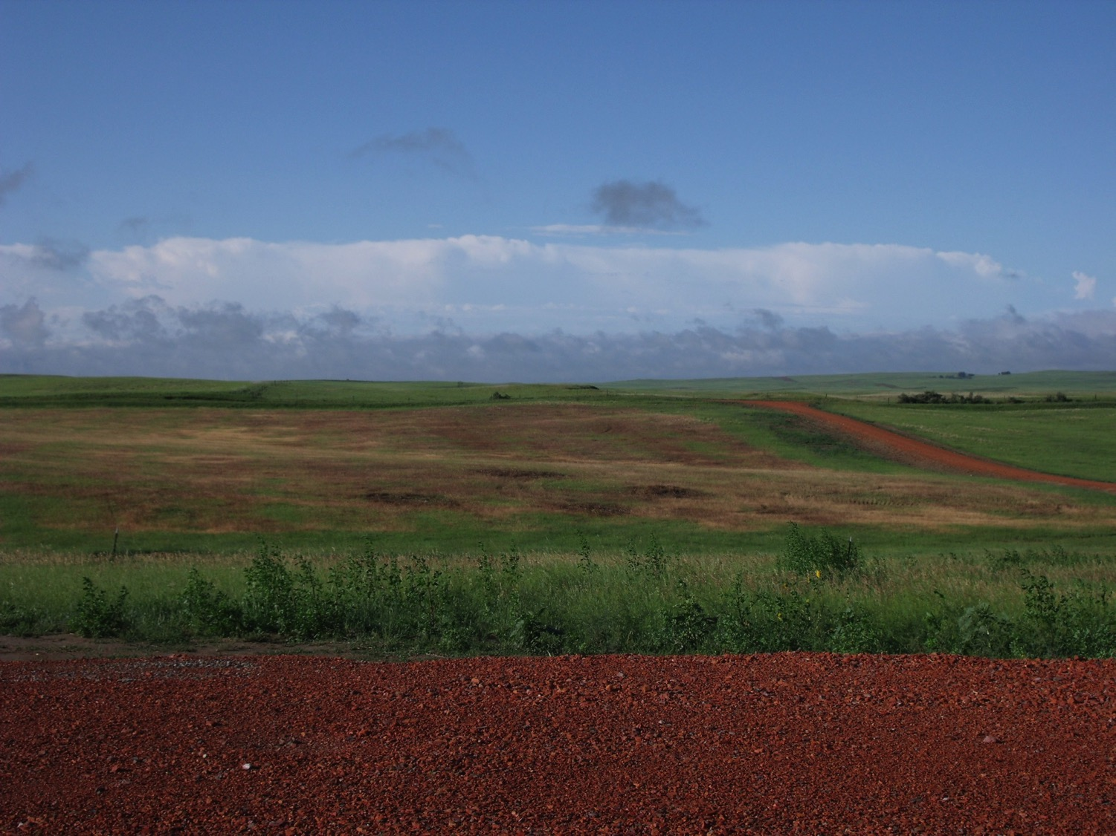
7-8-2013

Slide 18
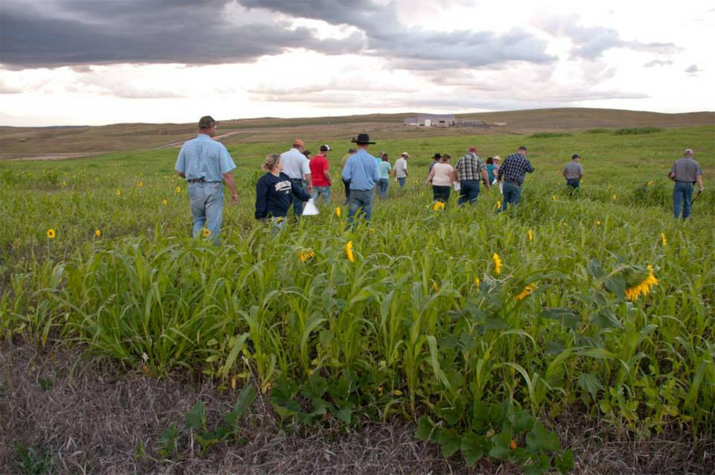
9/18/2013 Golden Valley County Cover Crop Tour

Slide 19
Grazing days on cover crop
14 head of yearling bulls grazed the cover crop from Oct 10th to Nov 20th
Supplemented with hay starting Nov 20th
41 days of grazing on 20 acres

Slide 20
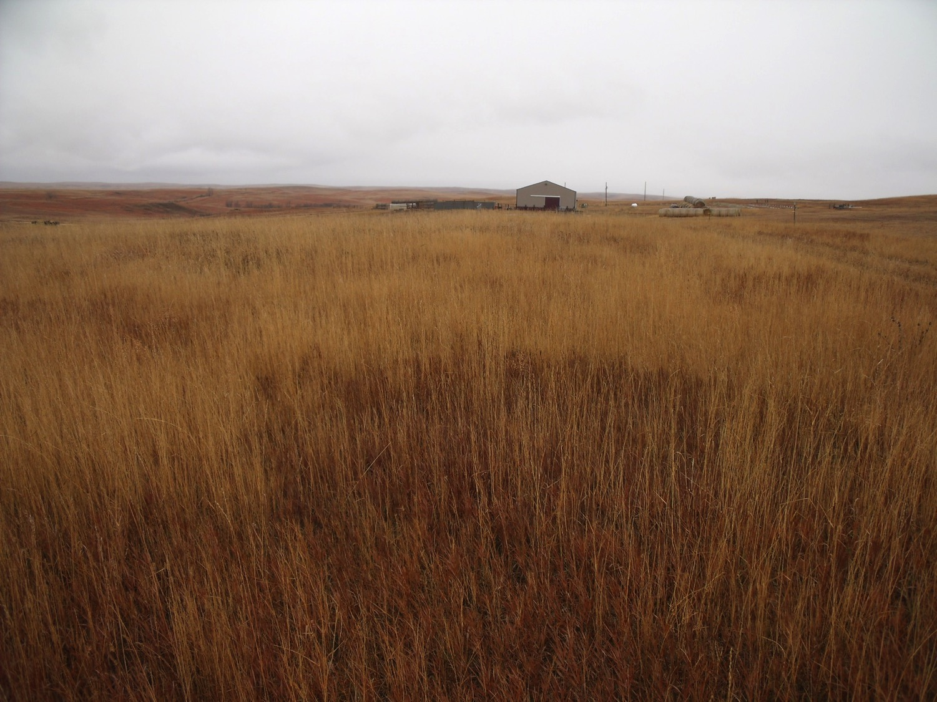
11-14-2013

Slide 21
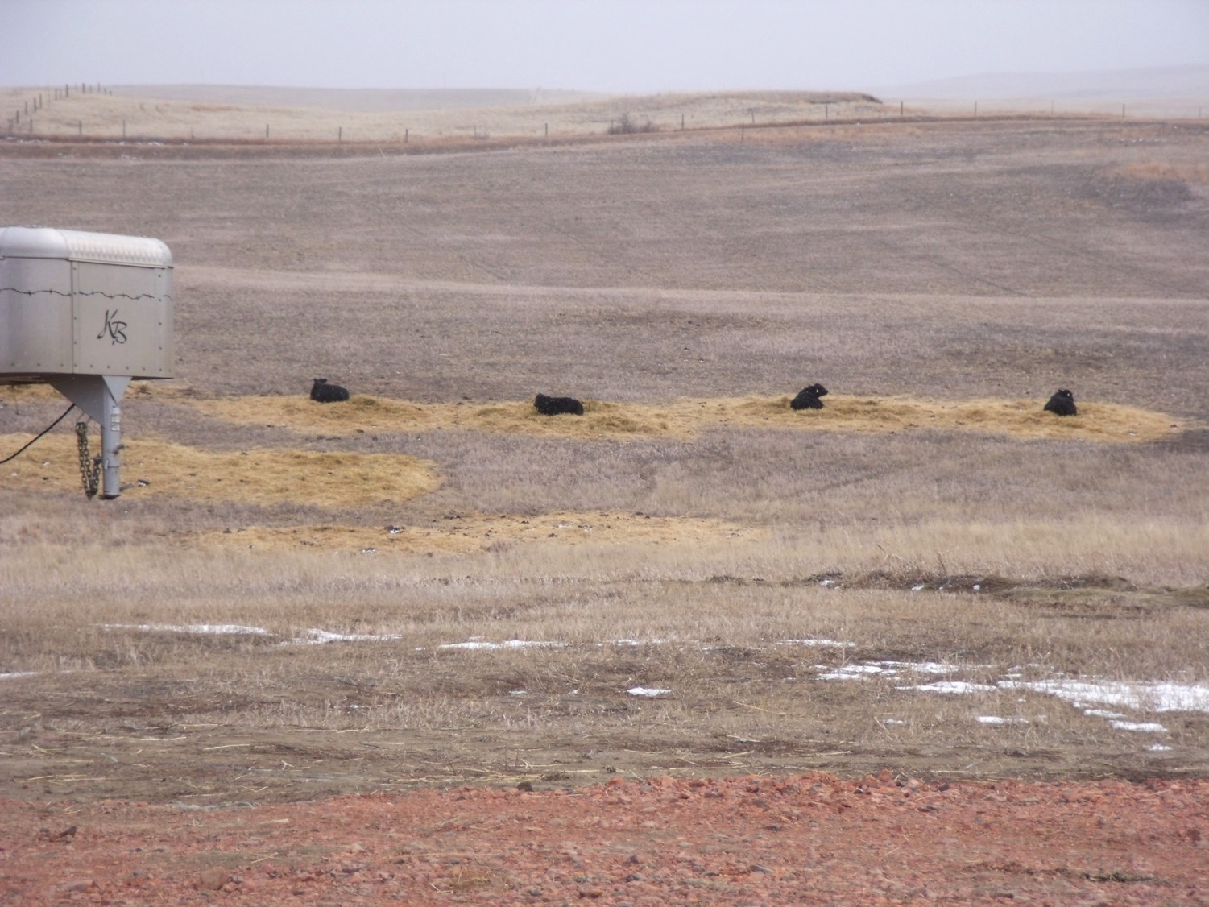
3-21-2014

Slide 22
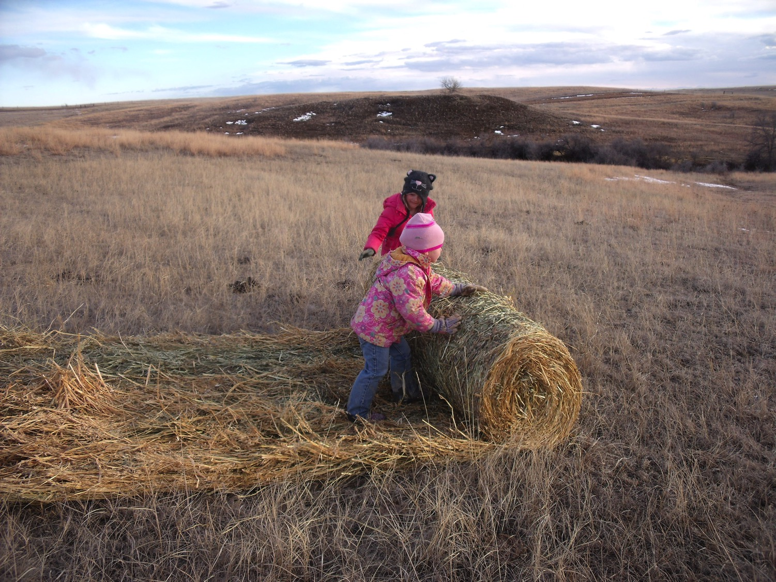
4-4-2014

Slide 23
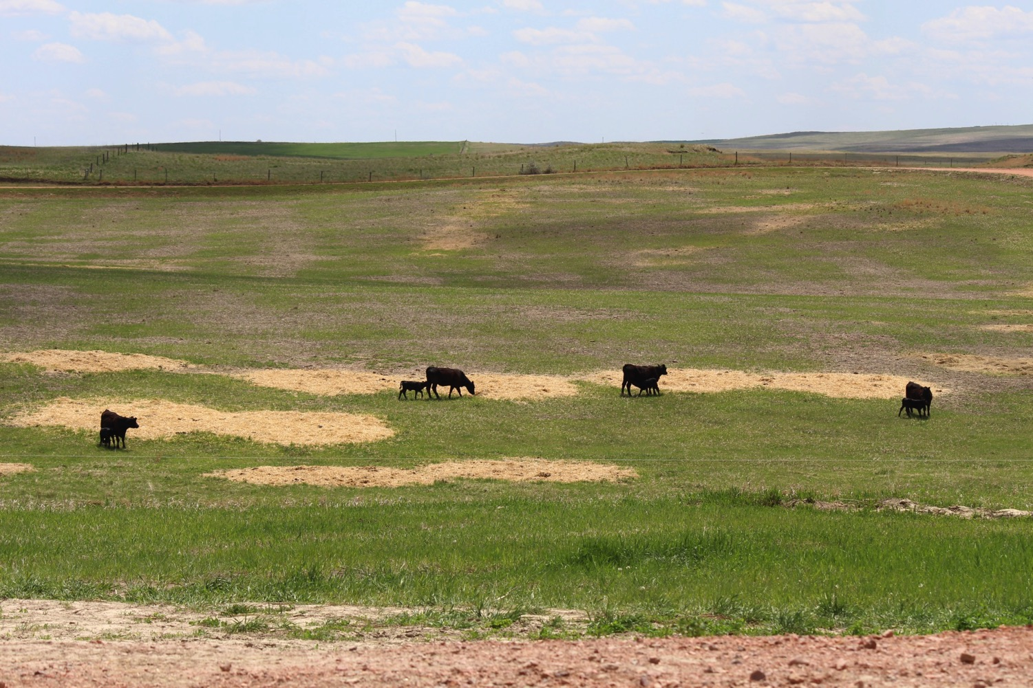
5-26-2014

Slide 24
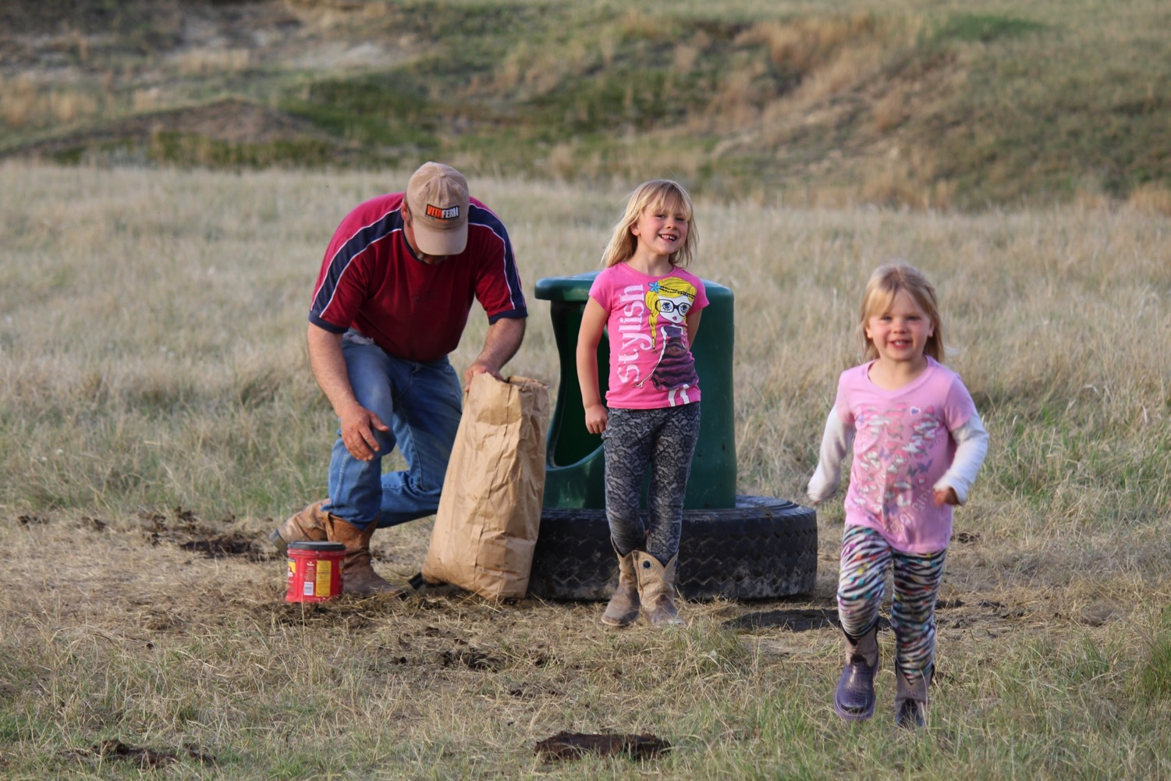
5-26-2014

Slide 25
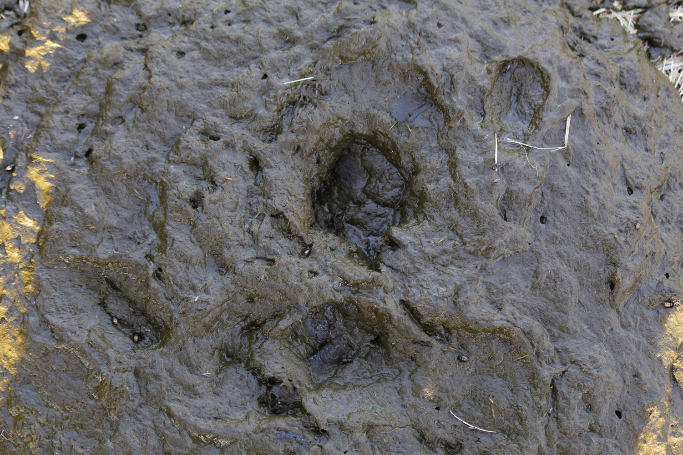
5-26-2014

Slide 26
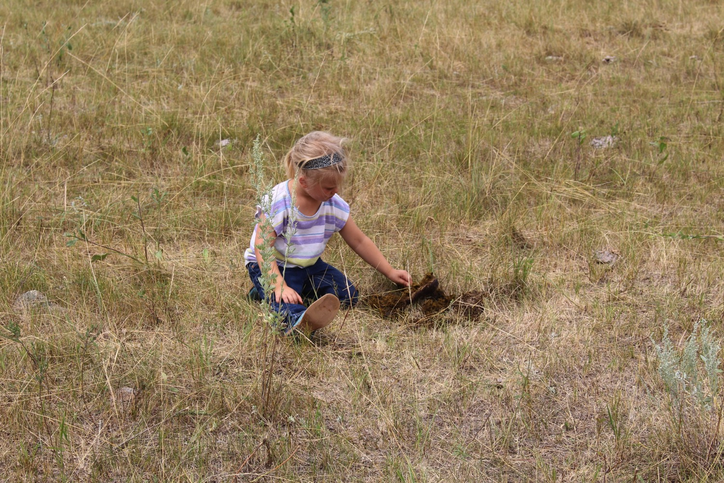

Slide 27
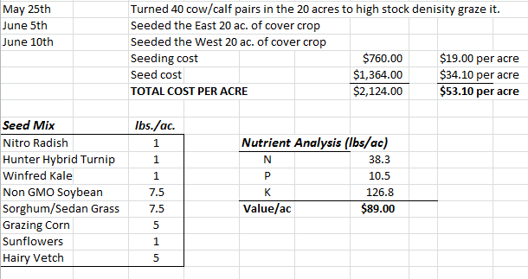
Spring of 2014

Slide 28
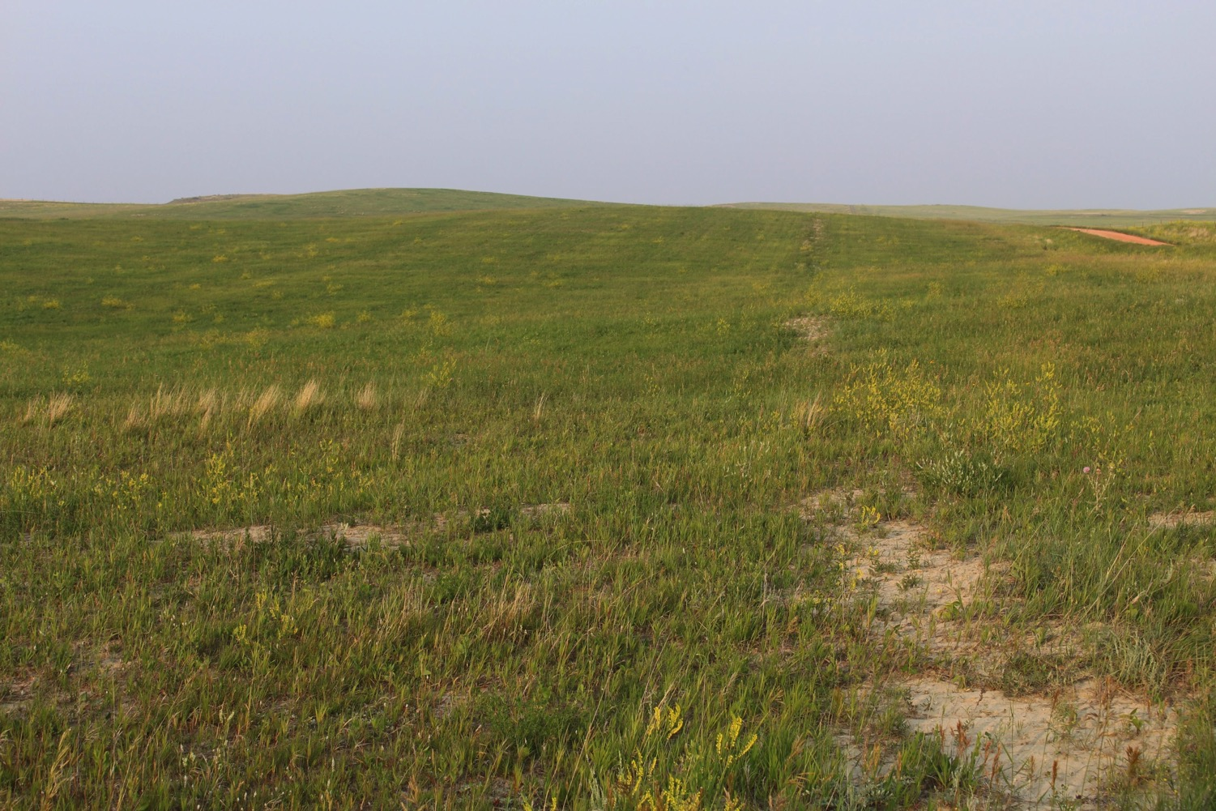
6-5-2014 Seeding the West 20 Ac.

Slide 29
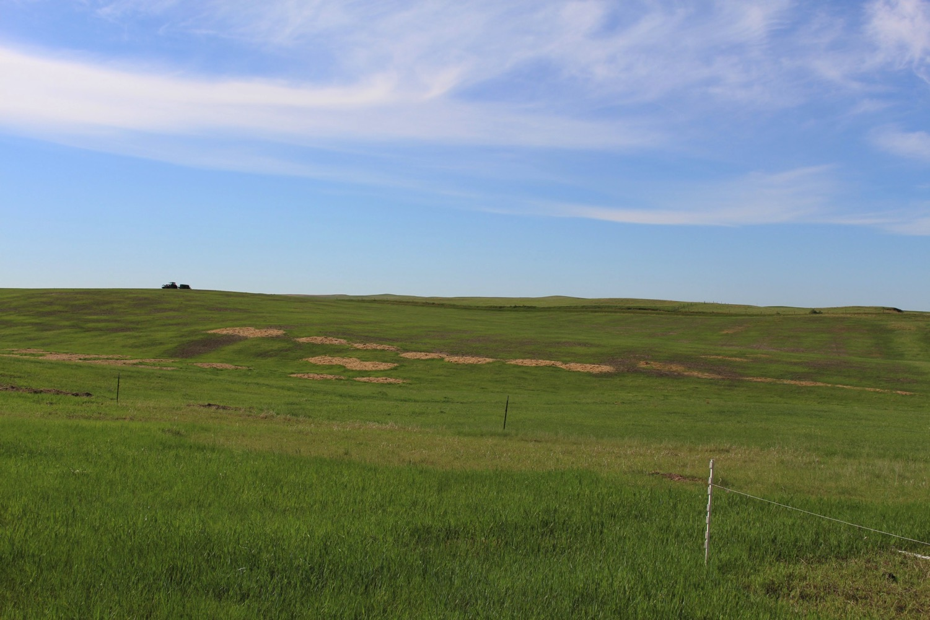
6-5-2014 Seeding the West 20 Ac.

Slide 30
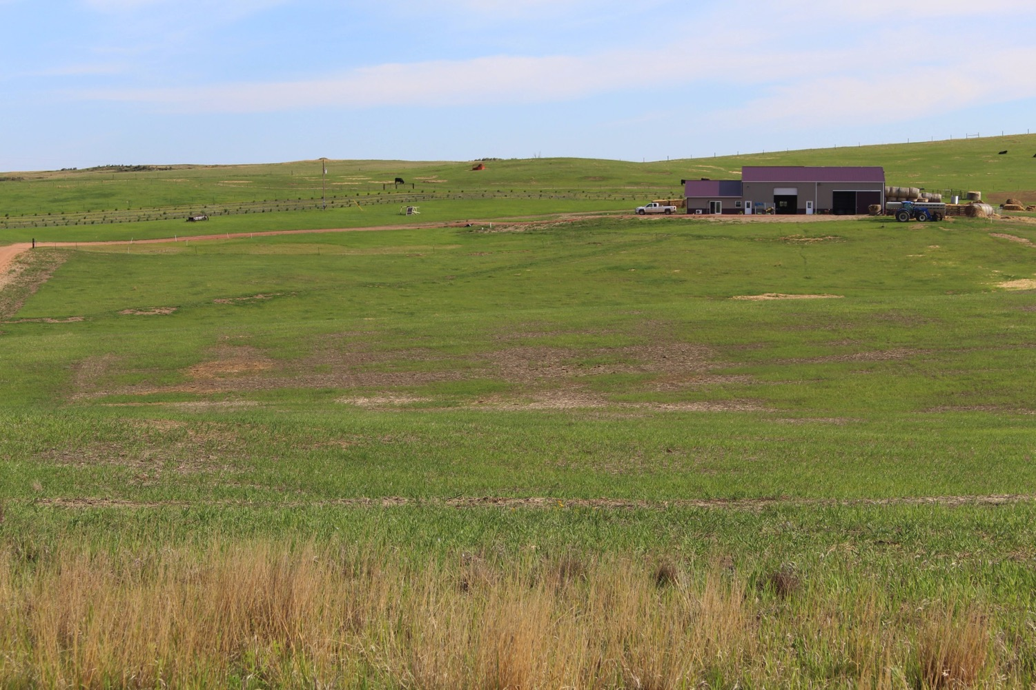
6-5-2014

Slide 31
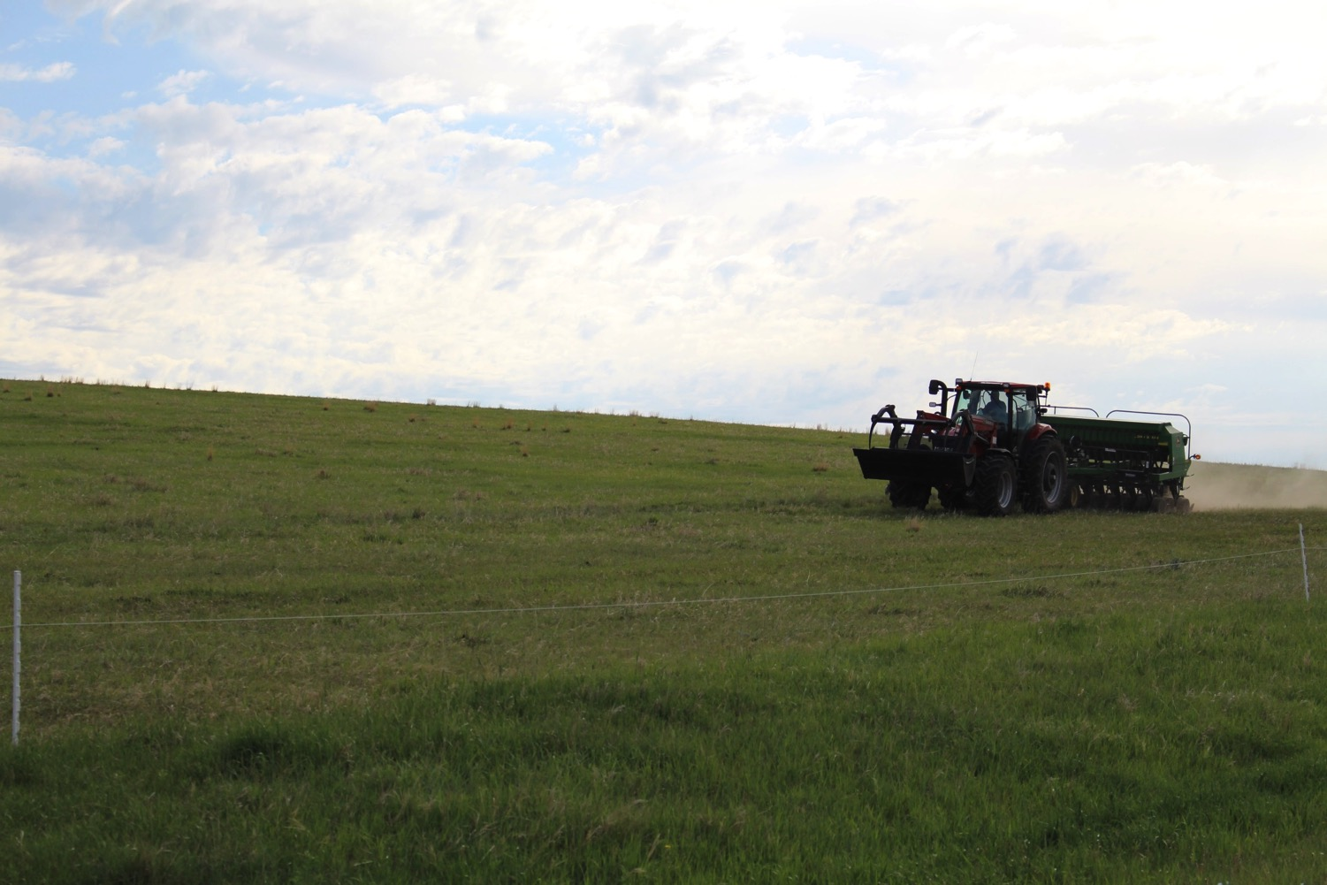
6-10-2014

Slide 32
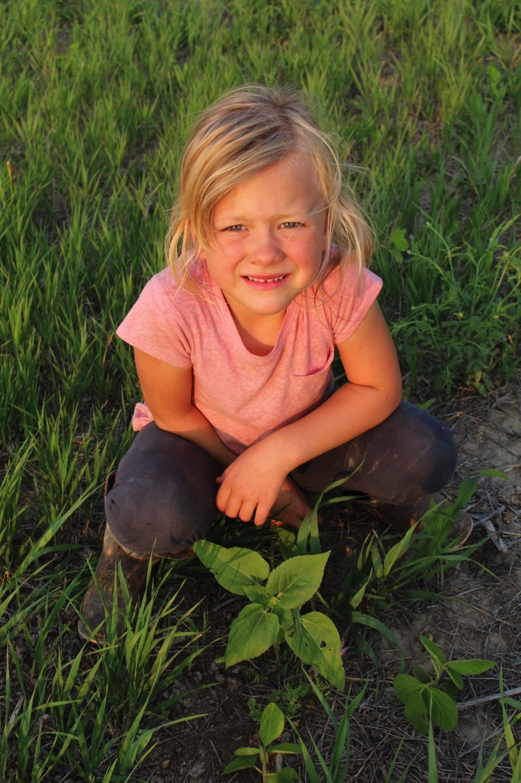
7-8-2014 Soybean

Slide 33
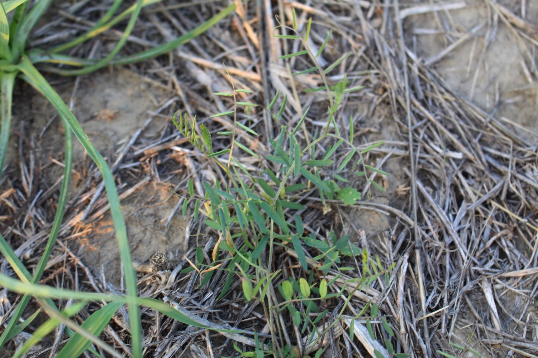
7-8-2014 Hairy Vetch

Slide 34
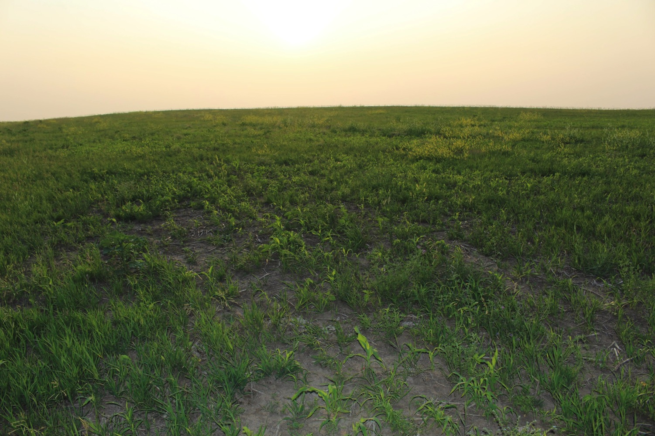
7-8-2014 West 20 acres

Slide 35
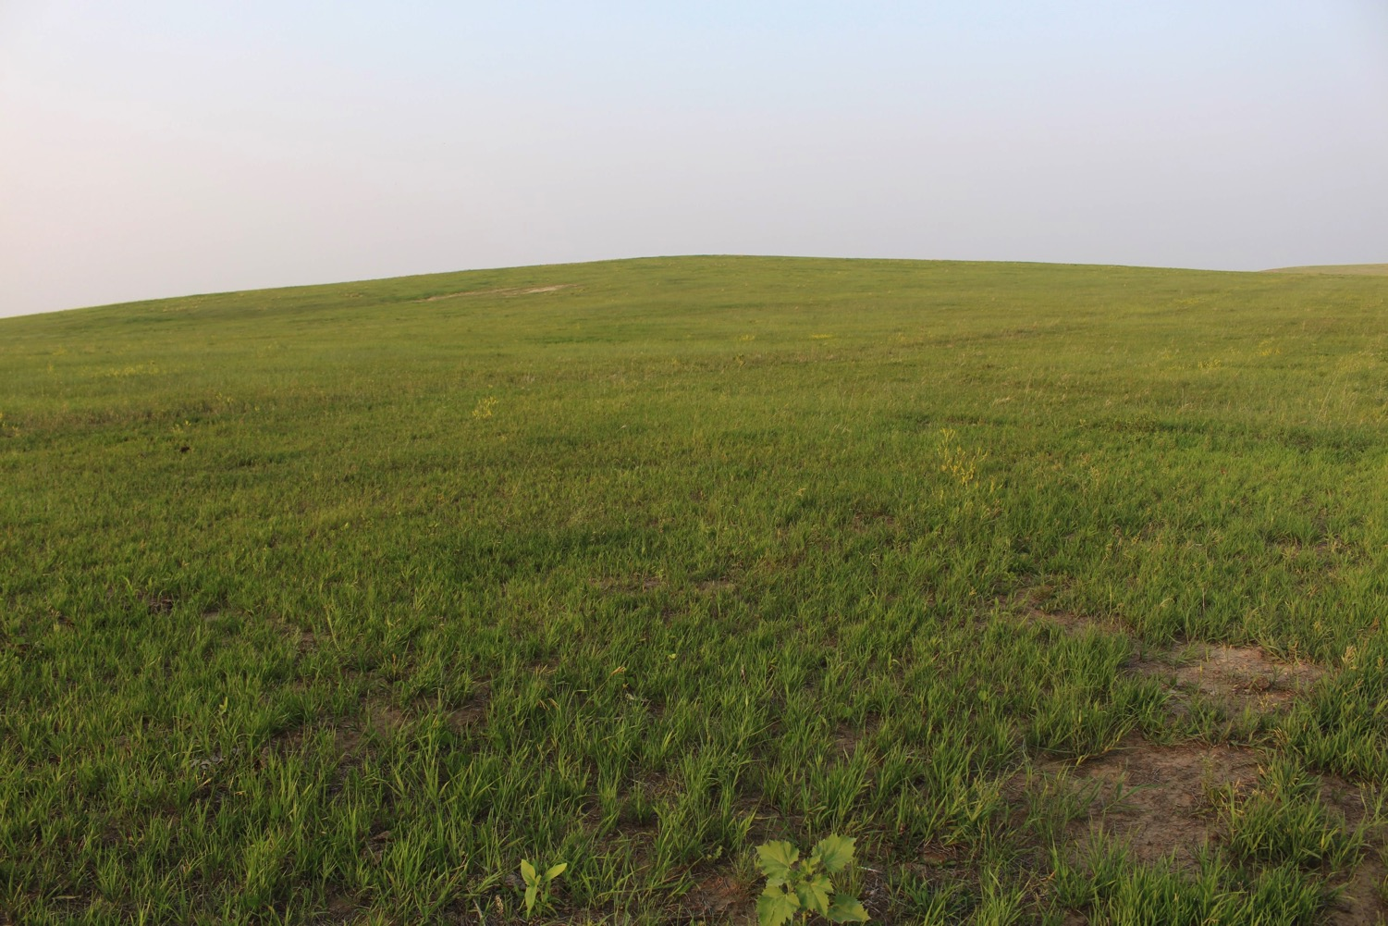
7-8-2014 East 20 acres

Slide 36
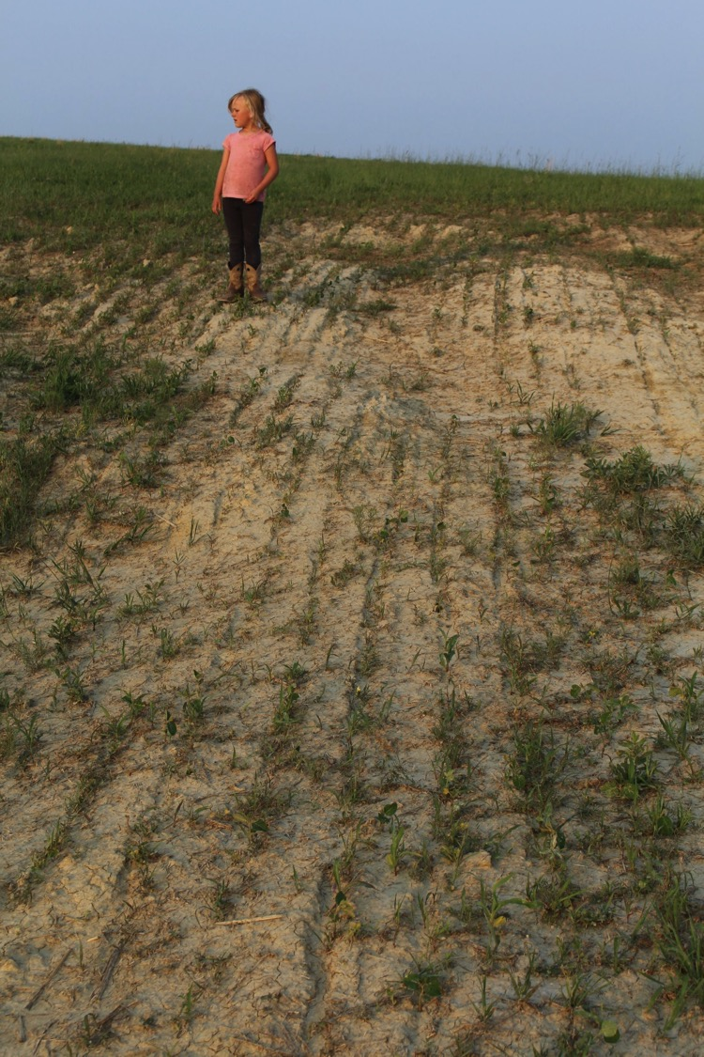
7-8-2014

Slide 37
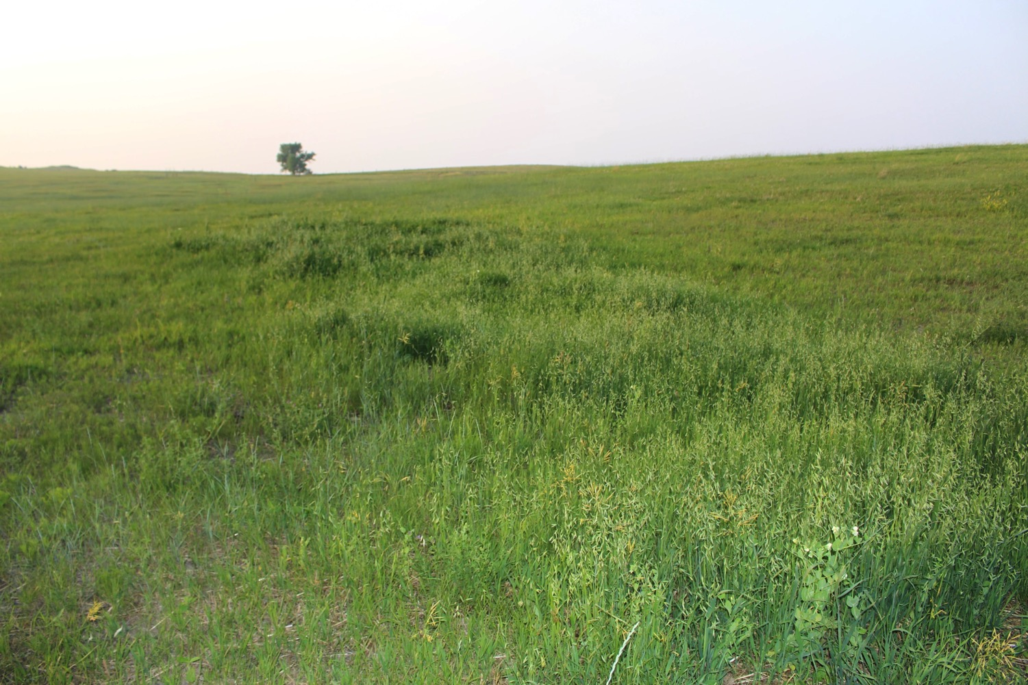
7-8-2014 Oats & Pea Bale Grazing

Slide 38
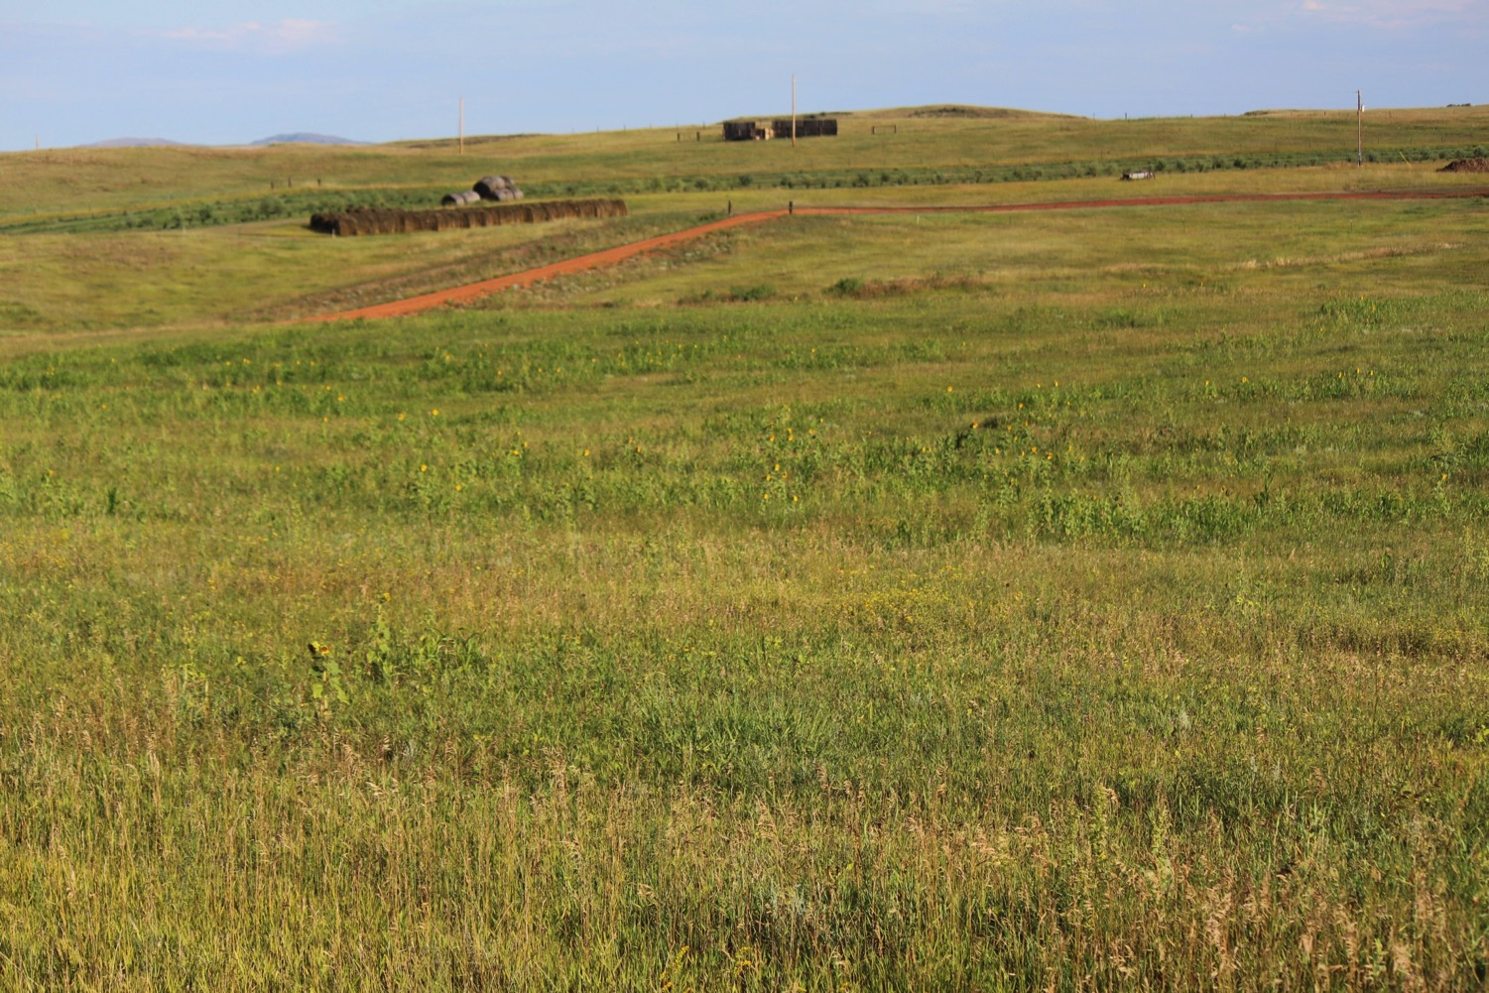
8-16-2014

Slide 39
Grazing days on cover crop
28 head of yearling bulls grazed the cover crop from Oct 13th to Nov 7th
Supplemented with hay starting Nov 7th
25 days of grazing on 20 acres

Slide 40
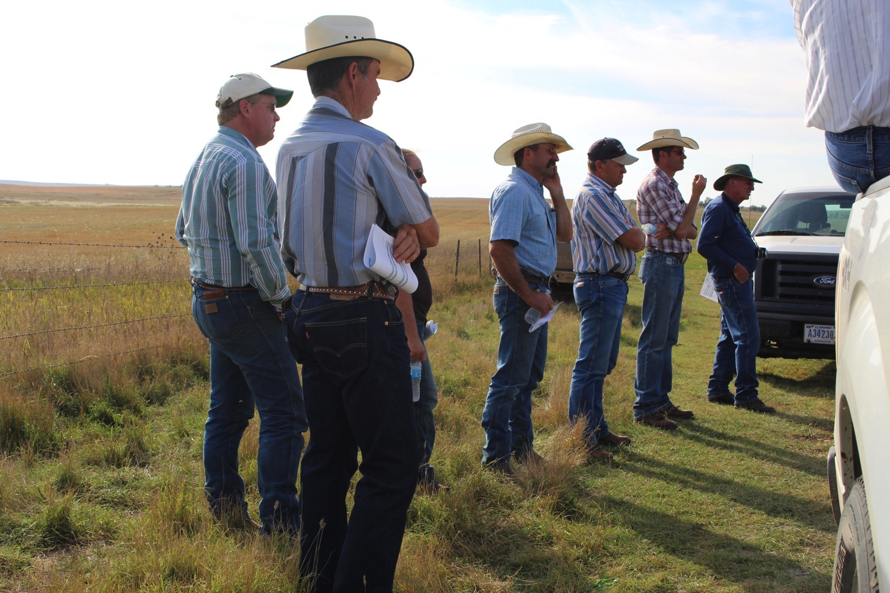
9-24-2014 NDGLC Pasture Walk

Slide 41
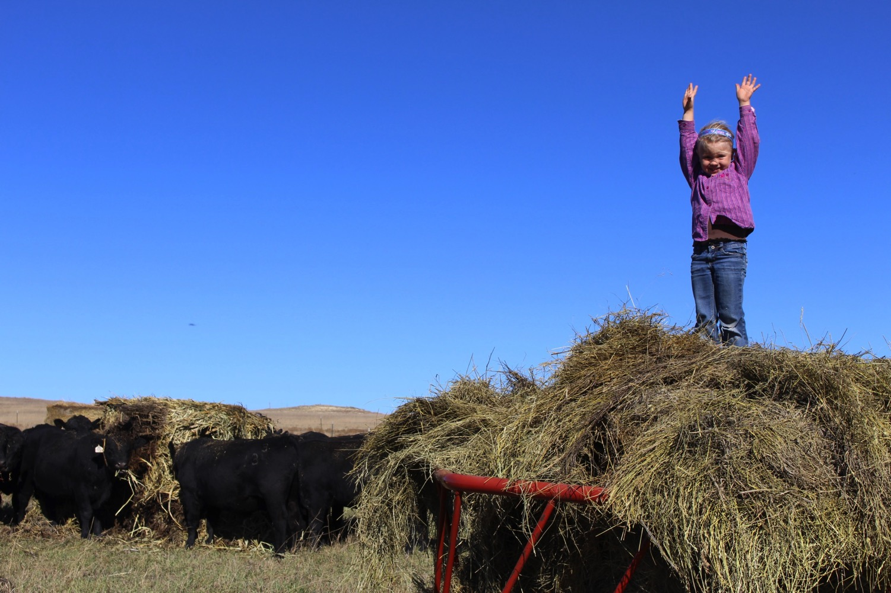
10-19-2014

Slide 42
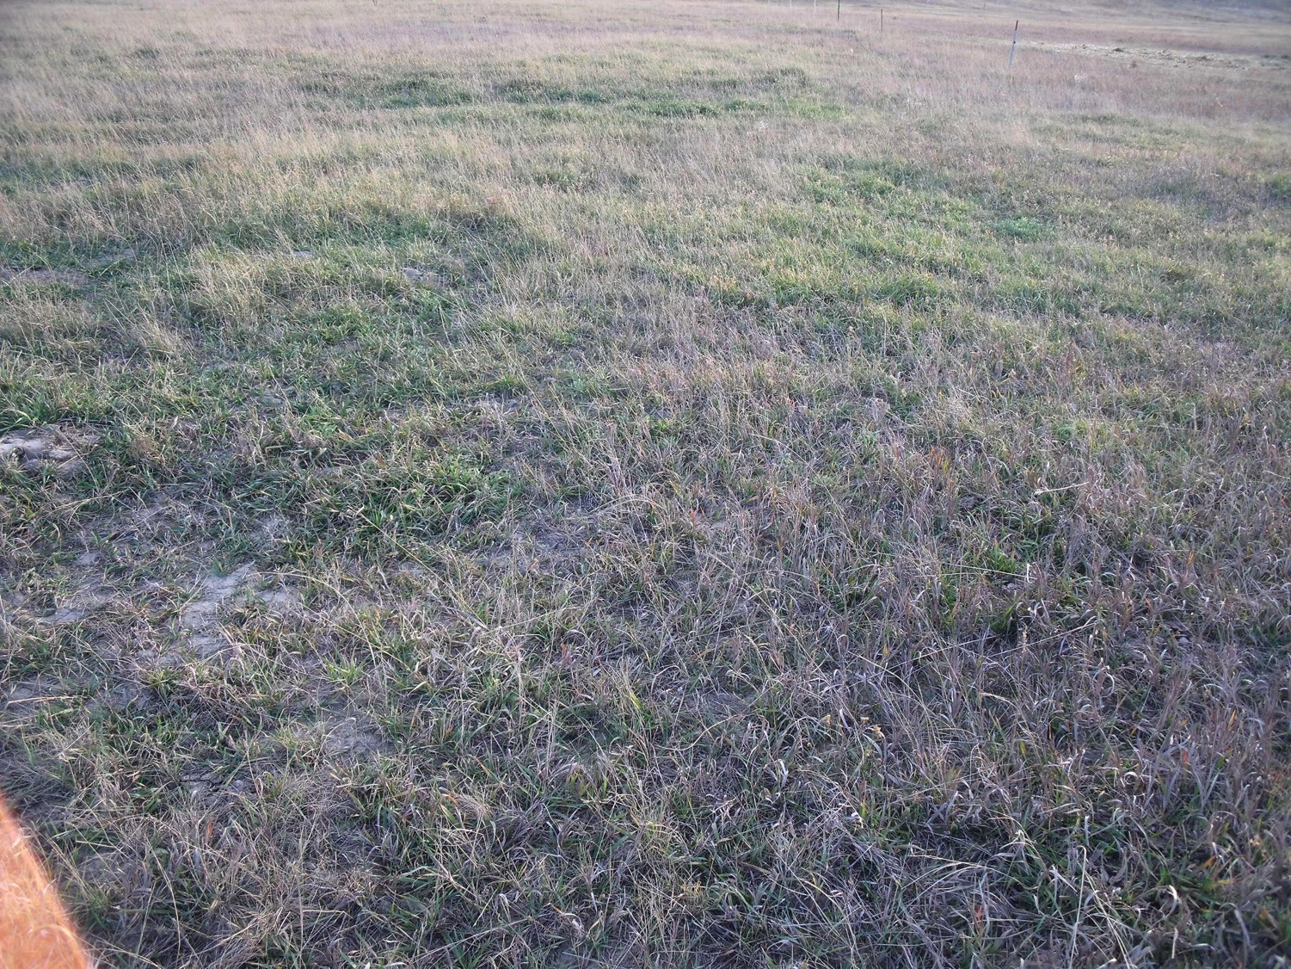
11-2-2014

Slide 43
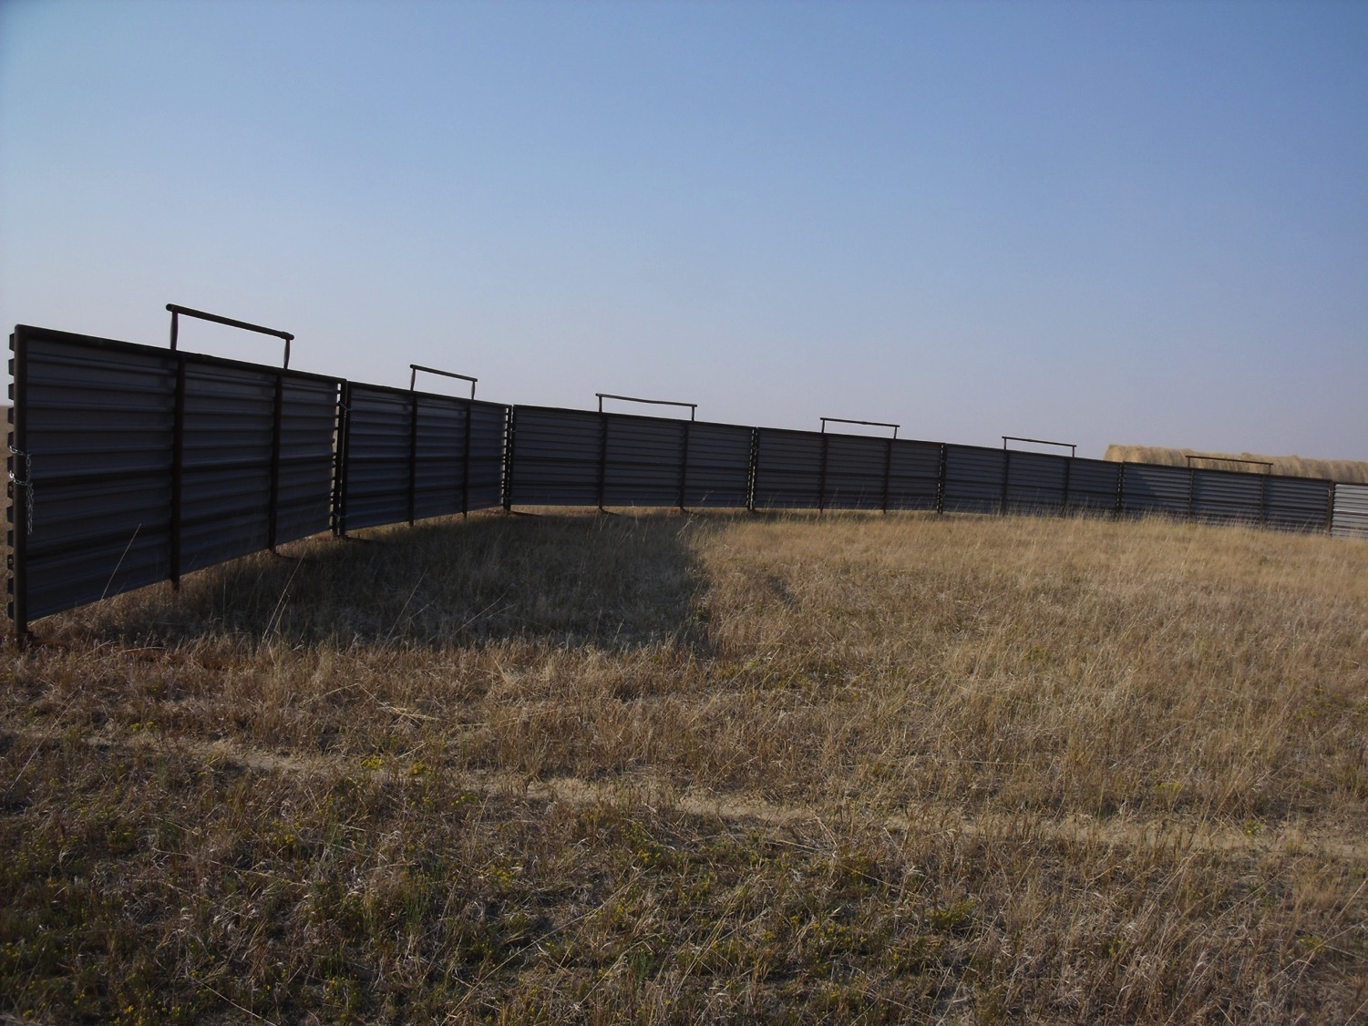

Slide 44
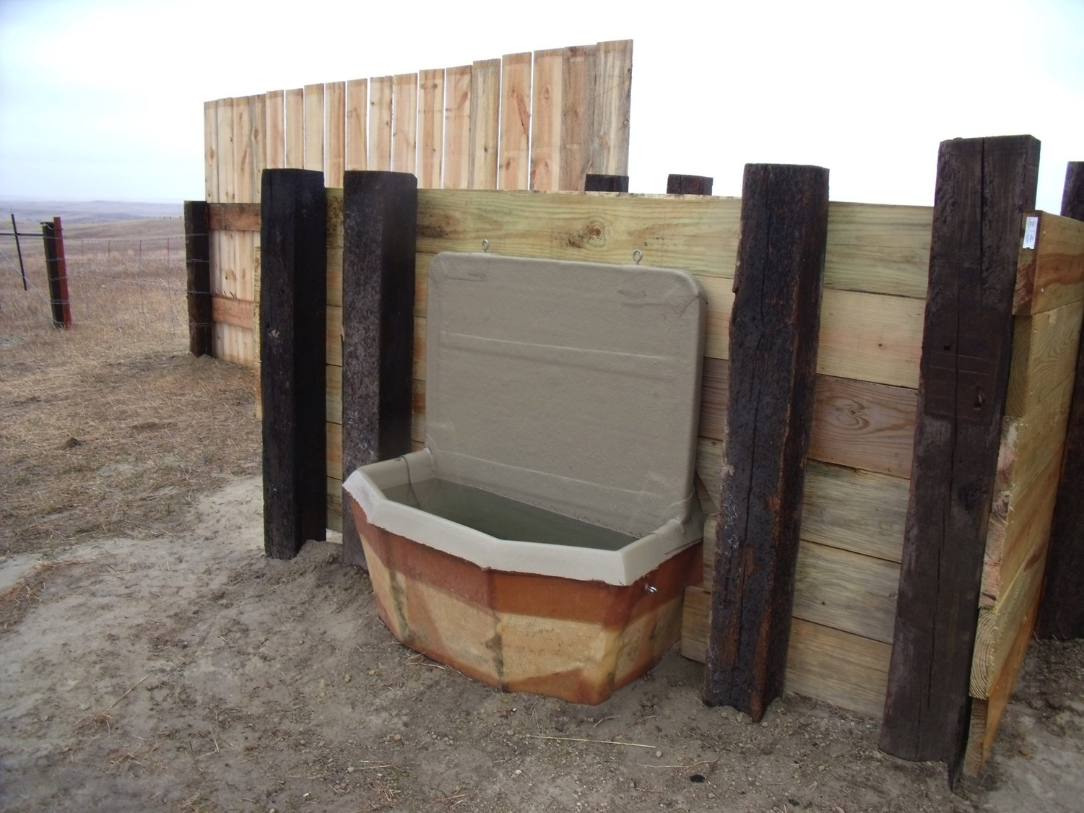

Slide 45
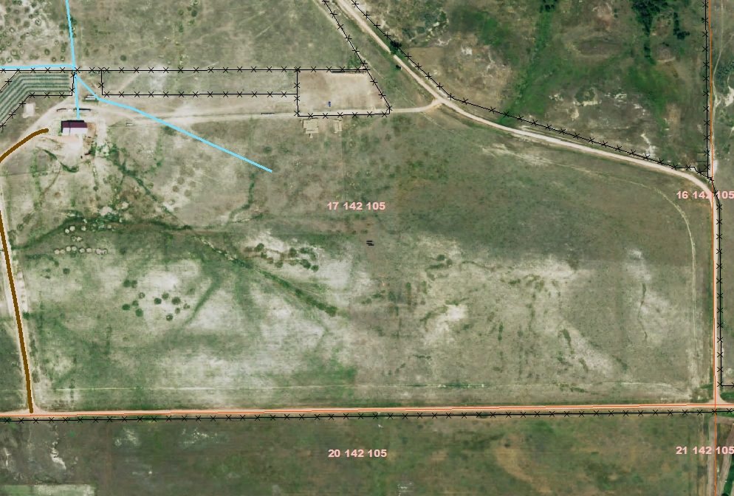

Slide 46
CONclusion
Need to increase the organic matter
Keep using the bale grazing
Utilize cover crops to cut down on the amount of hay that is purchased
The verdict is still out on the brome grass and what will happen with it. Areas that have been bale grazed have quadrupled production.

Slide 47
