Slide 1
New Buckwheat Varieties for Greater Sustainability

Slide 2
Buckwheat Importance
Exceptional crop for sustainable agriculture
Mellows soil
Releases phosphorus
Smothers weeds
Protects the soil
Organic markets strong
Human food
Seed

Slide 3
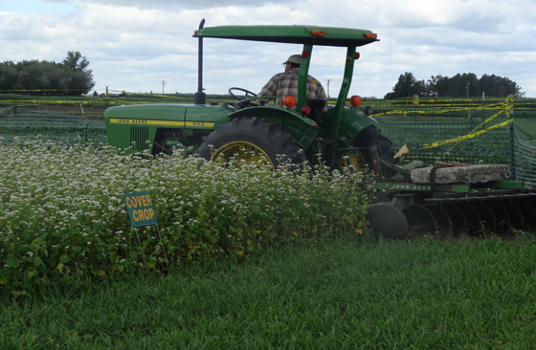
Buckwheat Importance Cover Crop Use
Long flowering periods
Habitat for pollinators

Slide 4
Buckwheat variety selection
Variety selection limited
# of varieties and public sources
Availability of varieties limited
Access to new varieties limited to contracts

Slide 5
Project Description
Collaborators will increase two varieties of buckwheat from Ukraine and compare their characteristics of with those of available varieties grown in North Dakota in regional trials, and make seeds and data available.

Slide 6
Project Participants
Farmers:
Researchers:
Anne Ongstad, Robinson, ND-Project Leader
Rick Mittleider, Tappen, ND
Wayne Mittleider, Tappen, ND
Carmen Fernholz-UMN
Pat Carr, Steve Zwinger-NDSU
Kevin Murphy-WSU
Outreach:
Frank Kutka, Theresa Podoll
NPSAS/Farm Breeding Club

Slide 7
Project Timeline
2013
acquire seed & increase
2 varieties
Field tour
2014
Field tour
Variety trials
Multiple locations
Seed increase
Distribute seed

Slide 8
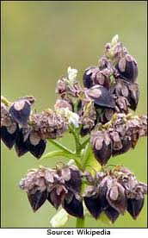
Дикуль
Dee-kool
Dikul

Slide 9
Девятка
Dev-YAHT-ka
Devyatka

Slide 10
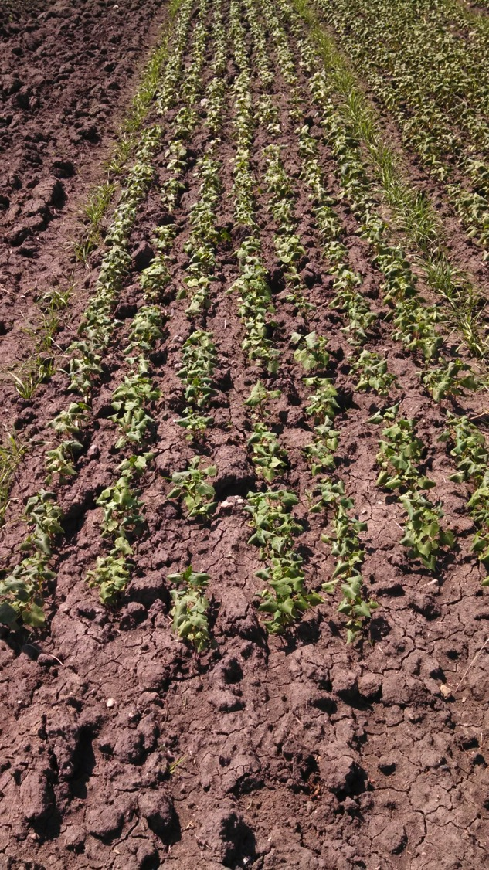
2013 ND increases
Devyatka increase
Anne’s farm
600 gms sown, June 12
Swathed, August 27
Harvested, September 3
Increase yielded ~55 lbs
Dikul increase
Rick’s farm
1000 gms sown, June 12
Swathed, September 3
Increase yielded,~700gms
Hail, drought, grasshoppers

Slide 11
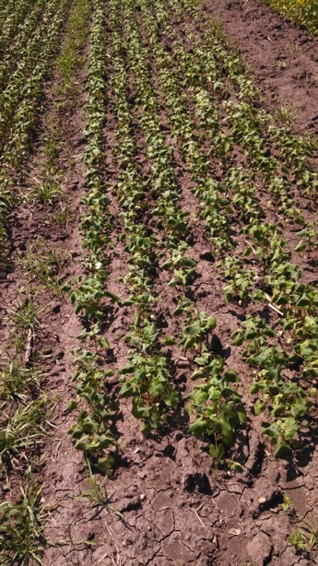
2013 WA increases
Kevin Murphy, plant breeder WSU
Backup increases

Slide 12
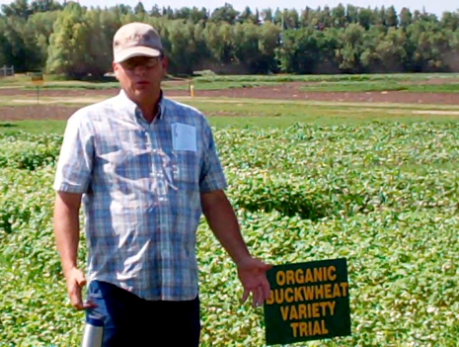
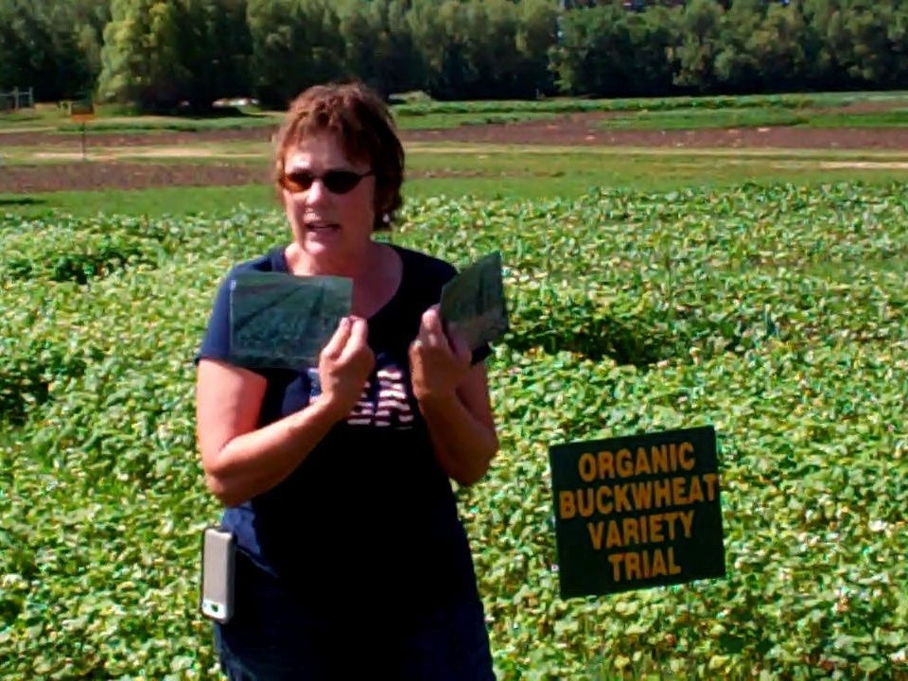
2013 Field Tour

Slide 13
2014 Seeding Devyatka Increase

Slide 14
Devyatka seed

Slide 16
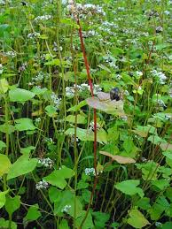
2014 Dikul seed increase
400 gms sown
June 7
Fast early growth
flower July 5
Storms throughout season
July 22, wind & rain
Sept 3, hail

Slide 17
2014 Variety Trials

Slide 18
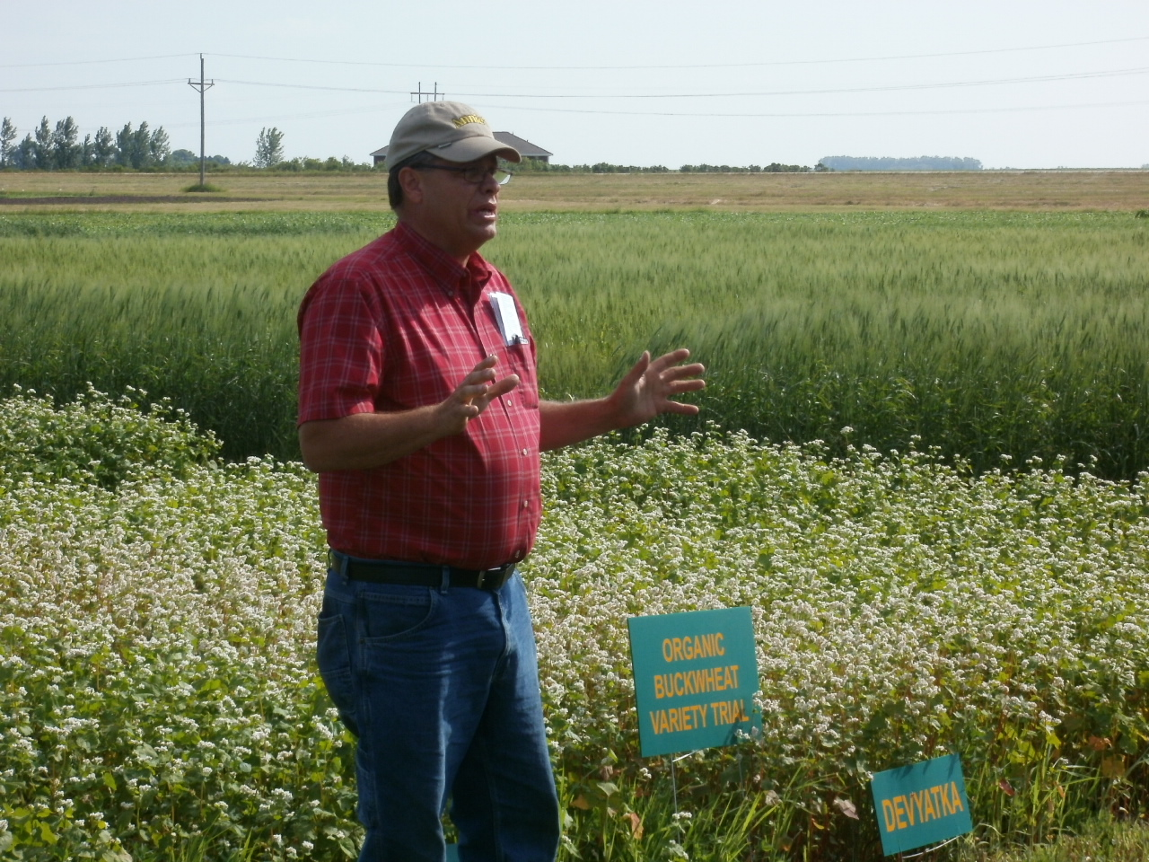
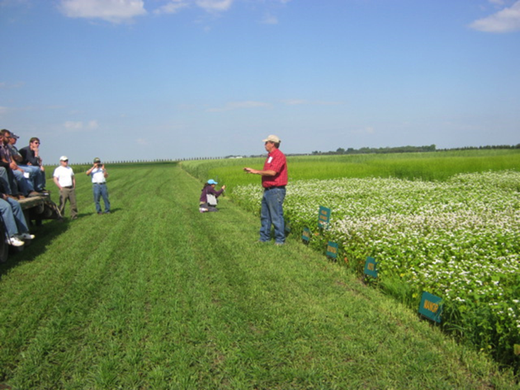
2014 Field Tour

Slide 19
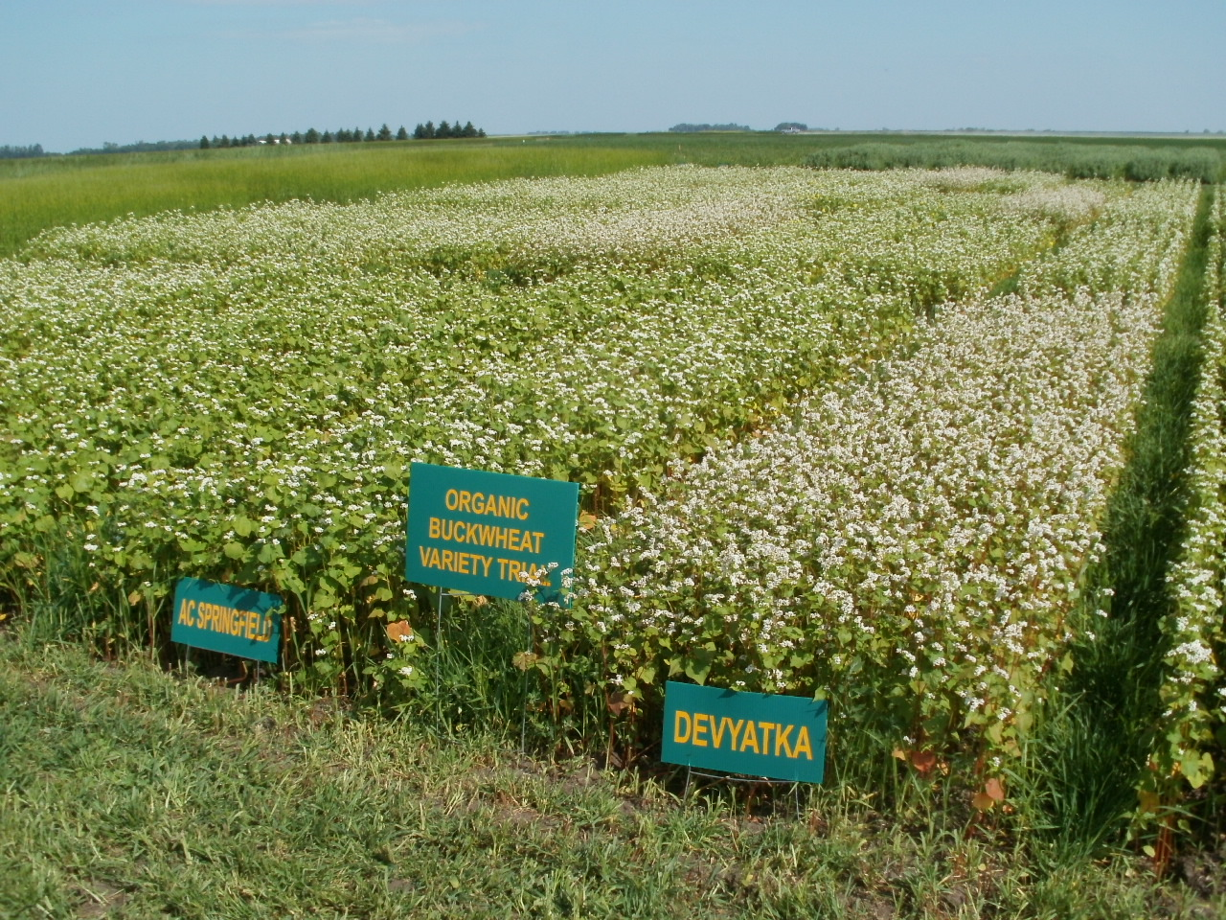
2014 CREC Organic Variety Trial

Slide 20
2014 buckwheat trials 3 site average

Slide 21
2014 buckwheat trials 3 site average plant height

Slide 22
2014 buckwheat trials 3 site average

Slide 23
2014 buckwheat trials 3 site average

Slide 24
2014 buckwheat trials 3 site average

Slide 25
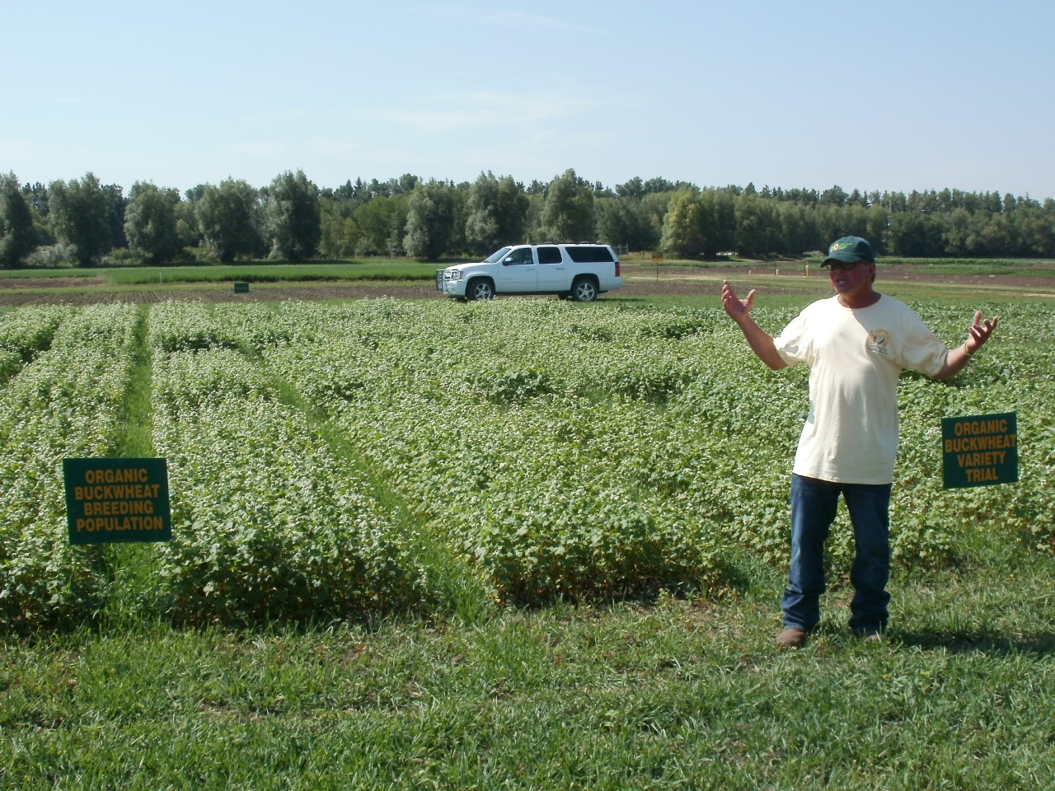
Where do we go from here?
S
Notes:
Steve

Slide 26
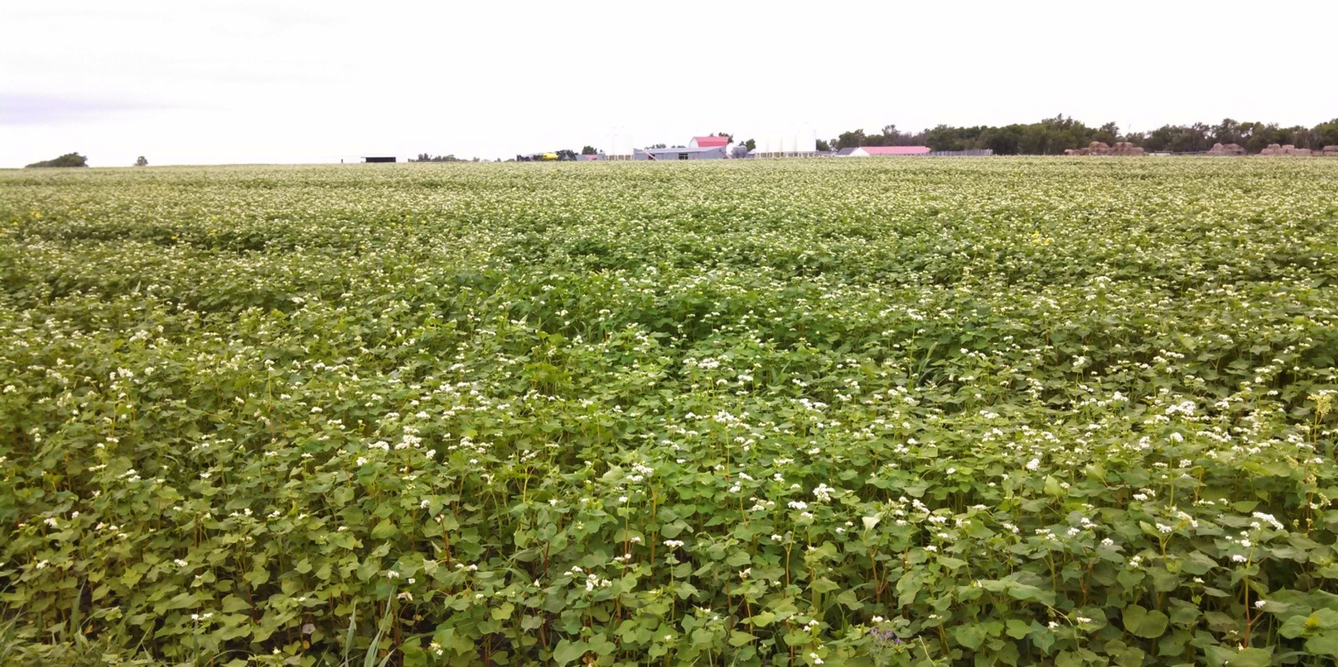
Whitman Ranch Buckwheat Field

Slide 27
Thank You!

