Slide 1
Making Goats Milk Soap Business Sustainable By Implementing Standard Manufacturing and Testing Protocols
Penny Adler, SARE FNC14- 942
NCR-SARE’s Farmers Forum, 2015

Slide 2
Our Story
Cool Product!
Failed Batch ☹
Can it be 100% “natural”?

Slide 3
Project Purpose:
Consistent Safe Product
Fiscal Viability
Reduce costs
Market Differentiator

Slide 4
Goals
1. Create manufacturing and testing protocols. 2. Evaluate natural vs man-made preservatives and overall product safety 3. Manufacture consistent and safe batches of cream soaps 4. Market the product testing and safety of the product.

Slide 5
Is soap a cosmetic?
Soap is excluded as a cosmetic
BUT soap must meet this definition
the bulk of the nonvolatile matter in the product consists of an alkali salt of fatty acids and the product's detergent properties are due to the alkali-fatty acid compounds, and
the product is labeled, sold, and represented solely as soap
Documentation: Is It a Cosmetic, a Drug, or Both? (Or Is It Soap?)
http://www.fda.gov/Cosmetics/GuidanceRegulation/LawsRegulations/ucm074201.htm

Slide 6
Sometimes soap is a COSMETIC
If a product
consists of detergents, or
primarily of alkali salts of fatty acids, and
is intended not only for cleansing but also for other cosmetic uses,
it is regulated as a cosmetic. Examples of cosmetic uses include making the user more attractive, by acting as a deodorant, imparting fragrance to the user, or moisturizing the skin

Slide 7
Sometimes soap is a DRUG
If a product
consists of detergents, or
primarily of alkali salts of fatty acids, and
is intended not only for cleansing but also to cure, treat, or prevent disease, or to affect the structure or any function of the human body,
it is regulated as a drug, or possibly both a drug and a cosmetic. Examples include antibacterial cleansers and cleansers that are also intended to treat acne.

Slide 8
The Federal Food, Drug and Cosmetic Act prohibits the introduction or delivery for introduction into interstate commerce of cosmetics that are adulterated or misbranded (Sec 301)
A cosmetic may be deemed adulterated (Sec. 601) for essentially four reasons, namely:
The product or its container is composed of potentially harmful substance
It contains filth.
It contains a non-permitted, or in some instances non-certified, color additive.
It is manufactured or held under insanitary conditions whereby it may have become injurious to users or contaminated with filth.
A cosmetic may be deemed misbranded (Sec. 602) for reasons of:
False or misleading labeling.
Failure to state prominently and conspicuously any information required by or under authority of this act.
Misleading container presentation or fill.

Slide 9
Create manufacturing and testing protocols.
Establish GMP (Good Manufacturing Practices) to reduce the risk
Documentation: Guidance for Industry – Cosmetic Good Manufacturing Practices
http://www.fda.gov/downloads/Cosmetics/GuidanceComplianceRegulatoryInformation/GuidanceDocuments/UCM358287.pdf
Book: http://www.mariegale.com/good-manufacturing-practices/

Slide 10
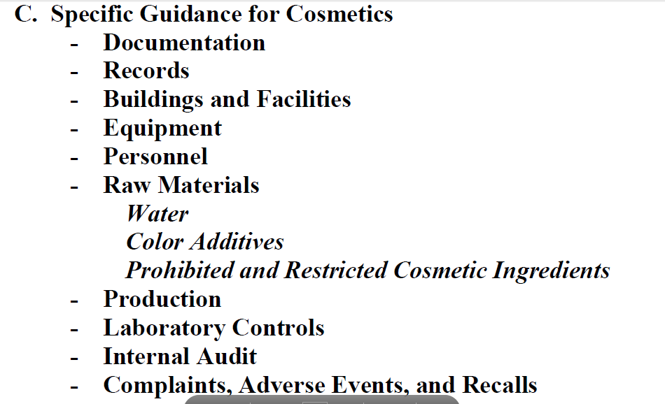
Sections

Slide 11
GMP (Good Manufacturing Practices)
Guidelines not regulations
Not legally enforceable
GMP is BIG. Start with the easiest places to make the biggest mistakes.

Slide 12
Master Formula
Master Formula – “your recipe” with enough detail that when followed exactly should produce the same product every batch, every bottle, every time.
Without it, you can’t guarantee that your product will be consistently produced at the quality you and your customers expect.
It contains:
Ingredients / Quantity
Detailed steps (Step by step but also what temps, how do you know when mixing is complete etc.)
Details for quality control – what does it look like? Smell like? Consistency?
It contains the amount of detail, if a person reasonably familiar making similar products can follow master formula without supervision.

Slide 13
Batch Record
Batch Record – Documenting that you are following the master record.
Can be as simple as the master record with checkboxes that you tick off as you complete a step.
Includes the date made, who made it, how many units were produced and a unique batch record.

Slide 14
Ingredient Specifications
If your ingredients are different than you used before, your product won’t turn out as expected even with following your master formula.
Establish standard criteria for your ingredients and materials
Purchase ingredients that match your criteria from a reliable supplier
Verify ingredients before using them

Slide 15
So far…
Master Formula
Batch Record
Batch Log
Material Specifications
Inventory Log
Inventory Batch Record

Slide 16
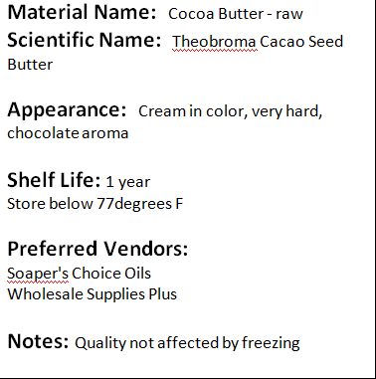
Material Specification

Slide 17
Incoming Raw Material Log
Product Label: Product Name, Lot #, Expire Date

Slide 18
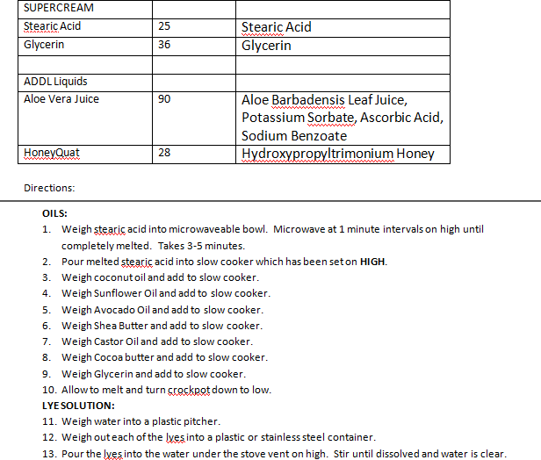
Master Batch

Slide 19
Batch Log

Slide 20
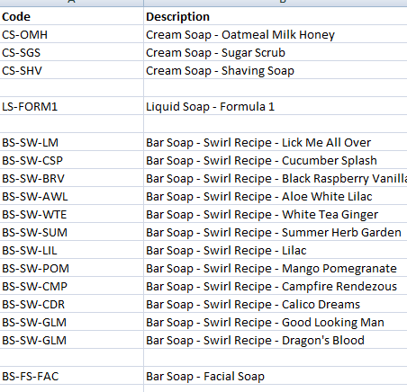
Product List

Slide 21
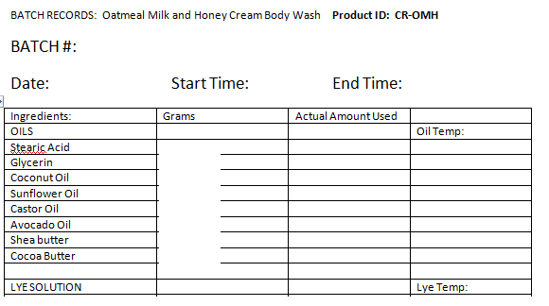
Batch Record
Product Name, Batch #, Manuf. Date

Slide 22
SOP (Standard Operating Procedures)
Is your scale accurate?
How often will you calibrate your pH meter?
Safety precautions
Internal audits
Testing protocols
How will you handle complaints (a complaint log ☺)

Slide 23
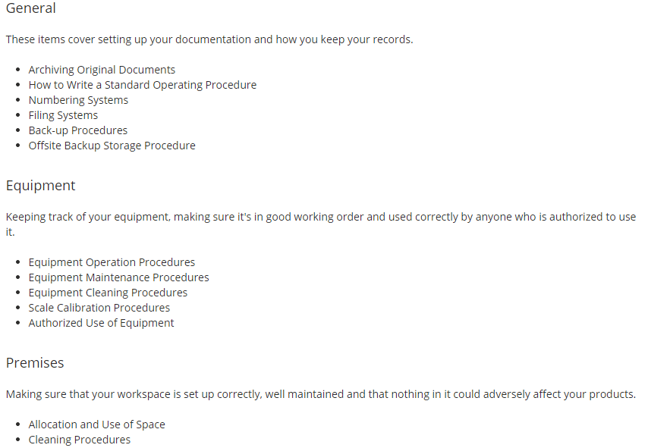

Slide 24
Labeling
Documentation: Cosmetic Labeling Guide
http://www.fda.gov/Cosmetics/Labeling/Regulations/ucm126444.htm
Book: http://www.mariegale.com/soap-and-cosmetic-labeling/

Slide 25
Front Panel
There are three items that MUST go on the front panel of any product that is sold to consumers:
Name. This is usually the brand name or product name.
Identity. What is the product? (soap, lotion, bubble bath, etc).
Net Quantity of Contents. How much actual product is there? In both US (oz, pounds, pints, etc) AND metric (ml, grams, liters, kilos).
The Name should not include the name of one ingredient if there are two or more ingredients in the product.
The Net Quantity of Contents should be in a large enough text size (usually 1/8" high, measuring the lower case "o") and be placed parallel to the bottom of the package, in the bottom 30%

Slide 26
Back or Side Panels
For all products:
The name and address of the responsible party.
Directions for safe use (if applicable)
For cosmetics:
The declaration of ingredients.
Any required warning statements.

Slide 27
Name and Address Requirements
The address must include the full street address, city, state and zip code.
IF the name used on the label is listed in a PRINT phone or city directory (not an online directory), the street address may be omitted from the label (but the city, state and zip code are still required).
PO Boxes may NOT be used

Slide 28
Ingredients
Identified by the name listed in the Cosmetic Ingredient Dictionary EXCEPT that botanical ingredients should be listed by their common name.
Listed in descending order of predominance (based on their percentage, by weight, in the product).
Blended ingredients used in the product (such as pre-made bases or preservatives) follow same rules.

Slide 29
Ingredient Exceptions
Fragrances may be listed as "fragrance" without identifying all the component ingredients in the fragrance blend.
Ingredients that are present at less than 1% may be listed in any order after the ingredients present at 1% or greater.
Color additives (which must be on the FDA list of approved color additives), may be listed after all other ingredients (regardless of the percentage at which they are used).

Slide 30
What about essential oils
If you consider that they are individual ingredients, then yes, they do need to be individually listed.
Or you can use the term "fragrance" as an all-inclusive description of the essential oil blend.

Slide 31
Making Goats Milk Soap Business Sustainable By Implementing Standard Manufacturing and Testing Protocols
Penny Adler, SARE FNC14- 942
NCR-SARE’s Farmers Forum, 2015

