Slide 1

Integrating host-plant resistance and insecticides for soybean aphid management
Anthony Hanson & Dr. Robert Koch
University of Minnesota
NCR-SARE Project: GNC13-170

Slide 2
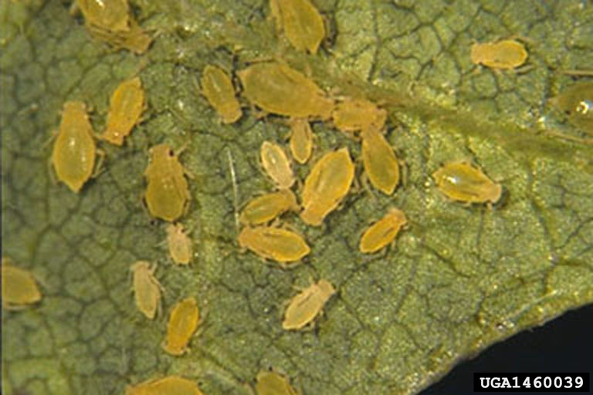
Soybean aphid
  Primary soybean pest in
  the upper Midwest.
  Control with insecticides (e.g. pyrethroids and organophosphates) (Ragsdale et al. 2011).
  Scouting.
  Economic threshold: 250 aphids/plant (Ragsdale et al. 2007).
  Prevent economic injury level: 675 aphids/plant.

Slide 3
Host-plant resistance
Antibiosis: compounds in plant affect pest biology (e.g., reduced survival and reproduction).
Antixenosis: non-preference (e.g., reduced colonization and nymphs) due to chemicals or physical barriers.
Some characterized resistance to Aphis glycines (Rag) genes (Hesler et al. 2013).
Gene | Antibiosis | Antixenosis
Rag1 | + | +
rag1c | +
Rag2 | +
Rag3 |  | +
rag4 | +
Notes:
Subsample of genes

Slide 4
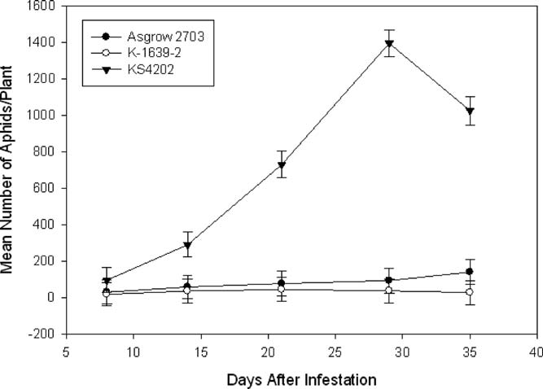
Susceptible
Resistant
(Pierson et al. 2010)

Slide 5
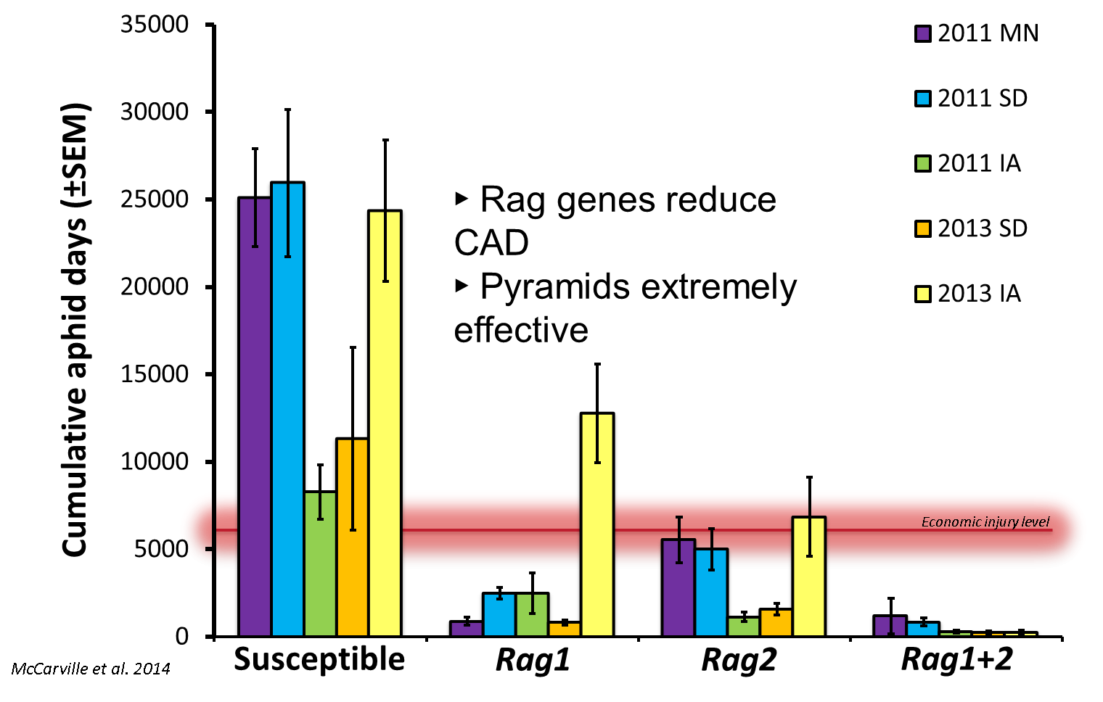

Slide 6
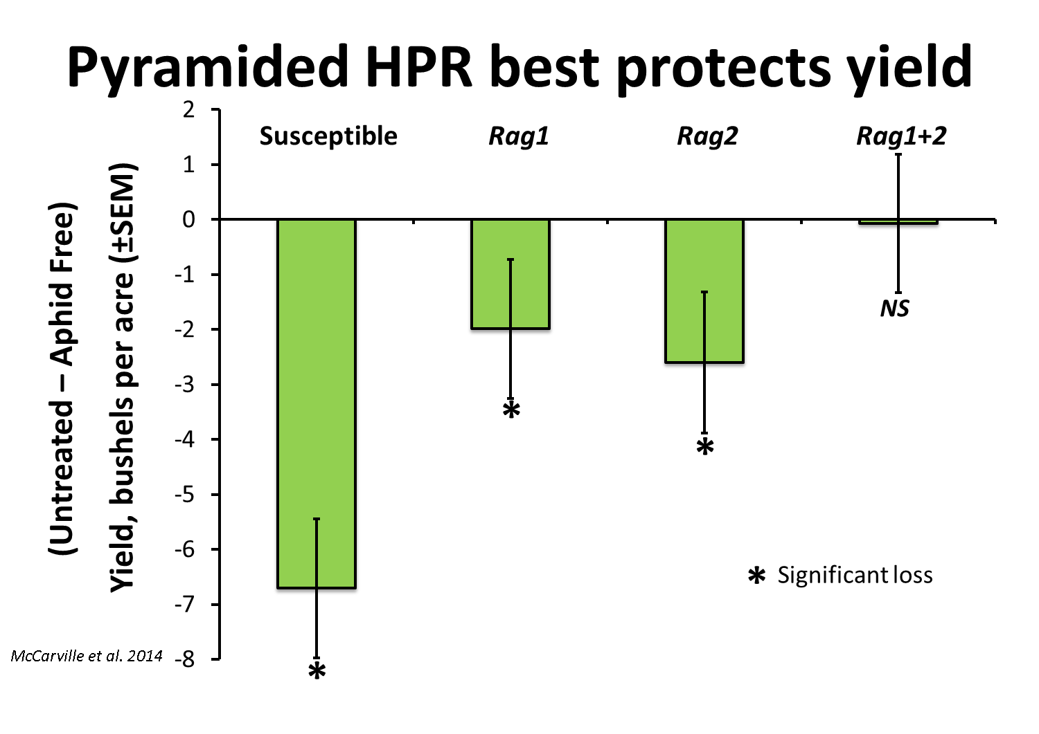

Slide 7
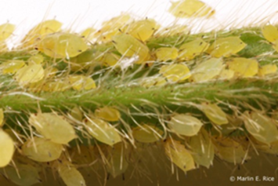
Virulent biotypes of soybean aphid
Biotype 1: Avirulent
Biotype 2: Virulent to Rag1
Biotype 3: Virulent to Rag2
Biotype 4: Virulent to Rag1 & Rag2
New sources of resistance & pyramiding of genes needed.
Hill et al. 2012.
Alt & Ryan-Mahtmutagic. 2013.

Slide 8
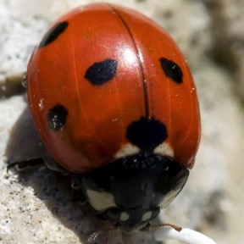
Integrated pest management (IPM)
Insecticides main control method.
  Not easily controlled with insecticides available to organic growers.
  Overuse can affect aphid natural enemies.
Resistant plants on the market since 2009 (Hodgson et al. 2012).
  Sometimes difficult to find resistant varieties.
7-spotted ladybeetle (Bugguide.net)

Slide 9
Combined host-plant resistance and insecticide effects
Do resistant soybeans increase, decrease, or not effect insecticide susceptibility?
Additive interaction
Synergistic interaction
Antagonistic interaction

Slide 10
Synergistic interaction
Documented synergistic interaction with other insects: corn earworm and rice plant hoppers (Kea et al. 1978; Heinrichs et al. 1984).
Potential outcomes:
    Fewer insecticide applications.
    Improve insecticide efficacy (e.g., organic-approved).
    Fewer non-target effects on natural enemies.
Additional tool for IPM tactics for soybean aphid.

Slide 11
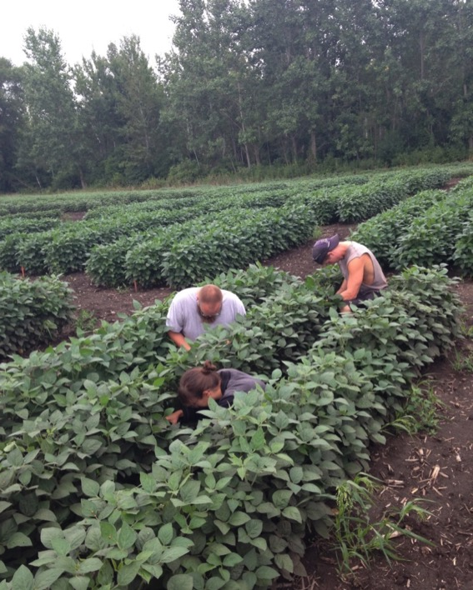
2013-2014 field study
IA3027: Susceptible.
IA3027RA1: Resistant (Rag1) (Wiarda et al. 2012).
Insecticide application:
  Azera (pyrethrum + neem).
  Lorsban (chlorpyrifos)
  Warrior (lambda cyhalothrin).
  No insecticide.

Slide 12
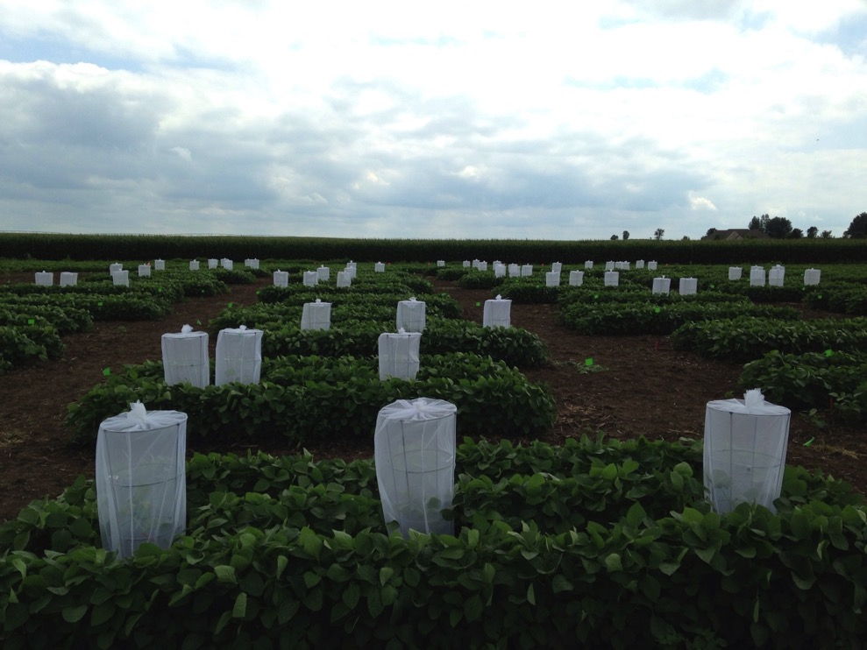
Insecticide application
2013:
  Low populations,July 15.
  Predator exclusion cages.
2014:
  Economic threshold, August 8.

Slide 13
2013 field data
Additive
Synergistic
Notes:
Cumulative aphid days
Cage data the same, not used in 2014.

Slide 14
2013 Azera field trial
No insecticide effect

Slide 15
2014 field data
No
effect
Synergistic
Additive

Slide 16
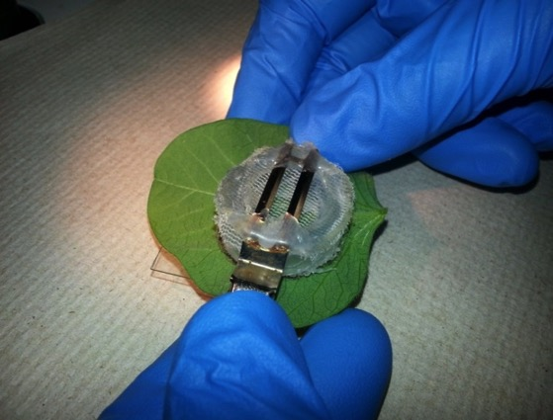
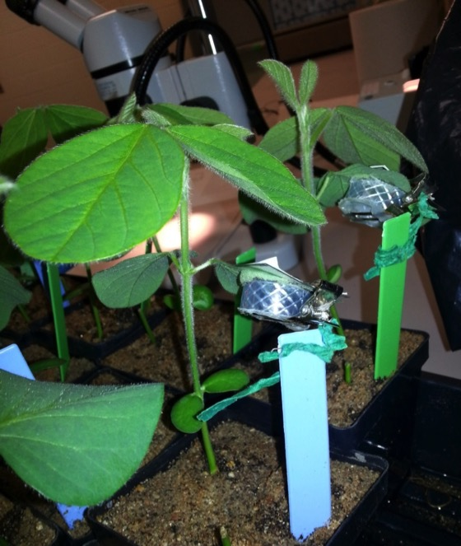
Lab bioassays
Controlled insecticide doses to measure:
  Mortality
  Reproduction
Aphids held in clip-cage on treated leaf for 2 days.
Lambda-cyhalothrin.
Azera (ongoing).

Slide 17
Lab assay doesn’t replicate synergistic effects
Additive

Slide 18
Conclusions
Did not find antagonistic interactions.
Aphids more susceptible on resistant plants to lamda-cyhalothrin in 2013, chlorpyrifos in 2014.
  Weather after application may be a factor.
Azera was not effective.
  Deteriorates quickly.
Additional bioassays ongoing.

Slide 19
Outlook
Aphids are more susceptible to some insecticides on resistant plants.
Next step? Look for other insecticides with synergistic effects that have other uses:
  Safer for natural enemies.
  Available to organic growers.
Multiple IPM tools available: scouting, resistant plants, insecticides, natural enemies.
Notes:
Doesn’t adversely affect. Sometimes additive or synergistic.

Slide 20



Acknowledgements
NCR-SARE
Minnesota Soybean Growers
MGK (McLaughlin Gormley King)
Students and staff
Tavvs Alves
Anh Tran
Walter Rich
James Anderson-Menger
Celia Silverstein
Kathyrn Pawely
Annika Asp
Kealy Porter
Tracy Eicholz

Slide 21
Questions?
Anthony Hanson (hans4022@umn.edu)
University of Minnesota Entomology
Selected references:
Heinrichs et al. 1984. Environ. Entomol.13: 455-458.
Hodgson et al. 2012. J. Integ. Pest Mngmt. 3(1)
Kea et al. 1978. Econ. Entomol. 71: 58-60.
Pierson et al. 2010. J. Econ. Entomol. 103: 1405-1411
Ragsdale et al. 2007. J. Econ. Entomol. 100: 1258-1267
Ragsdale et al. 2011. Annu. Rev. Entomol. 56:375–99
Wiarda et al. 2012. J. Econ. Entomol. 105: 252-58

