Slide 1
Mob Grazing: What is it all about?
Alexander “Sandy” Smart

Slide 2
Definition
Shared Characteristics
High stocking density (25,000 to over 1 million pounds of live weight per acre)
Frequent movement of livestock (Once per day to several times per day)
High trampling and/or consumption of forage
High labor and management

Slide 3
Common Objectives
Improve the land (landscaping)
Vegetation and soil health
Increase harvest efficiency
Carrying capacity

Slide 4
Mob Grazing Project Sites
New Underwood
Quinn
Kadoka
Selby
Eureka
Reliance
Chamberlain
Hayti
Volga
Gary

Slide 5
Stocking density

Slide 6
Harvest
Efficiency
33%
43%
63%
34%

Slide 7
Different stocking densities - Volga

Slide 8
2012 % Grass Cover
Mob grazing reduced grass cover by 59% whereas rotation reduced grass by 43% for sites sampled before and after both grazing systems.

Slide 9
Before vs. After Mob Grazing July 11, 2012 (57,000 lbs/acre for 24 hours)
Before
After

Slide 10
After Mob vs. After Rotation July 17, 2012
Mob (1,000,000 lbs/acre)
for 1.3 hours
Rotation (55,000 lbs/acre)
for 12 hours

Slide 11
% New litter cover

Slide 12
Dung density

Slide 13
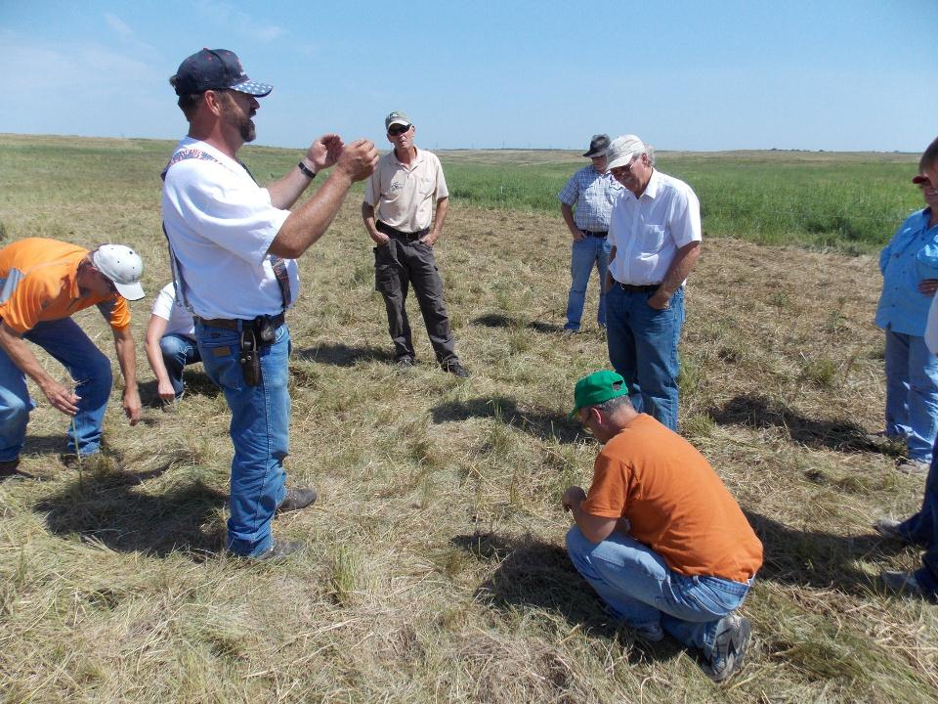
2012 Tour

Slide 14
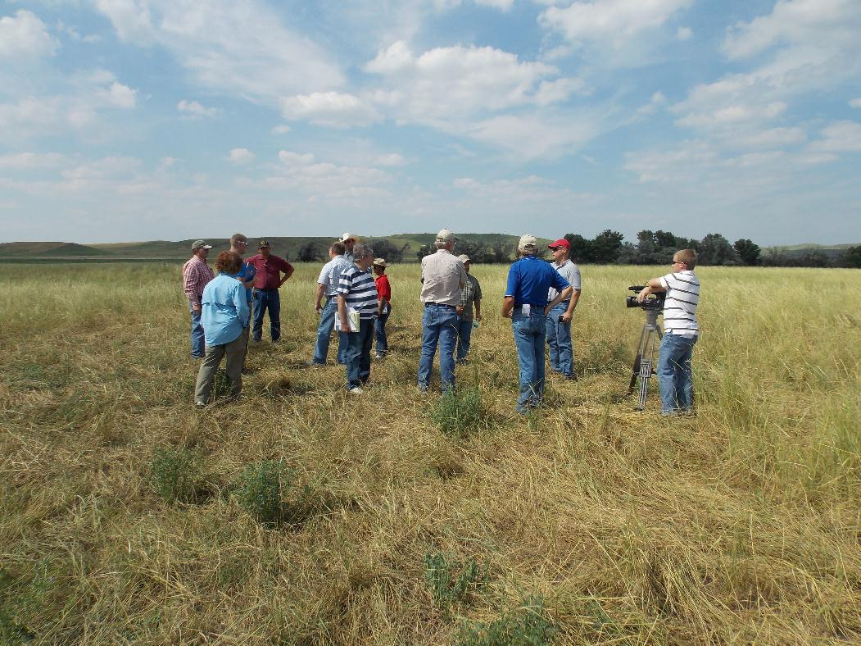
2013 Tour

Slide 15
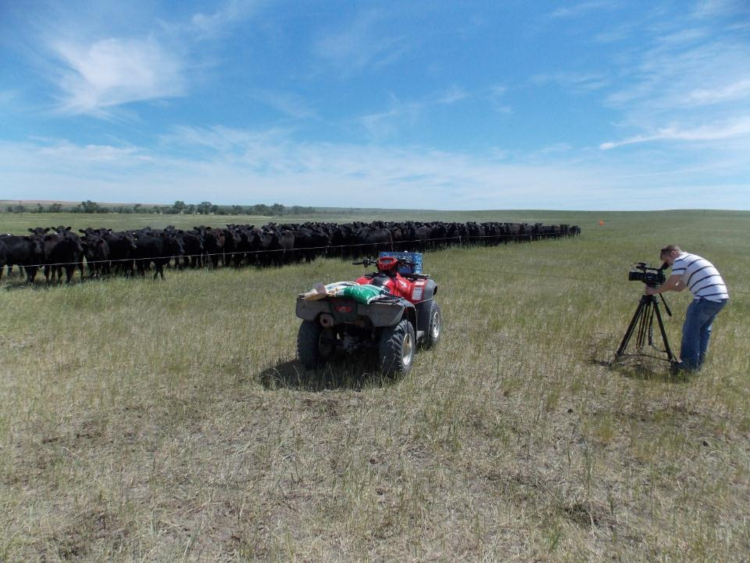
Videos
Pat Guptill https://www.youtube.com/watch?v=fWC9qkYdDNA
Charlie Totton https://www.youtube.com/watch?v=MJ4tlSkVxAk
Rick Smith https://www.youtube.com/watch?v=NA9D5eiLHlw

Slide 16
Summary
Producers are getting a higher harvest efficiency
Haven’t documented a change in productivity or soil health yet

Slide 17
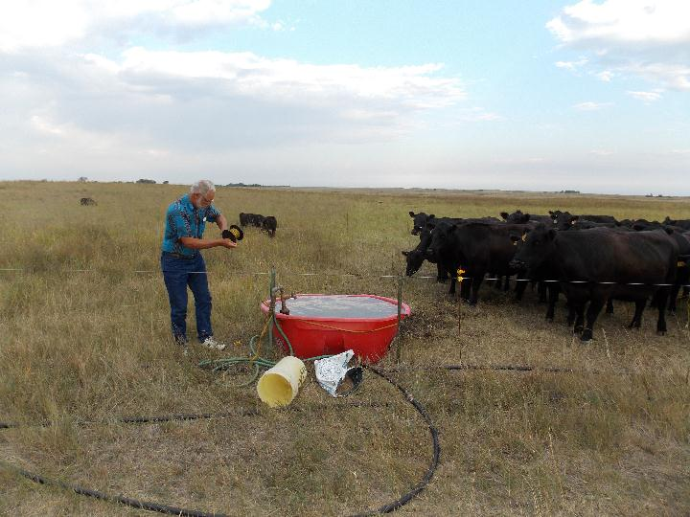
Questions

