Slide 1
Adjust 2015
The New Farm Reality Check
John Mesko, Lisa Mesko, Sustainable Farming Association
LNC12-342
NCR-SARE’s Farmers Forum, 2015

Slide 2
New Farm Reality CheckTM
John Mesko, SFA Executive Director
john@sfa-mn.org
@johnmesko
@lisamesko
#adjust2015

Slide 3
Sustainable Farming Association

Slide 4
Mission
The Sustainable Farming Association supports the development and enhancement of sustainable farming systems through farmer-to-farmer networking, innovation, demonstration, and education.

Slide 5
Farmer-to-Farmer Network®
Established in 1990. Focus on Networking
Nine Regional Chapters
Farmer Led
Farmer Focused
Farmers are the educators, leaders, developers

Slide 6
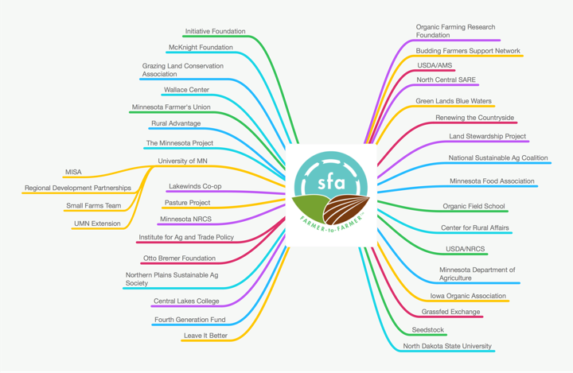
SFA Connections

Slide 7
Sustainability
Financial: Sustainable Agriculture is only sustainable if farmers can make an adequate living.
Environmental: Leaving the land in as good or better condition over the long term.
Social: Stronger communities, stronger relationships and families.

Slide 8
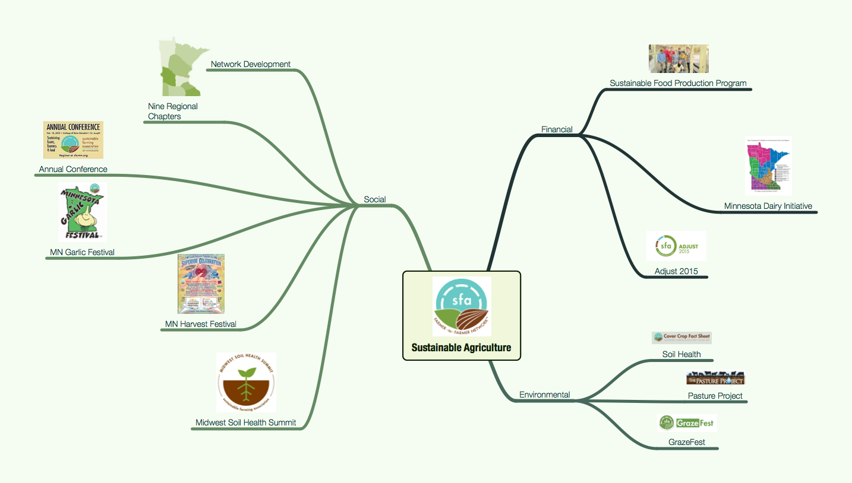
SFA Work

Slide 9
Key Projects / Programs
Sustainable Food Production Program (Farm Skills 101)
Focus is practical, hands on, in the field.
Small class size, one on one relationship building.
Sells out immediately.

Slide 10
Key Projects / Programs
Minnesota Dairy Initiative
MDA-Funded
Focus is on organic dairies, on farm processing, farm transitions, grazing and grass-based dairies.
Goat dairies, cheese making
Foundational to our work on grazing and livestock management/production.

Slide 11
Key Projects / Programs
GrazeFest / Pasture Project / Soil Health
Largest area of growth in SFA activity currently.
Work is extending to the entire Upper Mississippi Watershed.
Soil Health Summit - Feb 18-19, 2015, Alexandria, MN

Slide 12
Adjust 2015 Team
John Mesko, Project Lead
Dr. Valentine Cadieux, UMN
Dr. Michael Rosmann, AgriWellness, Inc.
Jan Joannides, Renewing the Countryside
Lisa Mesko, RN
Jerry Ford, SFA
Jason Walker, SFA

Slide 13
Adjust 2015 Team
Dennis Ingle, Farmer
Josh Reinitz, Farmer
Chris Kudrna, Farmer
Tim Arlt, UMN
Kevin Plante, MN Dept. of Ag
Tony Nye, OSU
Karri Stroh, NPSAS
Beth Larabee, IA Organic Assn.

Slide 14
Adjust 2015
NCR-SARE Funded Project
More Successful farmers needed.
Surveyed and interviewed ~200 farmers and farm families.
Determine the range and causes of farm difficulties, especially new businesses.
Develop add-on curriculum to support beginning farmer education.

Slide 15
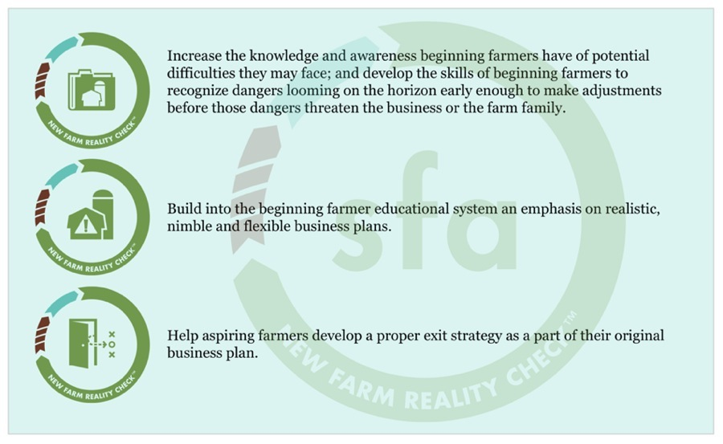
Adjust 2015

Slide 16
Adjust 2015
71 % of respondents intended their farm business to provide a full-time income
54 % make less than 25 % of their net income from the farm, and 33 % make less than 10 % of their net income from farming
About 69 % of respondents are not satisfied with their farming income

Slide 17
Adjust 2015
62 % of respondents are not able to pay salary or wages to themselves / family members on the farm.

Slide 18
Adjust 2015
75 % of respondents have changed goals since they started farming.
3/4 original business plan did not predict farming experience, while 18 percent rated plan as “not accurate at all”

Slide 19
Adjust 2015
“The reality of how hard it is to take on all that (we planned/dreamed) and to build our business from the ground up has been a shock. I admire people who have gone before us and set up great farm businesses, especially the people who have done so without a partner. There are just so many hurdles to get over when starting a farm business.”

Slide 20
New Farm Reality Check
Farming is stressful.
Success is difficult.
These factors contribute to overall health and wellness issues.
Which in turn, affects sustainability.

Slide 21
New Farm Reality Check
Identify the key components of a curriculum which can improve farm success.

Slide 22
New Farm Reality Check
Acquire basic understanding of soil literacy.
Identify progress benchmarks including business exit benchmarks consistent with realistic expectations.
Basis for business plan assumptions
Ability to develop community networks.

Slide 23
New Farm Reality Check
Understand basic employee management.
Identify contrary life patterns.
Identify business plan alternatives.
Family roles on the farm and children.

Slide 24
New Farm Reality Check
Ability, awareness, impetus to actually build a network of experts, friends, colleagues, consultants, professionals who are your “team” Including an “honest skeptic.”

Slide 25
New Farm Reality Check
Identify community building opportunities.
Identify life patterns (relationship and behavior) contrary to farming or business success.

Slide 26
New Farm Reality Check
Identify community building opportunities.
Be able to develop alternative plans (3) in addition to primary plan.

Slide 27
New Farm Reality Check
Discuss expectations and understanding regarding farming with children.
Establish farming roles with family members. Managing family differs from employees.

Slide 28
Identify Progress Benchmarks
Red lights on the dashboard of your car.
When do you “check engine?”
When do you “STOP engine?”
What are the indicators of a need for some maintenance?

Slide 29
Types of Benchmarks
Financial
Community
Environmental
Quality of Life
Timeline

Slide 30
Financial Benchmarks
Current Ratio
Calculated by: Current Assets
Current Liabilities (short term)
Calculate monthly
Acceptable Range: 1.5 - 3.5+
<1.5 | 1.5 - 2.5 | 2.5 - 3.5 +

Slide 31
Financial Benchmarks
Operating Profit Margin
Calculated by: NFI + Int. - Fam. Exp. - Taxes
Total Revenue
Calculate Annually
Acceptable Range: 8 - 32%+
<8.0% | 8.0 - 20.0% | 20.0 - 32%+

Slide 32
Financial Benchmarks
Revenue per Full Time Labor
Calculated by: Total Revenue
Person - years of labor
Calculate Annually
Acceptable Range: $125,000 - 275,000+
<$125,000 | $125-200,000 | $200,000+

Slide 33
Community Benchmarks
# Customers
May want to set a minimum purchase amount. (# customers spending >$xxx.xx)
Calculate Annually
Acceptable Range: (varies) 50-200
<50 | 50-100 | 100+

Slide 34
Community Benchmarks
# Newsletter subscribers
Calculate continually
How many newsletter subscribers per paying customer?
Acceptable Range: (varies) 500-1000
<100 | 100-1000 | 1000+

Slide 35
Quality of Life Benchmarks
# Days off the Farm
Calculate Annually or Monthly
Acceptable Range: (varies) 10 - 20
<10 | 10-20 | 20+

Slide 36
Quality of Life Benchmarks
# Days off the Farm
Calculate Annually or Monthly
Acceptable Range: (varies) 10 - 20
<10 | 10-20 | 1000+

Slide 37
Timeline Benchmarks
Tracking Family/Business Goals
Kitchen
Remodel
College
Education
Formal Transition
Scale Back
Credit Card
Debt
Additional
Full-time
Land Paid Off
Better
Tractor
Europe
New
Barn
2015
2018
2021
2024
2027
2030
2033
2036
2039
2042
2045

Slide 38
Timeline Benchmarks
Tracking Family/Business Goals
Kitchen
Remodel
College
Education
Formal Transition
Scale Back
Credit Card
Debt
Additional
Full-time
Land Paid Off
Better
Tractor
Europe
New
Barn
2015
2018
2021
2024
2027
2030
2033
2036
2039
2042
2045

Slide 39
Timeline Benchmarks
Tracking Family/Business Goals
Kitchen
Remodel
College
Education
Formal Transition
Scale Back
Credit Card
Debt
Additional
Full-time
Land Paid Off
Better
Tractor
Europe
New
Barn
2015
2018
2021
2024
2027
2030
2033
2036
2039
2042
2045

Slide 40
Timeline Benchmarks
Tracking Family/Business Goals
Current Ratio - Green
Gross Sales - Growing @10%
Profit Margin - Green
$20,000
Revenue/FTL
$75,000

Slide 41
Assumptions
Assume = ASS - U - ME

Slide 42
Good Assumptions
60 feet, 6 inches in 0.4 sec.
Difference between average and HOF
baseball player =
Batter must start swinging when
ball is 25 feet away.
X
ASSUMPTIONS

Slide 43
Bad Assumptions
Overestimating ability, knowledge, capacity, commitment
Underestimating costs, difficulties obstacles
Status quo
Weather
Yields
Health

Slide 45
Family, Farming, Roles
45% had experience with farming >> ~half had little or no experience.
34% had no formal training in farming.
Family tensions
Need for knowledge about integrating farming and family roles.
Framework of knowledge to equip them

Slide 46
Family, Farming, Roles
Off-farm job(s)
Farm work/chores
Family - children on the farm
Household
Accounting
Marketing
Networking

Slide 47
Family, Farming, Roles
Gallup Strengths Finder
How to have a family business meeting
Conflict management

Slide 48
New Farm Reality CheckTM
Short Workshop
Day Long Workshop
Website : www.sfa-mn.org/adjust2015
Incorporated into SFAs DeepRoots Farmer Development Program

Slide 49
New Farm Reality CheckTM
Iowa Rural Psychology Association
MN Organic Conference
NPSAS
SFA Annual Conference
DeepRoots Farmer Development
More…

Slide 50
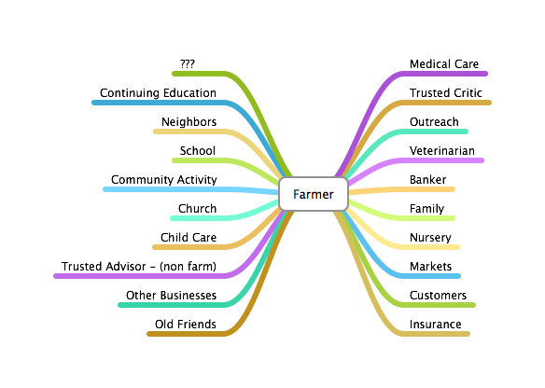
Building Teams / Networking
Success = Community

Slide 51
Building Networks
Relationships
Rural Revitalization
New Farmers bring something to the community.
Become a networker, change-agent.

Slide 52
New Farm Reality Check
Developing a presentation for use in general educational settings, sharing the learnings, offering examples of adjustment made.

Slide 53
New Farm Reality Check
Short workshop (2-3 hours): Covers most of the objectives and topics, some interaction among attendees, some farmer-speakers. Could be easily added to existing programs.
MN Organic Conference Jan. 2015

Slide 54
New Farm Reality Check
Longer workshop (4-7 hours): Covers all the topics, multiple speakers, interactions, videos, stand-alone program.

Slide 55
Beyond Scope of Adjust
Assessment of Strengths and hampering factors. Within relationships to other farming partners, family members, personal strengths and hampering factors.
Farming readiness score.
Applying SF, MBTI to farming, farmers.
Farm Management Game. For real.
Site and business plan assessment, land, buildings, traffic, wildlife, financial and insurance assessment, safety assessment, certified safe farm analysis leading to a reduction in premiums.

Slide 56
Looking for Partnerships
Applying findings in rural health programs, applications.
Help in getting the message out that successful farms are healthy farms and are sustainable farms.

Slide 57
Other Areas of Focus
Specialty Crops
Testing, evaluating, field days, education.
Train the Trainer Initiatives
Soil Health
Grazing
Cover Crops

Slide 58
SFAs 25th Anniversary
1990-2015
Celebrating all of Sustainable Agriculture
Past, Present and Future
State of Sustainable Agriculture
Seeking endowment funding for
New Farmers
Expanded programming to conventional audiences

Slide 59
Thank You!
763-260-0209
john@sfa-mn.org

Slide 60
Adjust 2015
The New Farm Reality Check
Thank You!
NCR-SARE’s Farmers Forum, 2015

