Slide 1
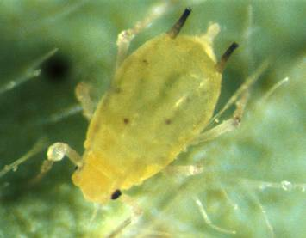

Promoting sustainable biological control of the soybean aphid: biodiversity and releases of parasitoid wasps
George Heimpel, LNC13-353
University of Minnesota Dept. of Entomology
NCR-SARE’s Farmers Forum, 2015

Slide 2
Arrival and Spread of the Soybean Aphid

Slide 3
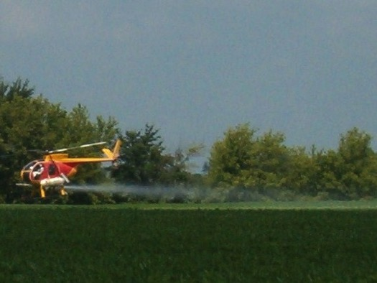
Insecticide use in North Central States
Source: National
Ag. Statistics Serv.

Slide 4
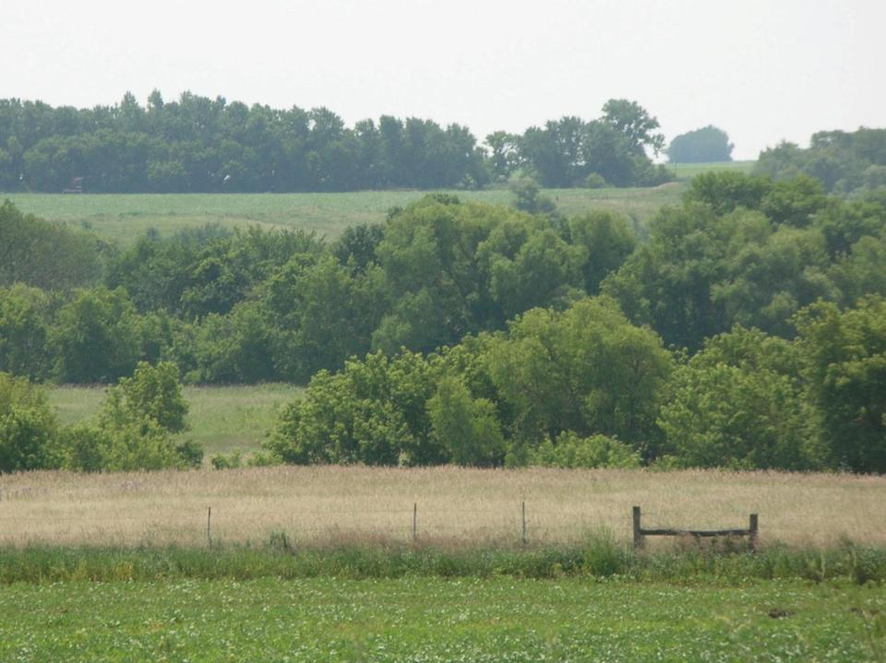



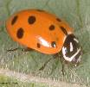
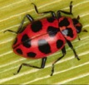
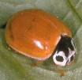





Supply of natural enemies in the landscape
Notes:
4

Slide 5
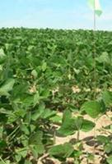
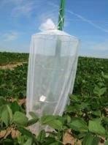
Biological Control
1200
A
1000
Exclusion
Open
800
Soybean aphid per plant +/- SEM
<
600
400
a
B
200
b
0
Day 7
Day 14
Generalist predators provide biological control of soybean aphid

Slide 6
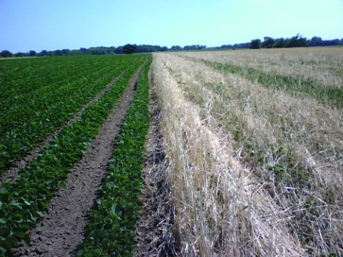
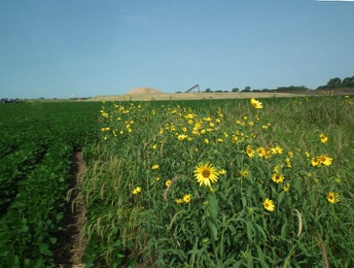
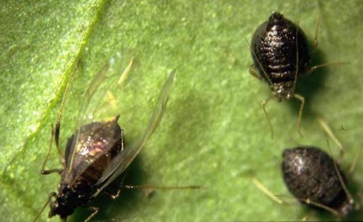
How can we improve upon this level of biological control?
1. Taking advantage of biodiversity
2. Releasing parasitoid wasps

Slide 7
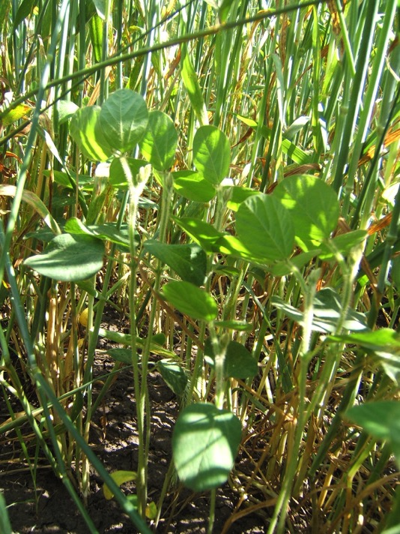
Winter-Planted Rye Cover- Cropped with Organic Soybean
Autumn: Harvest corn
Autumn: Plant rye
Spring: Plant soybean
Summer: Mow rye
Autumn: Harvest soybean

Slide 8
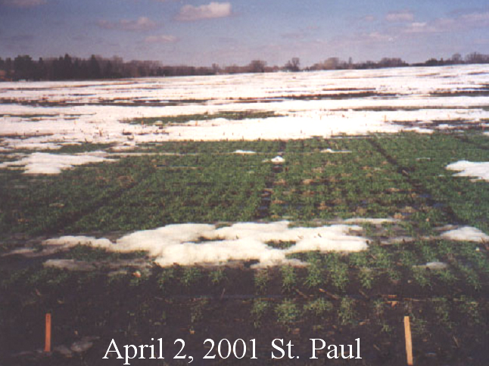
P. Porter

Slide 9
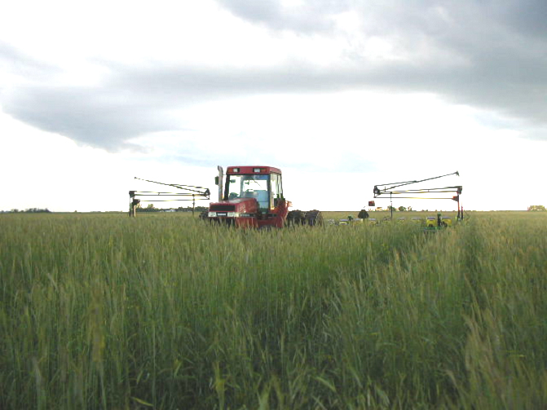
P. Porter

Slide 10
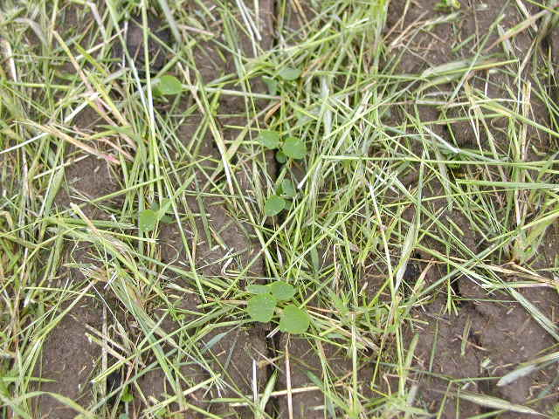
Soybean drilled into rye
Lee Thomas
June 12, ‘03
P. Porter

Slide 11
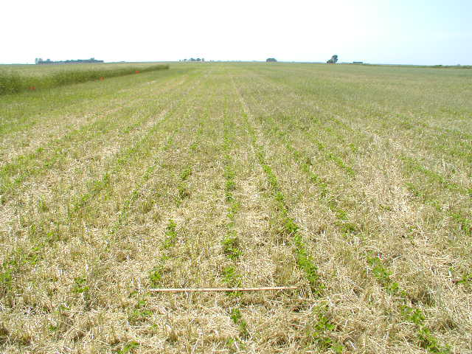
P. Porter

Slide 12
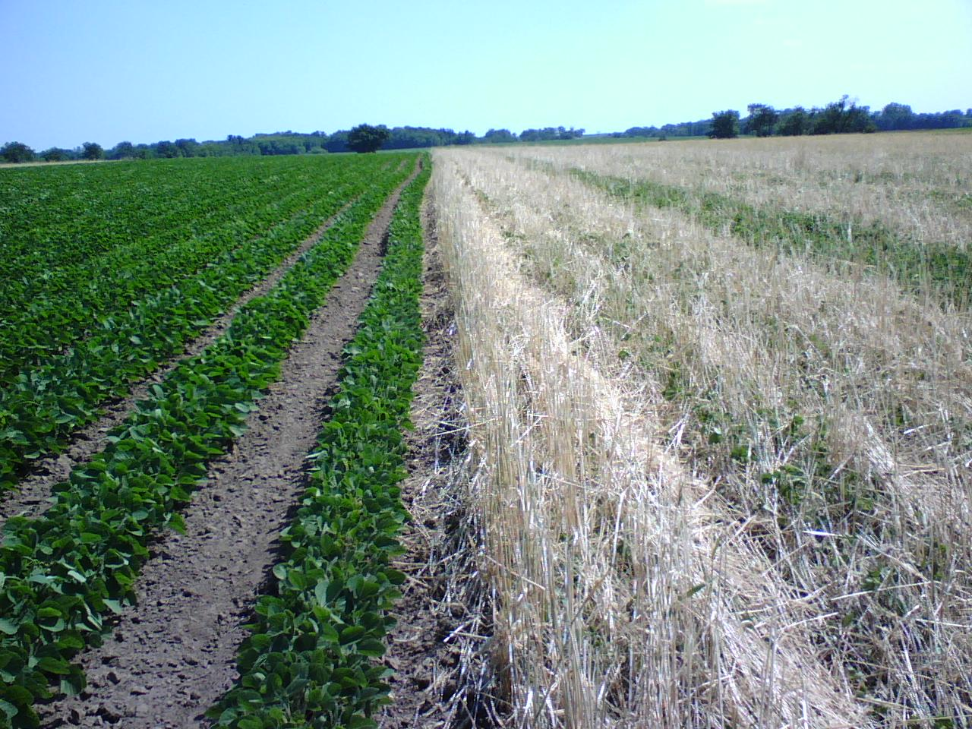
Z. Sezen

Slide 13
Results: Austin (Organic Farm)

Slide 14
Results: Lamberton Exp. Station

Slide 15
Results: Felton (Organic Farm)

Slide 16
Results: Rosemount Exp. Station

Slide 17
Why fewer aphids in the presence of rye?
Little evidence for better biological control.
Likely less aphid colonization or lower aphid growth rates.
Z. Sezen

Slide 18

The role of Asian parasitoids
Aphelinus certus - established
Aphelinus glycinis – being introduced

Slide 19
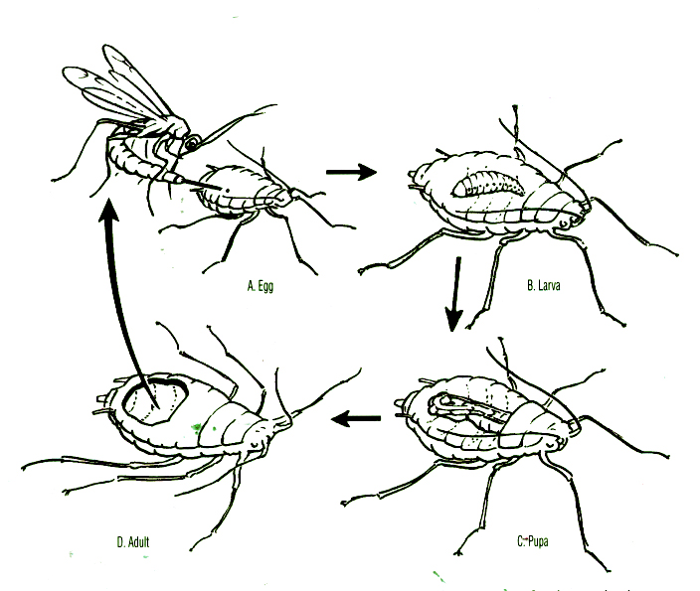
Aphid parasitoid life cycle

Slide 20

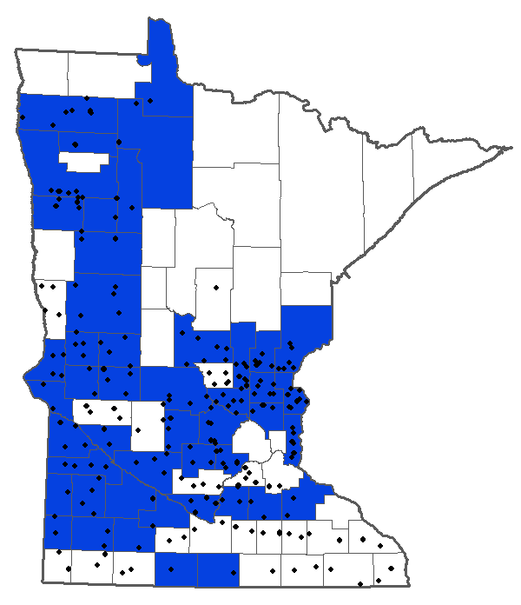
Aphelinus certus
Dots: sampling locations (Minn Dept. of Ag.)
Blue: counties with Aphelinus certus

Slide 21
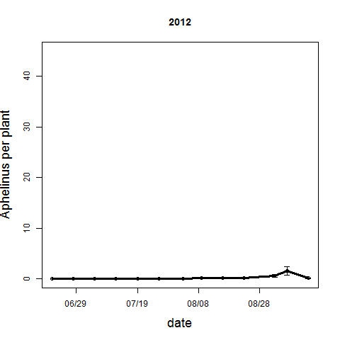
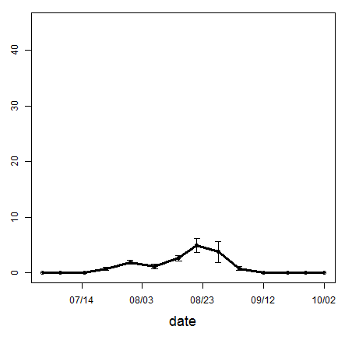
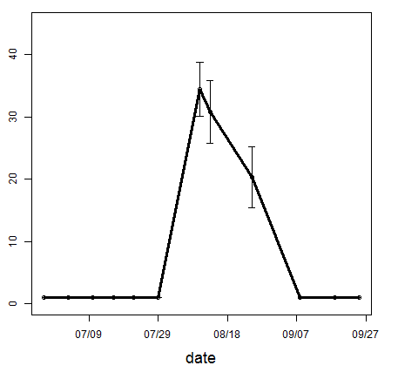
Aphelinus certus
In Rosemount, MN
2012
2013
2014

Slide 22
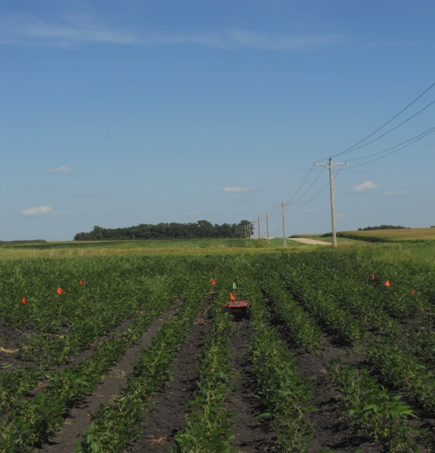
Aphelinus glycinis
2013 releases
2014 releases
Overwintering study
75,000 A. glycinis
released at each site

Slide 23
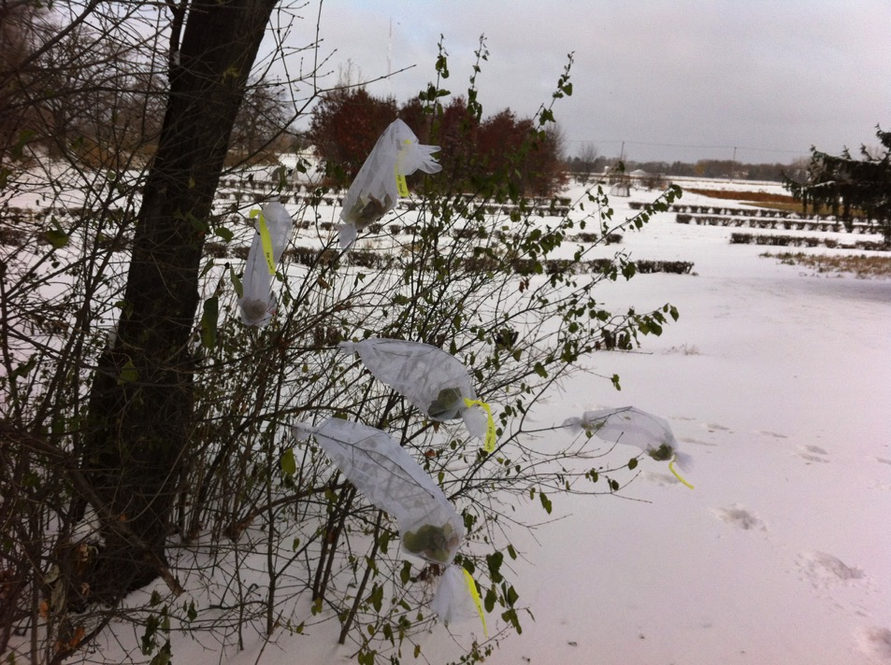
Aphelinus glycinis
Overwintering study

Slide 24
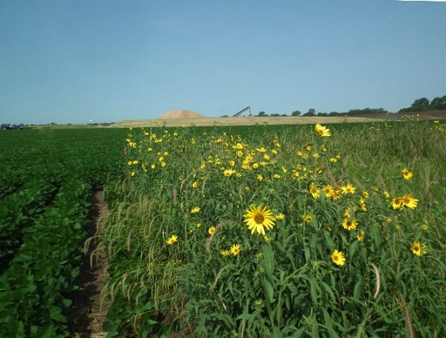
Conclusions
Soybean aphid is a pest despite natural biological control
We are trying to improve this control by:
  Increasing landscape diversity
  Releasing Asian parasitoid wasps.
Next Steps: Combine these strategies

Slide 25






Acknowledgements
Rye Cover Cropping Work
  Paul Porter, Bob Koch, Lee Thomas,
  Paul Guiney
Aphelinus certus
  Joe Kaser, Keith Hopper
Aphelinus glycinis
  Nick Padowski, Keith Hopper

