Slide 1
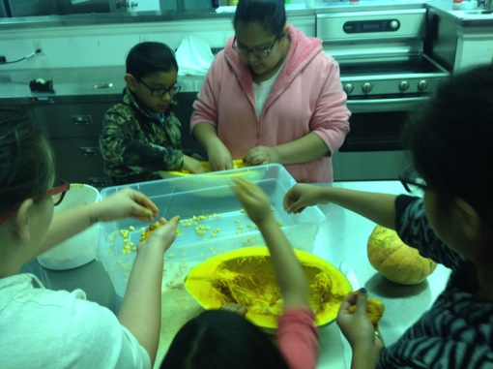
Youth Adventures with Squash
Sue Isbell, NDSU Sioux County Extension; Robert Fox, UTTC; Frank Kutka, NPSAS

Slide 2
The “Squash in Sustainable Food Production” project
Funded by a SARE Youth Educator Grant
Partners include Sue Isbell, NDSU Sioux County Extension, Colette Wolf and Robert Fox, UTTC Land Grant Program, and Frank Kutka, Northern Plains Sustainable Agriculture Society
Two years of demonstration, research and outreach to breed squash and learn about food with Indigenous youth

Slide 3
Goals of the “Squash in Sustainable Food Production” project
Empowered youth who have skills and knowledge about food, gardening, marketing, and plant breeding
Healthier communities with more options for high quality food and income
New squash varieties with delicious fruits off of bush type plants for small gardens
Model of youth plant breeding work for other groups across the country

Slide 4
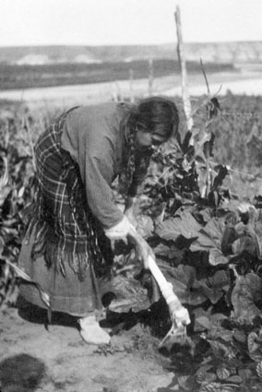
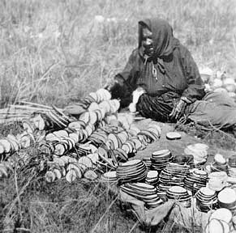
How did we get started?
Squash, gardening, seed saving, and marketing are old traditions of many Indigenous peoples

Slide 5
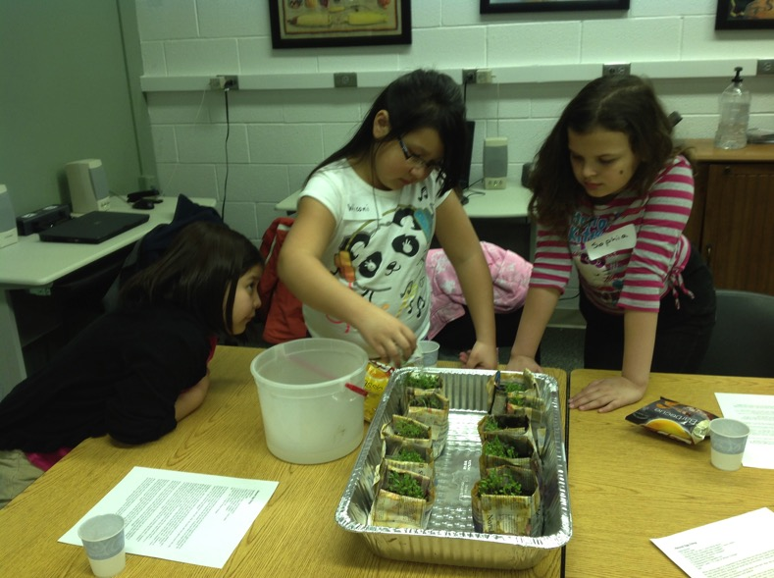
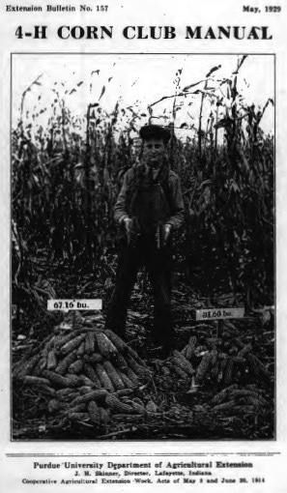
Youth education once included the basics of agriculture, plant breeding, nutrition, and marketing…
Why not now?

Slide 6
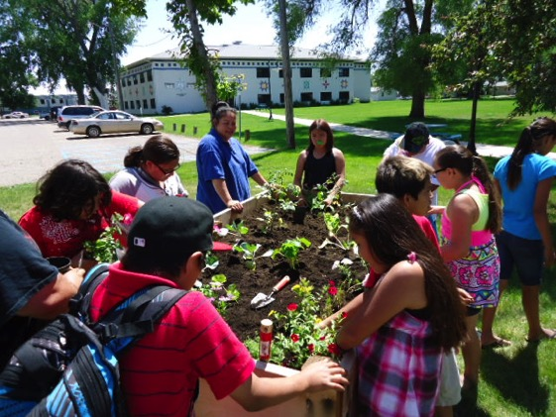
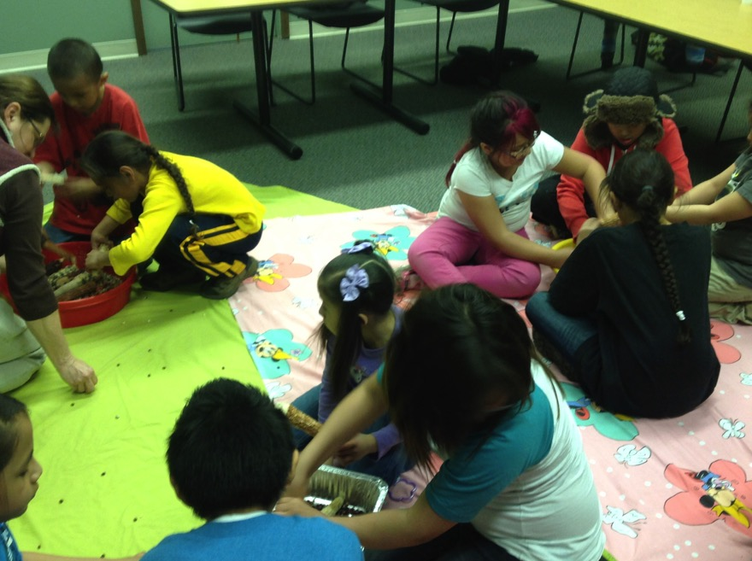
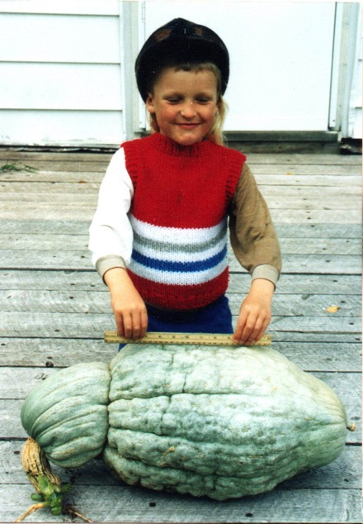
Some of us had good experiences with young folks in the garden and were ready to share

Slide 7
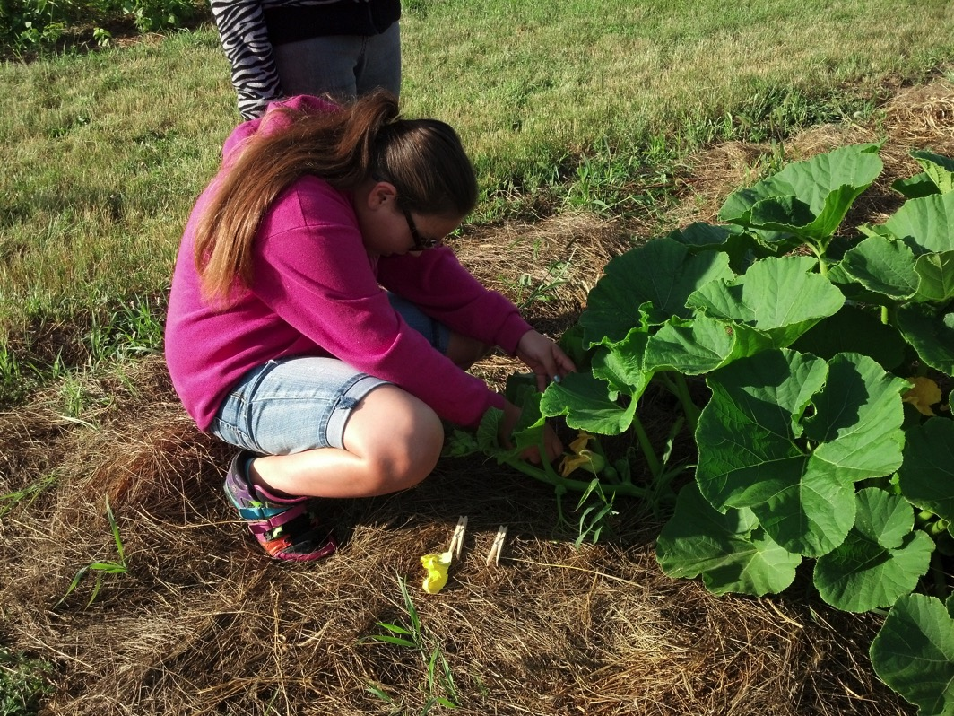
Squash have big flowers and seeds, and tasty fruit, so they are easy for anyone to work with. You can even eat the flowers!

Slide 8
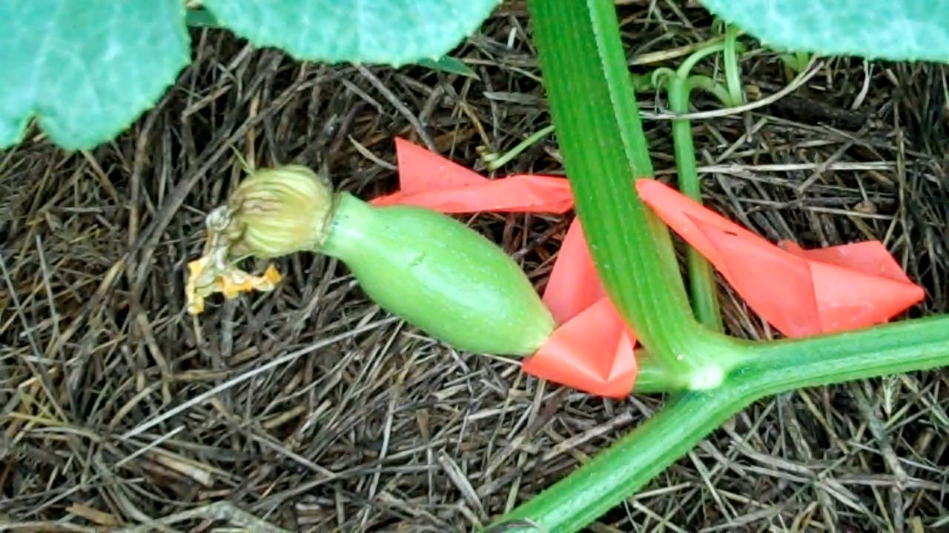
Frank made crosses the year before so we could have a quick start
fdhsafg

Slide 9
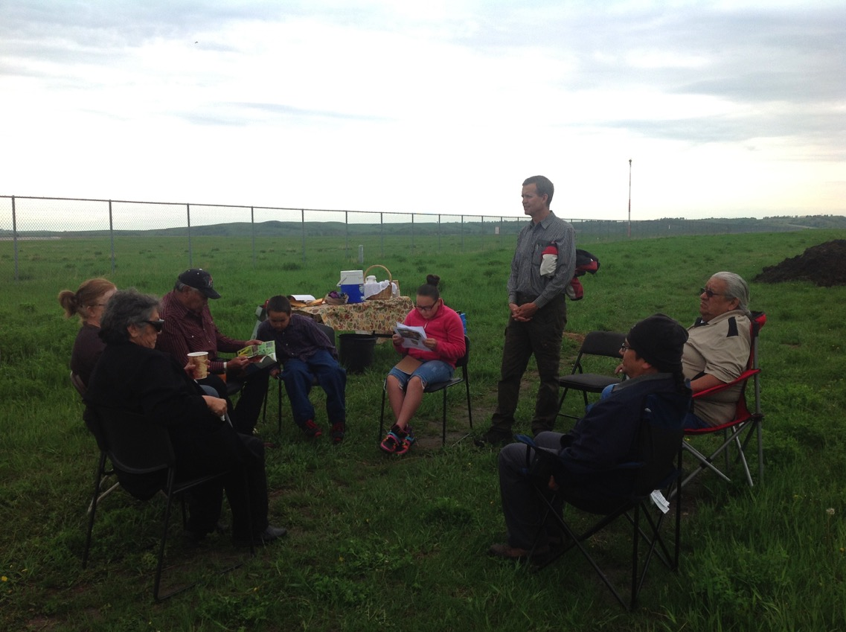
Elders from Ft. Berthold and Standing Rock on the first day at UTTC, telling stories and praying before the seeds were planted in the ground

Slide 10
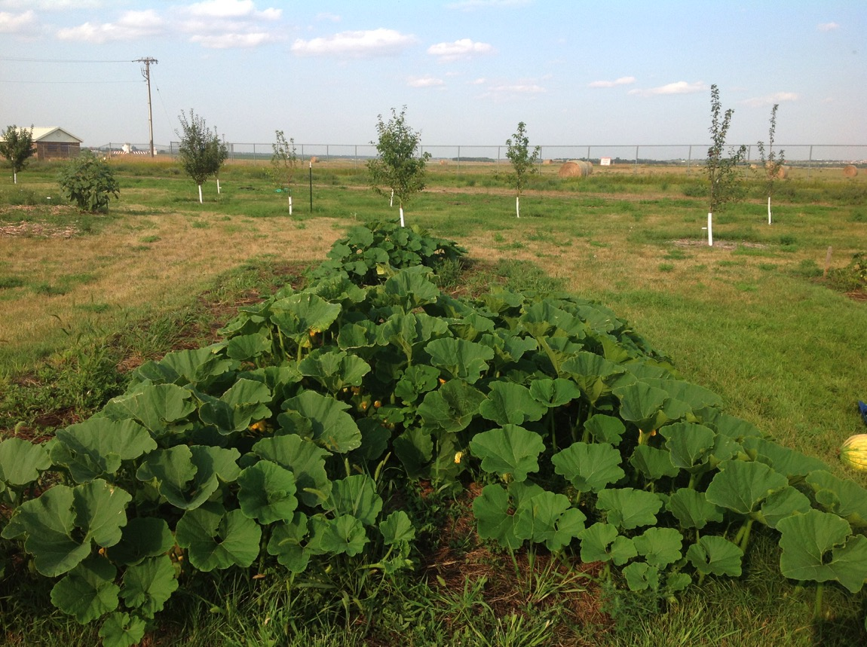
The Hubbard x Gold Nugget plants the first year were vigorous vines

Slide 11
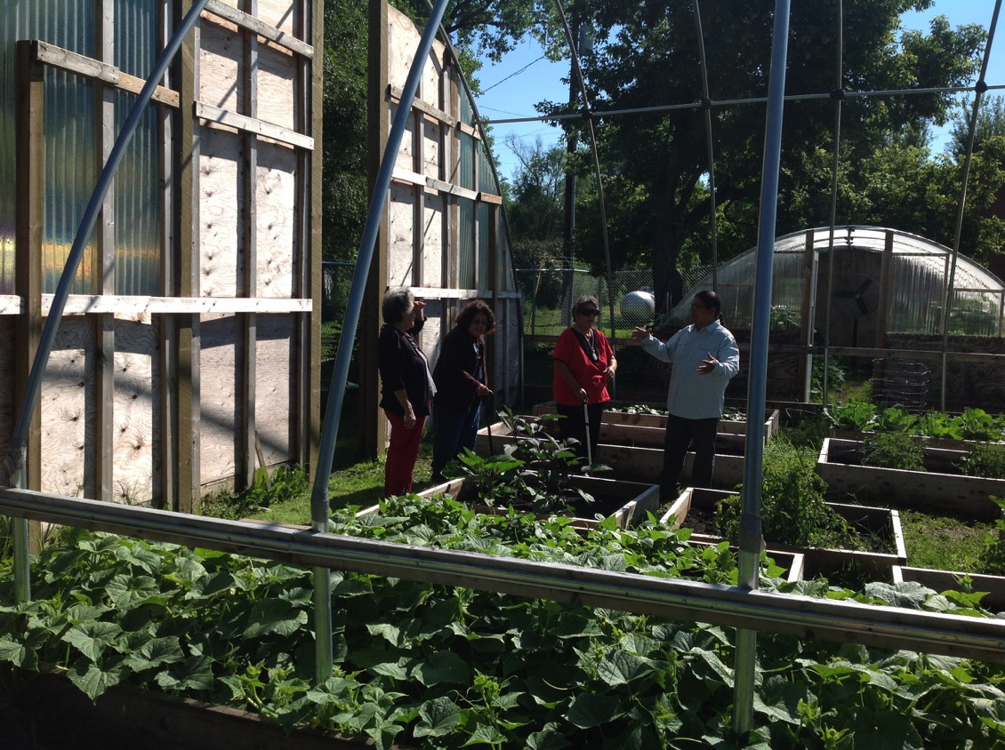
Elders from White Shield visited the Sioux County Extension Office during our pollination workshop

Slide 12
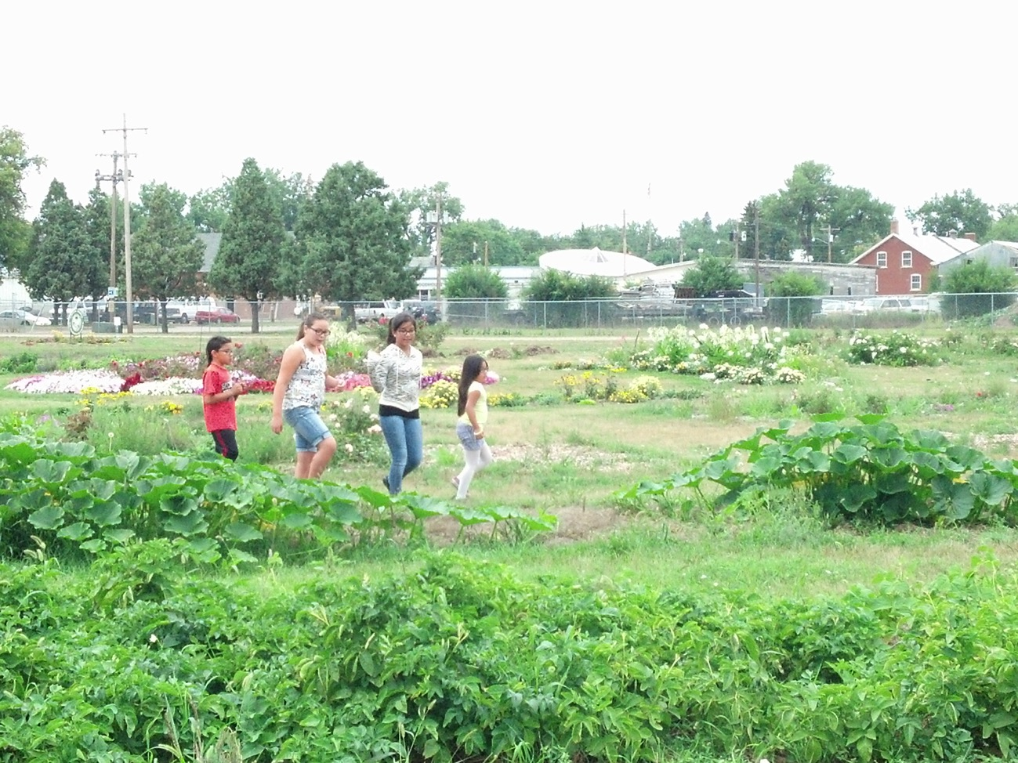
Hunting for flowers to pollinate

Slide 13
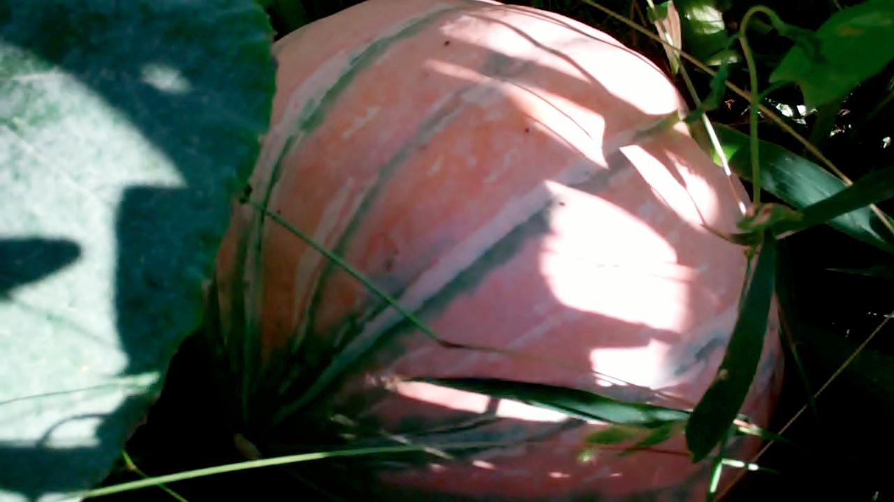
One of the fruits from the crossed squash

Slide 14
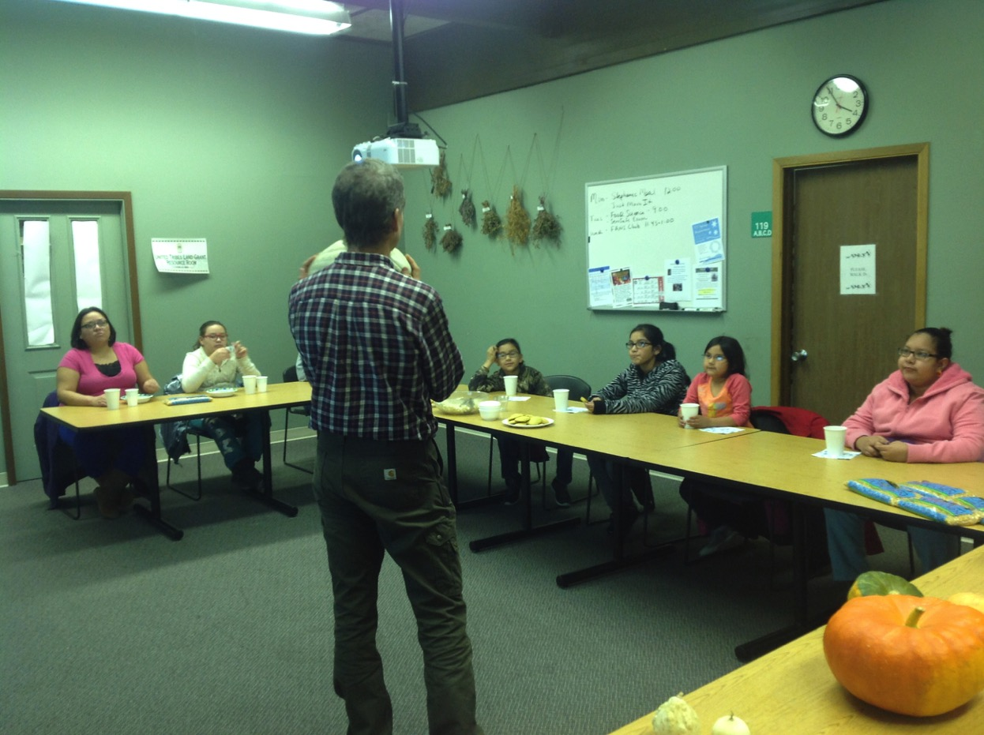
Class room time was to discuss marketing, genetics, etc.

Slide 15
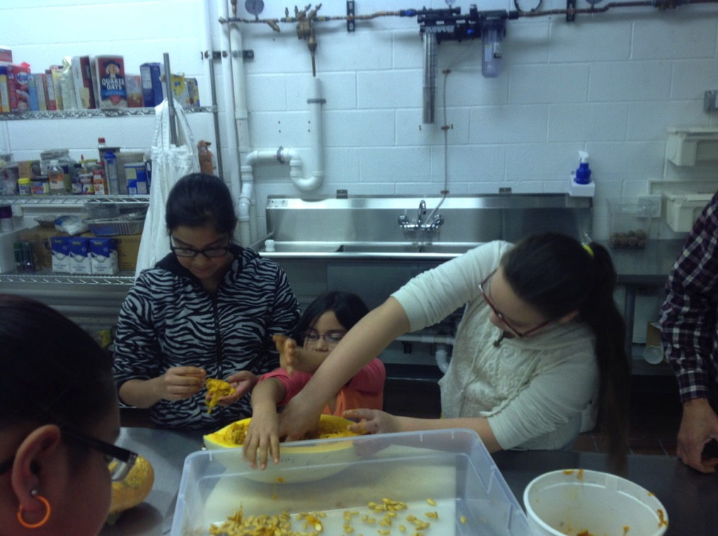
The first fall we saved seeds from hand pollinated fruits

Slide 16
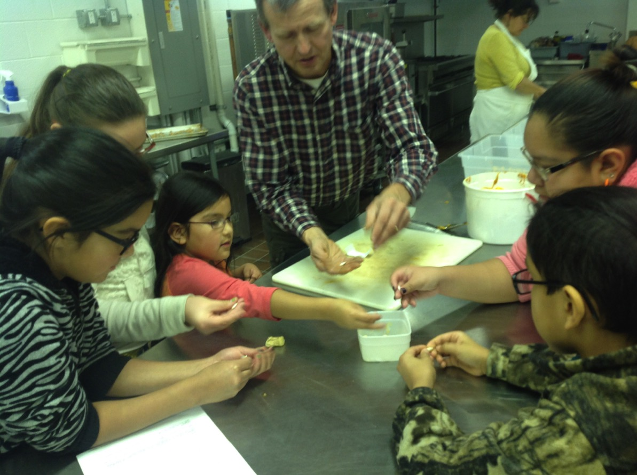
It was really fun, but slippery

Slide 17
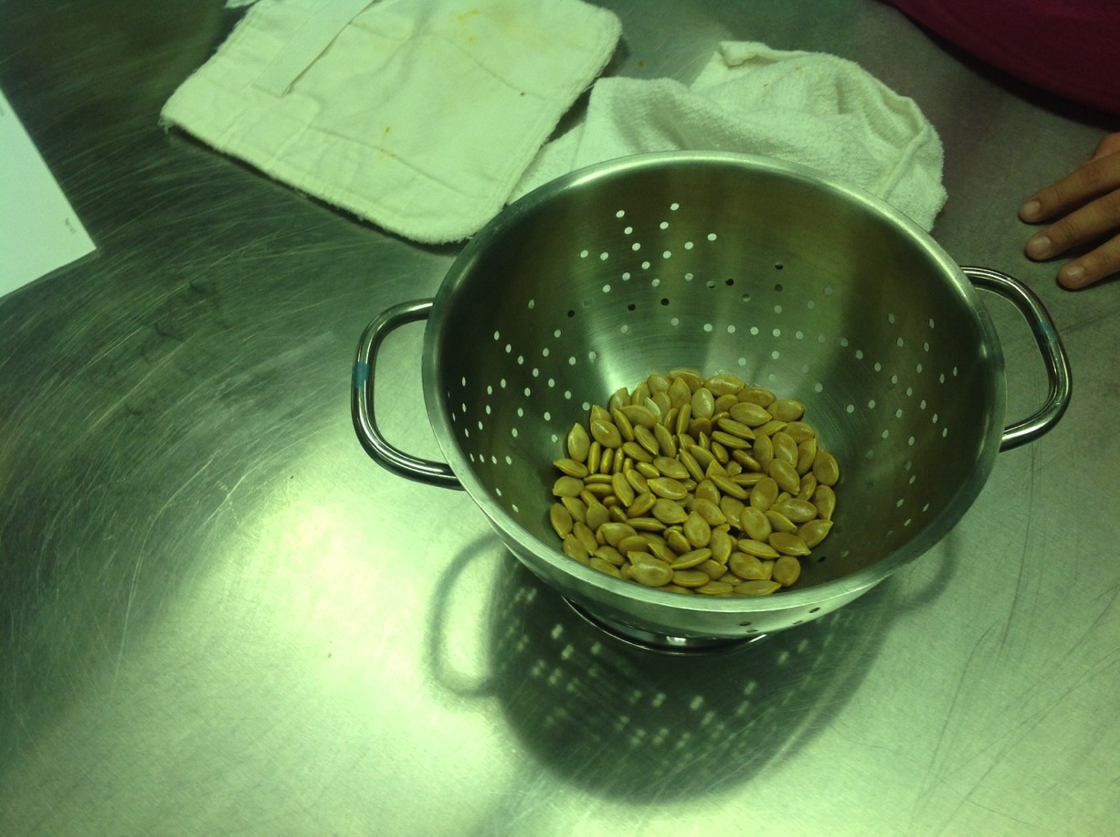
Clean seeds ready to dry

Slide 18
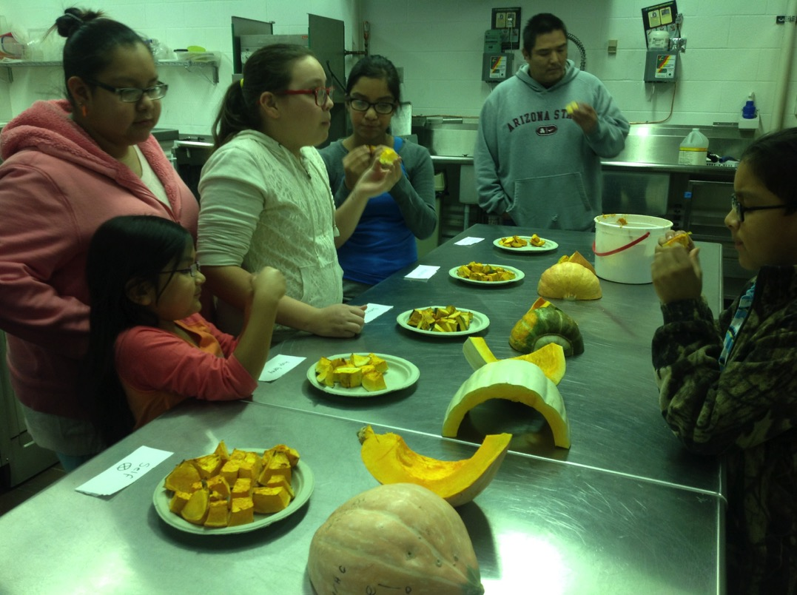
We tasted several varieties, and the sweetest kind was not the favorite one of the UTTC youth

Slide 19
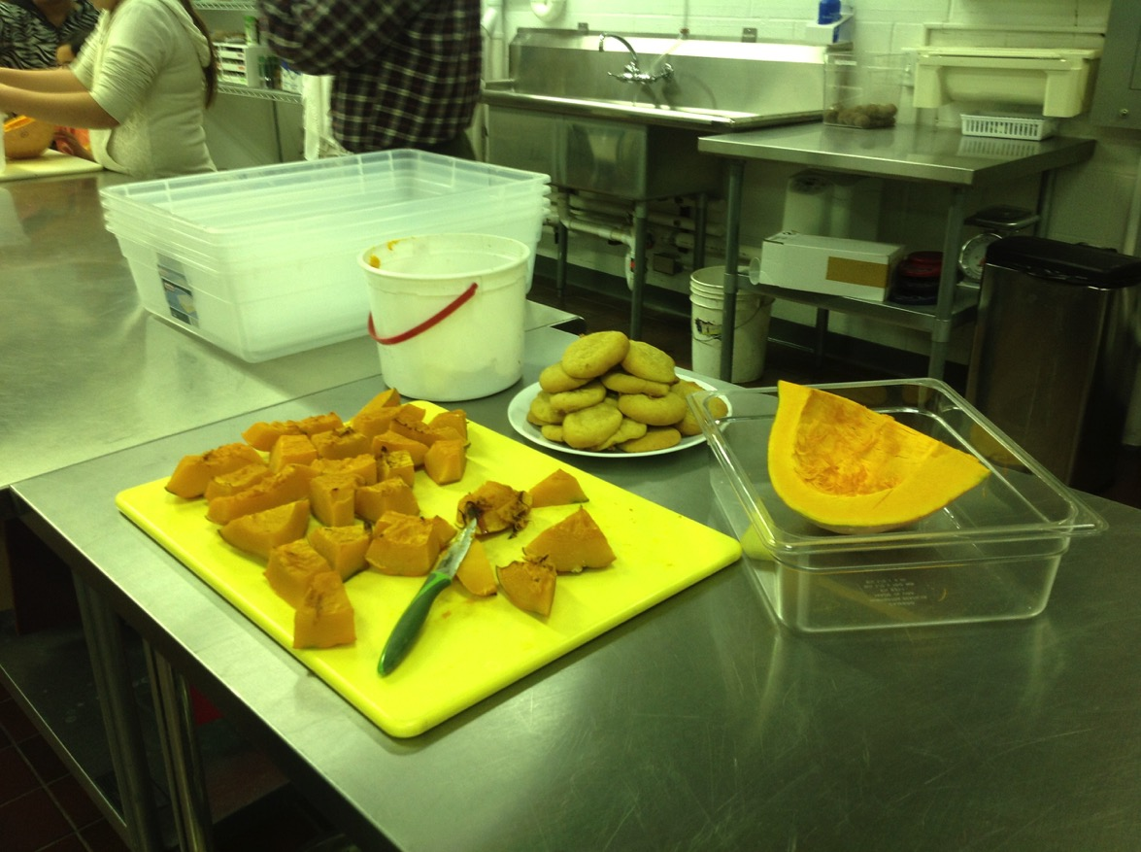
Colette cut up squash to bake, and she also made squash cookies (a real favorite)

Slide 20
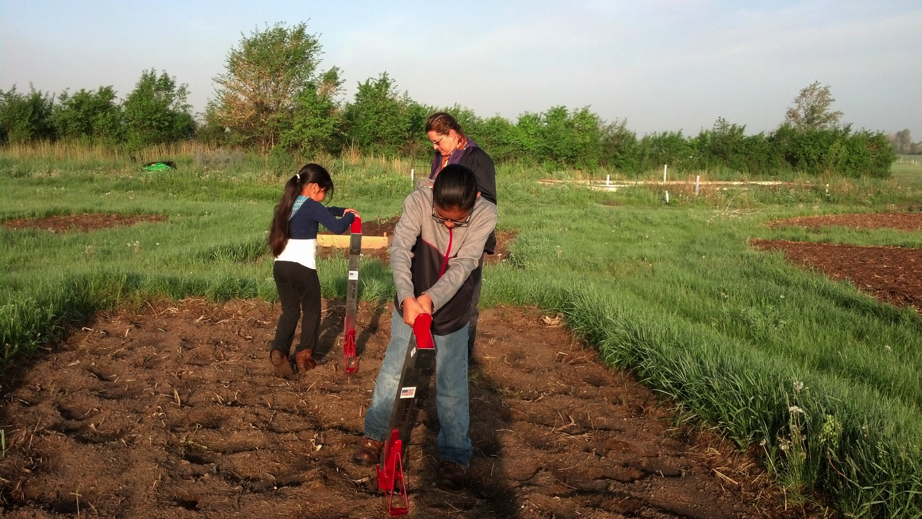
This year we planted the saved seeds

Slide 21
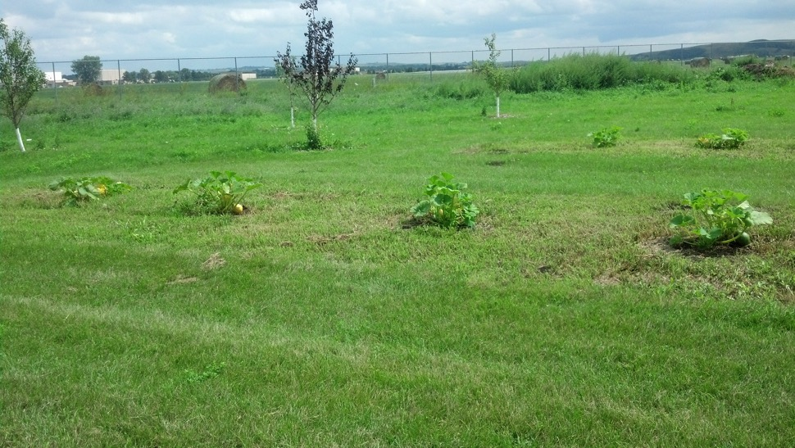
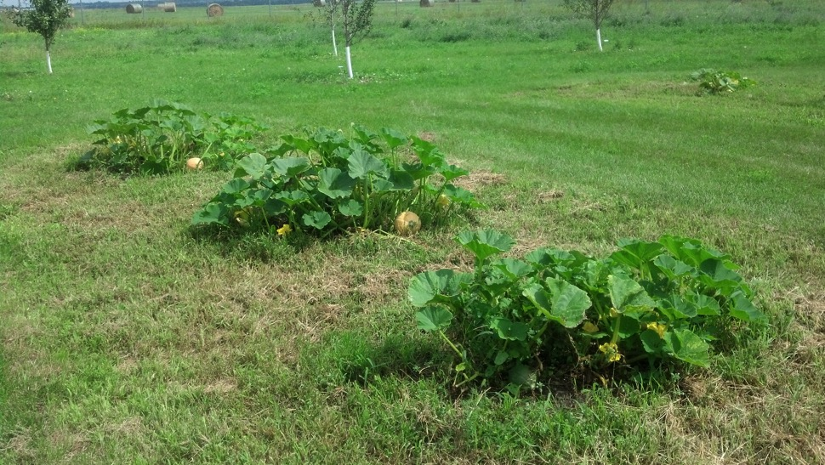
And we only pollinated the bush types of plants

Slide 22
Outreach to Others
Squash for elders, kitchens, and for sale
Conference presentations (IFC, NPSAS)
New squash varieties developing
Youth presentations this spring (in the works)
YouTube videos (in the works)
Sustainable squash growing, eating, marketing, seed saving, and plant breeding manual for Junior Master Gardeners (in the works)

Slide 23
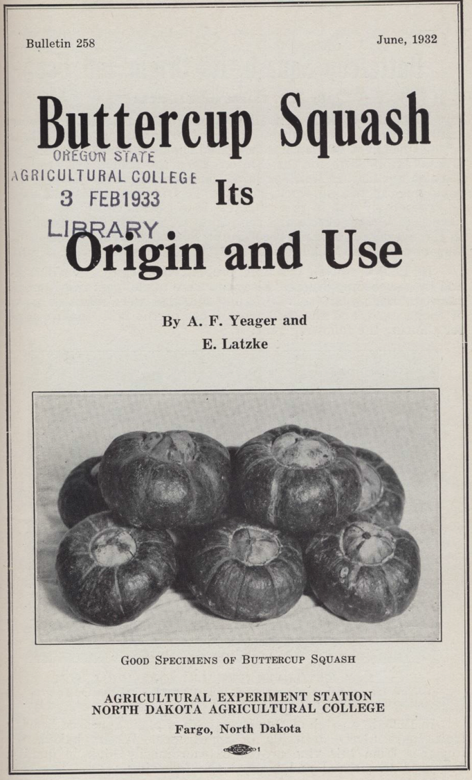
We will use Dr. Yeager’s breeding methods for Buttercup squash, 4H Corn Club manuals, and our experiences to guide development of our youth bulletin

Slide 24
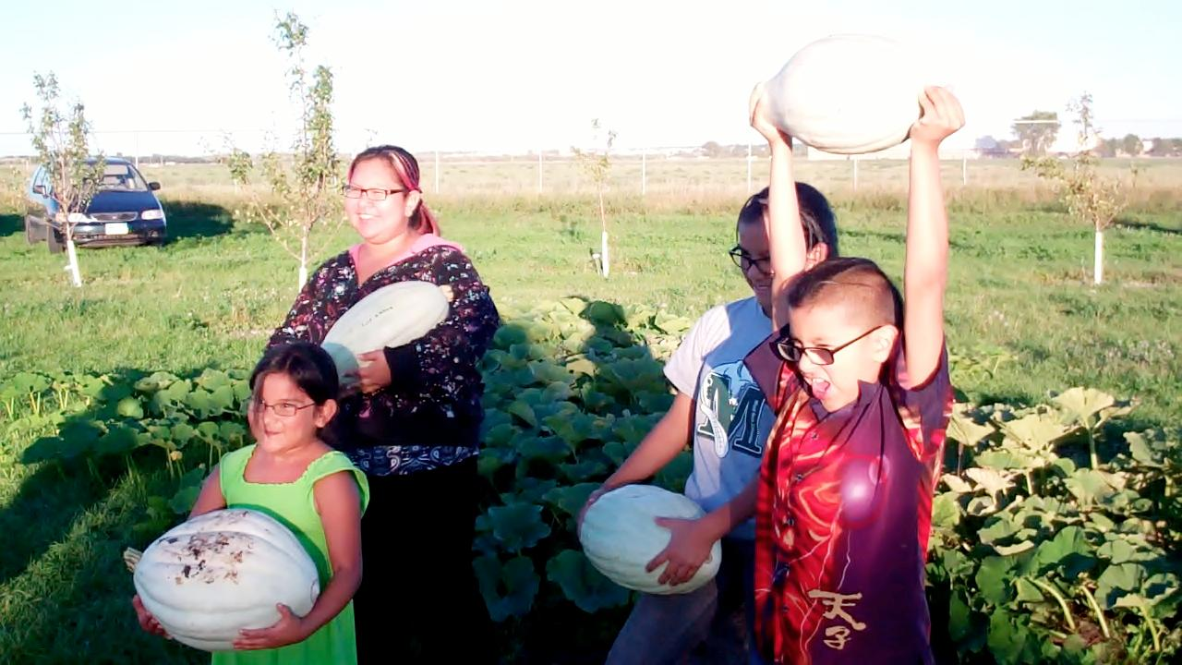
Thank You!

