Slide 1
From Waste Stream To Protein!
Closed Loop Mushroom Production on 100% Waste Stream Substrate

Slide 3
OBJECTIVES OF THE STUDY
To develop substrate formulations that utilize readily available waste stream products for growing edible mushrooms.
To compare the yields of waste stream substrates to that of the “industry standard” commercial substrate formulation.
To compost spent mushroom bags for use as a nutrient rich fertilizer, thus closing the loop

Slide 4
WHY IS THIS STUDY VALUABLE?
Thousands of pounds of waste stream products are discarded into landfills every day in every city in the world.
Many of these products may be suitable as substrates for growing edible and medicinal mushrooms.
This study will determine the feasibility of using these substrates in commercial mushroom production.

Slide 5
Meet Pleurotis ostreatus The tree oyster!

Slide 6
The Industry Standard Formulation (20 % enriched)
40 lbs of compressed hardwood fuel pellets (the lignin source)
8 lbs of Bran (the Nitrogen source)
1.5 lbs of Gypsum (provides sulfur, which fungi require for growth)
7 gallons of water (hydrate to carrying capacity)

Slide 7
Advantages of Using This Formulation
Convenient, tried and true!
Pellets are semi-pasteurized by extrusion process.
High Yield.
Easy to get hydration just right (almost) every time.
Ingredients readily available most of the year.

Slide 8
Disadvantages of Using This Formulation
You must buy the ingredients.
You must pay shipping costs if delivered.
Certain ingredients may be unavailable in certain geographic locations or at certain times of the year.
Depending on sourcing, certain ingredients may not be environmentally friendly.

Slide 9
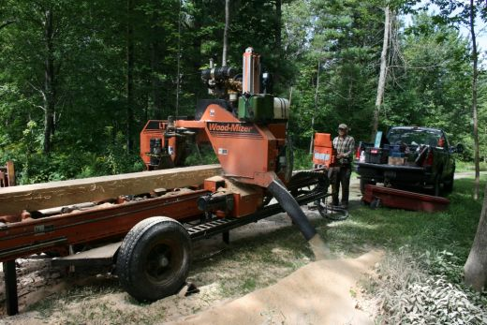
WS Partner Number One: Bee Tree Sawmill
Bee Tree Provided the Carbon and Lignin Source In The Form Of Mixed Sawdust. The Sawdust Came From Numerous Species.
How is this different from hardwood fuel pellets?

Slide 10
Waste Substrate Partner Number Two: Spent Coffee Grounds from Clingman Cafe
Spent coffee grounds are high in nitrogen and replace
The bran in the mix.
How is it different from the bran?

Slide 11
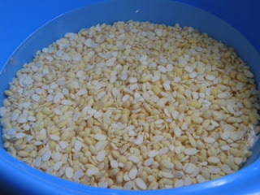
WS Partner Number Three: Soy husks and Dust from Smiling Hara Tempeh Co.
The soy waste product is high in nitrogen and replaces the bran in the mix.
How is it different from the bran?

Slide 12
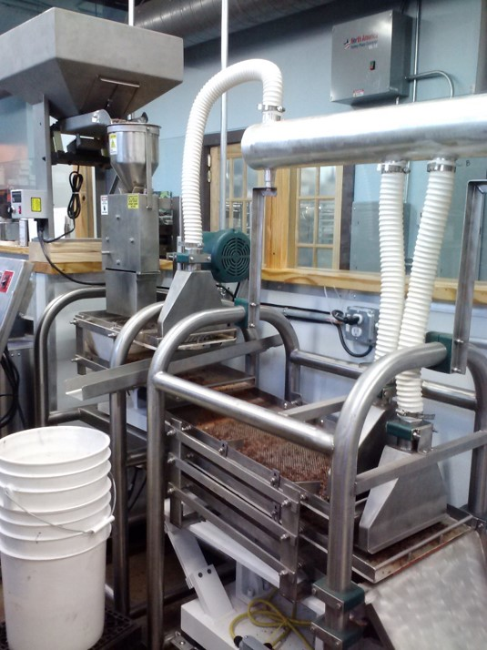
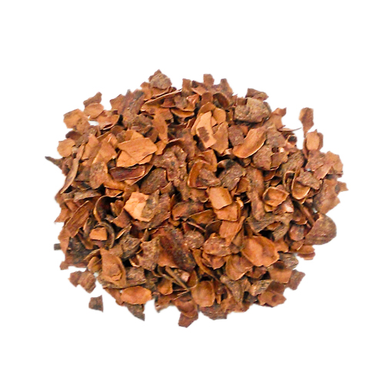
WS Partner Number Four: Cacao Shells From French Broad Chocolate Factory.
Cacao Shells are high in nitrogen and are a waste product of the chocolate making process. They replace the bran in the mix.
How are Cacao Shells different from bran?

Slide 13
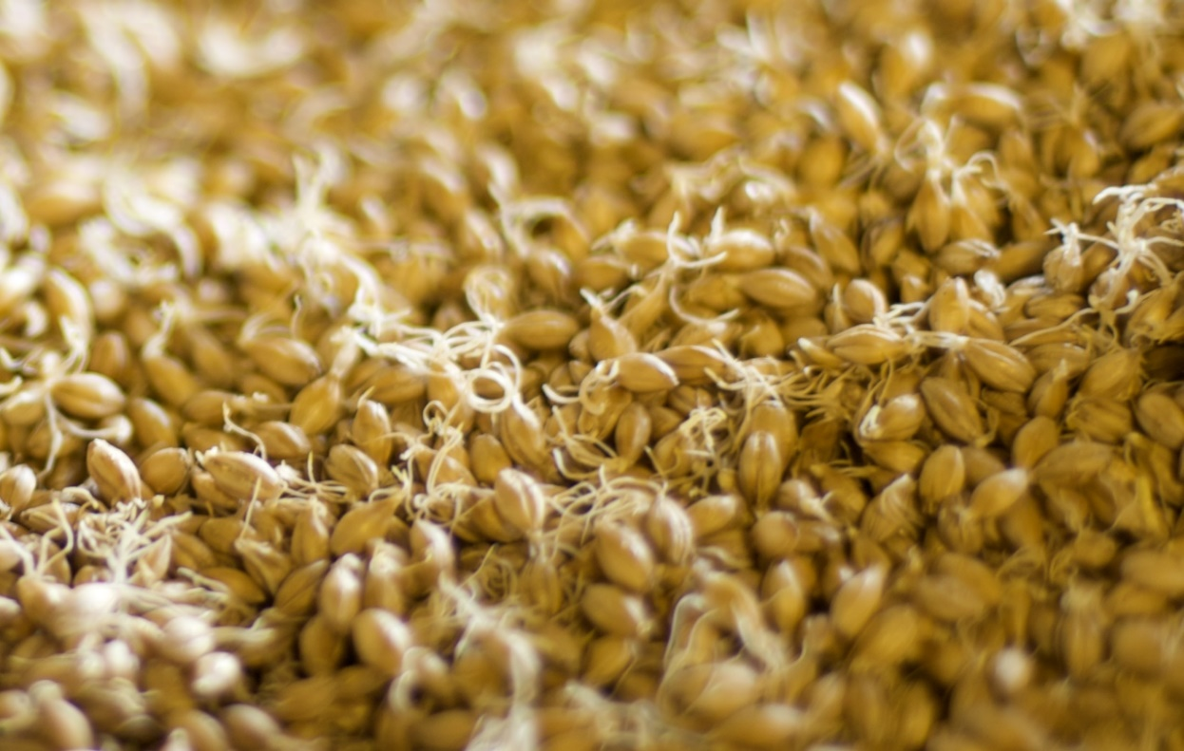
WS Partner Number Five: “Fines and Beards” from River Bend Malt House
Fines and beards are a waste product of the malting of grain. They replace the bran as an enriching agent and nitrogen source.
How is it different from bran

Slide 14
RECIPES, RECIPES, RECIPES, RECIPES, RECIPES
The sawdust from Bee Tree was used in all WS recipes as a lignin source
Recipe one uses spent coffee grounds in place of bran.
Recipe two uses soy dust and husks in place of bran.
Recipe three uses cacao shells in place of bran.
Recipe four uses fines and beards in place of bran.
All recipes are enriched to approximately twenty percent by weight.

Slide 15
Hydrating and Mixing the Substrate

Slide 16
Bagging, Sterilizing, Inoculating and Sealing.

Slide 17
Experimental Controls
Harvest period- 90 days for all substrate formulations.
Hydrated bag weight- 5 pounds for all substrate formulations.
Sterilization- active steam for 8 hours for all substrate formulations.
Spawn Rate- 250 ml spawn per bag for all substrate formulations.

Slide 18
The Spawn Run on Spent Coffee Grounds

Slide 19
The Spawn Run On Cacao Shells

Slide 20
The Spawn Run on Soy Dust

Slide 21
Fruiting on Coffee Grounds

Slide 22
Fruiting on Soy Dust

Slide 23
Fruiting on Cacao Shells

Slide 24
Fines and Beards: 100 % Contamination

Slide 25
Results: Standard Mix (Control)
Harvest Period- May 30th to Aug 30th (90 Days)
Average weight harvested per bag- 2.15 pounds
Biological Efficiency (wet weight)- 43%
Biological Efficiency (dry weight)- 107%

Slide 26
Results- Spent Coffee Grounds
Harvest Period- May 31st to August 31st (90 Days)
Average weight harvested per bag- .81 pounds
Biological Effeciency (wet weight)- 16.2 %
Biological Efficiency (dry weight, estimated) 40.5 %

Slide 27
Results- Soy Dust and Husk
Harvest Period- August 7th to November 7th (90 Days)
Average weight harvested per bag- .89 pounds
Biological Effeciency (wet weight)- 17.8 %
Biological Efficiency (dry weight, estimated)- 44.5 %

Slide 28
Results- Cacao Shells
Harvest Period- August 30 to November 30 (90 Days)
Average weight harvested per bag- 1.32 pounds
Biological Efficiency (wet weight)- 26.4 %
Biological Efficiency (dry weight, estimated) 66 %

Slide 29
Graphical Data Interpretation

Slide 30
Production Difficulties Associated With WS
Getting the Moisture Correct: Unlike the commercial formulation, waste substrates vary greatly in moisture content, meaning you have to spend more time mixing to get the moisture to carrying capacity.
Little control over sawdust species and initial moisture content
Contamination: Wood pellets are semi-pasturized on arrival because of the extrusion process. Not so with waste subsrates. Overall, WS seemed more prone to contamination issues.
Spawn run and fruiting time: In general, the spawn run and fruiting took longer for WS than for the commercial formulation.

Slide 31
Experimental Design Flaws
Control of the fruiting environment (time of year).
Control of the fruiting environment (location in grow room).
Difficulty in calculating WS dry weight.

Slide 32
Cost Analysis
Although only about a third as productive on average, waste substrates have one major advantage….
THEY ARE FREE!
Aside from the cost associated with picking them up.
Important that they are sourced in close proximity to the grower.
Typically available year round
Great for growers on a tight budget

Slide 33
COST ANALYSIS (ACTUAL NUMBERS)
Cost to run 50 bags of commercial formulation: $110.00
Cost to run 50 bags of WS: $30-$45

Slide 34
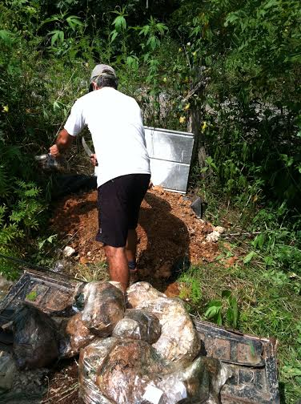
Composting of Spent Bags is Easy!

Slide 35
Soil Test Analysis

Slide 36
THANKS TO OUR COLLABORATORS

