Slide 1
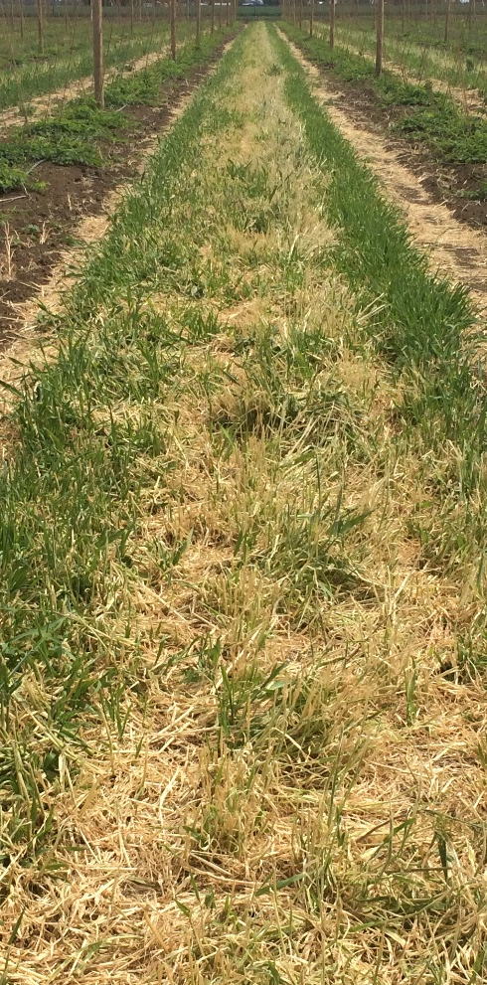
Cover Crops for Hop Production in Semi-arid Climates
Sarah K. Del Moro¹, Jeff T. Barnes¹, Joan R. Davenport²
¹John I. Haas Inc. and ²Washington State University-Prosser Irrigated Agricultural Research & Extension Center (IAREC)
Dust produced from dry, tilled hop (Humulus lupulus L.) yard interrows erodes topsoil, reduces air quality, and intensifies pressure from a severe hop pest, the twospotted spider mite (Tetranychus urticae). Cover crops currently used in hop yards either require additional irrigation of interrows, annual seeding, provide limited dust and weed control, or risk becoming weeds themselves.
Drought-tolerant cover crops may be an efficient alternative to tilled, bare interrows to suppress weeds and dust without additional management or irrigation. Investigations of drought-tolerant, non-irrigated cover crop species have been limited for hop production.
Objective
The objective of this study was to investigate the propensity of several drought tolerant cover crop species to conserve soil and compete with weeds in hop yards of the semi-arid Yakima Valley.
Treatments
Cover Crop Ground Cover and Growth
Barley averaged up to 95% ground cover by Jul. 17, 2015; growth stopped after last mow event on Jun. 30, 2015
Alfalfa resulted in least spring ground cover relative to weeds
Alfalfa and grass cover crop species, especially streambank wheatgrass, resulted in accelerated growth after mowing events
Financial support for this research was provided by the Western Sustainable Agriculture Research and Education (SARE) program.
Introduction
Results
 | Average Crop Height ------------------------------ cm ------------------------------ |  |  |  |  | Average Ground Cover† ------------------------------ % ------------------------------
Date | Alfalfa | Fescue | Siberian WG | Streambank WG | Barley | Alfalfa | Fescue | Siberian WG | Streambank WG | Barley
10 Nov. 2014 | 1 | 2 | 3 | 3 | 5 | <1 | <1 | <1 | <1 | 2
20 Apr. 2015 | 0 | 8 | 14 | 5 | 44 | 0 | 6 | 23 | 3 | 82
17 Jun. 2015 | 22 | 15 | 48 | 24 | 44 | 6 | 23 | 60 | 28 | 95
24 Jun. 2015 | 31 | 18 | 57 | 24 | 44 | 8 | 18 | 65 | 35 | 93
1 Jul. 2015‡ | 15 | 15 | 15 | 15 | 15 | 10 | 15 | 65 | 35 | 88
9 Jul. 2015 | 33 | 27 | 29 | 34 | 16 | 20 | 33 | 63 | 53 | 90
15 Jul. 2015 | 33 | 27 | 29 | 38 | 16 | 8 | 18 | 63 | 38 | 83
Materials and Methods
Above Average alfalfa, hard fescue (fescue), Siberian wheatgrass (WG), streambank WG and barley crop height and percent ground cover as measured from Nov. 10, 2014 to July 15, 2015
† Average percent ground cover reductions from previous week due to increased weed competition
‡ Cover crops were mowed on Jun. 30, 2015 to a height of approximately 15 cm
Crop Species | Cultivar | Minimum Precipitation | Seed Density | Seeding Rate Used | Approximate Cost | Characteristics
 |  | (cm) | (seeds kg⁻¹) | (kg ha⁻¹) | (USD kg⁻¹)
Falcata alfalfa Medicago sativa subsp. falcata L. | ‘Don’ | 30 | 880,000 | 5 | 3.50 | Perennial Legume
Hard fescue Festuca brevipila | ‘Henry’ | 36 | 254,000 | 11 | 1.13 | Perennial Bunchgrass
Siberian wheatgrass Agropyron fragile | ‘Vavilov II’ | 20 | 72,480 | 9 | 1.50 | Perennial Bunchgrass
Streambank wheatgrass Elymus lanceolatus subsp. lanceolatus | ‘Sodar’ | 20 | 61,155 | 11 | 3.20 | Perennial Sod-forming grass
Barley Hordeum vulgare L. | ‘Alba’ | 20 | 6,342 | 110 | 0.30 | Annual Grain
mow
Above Average weed and cover crop fraction, displayed as a percentage, of overall vegetative ground cover between Jun. 15 and Jul. 15, 2015
Above Average weekly cover crop plant growth progression before and after mowing on Jun. 31, 2015
Above Details of cover crop treatments tested in this study, including: species, cultivar, minimum required precipitation, seed density, rate, cost and characteristics
Conclusions
a)
b)
Field Site and Experimental Design
Planted between Oct 21 and Oct 30, 2014
Double recommended seeding rate, drilled in plowed interrows in 7-cm rows
Uniform soil type, 14 ha field, average pH: 7.9, drip-irrigated, mixed-cultivar hop rows
Four replications; randomized complete block design including unplanted control
Mowed cover crops three times and disced controls
Cover crops evaluated in this study provided significant hop interrow ground cover and weed suppression compared to unplanted tilled and no-till interrows, without additional irrigation or management expense
Double or triple seeding rate and earliest fall planting recommended for best spring establishment
Early season weed control most important for hops
Cover crops will be evaluated for additional 2 to 3 years
Unplanted, no-till
Barley
Above Weeds in unplanted, no-till control interrow (left), and barley cover cropped interrow (right), taken in June, 2015
c)
d)
Cover Crop Measurements
Monthly from Mar 2015, weekly from June 2015 to present
Soil conservation potential determined by:
Fraction ground covered by crop (%)
Cover crop height (cm)
Weed suppression potential determined by:
Ratio of ground covered by (%) and height of (cm) cover crop vs. weeds
Acknowledgements
Above Hop interrows of (a) unplanted control in Mar 2015, (b) barley in Mar 2015, (c) mowed barley in May 2015, and (d) regrown barley in June 2015

