Slide 1


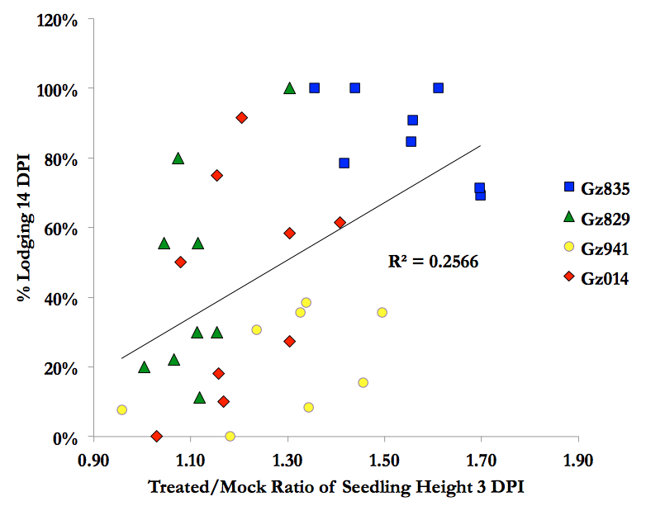
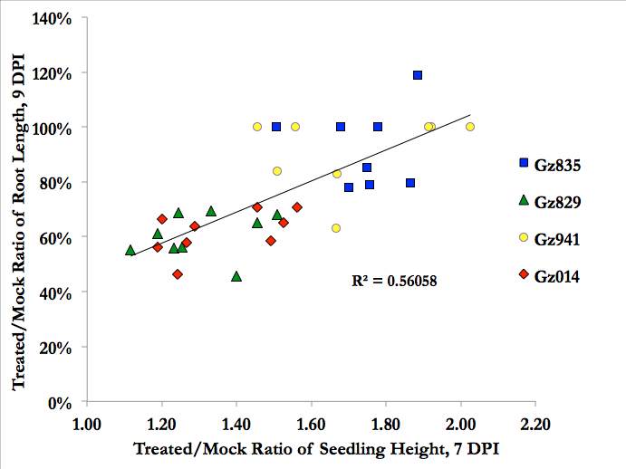
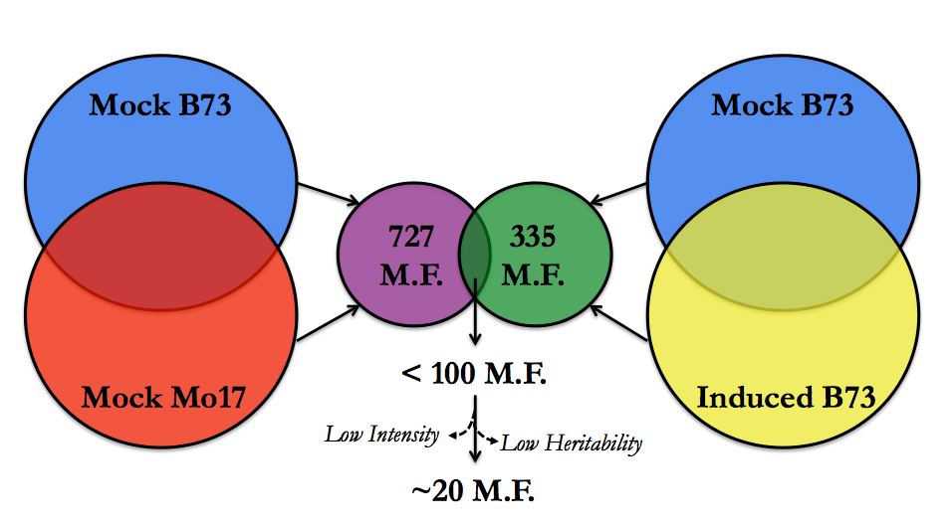
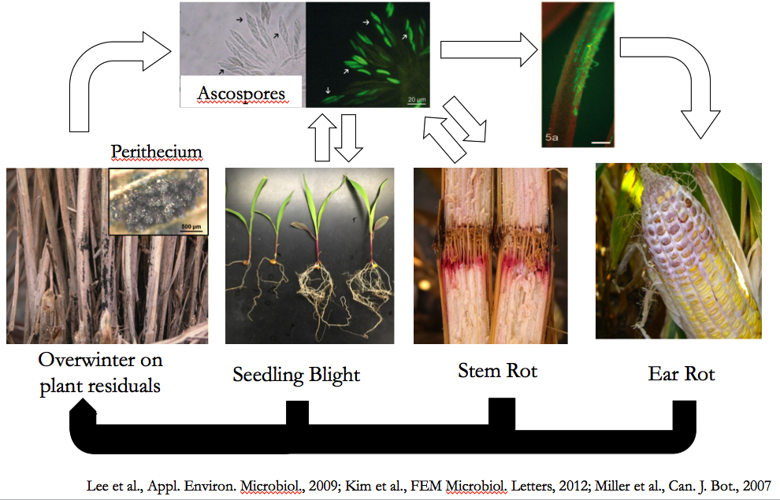
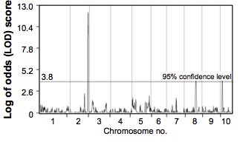
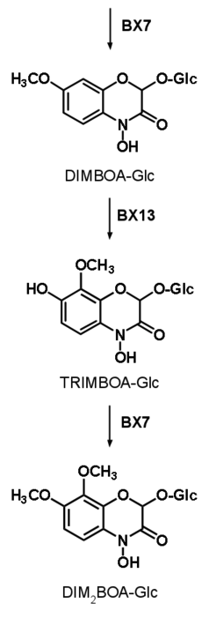
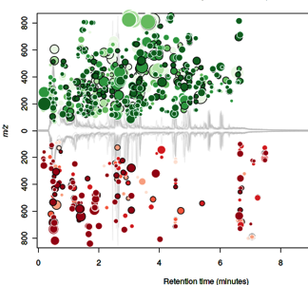
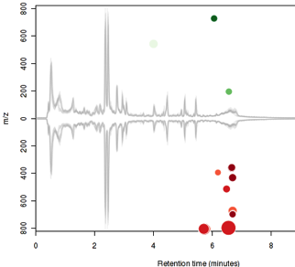
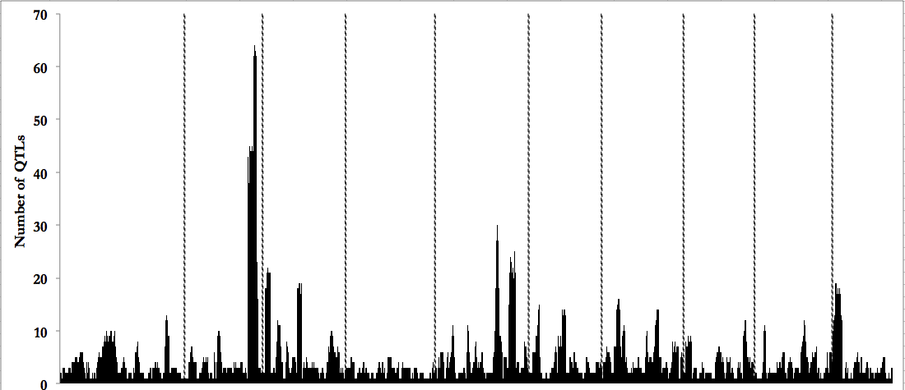
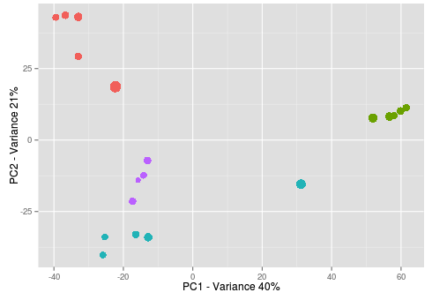
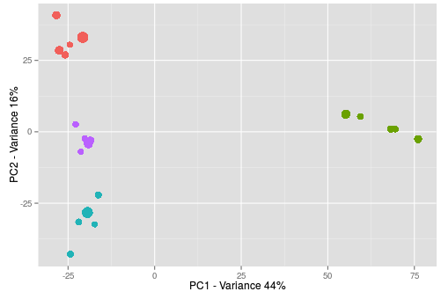

Natural Variation in Fusarium graminearum Induced Changes in Maize Seedlings
Shaoqun Zhou^{1,2}, Meena Haribal², Gary Bergstrom¹, and Georg Jander²
¹School of Integrative Plant Sciences, Cornell University, Ithaca, NY
²Boyce Thompson Institute for Plant Research, Ithaca, NY
Introduction
Fusarium graminearum is one of the most destructive and widespread fungal pathogens attacking small grain crops. In maize, it is a major concern for contaminating kernels with mycotoxins, as well as infecting stems (Gibberella stem rot) and seedlings (Gibberella seedling blight). Previous genetic mapping efforts for resistance in maize have identified a large number of environment-dependent quantitative trait loci (QTL) with small effect size. In this project, we focus on a less studied developmental stage (V3 seedlings) and tissue type (roots) in maize-F. graminearum interaction studies, use better defined and quantitative traits, and perform artificial inoculation experiment with diverse maize and fungal genotypes in controlled growth chambers. We evaluate the natural variation in morphological changes induced by F. graminearum root infection, and take a comparative approach to identify potential biochemical component of resistance. These studies provide data for future genetic mapping of resistance against F. graminearum in maize seedlings.
Fusarium-Induced Shoot Elongation Correlates with Seedling Lodging Rate and Root Reduction
Natural Variation in Fusarium-Induced Morphological Changes
          Error bars = standard errors
Metabolic Profiles Constitutive and Fusarium-Infected Roots Differ Among Maize Inbred Lines
Each circle represents a significantly changed mass fragment comparing roots inoculated with strain Gz014 spores and mock inoculum. Color of circles: up (green) or down (red) regulation upon fungal infection; intensity of color: p value calculated from one-way ANOVA; size of circles: fold change.
DIM₂BOA is significantly different between constitutive B73 and Mo17 roots, and is significantly changed in B73 roots upon F. graminearum inoculation.
QTL mapping of constitutive DIM₂BOA content in seedling roots identifies a novel benzoxazinoid biosynthetic gene.
QTL mapping of metabolites with contrasting constitutive content in B73 and Mo17 roots identifies a few genomic hotspots simultaneous regulating multiple metabolites.
Future Perspectives
Purify and identify putative F. graminearum resistance-related compounds, and test for in vitro effect on fungal growth.
Combine QTL mapping results with a transcriptomics study to identify candidate genes and validate with near isogeneic lines, transposon insertion lines, and/or heterologous expression.
R² = 0.2556
R² = 0.5606
DIMBOA-Glc
TRIMBOA-Glc
Goals
Explore the natural variation in F. graminearum induced plant morphological changes using diverse plant and fungal genotypes, and test for correlation between these changes.
Compare metabolic profiles of maize genotypes showing contrasting morphological changes in response to F. graminearum infection to identify potential biochemical components of fungal resistance.
Investigate the genetic control of F. graminearum-induced morphological changes and dynamics of potentially resistance-related compounds.
DIM₂BOA-Glc
Handrick et al., Submitted
B73
Mo17
m/z
m/z
70
60
50
40
30
20
10
0
Fusarium Reduces Roots and Elongates Shoots of Maize Seedlings
Seedlings inoculated with F. graminearum spore suspension (4.5x10⁵/mL) when primary roots reached ~9 cm. Pictures taken 6 days post inoculation.
B73
B73
Retention Time/min
Retention Time/min
Number of QTLs
NC358
Mo17
Mo17
1 2 3 4 5 6 7 8 9 10
Chromosome no.
B73
NC350
B73
PC2 – Variance 21%
PC2 – Variance 16%
NC350
Mock
Strain Gz014
Mock
Strain Gz014
NC358
NC358
Acknowledgement
Part of this project is funded by Northeast Sustainable Agriculture Research & Education Graduate Student Grant, Project Number GNE14-092. F. graminearum strains used in this project are generous gifts from Dr. Gary Bergstrom. Commercial maize hybrids are kindly provided by Blue River Hybrids Organic Seed. Training for root measurement with RootReader2D platform was provided by Dr. Eric Craft.
PC1 – Variance 40%
PC1 – Variance 44%
Mock (Constitutive)
Gz014 (Induced)

