Slide 1
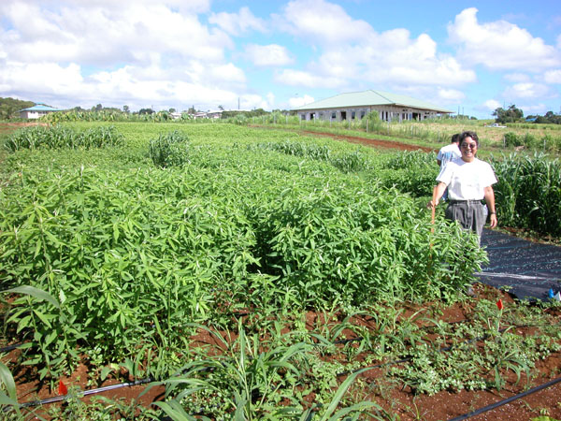
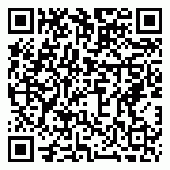


Benefits of Sunn Hemp
Prevents soil erosion
Adds nitrogen to the soil
Increases soil organic matter
Reduces a variety of nematodes
‘Tropic Sun’ is nontoxic to poultry and livestock
For more information contact your county agent
Oahu: 956-7138 Maui: 244-3242
Kauai: 274-3471 Molokai: 567-6929
Big Island: 981-5199
Or visit
www.ctahr.hawaii.edu/
sustainag/cc-gm/sunn-hemp.html
www.youtube.com/
watch?v=AG_CYsVmqN4

Slide 2
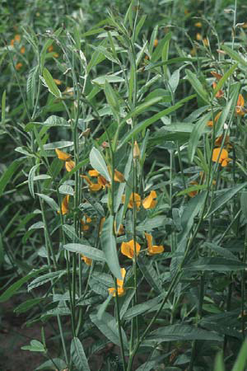
Consider
Sunn Hemp
as a
Cover crop
or
Green Manure
for your farm

