Slide 1
2024 field experiments – Preliminary results:
Influence of cover crop on water use in a maize-soybean rotation system in West Central Nebraska.
4

Slide 2
2024 field experiments - Preliminary Results
2024 Experiment Overview: A quick recap for the committee
Research question:
Can the use of cover crops improve the water use efficiency in soybean regardless of the water regime?
Hypothesis:
The use of cover crops increases the water use efficiency regardless of the water regime.
Objective:
Determine how the water use efficiency of soybean can be affected by cover crop use across water regimes in West Central Nebraska.
5

Slide 3
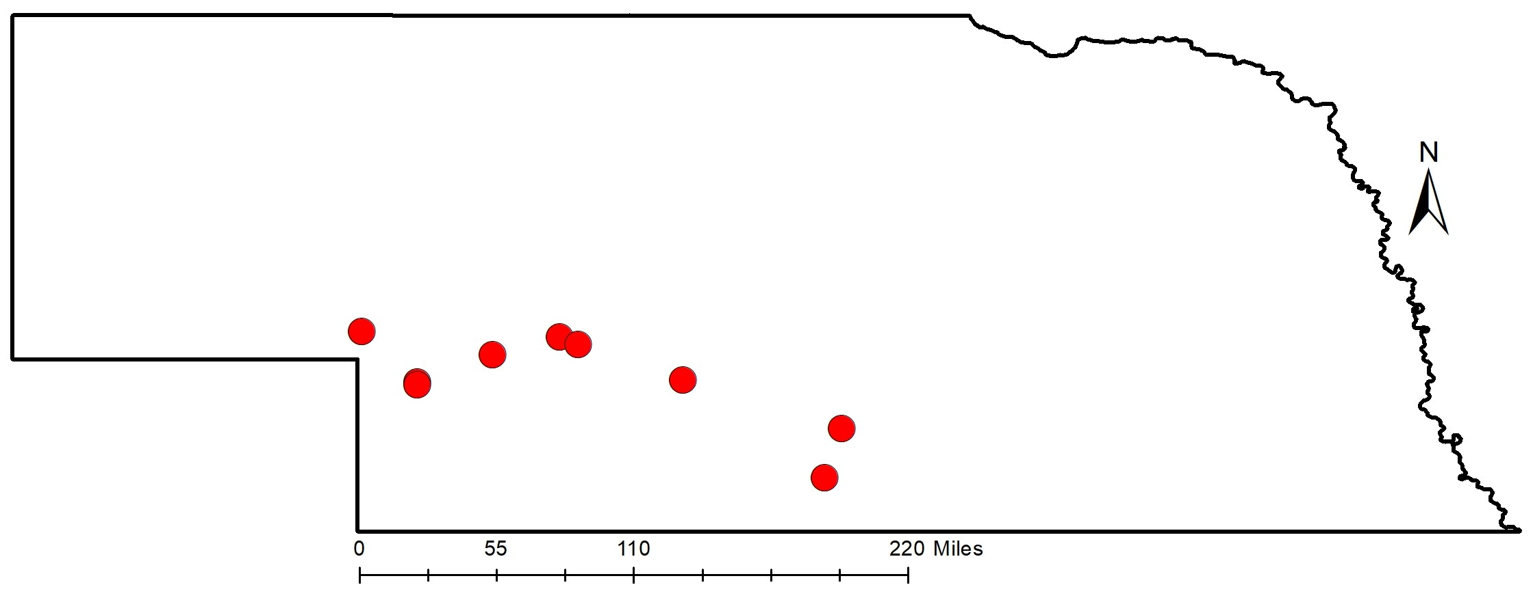
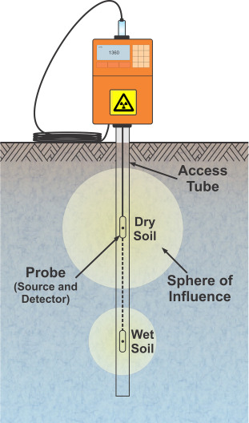
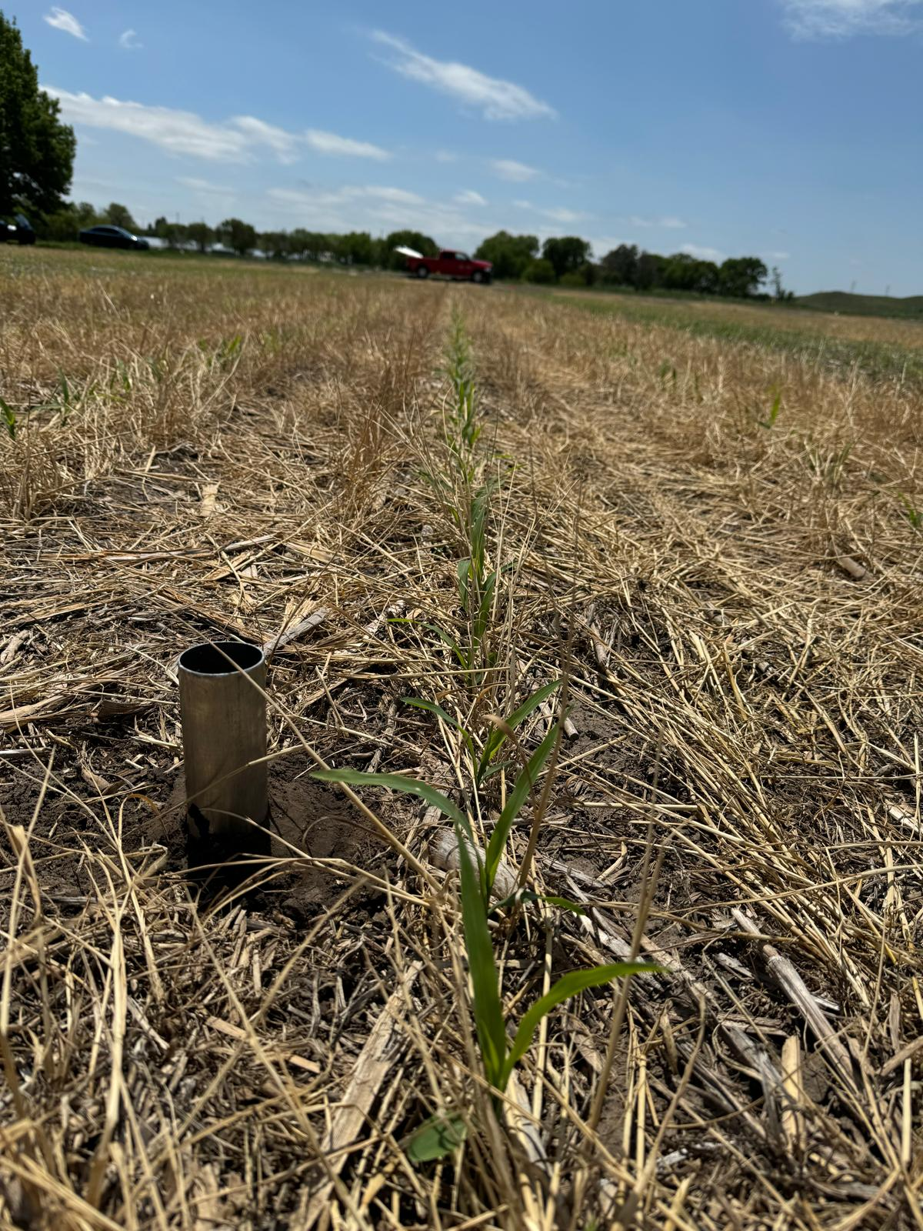
2024 field experiments - Preliminary Results
2024 Experiment Overview: A quick recap for the committee
University research farms in North Platte, Brule, Grant NE, and at Bayer field research in Gothenburg.
Two strips of cover crop with 68 m long x 12.2 m wide and two strips without cover crop with same plot sizes.
Five irrigation treatments with four replications in each location.
In each field, we have 40 Neutron tubes and three data loggers with Watermarks sensors at four depths.
Soybean
Soybean
6

Slide 4
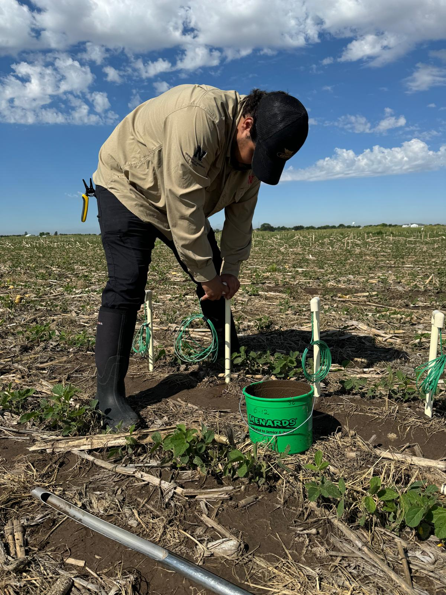
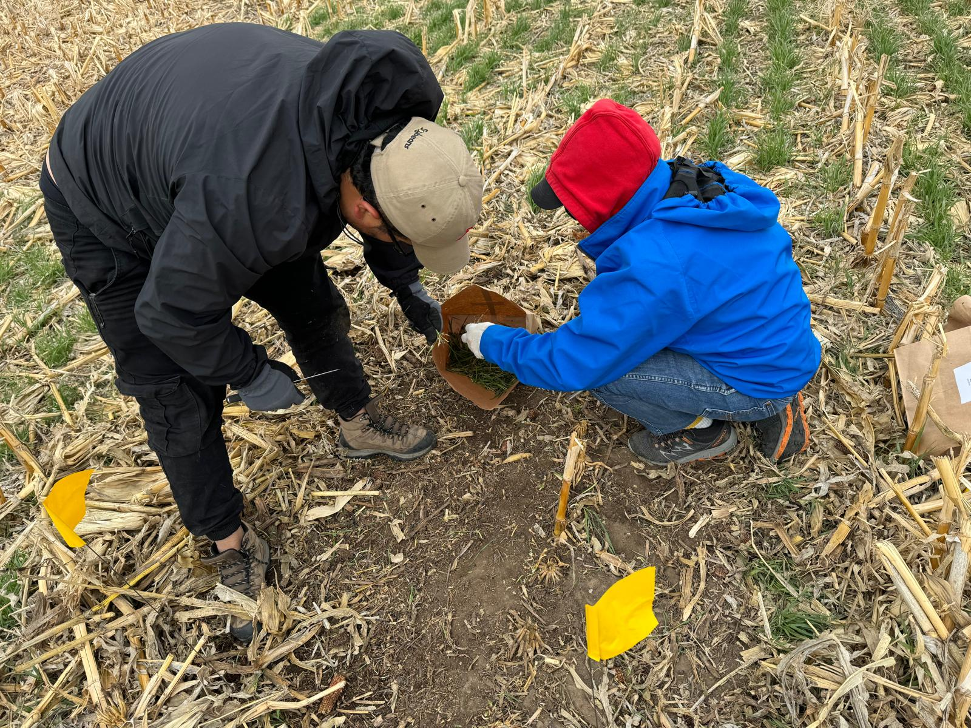
2024 field experiments - Preliminary Results
2024 Experiment Overview
Data collected during the 2024 season:
Cover Crop biomass week before plant.
Biomass colection at V3, R1, R3, R5, and R7, each plot.
Yield at R8.
Neutron Readinds:
  Brule 14 readings
  Grant 14 readings
  North Platte 12 readings
  Gothenburg 5 readings
Arthropod collections five time in the season in foliar + flying and in epigeal traps.
Data analysis in progress
7

Slide 5
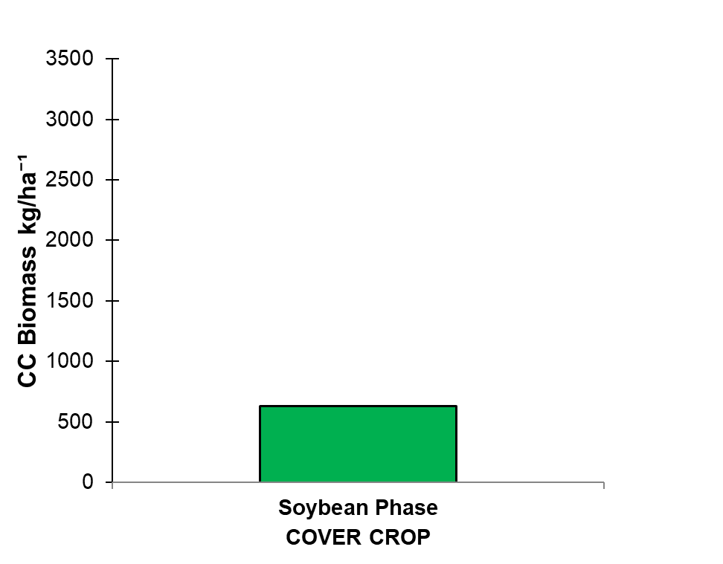
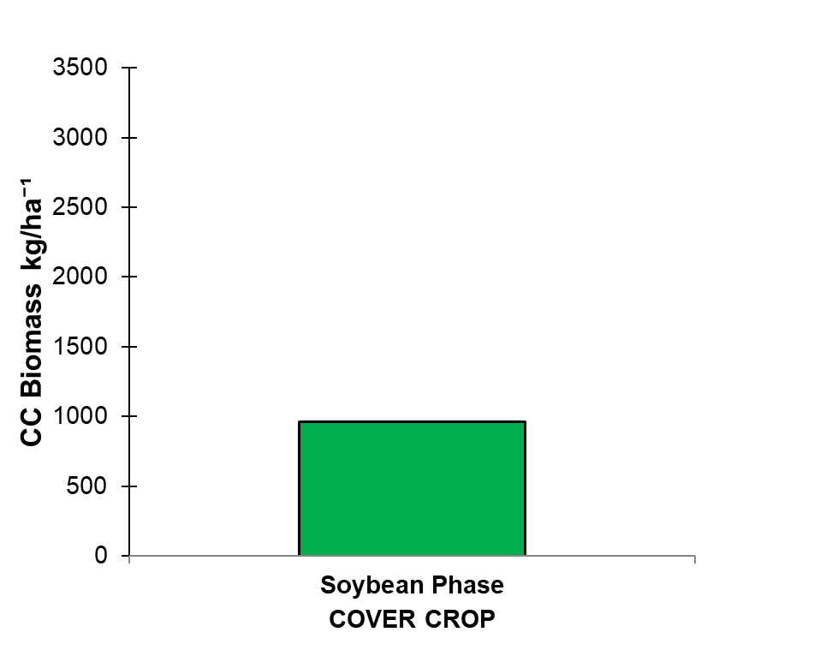
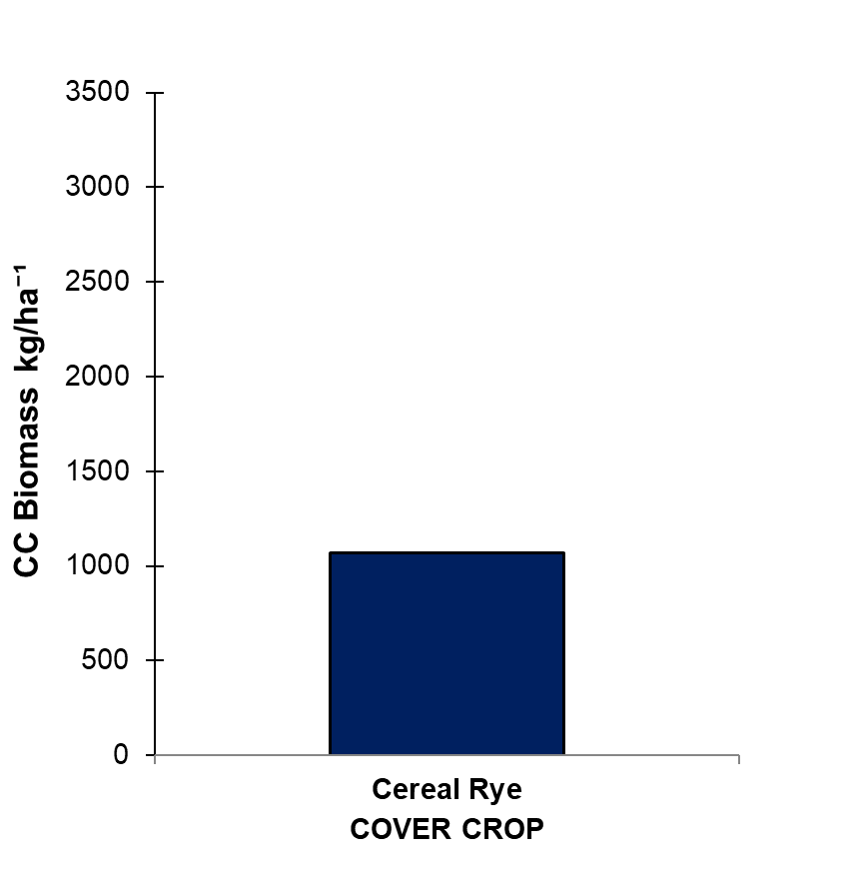
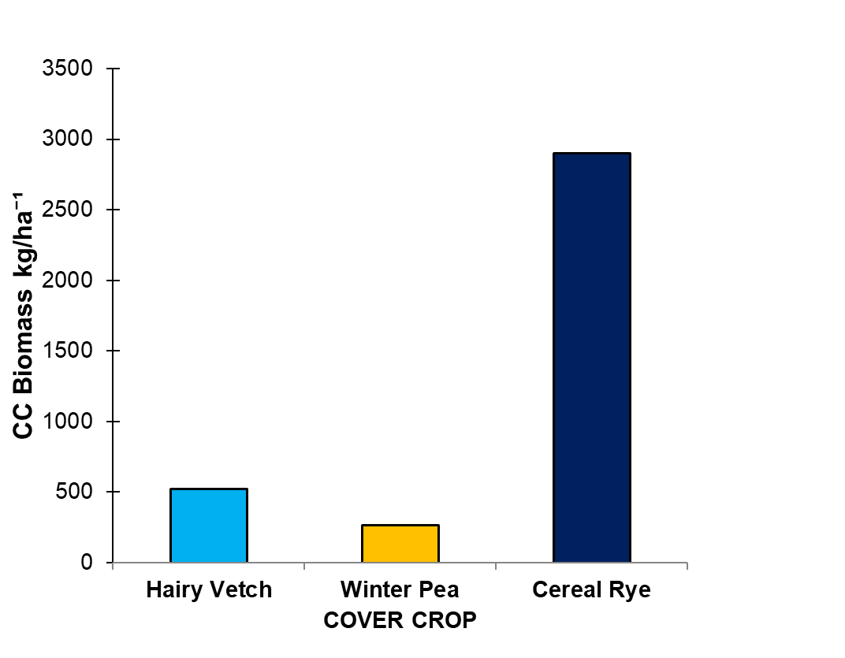
2024 field experiments - Preliminary Results
Preliminary results – Cover crop biomass
Brule
Grant
North Platte
Gothenburg
8

Slide 6
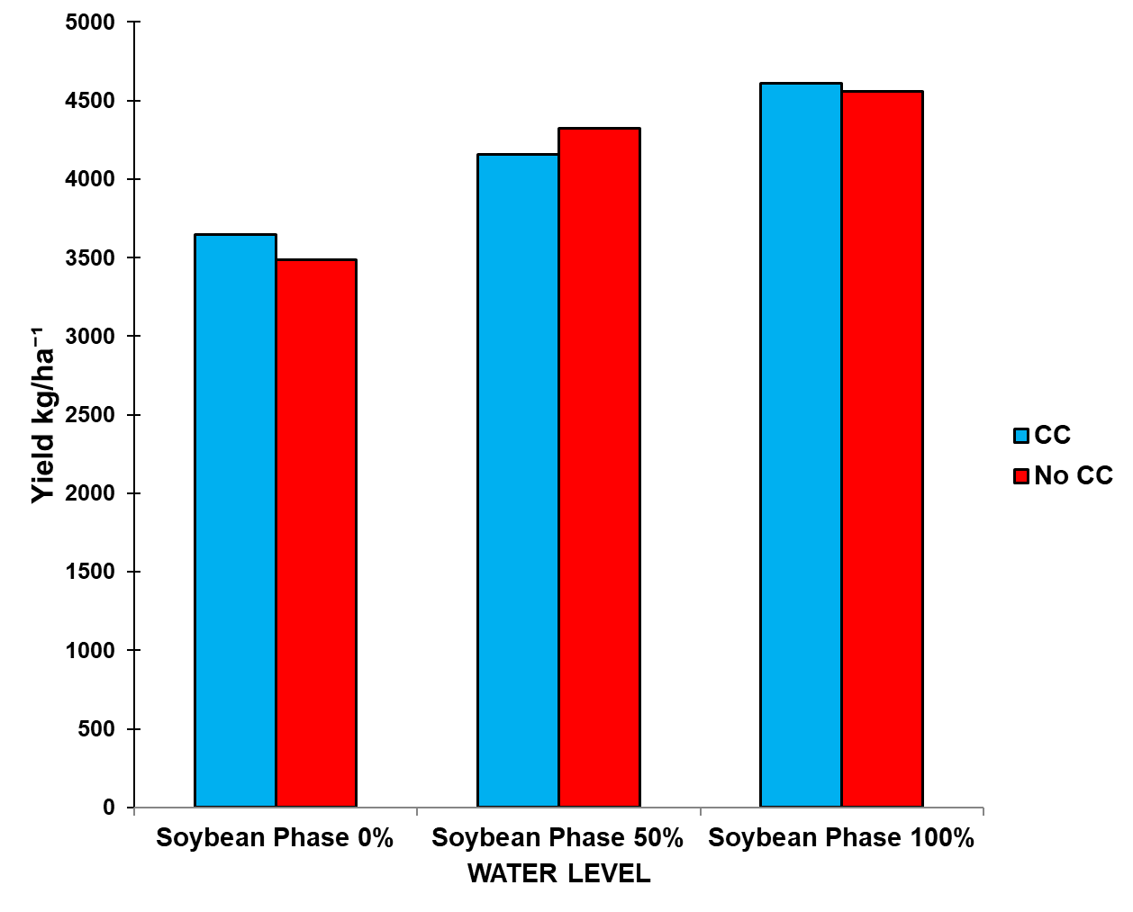
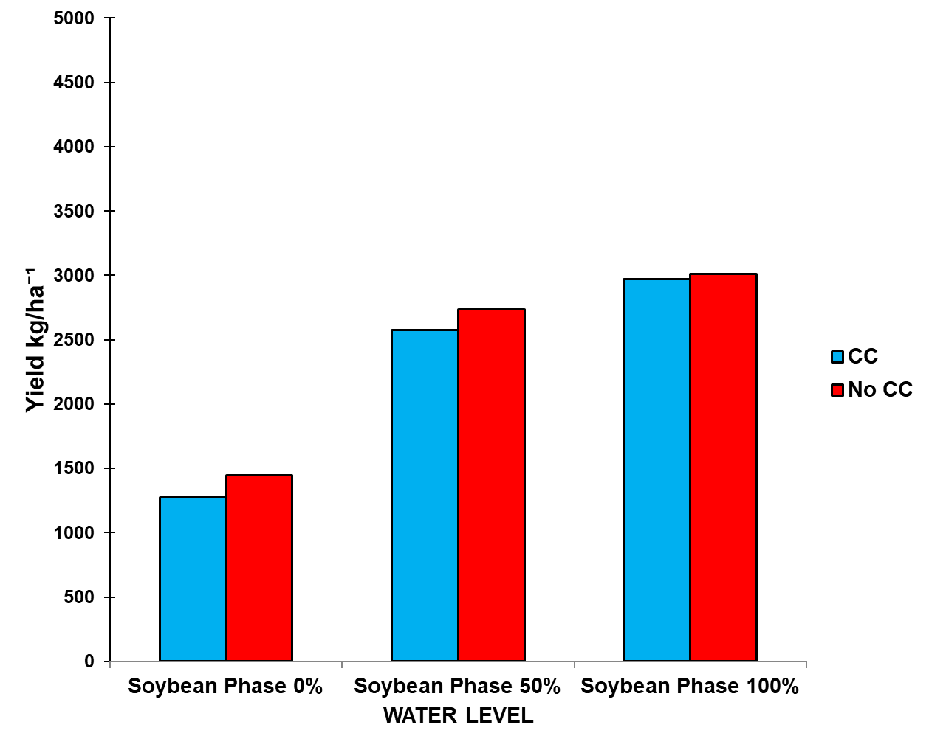
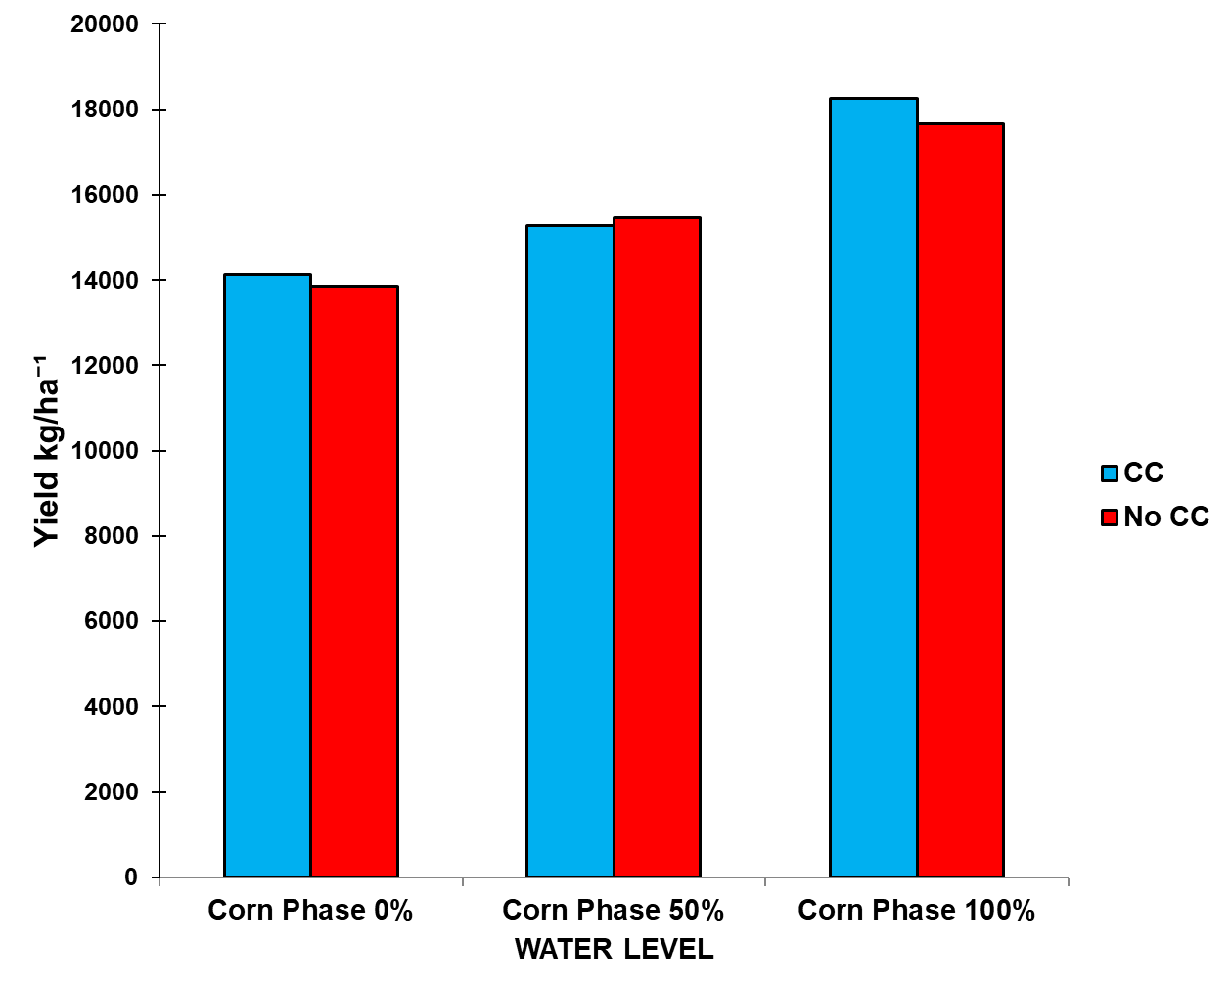
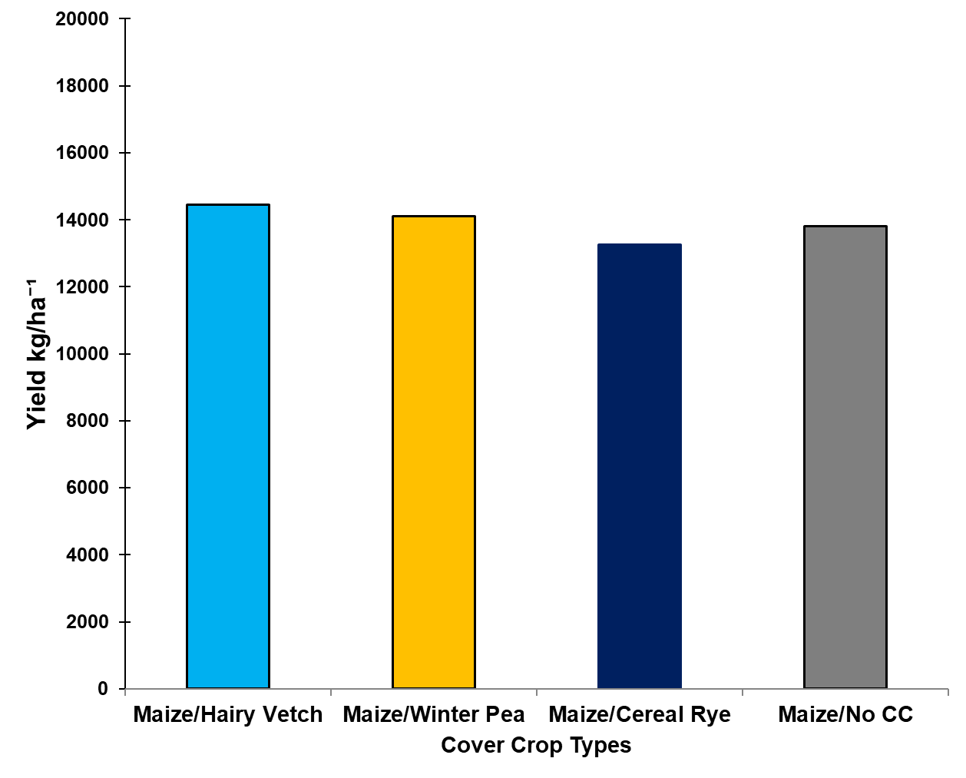
2024 field experiments - Preliminary Results
Preliminary results – Yield average
Brule
Grant
North Platte
Gothenburg
9

Slide 7
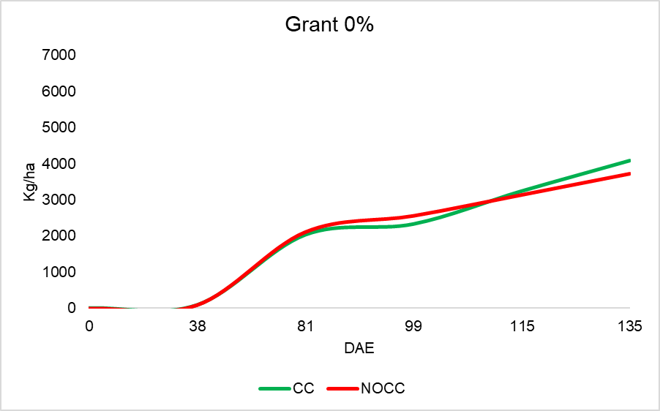
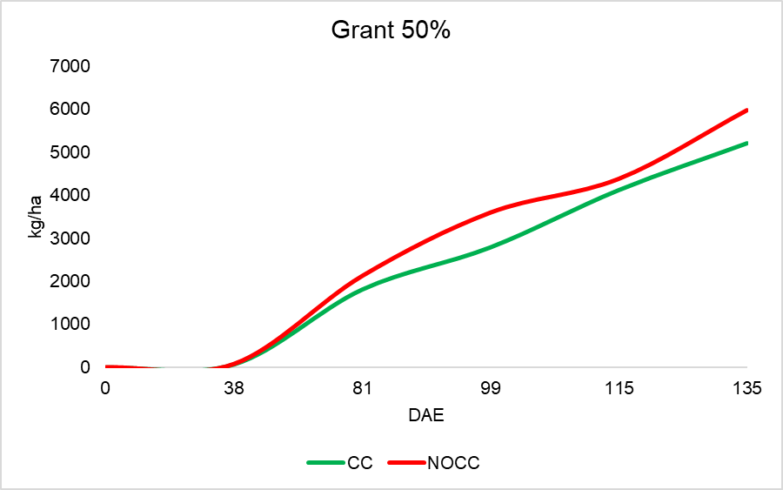
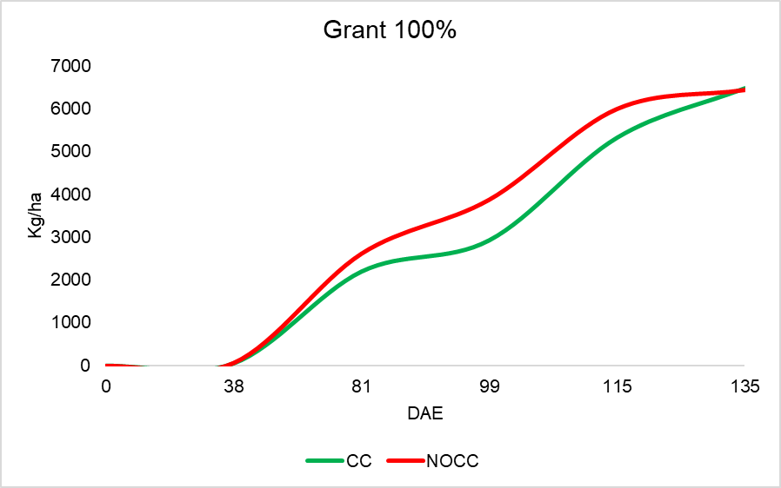
Soybean aboveground biomass at the Grant, NE site with (CC) and without (No-CC) cover crop

Slide 8
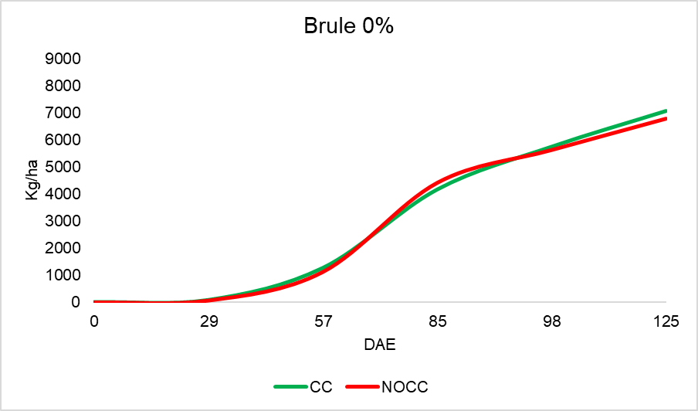
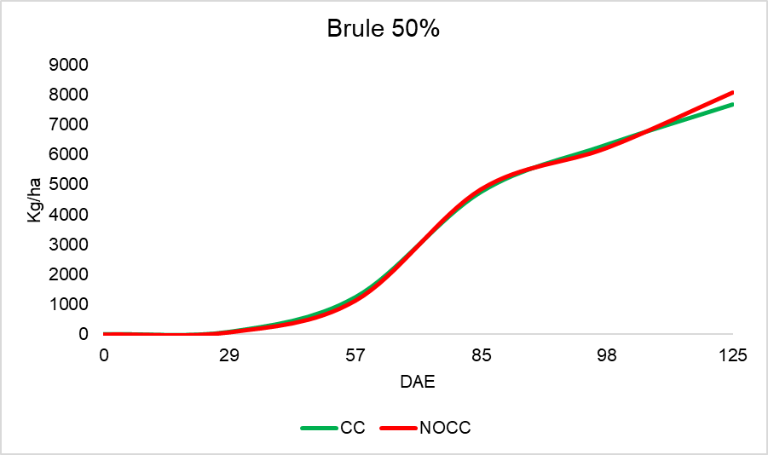
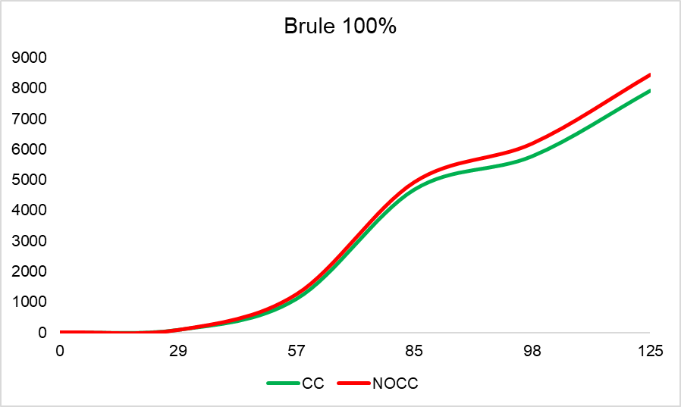
Soybean aboveground biomass at the Brule, NE site with (CC) and without (No-CC) cover crop

Slide 9
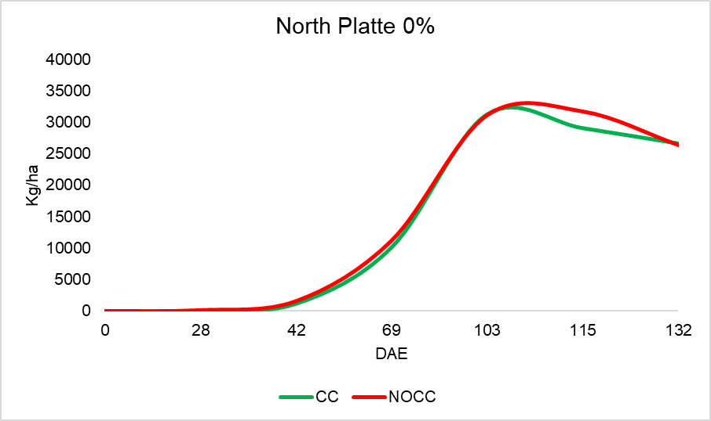
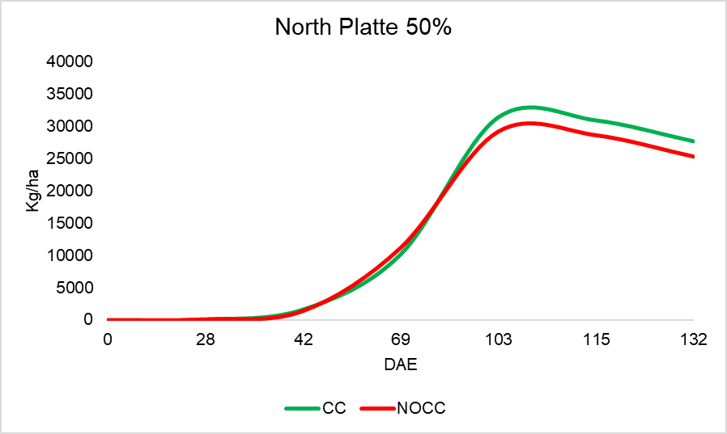
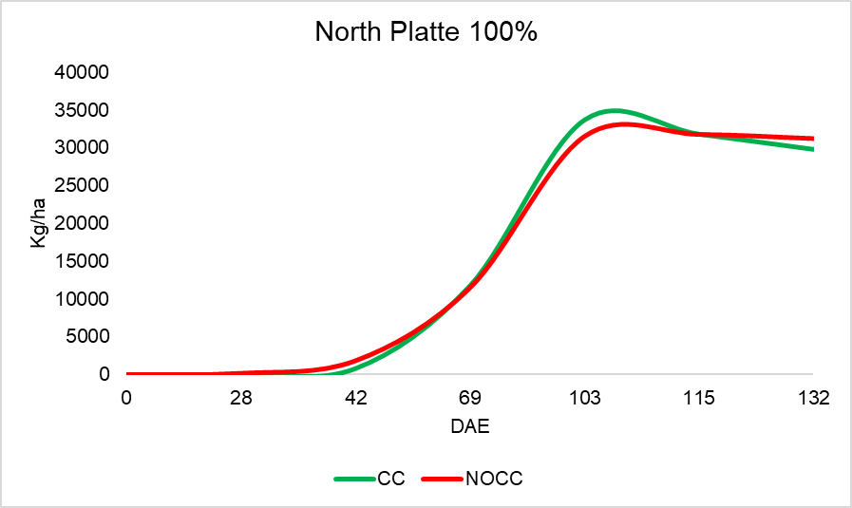
Corn aboveground biomass at the North Platte, NE site with (CC) and without (No-CC) cover crop

Slide 10
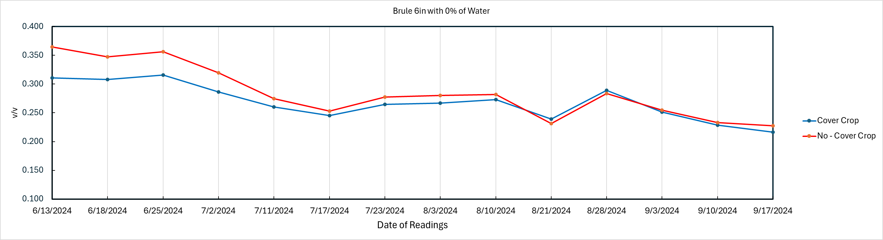
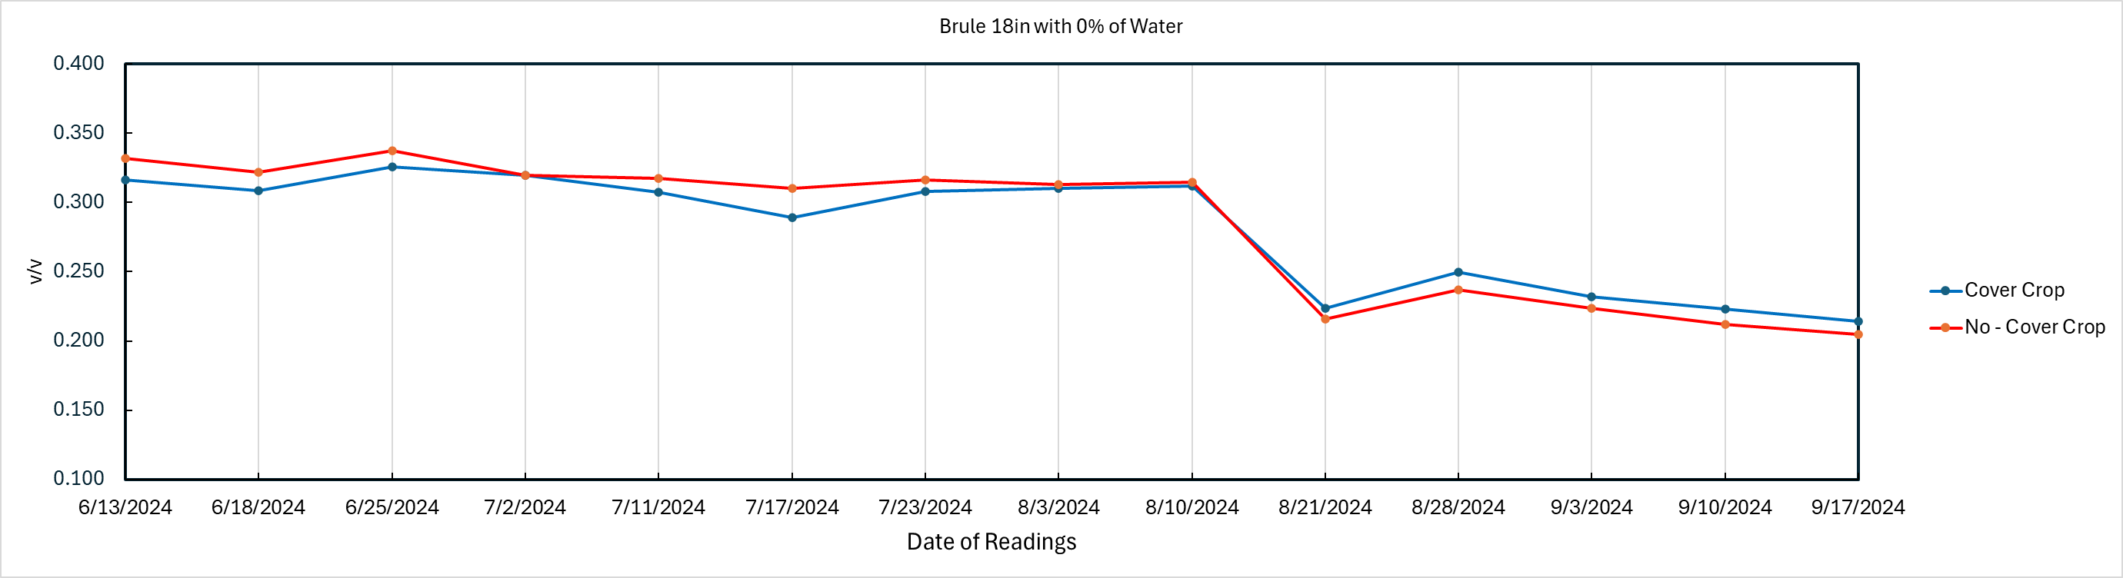

Slide 11
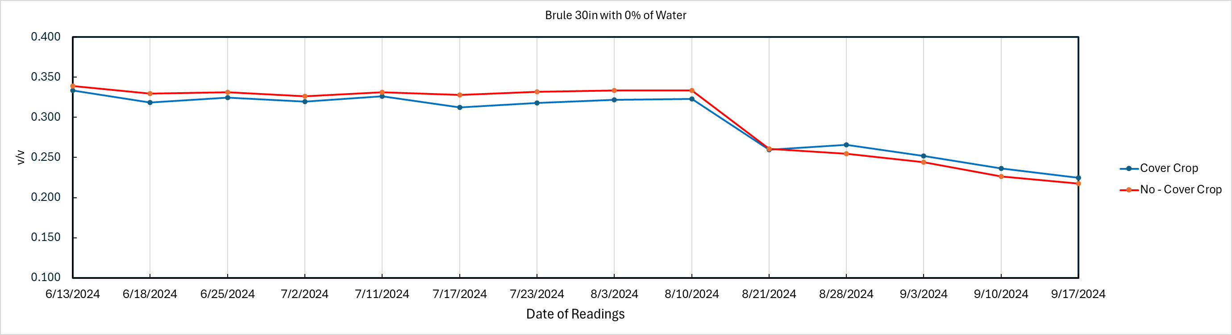
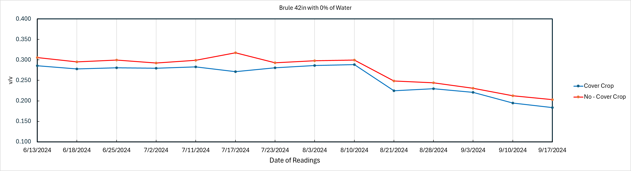

Slide 12
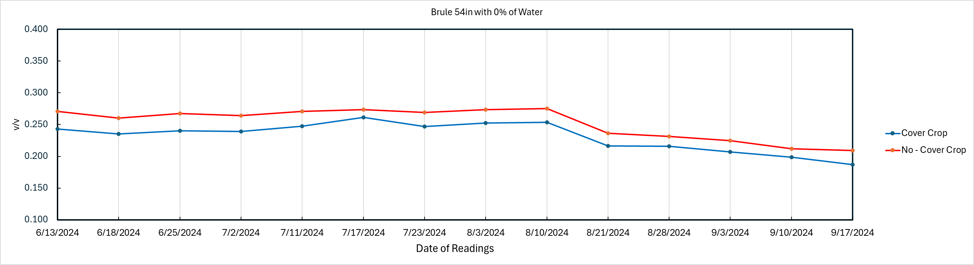
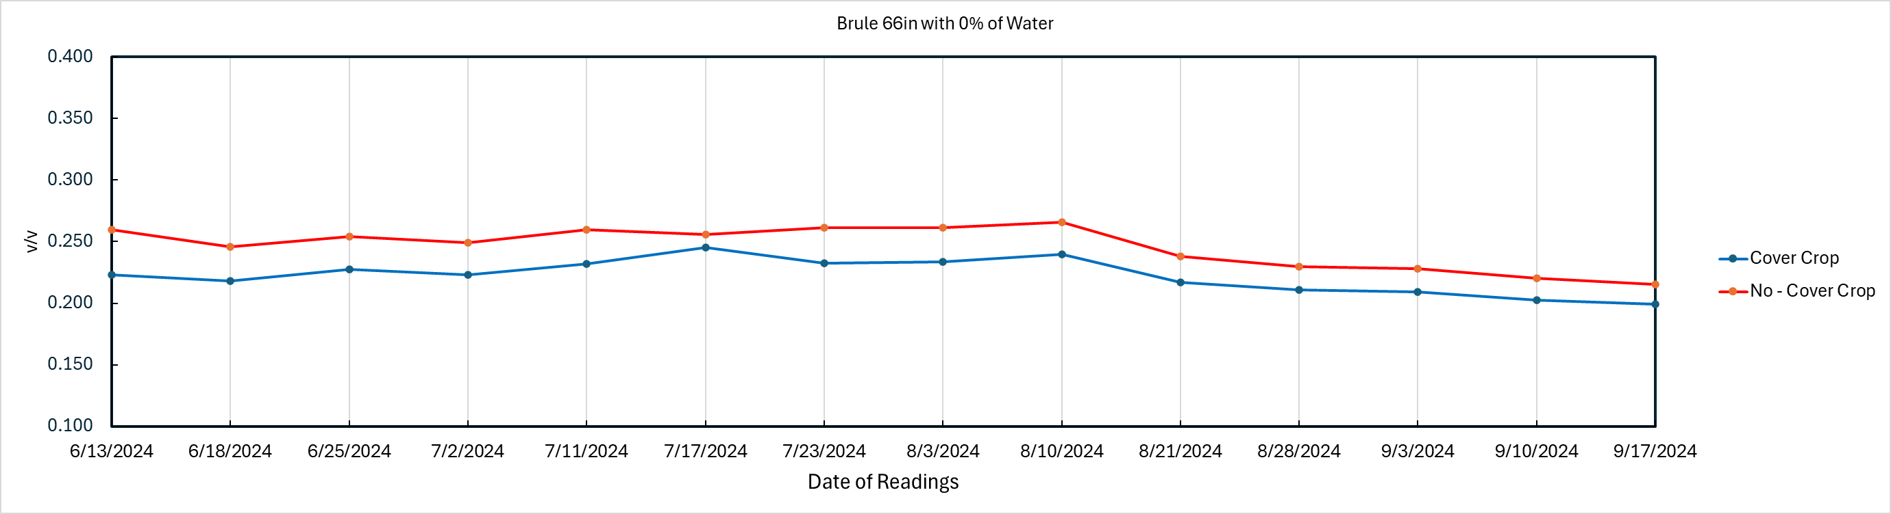

Slide 13
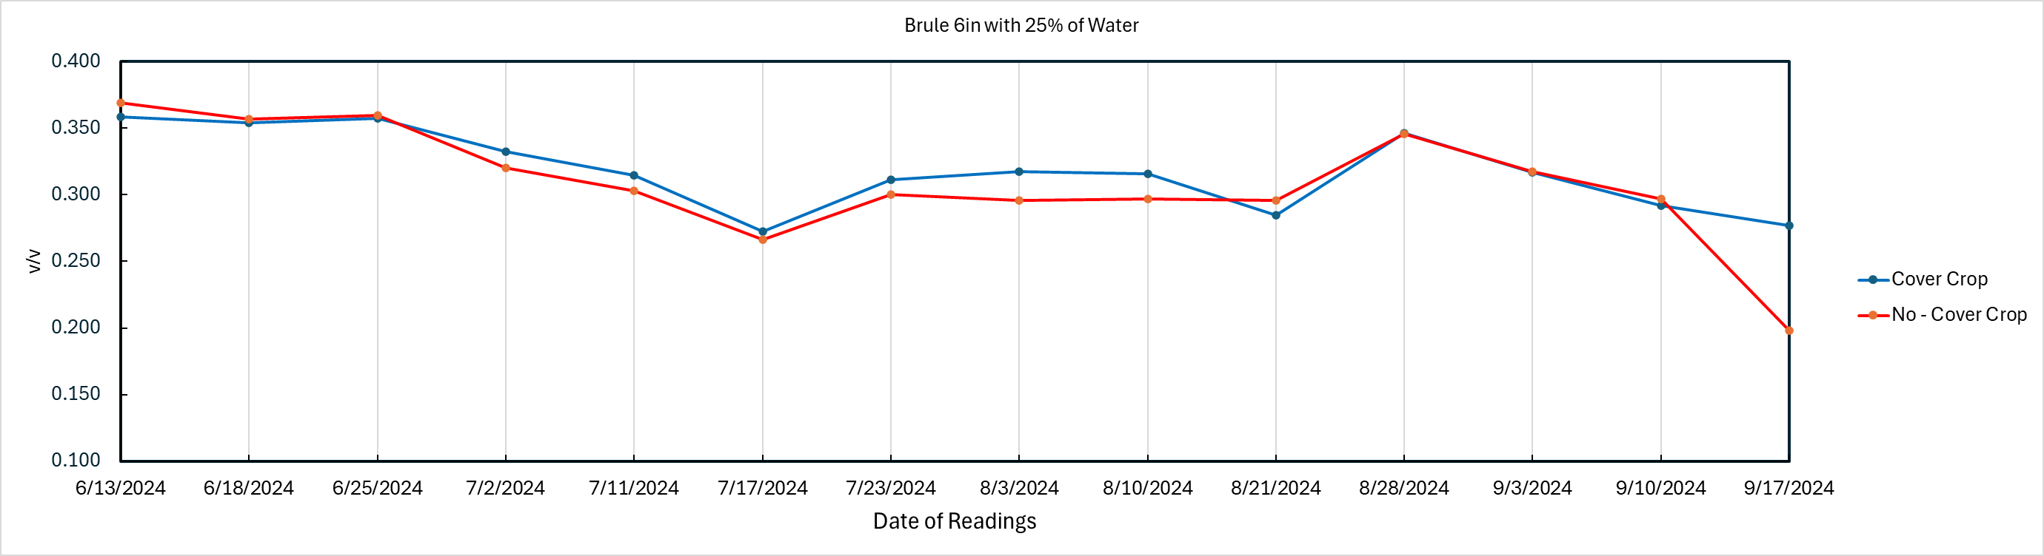
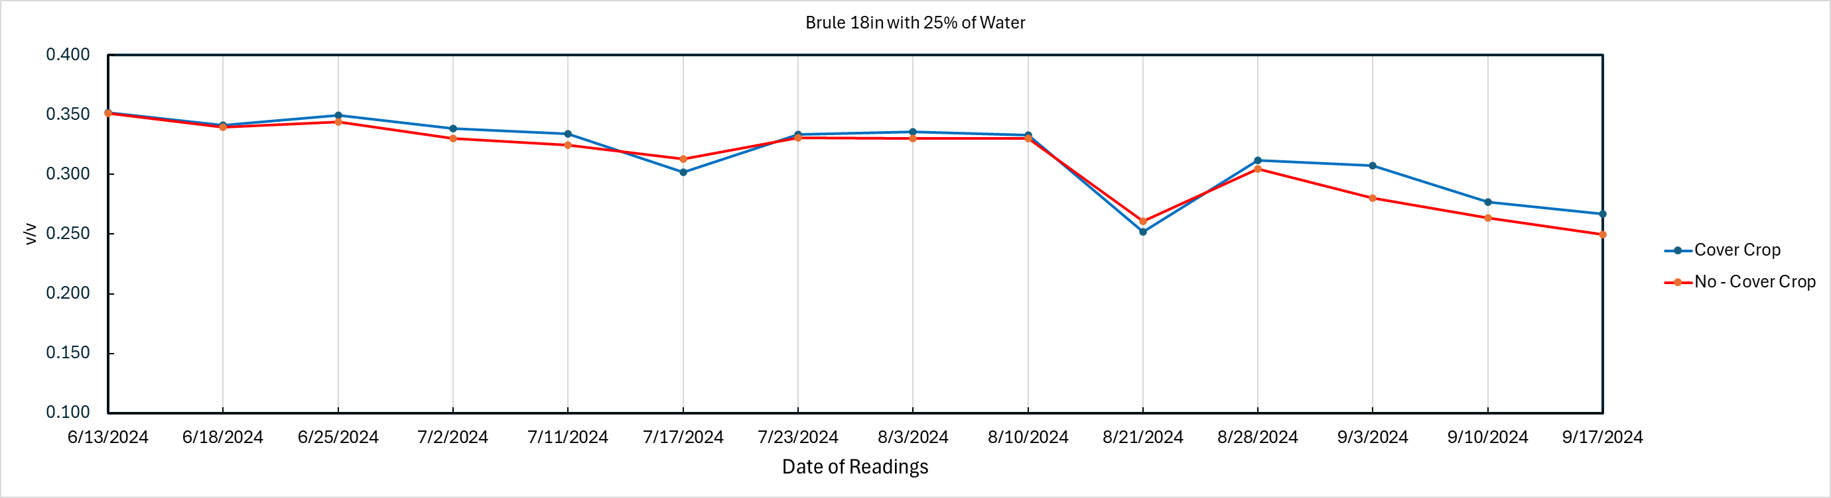

Slide 14
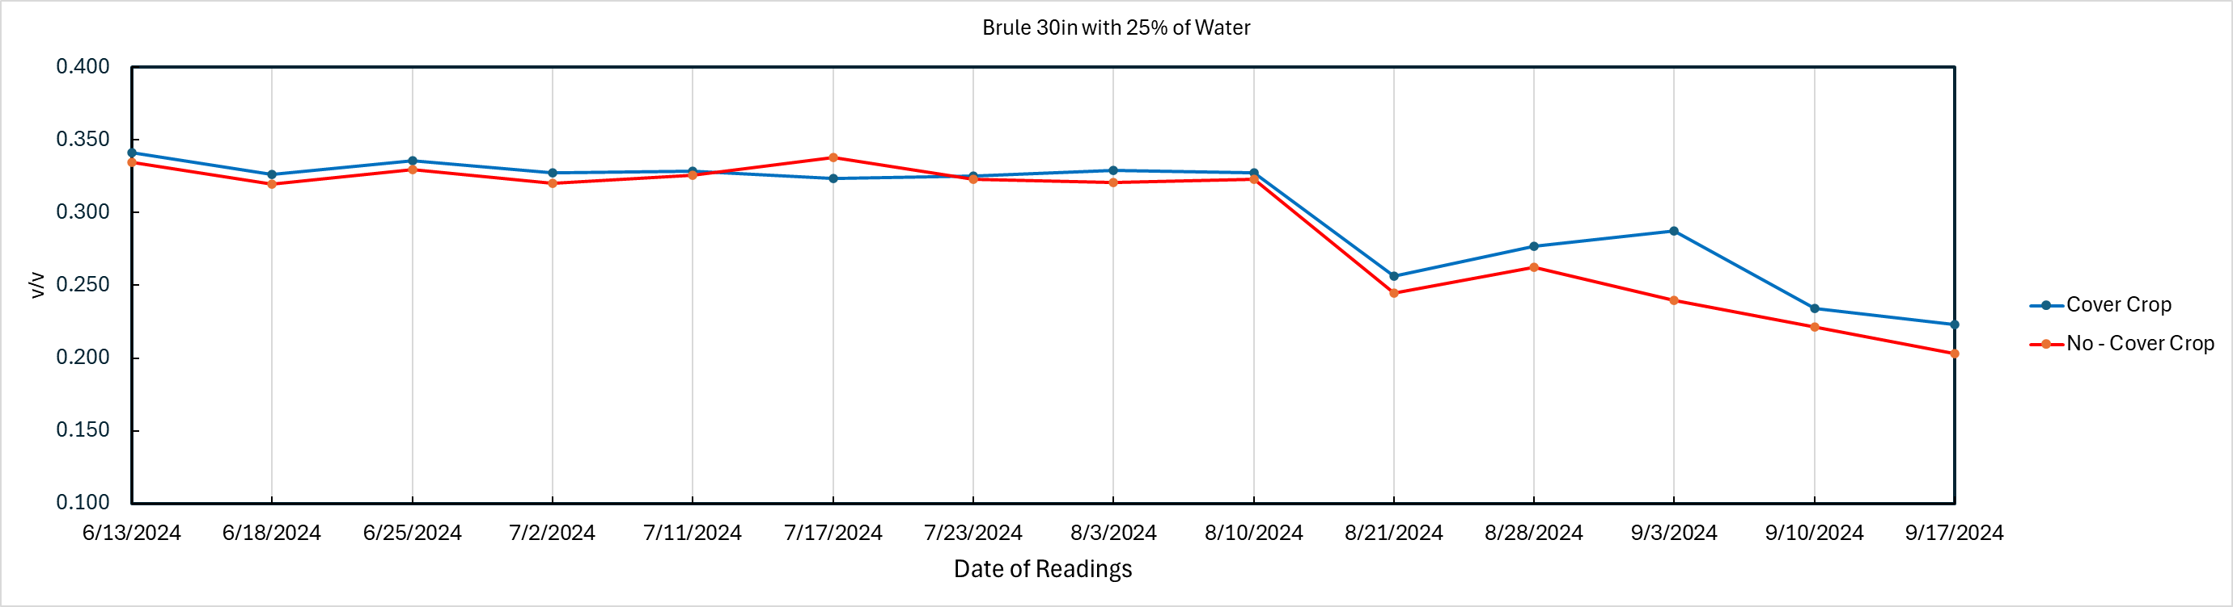
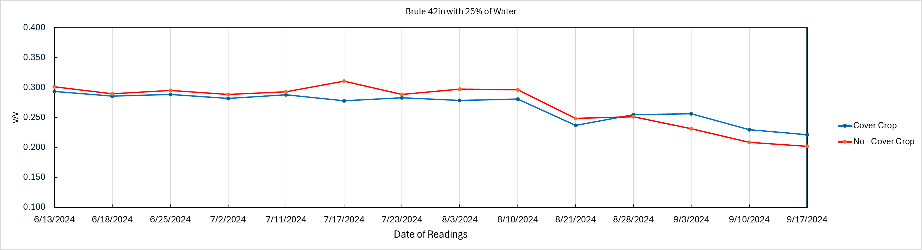

Slide 15
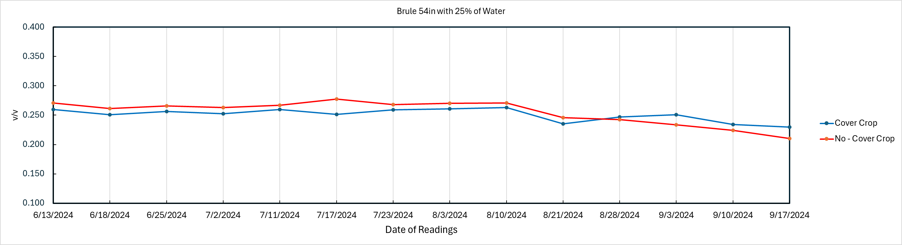
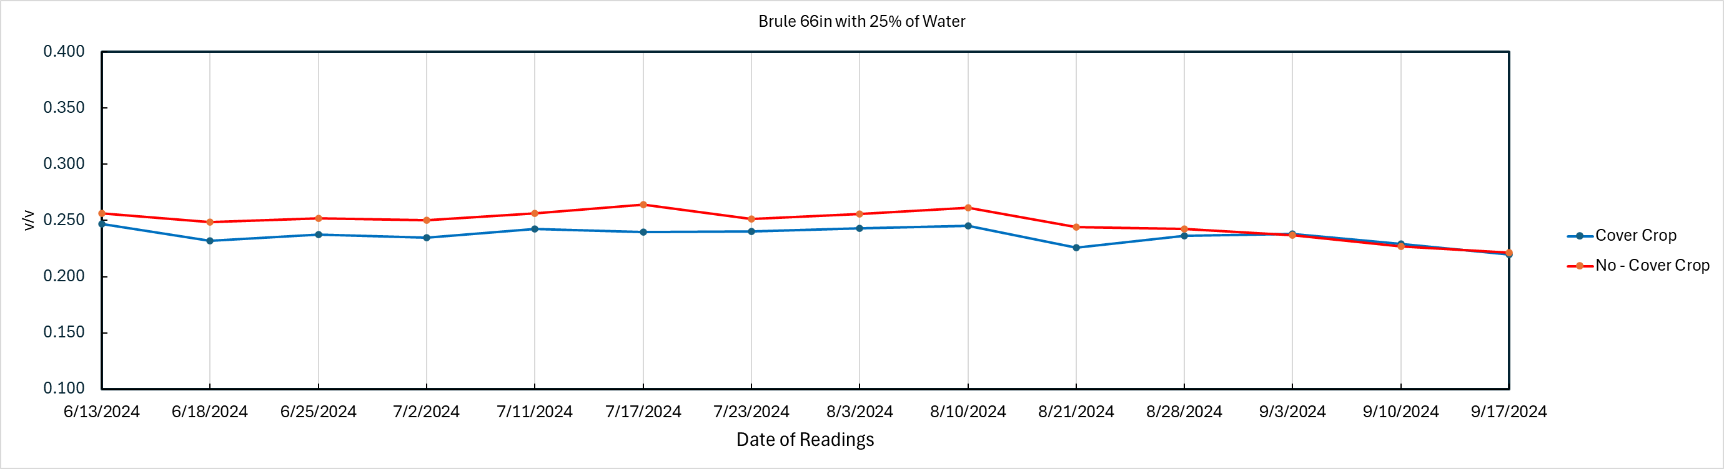

Slide 16
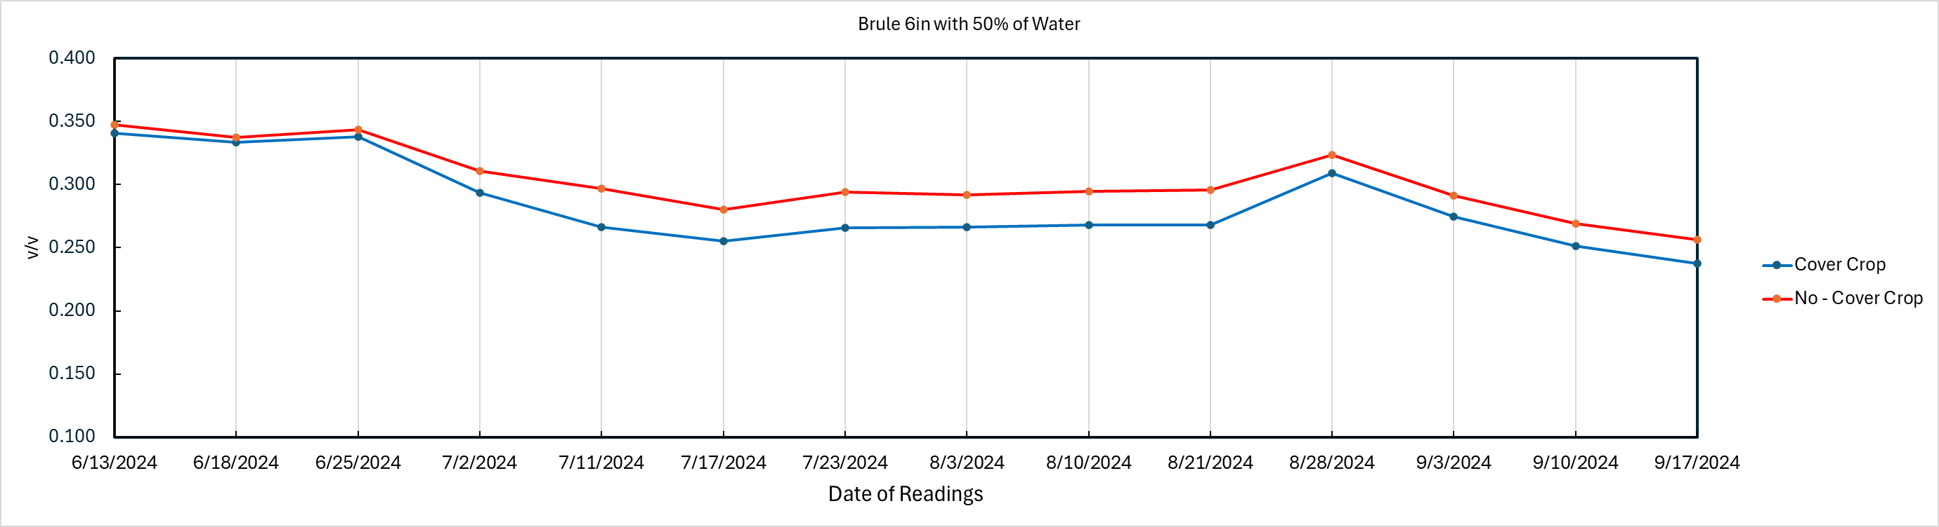
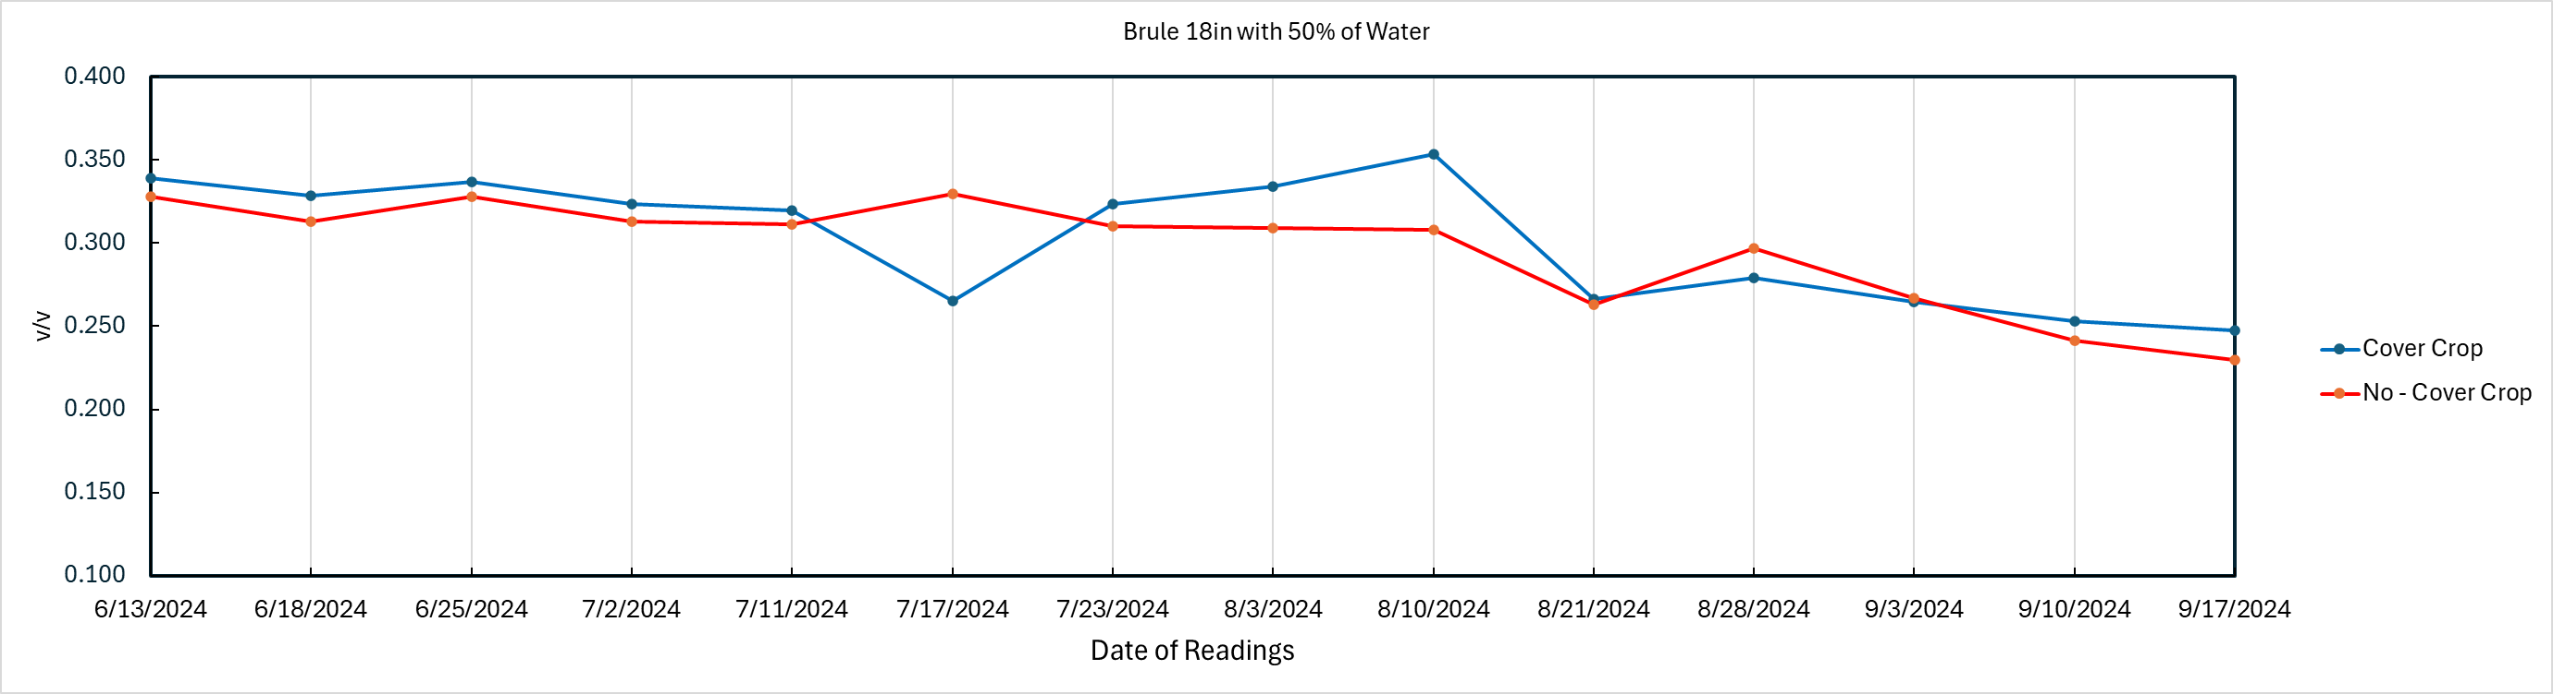

Slide 17
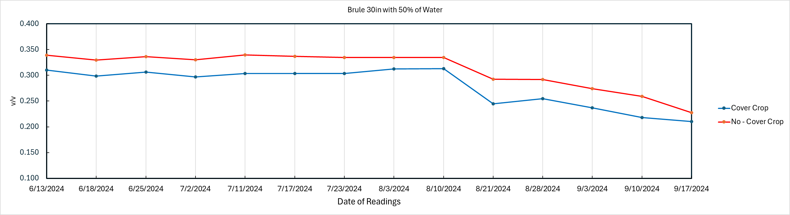
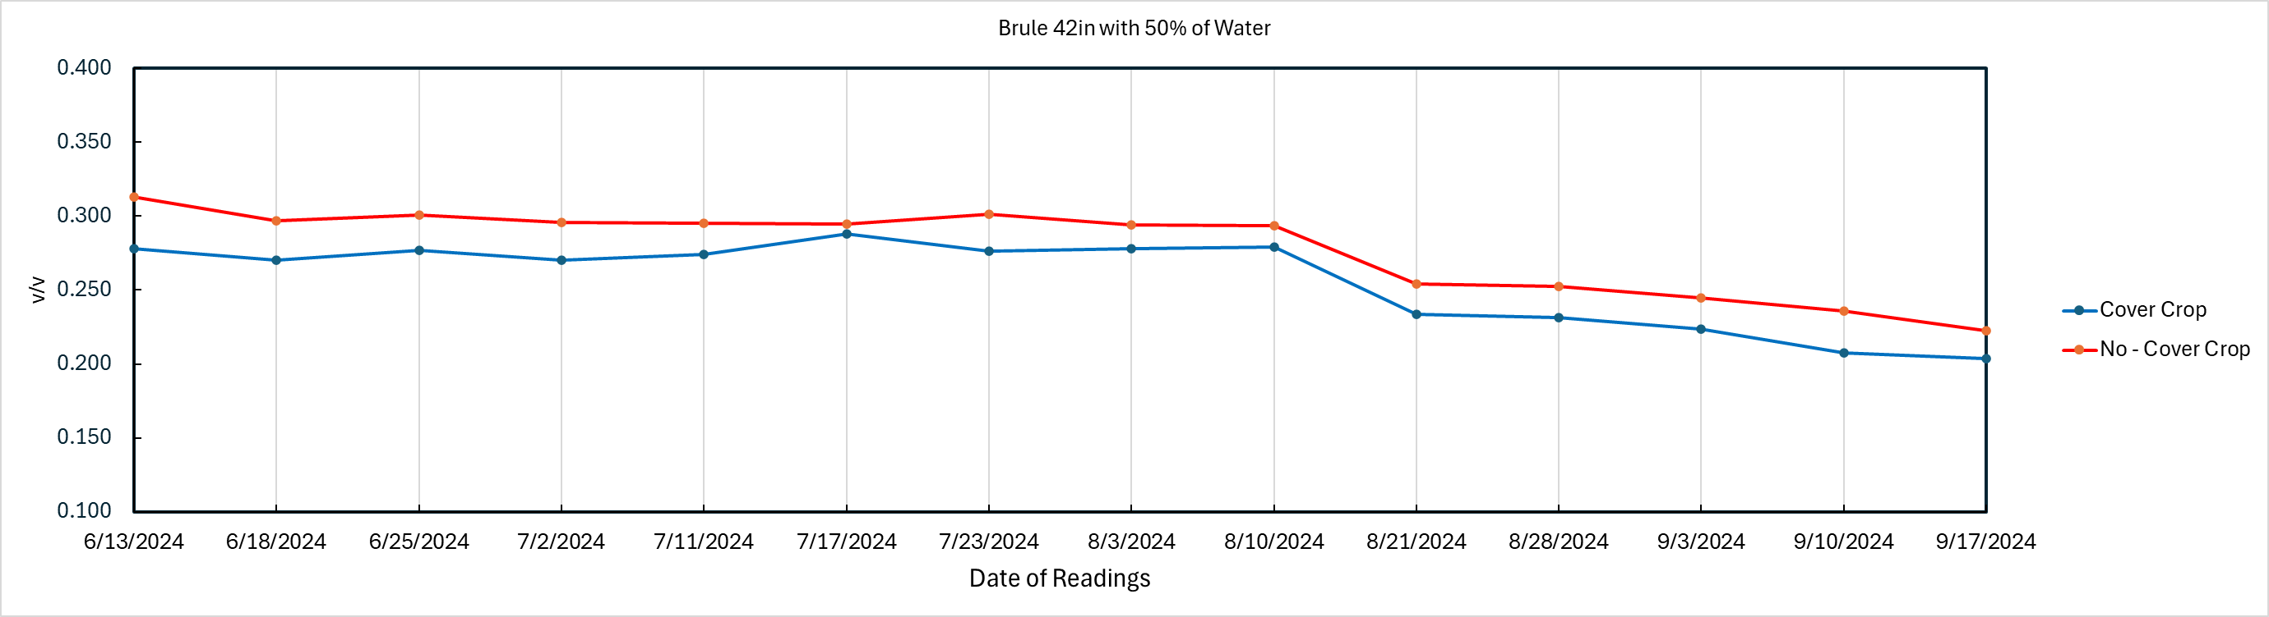

Slide 18
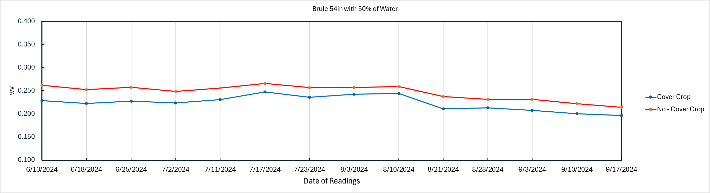
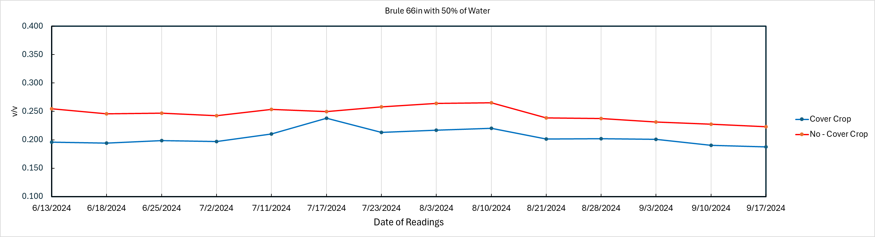

Slide 19
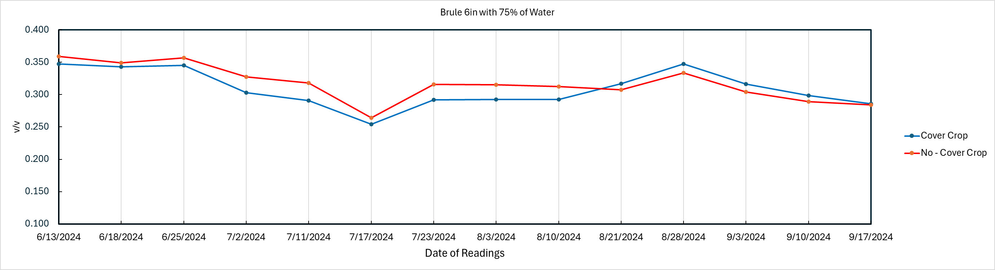
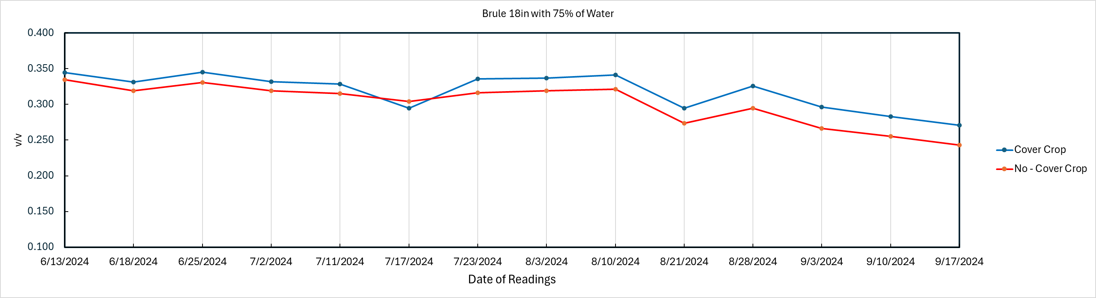

Slide 20
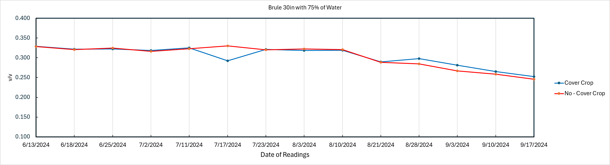
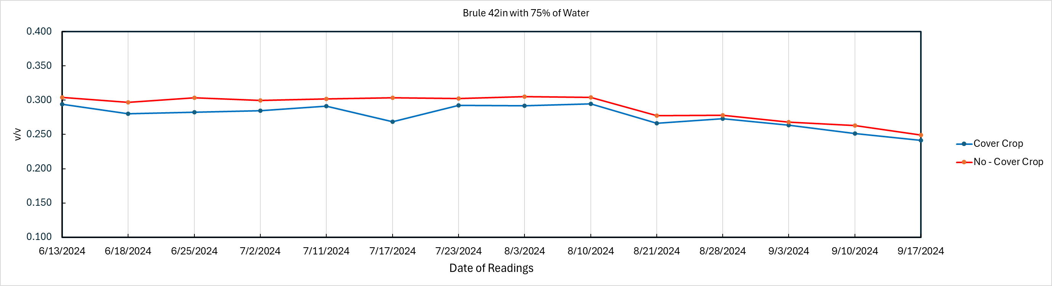

Slide 21
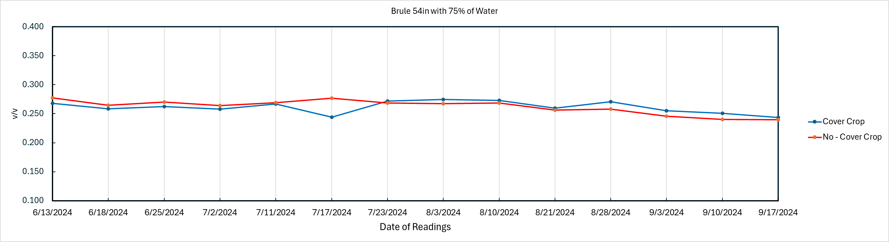
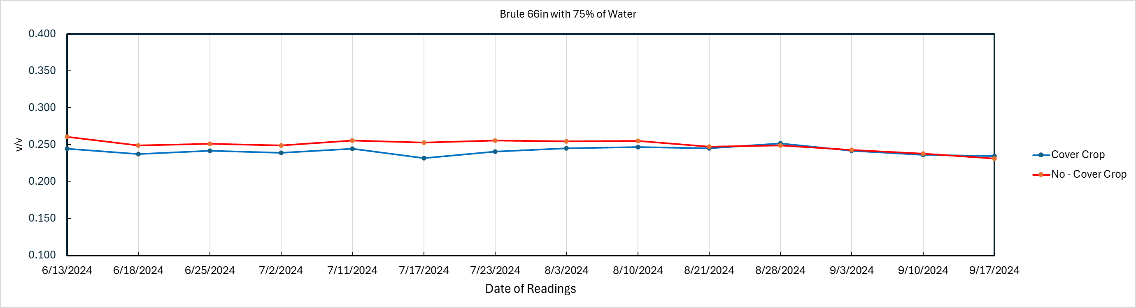

Slide 22
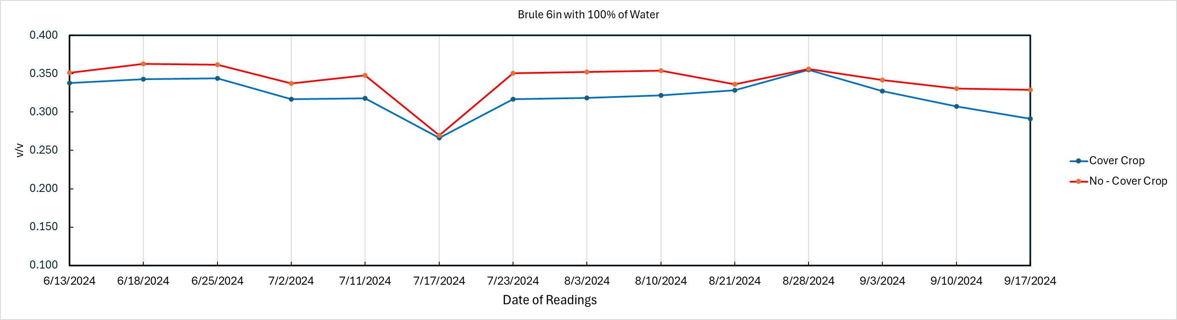
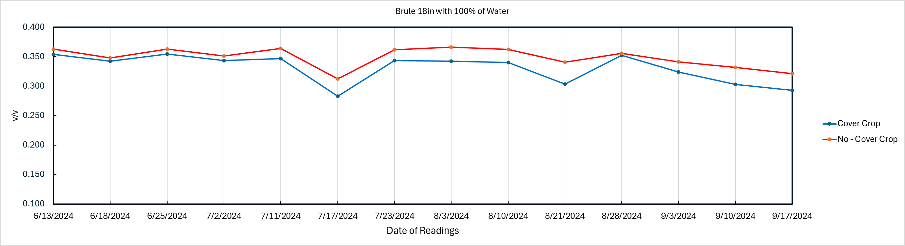

Slide 23
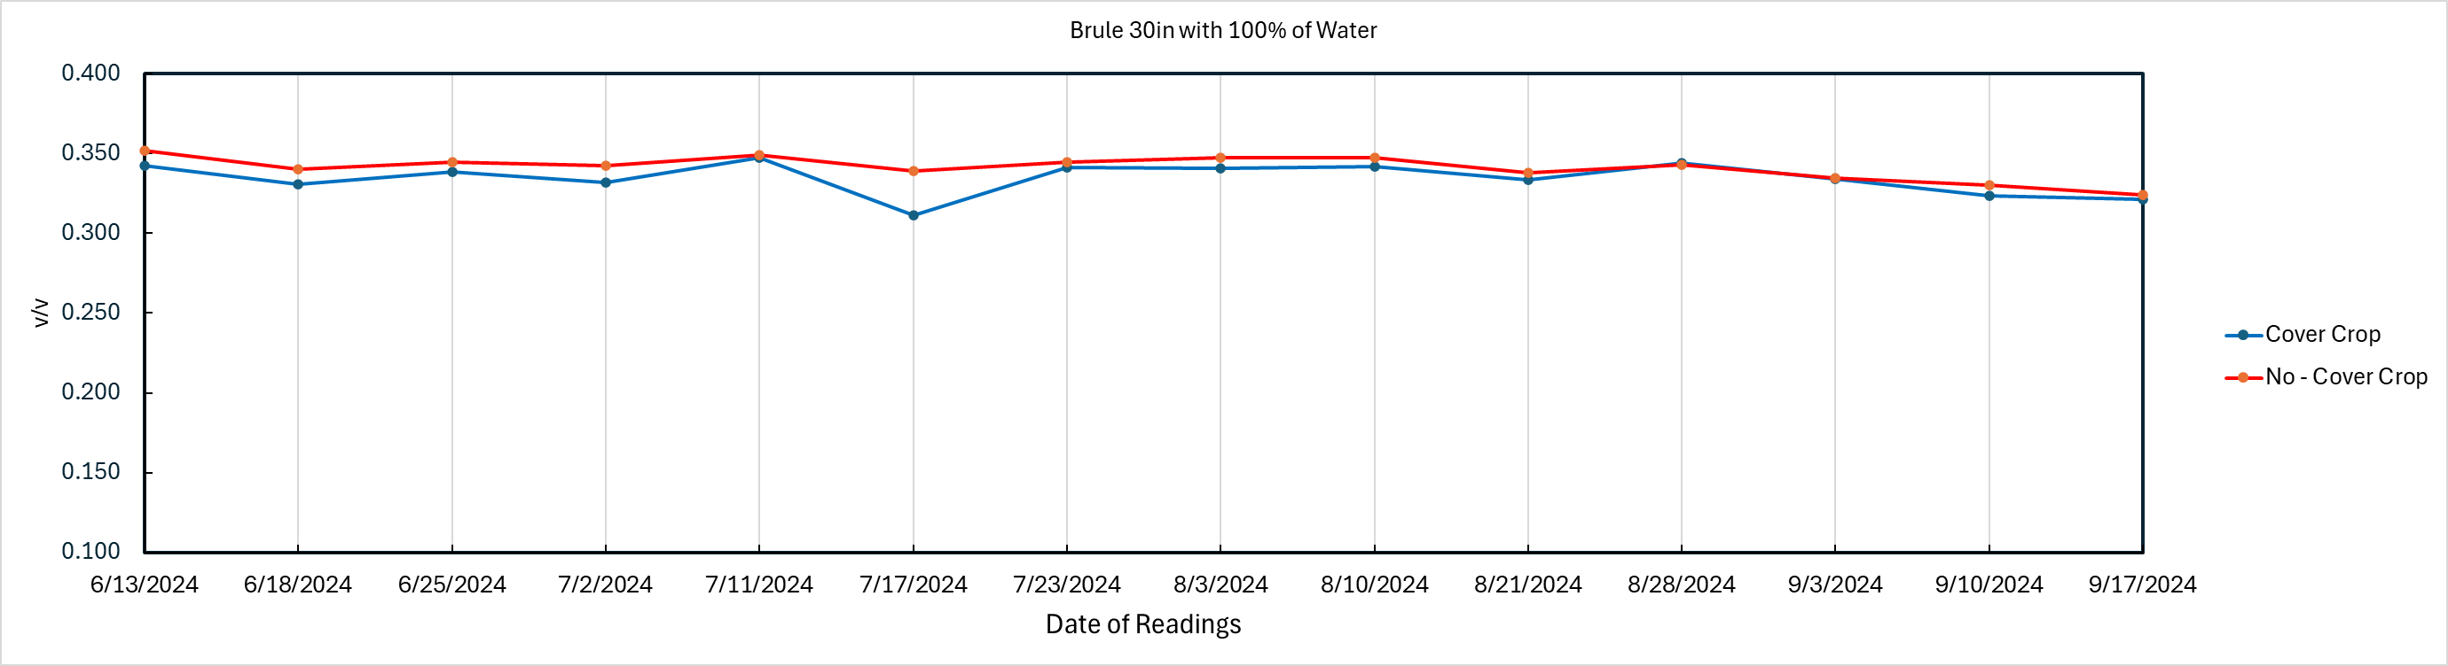
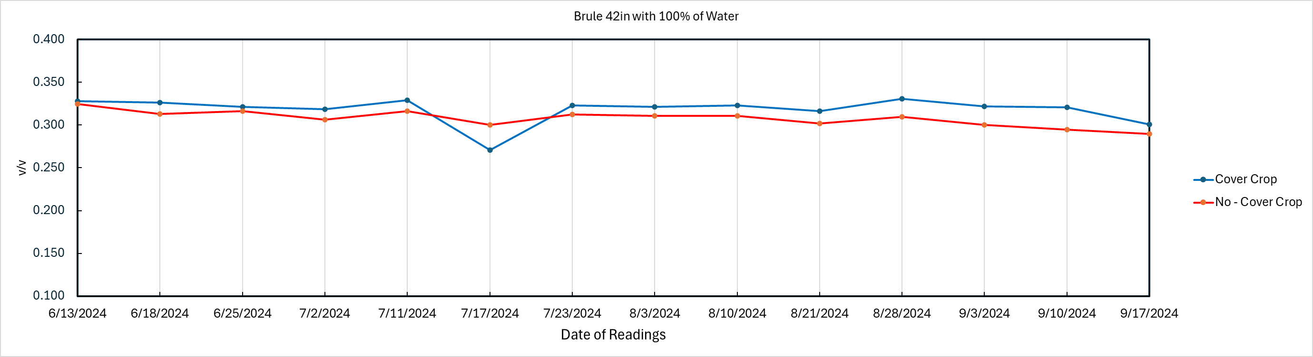

Slide 24



Slide 25



Slide 26



Slide 27



Slide 28



Slide 29



Slide 30



Slide 31



Slide 32



Slide 33



Slide 34



Slide 35



Slide 36



Slide 37



Slide 38



Slide 39



Slide 40



Slide 41



Slide 42



Slide 43



