Slide 1
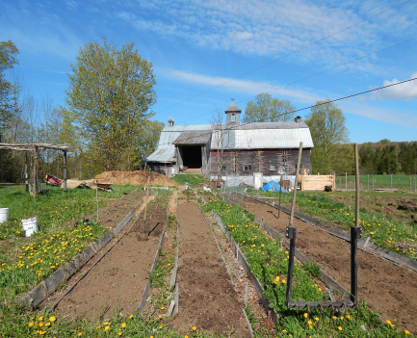
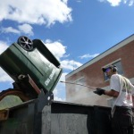
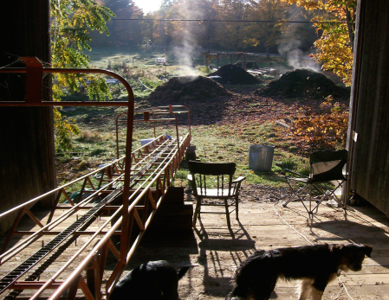

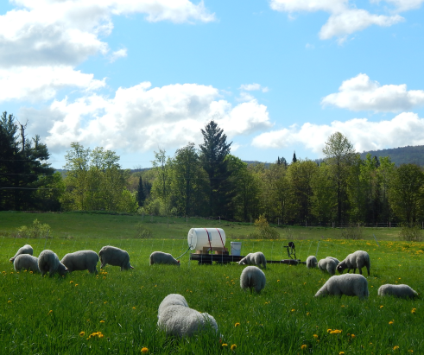

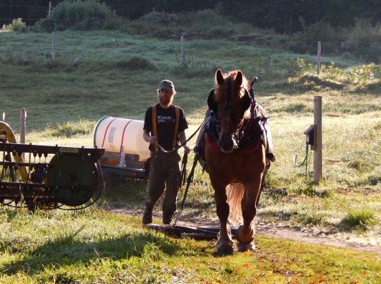
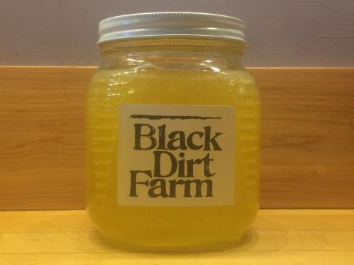
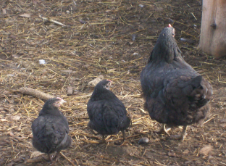
StannardVT

Slide 2

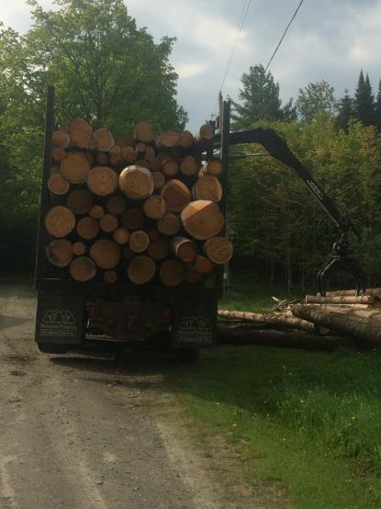
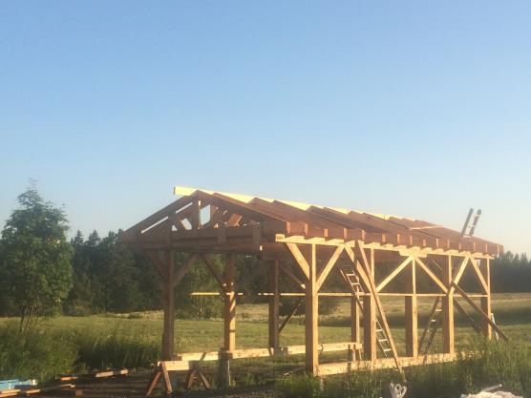
Other Farm Enterprises
Forest to Frame

Slide 3
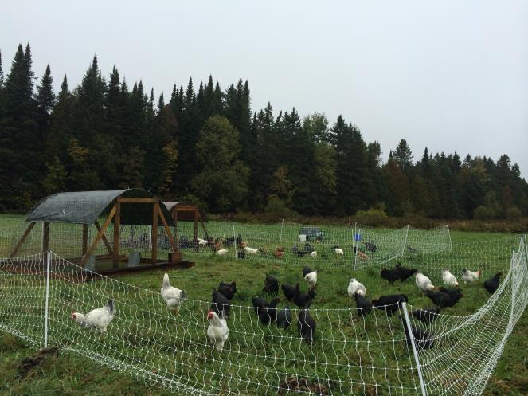
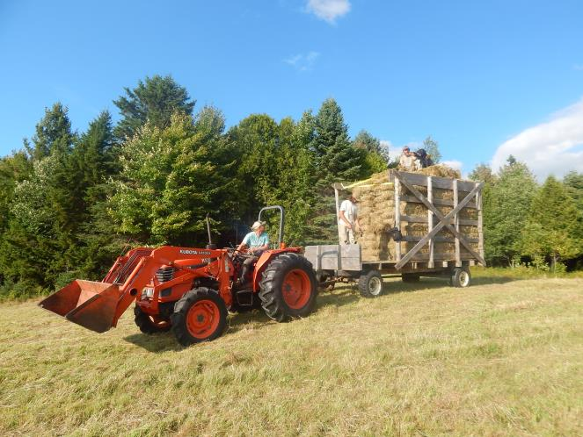
Other Farm Enterprises
Pastured Poultry
Hay

Slide 4
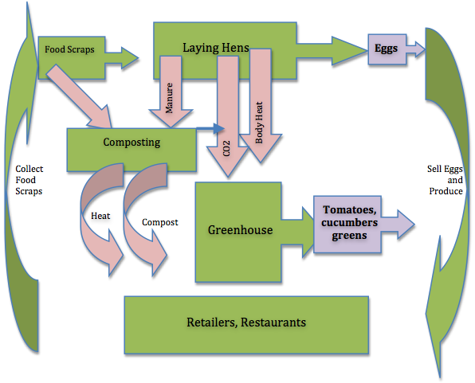
Food Scraps in the Farm System

Slide 5
USDA SARE Project
Feeding Laying Hens on Food Scraps
There has been no formal review of the use of community food scraps in egg production previously. We set out to look at:
Feed ration development
Pathogens – Salmonella Entridis
Productivity & Economic viability
Egg Quality – Nutrition, Weight, Conformity
Yoke Color

Slide 6
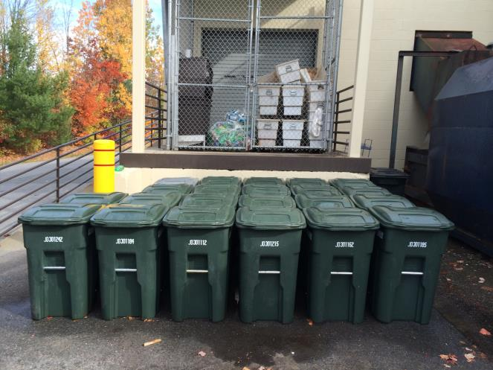
Food scraps source separated by diverse generators
~50 customers, including: grocers, schools, prison, restaurants, hospitals, food processors, nursing homes, recycling center
~200 48-gal totes/wk; ~20 TPW
Deliver to Tamarlane Farm & Black Dirt Farm
Once per wk collection
Focus on high quality of service and cleanliness of product

Slide 7
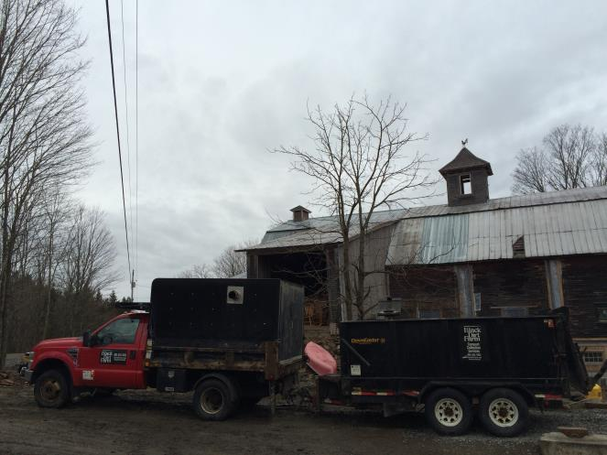
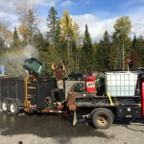
Collection Set-up

Slide 8
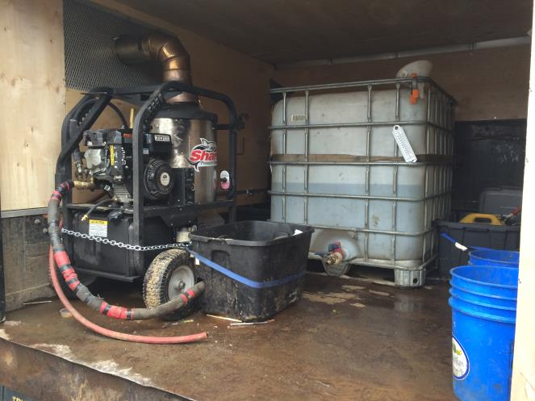
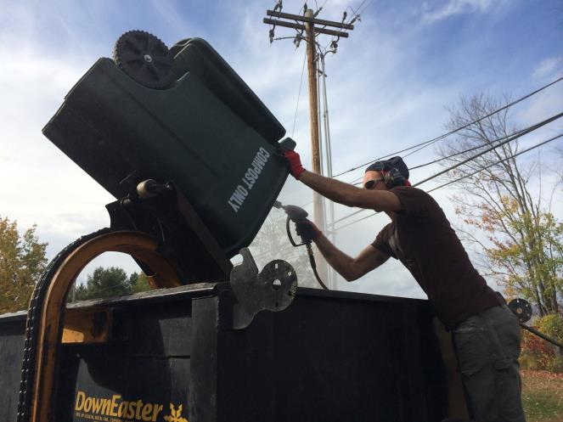
Tote Tipping & Washing

Slide 9
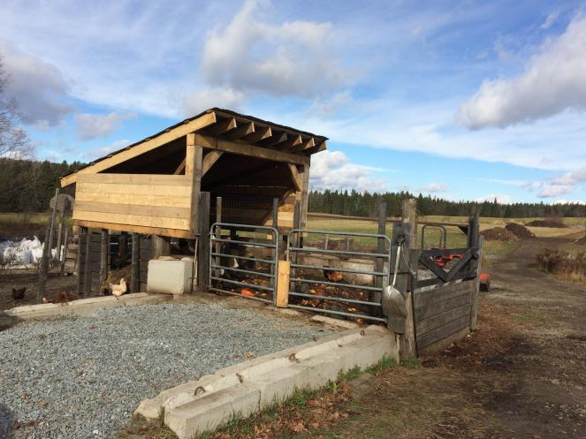
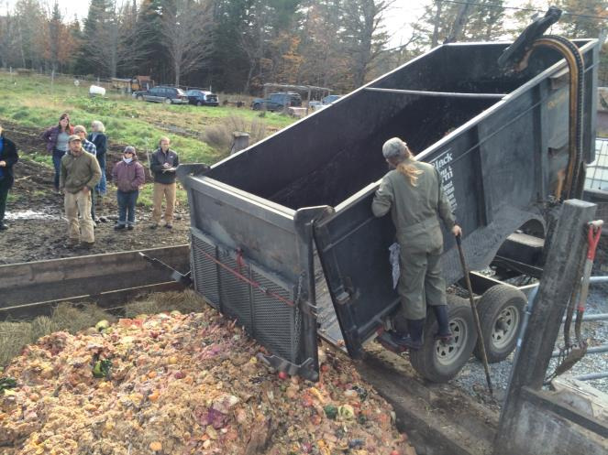
Layer Operations – Farm Receiving

Slide 10
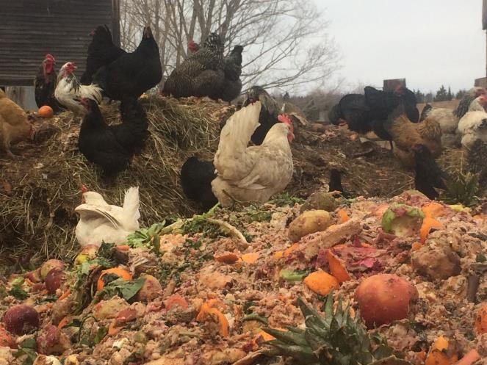
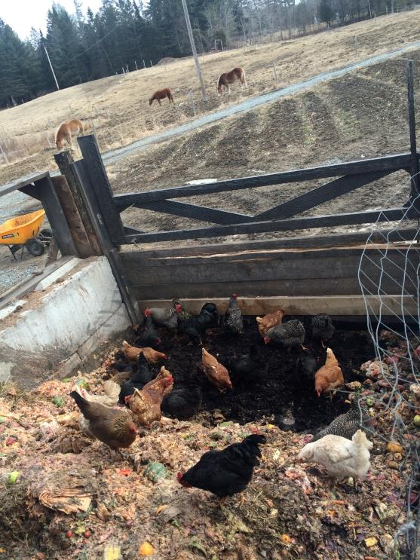
Blending & Feeding Food Scraps

Slide 11
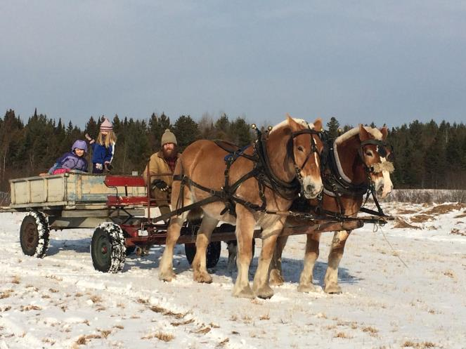
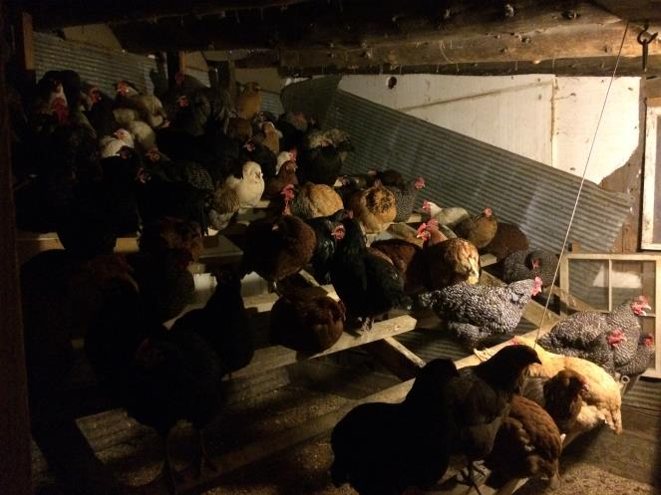
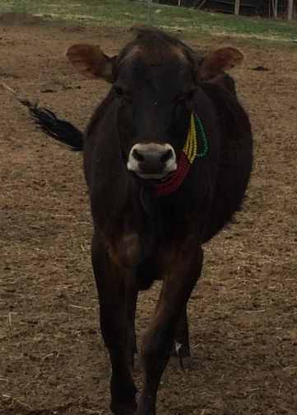
On-farm Feedstocks

Slide 12
Feedstocks
Diversity is Important
Nitrogen Sources
Food Scraps
Juniper Berries
Beef Manure
Horse Manure
Hen & Chick Manure
Fermented Corn Mash (occasionally)
Carbon Sources
Sugars
Maple Sugar/ Nitre
Cellulose
Paper Food Processing Filters
Brown Paper Towels
Hay
Lignin & Cellulose
Softwood Sawdust
Hardwood Sawdust
Mixed Species Wood Chip

Slide 13
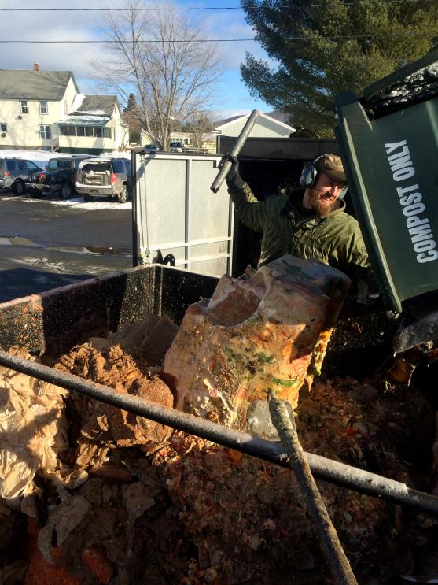
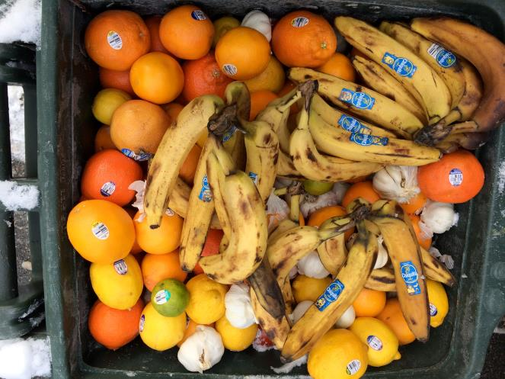
Challenges

Slide 14
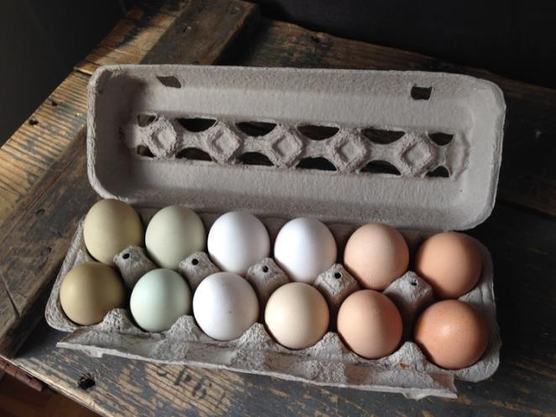
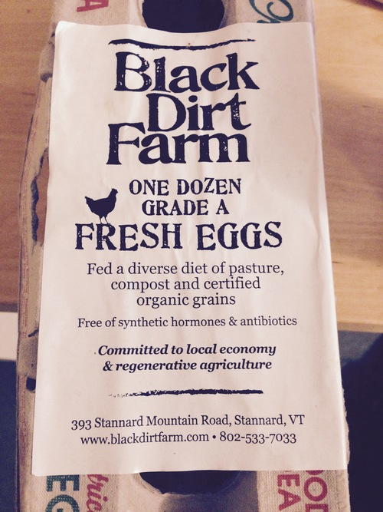
Eggs

Slide 15
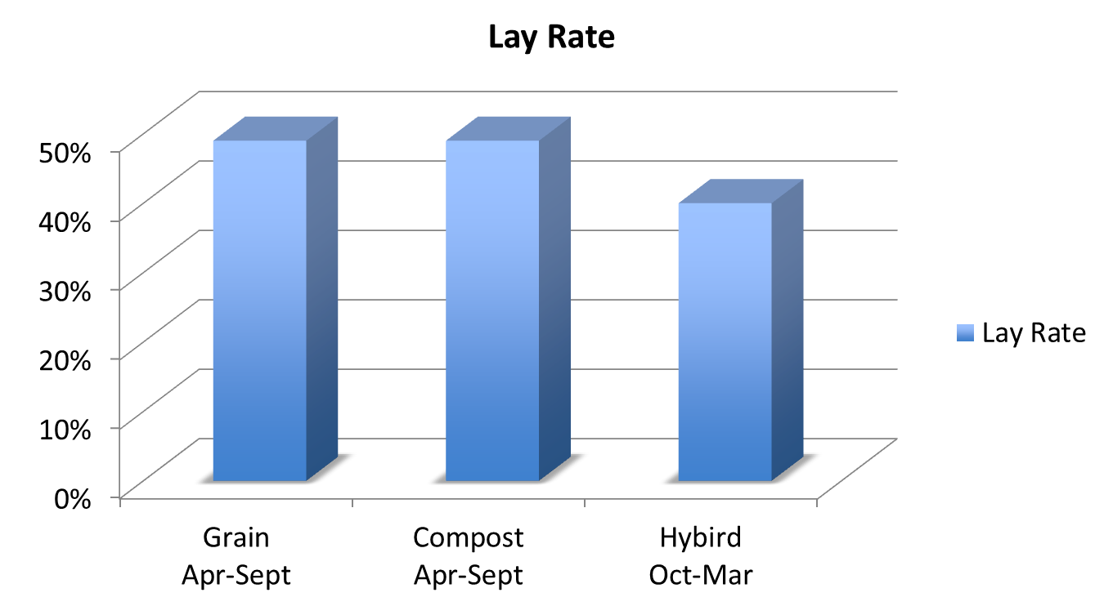
SARE - Productivity

Slide 16
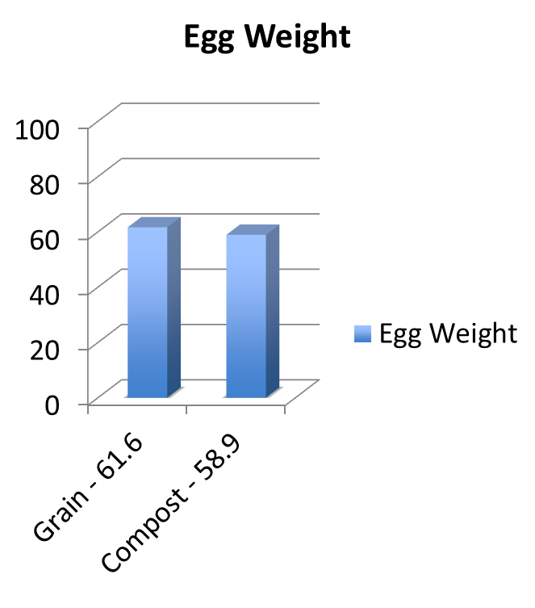
SARE – Egg Quality
Yoke Color Comparison
Six Month Avg
Based on DSM Color Fan – Scale of 1-15
Grain Group Compost Group
DSM – 5 DSM - 12

Slide 17
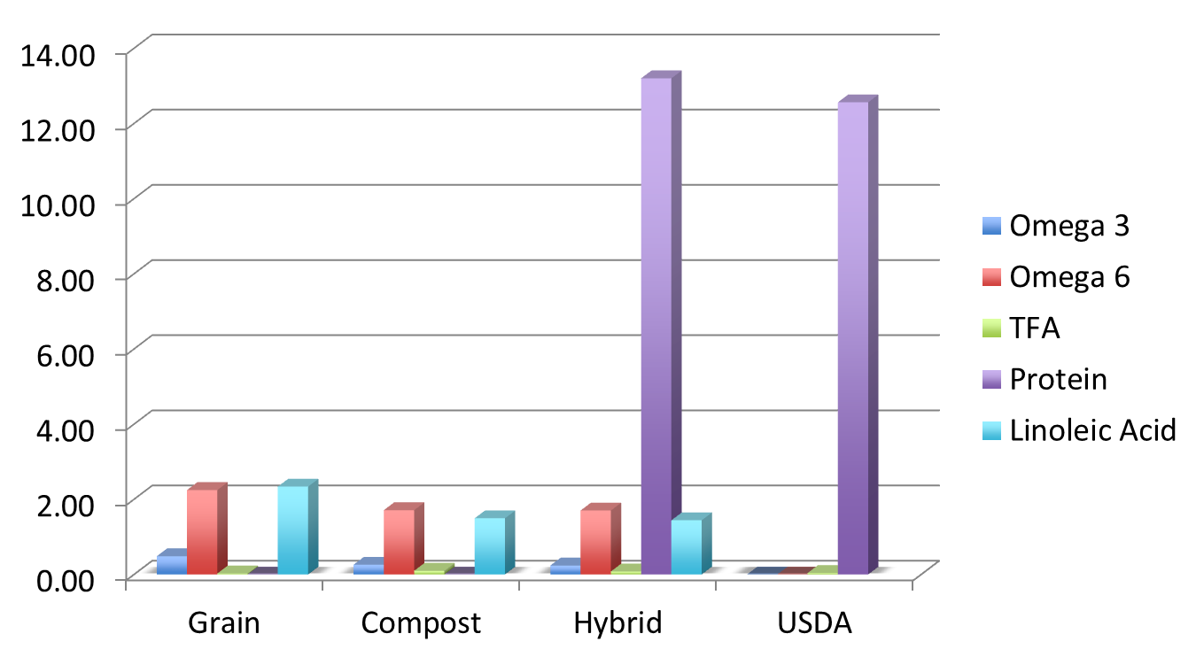
Egg Quality – Fatty Acids & Protein g/ 100g

Slide 18
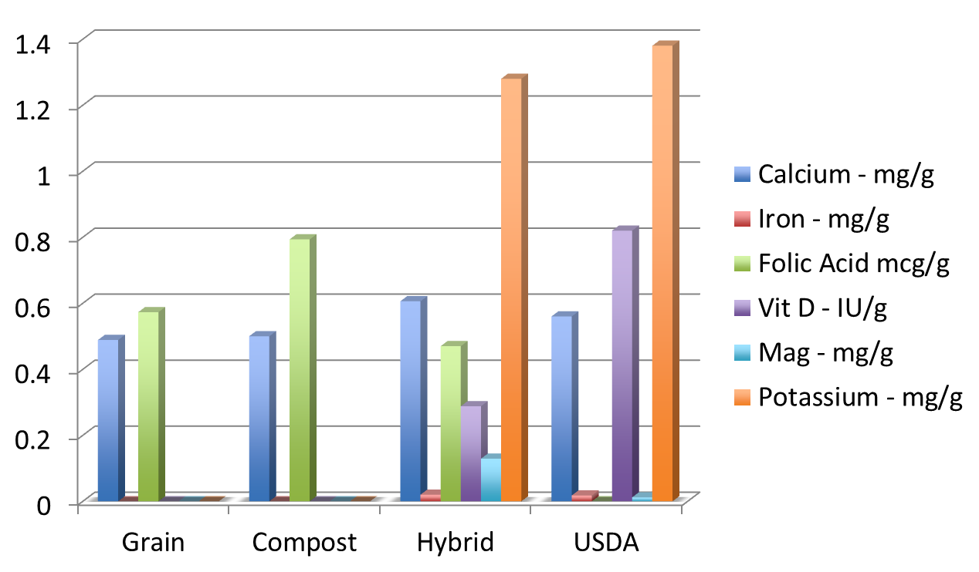
Egg Quality - Vitamins

Slide 19
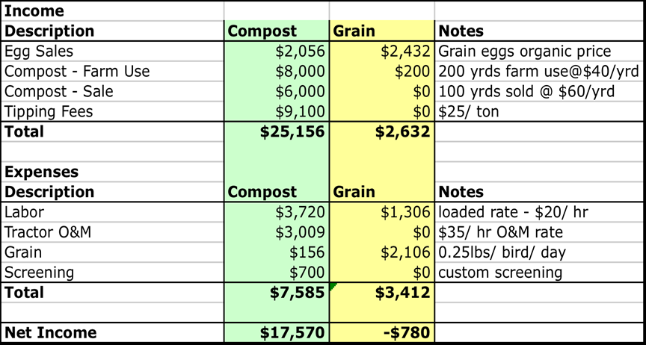
SARE Project – Financials
44 hens per group

Slide 20
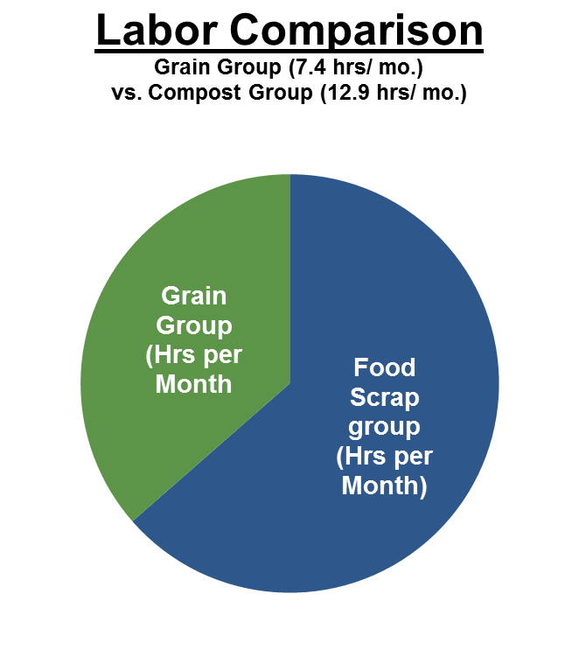
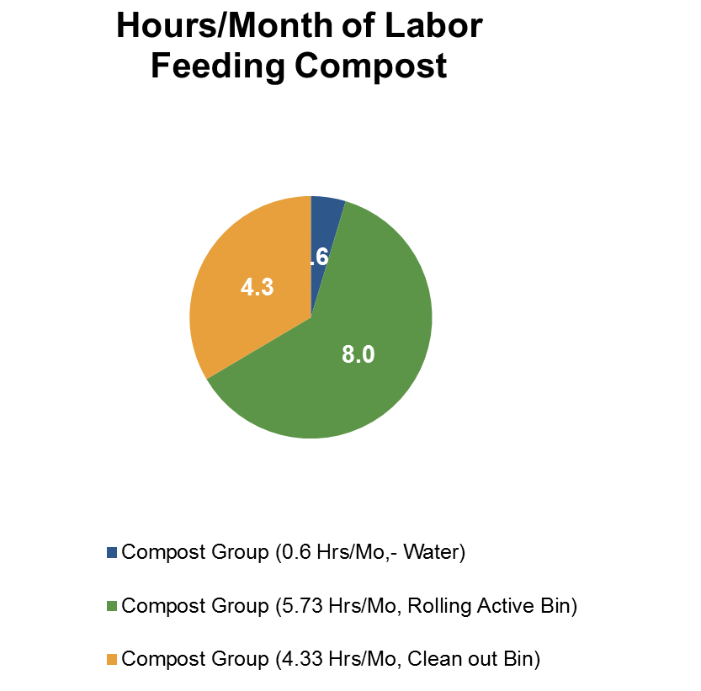
SARE – Labor
Does not include tasks which feeding strategy does not impact

Slide 21
Lessons Learned
Viable strategy
Salmonella Entridis does not appear to be concern
Requires supplemental feed in winter ~0.13 lb/hen/day (compared to 0.25/hen/day)
Antidotal: Shells more susceptible to cracking & deformity
Believe energy & protein may be limiting factors
Food scraps contain 75-80% moisture – reduces H20 intake, also fills up bird faster with less nutrition
Compost feeding strategy is chaotic & challenging to prescribe
Challenges: winter mgmt, rodents, ration precision
Further Study: Feed ration & supplementation, egg nutrition, dehydrating food scraps, salt intake, mycotoxins

Slide 22
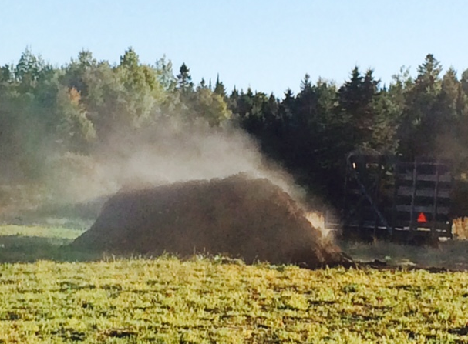
Compost
Mix removed from feeding bin at 4 weeks
Semi-aerobic fermentation in bin
Compost stacked in 6-8’x14’x45’ windrows
Meet Organic & State standards – 15 days at 131F+ with 5 turns
Worms fed after PFRP
Compost cured 1-3 mo.
Compost spread & sold

Slide 23
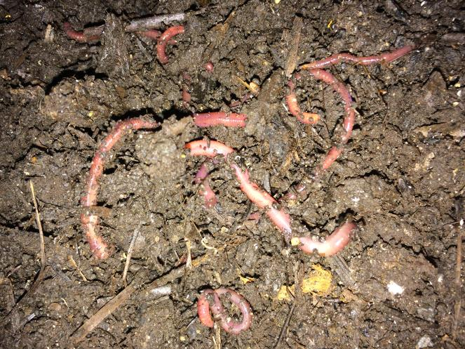
Castings Production
Species: Eisenia Fetida – Red Wiggler or Tiger Worm
Highly efficient processor
Requires Moisture of 65-85%
Optimal processing - 70-80F
Cannot survive in wild in climates below Zone 5 or 6
Hermaphroditic

Slide 24
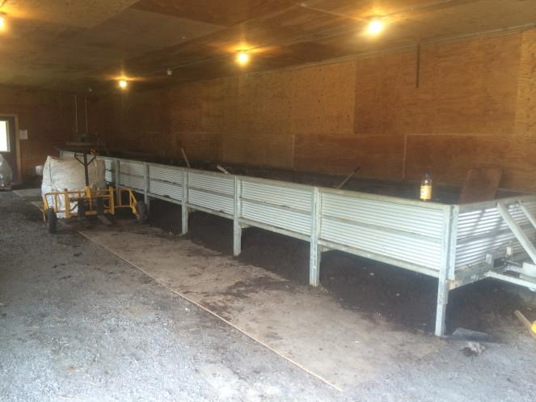
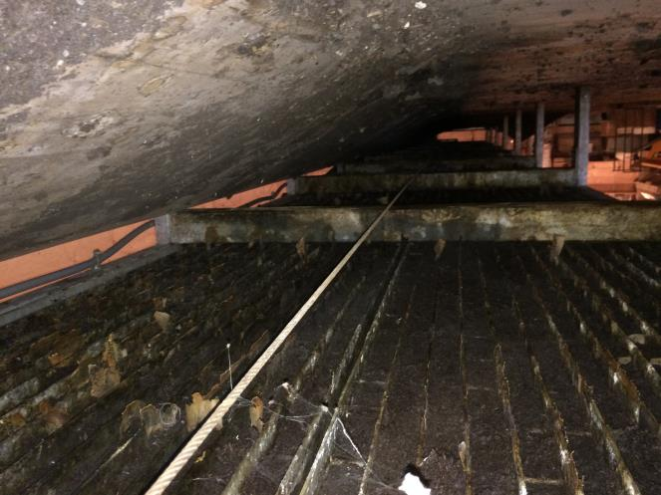
Worm Bin

Slide 25
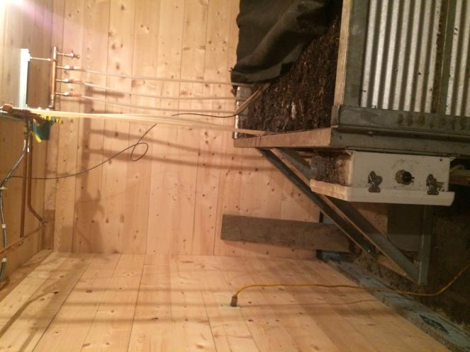
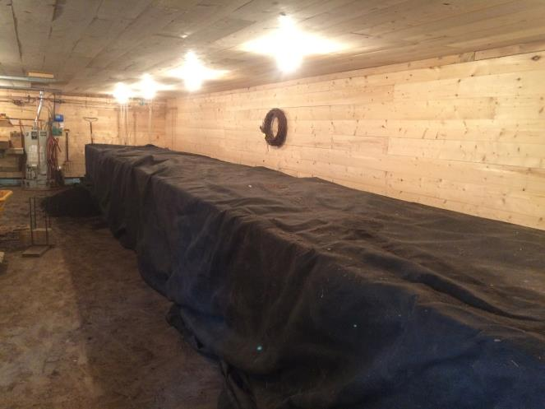
Bin Heating and Motor

Slide 26
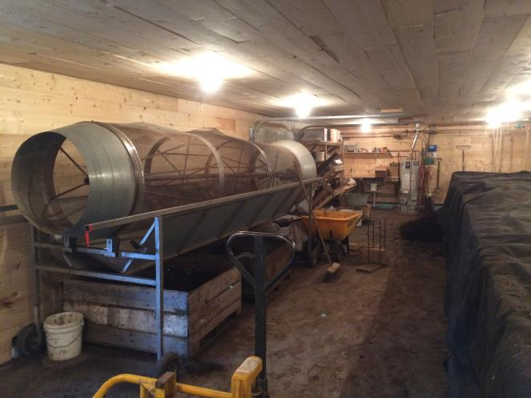
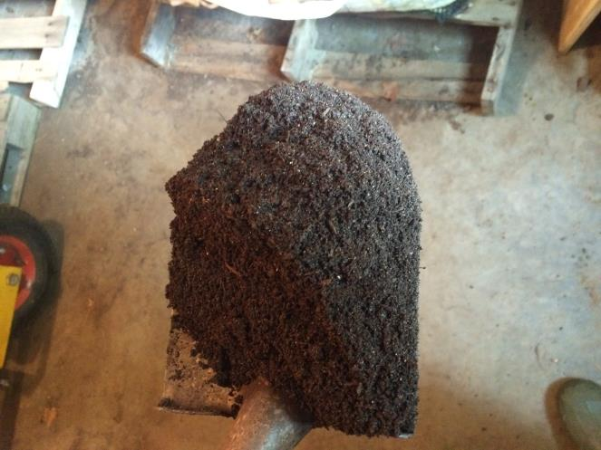
Screened Castings

Slide 27
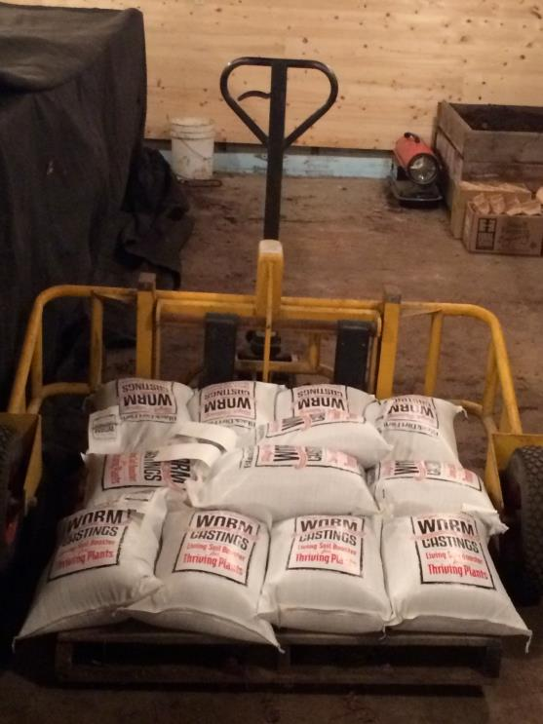
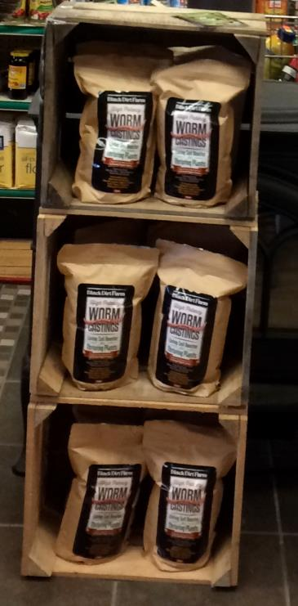
Packaged Castings

Slide 28
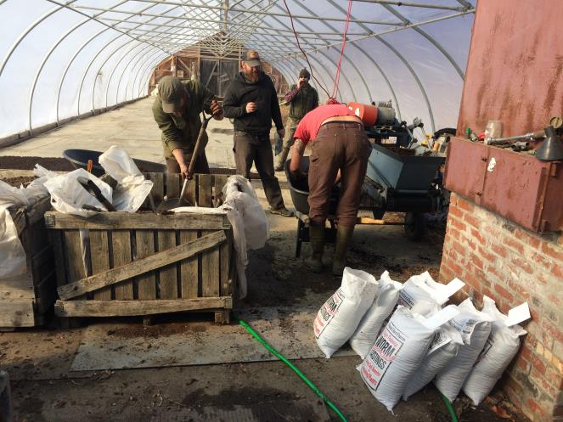
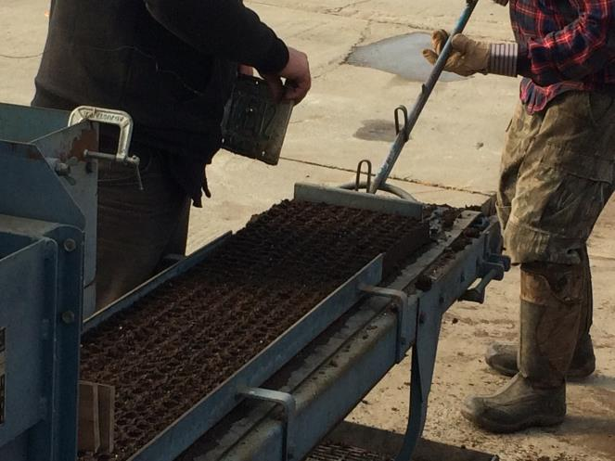
Castings in Potting Mixes

Slide 29
Qualities of Castings
N content of 0.5-3%, with high concentration of nitrate
P & K concentrations of 0.25-2.5%
P, Ca and Mg more soluble
Concentrated humic acids
Plant Growth Hormones (PGHs) – auxins, gibberellins, cytokinins, fulvic and humic acids
Diverse biology – bacteria, fungi and actinomycetes

Slide 30
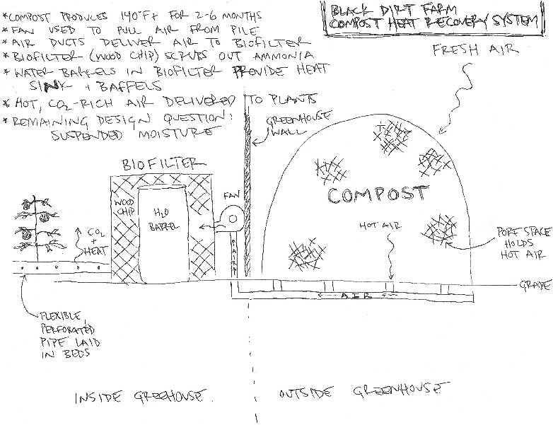

Slide 31
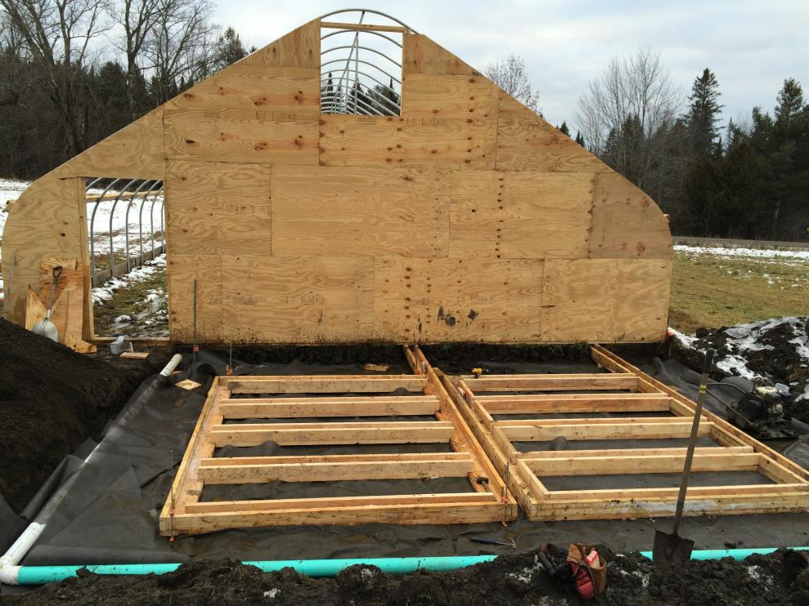
Compost Heat Recovery

Slide 32
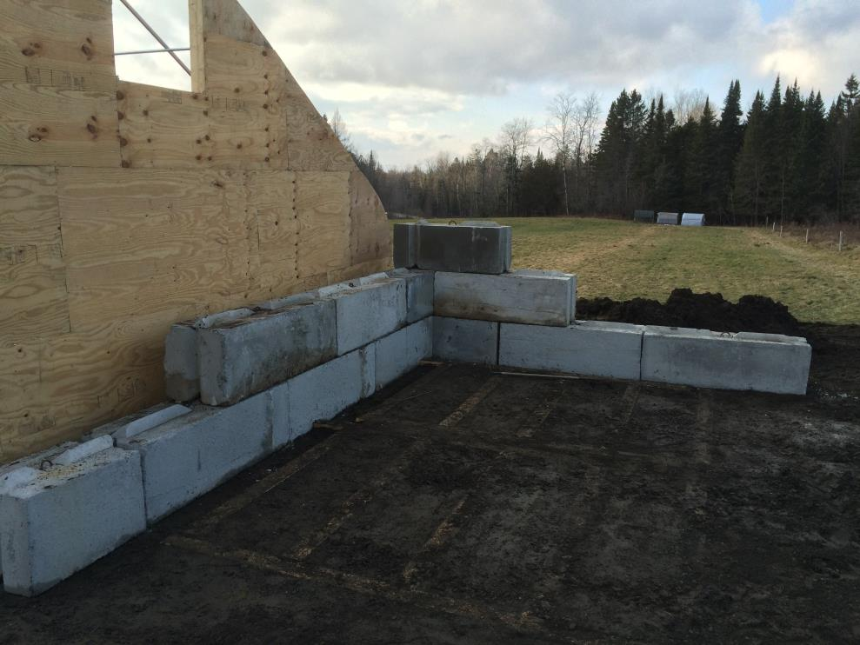
Compost Heat Recovery

Slide 33


Greenhouse Crops

