Slide 1
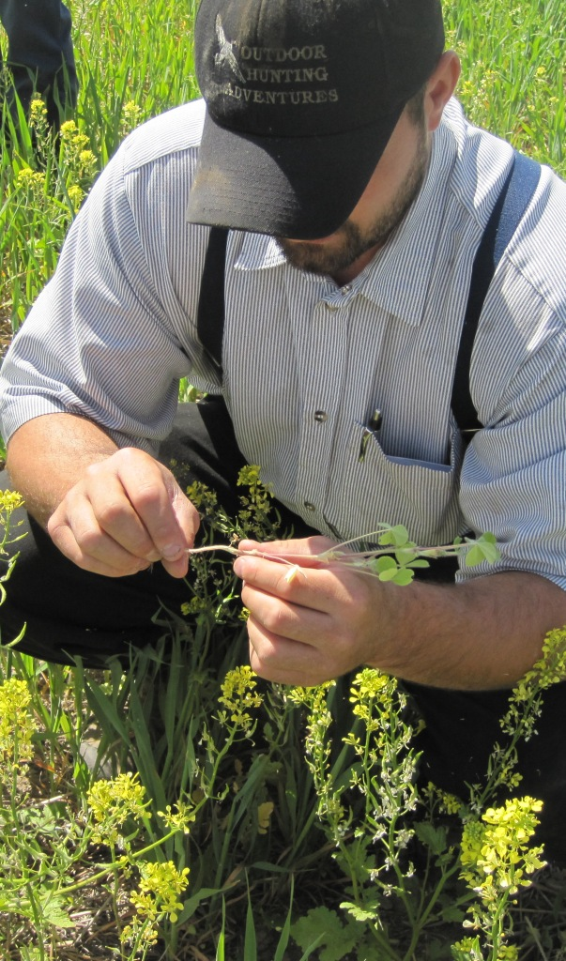

Cover Cropping
& Companion Cropping for the
Inland Northwest; a work in progress
Diana Roberts
Area Extension Agronomist
WSU Extension
Spokane, WA

Slide 2
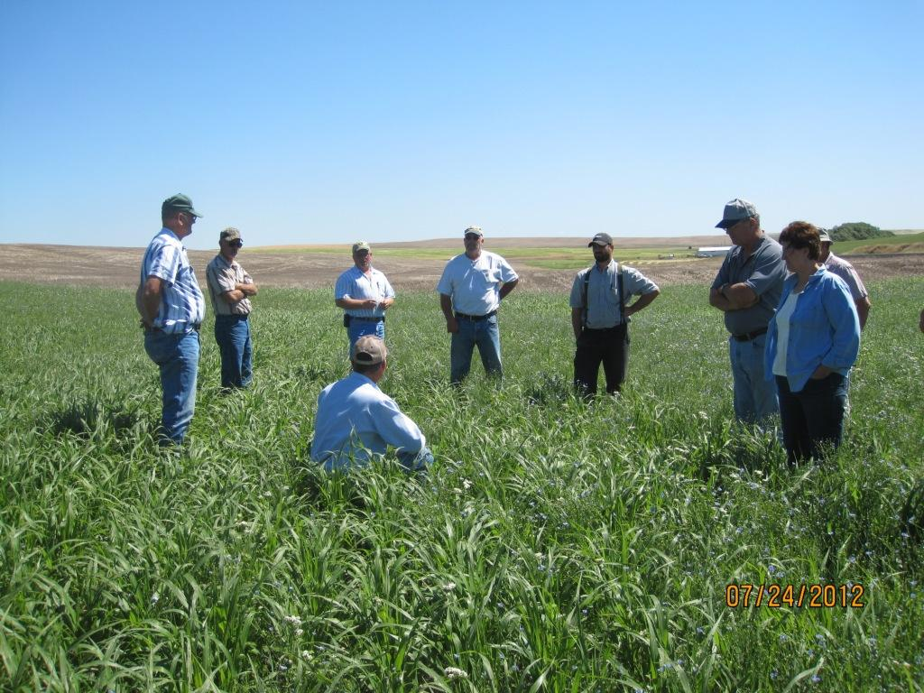
A Farmer-Driven Project!
Fred Fleming, Bryan & David Dobbins, Charles Gross, Chris Laney, Tracy Rush, Ed Warner
Aaron Esser – WSU Extension
Derek Appel – WSU Extension
Jill Clapperton – Rhizoterra Inc
David Lundgren – Lincoln CD

Slide 3
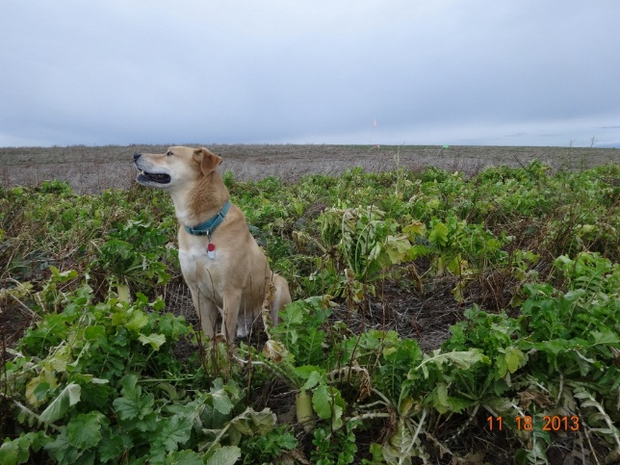
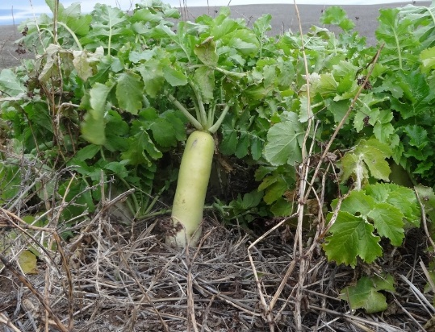
Project model: The farmers have the Great Ideas!
… then we grow acres of strange plants in replicated strips on the WSU Wilke Farm…

Slide 4
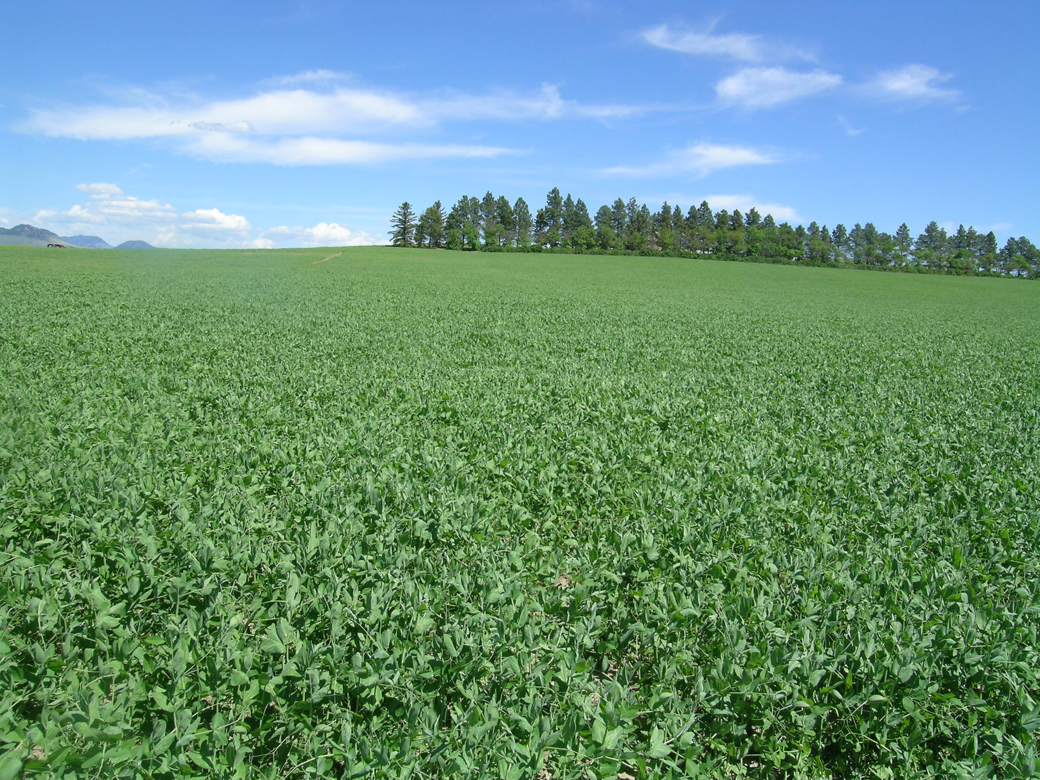
Why cover crops?
Austrian pea cover crop, Bob Quinn farm, Big Sandy, MT
14 inch precip, 40% in May and June
Zone 3 (-40 F)
4,000 acres
Certified organic since 1991
9-yr rotation
50% in cover crop all the time
NO supplementary fertilizer

Slide 5
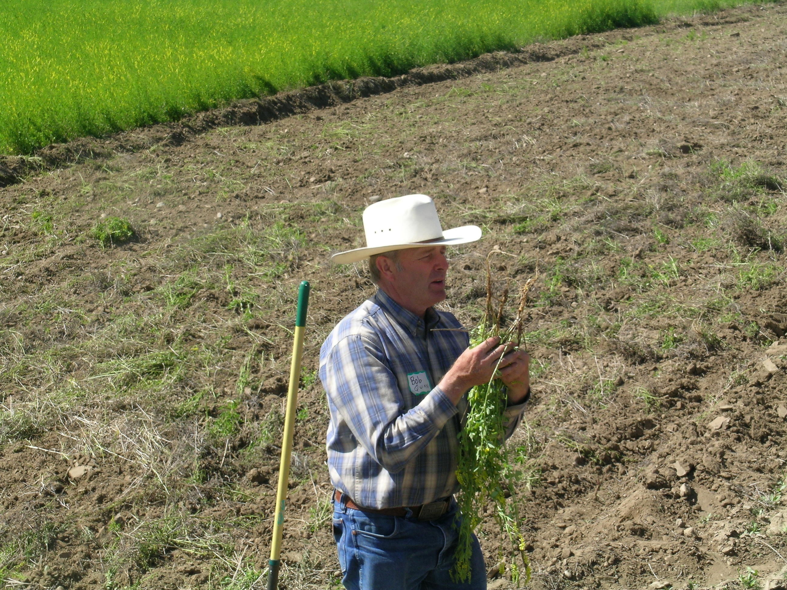
Yellow sweet clover cover crop
Seeded with nurse/companion crop (barley)
Disked down at flowering after 14 mths
Bob Quinn, “ I feed the soil, not the crop.”

Slide 6
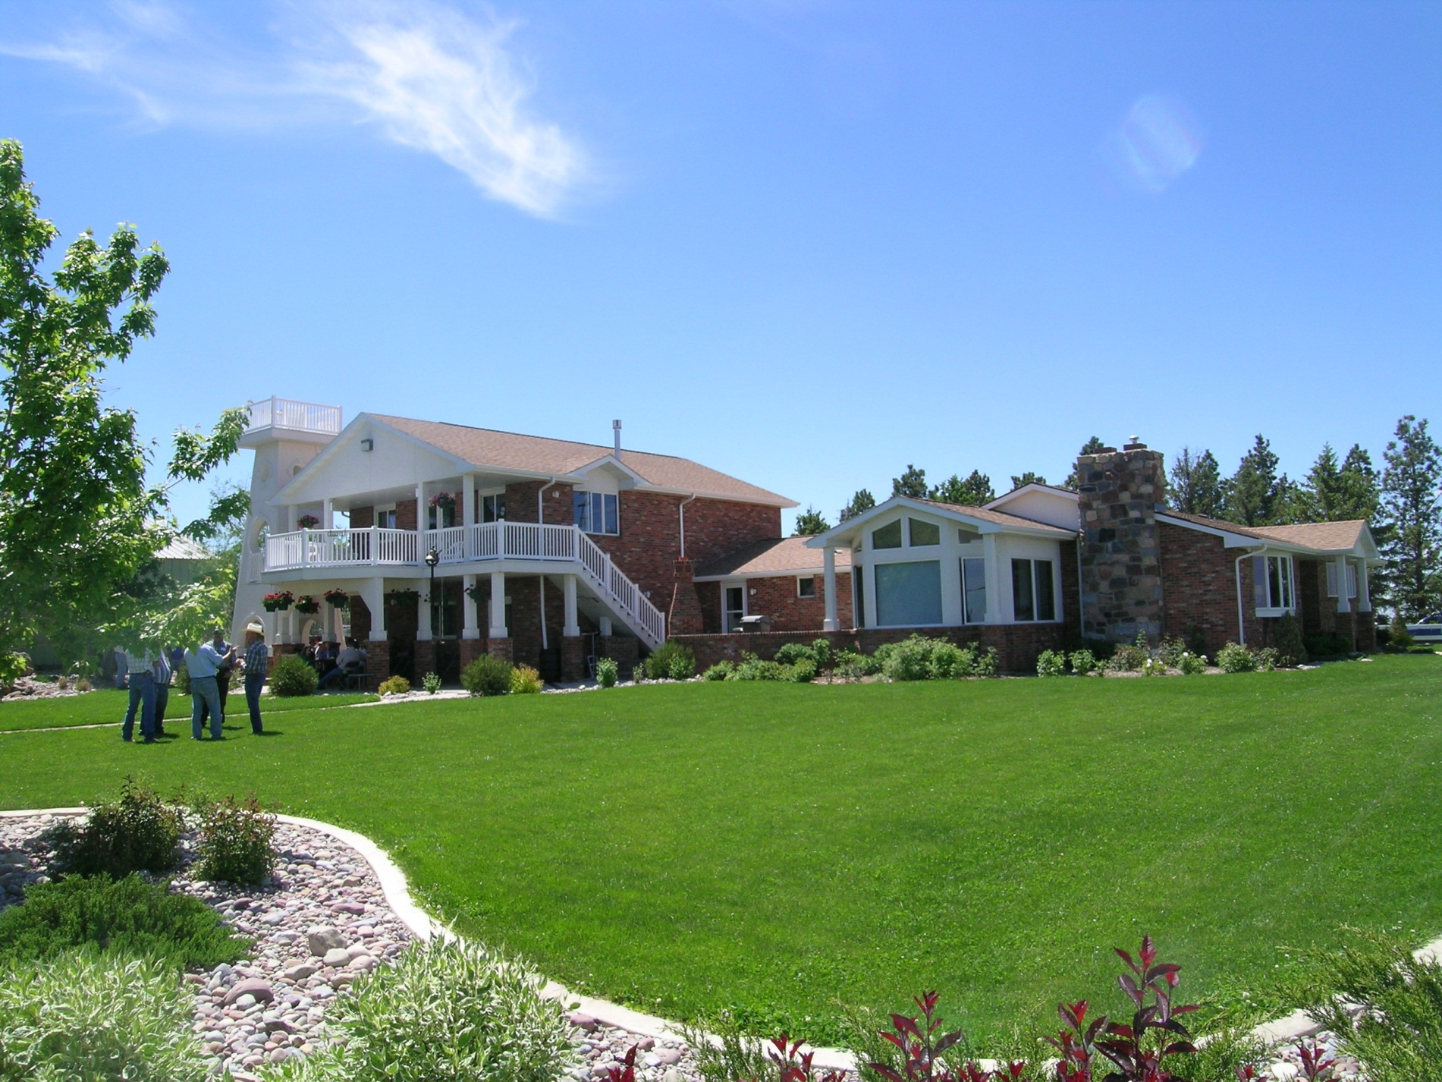
Bob Quinn homestead

Slide 7
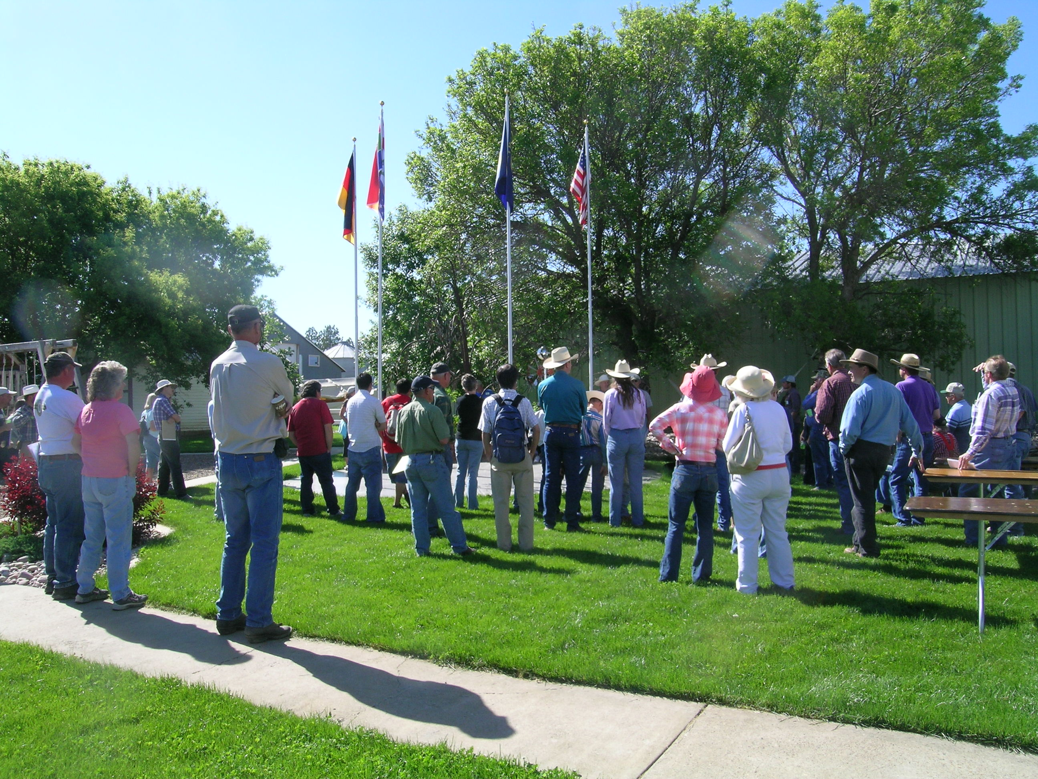
Fred Fleming, “After taking this tour and seeing Bob's farm it confirmed my belief that
a cover crop for soil health needs to be incorporated into my own direct seed farming system.”

Slide 8
Cover crop history in WA
Walter Goldstein (1980s) – crimson clover promising
Joel Jahn, Cliff Carstens (1992) – black medic not competitive
David Huggins (USDA-ARS) “We tried cover crops at Pullman and nothing was economic”
I have confidence in Farmers to Find a Way!

Slide 9
Definitions:
Cover Crop – grown to feed/benefit the soil so no harvested material leaves the field. Incorporated by tillage or sprayed down
  Legumes in the Palouse benefit subsequent crops but are not cover crops
Companion Crop – cover crop grown together with a harvested crop
Cover Crop Cocktail - mixture of 7 – 9 species as cover crop
  Warm season
  Cool season
  Grasses - biomass
  Broadleaves – tap root
  Legumes – fix nitrogen
ND data showed very little moisture loss, even in a dry year
“Something will thrive!”

Slide 10
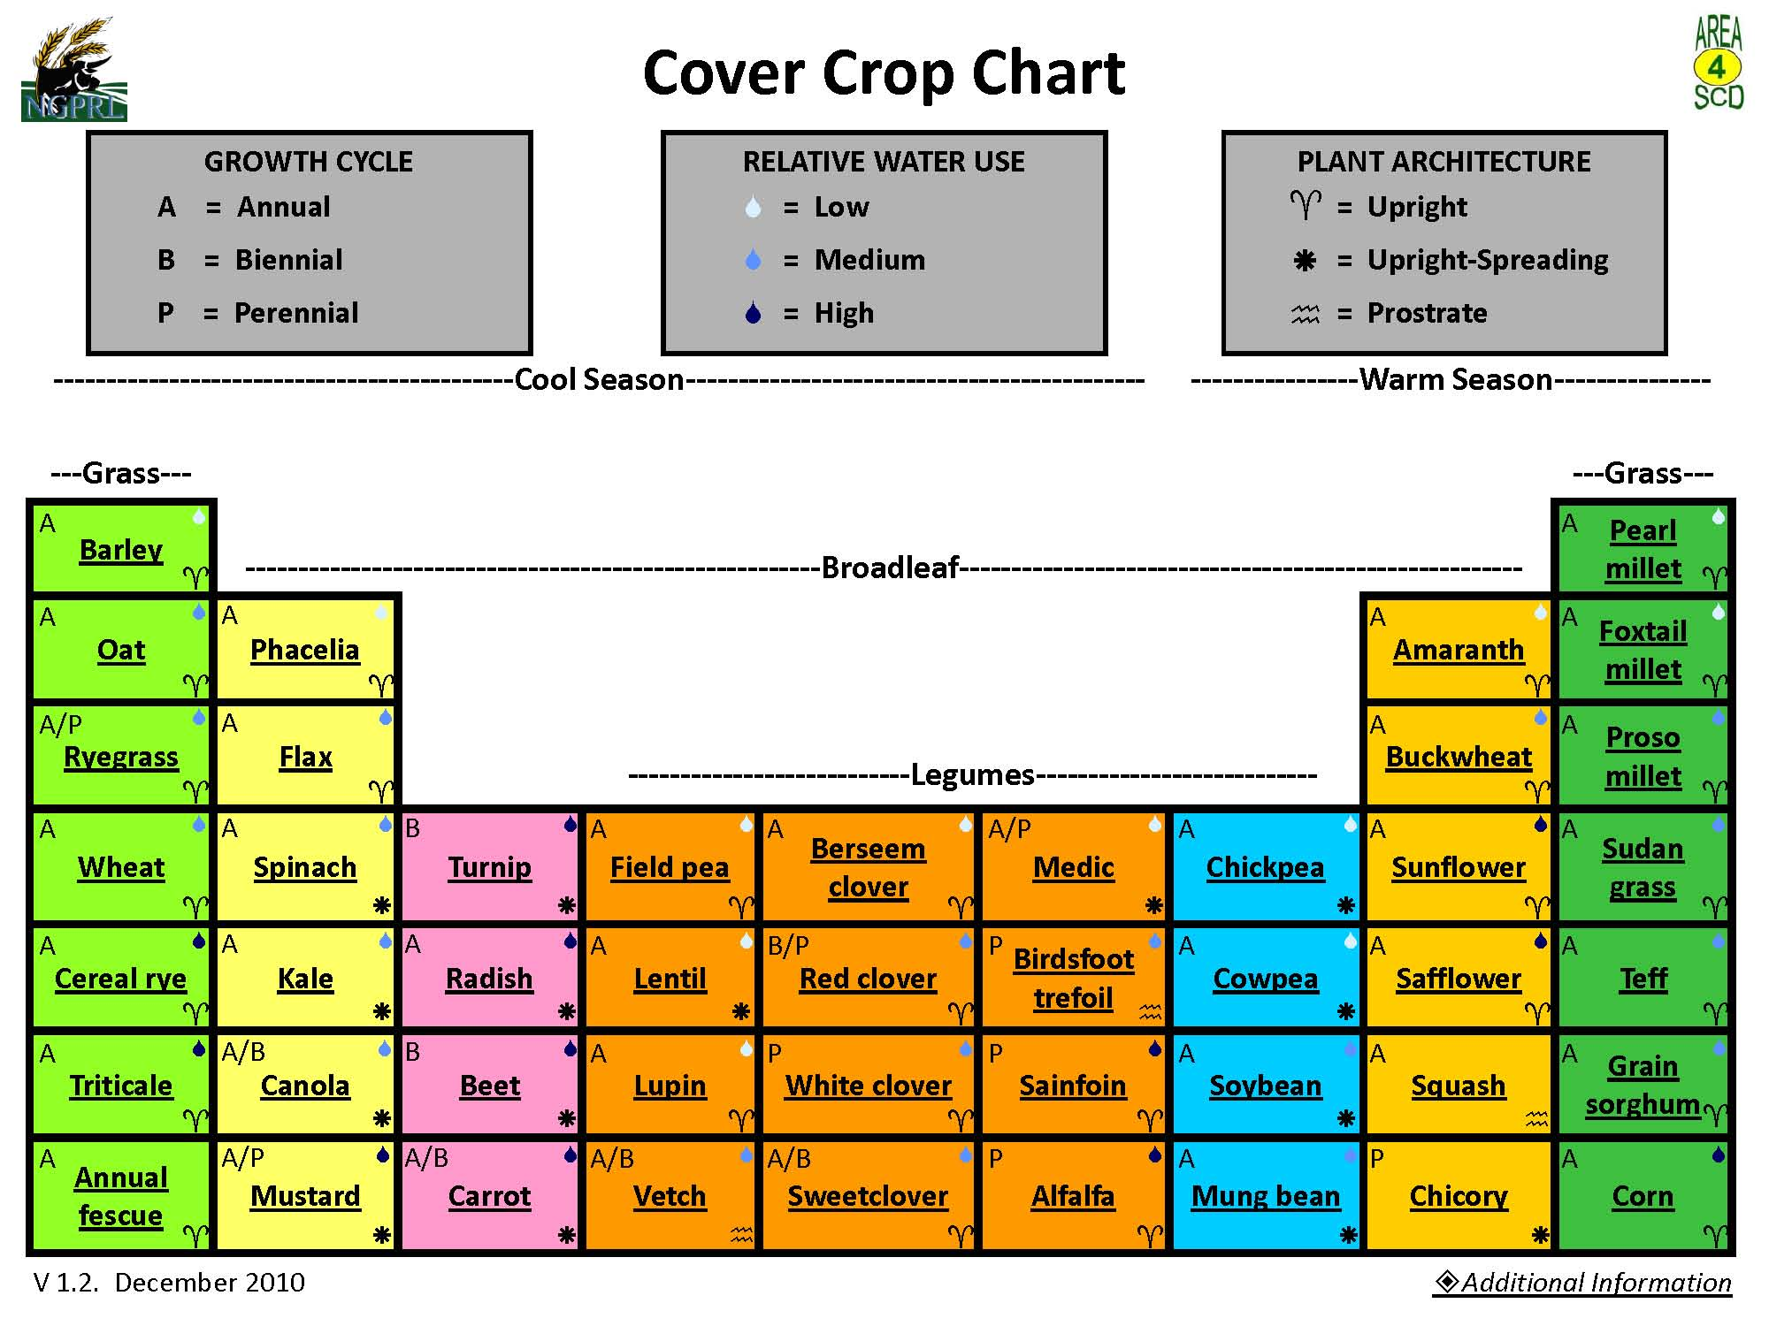

Slide 11
Goals/Resource Concerns of the Group
Increase nitrogen
  Scavenge nitrogen from deep soil
Increase soil organic matter
  Increase water holding capacity
  Improve soil structure
  Increase microbial activity
Break hardpan
Feed livestock
Control wireworms

Slide 12
2011 Cover Crop Trial A

Slide 13
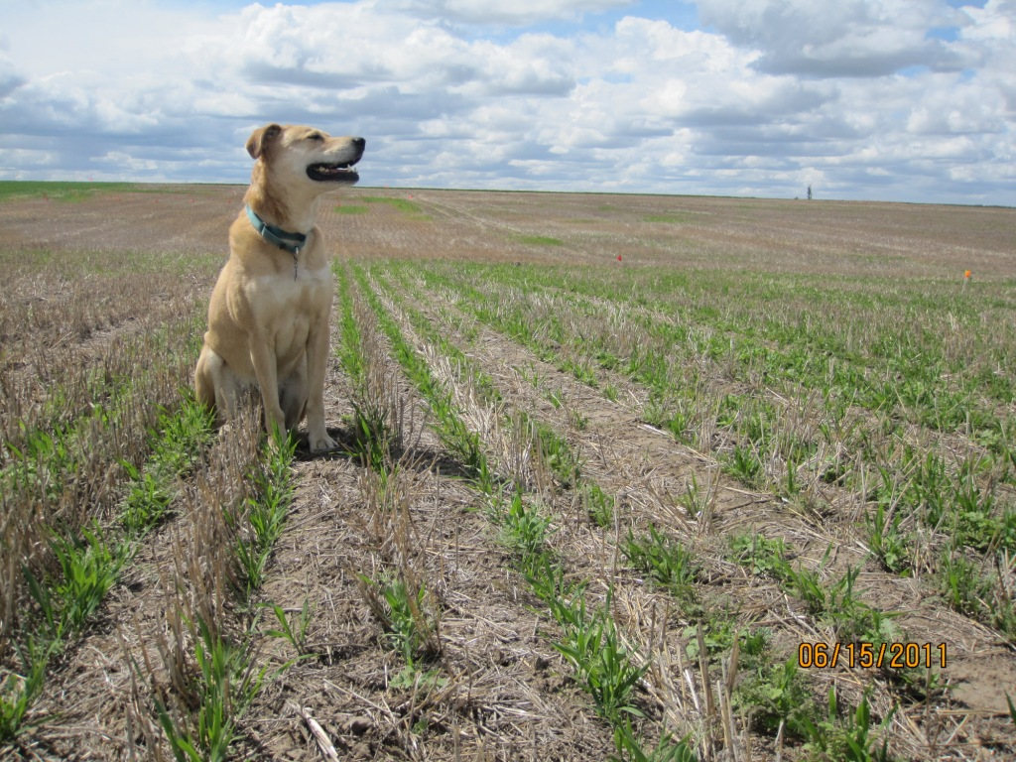
WSU Wilke Farm, Davenport, WA
- replicated strips 18 ft x 200 ft
- seeded mid-May
7 area farms, 5-acre demonstrations

Slide 14
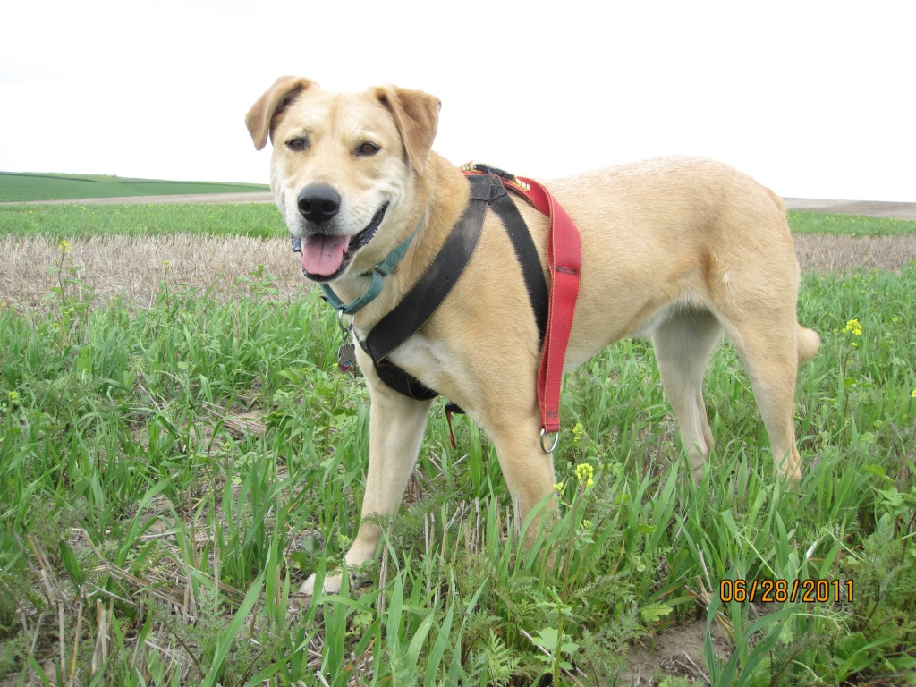

Slide 15
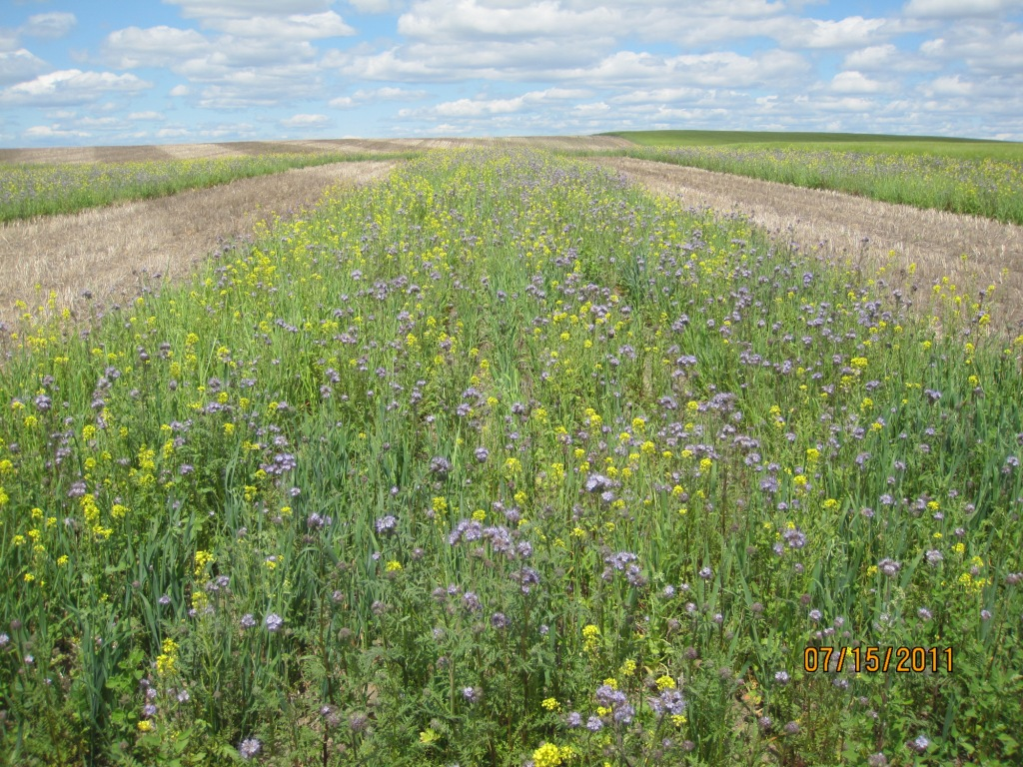

Slide 16
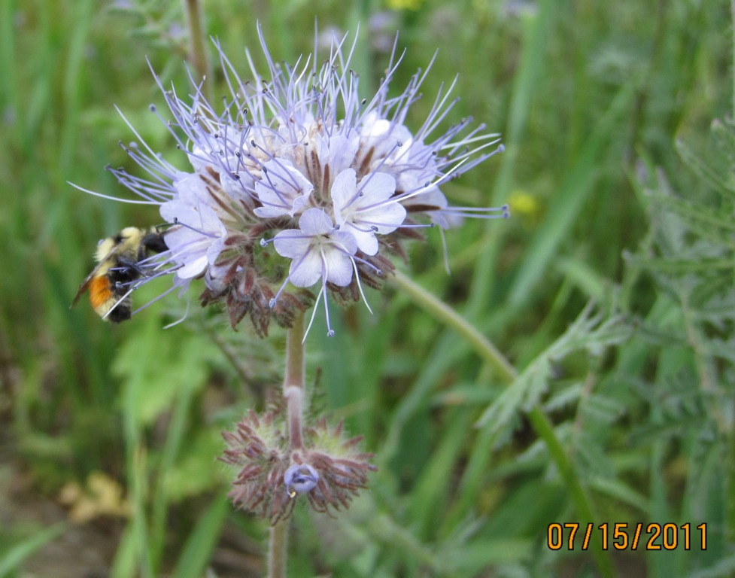
Phacelia tanacetifolia (lacy Phacelia) attracts native pollinators

Slide 17
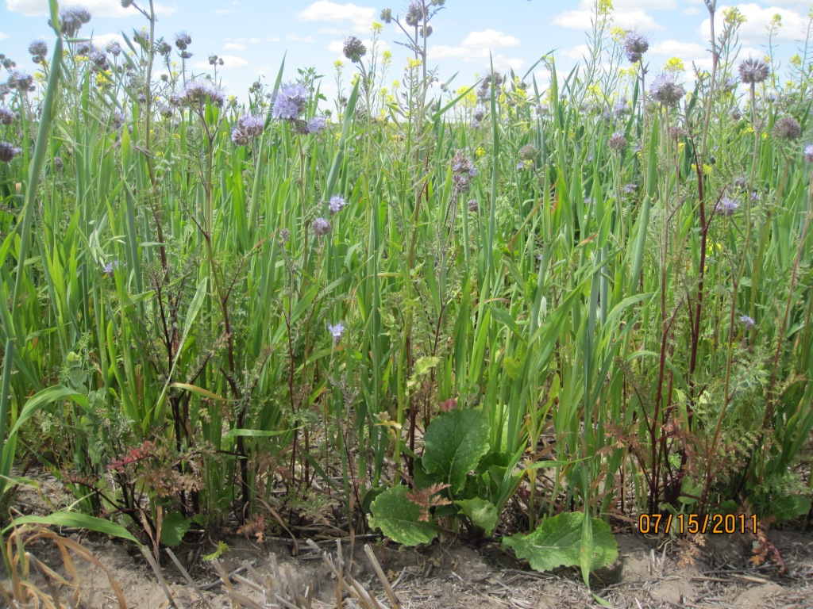

Slide 18
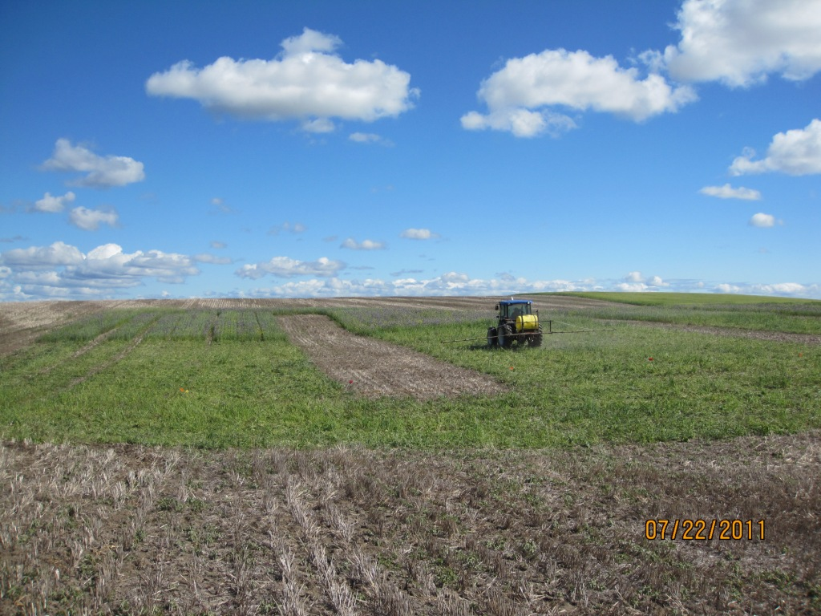

Slide 19
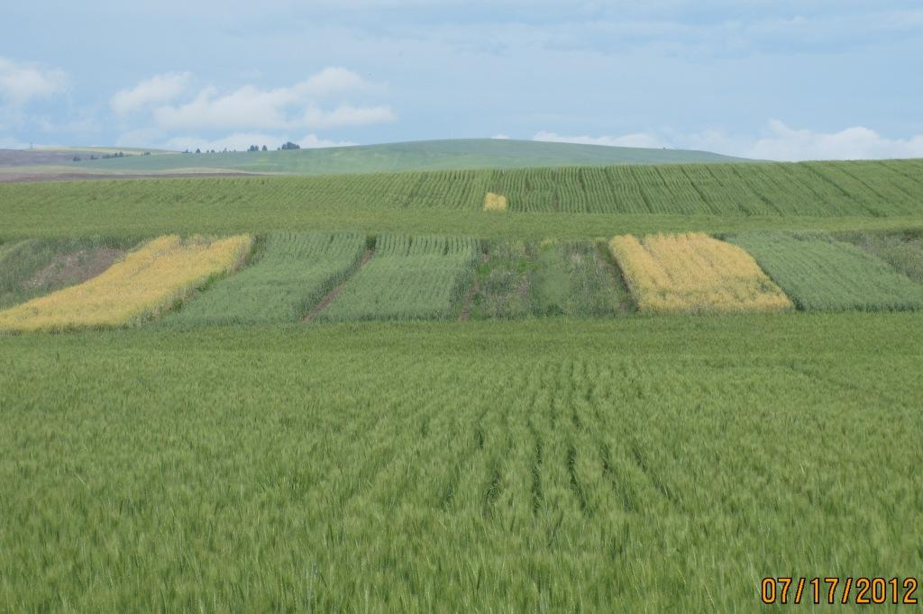
2012 wheat yields after CCC
44 bu/A
0 bu/A
Later seeding
55 bu/A
All plots spring canola in 2013

Slide 21
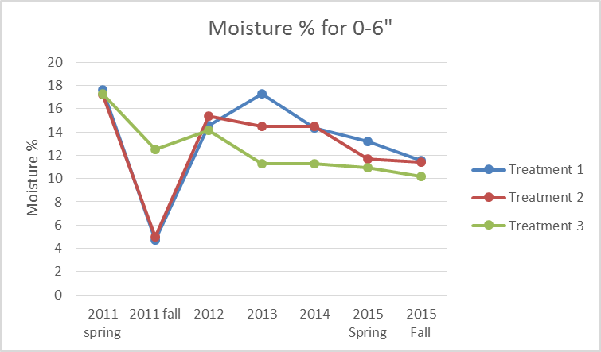
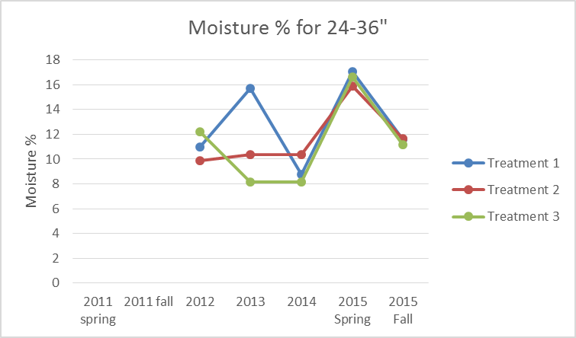
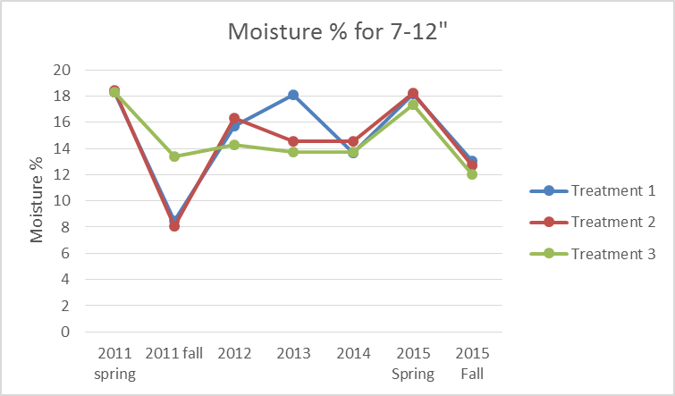
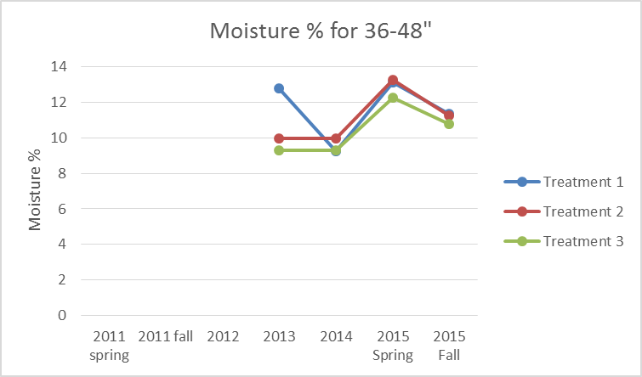
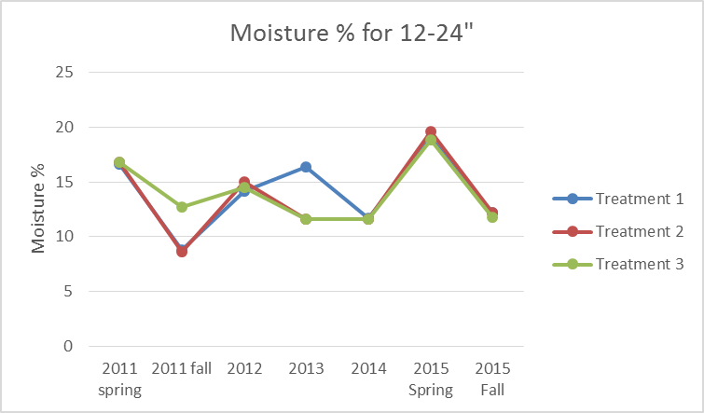

Slide 22
Stratification of pH

Slide 23
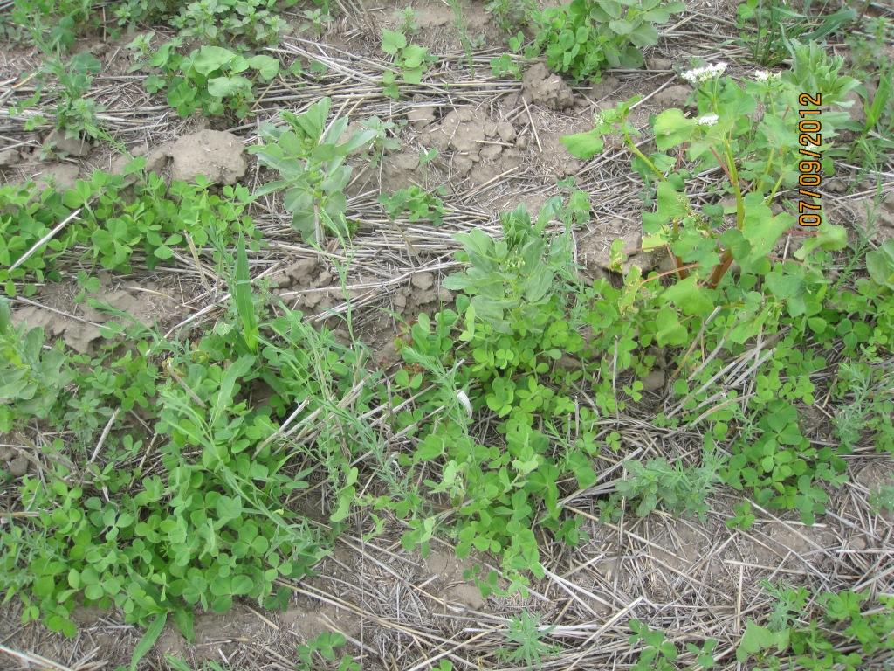


2012 Cover Crop Trial B
Faba bean
Millet
Buckwheat
Crimson clover
Flax

Slide 24
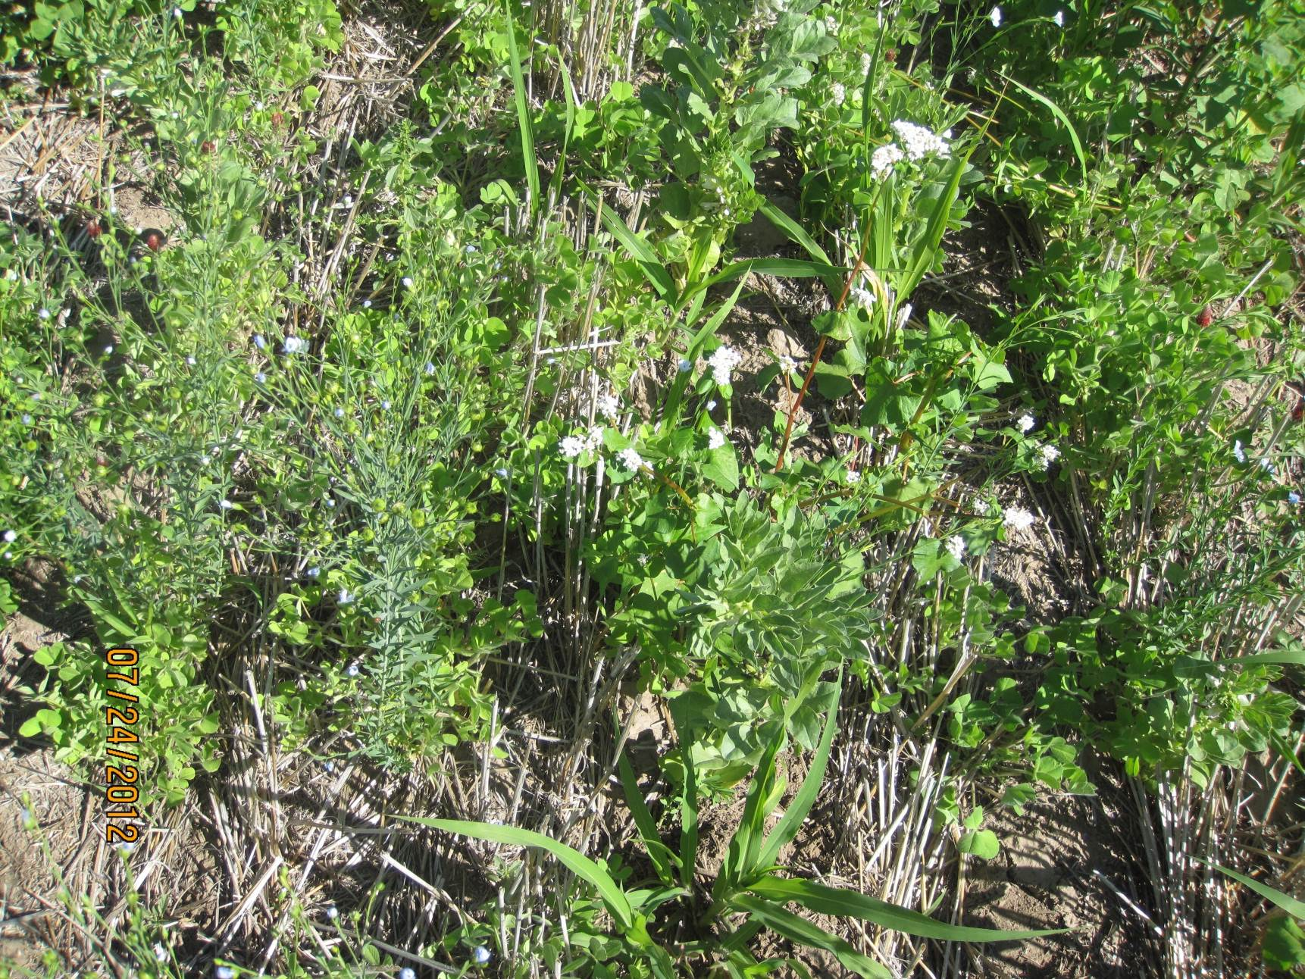
2012 – Warm season CCC
Crimson clover
Buckwheat
Faba bean
Flax
Millet

Slide 26
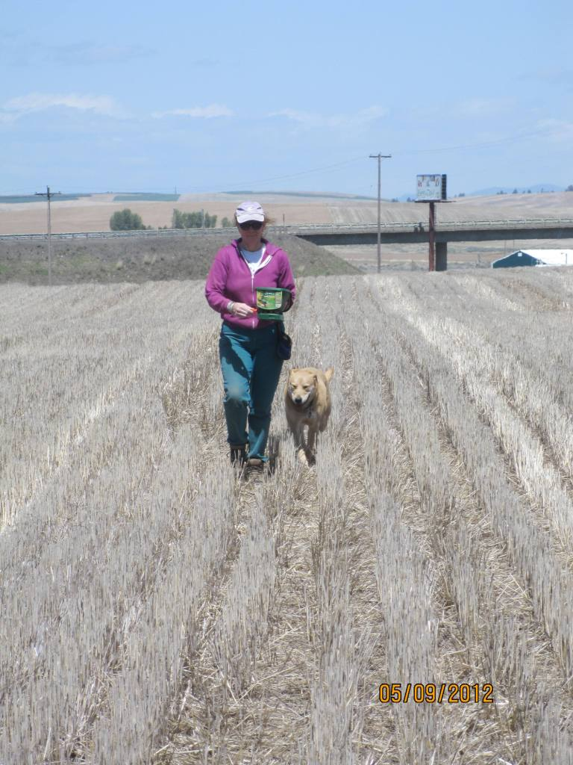
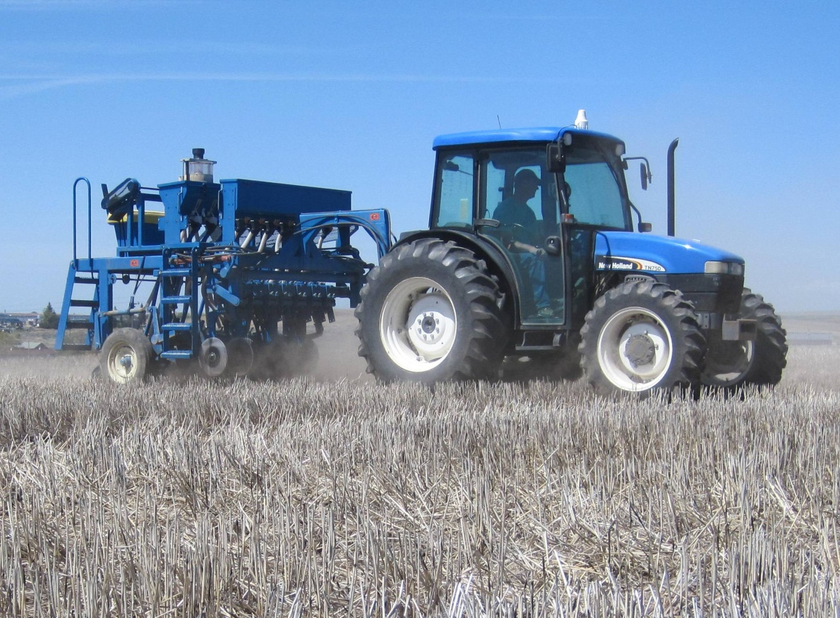
Revised Goal – Cover crops work with winter precip. system
My name is Murungu – not “Raven”
Grandfathers used yellow sweet clover as cover crop…

Slide 27
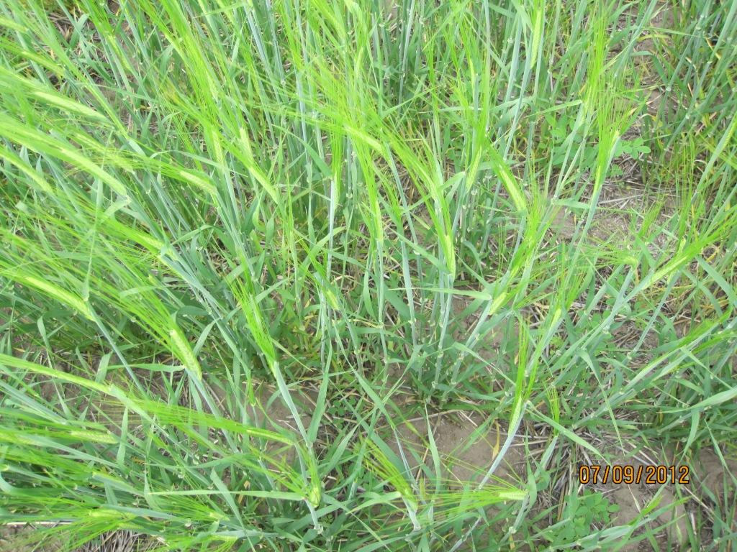
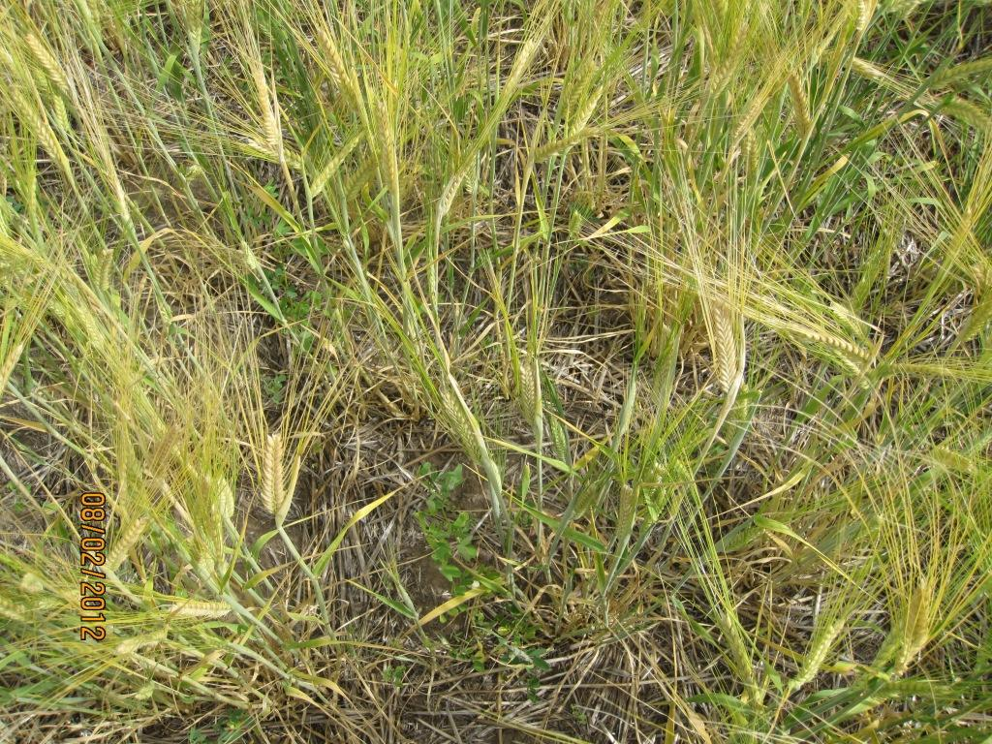
YSC is a biennial…

Slide 28
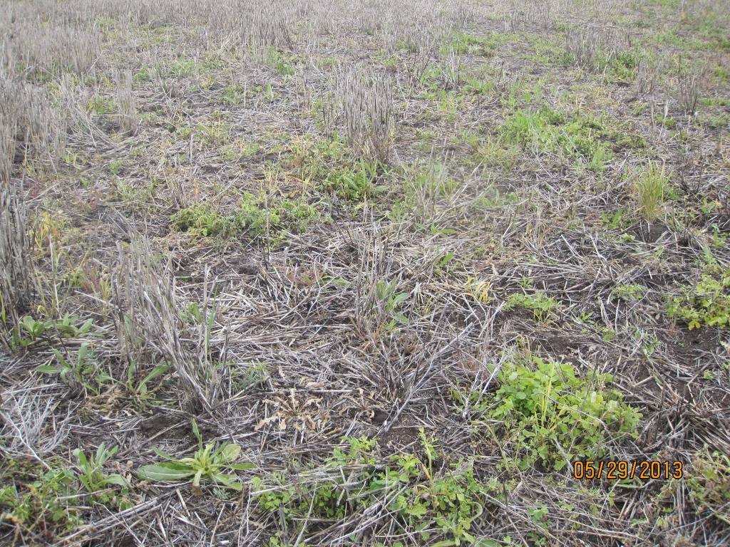
I was nervous waiting for the YSC to show last spring…

Slide 29
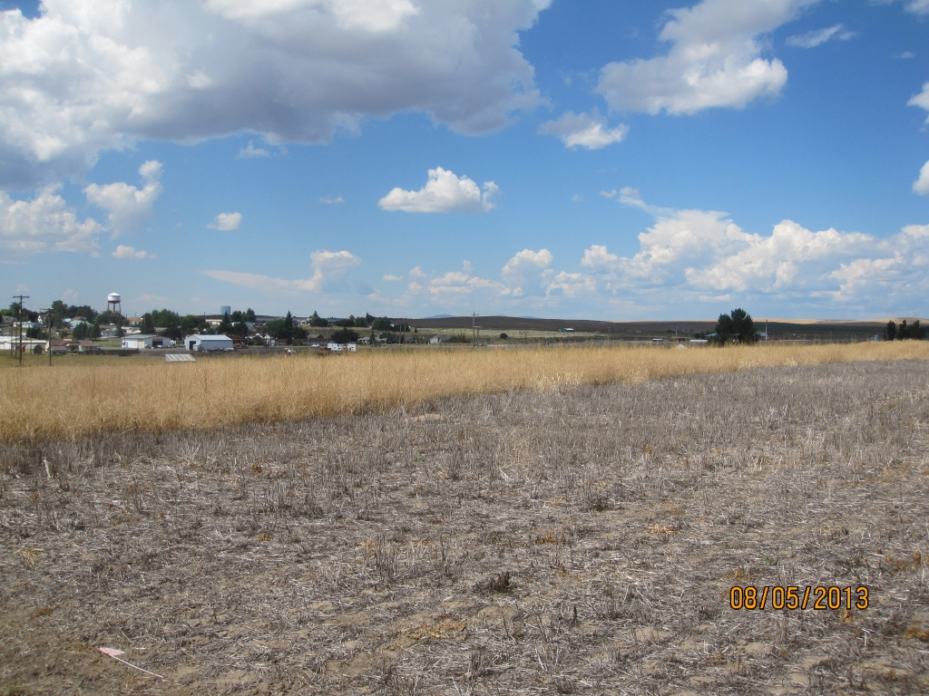
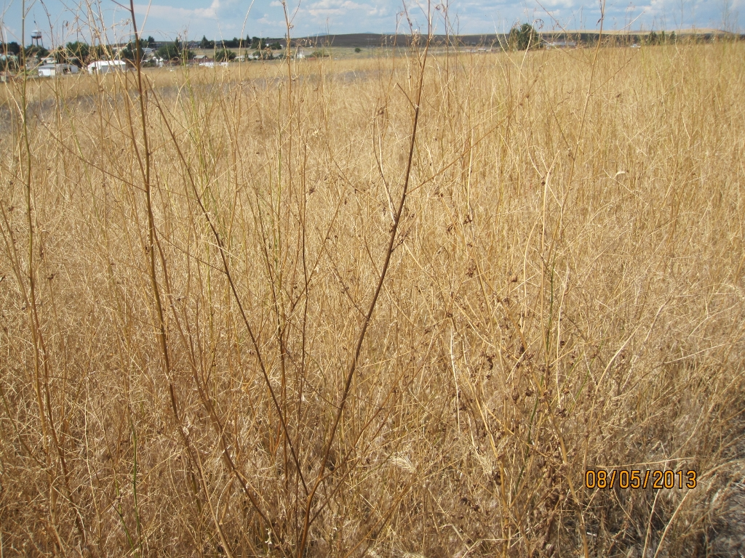
Spray out at Bolting
Spray out at Flowering
(nodules slough off)

Slide 30
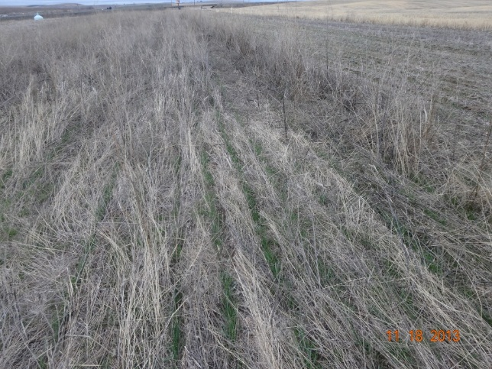

Slide 31
Wilke 2012 Companion Crop Trial C
2012 | Spring barley - Lenatah - Companion crop Yellow sweet clover - Madrid | Spring barley - Lenatah - Companion crop Yellow sweet clover - Madrid | Spring barley - Lenatah - Companion crop Yellow sweet clover - Madrid | Spring barley - Lenatah - Companion crop Yellow sweet clover - Madrid
3 reps | Fert: Zero :( Seed 70 lb/A | Fert: Zero :( Seed 70 lb/A | Fert: Zero :( Seed 70 lb/A | Fert: Zero :( Seed 70 lb/A
2012/13 | YSC biennial | YSC biennial | YSC biennial | YSC biennial
 | Fert: Zero :( Seed 10-15 lb/A Broadcast No Inoculum :( | Fert: Zero :( Seed 10-15 lb/A Broadcast No Inoculum :( | Fert: Zero :( Seed 10-15 lb/A Broadcast No Inoculum :( | Fert: Zero :( Seed 10-15 lb/A Broadcast No Inoculum :(
2014 | Winter wheat - Xerpha | Spring wheat | Winter wheat - Xerpha | Spring wheat
3 reps | 10-Sep |  | 10-Sep

Slide 32
Wilke 2013 Companion Crop Trial D
2013 | Spring barley - Lenatah - Companion crop Yellow sweet clover - Madrid | Spring barley - Lenatah - Companion crop Yellow sweet clover - Madrid | Spring barley - Lenatah - Companion crop Yellow sweet clover - Madrid | Spring barley - Lenatah - Companion crop Yellow sweet clover - Madrid
3 reps | Barley April 25 - Aug 24 1.6 ton/A | Barley April 25 - Aug 24 1.6 ton/A | Barley April 25 - Aug 24 1.6 ton/A | Barley April 25 - Aug 24 1.6 ton/A
2013/14 | YSC biennial | YSC biennial | YSC biennial | YSC biennial
3 reps | May 25, 2013 Seed 20 lb/A Broadcast No inoculant :( | May 25, 2013 Seed 20 lb/A Broadcast No inoculant :( | May 25, 2013 Seed 20 lb/A Broadcast No inoculant :( | May 25, 2013 Seed 20 lb/A Broadcast No inoculant :(
 | May 30, 2013 10 lb/A Drilled No inoculant :( | May 30, 2013 10 lb/A Drilled No inoculant :( | May 30, 2013 10 lb/A Drilled No inoculant :( | May 30, 2013 10 lb/A Drilled No inoculant :(
2015 | Winter wheat | Spring wheat | Winter wheat | Spring wheat
3 reps

Slide 33
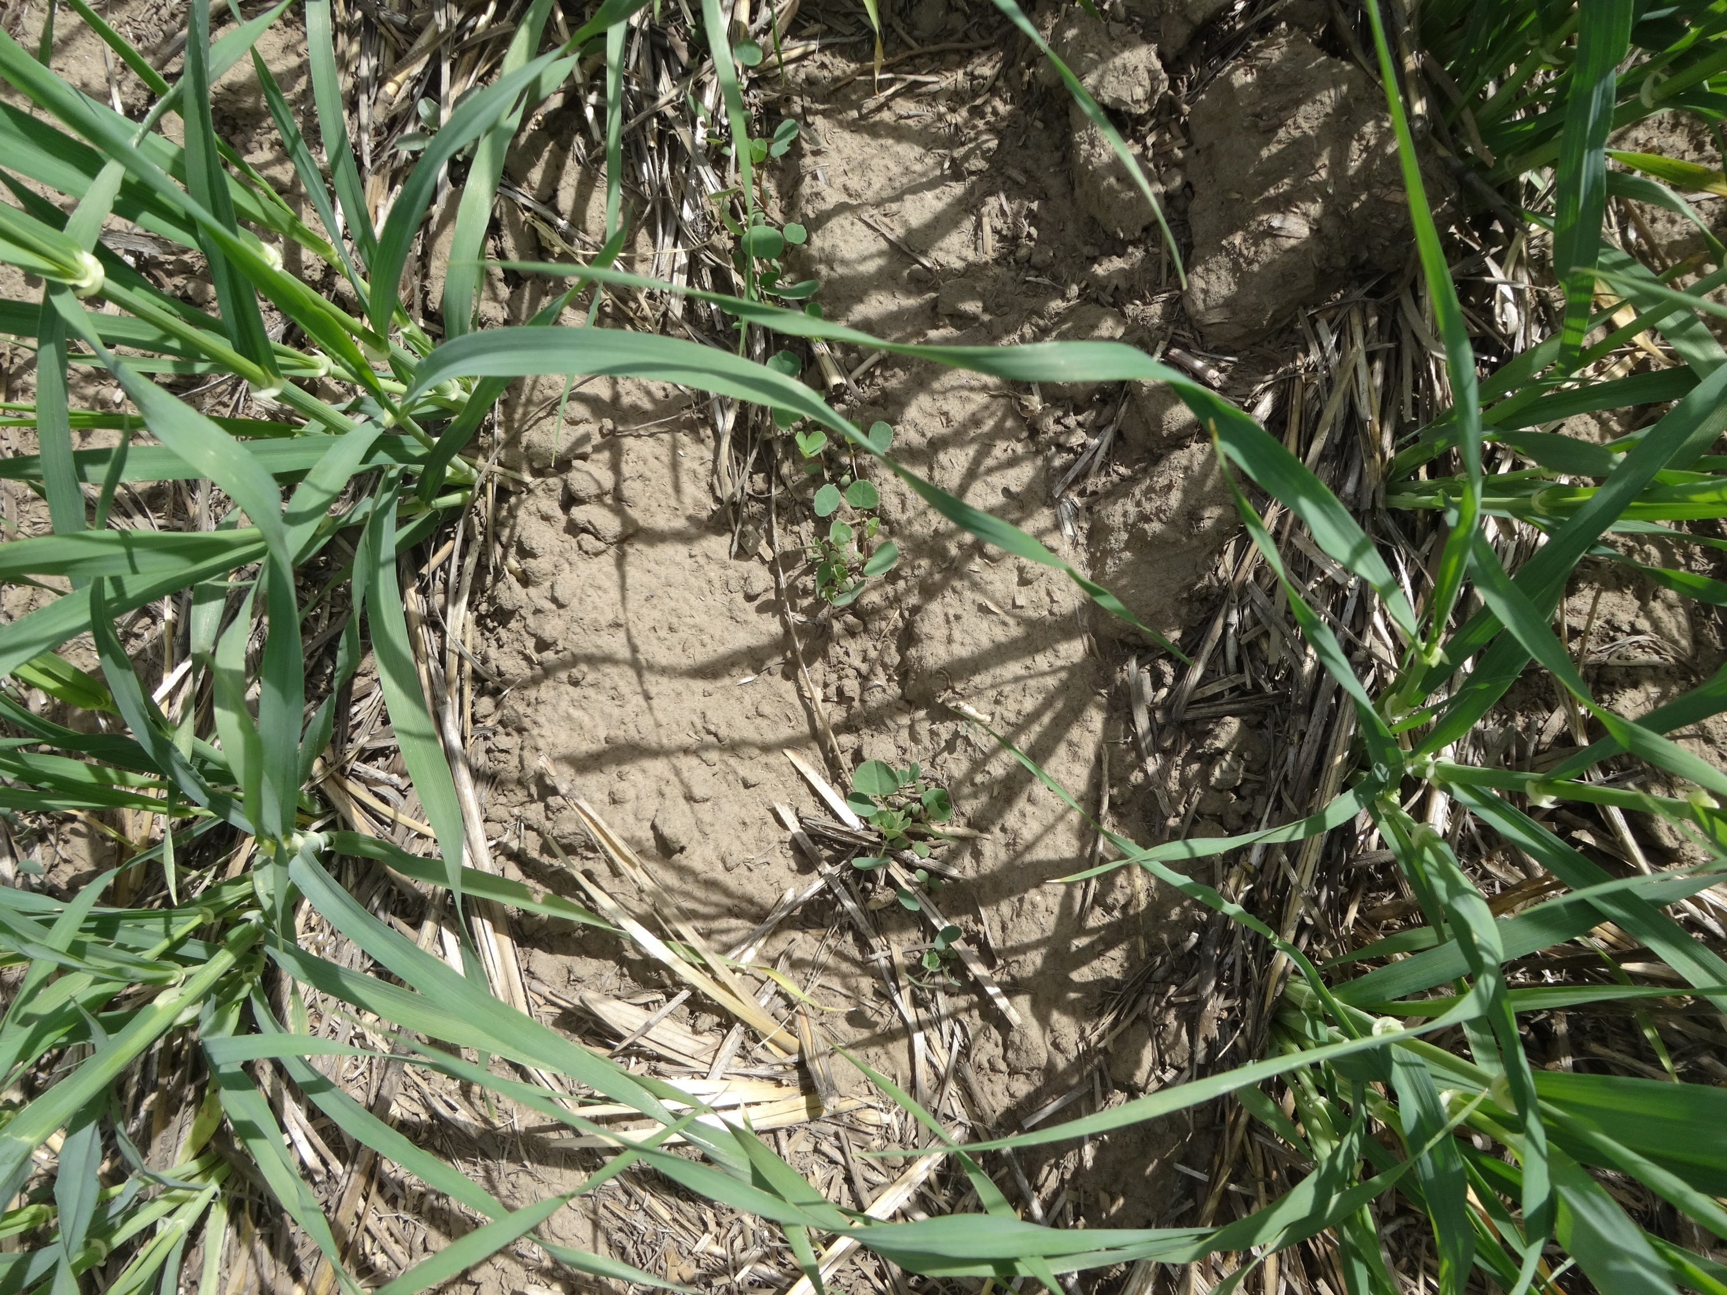

Slide 34
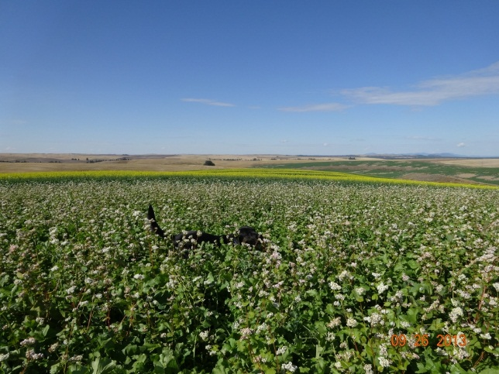
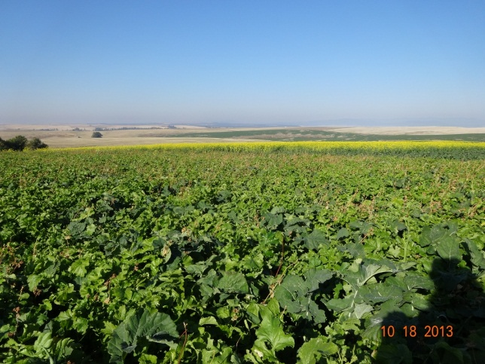
Fall 2013 Companion Crop - Charles Gross’s idea

Slide 35
Wilke 2013 Companion Crop Trial E

Slide 36
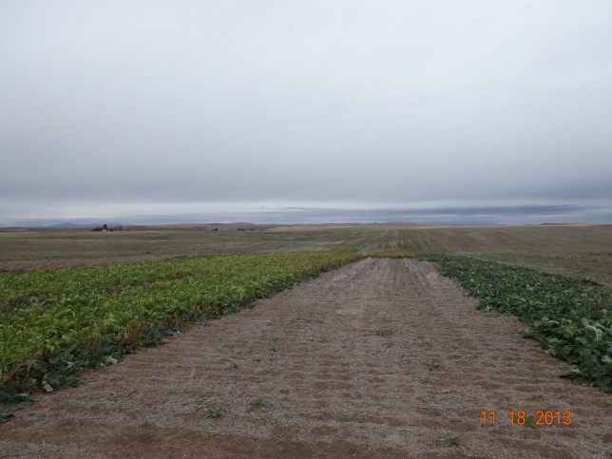
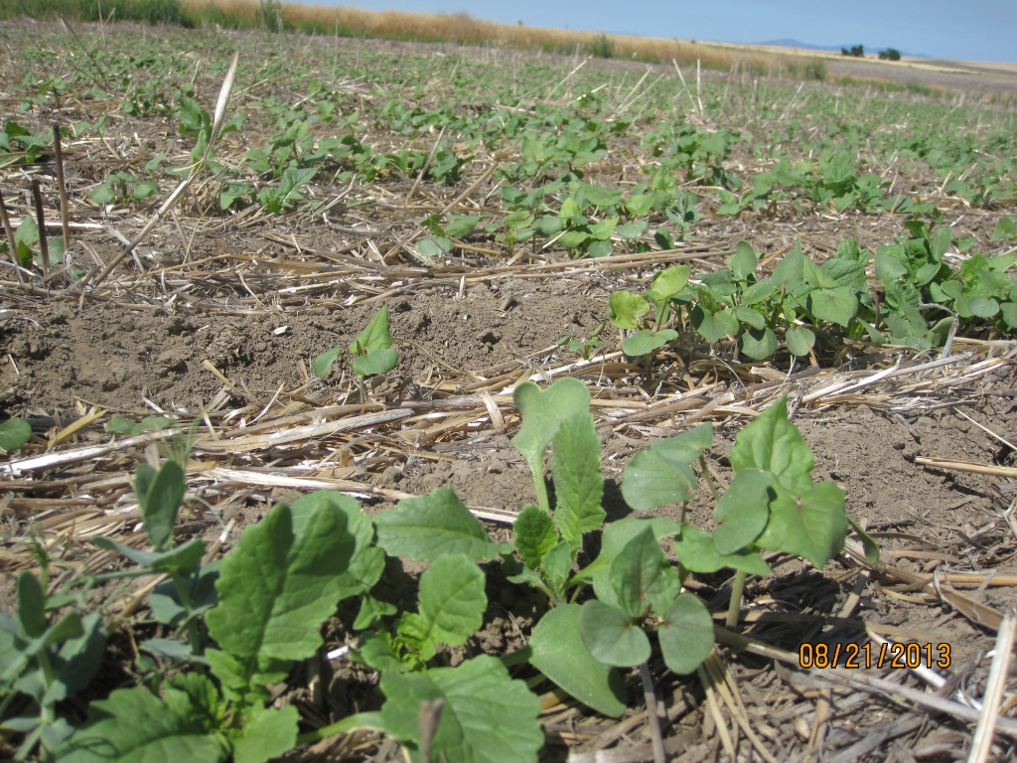
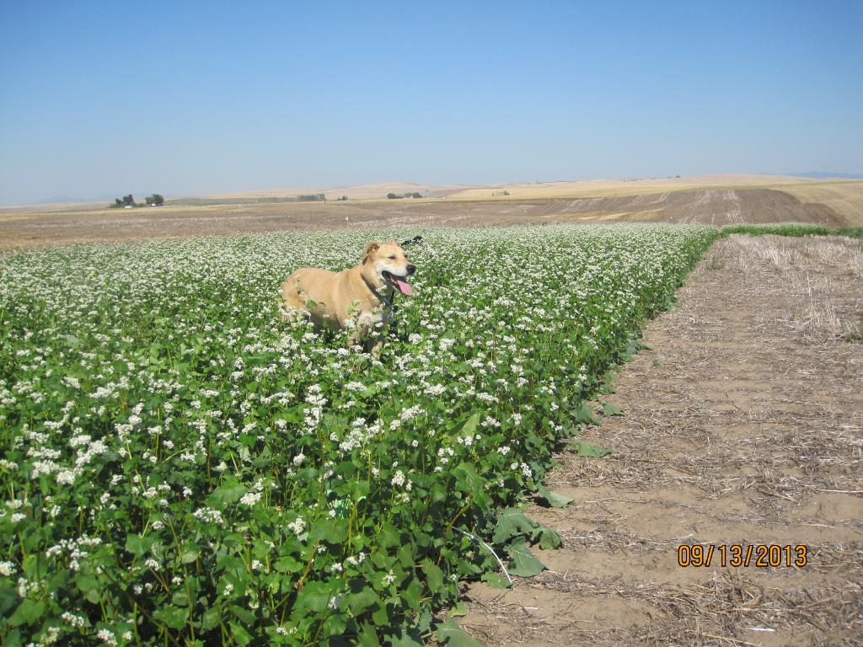
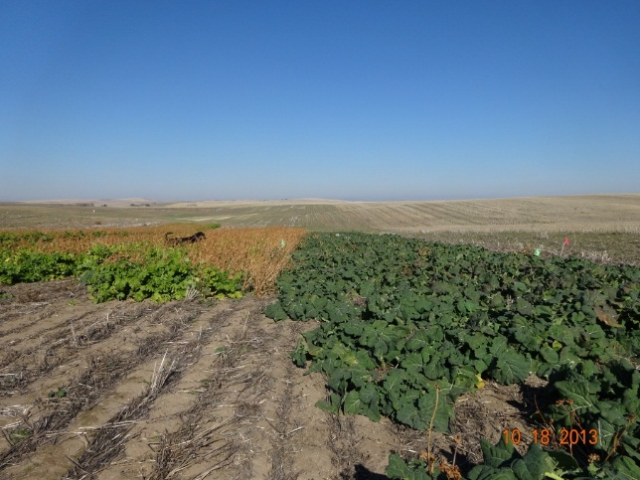
Wilke Companion Crop Trial E (Fall 2013)

Slide 37
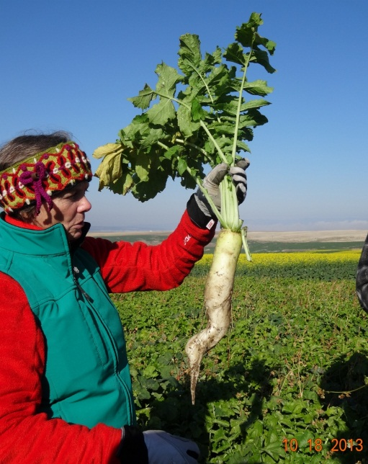
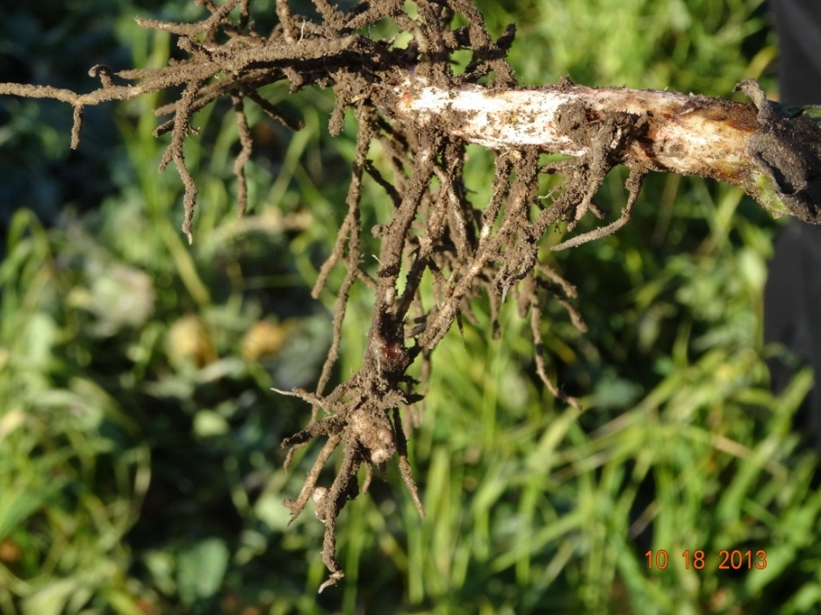
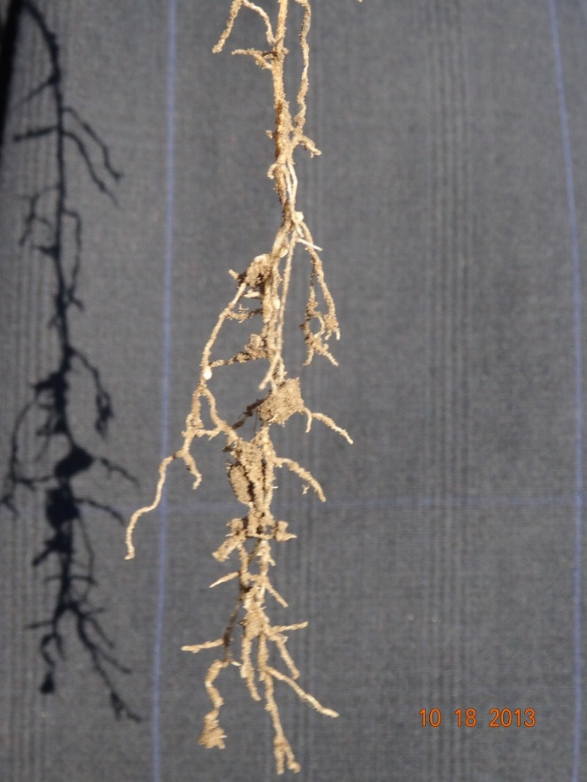
Effective crop species?
Jill Clapperton
Nitro radish
Faba bean
NRCS (Pamela Pavek) testing individual species
Crimson clover

Slide 38
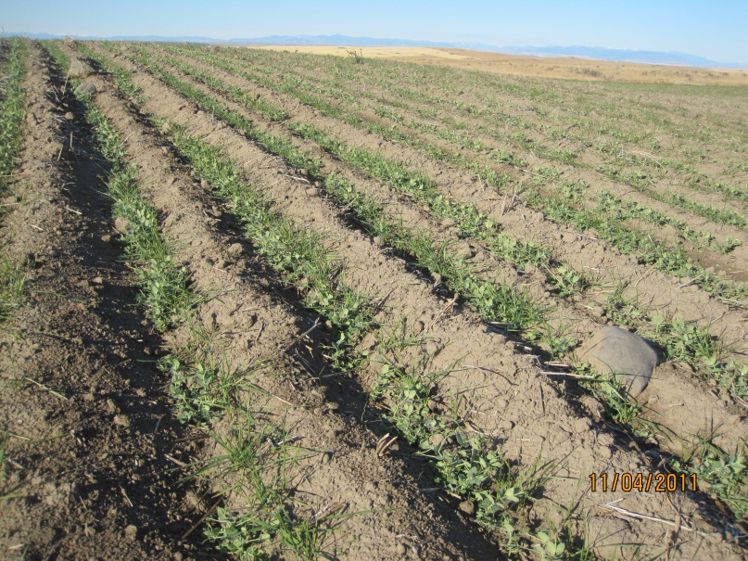
Lessons learned to date:
Legumes benefit subsequent crops only
Fertilize companion/cover crops?
Use inoculant for all legumes
Fallow provides H2O for germinating crop – cover crop likely reduce this
Need to seed companion crops at economic rate and don’t outcompete the primary crop…

Slide 40
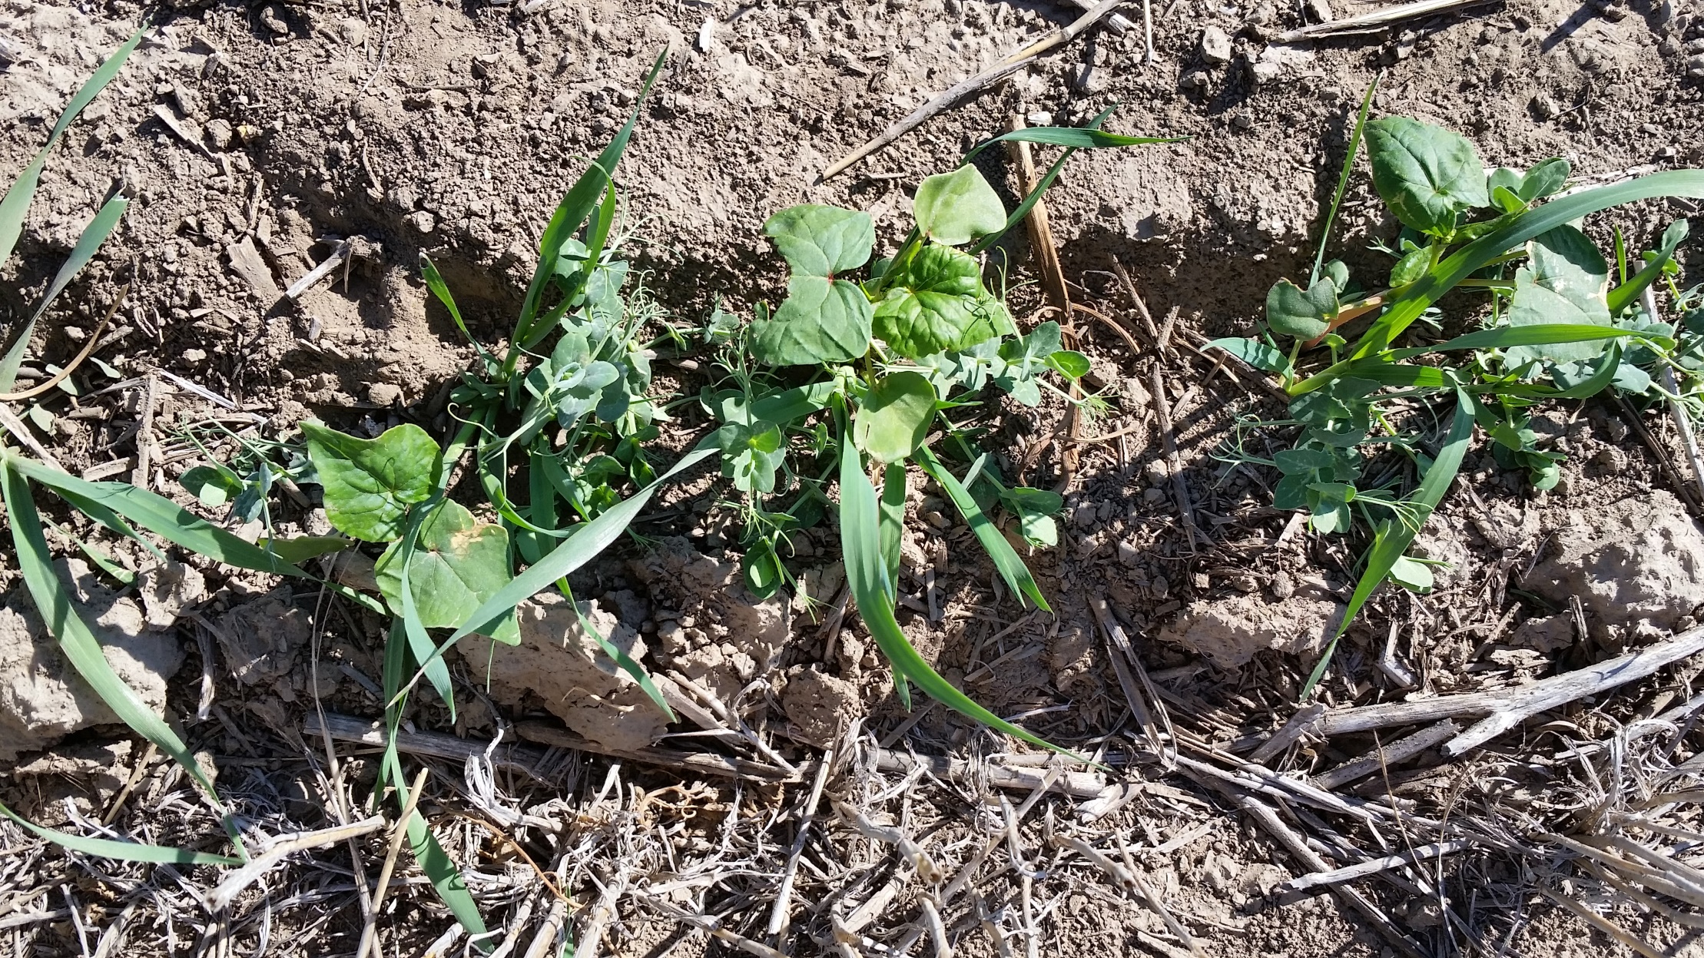
Companion crop with winter pea fall 2015

Slide 41
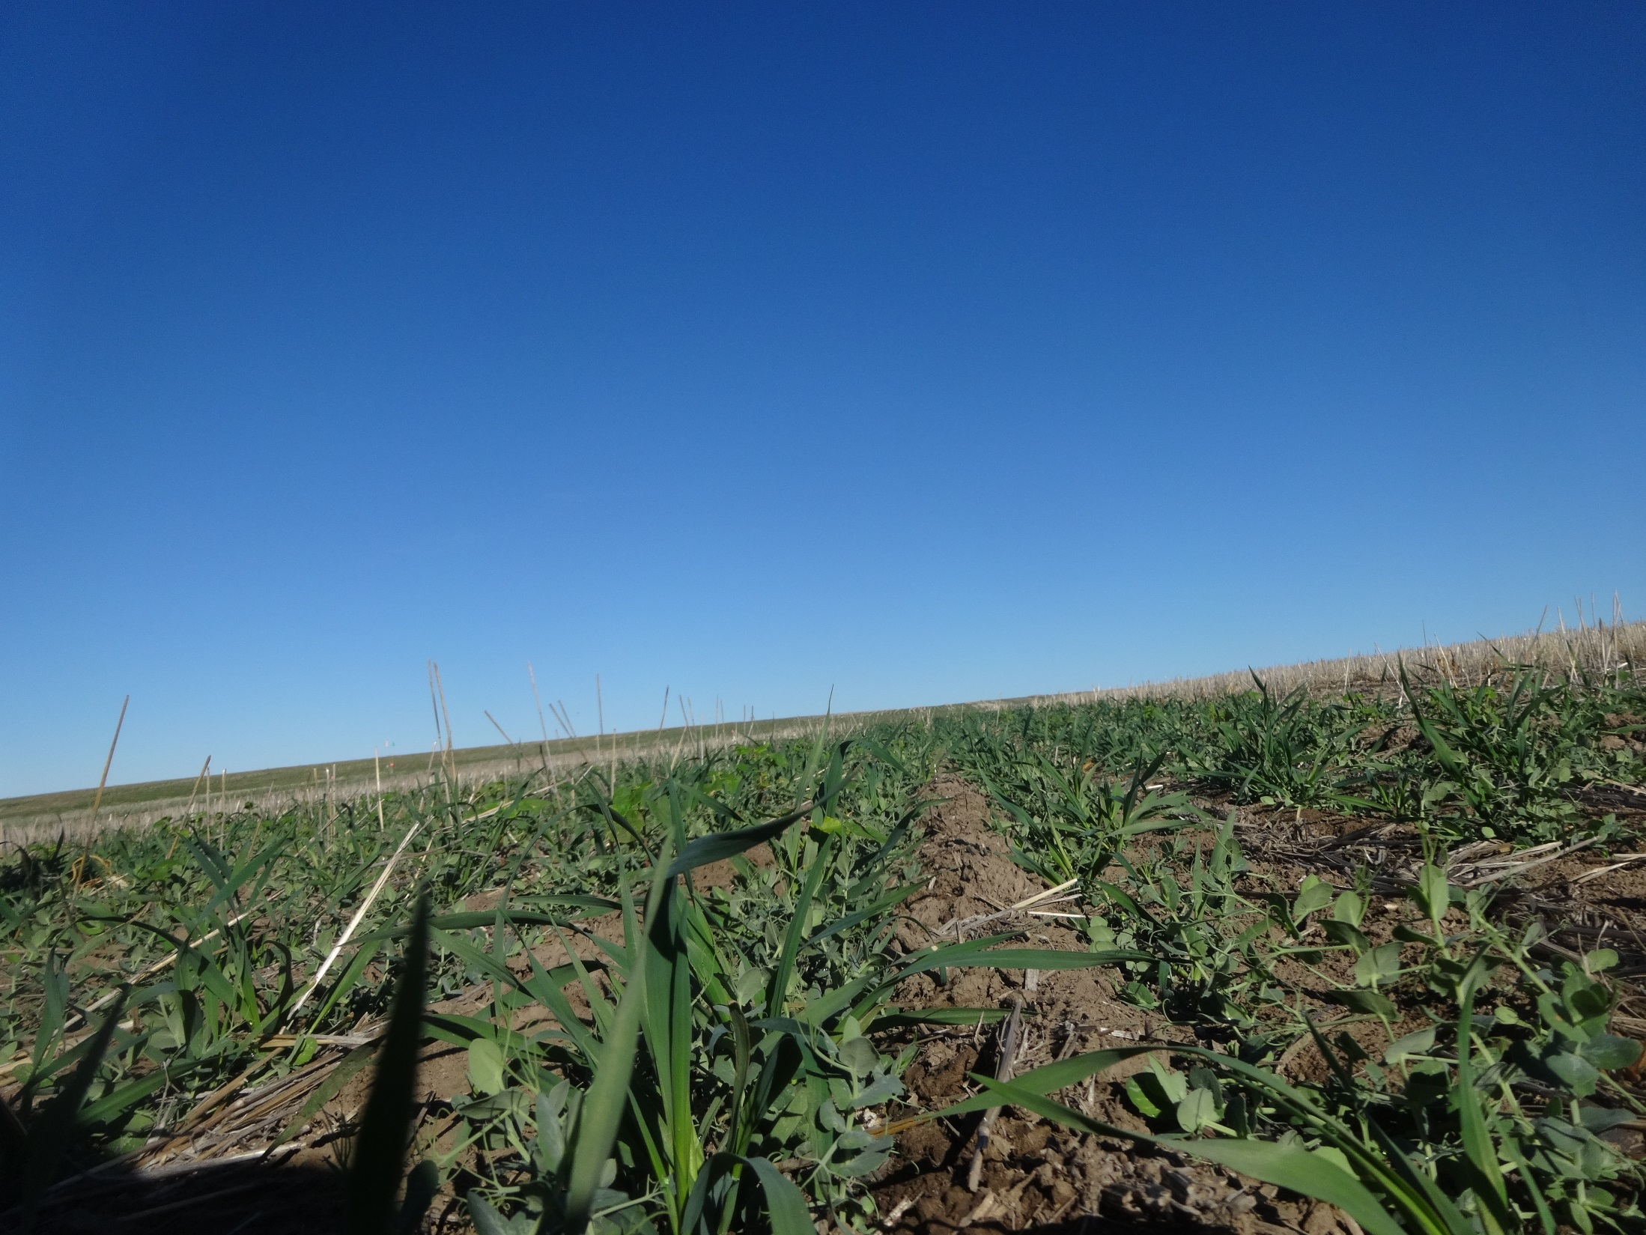

Slide 43
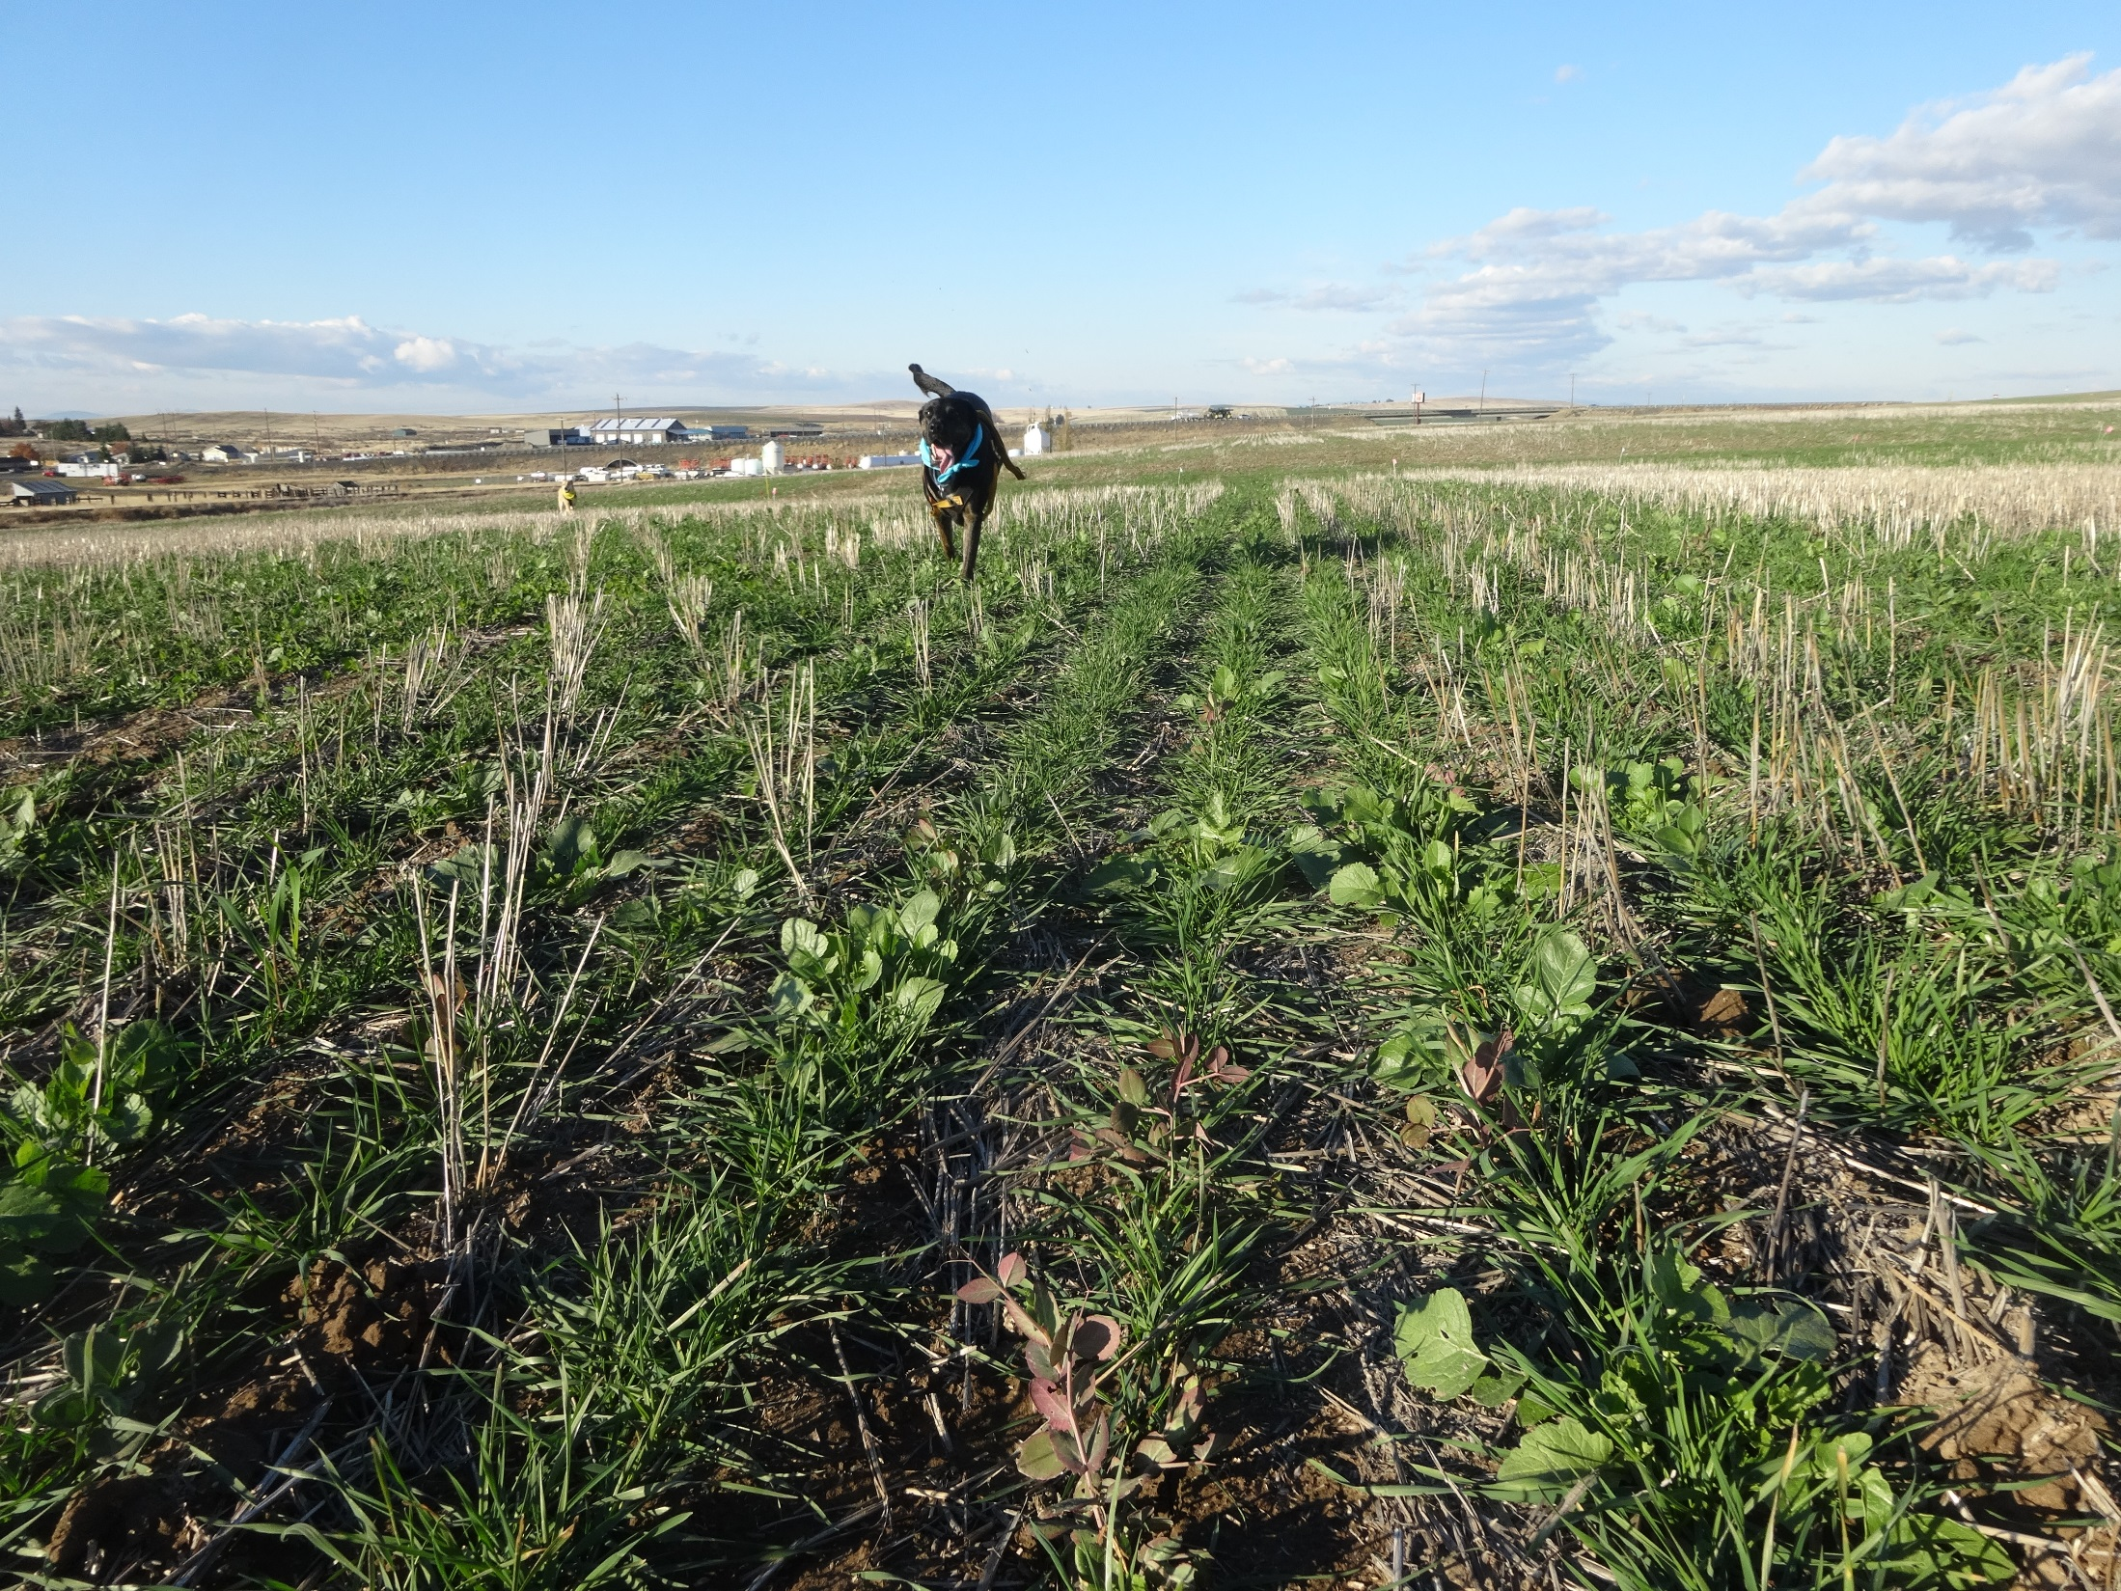

Slide 44
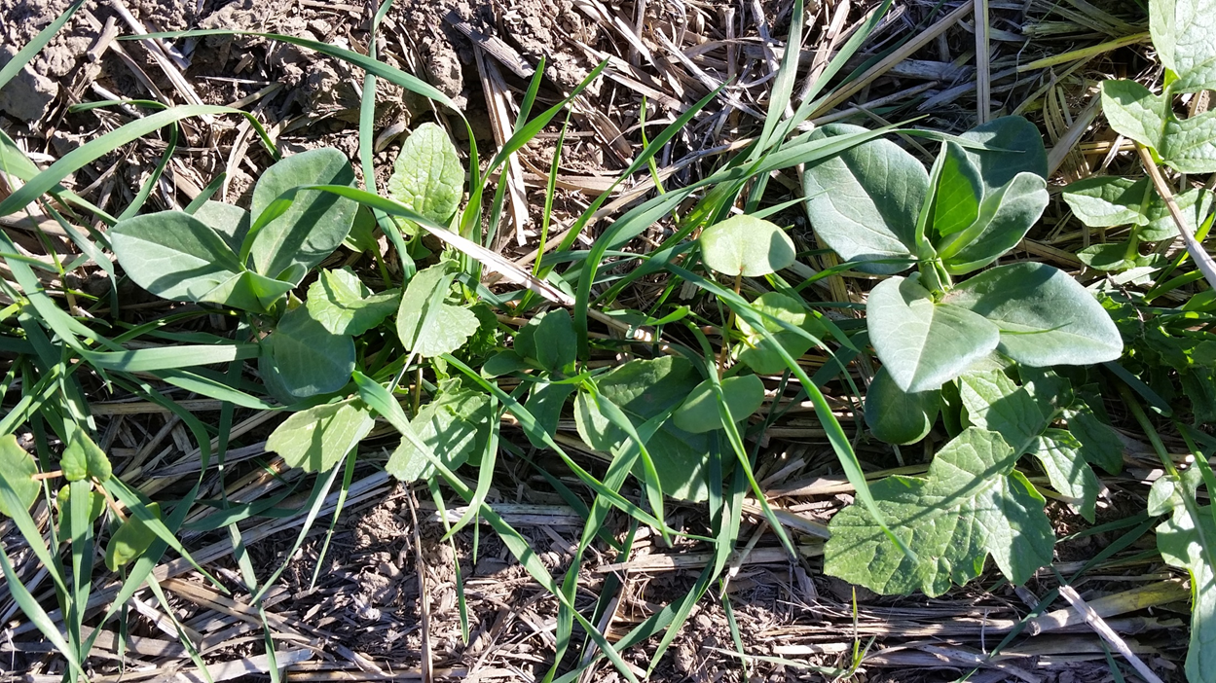
Companion crop with winter wheat fall 2015

Slide 45
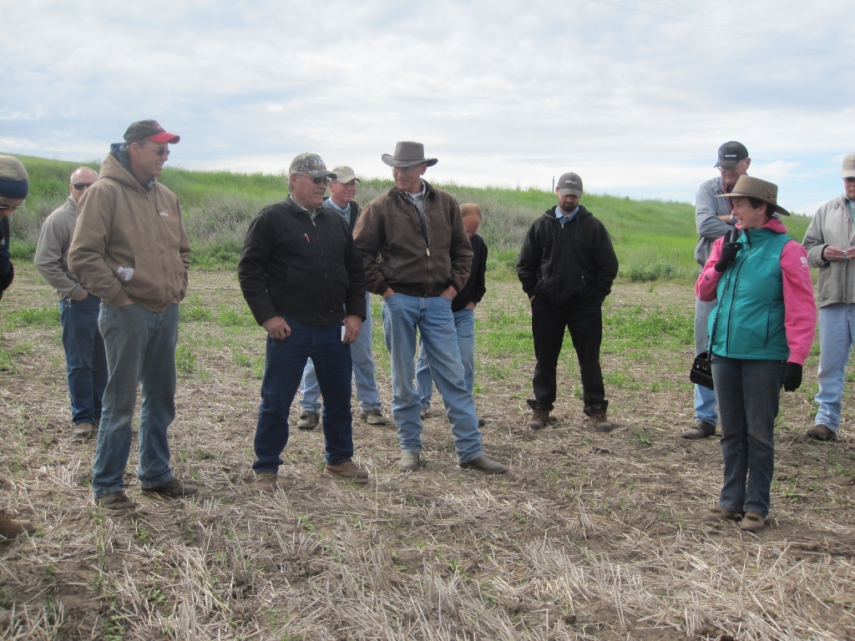
Additional lessons/goals:
Cover crop in place of fallow is high risk in our environment
Farmers want to maintain cash crop economics
Companion crops may be more feasible
Trying to secure more funding
Questions?

Slide 46
Answer all applicable
I have tried cover/companion crops – successfully
I have tried cover/companion crops – never again
Cover/companion crops won’t work in my area
I plan to try cover/companion crops

