Slide 1
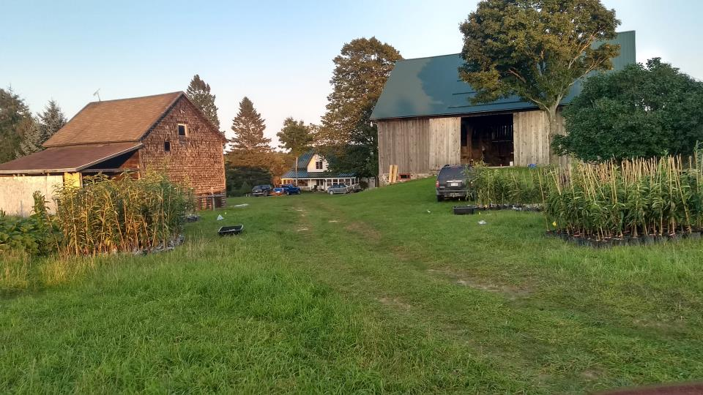

Slide 8
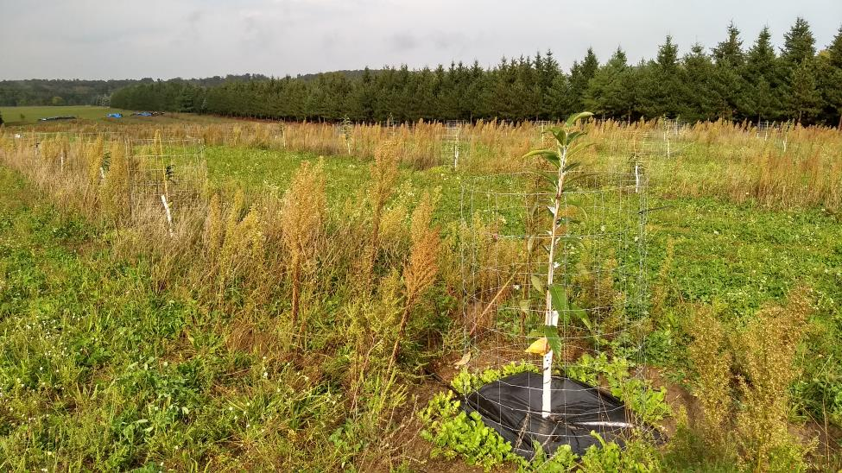
Planted on north slope peaking at 935ft in elevation about 5 miles from Lake Huron
Moltke Ridge, MI
Newly seeded clover and orchard grass in between rows
3 ft by 3 ft Weed-guard with drip irrigation under
Tillage Radish for tillage, food, and aeration for roots growing summer 2018

Slide 9
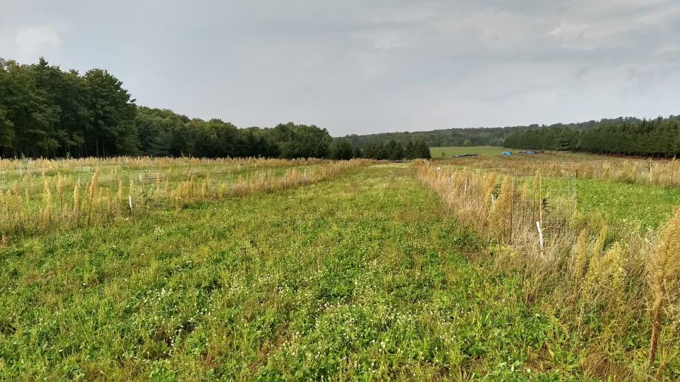
Trees planted at 20 ft by 30 ft spacing

Slide 10
Collecting initial height and diameter data

Slide 11
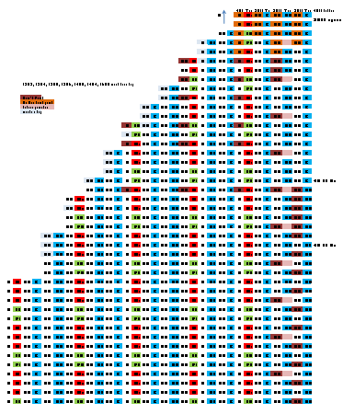
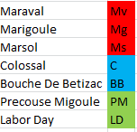
Orchard Planting Plan: 440 planted this year, 80 to plant next year
N

