Slide 1
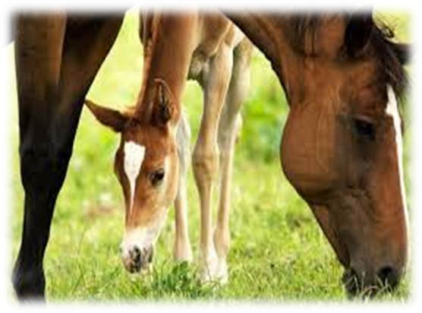
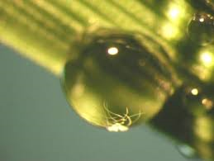
The Penn State Parasite Project
Reducing Parasite Resistance on Equine Operations Using a Comprehensive Whole Farm Approach

Slide 2
Changing Minds One at a Time “By now virtually every equine veterinarian in this country knows that regularly scheduled, across the board deworming is a bad idea. And I know many horse people do as well. But how many people have acted on this information and changed their approach to parasite control. Not nearly enough.” Dr. Martin Nielsen , DVM< PhD, DECK, DACVM quoted in Equus magazine

Slide 3
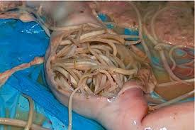
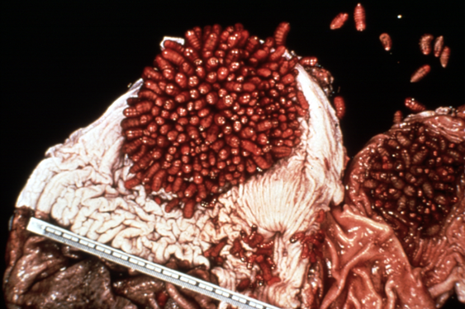
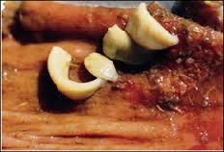
Major Types of Equine Internal Parasites
*Threadworms * Bots
* Pinworms * Ascarids
* Tapeworms * Large Strongyles
* Small Strongyles * etc.

Slide 4
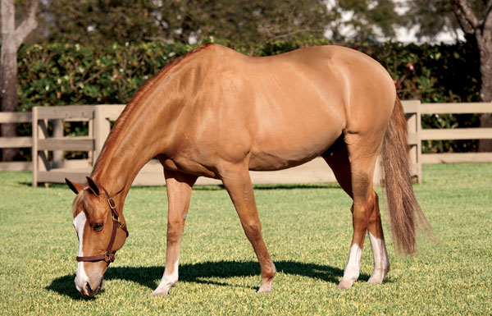
Parasite Control Misconceptions
All worms are bad and no worms should be tolerated in a horse.
2. All horse are susceptible
to worms and should be
treated the same.
Notes:
Ideas that need to change
All worms are bad and that no worms should be tolerated in a horse
Horses evolved with their worms and small numbers of most worms do not cause a problem
Small numbers actually help to stimulate the horses immune system to protect them from larger infestations
All horses are highly susceptible to worms and should be treated the same
All horses are not the same (older horses 3 years and older)
20-30% of horses (on some farms this number is even smaller) harbor 80 % of worms

Slide 5
History of Parasite Control
1960’s
Introduction of Benzimidazole anthelmintics
Recommendation - deworming every 8 weeks
1970’s and 1980’s
Development of ivermectin and other classes of dewormers
Recommendation - rotate dewormers and deworm every 8 weeks

Slide 6
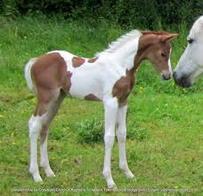
Changes in Parasite Populations
Large strongyles are now rare
Small strongyles are the parasites of concern in adult horses
Ascarids remain the most
important parasite in foals
and weanlings.

Slide 7
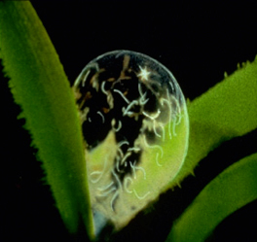
Small Strongyles (Cyathostomes)
Present in all horses.
Are relatively mild pathogens - only produce disease when the parasites are present at very
high levels.
Generally only migrate into the
intestinal lining.
Frequent deworming treatments
are not needed to keep most
adult horses healthy.

Slide 8
Product Resistance 2001-2002 University of Kentucky tested 1274 horses on 44 large farms in 5 southern states. What about Pennsylvania?
- 97.7 %
53.5 %
40.5 %
0 %
Fenbendazole -
Oxibendazole -
Pyrantel
Ivermectin

Slide 9
The New Protocol
*Use products with proven efficacy
*Administer at the appropriate time of the year
*Deworm based on the parasite burdens of individual
horses
The question you need to ask is what are you most
afraid of – allowing your horses to retain some
parasites or developing anthelmintic
resistant parasites that can no longer be killed.

Slide 10
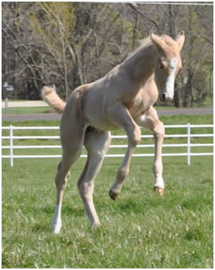
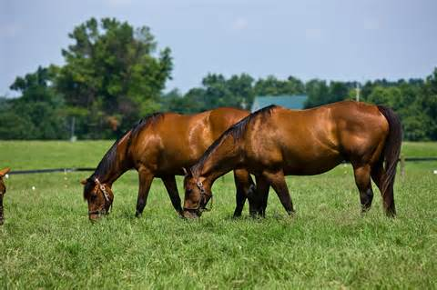
Penn State Parasite Project Goals
* To empower farm managers to make changes in their parasite
management program in order to reduce the overuse of
dewormers that leads to product resistance.
* To document levels of parasite burdens and product resistance
on PA horse farms.

Slide 11
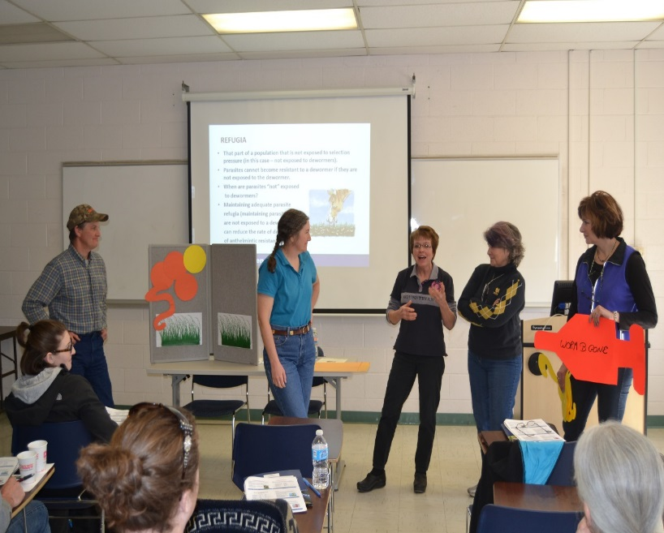
Eliciting Change…………….. “In order to empower horse owners to make changes to their deworming program it is necessary to provide them with the knowledge and skills necessary to be confident that they are making good management decisions.”
Developed a comprehensive short
course offered statewide: Reducing
Parasite Resistance Using a Whole
Farm Approach - attended by 287
farm managers.

Slide 12
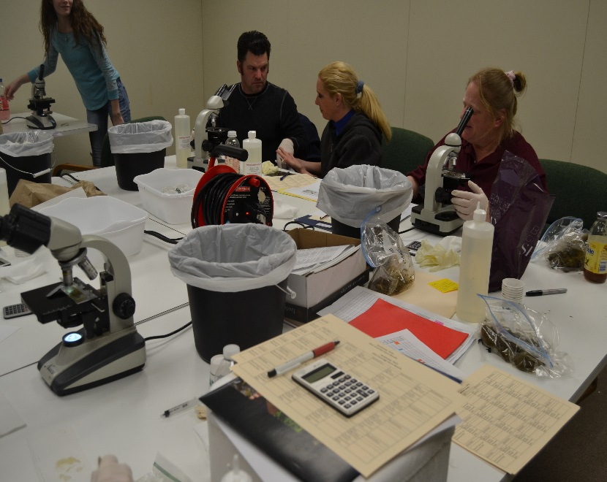
2. Engaged farm managers in a project designed to monitor farm
specific strongyle egg production, identify “shedders” and
evaluate product efficacy by conducting pre and post
deworming egg count.
3. Supplied microscopes and supplies
and hosted “manure” parties every
eight weeks at predetermined sites.
Funded by $146,000 SARE grant.

Slide 13
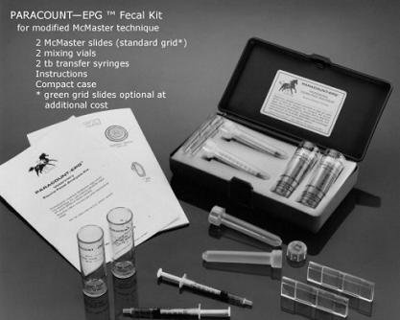
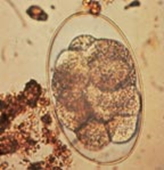
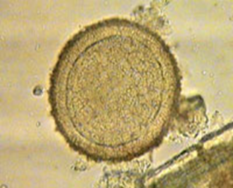

Slide 14
Determining Product Resistance Using Fecal Egg Count Reduction (FECR) Tests
Conduct Whole Farm Fecal Egg Count
Deworm moderate to high shedders
Conduct egg counts 14 days later
% Fecal Egg Count Reduction (FECR)
FEC before deworming – FEC post deworming / FEC before deworming x 100
Resistance occurs at the farm level – at least 3 horses should be included in FECR and the results should be averaged.
Pyrantel and Benzimidazoles should show at least a 90% reduction.
Ivermectin and moxidectin should show a reduction of at least 95%.

Slide 15
Windy Hill Farm
Product – pyrantel
Date of fecal egg count – 7/1
Date dewormed – 7/2
Date of recheck – 7/15
Horse FEC before deworming FEC after deworming % reduction
Ghost 1475 562 61%
Lucky 2350 450 80%
Deli 650 300 54%
Rocky 1800 2350 0%
Fred 475 125 74%
Farm average – 53.8%

Slide 16
Dewormer Resistance on PA Farms Pyrantel * * 300-500 eggs per gram ** Farms with 3 or more horses that were moderate or high shedders ***Farm average egg shedding was reduced less than 90% ****Farm average egg shedding reduction was at least 90%
 | 2015 | 2016 | Total
Number of farms in the study | 52 | 22 | 74
Number of horses in the study | 467 | 244 | 711
*Farms with no horses at deworming threshold | 14 (27%) | 5 (23%) | 19 (26%)
*Farms at deworming threshold | 38 (73%) | 17 (77%) | 55 (74%)
** Qualified farms | 20 (38%) | 9 (41%) | 29 (39%)
***Farms showing reduced efficacy | 16 (80%) | 6 (67%) | 22 (76%)
****Farms showing intact efficacy | 4 (20%) | 3 (33%) | 7 (24%)

Slide 17
Dewormer Resistance on PA Farms Fenbendazole * * 300-500 eggs per gram ** Farms with 3 or more horses that were moderate or high shedders ***Farm average egg shedding was reduced less than 90% ****Farm average egg shedding reduction was at least 90%
 | 2015 | 2016 | Total
Number of farms in the study | 52 | 22 | 74
Number of horses in the study | 467 | 244 | 711
*Farms with no horses at deworming threshold | 28 (54%) | 8 (36%) | 36 (49%)
*Farms at deworming threshold | 24 (46%) | 14 (64%) | 38 (51%)
** Qualified farms | 11 (21%) | 10 (45%) | 21 (28%)
***Farms showing reduced efficacy | 11 (100%) | 9 (90%) | 20 (95%)
****Farms showing intact efficacy | 0 (0%) | 1 (10%) | 1 (.05%)

Slide 18
Dewormer Resistance on PA Farms Ivermectin * * 300-500 eggs per gram ** Farms with 3 or more horses that were moderate or high shedders ***Farm average egg shedding was reduced less than 95% ****Farm average egg shedding reduction was at least 95%
 | 2015 | 2016 | Total
Number of farms in the study | 52 | 22 | 74
Number of horses in the study | 467 | 244 | 711
*Farms with no horses at deworming threshold | 23 (44%) | 5 (23%) | 28 (38%)
*Farms at deworming threshold | 29 (56%) | 17 (77%) | 46 (62%)
** Qualified farms | 13 (44%) | 9 (41%) | 22 (30%)
***Farms showing reduced efficacy | 0 (0%) | 0 (0%) | 0 (0%)
****Farms showing intact efficacy | 13 (100%) | 9 (100%) | 22 (100%)

Slide 19
Farm Partner Survey Results 100% were able to identify high shedders. 95% were able to identify horses with good immunity against small strongyles. 95% were able to identify products that were viable on the farm. 81% reduced the use of dewormers. 100% had increased confidence in surveillance based deworming. 100% planned to continue to use FECs in their deworming program. 68% adopted practices to improve pastures to reduce parasite exposure. 45% removed manure from pastures. 79% stopped harrowing pastures or restricted harrowing to fall. 97% remained in the project.

Slide 20
Other Factors Being Evaluated
Age and health of horses
Horse genetics
Manure removal/management
Pasture management
Horse density
Stability of horse population
Use of daily dewormer
History of dewormer use

Slide 21
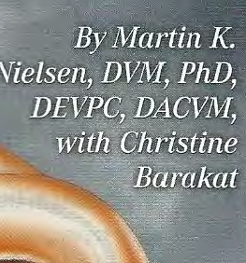
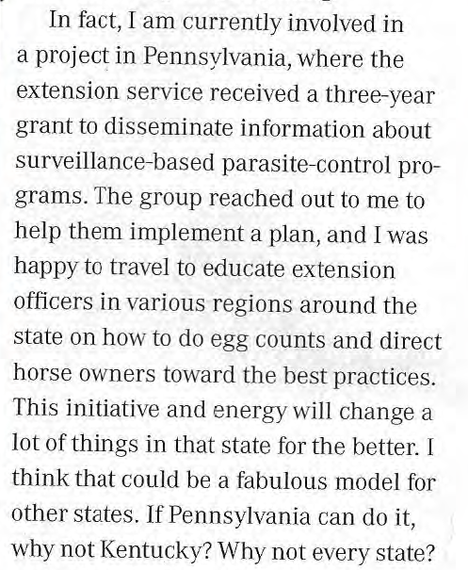
Equus Magazine

Slide 22
Conclusions
Most PA horses in the study were low shedders and consistently shed low or no eggs. High shedders tended to remain high and needed to be strategically dewormed.
There is reduced efficacy and appears to be significant resistance to Pyrantel and Fenbendazole on Pennsylvania farms.
It is critical for horse owners to use a comprehensive approach to manage parasites to reduce the rate of resistance development.
Farm managers will adopt changes to their parasite management program when they have the knowledge and tools necessary to make those changes.

Slide 23
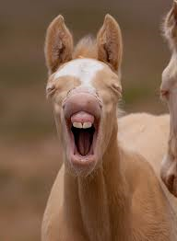
We are very grateful for the dedication of all of our farm partners who are truly committed to the project and the research that benefits their horses and the equine community. The bonds of trust that are generated in working together and the strong relationships that develop along the way are priceless.

Slide 24
This project is partially funded by:

Slide 25
Presentation Contributors
Donna Foulk
Penn State Extension Equine Natural Resources Educator
610-746-1970, ext. 5 dlf5@psu.edu
Dr. Martin Nielsen, DVM, PhD.
Equine Parasitologist, University of Kentucky, Gluck Institute
Dr. Ed Jedrzejewski – DVM
Penn State Unversity
The Pennsylvania State University is committed to the policy that all persons shall have equal access to programs, facilities, admission, and employment without regard to personal characteristics not related to ability, performance, or qualifications as determined by University policy or by state or federal authorities. It is the policy of the University to maintain an academic and work environment free of discrimination, including harassment. The Pennsylvania State University prohibits discrimination and harassment against any person because of age, ancestry, color, disability or handicap, national origin, race, religious creed, sex, sexual orientation, gender identity, or veteran status. Discrimination or harassment against faculty, staff, or students will not be tolerated at The Pennsylvania State University. Direct all inquiries regarding the nondiscrimination policy to the Affirmative Action Director, The Pennsylvania State University, 328 Boucke Building, University Park, PA 16802-5901; Tel 814-865-4700/V, 814-863-1150/TTY
This publication is available in alternative media on request.

