Slide 1

Finding the right mix of Cover Crops in a Sweetcorn and Snap Bean operation in the Midwest
Mark O’Rourke
O’Rourke Family Gardens
Downs, Illinois

Slide 2
Finding the right mix of Cover Crops
ABSTRACT: In 2017 we introduced a mechanical green bean harvester into our vegetable production system that dramatically increased the number of acres devoted to snap beans. Increasing the annual acres of snap beans from less than ¼ acre to 3 acres provides an opportunity to enter into a crop rotation with sweet corn acres. The weight of the new harvesting equipment and utilization of 2-row equipment at the time made us realize we needed to make changes to our operation. The investigation of proper cover crop systems is part of our operation upgrade. We feel the by upgrading to 4-row no-till planting equipment while incorporating cover crops into the system will reap dividends in overall soil health.

Slide 3

Cereal Rye 1 - 100% Cereal Rye planted September 2nd
Cereal Rye 2 - Custom 95% Cereal Rye & 5% Hairy Vetch blend planted October 16th
Cowpea/Barley - 50/50 Custom Blend
NitroMax CC1 Mix - Commercial blend 48.5% Yellow Field Pea, 48.5% Oats, 3% Daikon Radish

Slide 4
Snap Bean Cover Crop Evaluation

Slide 5
Snap Bean Cover Crop Evaluation
What is our objective of Cover Crops in our Snap Bean System?
Since the acquisition of the mechanical Snap Bean Harvester in 2017, we have been evaluating ways to produce snap beans in a system that will reduce compaction while suppressing weeds in order to improve the mechanical harvest. We prefer to use a system where in-crop chemical weed control is not needed, thus improving the perceived value of our product to our customers.
Mechanical weed control in a conventional system requires significant trips across the field followed by field crews with hoes to reduce weed pressure. One of the results of row-crop cultivation during the Snap Bean vegetative growth is the hilling affect raising the soil level at the bean row. At harvest, when the mechanical harvester must be raised in order to avoid the collection of soil clods and possibly root balls from a previous crop, resulting in additional sorting and cleaning issues during harvest. A second major with multiple cultivations is that soil compaction is significant. We are looking for a system that will use pre-plant cover and weed species control while leaving enough residue to provide a weed suppression benefit resulting in less labor to keep the production field clean from weeds.

Slide 6
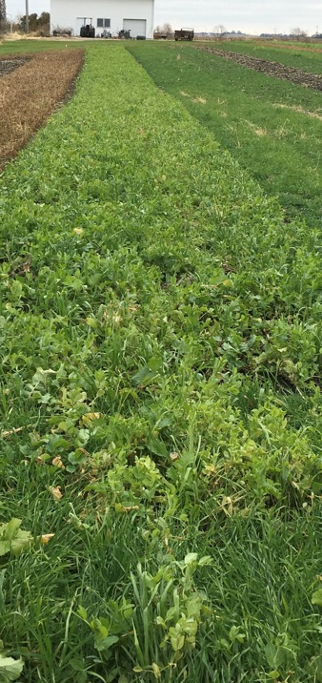
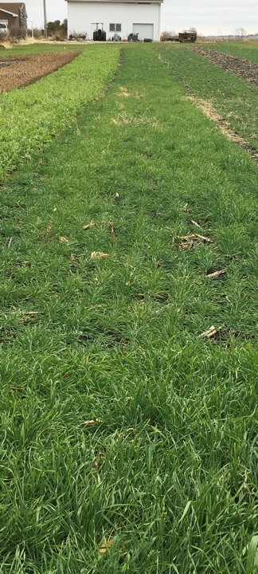
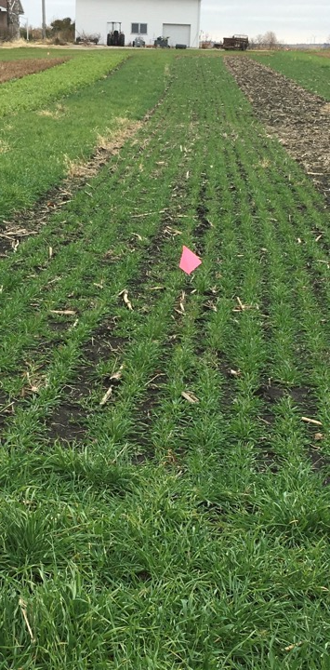
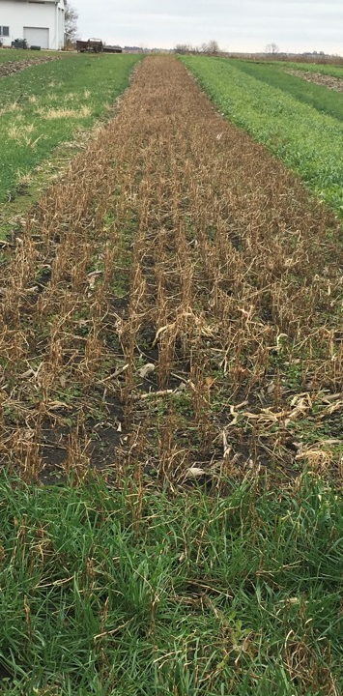
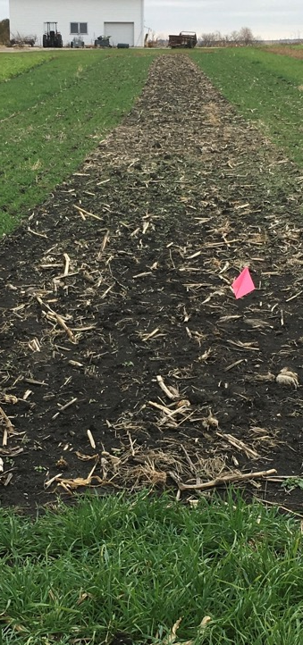
Snap Bean Cover Crop Evaluation
NitroMax Cereal Rye 1 Cereal Rye 2 Buckwheat None

Slide 7
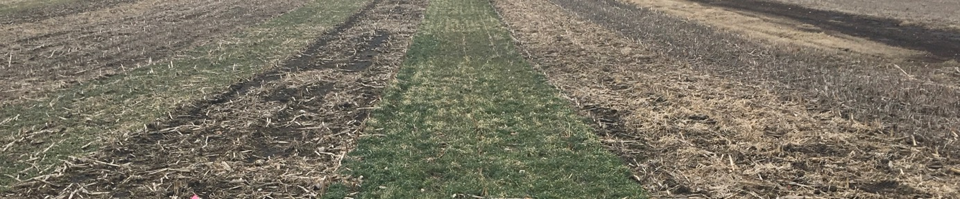
Snap Bean Cover Crop Evaluation
Note: Ratings 1 to 5 where 1 = Most Desireable; 5 = Least Desireable
Cereal Rye 2 Check Cereal Rye 1 NitroMax Buckwheat

Slide 8
Snap Bean Cover Crop Evaluation
NitroMax CC1 Mix
Fast growing in warm conditions
Attractive blend of 3 cover crop species
Relatively easy termination with herbicides
Does not terminate with first frost
Will terminate naturally during normal winters in Central Illinois
Provides limited Winter Annual weed suppression
Will allow soil to warm earlier than soils with growing cover in Spring
Needs to be planted August through Early September for adequate growth prior to onset of cooler weather

Slide 9
Snap Bean Cover Crop Evaluation
Cereal Rye
Fast growing in warm conditions
Relatively easy termination with herbicides at early vegetative stages
Will over-winter well in Central Illinois
Provides good Winter Annual weed suppression
May be plated from September through October, although will build greater biomass if planted in first half of September
Potential for growth of this cover to outpace need to terminate, especially if the growing season is wet

Slide 10
Snap Bean Cover Crop Evaluation
Cereal Rye plus Hairy Vetch
Fast growing in warm conditions
Hairy vetch adds a desirable quality in this blend
Relatively easy termination with herbicides at early vegetative stages
Will over-winter well in Central Illinois
Provides good Winter Annual weed suppression
Considering increasing hairy vetch percentage in blend
Potential for growth of this cover to outpace need to terminate, especially if the growing season is wet
Hairy Vetch may provide some benefit to pollinators if this blend is terminated late in growing season

Slide 11
Snap Bean Cover Crop Evaluation
BUCKWHEAT
Fast growing in warm conditions
Attractive blend of 3 cover crop species
Will terminate with first frost
Provides limited Winter Annual weed suppression
Will allow soil to warm earlier than soils with growing cover in Spring
Needs to be planted August through Early September for adequate growth prior to first frost

Slide 12
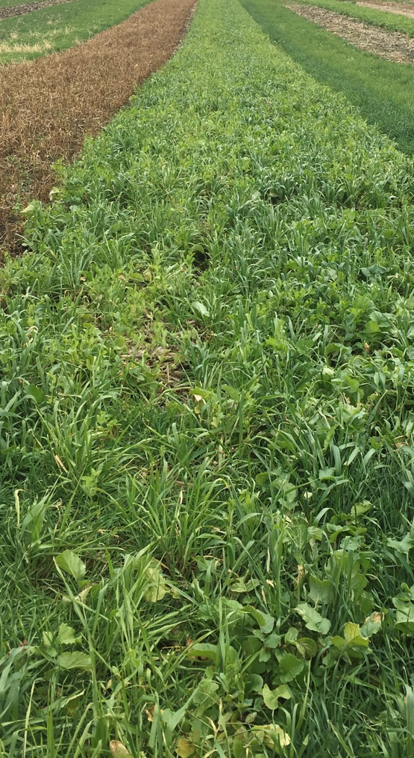
Snap Bean Cover Crop Evaluation
PROJECT RECOMENDATION
– EARLY GROWING SEASON
Will plan to use NitroMax Blend in areas where first snap bean planting is scheduled
Continue to experiment with Buckwheat when there is an opportunity to seed late August into early September.

Slide 13
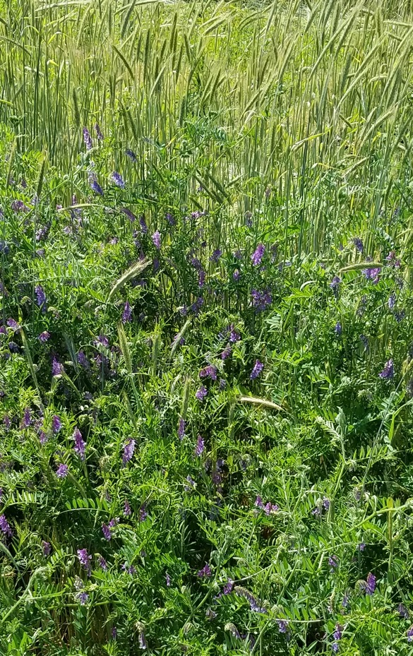
Snap Bean Cover Crop Evaluation
PROJECT RECOMENDATION
– MID to LATE SEASON
Will plan to use a Cereal Rye & Hairy Vetch blend for soil building qualities
Will continue to develop practical equipment to have as a tool to manage/terminate Cereal Rye in addition to using herbicides
Need to be vigilant in managing this combination

Slide 14
Fall Sweetcorn Cover Crop Evaluation

Slide 15
Fall Sweetcorn Cover Crop Evaluation
Cover Crops and Sweet Corn, a complex management strategy.
Anyone who has attended a Producer only Farmer’s Market in the Midwest knows that one of the most anticipated products of the summer is Sweet Corn. Every producer hopes to have the first sweetcorn available at the market each season. One of the challenges of using cover crops in a Sweet Corn production system is to provide a warm seed bed early in the season where the conditions are adequate to promote prompt emergence. Many cultivars have labels attached to the seed package warning that for best results the soil temperature should be at least 65 degrees F. This can be a significant challenge to producers in a normal year using conventional tillage, let alone in systems where soil temperatures are typically cooler.

Slide 16
Fall Sweetcorn Cover Crop Evaluation
Cover Crops and Sweet Corn, a complex management strategy.
One of the needs of a cover crop system for our operation is to provide some level of weed suppression as well as providing soil health benefits. The system should also allow for the soil to warm as early as practical. Fortunately, we do not believe in a “one system fits all” scenario and understand that incorporating cover crops properly into our production will result in the adoption of several cover crop types and varieties.
Nothing is free. We recognize that improving the soil health of the land we manage is worth the investment in learning new practices and implementing sound agricultural systems.

Slide 17
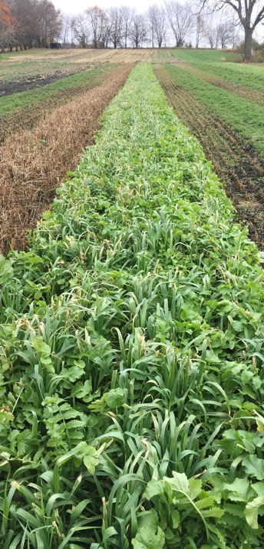
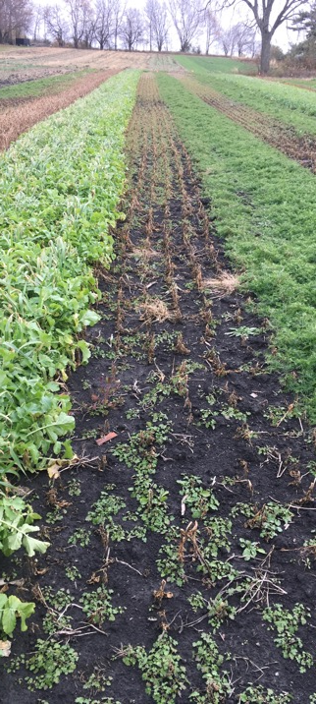
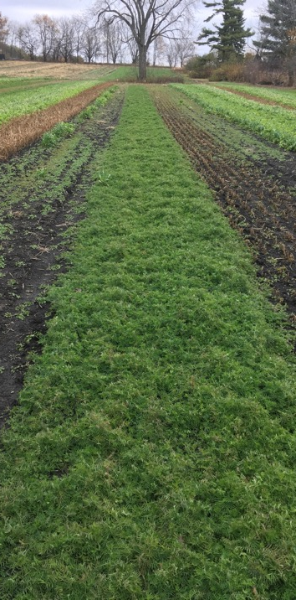
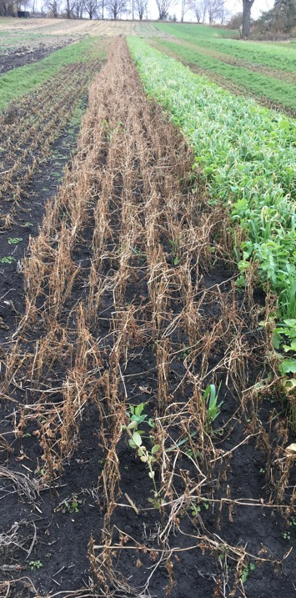
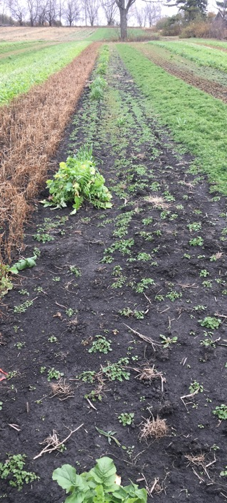
Fall Sweetcorn Cover Crop Evaluation
NitroMax Cowpea Hairy Vetch Buckwheat None

Slide 18
Fall Sweet Corn Cover Crop Evaluation
Note: Ratings 1 to 5 where 1 = Most Desireable; 5 = Least Desireable

Slide 19
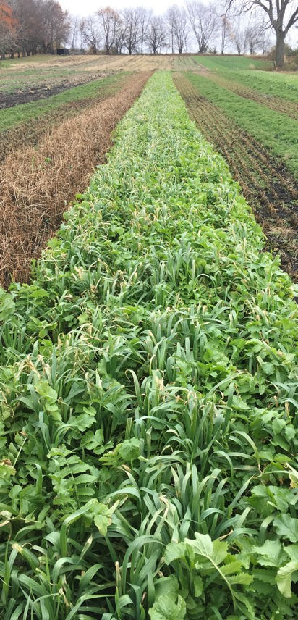
Fall Sweet Corn Cover Crop Evaluation
NITROMAX BLEND
Requires warm conditions for adequate growth
Will terminate with normal Winter
Adequate seeding rate will provide moderate weed suppression
Seeding August to Early September
Plantability into winter terminated crop is as favorable as fallow or Buckwheat
Good choice for first planted Sweet Corn in Spring

Slide 20
Fall Sweet Corn Cover Crop Evaluation
COWPEA
Requires warm conditions for adequate growth
Cowpea will terminate with first frost
May require spring tillage to control winter annuals
Seeding August to Early September
Plantability into winter terminated crop is as favorable as fallow or Buckwheat
Weed suppression is weaker than Hairy Vetch

Slide 21

Fall Sweet Corn Cover Crop Evaluation
HAIRY VETCH
Plant Late August to Early September for optimum growth before cooler weather arrives
Will not terminate in normal winters
Adequate seeding rate will provide very good suppression of Winter Annual and early Spring weeds
Seeding late August to early September for adequate growth for weed suppression
Plantability into Hairy Vetch good, but requires planter modification (raising trash whips)
Higher management requirement for proper termination timing

Slide 22
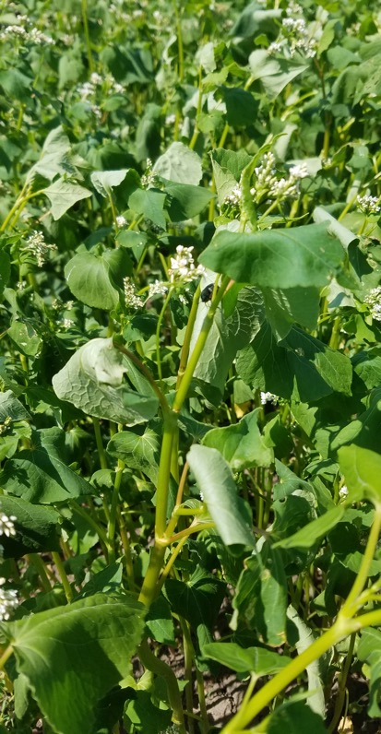
Fall Sweet Corn Cover Crop Evaluation
BUCKWHEAT
Requires warm conditions for adequate growth
Will terminate with first frost
May require spring tillage to control winter annuals
Seeding August to Early September to encourage sufficient growth prior to early frost
Weed suppression is weaker than Hairy Vetch

Slide 23
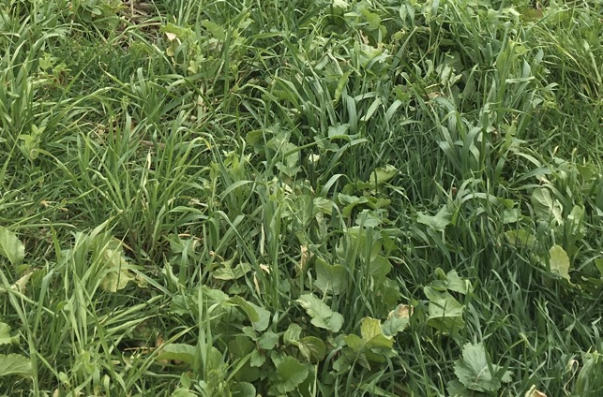
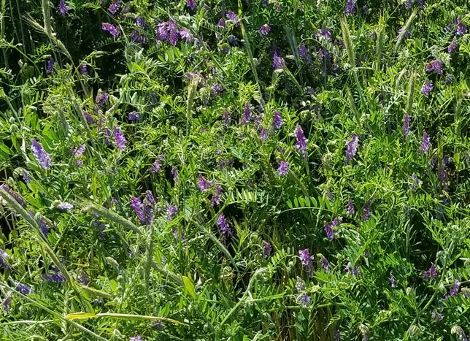
Fall Sweet Corn Cover Crop Evaluation
PROJECT RECOMENDATION
Utilize NitroMax or similar blend of varieties that will self-terminate with normal winter weather for first, early season Sweet Corn planting
Plan to use Hairy Vetch alone or in blends for areas that will be planted to Sweet Corn mid to late in growing season
Will avoid using grass species that will survive normal winter conditions

Slide 24
Spring Cover Crop Evaluation in Sweetcorn

Slide 25
Spring Cover Crop Evaluation in Sweetcorn
Why would we need Spring Cover Crops in Sweetcorn?
Due to the nature of our operation, we plant Sweetcorn typically beginning in Mid to Late April and continue planting every 120 heat units through Mid-July. We will have land that will normally be fallow for a couple of months until we need to plant the last plantings from late June into July. Prior to cover crops, this fallow ground would need to be sprayed or tilled to control weeds until we were ready to plant the late sweetcorn, often several times to maintain adequate control. With Cover Crops we are able to plant once, terminate, and then ideally plant directly into the terminated crop, benefiting from potentially soil-building residue and natural weed suppression.

Slide 26
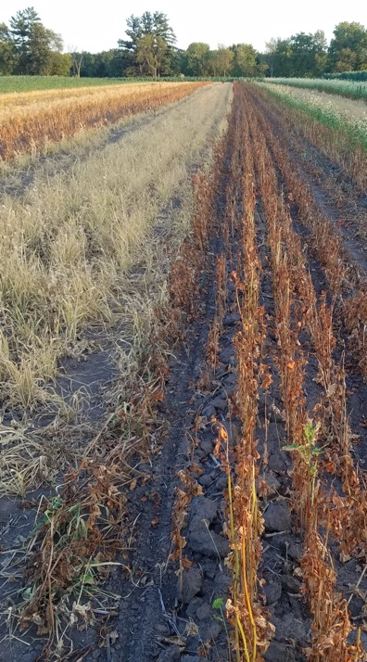
Spring Cover Crop Evaluation in Sweetcorn
Note: Ratings 1 to 5 where 1 = Most Desireable; 5 = Least Desireable

Slide 27
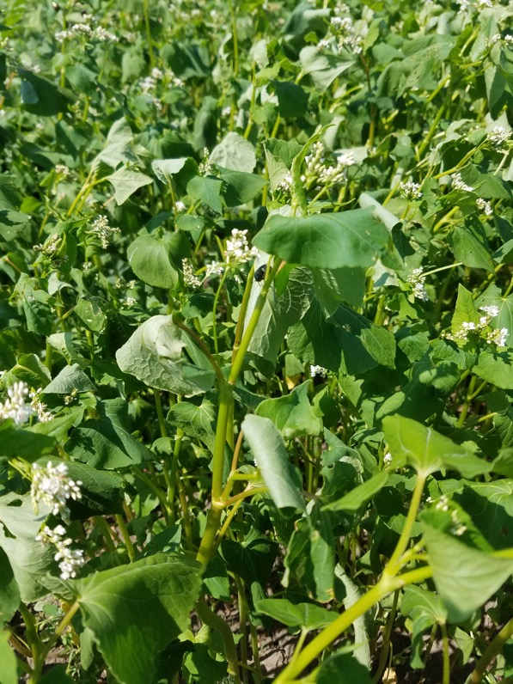
Spring Cover Crop Evaluation in Sweetcorn
BUCKWHEAT
Fast growing in warm conditions
Relatively easy termination with herbicides
Possible to terminate by mowing
Need adequate seeding to suppress weeds
Plantability into terminated crop is favorable

Slide 28
Spring Cover Crop Evaluation in Sweetcorn
COWPEA
Fast growing in warm conditions
Cowpea terminated fairly easily with herbicide
Adequate seeding will suppress weeds
Plantability into terminated crop is as favorable as fallow or Buckwheat

Slide 29
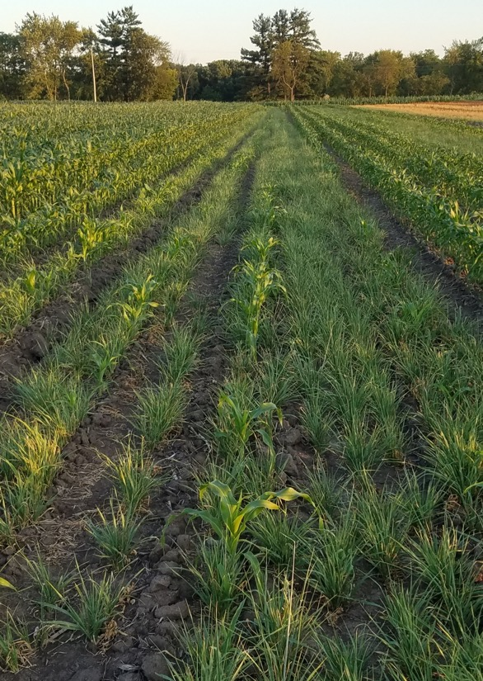
Spring Cover Crop Evaluation in Sweetcorn
COWPEA/BARLEY
Fast growing in warm conditions
Cowpea terminated fairly easily with herbicide
Adequate seeding will suppress weeds
Caution: Barley (and other grasses) may be tough to terminate under stressful conditions.
Plantability into terminated crop is less favorable than other options

Slide 30
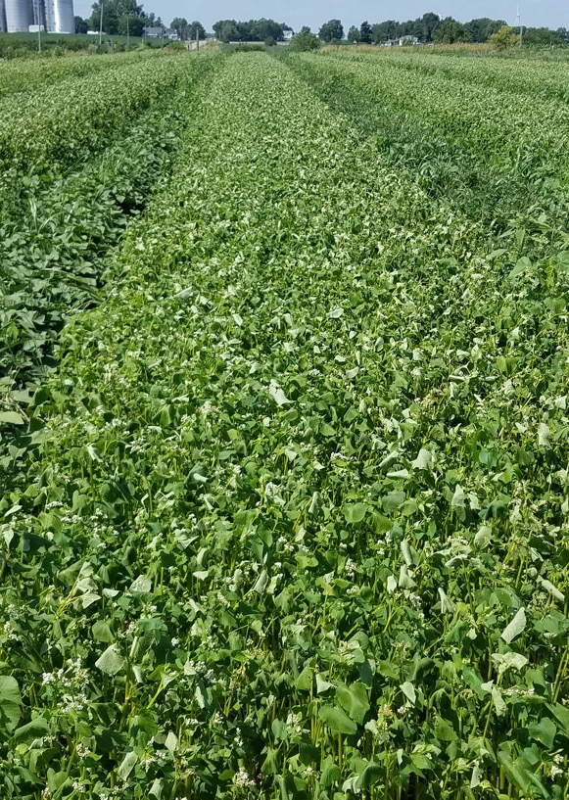
Spring Cover Crop Evaluation in Sweetcorn
PROJECT RECOMENDATION
Will continue to use Buckwheat, Cowpea, and other annual legumes in Spring Cover Crop Systems
Plan to avoid using and grass family cover crop, including blends with grass
Spring Cover crops will become part of our standard practice for “fallow” spring ground ahead of late sweet corn plantings

Slide 31
Conclusions:
It is challenging to identify the best Cover Crops to use in Farmer’s Market produce systems due to the long window of planting dates. It is important to first determine your goals in using cover crop systems. Following our main objective of providing weed control while building soil health, O’Rourke Family Gardens will implement the following practices:
Utilize a blend of winter terminating covers for first spring planted areas
Adopt Cereal Rye and Hairy Vetch blends for mid to late Snap Bean plantings
Adopt Hair Vetch as a significant part of covers planted ahead of sweetcorn
Use Buckwheat, Cowpea, and other annual legumes when Spring planted cover crops are needed while avoiding any mixes containing grass species when planted ahead of sweetcorn
Continue to look for ways to incorporate cover crops into other produce operations on our farm, i.e. sweet potatoes and squash

