Slide 1
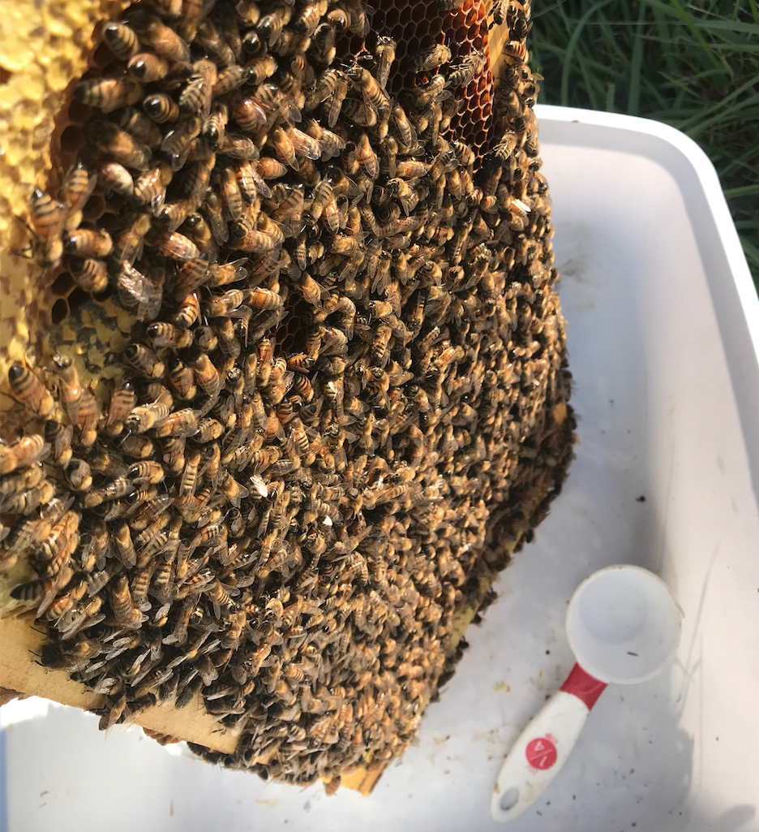
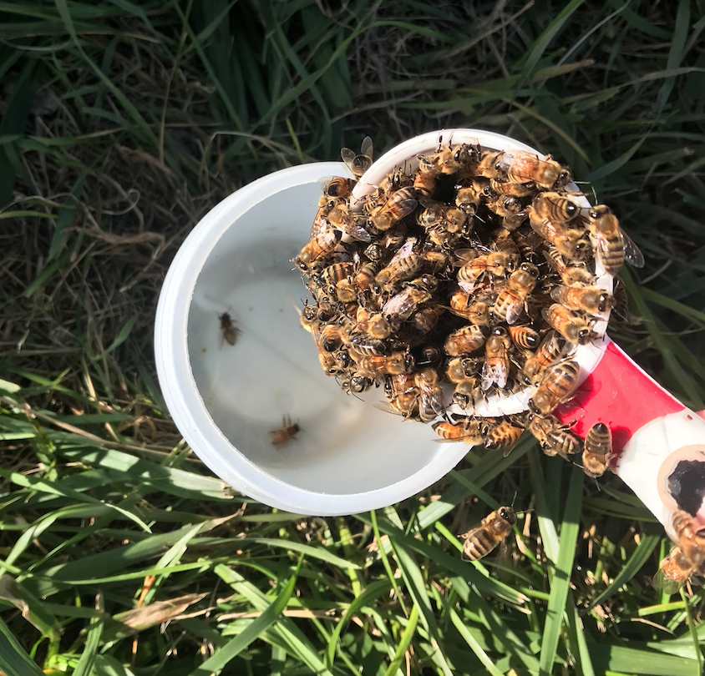
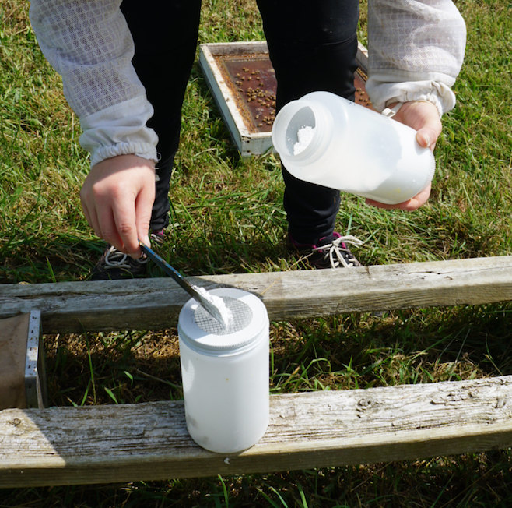
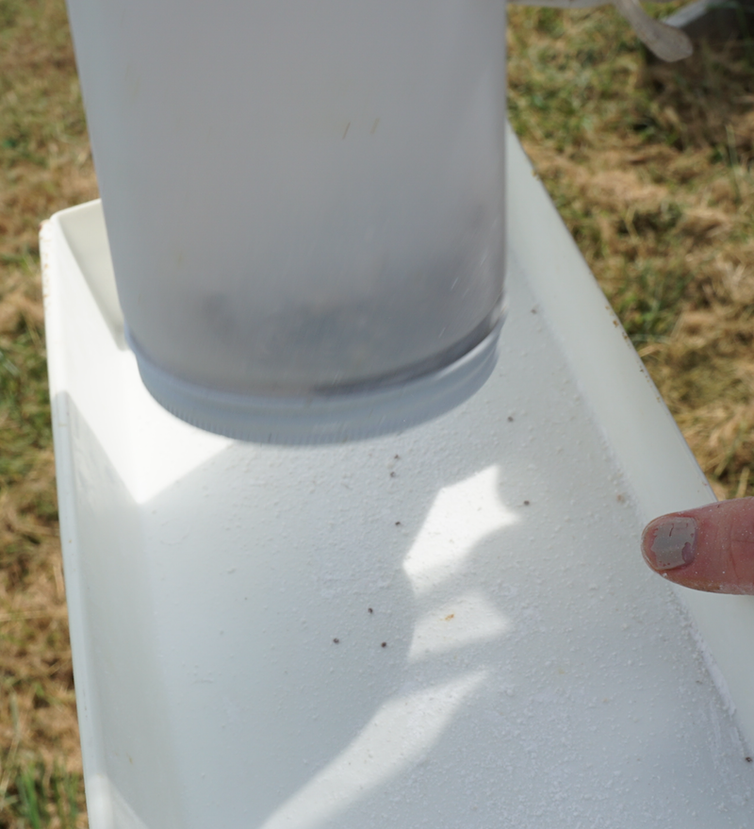
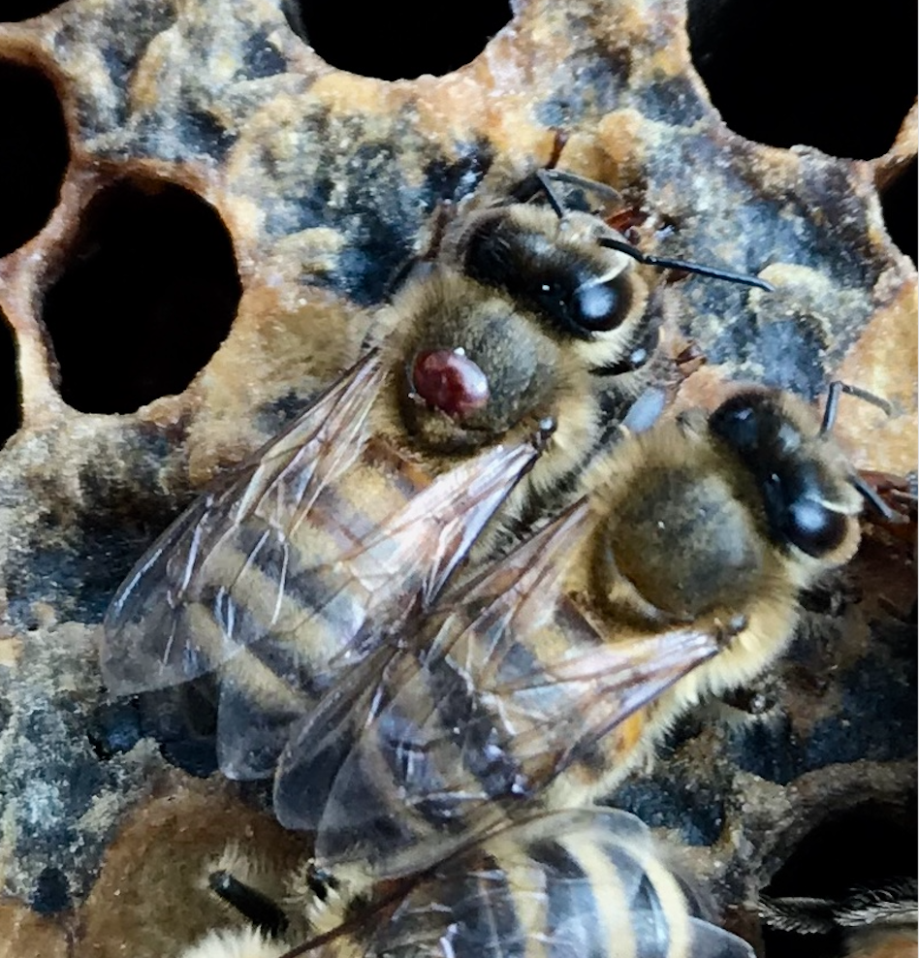
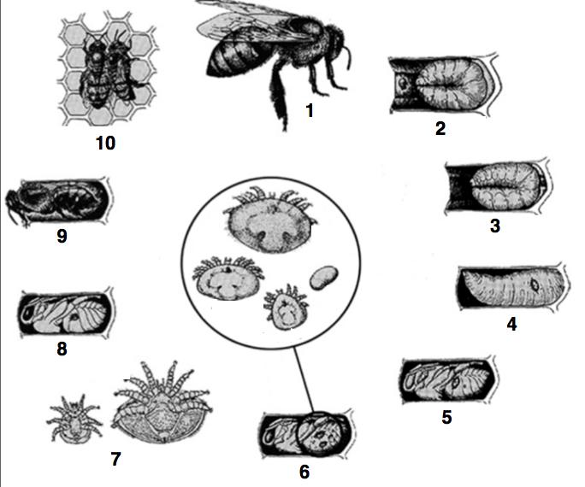
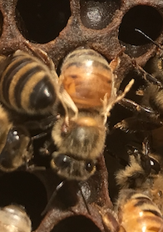
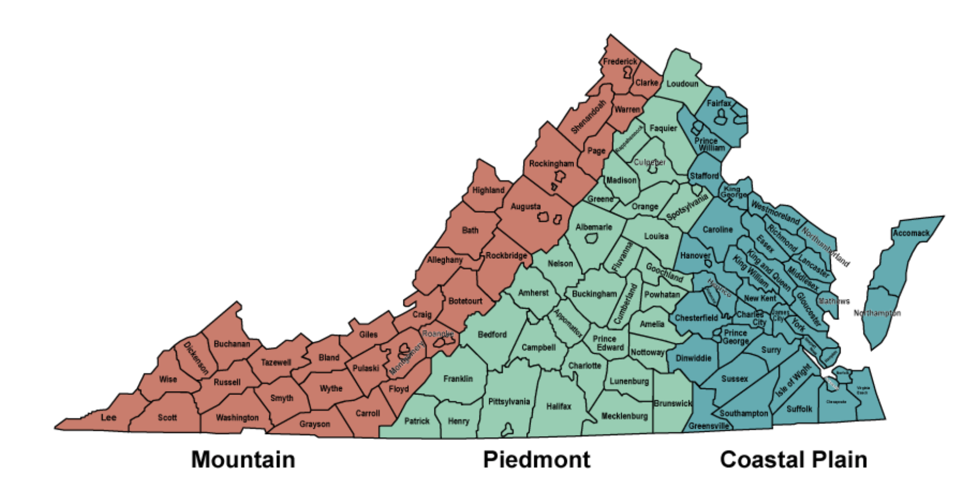
Determining Varroa destructor acaricide resistance and the success of Integrated Pest Management (IPM) techniques in Apis mellifera colonies of Virginia
Morgan A. Roth¹, James M. Wilson², and Aaron D. Gross¹
1. Molecular Physiology and Toxicology Laboratory, Department of Entomology, Virginia Polytechnic Institute and State University, Blacksburg, VA
2. Extension Apiculturist , Virginia Polytechnic Institute and State University, Blacksburg, VA
History and Impacts of Varroa destructor
Sampling and Resistance Bioassays
Acaricide Toxicity Results
Originally found in Apis cerana colonies, where mite reproduction occurs solely in drone brood.¹
First infestations of A. mellifera colonies seen in the early 1970s, first reported in United States in 1987.^{2,3}
Able to reproduce in A. mellifera drone and worker brood, dramatically increasing mite loads.¹
The V. destructor lifecycle has two stages: a phoretic stage (Figure 1) and a reproductive stage (Figure 2).⁴
Initially thought to feed upon hemolymph, but now believed to primarily feed on lipids. ⁵
Feeding transmits numerous diseases, with one of the most prevalent being Deformed Wing Virus (Figure 3).⁴
Original control was mainly synthetic acaricide treatments, however, mite resistance became a threat.⁶
Treatment methods have been
transitioning to an Integrated
Pest Management (IPM) approach.⁴
IPM strategies first implement
cultural and mechanical controls,
followed by biological, and then
chemical, controls.⁷
IPM relies on treatment rotation to
prevent resistance development.⁷
All mite sampling was performed using the powdered sugar shake method (Figure 6A-D).⁷
Sampling took place in three local apiaries, an apiary in Richmond, and an apiary near Virginia Beach, providing representative samples from each region of Virginia (Figure 7).
Resistance bioassays performed by cleaning mites in 1X DPBS and dividing them into scintillation vials coated in each treatment vial and an acetone control.
248 µg/vial of amitraz, 106 µg/vial of coumaphos, and 4.2 µg/vial of tau-fluvalinate were dissolved in 500 µL of acetone and added to the vials. These were doubled LD₉₀ values from Sammataro et al.⁸
A hot dog roller was used to ensure that the vials were evenly coated while the acetone evaporated.
Mite mortality and moribundity were noted at 3, 6, 12, and 24 hours (Figure 8 & 9).
Amitraz, Coumaphos, and tau-Fluvalinate were all significantly more effective (P<0.05) than the control.
A
B
C
D
Figure 6. Bees are removed from a frame of capped brood (A), approximately 200 bees are collected in a ¼ c. measuring cup (B), 1-2 tablespoons of powdered sugar are added (C), bees are shaken for 1 minute, rest for 1 minute, then mites are shaken out of mesh-topped jar for 1 minute (D).
Figure 8. Blacksburg combined toxicity results.
Figure 9.Richmond combined toxicity results.
Figure 1. Phoretic stage
V. destructor female.
Figure 2. Lifecycle of V. destructor, borrowed and modified from: articles.extension.org.
Figure 10. results of tau-Fluvalinate resistance bioassays (24 hr).
Figure 11. Results of Coumaphos resistance bioassays (24 hr).
Figure 12. results of Amitraz resistance bioassays (24 hr).
Significance of this Study
High mite counts post treatment with formic acid in both Prices Fork and Moore Farm apiaries suggest that continued treatment with organic acids or rotation with a synthetic acaricide treatment to be beneficial in future.
The significant difference (P<0.05) in mite mortality and moribundity suggest that the V. destructor populations in these areas are not resistant to Amitraz, Coumaphos, and tau-Fluvalinate.
Seasonal Infestation Results
A
B
Figure 3. Symptomatic deformed wing virus.
Conclusions and Future Research
Varroa mite infestations increase throughout the season (spring to fall).
Resistance to amitraz, coumaphos, and tau-fluvalinate were not detected in the tested apiaries.
Expanding this study to encompass more apiaries, especially those that frequently administer synthetic acaricides.
Experimenting with the use of more treatment types in the field, following an IPM model.
Goals: Monitoring Infestation and Resistance
Explore effectiveness of IPM strategies in V. destructor control and monitor infestation rates throughout the season (May-October, 2018).
Assess the effects of three synthetic acaricides (Figure 3) through resistance monitoring of V. destructor specimens collected throughout the three geographic regions of Virginia (Figure 4).
C
D
References
Boot, W. J., Calis, J. N. M., Beetsma, J., Hai, D. M., Lan, N. K., Van Toan, T., Trung, L.Q., Minh, N. H. (1999). Experimental and Applied Acarology. 23(2), 133–144.
Fries I., Camazine S., Sneyd J. (1994). BeeWorld, 75, 5–28.
﻿De Guzman, L.I., Rinderer, T.E., 1999. Apidologie 30, 85–95.
﻿Rosenkranz, P., Aumeier, P., & Ziegelmann, B. (2010). Journal of Invertebrate Pathology, 103, 96-119.
Dolezal, A.G., Carrillo-Tripp, J., Miller, W.A., Bonning, B.C., & Toth, A.L. (2016). PLoS ONE 11(4): e0153531. doi:10.1371/ journal.pone.0153531
De Mattos, I. M., Soares, A. E. E., & Tarpy, D. R. (2017). Apidologie, 48(4), 483–494.
Honey Bee Health Coalition. (2015). Tools for Varroa Management a Guide To Effective Varroa Sampling & Control, 24.
Sammataro, D. Untalan, P., Guerrero, F., & Finley, J. (2005), International Journal of Acarology, 31:1, 67-74, DOI: 10.1080/01647950508684419.
I
II
E
Figure 7. Seasonal mite infestation levels at Virginia Beach (A), Richmond (B), Moore Farm (C), Prices-Fork Research Station (D), and Blacksburg Community Garden (E).
III
Figure 4. The three geographic regions of Virginia, borrowed from: Virginia Department of Conservation and Recreation (www.virginiaplaces.org).
Acknowledgments
Figure 3. Chemical structures of the three synthetic acaricides tested in this study: amitraz (I), coumaphos (II), and tau-fluvalinate (III).
Funding Source: Southern IPM Center, Grant Number: 9998641 to ADG; Southern SARE, Grant Number: OS18-122 to: JMW
VAES Hatch Project (ADG) VA-160100
Collaborators: Keith Tignor, Pam Fisher,
Richard Reid, and Jerry Borger
Undergraduate students:
Annmarie Taheney and Dakotah Todd

