Slide 1


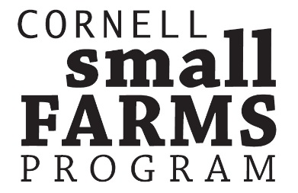
“Baskets to Pallets”:
Preparing Small and Mid-size Farmers to Enter Larger Markets
test
Notes:
A complete marketing strategy will consider the costs and benefits of multiple market channels. The wholesale channel, in which the producer’s products are handled by at least one intermediary before reaching the consumer, is an important option and should be understood and analyzed in the development of a marketing plan. Selling to wholesale buyers requires a different set of skills and competencies than marketing direct-to-consumer. In this lesson, farmers will learn the fundamental concepts and practices used in successful collaborative marketing.

Slide 2
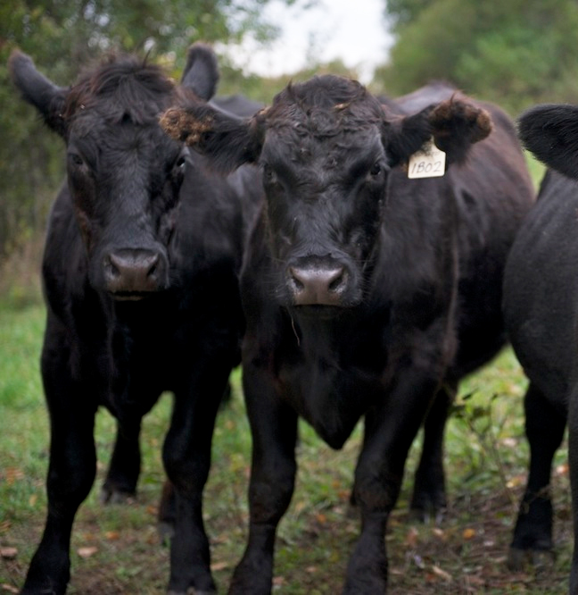
Module 2.3
Collaborative Marketing
This powerpoint presentation is a companion resource to the curriculum “Baskets to Pallets” available for download at www.insertwebsitehere.com
Please see ‘Module 2 – Marketing’ for additional teaching resources.
test
Rosie’s Beef, LLC in Granville, NY is a member of the Adirondack Grazers Cooperative. Photo courtesy http://www.grazersfilm.com/our-farmers/
Notes:
The lecture focuses on collaborative marketing as a piece of your farm marketing strategy. Topics covered include: a compare and contrast of collaborative versus cooperative marketing, options for formal structures for collaborative marketing, obstacles to consider and success factors.

Slide 3
Collaborative Marketing ≠ Cooperative Marketing
Cooperatives are businesses owned and controlled by the people who use them. Cooperatives differ from other businesses because they are member owned and operate for the mutual benefit of members. Like other businesses, most cooperatives are incorporated under State law. (National Council of Farmer Cooperatives)
- Types: Marketing, Bargaining, Supply, Credit
Collaborative Marketing, in a nutshell, is the process of sharing resources to increase leads, brand, and influence. (Forbes Magazine)
Notes:
Let’s talk about some definitions. Cooperatives are… They are formal structures governed by law and their members. Collaborations are (potentially) less structured with the very specific focus on increasing sales and/or brand recognition.

Slide 4
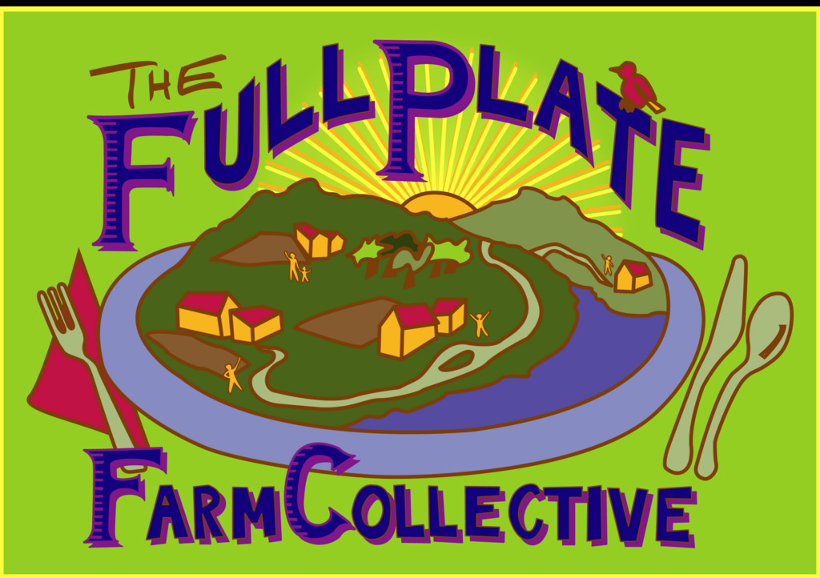
test
Who, Why & What of Collaborative Marketing
Who:
  Who is exploring forming a relationship
Why:
  Reasons for collaborative marketing:
    Reduce time & marketing expenses
    Ability to sell larger amounts of product to a single buyer
    Maintain product availability
    Buyer expectations for product quantities
    Other?
What:
  One product or many products
  Specifics should be documented, included quantity, price, grade, etc…
The Full Plate Farm Collective is a multi-farm CSA in the Ithaca, NY area comprised of founding members Remembrance Farm and Stick & Stone Farm Photo courtesy http://www.localharvest.org/
Notes:
What could some other reasons for exploring a collaborative marketing relationship?
Document, document, document….You never want to leave anything up for interpretation, especially as it relates to which product(s) are part of the agreement, price, transportation logistics, etc…
Why → should get a mission for the collaborative. Why do they exist? This will help guide business decisions around marketing/sales of products as well as the reason for the group to come together; should not be one-time in nature, unless for a very specific purpose.

Slide 5
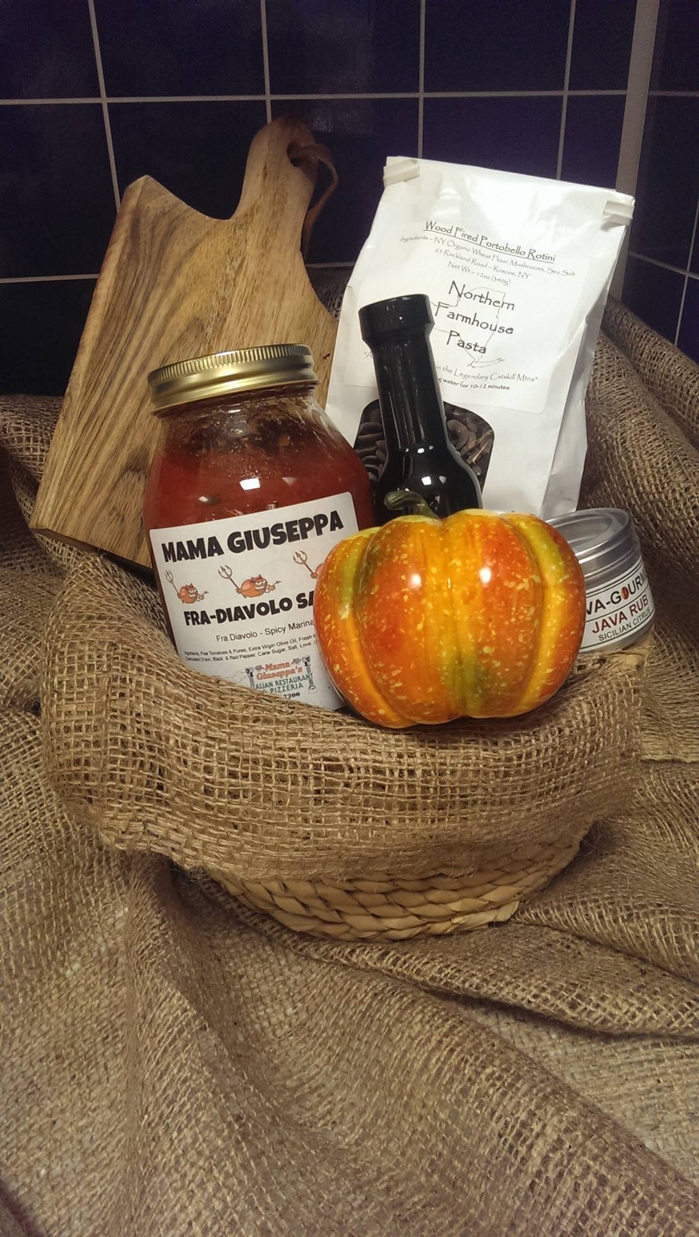
When & How of Collaborative Marketing
When:
  Formal relationship with start & end dates, or just an informal relationship with start date
  Need for formal agreements in case of disagreements and/or renewal
How:
  Many options depending on who the end buyer is. For wholesale the following are the recommended options:
    LLC formation
    Cooperative formation
    Wholesale purchase from partner farms
    Corporation structure (profit or non-profit)
Taste of NY gift basket from the Broome Gateway store. Photo courtesy of https://www.facebook.com/TasteNYBroome/?fref=ts
Notes:
Agreements could be during a growing season, for a specific product, etc…but this needs to be spelled out.
** Always consult a lawyer and accountant prior to pursuing any of these business formations. **

Slide 6
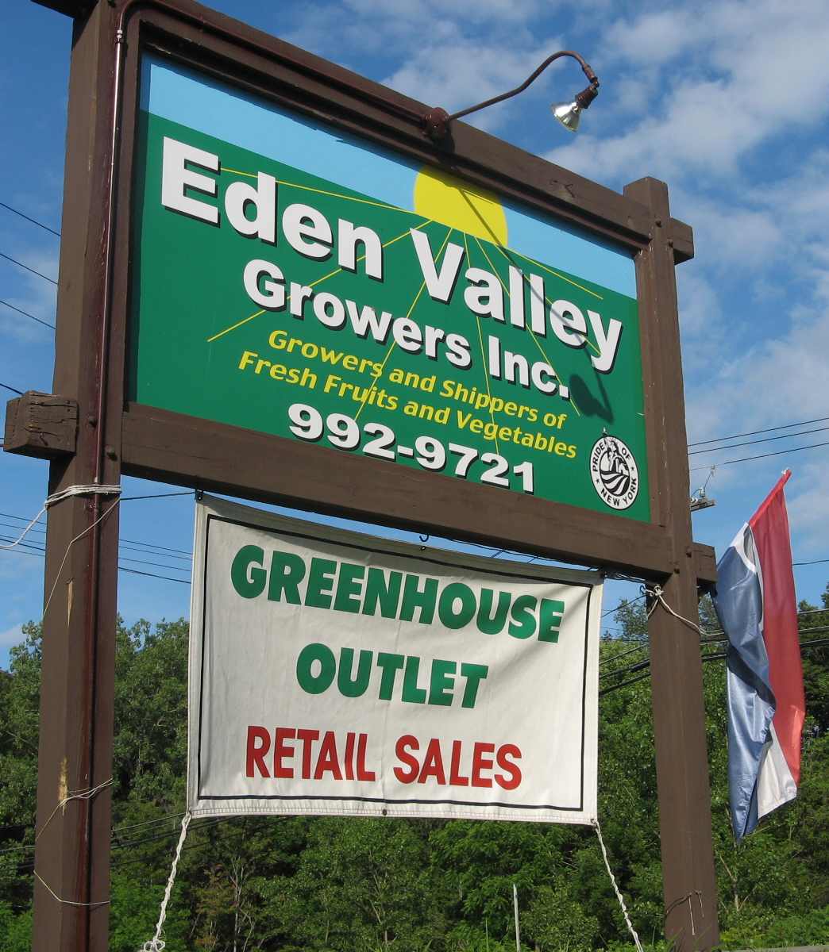
So What is Collaborative Marketing?
Examples
  Can be collaborating around product, transportation, aggregation, point of sale, etc..
    Old Barn Hollow (point of sale)
    Lucky Dog Food Hub (transportation)
    Good Food Farmers Network (product)
      CSA farms in the Hudson Valley
    Full Plate Collective (product)
“Crash & Burn”
  These didn’t work out & why
Eden Valley Growers is a growers coop located in Western NY. Photo courtesy http://edenvalleygrowers.com/.

Slide 7
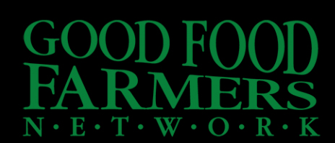
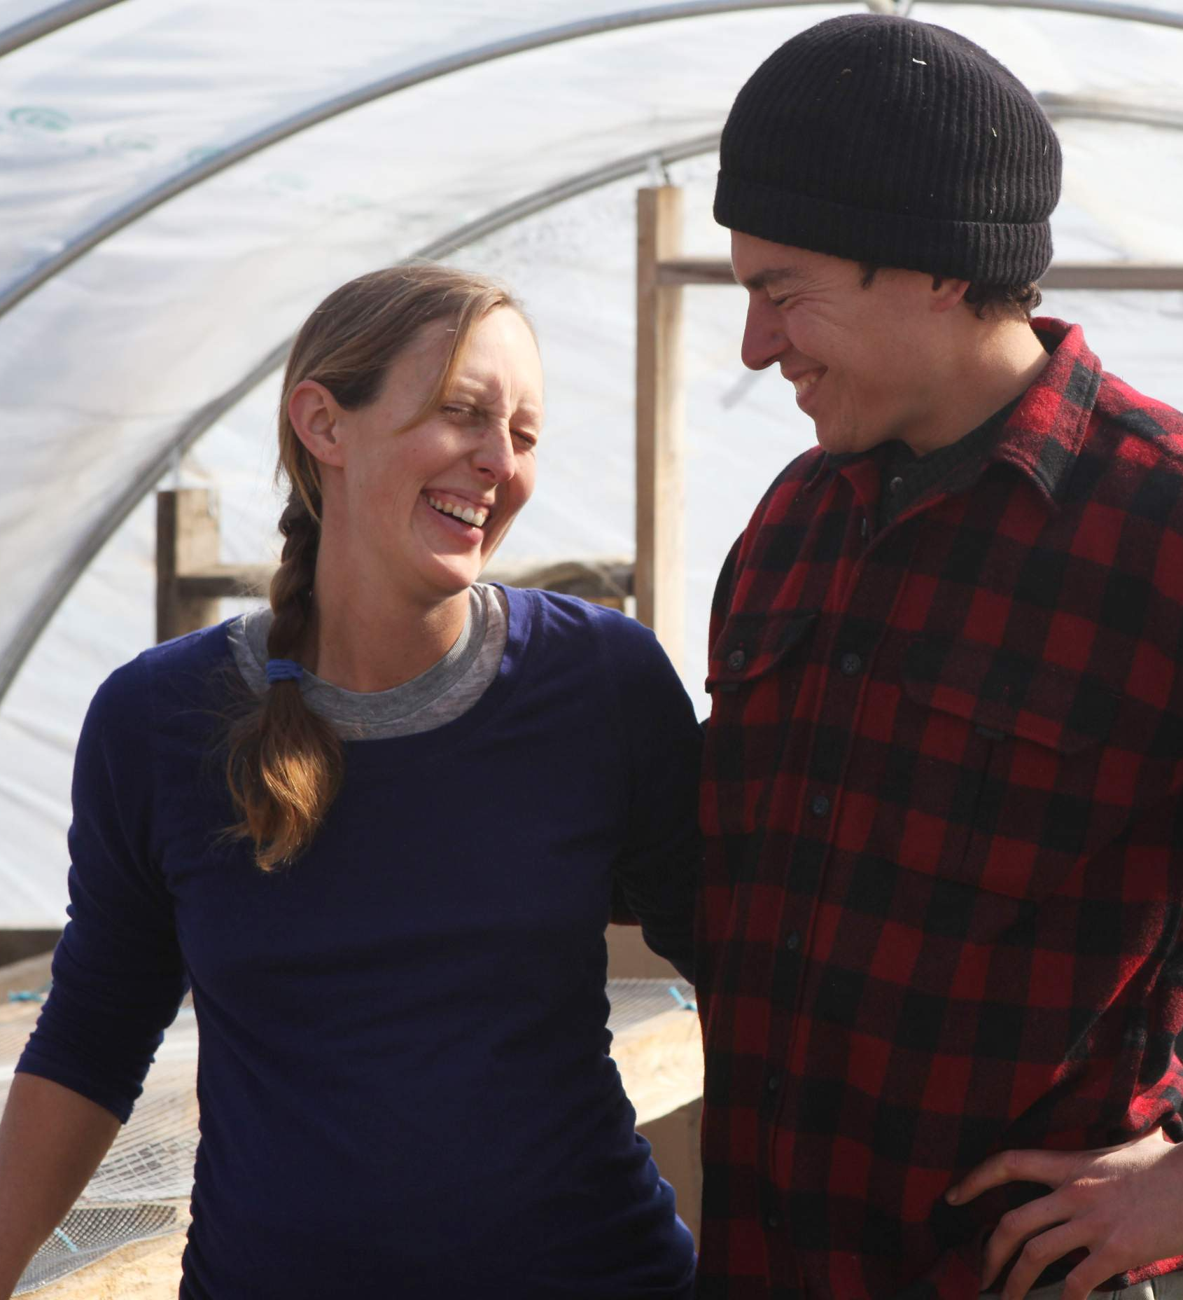
How to Set up Successful Collaborative Marketing Relationships:
Be Strategic
  What do you want? More overall customers? More of a specific type of customer?
Think like your customer
  What attracts your ideal customer? Collaborate with those types/brands of farms
Be true to your brand
  Is this relationship you are looking to pursue complimentary either in terms of product options, core values or customer type?
    If yes, look to pursue;
    If no, then keep looking
Cash is NOT king & Focus on the relationship to make it happen
  This will be discussed in another module (buyer-seller relationships)
Jon and Jen Ronsani of Lineage Farm, a member of the Good Food Farmers Network. The GFFN is a collaborative group of 4 farms in the Capital District of NY. Photo courtesy http://goodfoodfarmers.com/
Notes:
Collaborative marketing is all about relationships and understanding where your farm fits in the marketplace. Do you have an established brand for your farm? If so this can be a definite value to bring to the table.
Relationships between farms and relationships between the “entity” and the buyer.
Who is your target customer and what draws them to your products? Variety? Quality? Season extension? Price Point (low cost/high quantity or high cost/high quality)?What else?
Does this fit with your farm’s mission/vision? Revist the checklist to see how it fits with assessment.
Is the farm looking to collaborate with you have similar products or not? If they are similar, what is the draw to collaborate? Ability to access larger markets? If they are complimentary, what is the draw? Ability to draw from more “full diet” buyers?
Remember that your customer is not the end user of your product so you are reliant on the middleman representing your product(s) how you want them to be represented.
Remember the first two rules of customer service:
The customer is always right;
If the customer is wrong, refer back to #1

Slide 8
Who’s Responsibility is Marketing?
When Might a Breakdown Occur:
Lack of common mission
  Values, objectives, interests → need for a mission statement
Lack of commitment by members
  → will member farms stick with the group even when they could get better prices on their own?
Barriers to entry/exit
Cost of group decisionmaking
  → consensus with democratic membership & shared values → more members/voices & one person representation
Collaborative Marketing allows farms to retain their identity.
Who’s responsibility is marketing? How is this being communicated to the buyer?
- Who is key communicator?
- Is collaborative marketing more work for the buyer?
- Group dynamics (pros & cons)
- Who is doing the marketing?
* Communications and conflict management will be addressed in other modules *
Notes:
Buyers need to know they will be dealing with the same person all the time who is representing the product(s). This person must be a great communicator to explain who they are representing. This person will also be the neutral facilitator in the group and therefore if possible should not be one of the partner farms.

Slide 9
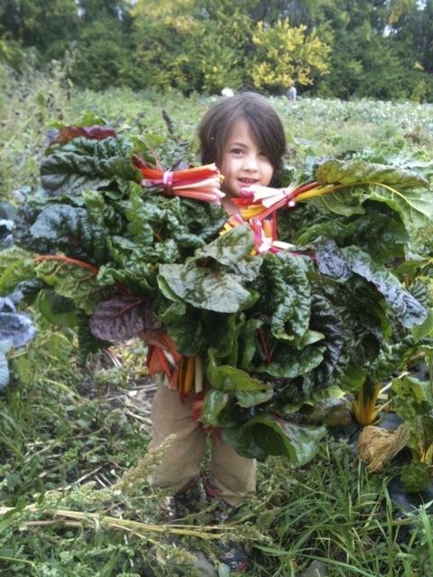
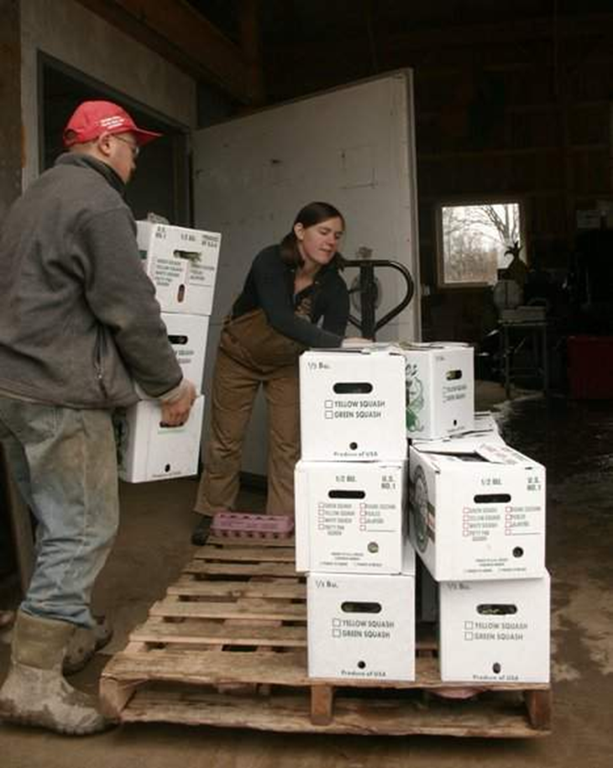
Let’s meet Stick & Stones Farm as a Collaborative Marketer
Why get into collaborative marketing? → Full Plate Collective
Like working with people
Wanted the infusion of income when most needed (CSA model)
Wanted to serve a larger group of consumers, but didn’t want to grow certain items
  Also allows for flexibility of excess/surplus
Why does it work?
TRUST & Time
Existing relationships with farms
Formal, but not formal
Having a paid coordinator to oversee the effort
  Communication
  Mediation
Accountability among partners
Share risk, resources, equipment & knowledge
Why does collaborative marketing work for them?
Stick & Stones Farm, a Ithaca-based produce farm with wholesale relationships. Photos courtesy Stick & Stones Farm.
Notes:
Trust – where this always can fall apart; must take time to build partnerships, farms must trust each other to go into business with each other. Works best with existing relationships since production practices are known, personalities are known
Coordinator – necessary to communicate with customers, market products, etc… Mediation among farm partners as a neutral party
Formal – LLC with Remembrance Farm, not formal – no formal contracts with partner farms, just confirm via email yield, price and product
Sharing – Full Plate bought a truck that all farms can use, tractors, etc… asking farms about questions/concerns, risk in terms of production by having people specialize in specific items

Slide 10
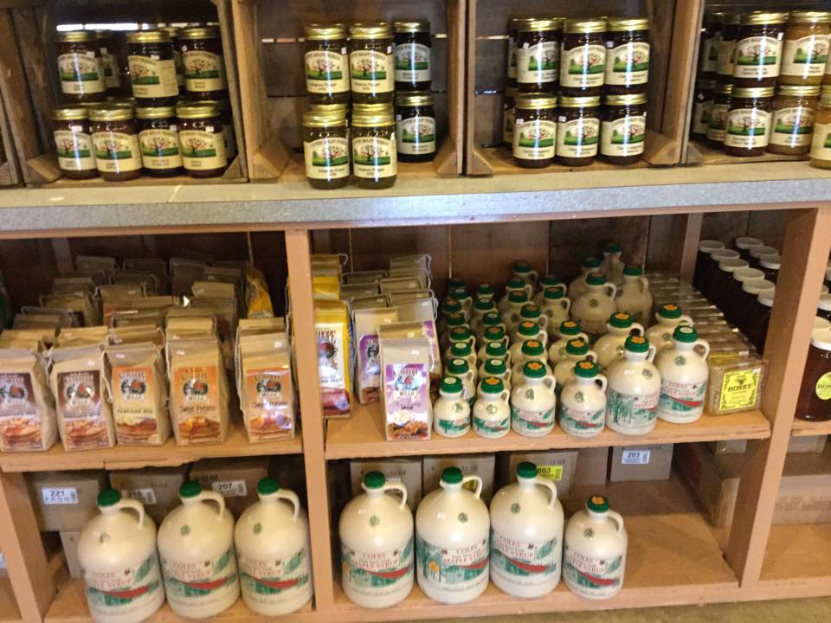
Common Collaboration Challenges/Activity (25mins)
Small Group Discussions:
  Matching the Needs of the Buyer with the Capacity of the Collaborative
  Inadequate post-harvest handling
  Lack of money/group dynamics
  Variability in certification & credentials
  Each group can pick a challenge and discuss an approach, or approaches, that a group of farms could set in place to ensure long-term success.
  Then each group can share with the larger group to get other insight/input.
Country Wagon Produce (Maine, NY) supports NYS farms by selling their products in her farm store. Photo courtesy of http://www.countrywagon1.com/
Notes:
What did you find that was common to all the group discussions? Have you encountered these issues before? Do you think the solutions would be implemented/accepted? How important is peer to peer monitoring in collaborative marketing?

