Slide 1
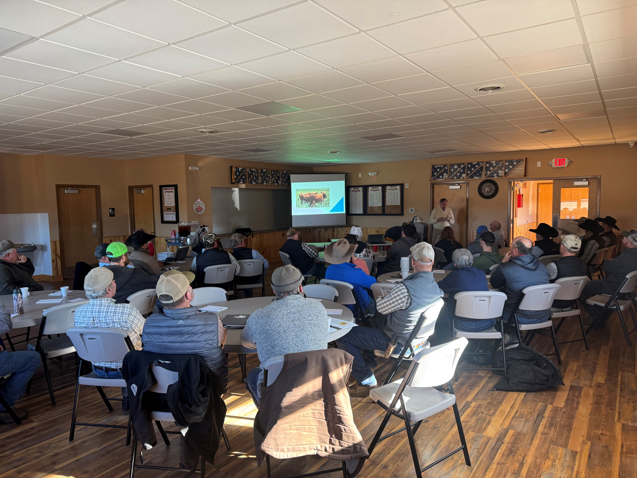
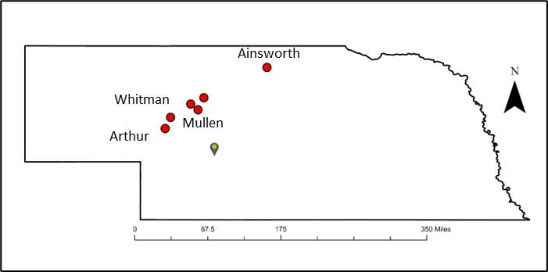
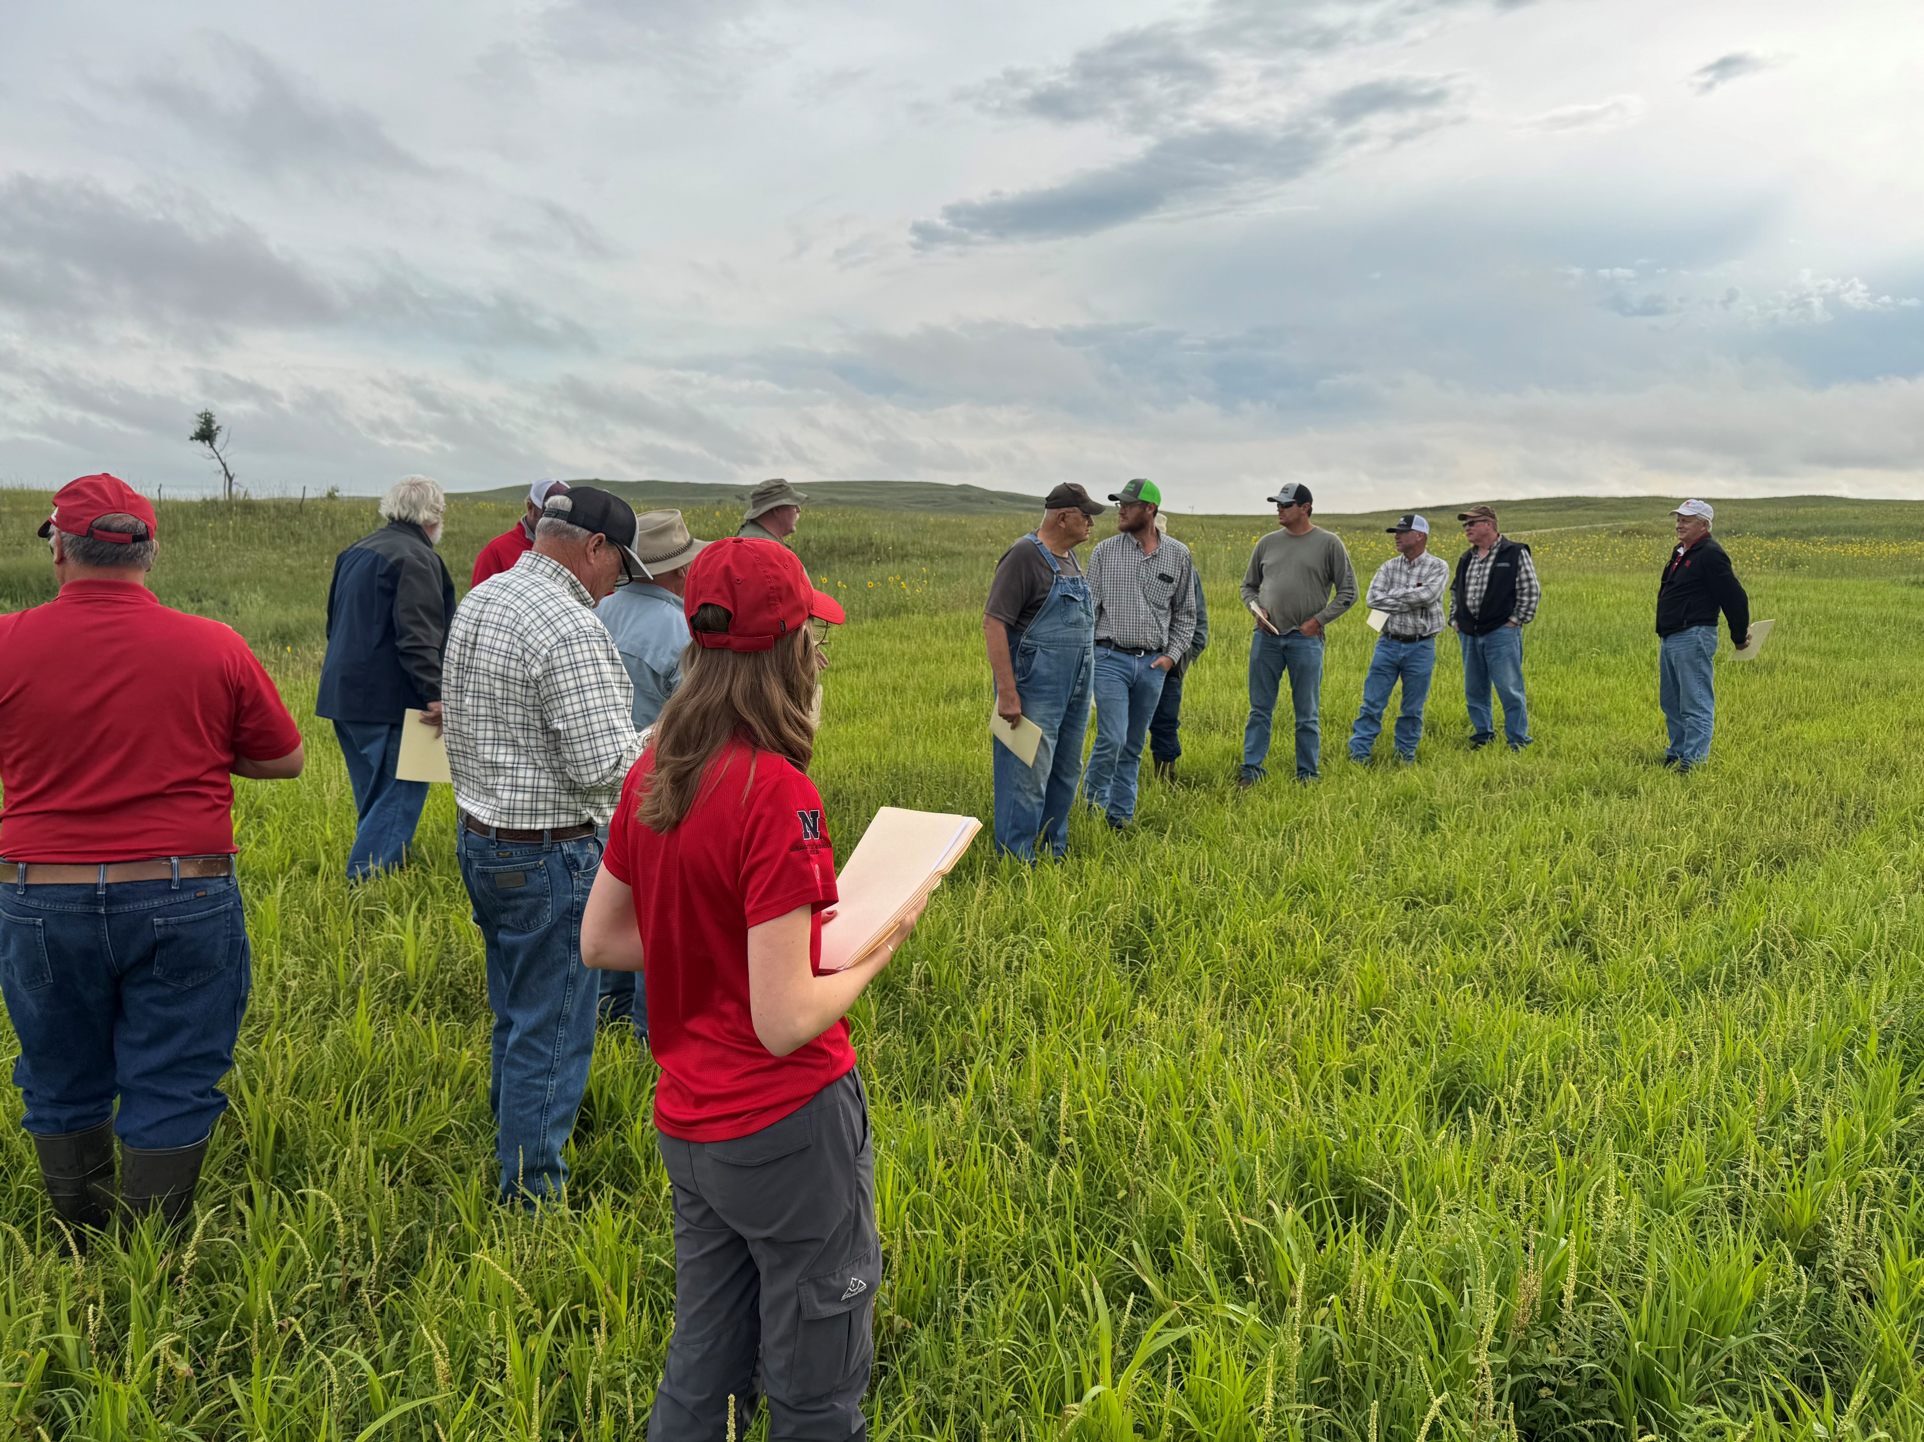
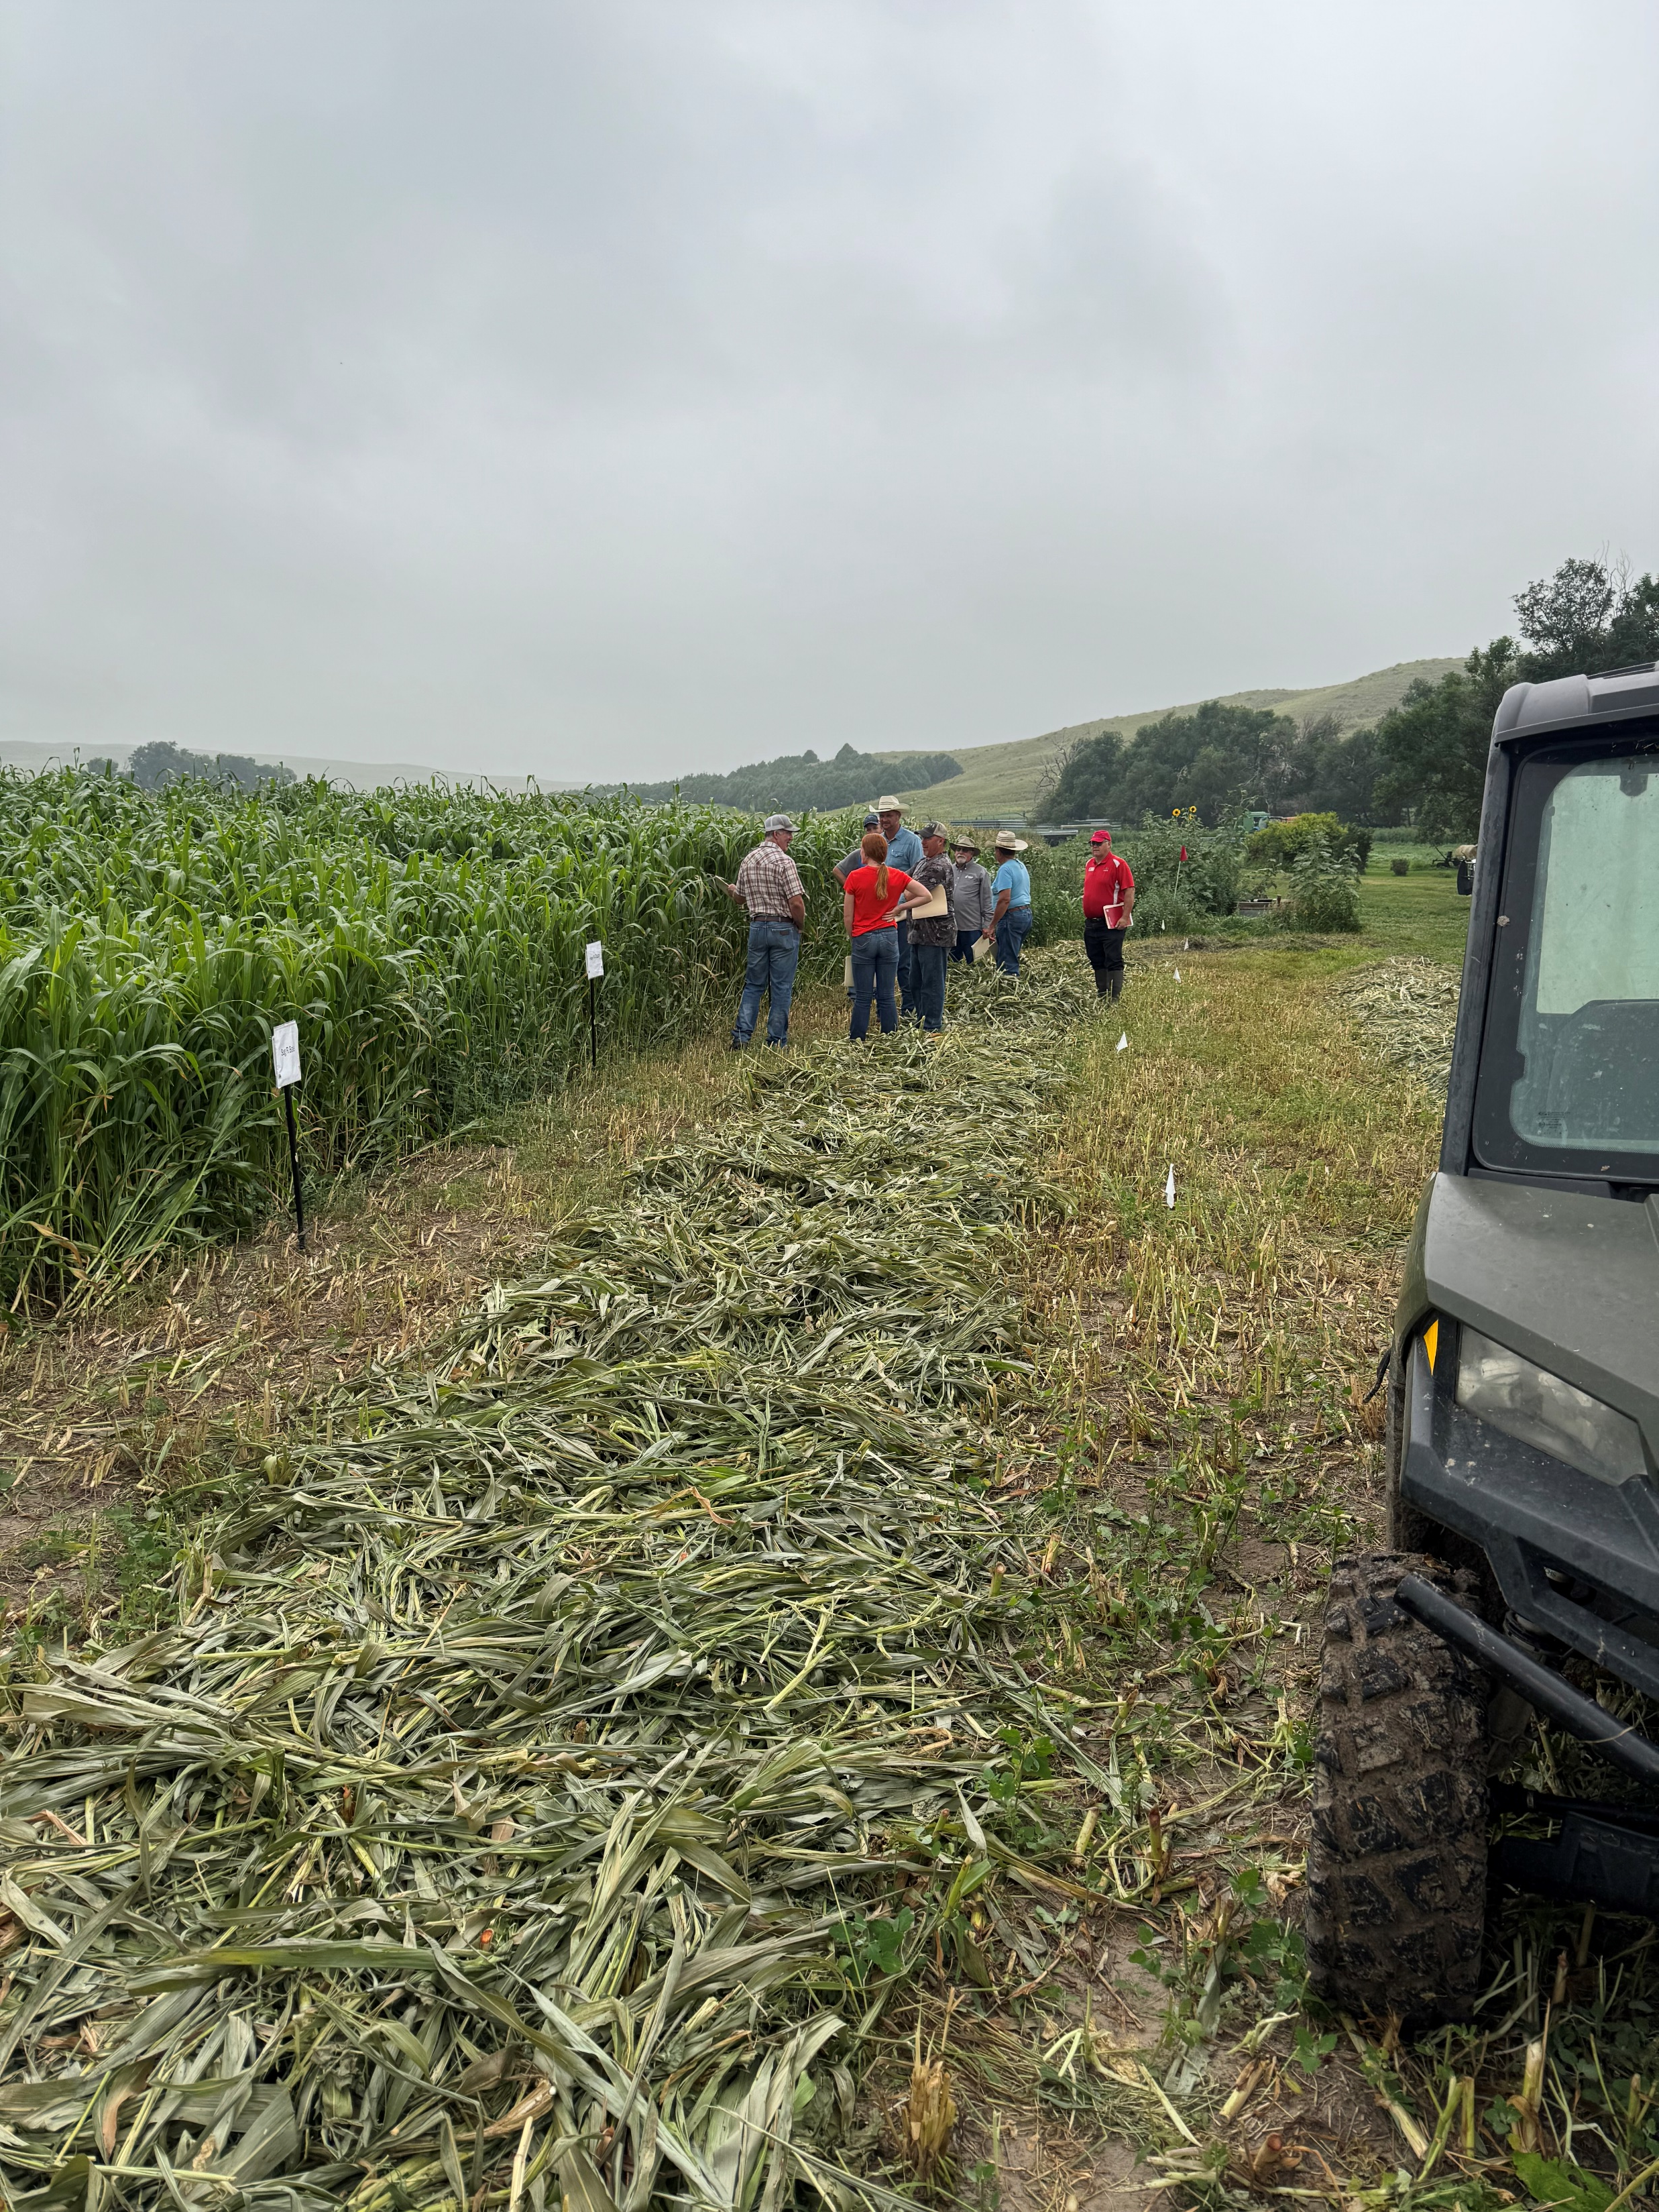

Summer forage crop options for North-Central Nebraska counties to improve production, forage quality, and soil health

Slide 2
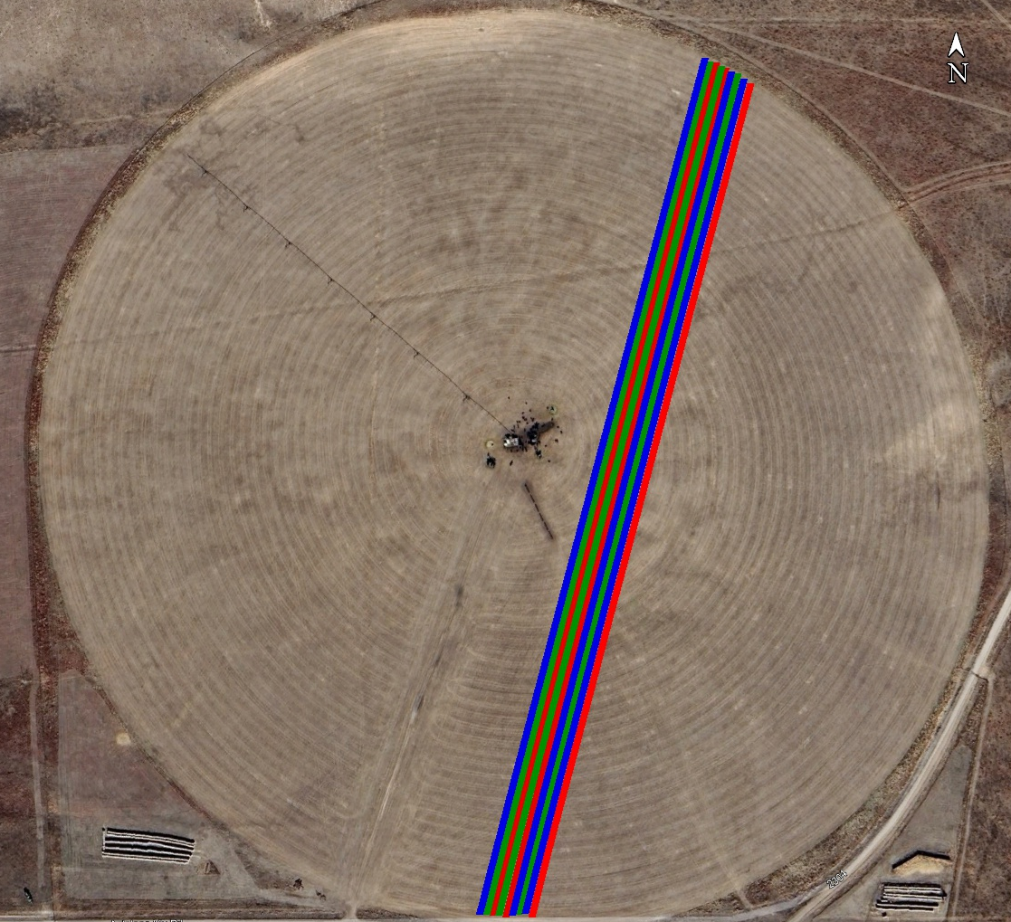
Example of field trial
One pass: 3 varieties (one variety per drill box)

Slide 3
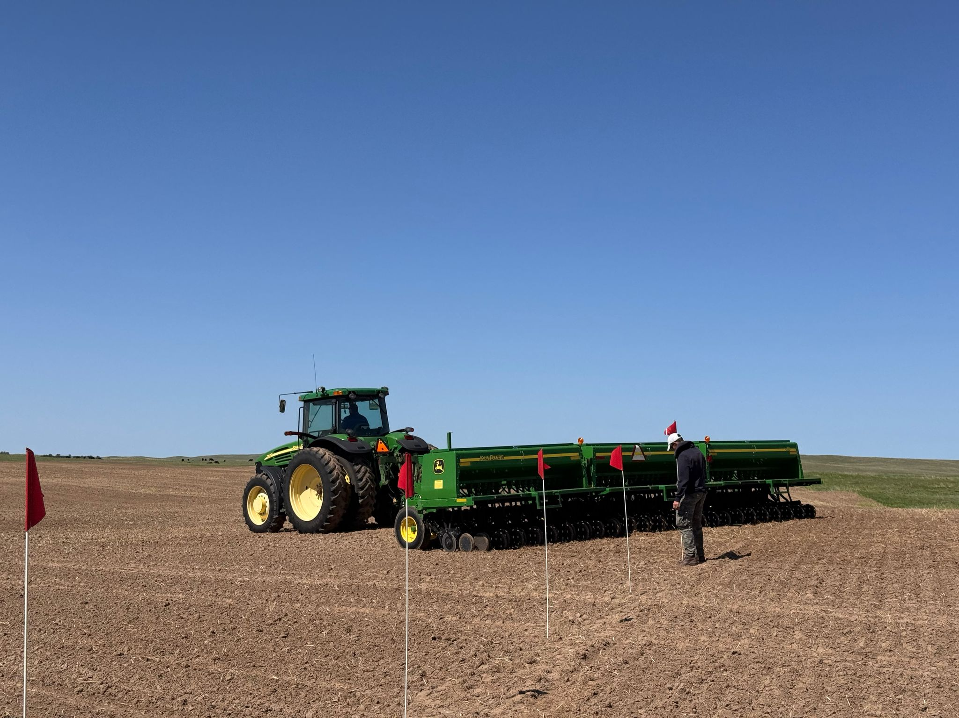

Slide 4
Summer forages tested and cost
Forage name | Rate (lb/ac) | Cost per acre ($/ac)
Master Graze Forage Corn | 20 | 83.0
Elite II Hybrid Pearl Millet | 40 | 68.8
Forage Silage Mix | 40 | 59.6
Multi-Cut Hay or Graze Mix | 40 | 55.6
Pacesetter SP | 40 | 50.9
Sug R Bale | 40 | 48.0
1st Choice BMR | 40 | 47.7
Honey Graze BMR | 40 | 47.7
Winter Grazing Mix | 40 | 46.4
Pacesetter SP & Soybean | 60 | 42.9
Hay N Graze | 40 | 33.6

Slide 5
2-Year Average Forage Production
Summer Forage | Production (tons/ac) |  |  | Average Seed Cost ($/ac) | Average Partial Production Cost ($/ton)
 | 2024 | 2025 | Average
Pacesetter SP & Soybean |  | 4.14 | 4.14 | 42.9 | 10.4
Hay N Graze | 3.14 | 3.09 | 3.11 | 41.6 | 13.3
Forage Silage Mix | 2.94 | 3.51 | 3.22 | 44.3 | 13.4
Pacesetter SP | 2.64 | 4.20 | 3.42 | 48.5 | 14.8
Honey Graze BMR | 3.18 | 4.26 | 3.72 | 57.1 | 16.1
Multi-Cut Hay or Graze Mix | 2.85 | 4.00 | 3.42 | 56.2 | 16.9
Winter Grazing Mix | 2.78 | 2.98 | 2.88 | 50.6 | 17.7
Honey Graze V | 2.83 |  | 2.83 | 50.4 | 17.8
Sug R Bale | 2.92 | 3.41 | 3.17 | 57.2 | 18.4
1st Choice BMR | 2.83 | 3.33 | 3.08 | 57.1 | 18.9
Elite II Hybrid Pearl Millet | 3.01 | 3.08 | 3.05 | 60.2 | 19.7
Master Graze Forage Corn |  | 4.12 | 4.12 | 83.0 | 20.2
Non-GMO Soybean | 1.23 |  | 1.23 | 52.5 | 42.7

Slide 6
2-Year Average Nutrient Extraction
Summer Forage | Nutrient Extraction (lbs nutrient/ac)
 | 2024 |  |  |  | 2025 |  |  |  | Average
 | N | P | K | S | N | P | K | S | N | P | K | S
1st Choice BMR | 105.6 | 15.5 | 104.7 | 12.0 | 119.8 | 16.5 | 141.2 | 11.7 | 112.7 | 16.0 | 122.9 | 11.8
Honey Graze BMR | 130.5 | 16.5 | 109.2 | 13.1 | 178.2 | 21.1 | 154.6 | 15.5 | 154.3 | 18.8 | 131.9 | 14.3
Sug R Bale | 100.6 | 15.5 | 104.4 | 10.8 | 135.0 | 20.0 | 147.2 | 12.5 | 117.8 | 17.7 | 125.8 | 11.6
Elite II Hybrid Pearl Millet | 101.5 | 14.6 | 129.8 | 11.9 | 91.6 | 15.1 | 164.8 | 13.4 | 96.6 | 14.9 | 147.3 | 12.6
Multi-Cut Hay or Graze Mix | 106.8 | 14.5 | 105.0 | 12.4 | 168.3 | 21.4 | 165.1 | 16.1 | 137.5 | 18.0 | 135.0 | 14.2
Winter Grazing Mix | 114.2 | 18.3 | 129.7 | 15.9 | 127.9 | 17.1 | 147.6 | 17.5 | 121.1 | 17.7 | 138.6 | 16.7
Non-GMO Soybean | 104.0 | 10.1 | 28.4 | 6.7 |  |  |  |  | 104.0 | 10.1 | 28.4 | 6.7
Honey Graze V | 101.4 | 13.7 | 103.0 | 10.7 |  |  |  |  | 101.4 | 13.7 | 103.0 | 10.7
Hay N Graze | 126.2 | 18.7 | 128.7 | 14.8 | 123.9 | 16.9 | 136.3 | 11.6 | 125.0 | 17.8 | 132.5 | 13.2
Pacesetter SP | 101.0 | 12.4 | 83.4 | 7.8 | 172.7 | 21.5 | 163.9 | 14.9 | 136.8 | 17.0 | 123.7 | 11.3
Forage Silage Mix | 115.9 | 16.4 | 115.5 | 11.7 | 129.5 | 19.0 | 155.5 | 12.6 | 122.7 | 17.7 | 135.5 | 12.1
Master Graze Forage Corn |  |  |  |  | 179.2 | 22.5 | 187.0 | 17.0 | 179.2 | 22.5 | 187.0 | 17.0
Pacesetter SP & Soybean |  |  |  |  | 190.2 | 22.4 | 168.0 | 16.2 | 190.2 | 22.4 | 168.0 | 16.2
Average Nutrient Extraction per year (lbs nutrient/ac) |  |  |  |  |  |  |  |  | 130.7 | 17.2 | 129.2 | 13.0

Slide 7
2-Year Average Nutrient Extraction

