Slide 1
Alternative Treatments for Chronic Bacterial Infection of Sheep and Goats
Sarah Paluso¹, Ann Bryant¹, Anne Lichtenwalner^{1,2} ¹ School of Food and Agriculture, University of Maine ² Extension, University of Maine

Slide 2
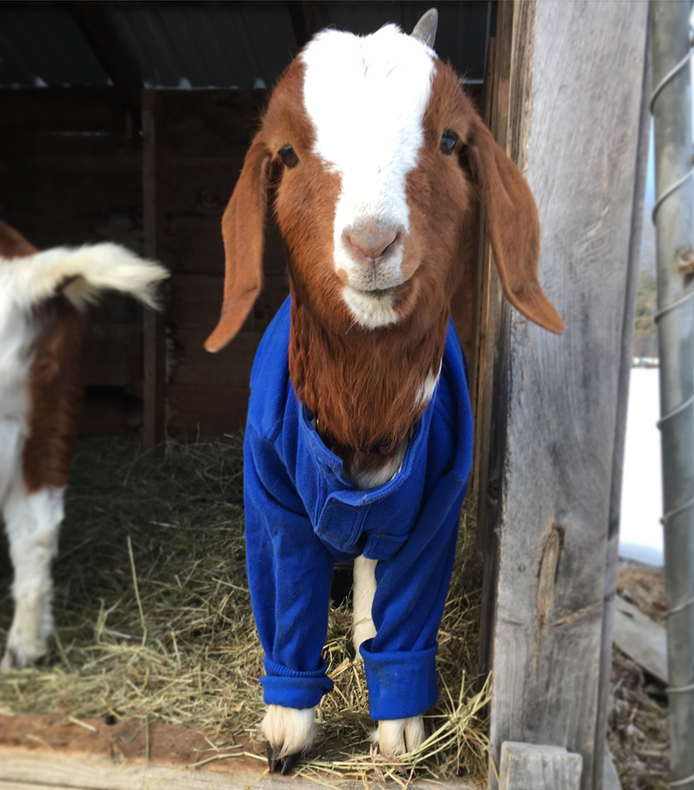
Overview
Introduction
Research Questions
Part 1
Methods
Results
Part 2
Methods
Results
Conclusions

Slide 3
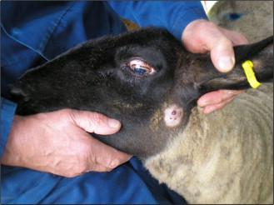
Caseous Lymphadenitis (CL)
Chronic bacterial infection of small ruminants
Caused by Corynebacterium pseudotuberculosis
Characterized by abscesses in internal or external lymph nodes
Transmission occurs through contact with ruptured abscesses
Direct: skin to skin contact
Indirect: contact with contaminated fomites
Baird and Fontaine, 2007
Lichtenwalner/UMaine

Slide 4
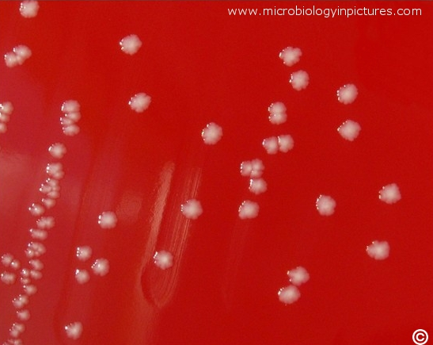
Corynebacterium pseudotuberculosis
Etiologic agent of CL
Facultative intracellular bacteria
Survive phagocytosis and live within immune cells such as macrophages
Difficult to eradicate from farms
Can survive on inanimate surfaces (plastic, wood, steel) for up to 55 days (Augustine and Renshaw, 1986)
In cool, damp conditions (bedding or soil), can survive for > 6 months (Brown and Olander, 1987)
Singh et al., 2018

Slide 5
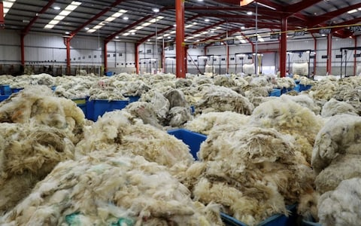
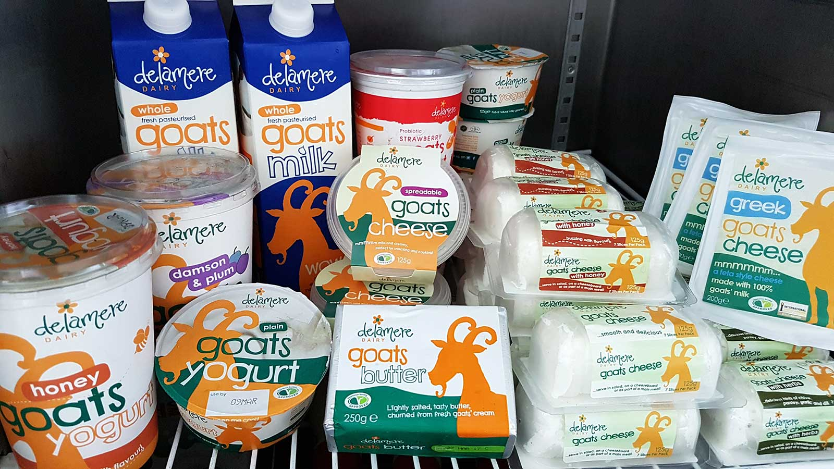
Impact on Industry
CL incidence rates in western U.S. have reached 42% (Stoops et al., 1984)
Approximately 22% of Maine sheep and 43% of Maine sheep farms tested were positive for CL in a 2012 study (Lichtenwalner, 2013)
CL abscesses decrease wool, meat, and milk production and reproductive efficiency
U.S. wool, mohair, and milk production worth approx. $9.39 million (USDA, 2012)
CL results in approx. 5% decrease in wool production → $500,000 loss annually (Paton et al., 1994)
https://tinyurl.com/yyfj6bxt
http://goatsmilk.com.sg/home/

Slide 6
Diagnosis & Treatment
Currently no effective/efficient vaccine
Available vaccines interfere with serologic diagnostic tests
Antibiotic treatment not effective
Thick-walled abscesses and intracellular pathogen
High cost (treatment of entire herd)
Veterinary Feed Directive – regulation of antibiotic use in food-producing animals (FDA, 2015)

Slide 7
Essential Oils
Bioactive compounds derived from plants
Complex mixtures (20-60 components)
Antimicrobial properties against many pathogenic bacteria, including Mycobacterium tuberculosis (Andrade-Ochoa et al., 2015)
Hydrophobic – alter integrity of bacterial cell walls (Ultee et al., 1999)
Can have cytotoxic effects on mammalian cells (Yoon et al., 2000)
https://tinyurl.com/y4elbs9q

Slide 8
Research Questions
Can essential oil (EO) components inhibit the growth of C. pseudotuberculosis?
Do essential oil components have cytotoxic effects on mammalian cells?

Slide 9
Methods: Part 1
Purpose: Find minimum inhibitory concentration (MIC) of nine anti-tubercular EO components (α-terpinene, β-citronellol, β-pinene, carvacrol, cuminaldehyde, p-anisaldehyde, terpinolene, thymol, trans-cinnamaldehyde) against C. pseudoTB (Andrade-Ochoa et al., 2015)
Disk diffusion assay
Inoculate plates with C. pseudoTB
Treat disk with EO component (100, 10, and 1 uL/mL) or control (antibiotic, ethanol, Tween, DI water)
Incubate 37°C, 5% CO₂
Measure zone of inhibition at 24, 48, and 72 hours

Slide 10
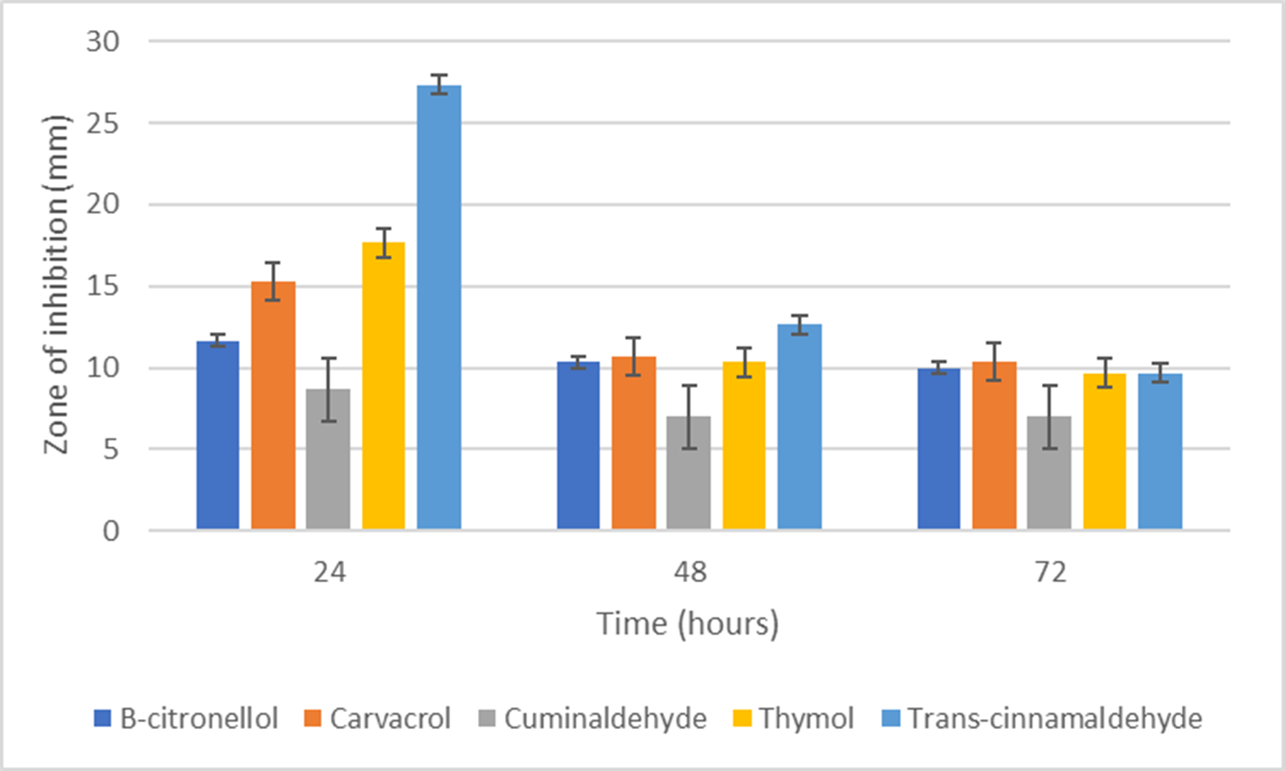
Results: Part 1
β-citronellol, carvacrol, cuminaldehyde, thymol, and trans-cinnamaldehyde had significant zones of inhibition (> 10 mm)
EO component | MIC (mg/mL)
β-citronellol | 10
Carvacrol | 10
Cuminaldehyde | 40
Thymol | 10
Trans-cinnamaldehyde | 10
Average zones of inhibition at 10 mg/mL

Slide 11
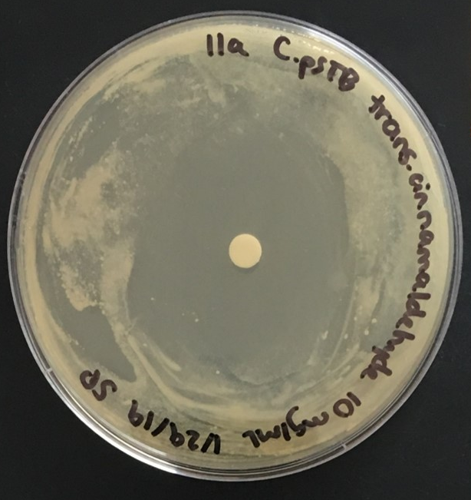
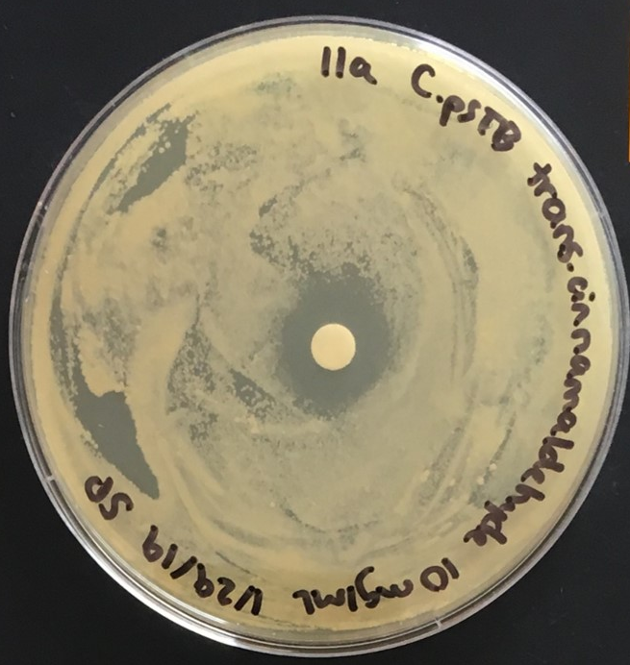
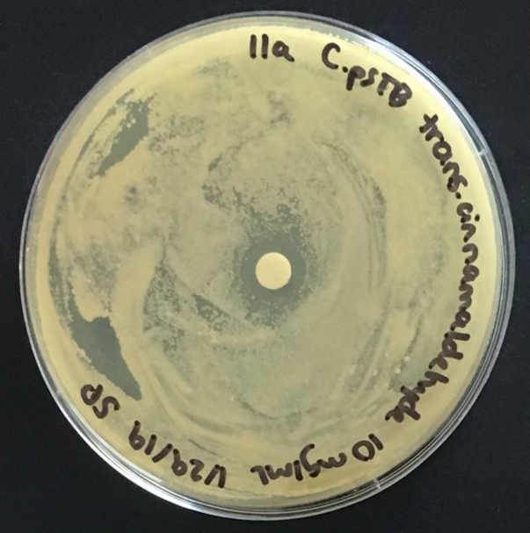
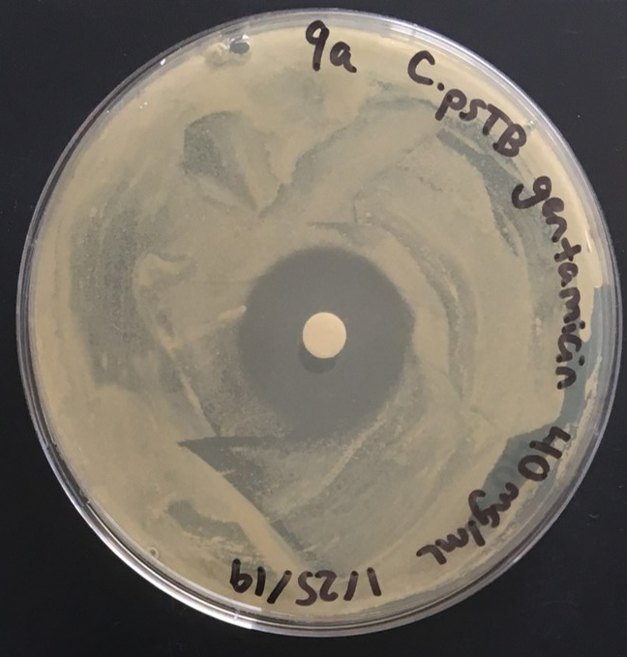
Results: Part 1
All EO component zones decreased in size over time
Trans-cinnamaldehyde (10 mg/mL)
24 hours
48 hours
72 hours
Gentamicin (control) (40 mg/mL)

Slide 12
Research Questions
Can essential oil components inhibit the growth of C. pseudotuberculosis?
Do essential oil components have cytotoxic effects on mammalian cells?

Slide 13
Methods: Part 2
Cell viability assay
Inoculate 96-well plate with Buffalo rat liver (BRL) fibroblast cells
Incubate overnight (37°C, 5% CO₂)
Treat cells with EO components (100, 10, and 1 uL/mL) or controls (bleach, ethanol, Tween, media)
Incubate 24 hours (37°C, 5% CO₂)
Add CellTiter 96® AQueous One Solution Reagent and measure absorbance at 490 nm after 1-4 hours
BRL cells (Photo: Paluso/UMaine
CellTiter 96® AQueous One Solution Reagent, Promega

Slide 14
Results: Part 2
Ethanol and Tween controls inhibited BRL cell growth → could not draw conclusions from EO components data
EO components do not dissolve in cell culture media alone
Repeat experiment without ethanol and Tween with shaking
Average absorbance at 490 nm
Ethanol (100 uL/mL) | Tween (200 uL/mL) | Untreated cells
0.246 | 0.203 | 2.199

Slide 15
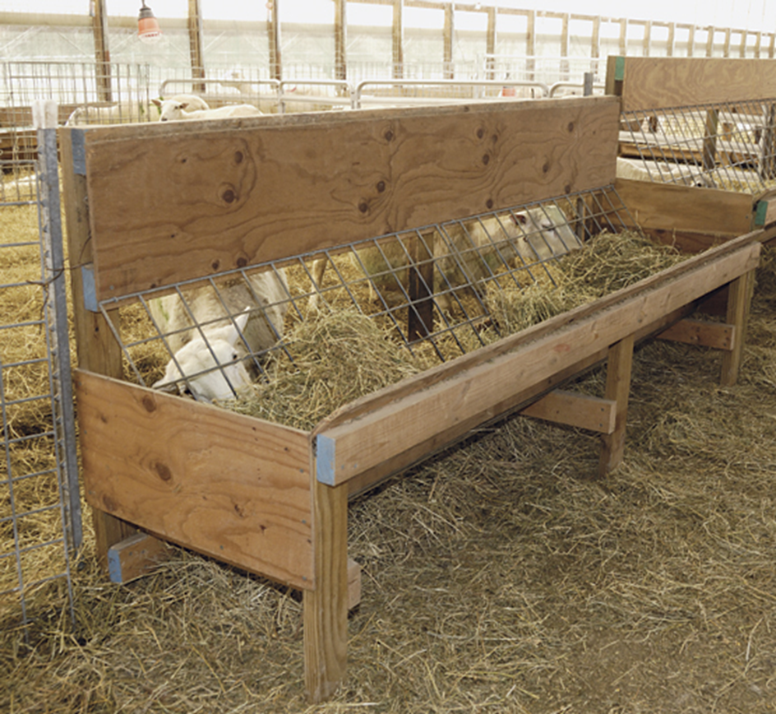
Conclusions
β-citronellol, carvacrol, thymol, and trans-cinnamaldehyde are able to inhibit C. pseudoTB growth in vitro at concentrations ≤ 10 mg/mL
Further evaluations of potential toxicity of these EO components are needed
Potential uses:
Topical antibiotic of abscesses (penetrate membranes)
Disinfectants for farm surfaces (wooden feeders, fencing, shearing equipment, etc.)
https://tinyurl.com/yyfe4wxf

Slide 16
Acknowledgements
Thank you to:
Anne Lichtenwalner
Ann Bryant
Cassie Miller
Northeast SARE
This material is based upon work supported by the National Institute of Food and Agriculture, U.S. Department of Agriculture, through the Northeast Sustainable Agriculture Research and Education program under subaward number GNE18-184

Slide 17
References
Andrade-Ochoa, S., Nevárez-Moorillón, G.V., Sánchez-Torres, L.E., Villanueva-García, M., Sánchez-Ramírez, B.E., Rodríguez-Valdez, L.M., Rivera-Chavira, B.E., 2015. Quantitative structure-activity relationship of molecules constituent of different essential oils with antimycobacterial activity against Mycobacterium tuberculosis and Mycobacterium bovis. BMC Complement. Altern. Med. 15, 1–11. https://doi.org/10.1186/s12906-015-0858-2
Augustine, J.L., Renshaw, H.W., 1986. Survival of Corynebacterium pseudotuberculosis in axenic purulent exudate on common barnyard fomites. Am. J. Vet. Res.
Baird, G.J., Fontaine, M.C., 2007. Corynebacterium pseudotuberculosis and its role in ovine caseous lymphadenitis. J. Comp. Pathol. 137, 179–210. https://doi.org/10.1016/j.jcpa.2007.07.002
Paton, M.W., Rose, I.R., Hart, R.A., Sutherland, S.S., Mercy, A.R., Ellis, T.M., Dhaliwal, J.A., 1994. New infection with Corynebacterium pseudotuberculosis reduces wool production. Aust. Vet. J. 71, 47–49. https://doi.org/10.1111/j.1751-0813.1994.tb06152.x
Stoops, S.G., Renshaw, H.W., Thilsted, J.P., 1984. Ovine caseous lymphadenitis: disease prevalence, lesion distribution, and thoracic manifestations in a population of mature culled sheep from western United States. Am. J. Vet. Res. 45, 557–561.
Ultee, A., Kets, E.P.W., Smid, E.J., 1999. Mechanisms of action of carvacrol on the food-borne pathogen Bacillus cereus. Appl. Environ. Microbiol. 65, 4606–4610.
Yoon, H.S., Moon, S.C., Kim, N.D., Park, B.S., Jeong, M.H., Yoo, Y.H., 2000. Genistein induces apoptosis of RPE-J cells by opening mitochondrial PTP. Biochem. Biophys. Res. Commun. 276, 151–156. https://doi.org/10.1006/bbrc.2000.3445

Slide 18
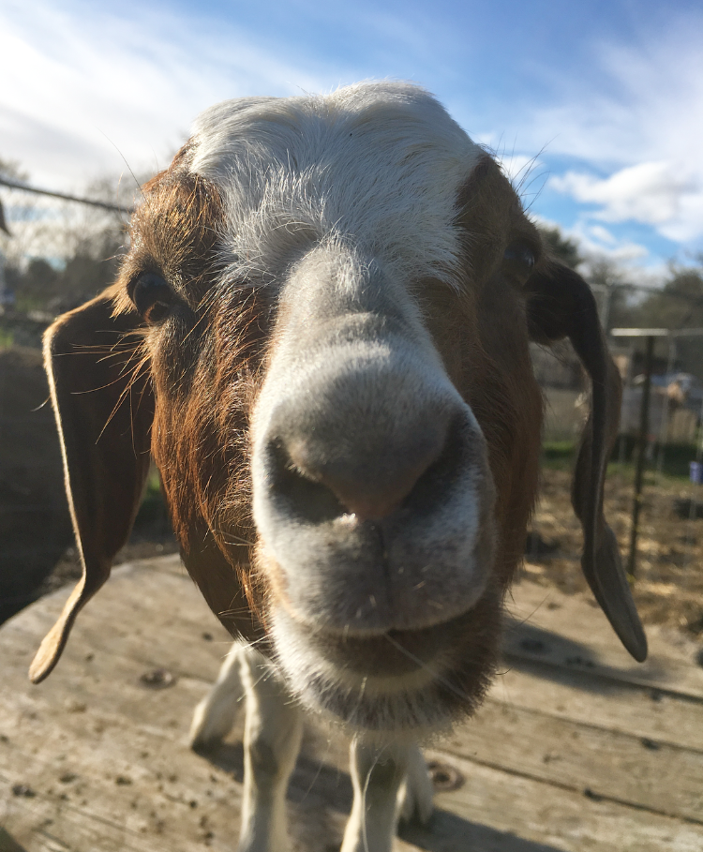
Questions?

