Slide 1
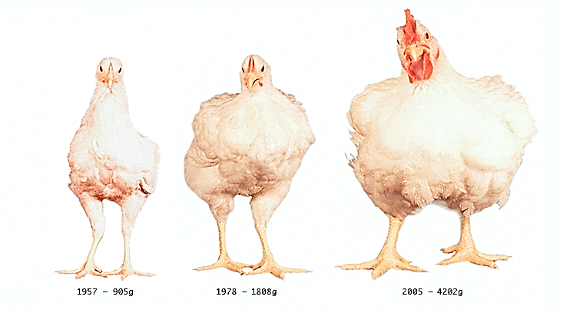
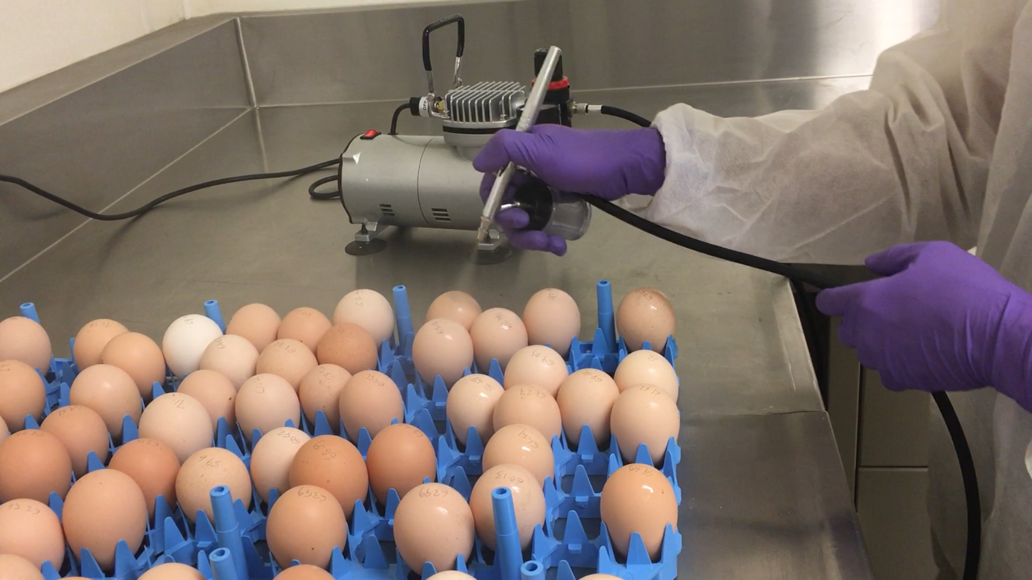
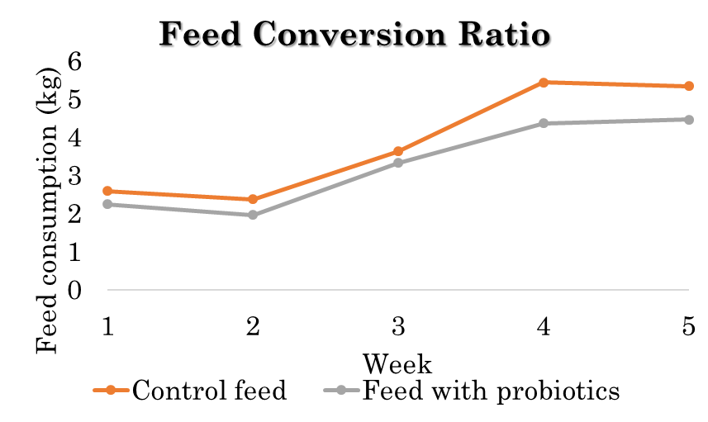
Probiotics Increased the Body Weight and Improved Feed Efficiency
Muhammed Shafeekh Muyyarikkandy

