Slide 1
A Survey of Relationships Among Rare Breeds of Swine
Kizzi Roberts

Slide 2
Breed Diversity
Over 70 different breeds of pigs
Vertical integration within the industry
Consumer demand for lean, uniform product
  Yorkshire, Landrace, Chester White, Duroc, Berkshire, Large White
The American Livestock Breed Conservancy (ALBC) was founded to protect rare breeds of livestock and poultry
  Approximately 180 livestock and poultry breeds

Slide 3
Importance of Breed Diversity
Industry breeds share similar genetic makeup
Bred to thrive in a specific environment
  Confined feeding operations
Less popular breeds of pigs are more genetically diverse
  Able to tolerate harsh living conditions
  Disease Resistance
  More self sufficient

Slide 4
Swine Breeds
Many breeds have unique traits not found in industry breeds
ALBC lists 7 critical swine breeds
  Fewer than 200 registered each year
Three breeds were selected from this list
  Guinea Hog
  Ossabaw Island
  Red Wattle

Slide 5
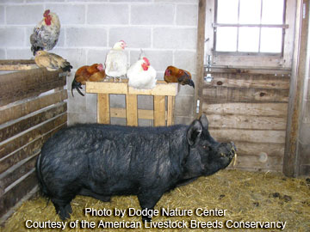
Guinea Hog
Small, hardy pigs
Excellent foragers
High fat content
Good for subsistence farming
  Small size
  Thrive on rough forage

Slide 6
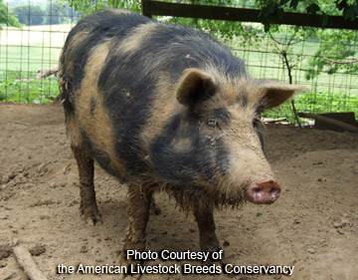
Ossabaw Island
Isolated feral herd on Ossabaw Island
Small, hardy pig
Large fat stores
Good model for non insulin dependent diabetes

Slide 7
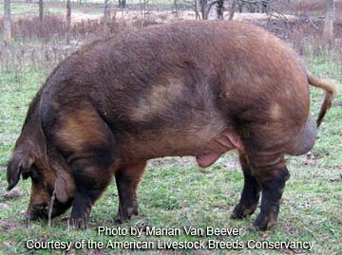
Red Wattle
Hardy, large pigs
Rapid growth rate
Lean, tender, flavorful meat
Mild temperament

Slide 8
Challenges of Conservation
These breeds are not as popular
  Small carcass, high fat content, relatively slow growth rate
Small breed population
  Difficult for farmers to find animals to purchase
Not as many pig farmers
  As compared to other small farming operations
Small herd size
  No confined feeding operations

Slide 9
Challenges of Conservation
Lack of pedigree information
  Old breeds
  Sometimes have no formal breed organization
Reduced genetic diversity
  Due to small population and lack of pedigree data
Inbreeding
  Not knowing relationships of animals makes planning matings difficult
  Ultimately reduces breed viability

Slide 10
Inbreeding
High levels of homozygosity (inbreeding)
Allows undesirable or lethal alleles to be expressed
Reduction in genetic diversity
Reduces breed viability

Slide 11
Objective
Determine relationships among rare breeds of pigs when pedigree data is incomplete or unknown so farmers can plan matings to reduce inbreeding
Compare rare breeds to each other and to industry breeds
  Determine which breeds are more similar to popular breeds and which are more genetically diverse

Slide 12
Methods
Collect DNA samples from each breed
  10-11 animals per breed
  Hair samples
Samples genotyped at GeneSeek
Determine relationships from genotypes

Slide 13
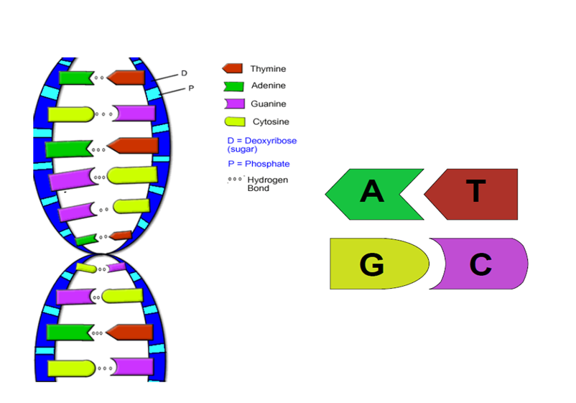
Quick Review
DNA is composed of four nucleotides
The sequence of nucleotides is important
  Codes for genes

Slide 14
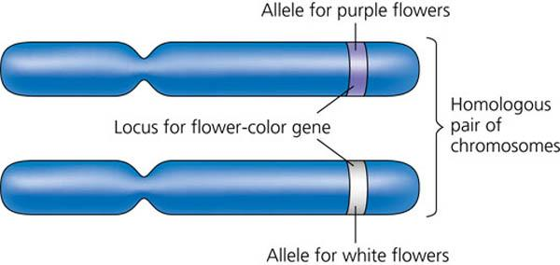
Allele
Two chromosomes
Two forms of a gene
  Each form is an allele
  Allele A and Allele B
An animal’s genotype is determined by which alleles it carries
  Homozygous means it has two forms of the same allele
    Either AA or BB
  Heterozygous means is carries a form of each allele
    AB
  Therefore there are 3 possible genotypes

Slide 15
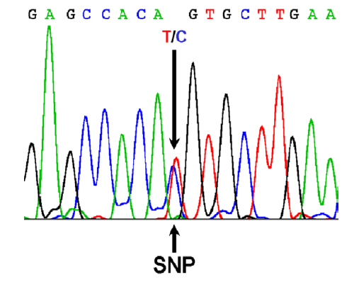
How Genetic Testing Can Help
Single Nucleotide Polymorphism (SNP)
  A change in a single nucleotide in DNA
  Creates two different alleles
    A or B
  Three different genotypes
    AA, AB, or BB
Related individuals will have similar genetic makeup

Slide 16
Genetic Testing
Swine 60k SNP chip
  Genotypes at over 60,000 sites
  Genotypes codes as A, H, or B
In matrix form, SNP data can be used to measure the levels of hetero- and homozygosity

Slide 17
SNP Data
 | ALGA09 | ALGA460 | ALGA376 | ALGA047 | ALGA087 | ALGA300 | ALGA370 | ALGA131 | ALGA133
Setty's MC Wart Side Sow | B | B | A | A | B | B | B | A | A
Setty's MC Big Old Stiff Boar | B | B | A | A | B | B | B | A | A
Houdini | B | B | H | A | H | H | H | A | H
DNC Seymour Sample A | B | B | A | A | H | B | B | A | H
Rose DNC | B | B | A | A | H | B | B | A | A
DNC Junior | B | B | A | A | B | B | B | A | H
Setty Lilly | B | B | A | A | B | B | B | A | A
DNC Seymour Sample B | B | B | A | A | H | B | B | A | H
Samson | B | H | A | A | A | B | H | A | A
Killian | B | B | A | A | B | B | B | A | A
Barnett | B | B | A | A | H | B | B | A | A

Slide 18
Relationships
Count of similar homozygous alleles
  Higher number of similar alleles between two individuals, indicates closer relationship
Expressed as a proportion or percentage

Slide 19
Proportion of Similar Alleles
 | Setty's MC Wart Side Sow | Setty's MC Big Old Stiff Boar | Houdini | DNC Seymour Sample A | Rose DNC | DNC Junior | Setty Lilly | DNC Seymour Sample B | Samson | Killian | Barnett
Setty's MC Wart Side Sow | 74.4 | 62.1 | 43.6 | 43.0 | 46.0 | 48.8 | 59.1 | 42.7 | 28.9 | 50.1 | 56.8
Setty's MC Big Old Stiff Boar | 62.1 | 74.8 | 44.7 | 40.7 | 45.0 | 46.9 | 59.9 | 40.4 | 29.6 | 51.6 | 53.8
Houdini | 43.6 | 44.7 | 76.1 | 43.4 | 57.3 | 40.4 | 47.2 | 43.1 | 27.8 | 49.6 | 47.1
DNC Seymour Sample A | 43.0 | 40.7 | 43.4 | 76.6 | 46.1 | 57.2 | 43.5 | 75.9 | 29.2 | 51.6 | 48.8
Rose DNC | 46.0 | 45.0 | 57.3 | 46.1 | 71.8 | 41.8 | 45.9 | 45.7 | 30.2 | 49.2 | 46.9
DNC Junior | 48.8 | 46.9 | 40.4 | 57.2 | 41.8 | 68.7 | 47.6 | 56.8 | 30.2 | 50.3 | 47.6
Setty Lilly | 59.1 | 59.9 | 47.2 | 43.5 | 45.9 | 47.6 | 73.0 | 43.2 | 27.8 | 51.0 | 55.2
DNC Seymour Sample B | 42.7 | 40.4 | 43.1 | 75.9 | 45.7 | 56.8 | 43.2 | 76.1 | 29.1 | 51.2 | 48.5
Samson | 28.9 | 29.6 | 27.8 | 29.2 | 30.2 | 30.2 | 27.8 | 29.1 | 54.2 | 29.7 | 28.9
Killian | 50.1 | 51.6 | 49.6 | 51.6 | 49.2 | 50.3 | 51.0 | 51.2 | 29.7 | 70.0 | 47.5
Barnett | 56.8 | 53.8 | 47.1 | 48.8 | 46.9 | 47.6 | 55.2 | 48.5 | 28.9 | 47.5 | 72.9

Slide 20
Grouping into Families
Order by shared number of alleles
Rough estimate of close families
This method does not give precise levels of relatedness

Slide 21
Families
Family 1 |  |  | Family 3 |  |  | Family 5
Samson |  |  | Killian |  |  | Rose DNC
 |  |  |  |  |  | Houdini
Family 2 |  |  | Family 4
Setty's MC Wart Side Sow |  |  | DNC Seymour
Setty's MC Big Old Stiff Boar |  |  | DNC Junior
Setty Lilly
Barnett

Slide 22
Calculating the Relationships
Sampling of pigs with known relationships
Calculate both pedigree relationships and number of shared genotypes

Slide 23
Relationship Matrix
Plug count of homozygous alleles into regression formula to get relationships for Guinea hogs
A relationship of 0.5 between two animals is equivalent to a sibling or parent-offspring relationship

Slide 24
Guinea Hog Relationship Matrix
 | Setty's MC Wart Side Sow | Setty's MC Big Old Boar | Houdini | DNC Seymour Sample A | Rose DNC | DNC Junior | Setty Lilly | DNC Seymour Sample B | Samson | Killian | Barnett
Setty's MC Wart Side Sow |  | 0.887 | 0.386 | 0.372 | 0.452 | 0.528 | 0.807 | 0.364 | -0.011 | 0.564 | 0.743
Setty's MC Big Old Boar | 0.887 |  | 0.418 | 0.310 | 0.424 | 0.478 | 0.828 | 0.302 | 0.008 | 0.602 | 0.662
Houdini | 0.386 | 0.418 |  | 0.383 | 0.758 | 0.300 | 0.485 | 0.374 | -0.039 | 0.550 | 0.482
DNC Seymour Sample A | 0.372 | 0.310 | 0.383 |  | 0.454 | 0.756 | 0.384 | 1.260 | 0.000 | 0.602 | 0.528
Rose DNC | 0.452 | 0.424 | 0.758 | 0.454 |  | 0.340 | 0.450 | 0.445 | 0.026 | 0.539 | 0.477
DNC Junior | 0.528 | 0.478 | 0.300 | 0.756 | 0.340 |  | 0.495 | 0.744 | 0.025 | 0.569 | 0.497
Setty Lilly | 0.807 | 0.828 | 0.485 | 0.384 | 0.450 | 0.495 |  | 0.378 | -0.040 | 0.588 | 0.702
DNC Seymour Sample B | 0.364 | 0.302 | 0.374 | 1.260 | 0.445 | 0.744 | 0.378 |  | -0.004 | 0.593 | 0.521
Samson | -0.011 | 0.008 | -0.039 | 0.000 | 0.026 | 0.025 | -0.040 | -0.004 |  | 0.012 | -0.009
Killian | 0.564 | 0.602 | 0.550 | 0.602 | 0.539 | 0.569 | 0.588 | 0.593 | 0.012 |  | 0.493
Barnett | 0.743 | 0.662 | 0.482 | 0.528 | 0.477 | 0.497 | 0.702 | 0.521 | -0.009 | 0.493

Slide 25
Partial Pedigree
Animal | Sire | Dam
DNC George | Biggers Arthur | Celesky's Tulip
DNC Chunky | Biggers Arthur | Setty Rose
Setty's MC Big Old Stiff Boar | DNC George | DNC Chunky
Setty's MC Wart Side Sow | DNC George | DNC Chunky
DNC Gabriella | Setty Houdini | Celesky's Tulip
Brothers CG | DNC George | DNC Chunky
Brothers GG | DNC George | DNC Gabriella
Setty Lilly | Setty Houdini | Celesky's Tulip
Fall Ivy | Brothers CG | Brothers GG
DNC Seymour | Biggers Arthur | Fall Ivy

Slide 26
Example Family Tree
Biggers Arthur
DNC George
Celesky’s Tulip
Setty’s MC Big Old Stiff Boar
Biggers Arthur
DNC Chunky
Setty Rose

Slide 27
Calculated Relationships from Pedigree
Animal | BiggersA | Celeskys | DNCGeorg | SettyRos | DNCChunk | SettysBi | SettysWa | SettyHou | DNCGabri | BroCG | BroGG | SettyLil | FallIvy | DNCSeymo
BiggersA | 1 | . | 0.5 | . | 0.5 | 0.5 | 0.5 | . | . | 0.5 | 0.25 | . | 0.375 | 0.6875
Celeskys | . | 1 | 0.5 | . | . | 0.25 | 0.25 | . | 0.5 | 0.25 | 0.5 | 0.5 | 0.375 | 0.1875
DNCGeorg | 0.5 | 0.5 | 1 | . | 0.25 | 0.625 | 0.625 | . | 0.25 | 0.625 | 0.625 | 0.25 | 0.625 | 0.5625
SettyRos | . | . | . | 1 | 0.5 | 0.25 | 0.25 | . | . | 0.25 | . | . | 0.125 | 0.0625
DNCChunk | 0.5 | . | 0.25 | 0.5 | 1 | 0.625 | 0.625 | . | . | 0.625 | 0.125 | . | 0.375 | 0.4375
SettysBi | 0.5 | 0.25 | 0.625 | 0.25 | 0.625 | 1.125 | 0.625 | . | 0.125 | 0.625 | 0.375 | 0.125 | 0.5 | 0.5
SettysWa | 0.5 | 0.25 | 0.625 | 0.25 | 0.625 | 0.625 | 1.125 | . | 0.125 | 0.625 | 0.375 | 0.125 | 0.5 | 0.5
SettyHou | . | . | . | . | . | . | . | 1 | 0.5 | . | 0.25 | 0.5 | 0.125 | 0.0625
DNCGabri | . | 0.5 | 0.25 | . | . | 0.125 | 0.125 | 0.5 | 1 | 0.125 | 0.625 | 0.5 | 0.375 | 0.1875
BroCG | 0.5 | 0.25 | 0.625 | 0.25 | 0.625 | 0.625 | 0.625 | . | 0.125 | 1.125 | 0.375 | 0.125 | 0.75 | 0.625
BroGG | 0.25 | 0.5 | 0.625 | . | 0.125 | 0.375 | 0.375 | 0.25 | 0.625 | 0.375 | 1.125 | 0.375 | 0.75 | 0.5
SettyLil | . | 0.5 | 0.25 | . | . | 0.125 | 0.125 | 0.5 | 0.5 | 0.125 | 0.375 | 1 | 0.25 | 0.125
FallIvy | 0.375 | 0.375 | 0.625 | 0.125 | 0.375 | 0.5 | 0.5 | 0.125 | 0.375 | 0.75 | 0.75 | 0.25 | 1.1875 | 0.7813
DNCSeymo | 0.6875 | 0.1875 | 0.5625 | 0.0625 | 0.4375 | 0.5 | 0.5 | 0.0625 | 0.1875 | 0.625 | 0.5 | 0.125 | 0.7813 | 1.1875

Slide 28
Pedigree VS Snp
Pedigree Calculation/ SNP Calculation
 | Setty Rose | Setty Big Boar | Setty Wart | Setty Houdini | Setty Lily | DNC Seymour
Setty Rose |  | 0.25/.42 | 0.25/0.45 | ./0.75 | ./0.45 | 0.06/0.45
Setty Big Boar | 0.25/0.42 |  | 0.62/0.88 | ./0.42 | 0.13/0.83 | 0.5/0.30
Setty Wart | 0.25/0.45 | 0.62/0.88 |  | ./0.39 | 0.13/0.81 | 0.5/0.36
Setty Houdini | ./0.75 | ./0.42 | ./0.39 |  | 0.5/0.49 | 0.06/0.38
Setty Lily | ./0.45 | 0.13/0.83 | 0.13/0.81 | 0.5/0.49 |  | 0.13/0.38
DNC Seymour | 0.06/0.45 | 0.5/0.30 | 0.5/0.36 | 0.06/0.38 | 0.13/0.38

Slide 29
Future Work
Determine relationships in Ossabaw Island and Red Wattle pigs
Compare SNP’s across breeds
More complete picture of the origin of these breeds
Provide information to producers and others interested in conservation of these breeds

Slide 31
Thank you
NCR-SARE
ALBC
  Jeannette Beranger
  Alison Martin
Dr. Tim Safranski
Dr. Bill Lamberson
Producers
  Cheryl Fanning
  Kevin Fall
  Robert Long
Megan Rolf
Tasia Taxis

Slide 32
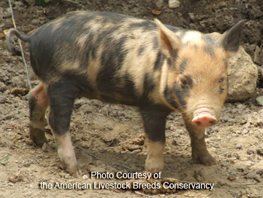
Questions?

