Slide 1
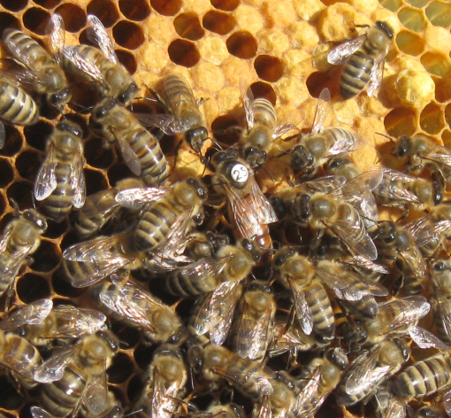
Breeding Bees
Starting a Breeding Program
and selecting for good traits

Slide 2
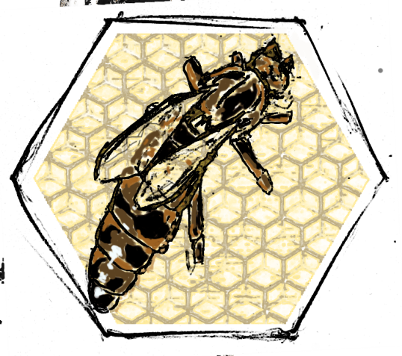
Starting a Breeding Program: Money, time, realistic goals
What do you want?
Are desired traits not currently available?
Adapt to your specific needs and conditions
Regional conditions
Dry summers
Early, short honey flows
Disease pressures
How do you get there?
Budget
Plan
Prioritize

Slide 3
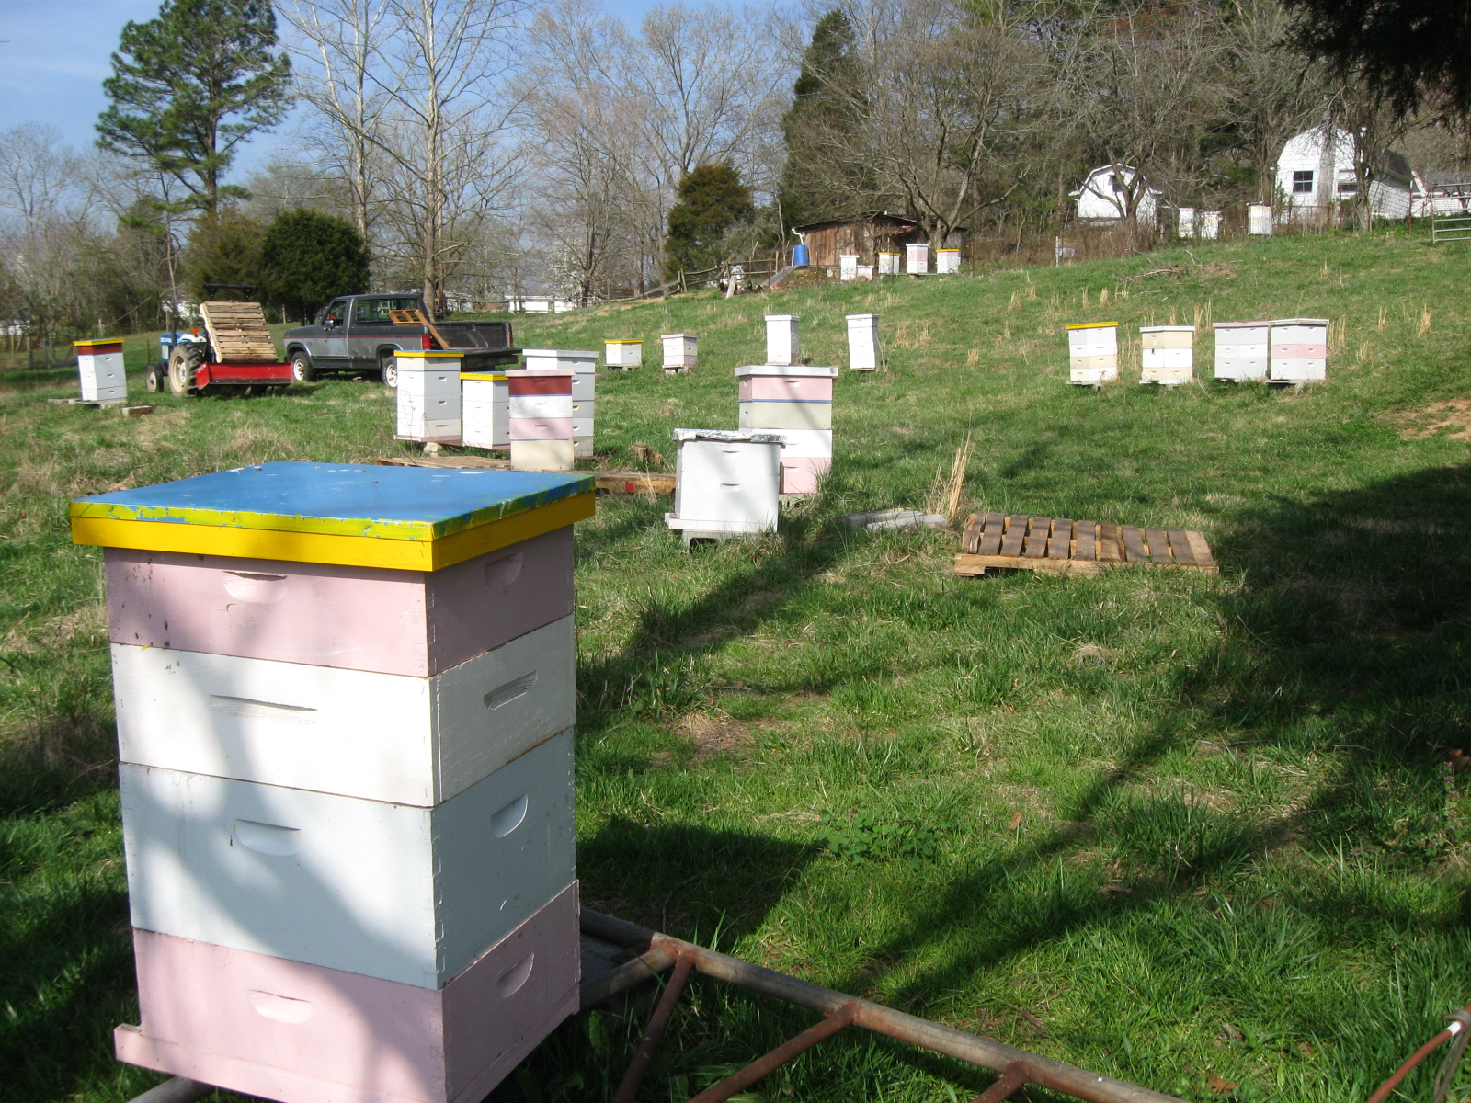
Which queens are the best ?
Hard to say without fair comparisons and standard measures.

Slide 4
Starting a Breeding Program

Slide 5
Start with good stock
II VSH breeder queens
II Carniolans from Glenn Apiaries

Slide 6
Influence the local population
4 years using II breeder queens, daughters open mated
Distribute daughters locally

Slide 7
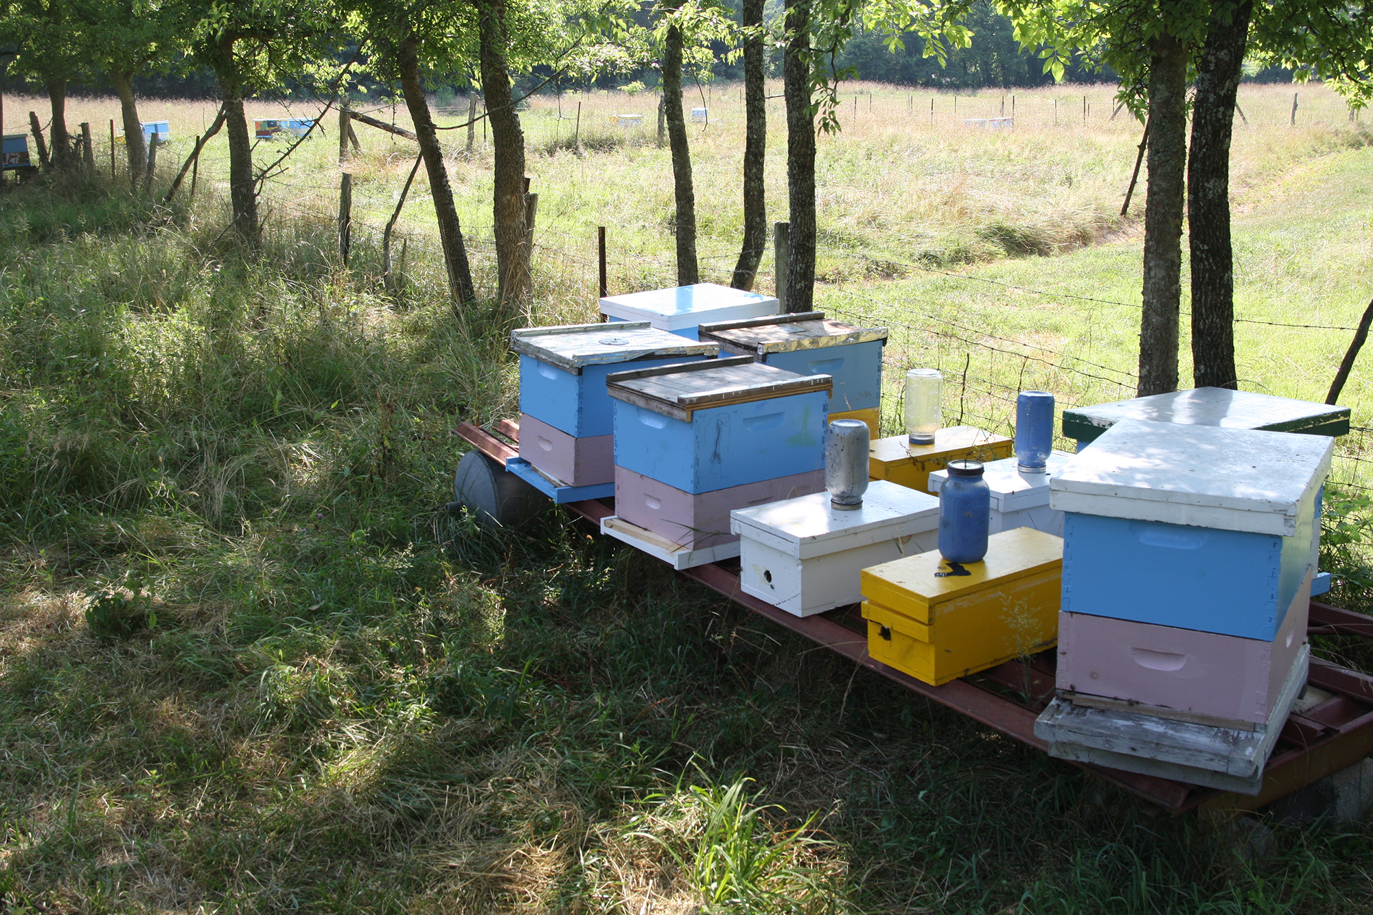
Setting up a comparison

Slide 8
Control of Variation
Used 1 location
Start in equal size colonies
Give each an equal chance to succeed

Slide 9
Equal size nucs
@ 14 days, mark her
@35 days, emerging bees from new queen
@56 days, foraging age bees should be from new queen
@98 days (14 weeks), 2 complete brood cycles after 56 days
@14 weeks after start, make comparisons

Slide 10
TIMELINE: Rosecomb Apiaries 2013 Queen Selection Timeline
Early August Mid August September Mid November early February in March
Start Virgin
Daughter queens in nucs
12 daughters
X 3 mother queens
= 36 nucs
(allows loss of 6)
@98 days (14 weeks), 4 complete brood cycles
@ 14 days, mark laying queens
Varroa mite count
year end measures:
Colony strength
Varroa mite infestation.
Nosema load
Starting measure for rapid spring population buildup
Adult bee count
Spring measures
colony strength
Varroa mite infestation
Nosema load
OVERWINTER
Start 30 nucs with queens mated in spring
SELECT top 10 – 15 breeder queens for grafting and further evaluation

Slide 11
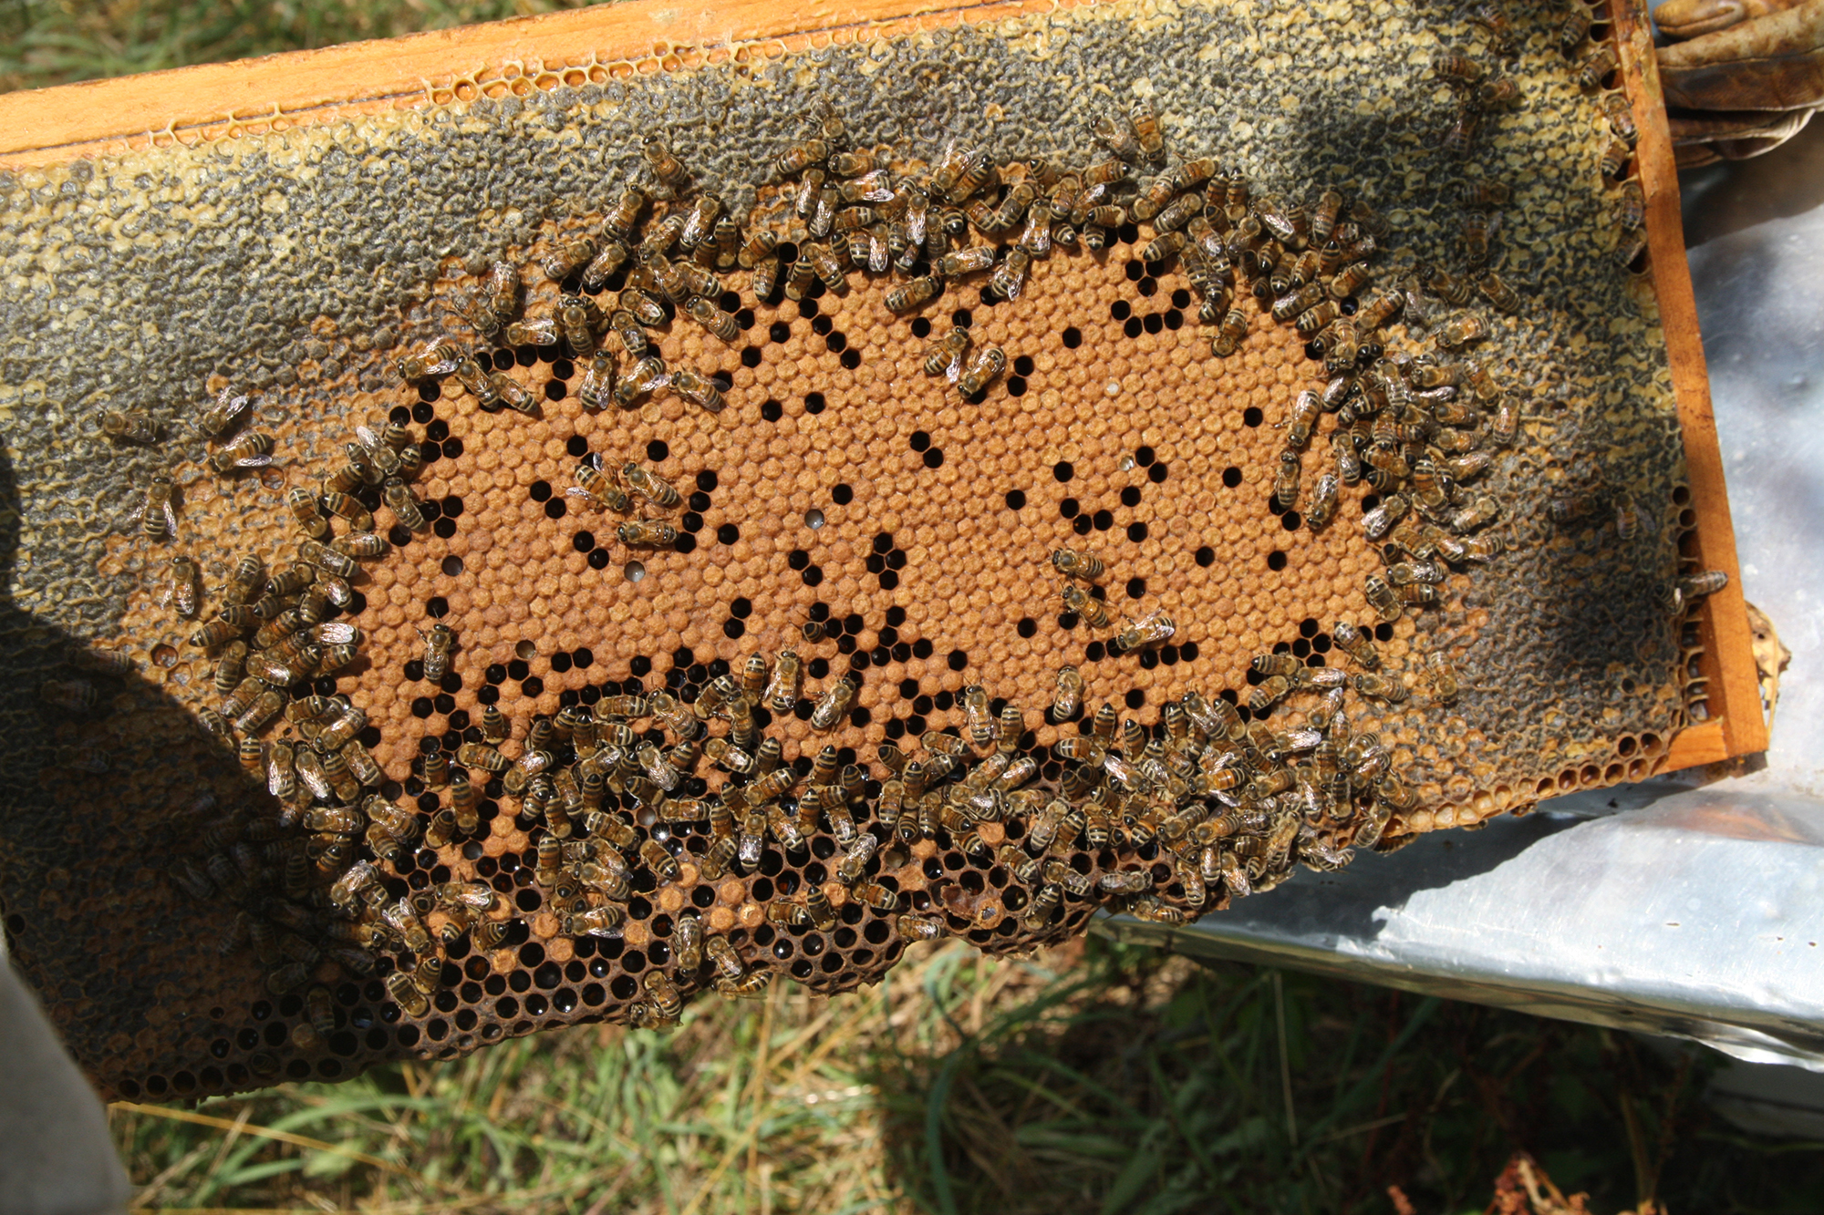
Colony Measures: Population

Slide 12
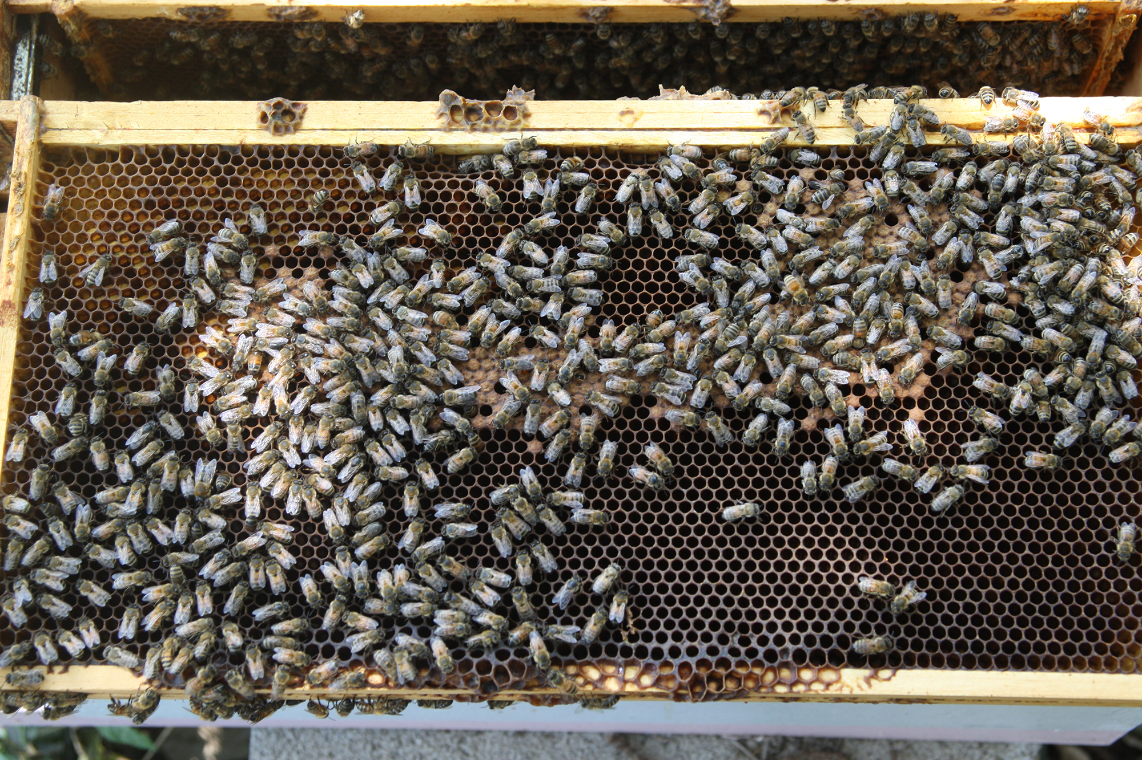

Slide 13
Hive #_______ Date________ Queenright ?____
Medium Box
adult bees Pupae / Larvae / eggs honey&pollen
# Frames
Deep Box
adult bees Pupae / Larvae / eggs honey&pollen
# Frames
Honey Supers
Honey Adult Bees_________________________
# Frames
__________________________________________________________________
Brood Disease __________ Deformed Wings _________ Pattern ____________
Temperament ________ Runny ___________ Other _____________________
(ratings: 1 = bad, 2 = OK, 3 = good)

Slide 14
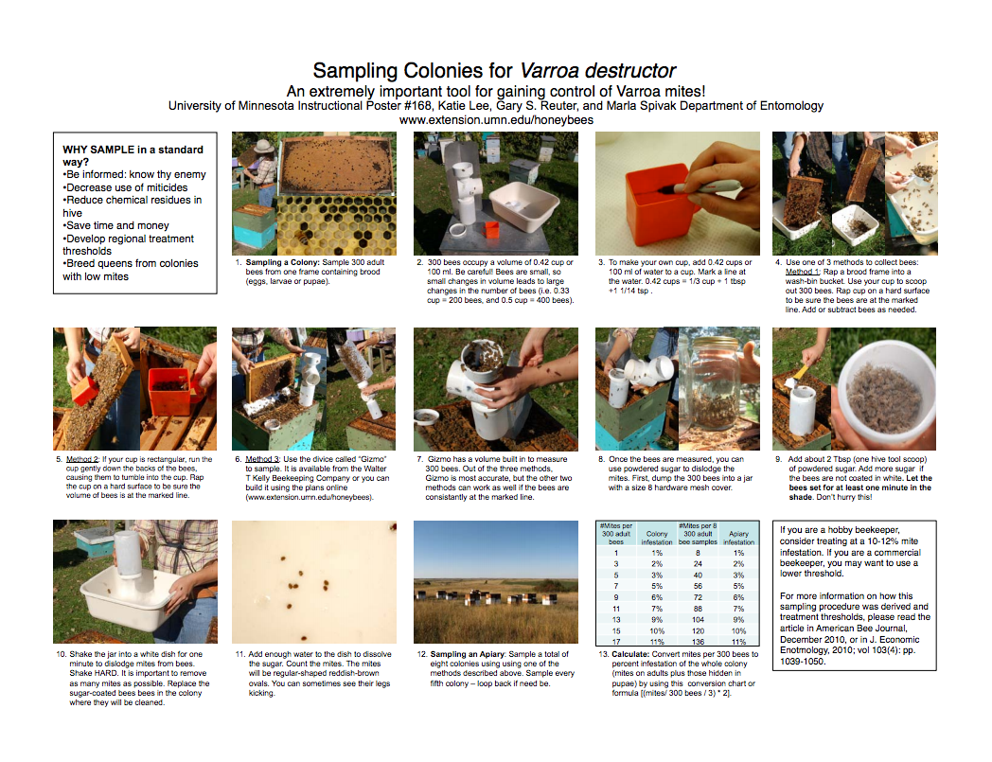
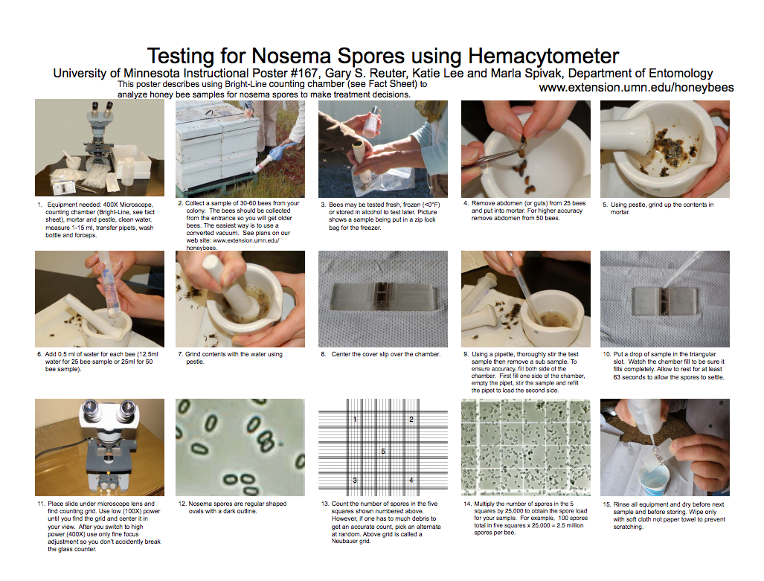
Sampling fact sheets: www.beelab.umn.edu or www.extension.org/bee_health
Colony Measures: Varroa mites and Nosema spores

Slide 15
2012 – 2013 Selection
50 nucs with mated queens ( from ~65 nucs w/ virgins)
Culled 15 in July due to slow buildup
14 died before March 2013
2 had re-queen events
19 untreated colonies in March to evaluate

Slide 16
Colonies with
2 Varroa samples

Slide 21
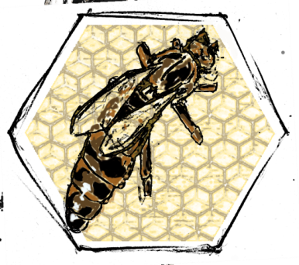
Queen Raising:
The Cloak Board Method

Slide 22
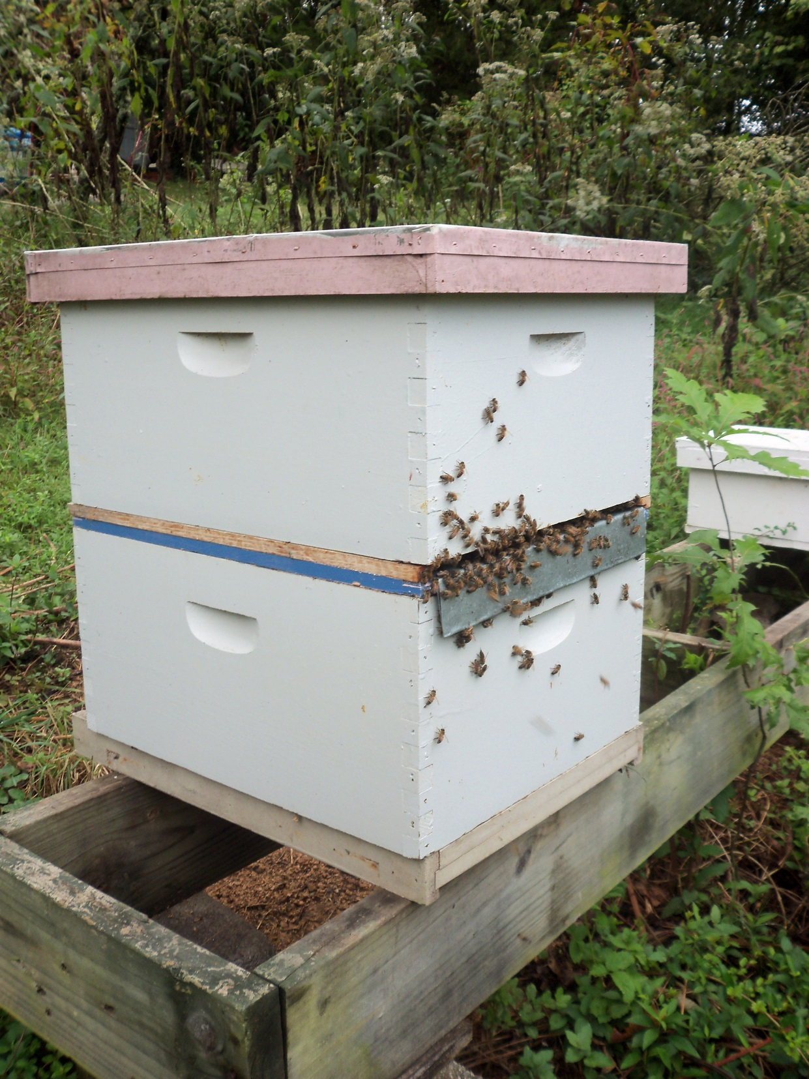
Details at RoseCombApiaries.com

Slide 23
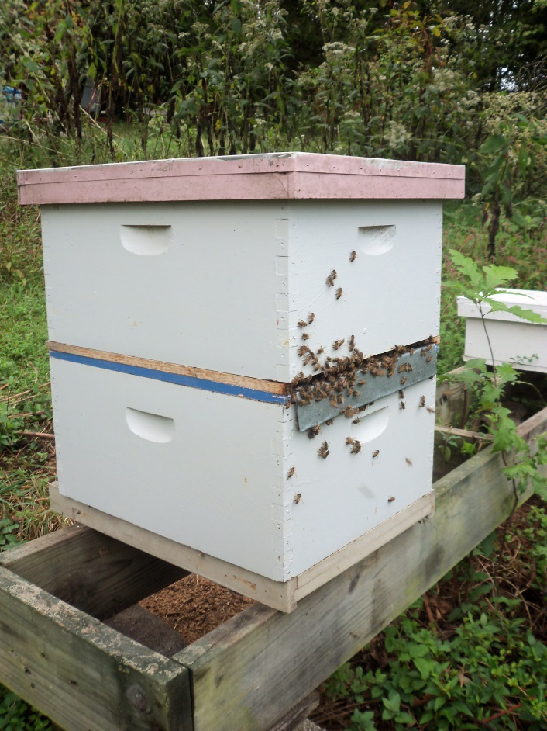
Setup: Make a strong double deep colony, reverse & close entrance, insert cloak board, feed throughout.
2 days before grafting: 1 frame larvae & pollen to top, cull cells, empty combs or emerging brood in bottom for queen to lay
1 day before grafting: close cloak, graft the next day
Next day, graft
Day 1 after grafting: open cloak
Day 5 after grafting: removed capped cells to incubator, setup cell builder as before.
Cloak Board
method:

Slide 24
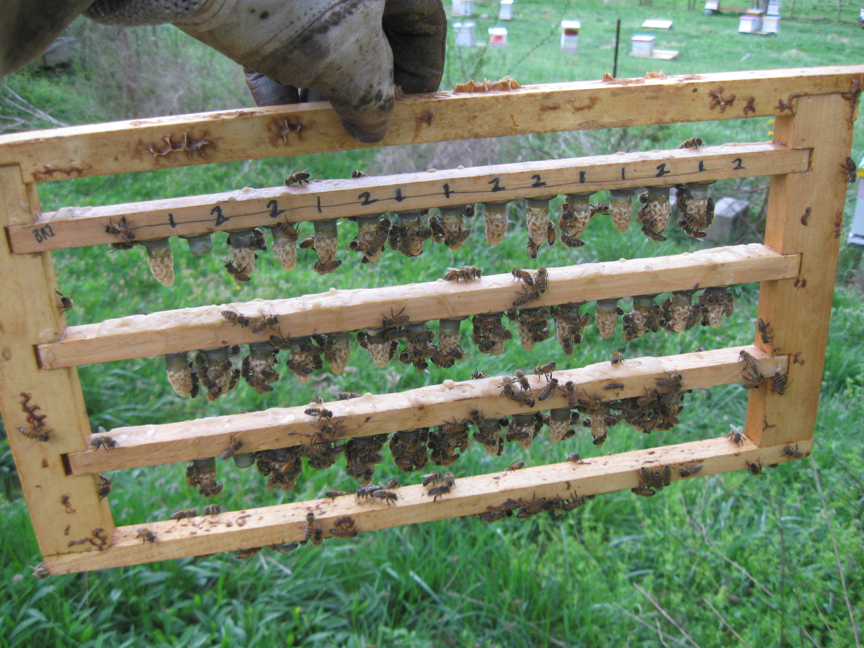
Capped queen cells were placed into an incubator on day 5 after grafting.

Slide 25
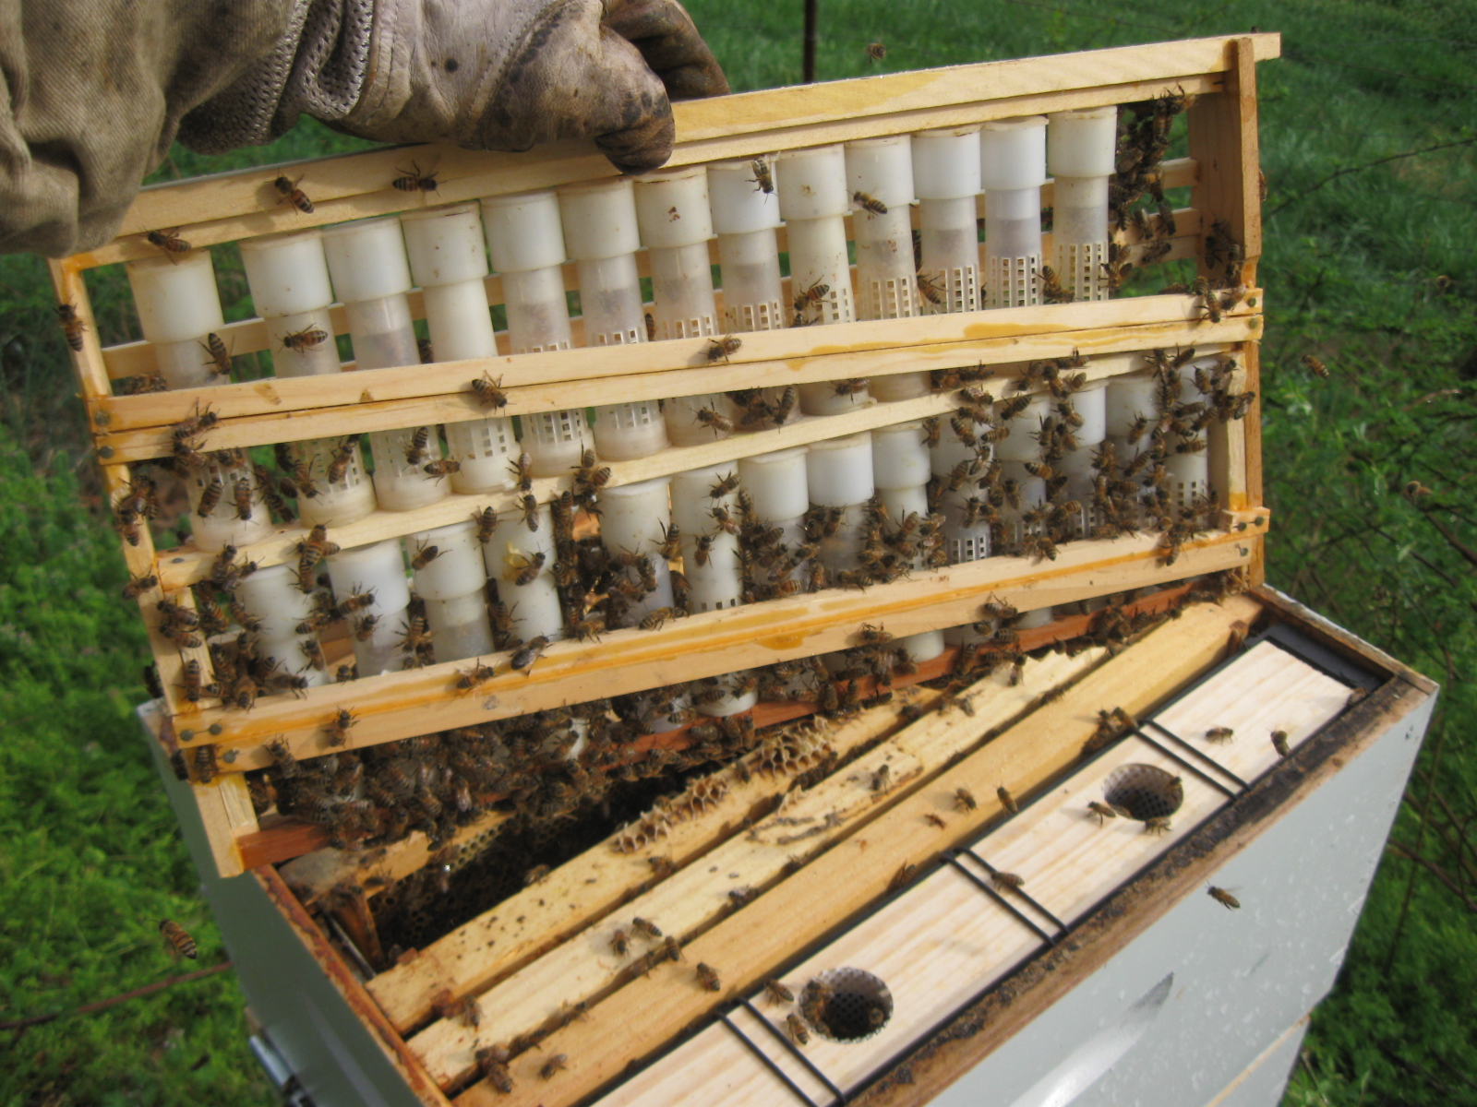
Cloak board colonies also used as a queen bank. This allowed introduction of virgin queens within a few days of emergence.

Slide 26
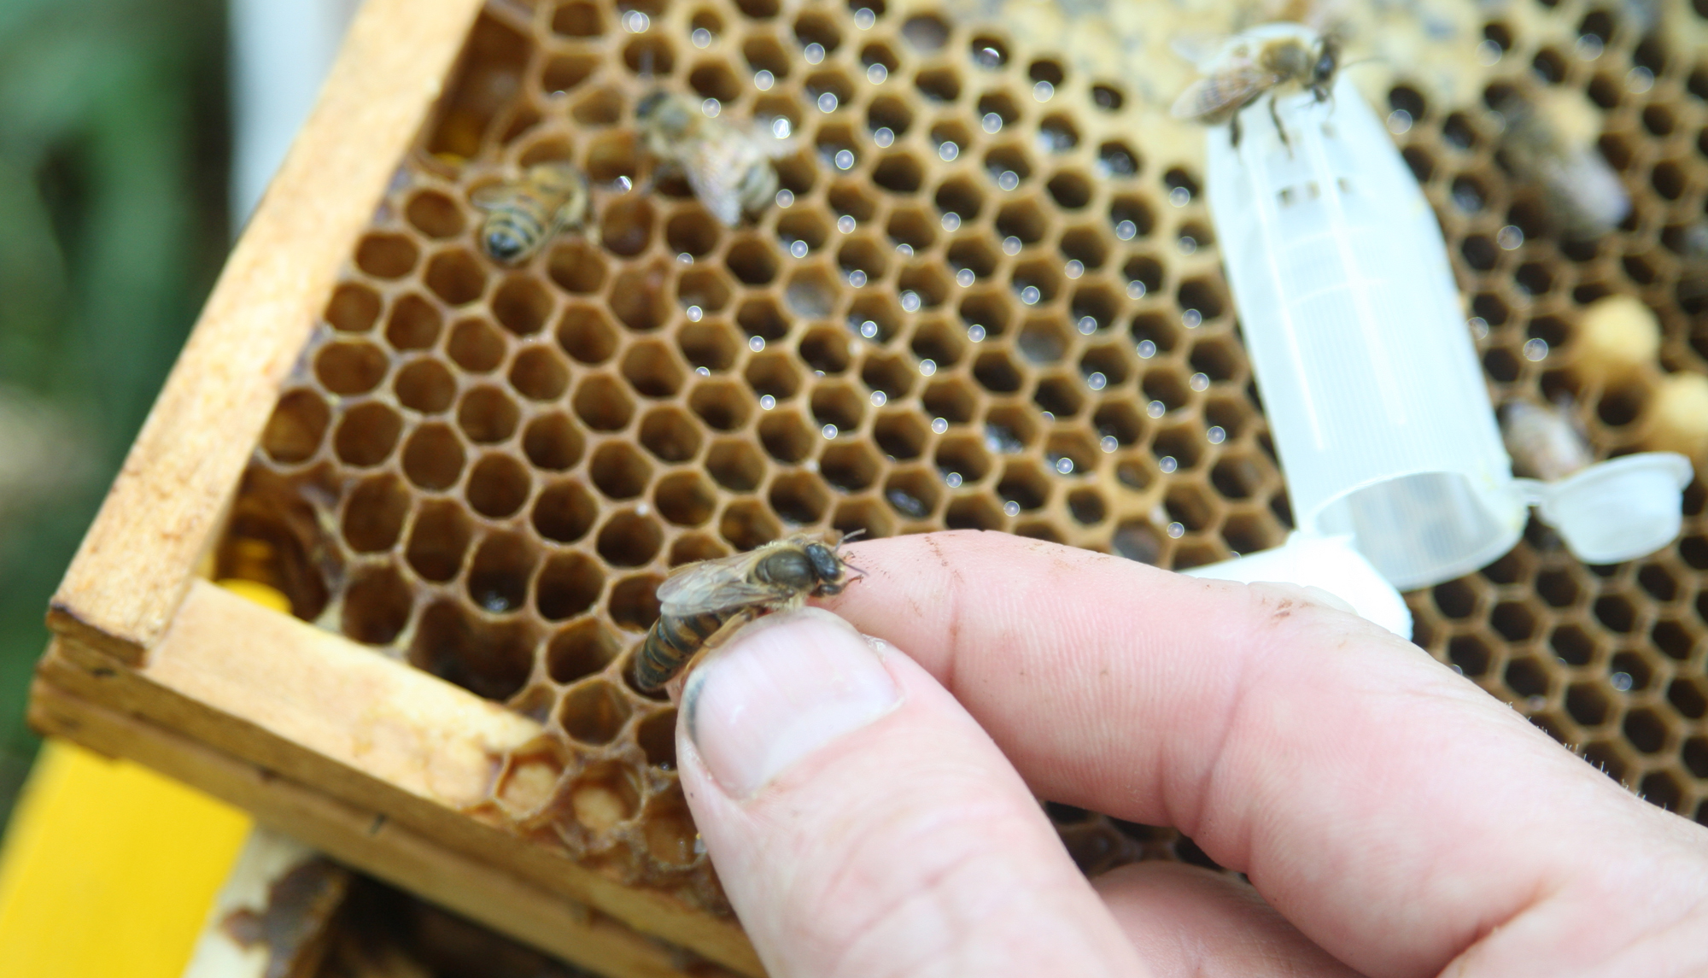
RoseCombApiaries.com

