Slide 1
Smoky Hill vineyards & Winery, Inc.
SARE Farmer & Rancher Grant Workshop
May 16, 2009

Slide 2
Study protocol
Evaluate bird spray chemicals.
Evaluate top wire netting.
Evaluate side applied fruit zone netting.

Slide 3
Test blocks
Upper Seyval block
365 total vines with side applied fruit zone netting.
Seyval – 12 rows with 54 vines per row.
2 rows untreated and no netting
2 rows treated with bird spray
4 rows top wire netting
4 rows side applied fruit zone netting

Slide 4
Liquid repellant
Rejex-it brand “Crop Guardian”
40% Methyl anthranilate (Concord derivative).
2 ½ gallons per acre per application – lower end of label recommendation
1 application (verasion) on August 8, 2008.
Harvested on September 20, 2009.
No detected loss.
Wine evaluated for “aroma” carry-over. None detected.
Cost per application - $185 per acre chemical only. Blast sprayer required!
Surfactant recommended to insure effectiveness.

Slide 5
Top wire netting
Heavy duty white netting
5/8” weave
Applied over top of vines
Bottom closed off using diaper method
Netting holes repaired
Requires tractor and net applicator
16 to 20 man-hours per acre
Cost for netting is $780 per acre for high quality 10 year material

Slide 6
Side applied fruit zone netting
Gintec Shade Technologies netting
43” tall with 1/8” x ¼” openings
Tops and bottoms closed with “price gun”
Excellent fruit exposure
Eliminates VSP wires
Leave on during winter (Velcro straps)
Improved spray efficiency
Tractor supply applicator or pipe stand
Apply from ground
Netting cost $1200 per acre

Slide 7
results
Bird spray showed no loss and no aroma or flavor carry-over. UV Exposure and encapsulated critical.
Top netting has canes growing through the net.
Top netting highest labor input.
Side applied netting best for quality – sun exposure and spray efficiency.
Side applied netting reduces VSP system cost.

Slide 8
recommendations
Where quality is a paramount concern the side applied netting is recommended.
Caution must be taken to obtain protection using the spray.
Spray vs side netting shows little over 6 year difference.
Spray can result in major problems with the wine!
Not all varieties need protection. SHVW sees pressure in Vignole, Vidal, Seyval and Chambourcin but not Ventura or Norton.

Slide 9
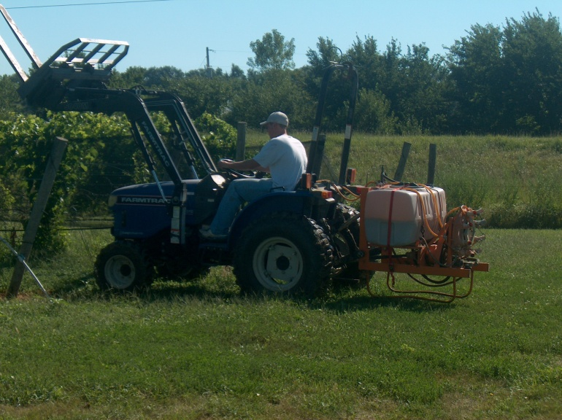
Machinery photos

Slide 10
Netting photos

Slide 11
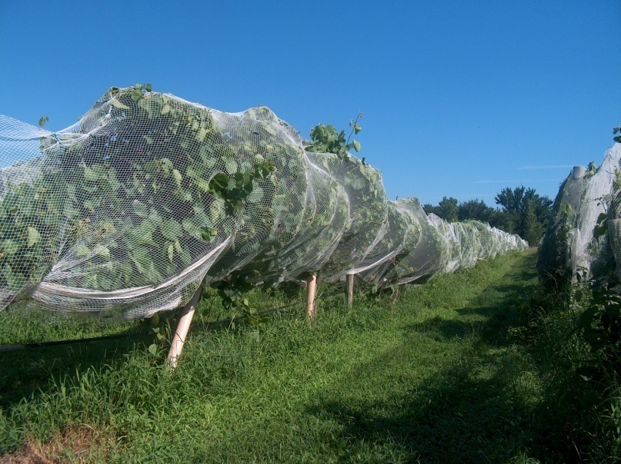
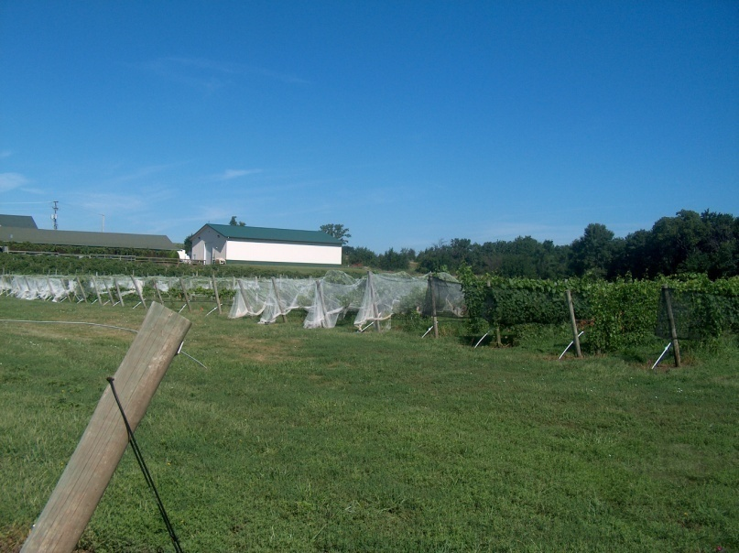
Netting Photos 2

Slide 12
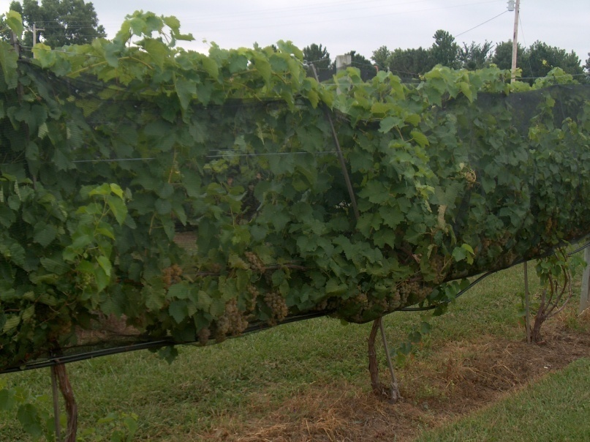
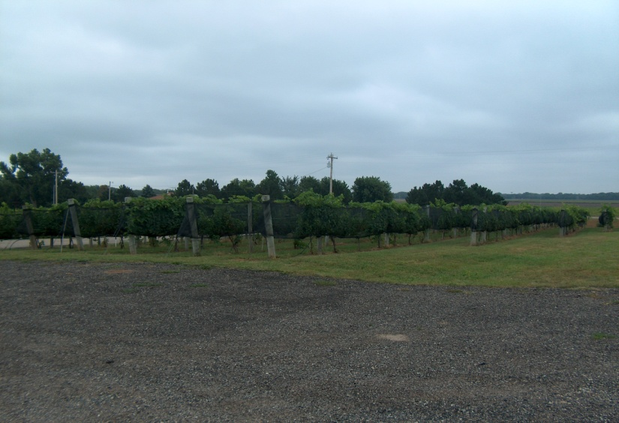
Fruit photos

