Slide 1
Winter Canola
Cover Crop and Renewable Energy Source
By Steve Tennes
Country Mill Farms
Charlotte, MI
www.countrymill.com

Slide 2
Project Objectives
Winter canola double cropped with short season vegetable crops (90 day pumpkins)
Harvest and press canola seeds to extract oil
Use oil in on farm diesel engines
Utilize leftover seed residue (canola cake) in on farm biomass burner to generate heat.

Slide 3
Planting
Sept 24th, 2008 a disc and cull packer prepared 8 acres of a harvested pumpkin field
Sept 25th Canola drilled
  Plot A: 7 acres at 15” rows with 5 pounds of seed per acre (setting #15*
  Plot B: 1 acre at 7.5” rows with 5 pounds of seed per acre (setting #5*). Note the “in row” planting density in the 7.5” rows was half that of the 15” rows.
  Plot C: 1 acre broadcasted with 10 pounds canola seed over unharvested pumpkins. Employees and customers visiting the farm market in October harvested the pumpkins in Plot C.
Rain & warm weather (highs in the 70s) followed for several weeks)
No fertilizer or pesticides were used in this project, thus far.
*Note: Settings are on a Great Plaines Drill

Slide 4
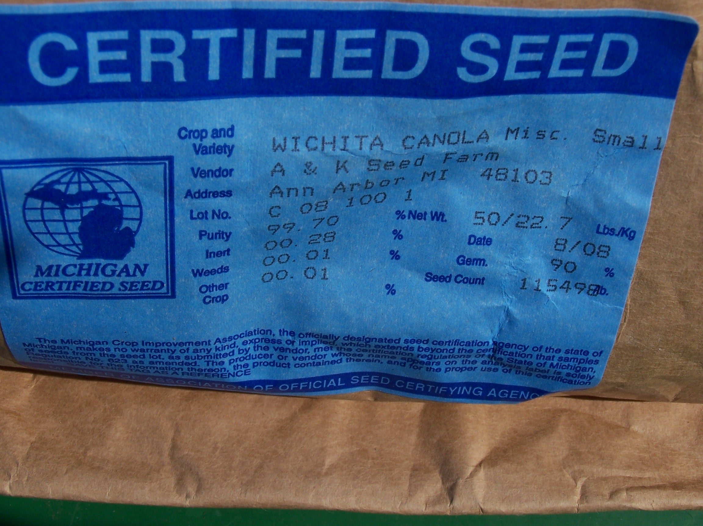
Most Important Decision!
Wichita Winter canola is non-GMO, but spring canola is mainly GMO

Slide 5
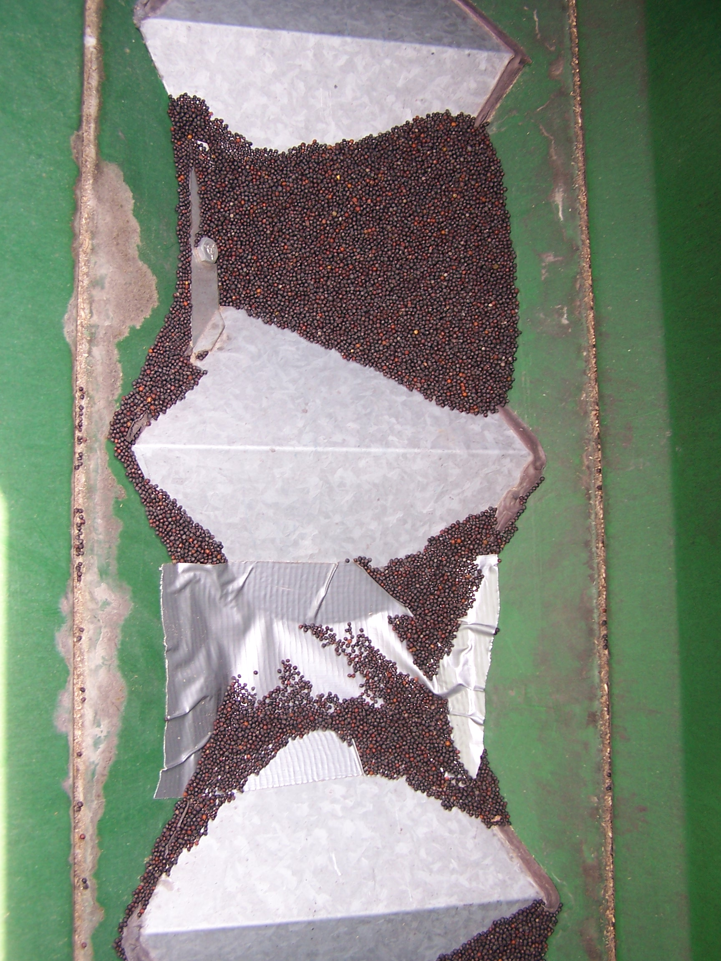
Duct Tape?
15” rows achieved by taping off every other hole on drill

Slide 6
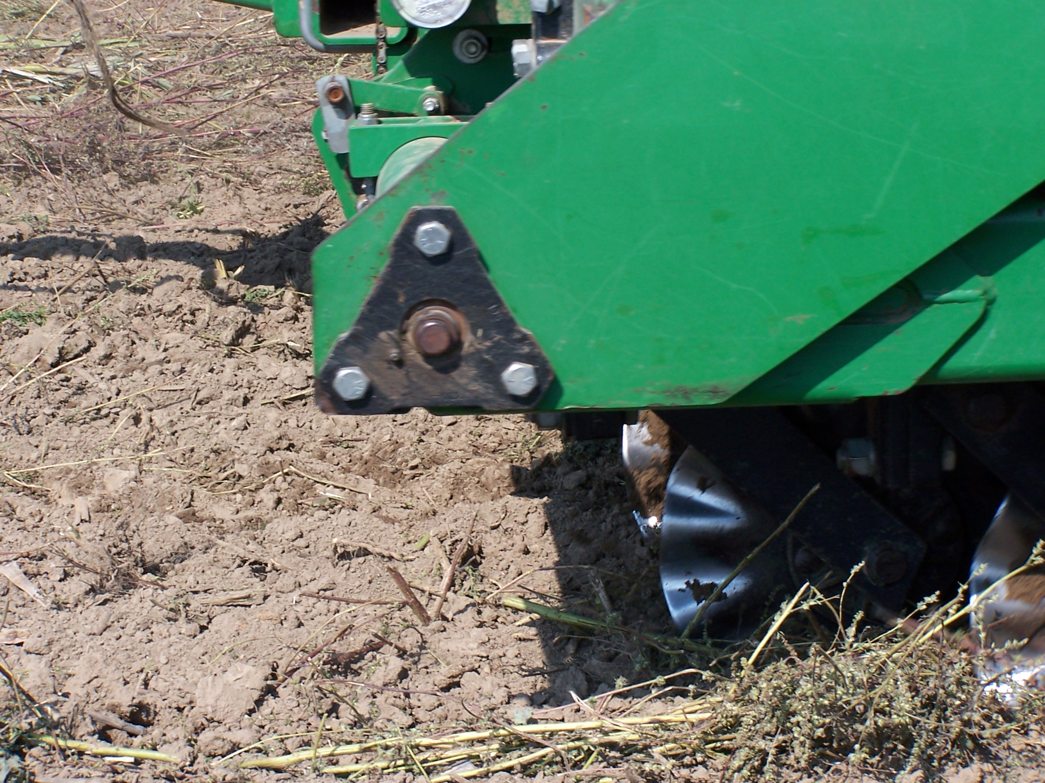
Seed to Soil Contact
Uniform Planting= Uniform Germination= Easy Harvest
Be careful with too much crop residue

Slide 7
Going into Winter
November 12th 2008, a site visit was conducted
  Dr. George Silva, MSU Extension
  Dr. Russ Freed, MSU canola expert
Germination in all three plots looked excellent.
Plot C (broadcast only) had no effort made to initiate soil to seed contact, yet it had similar germination rates as Plots A & B.
Plot C plants, however, were at a younger growth stage

Slide 8
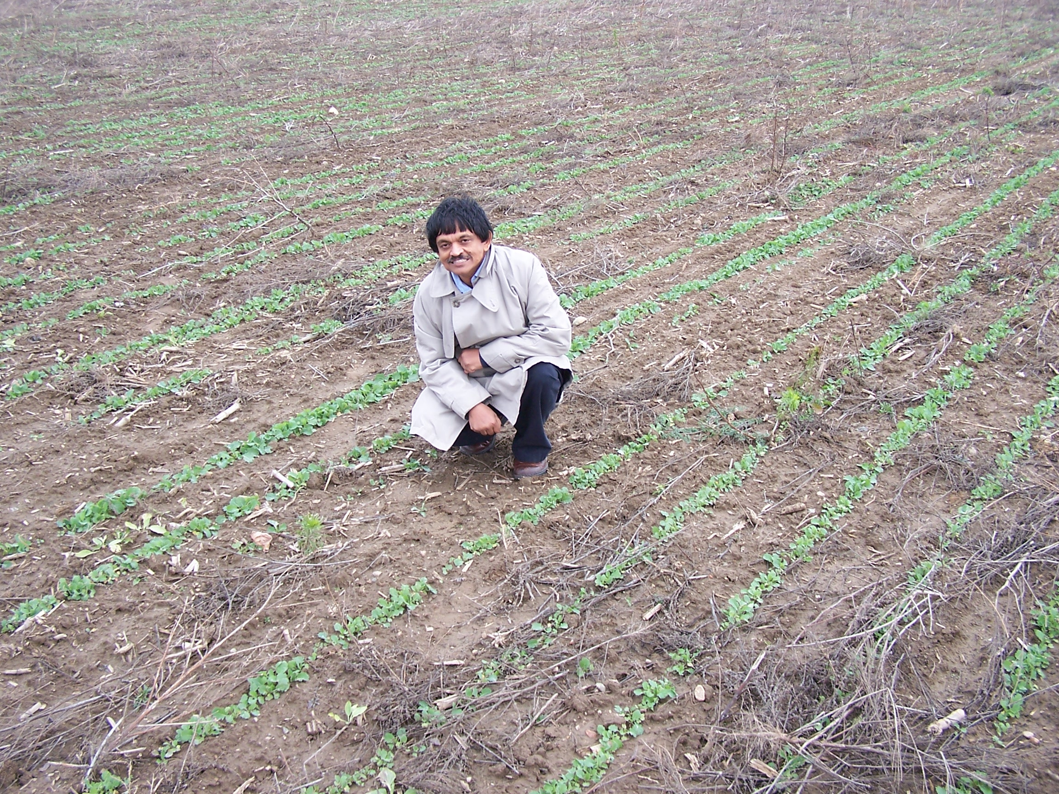
Excellent Germination
Mid-November growing stopped with a good stand of canola

Slide 9
Winter Kill
Come spring, canola plants send up new growth
Severe winter caused under developed plants to die.
Frost/ freeze cycle pushes tap root up and out of the ground.
Plot C (broadcast only) was at a younger growth stage and had 99% winter kill

Slide 10
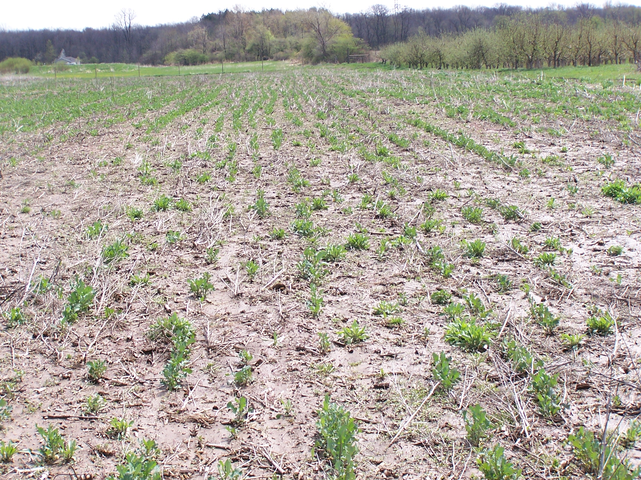
Winter Kill
-Excellent crop stand became marginal to poor in spring.
-Set the stage for weed competition later in the summer.

Slide 11
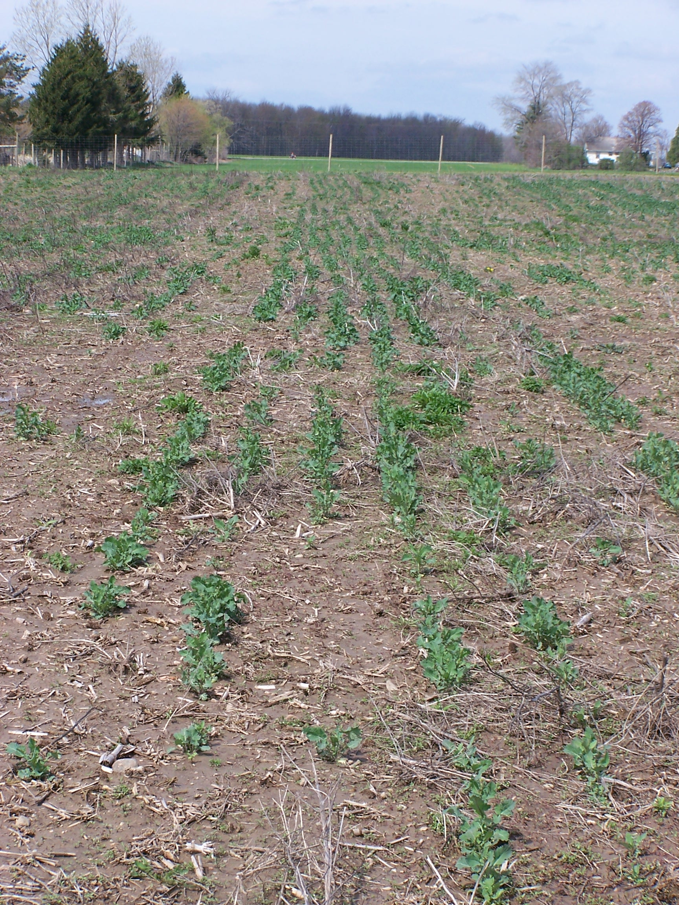
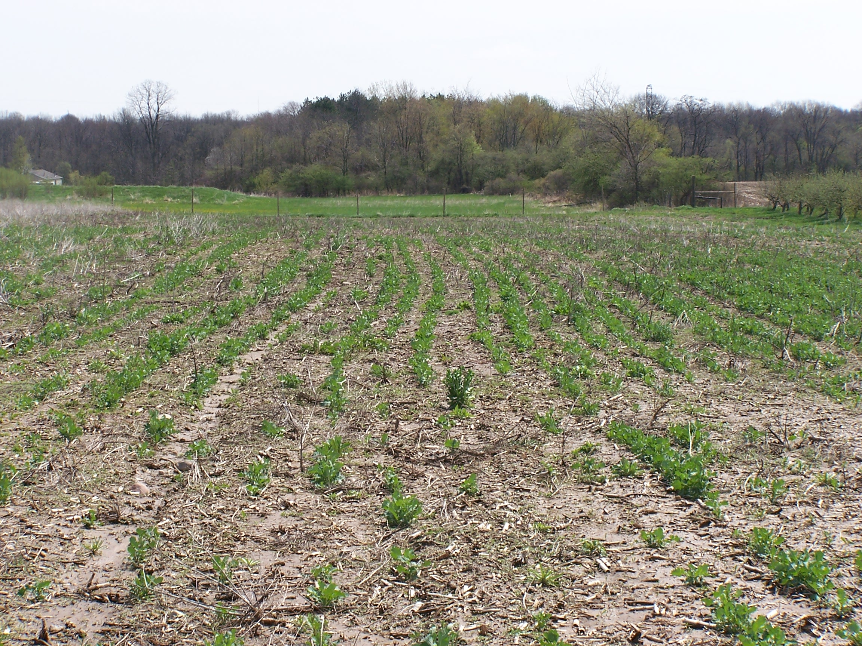
Winter Kill
Plots A & B had 75% winter kill

Slide 12
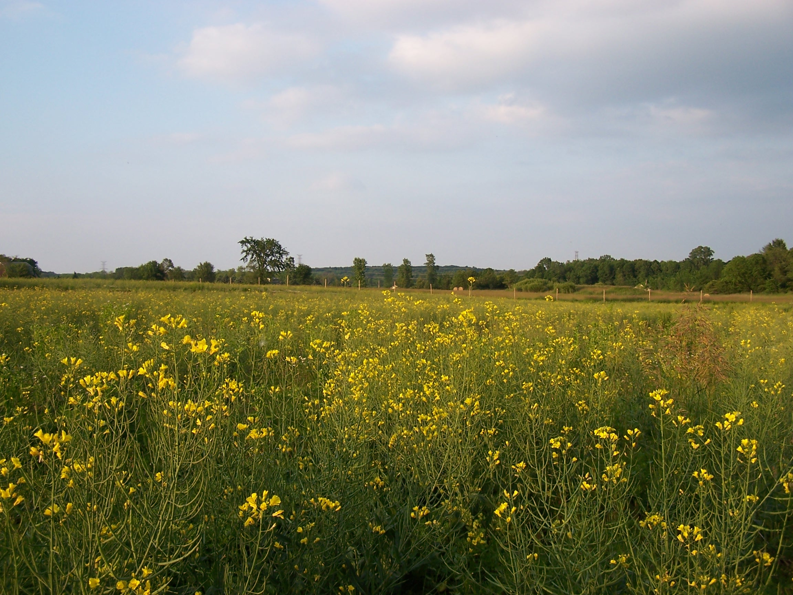
Flowering
-Plant has rapid growth in early spring (bolting)
-Flowering started May 5th and continued until June 15th
-This was longer than normal due to wet spring. Delayed harvest.

Slide 13
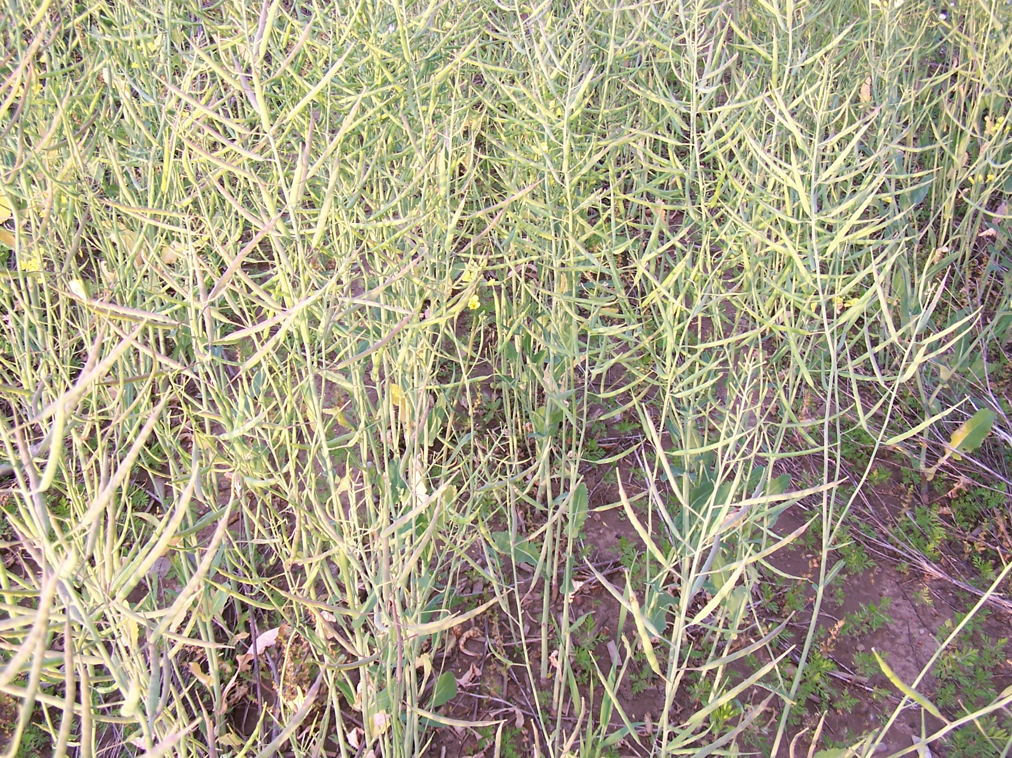
Pod Development
-After flowering, then seed pods develop during the month of June
-Seeds change from soft & green, hard & green, brown, to black

Slide 14
Harvest
Initially we wanted to harvest at the end of June
Late flowering created uneven seed development
  “Green seeds” and mature seeds on the same plant
  Mature seed pods (like a pea) can shatter sending seeds to the ground
  Birds love eating canola seeds
  Deer will eat as well, but this plot was within a deer fence.

Slide 15
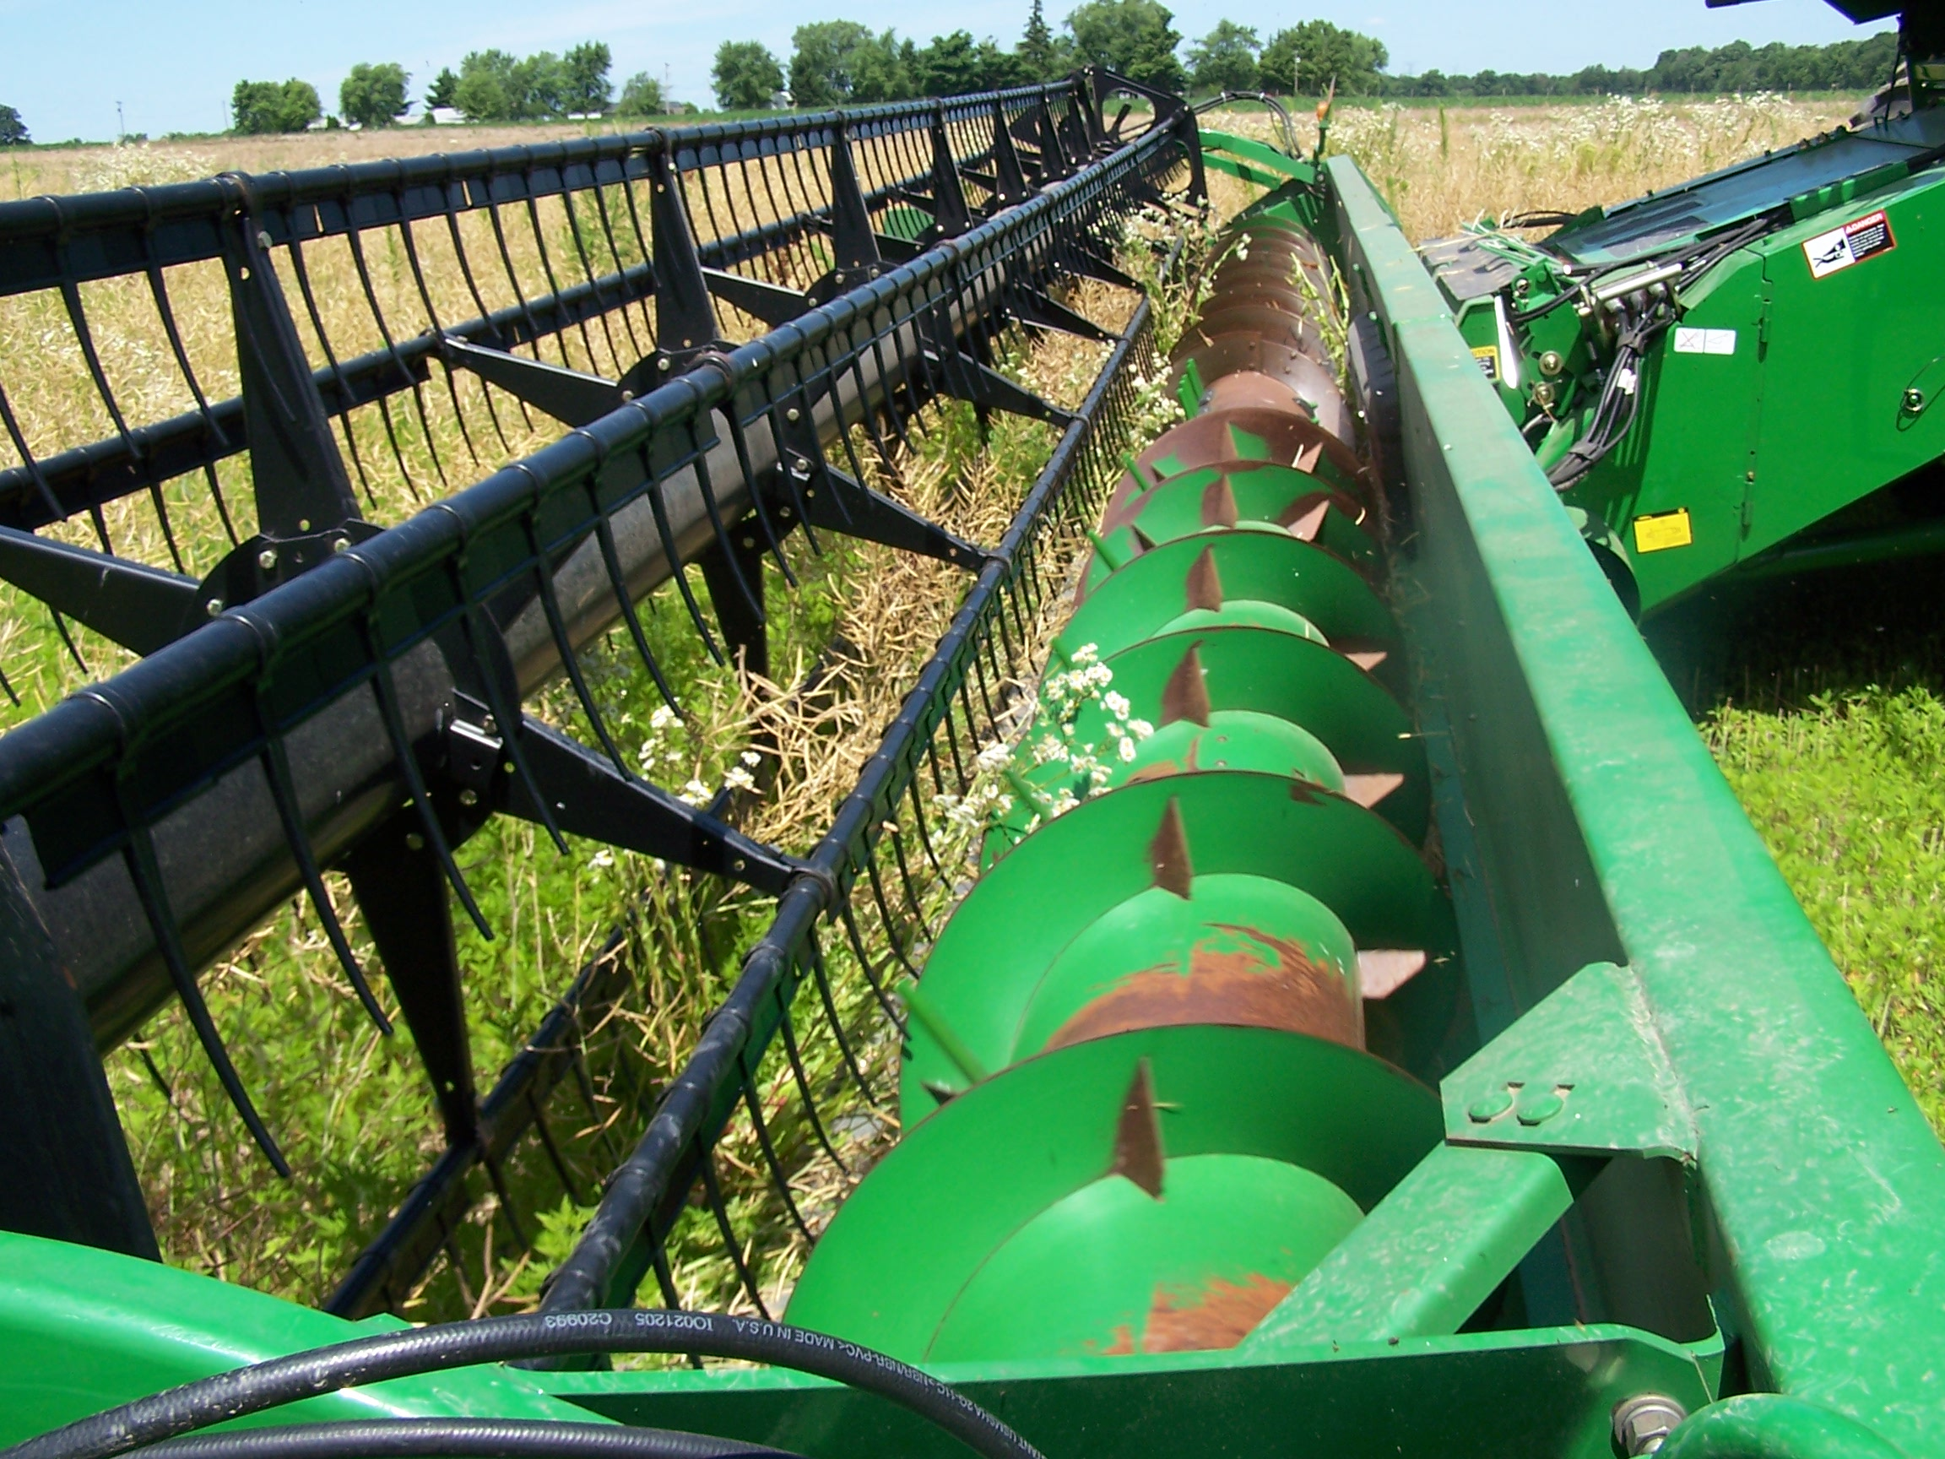
Harvest options
-This photo shows a wheat head being used to harvest the canola directly
-Canola can also be cut & field dried for two weeks and then use a “pick up head” on a combine to harvest.

Slide 16
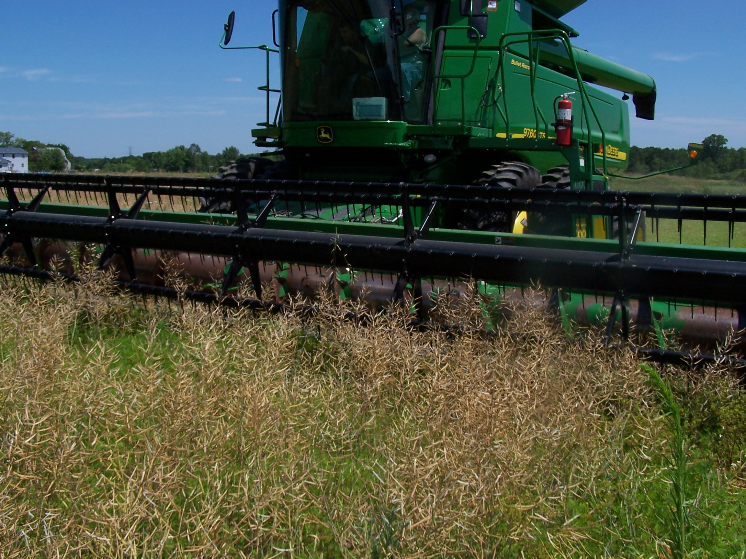
Harvest
-Winter kill reduced plant stand allowing weeds to be present at Harvest.

Slide 17
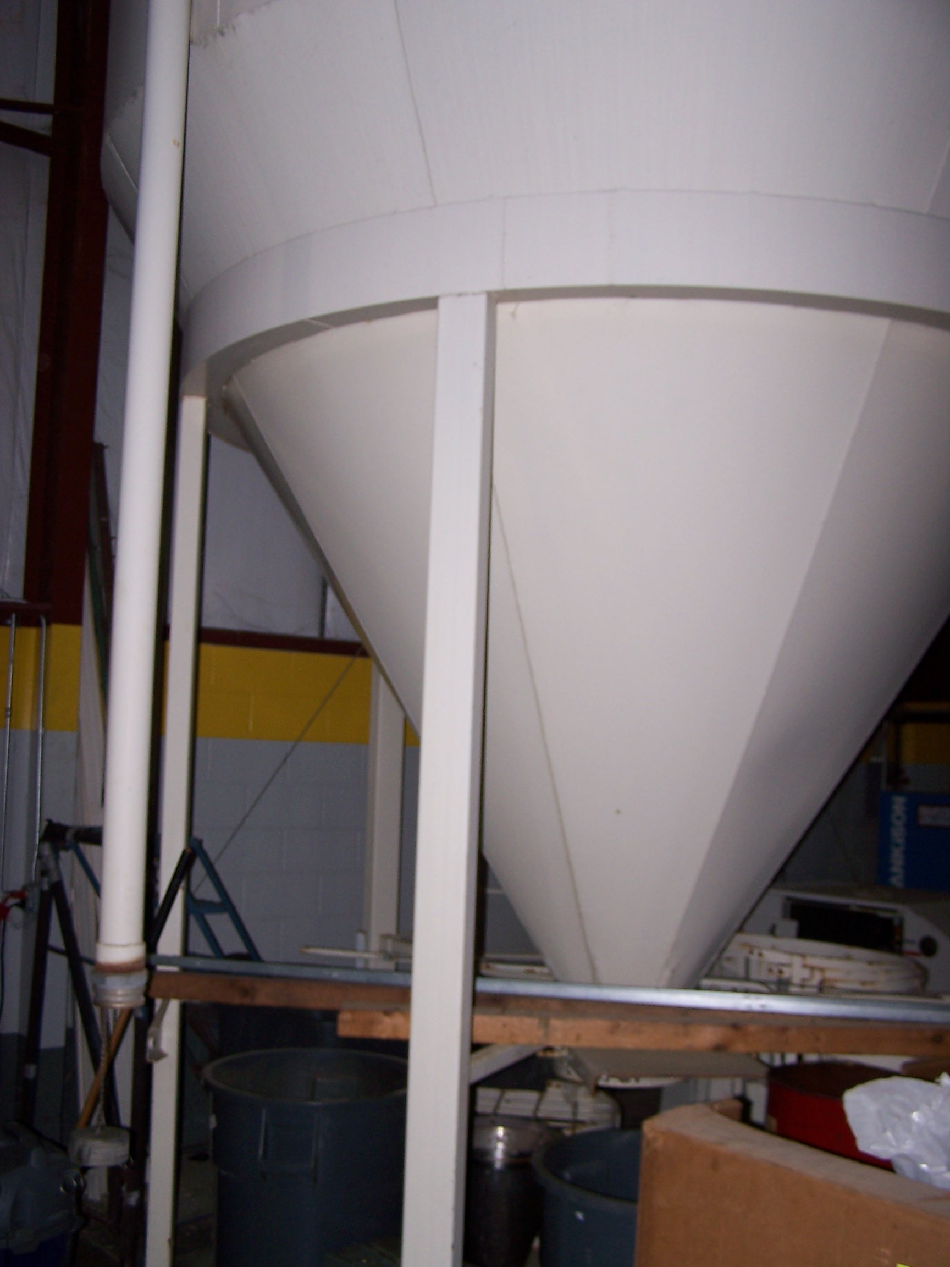
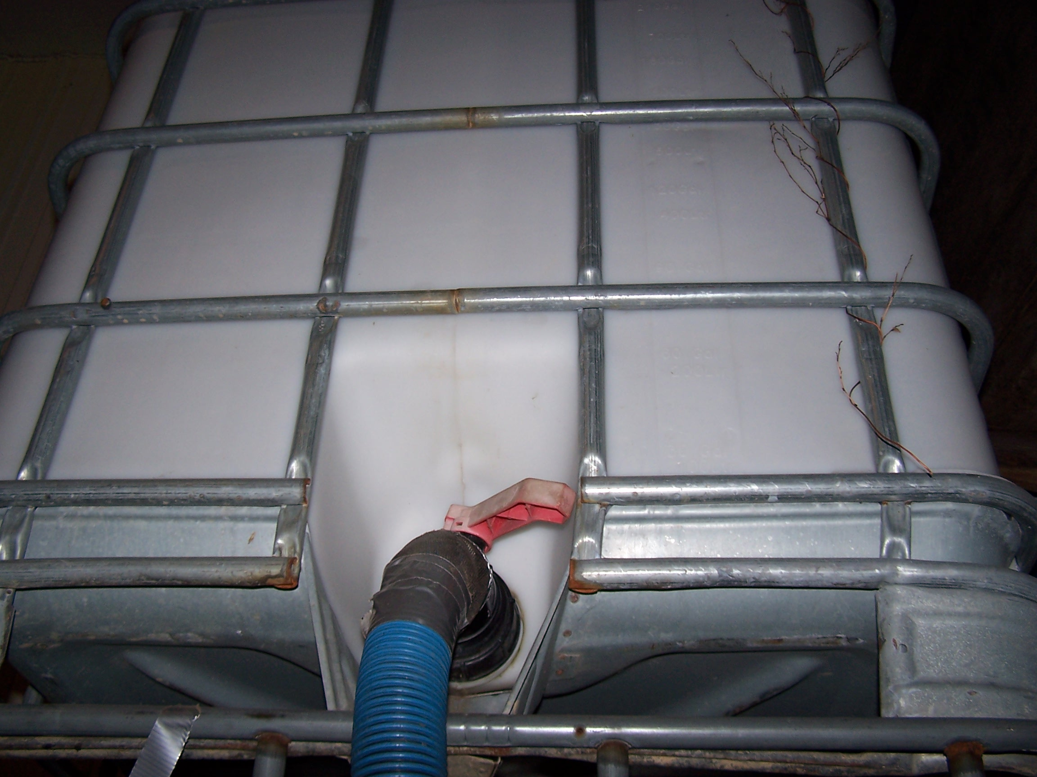
Storage
-Seeds must be CLEAN, COOL & DRY

Slide 18
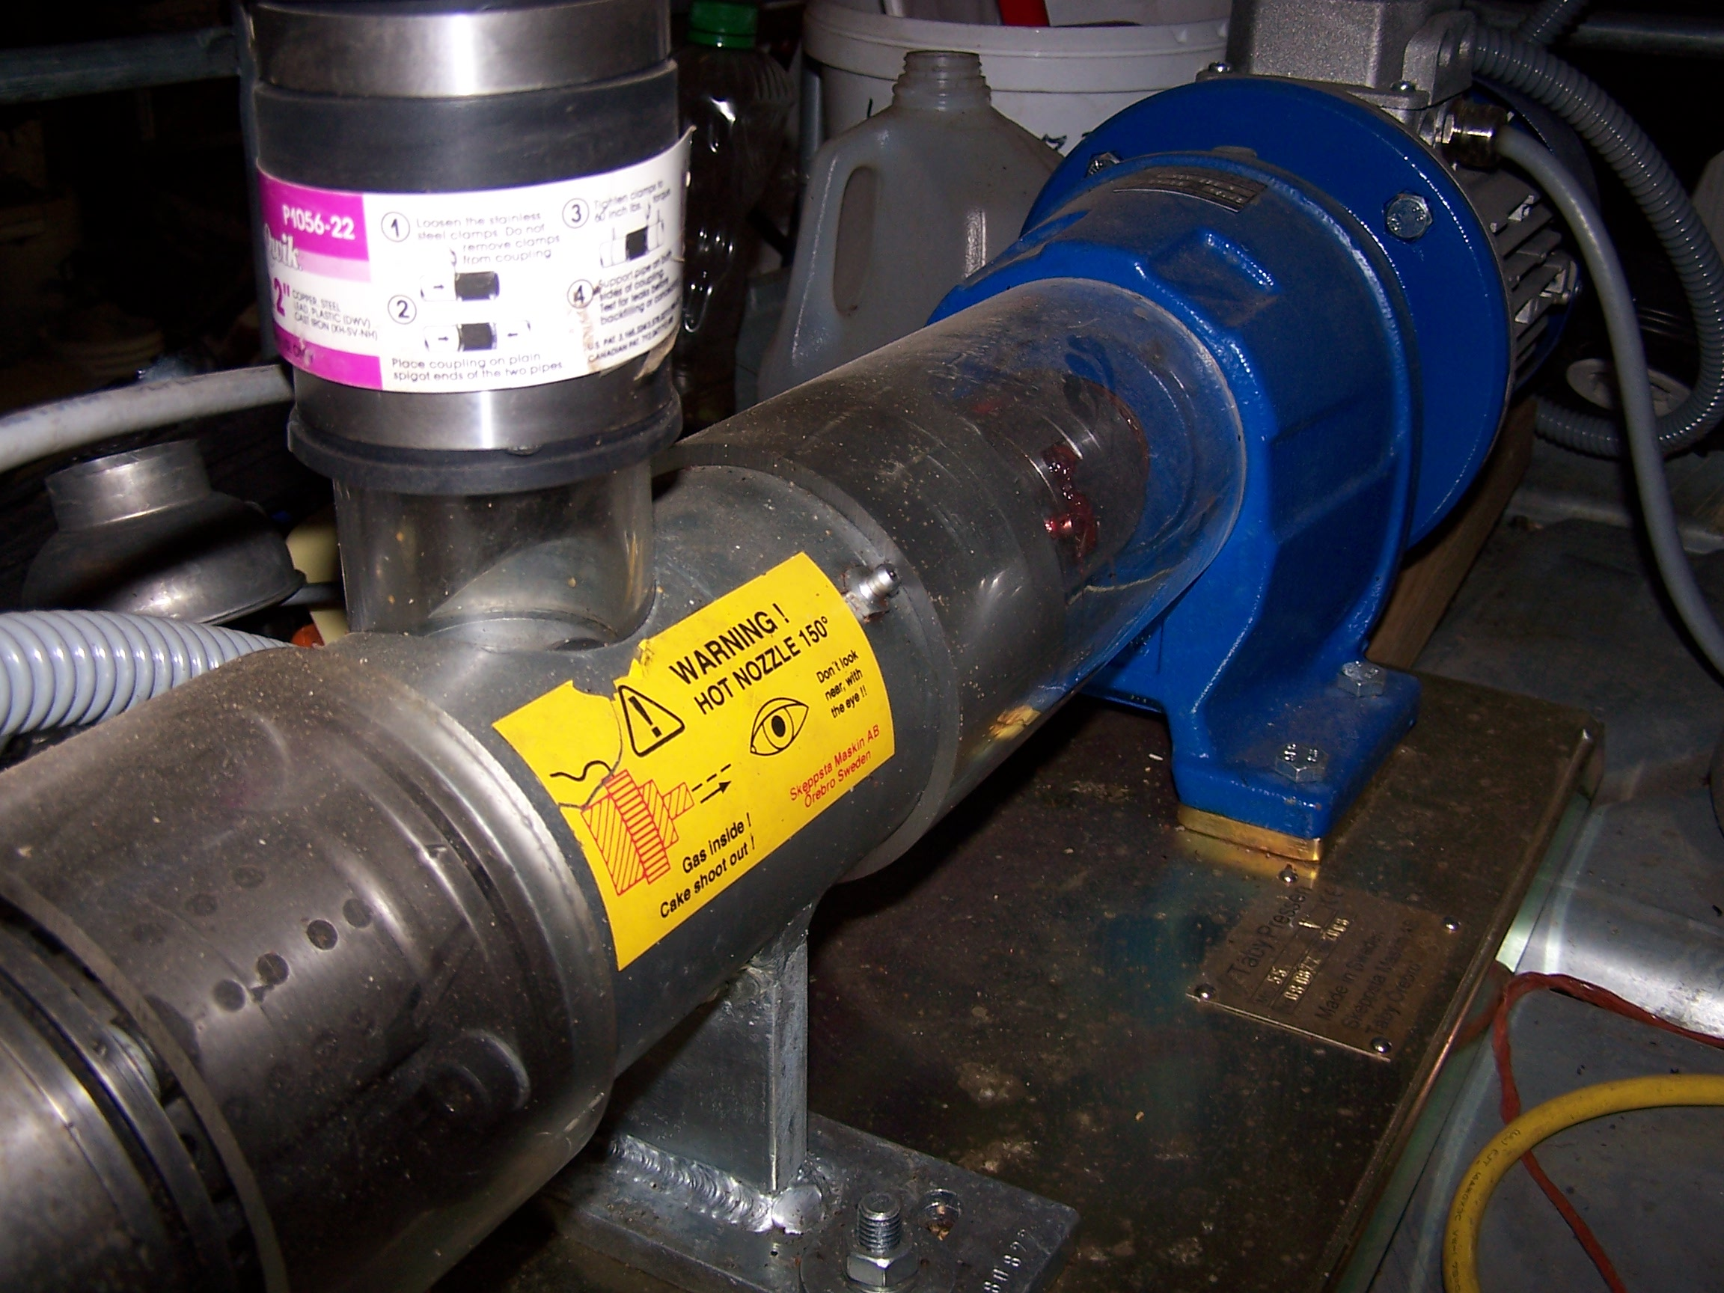
Pressing out the Oil
-An oil press can be set-up to run on its own.
-Output varies by press design. This press does 1.5 to 2.9 gal/hr.
-Seed quality is the number one factor for oil yield and quality.

Slide 19
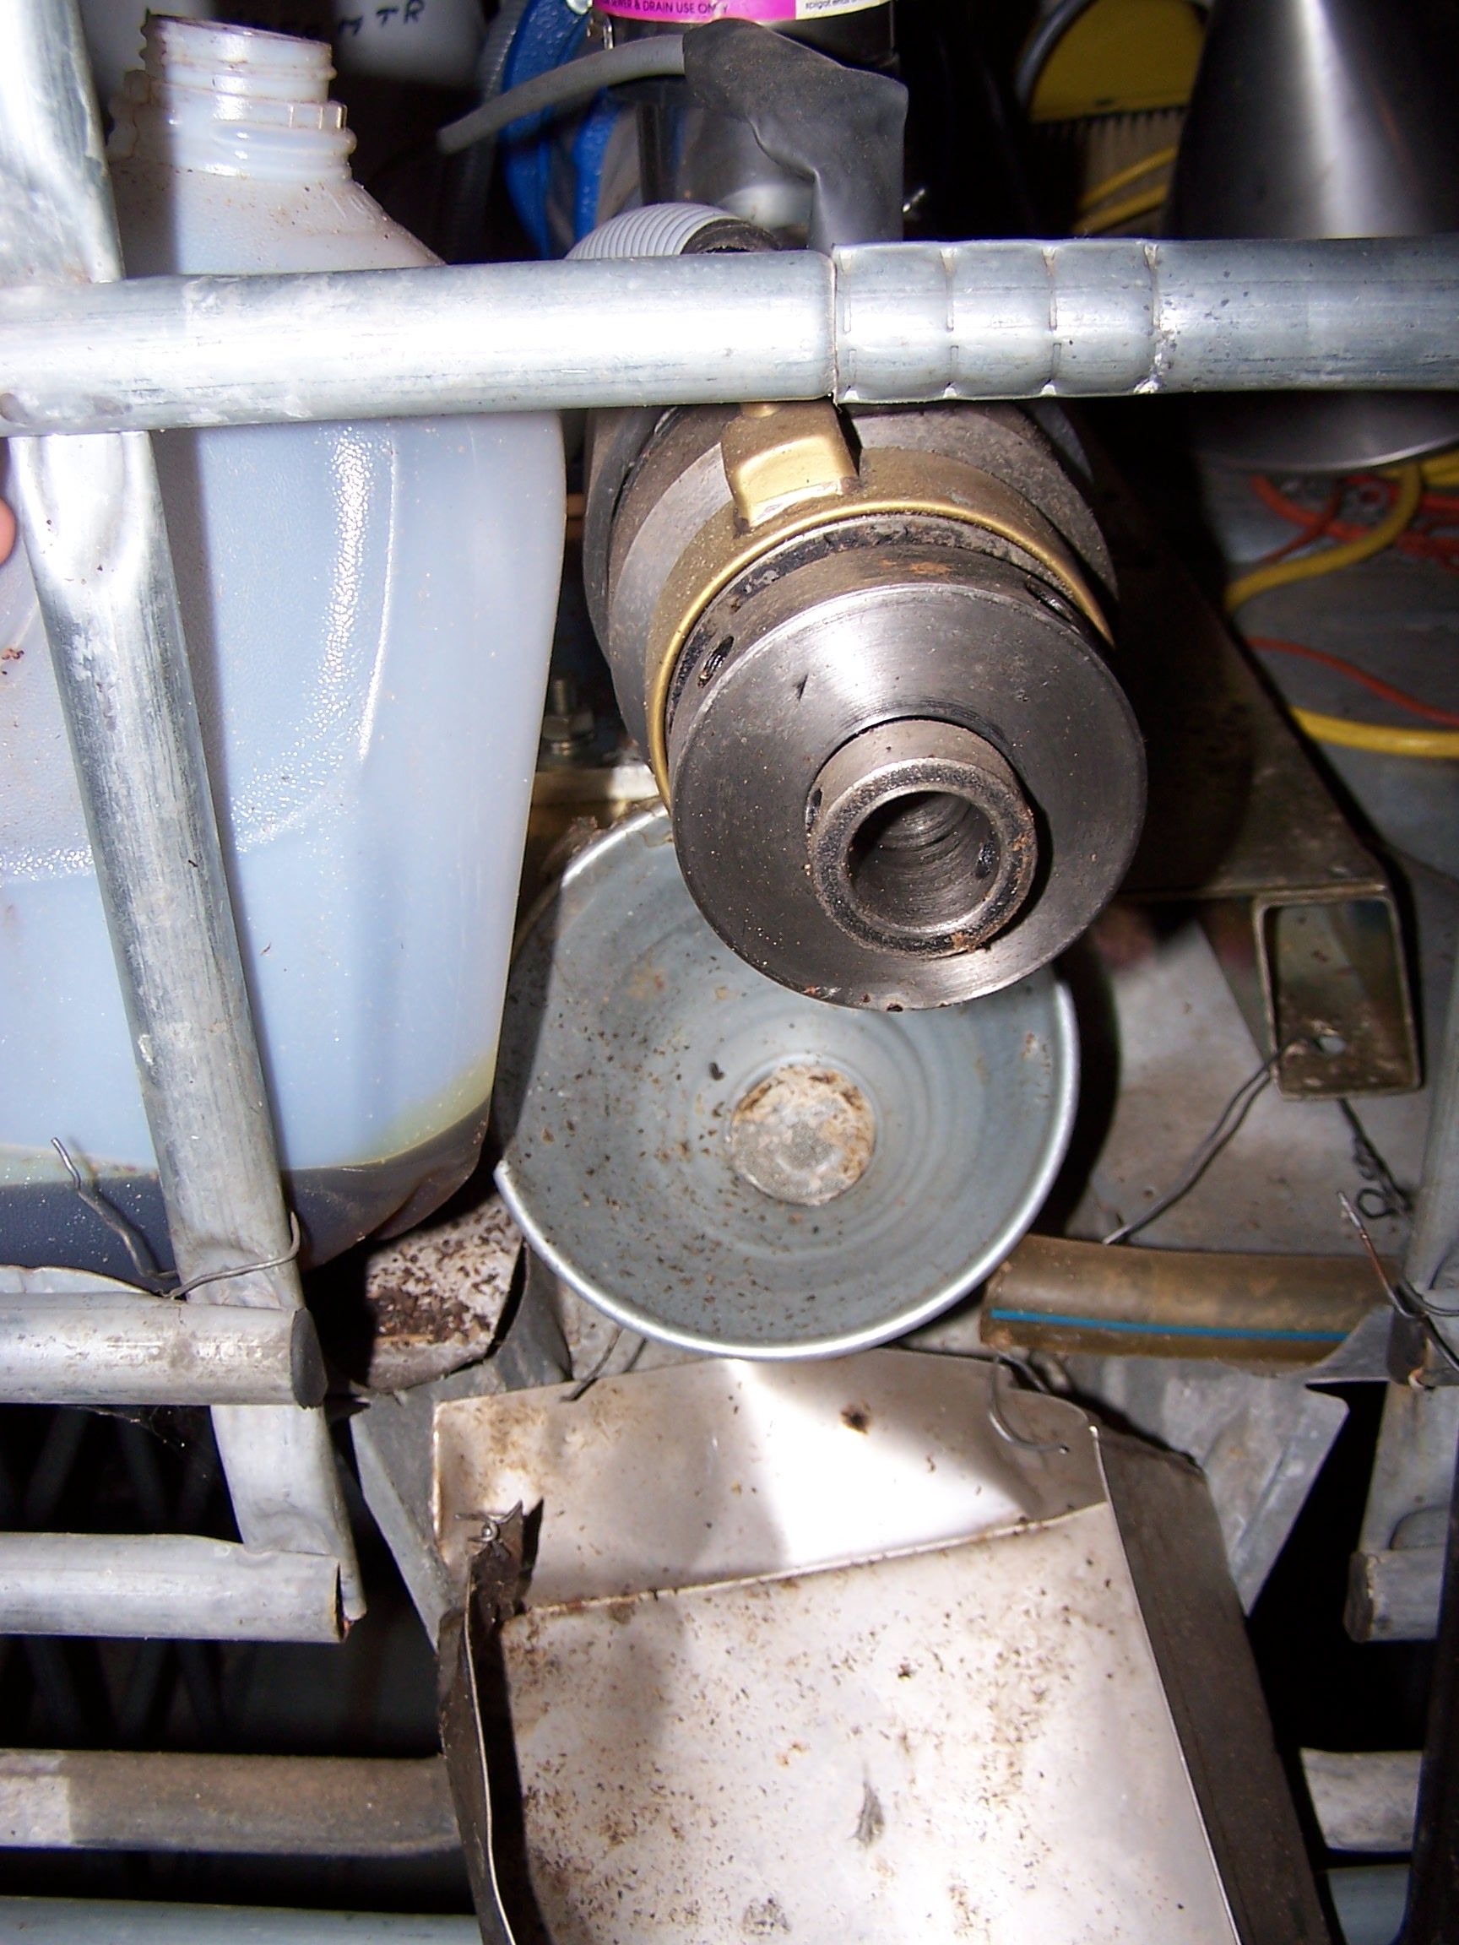
Settling & Filtering the Oil
-First allow solids to settle out to the bottom of the tank
-Then filter the oil on top through a filter.
-Coffee filters will work, but do take time.

Slide 20
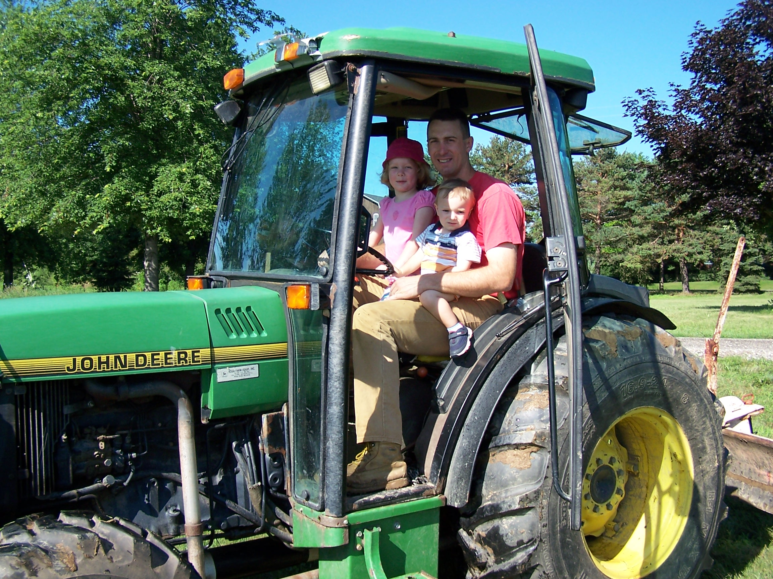
Renewable Energy
-Pure Canola is best used in unmodified diesel engines during the summer when temperatures are over 70F.
-Tractor modification allows the use of filtered canola oil year around. Tractor still starts & shuts off with diesel fuel in the engine & filter.

Slide 21
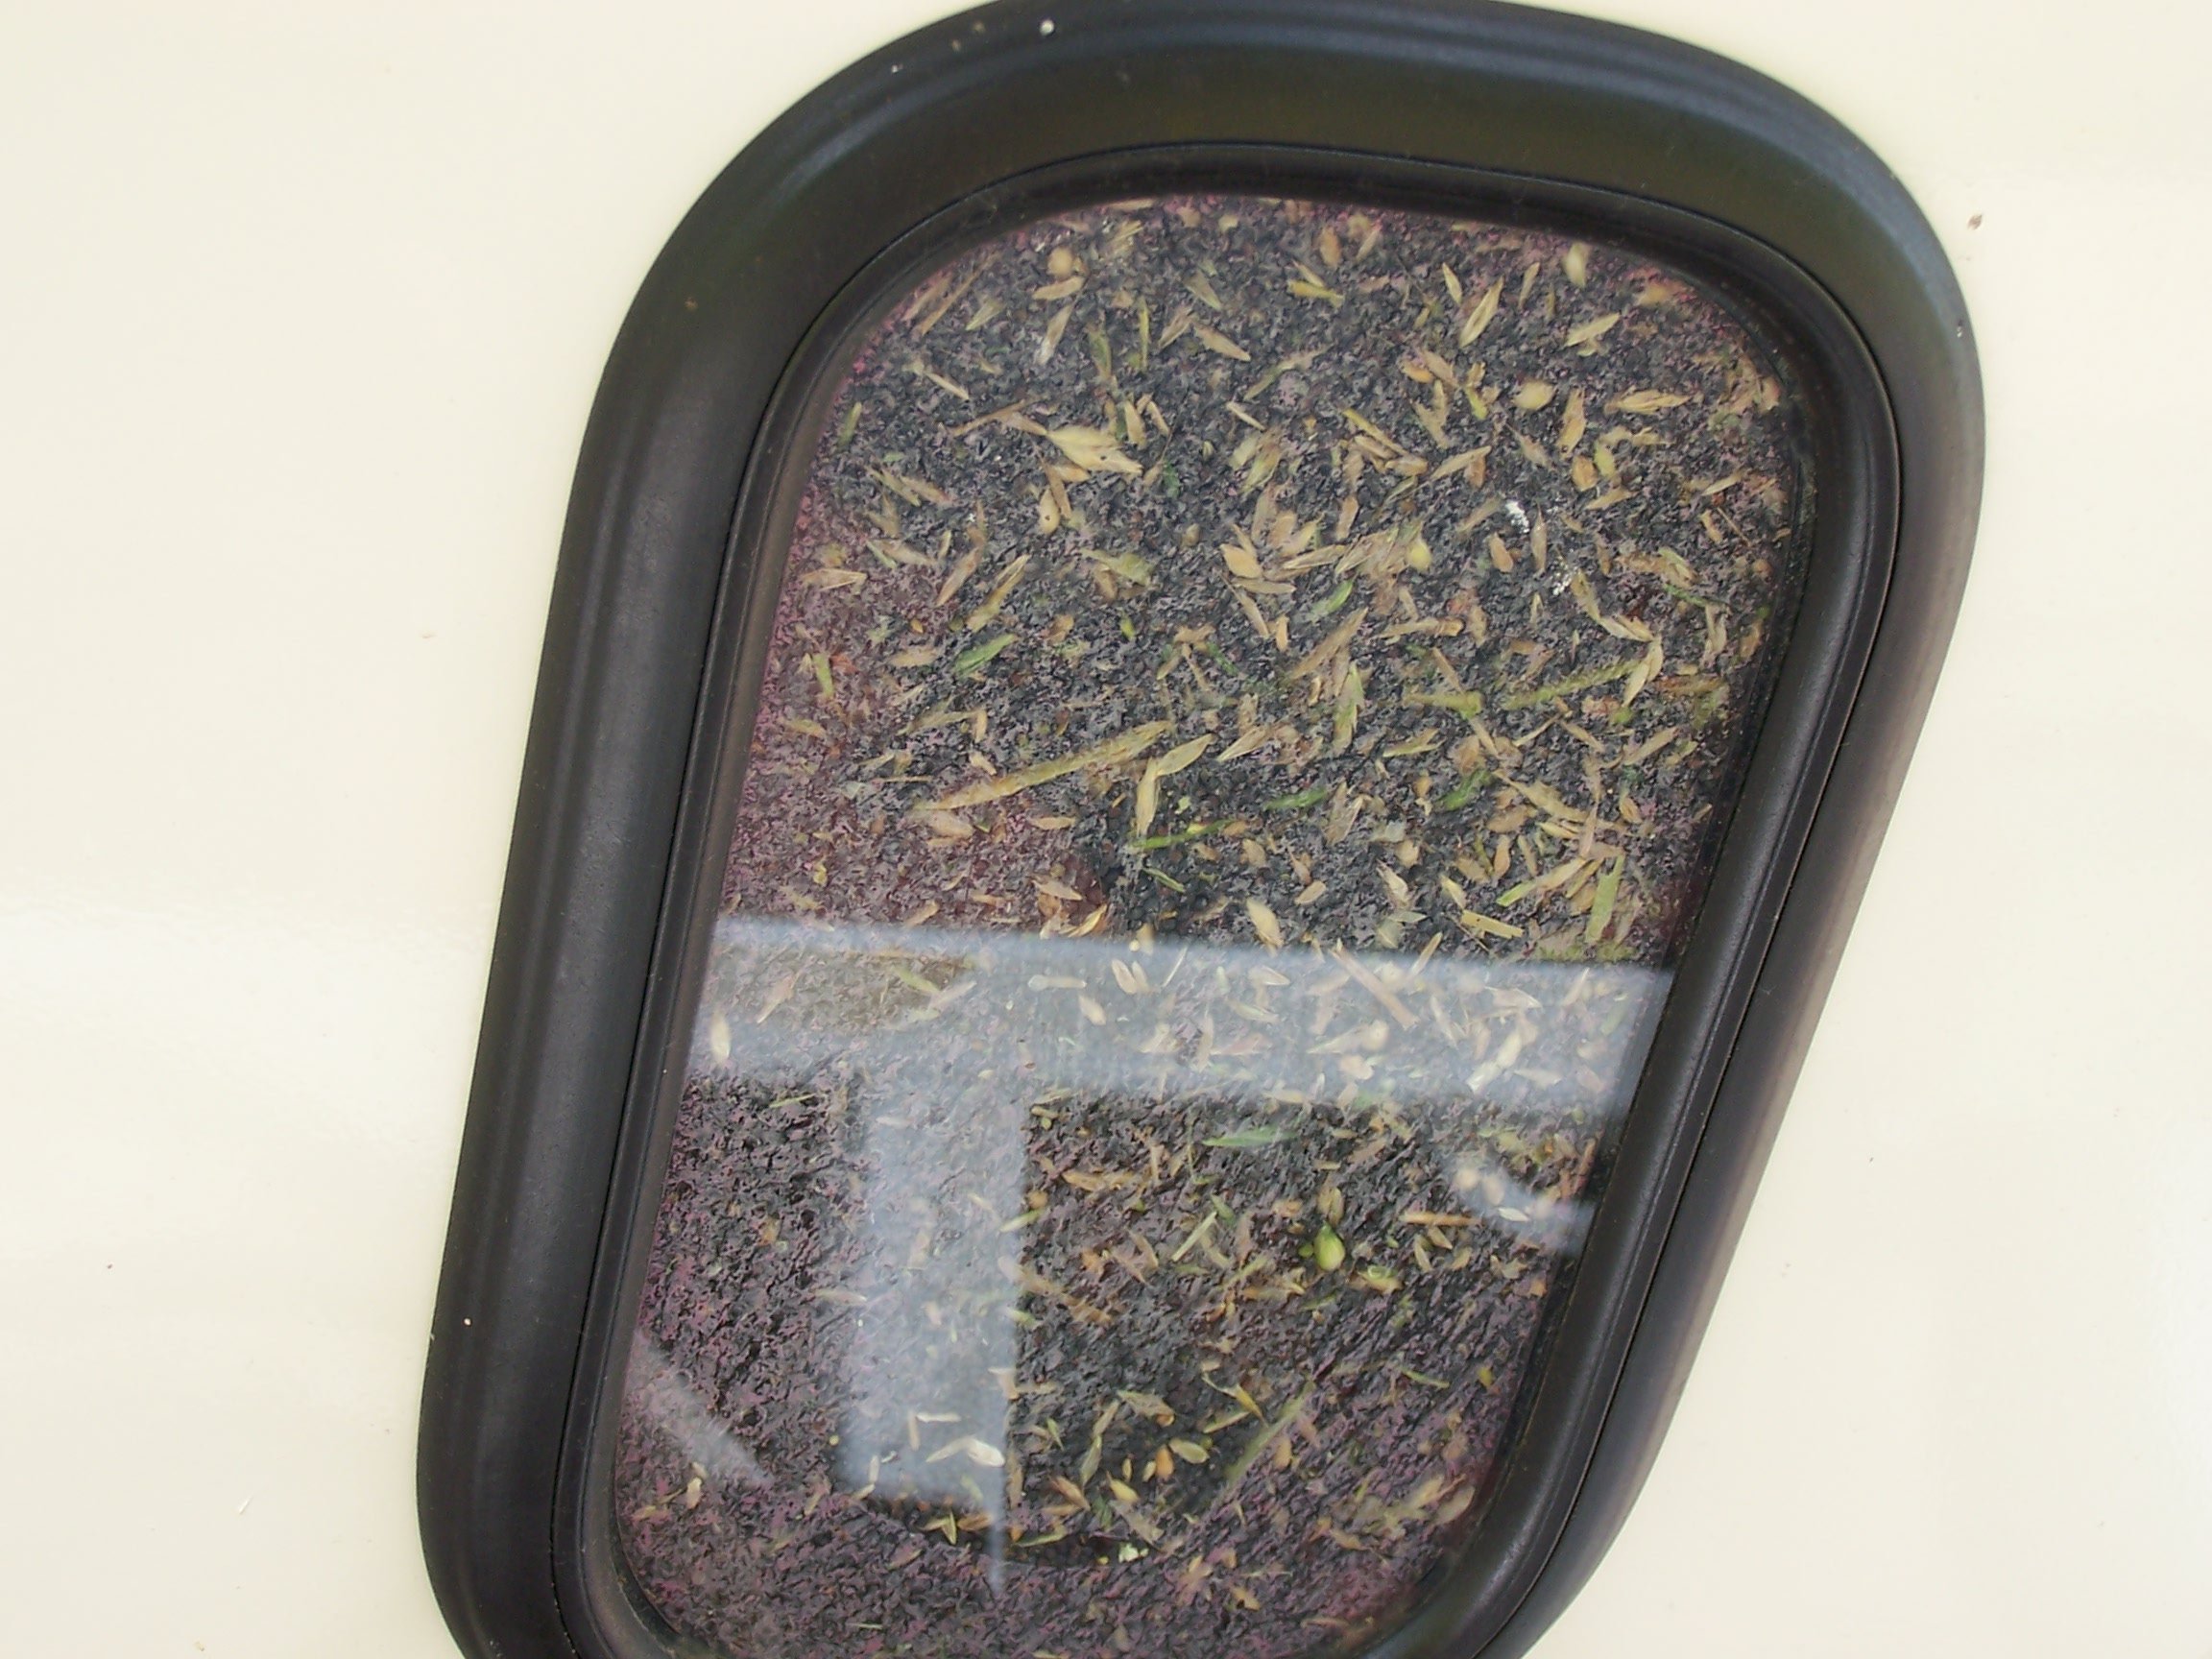
What not to do…
This photo is from a neighbor’s harvest. It is not recommended to plant winter canola on the same land as winter wheat or rye if you plan to harvest either. The combine can not separate them.

Slide 22
Conclusions
Planting date should be early September for southern MI.
Drilling canola is preferred.
If herbicides are not used, then a living mulch should be considered (i.e. white clover) for weed management.
Double cropping is possible if irrigation is used.

Slide 23
Conclusions
Under ideal growing conditions, canola oil can be produced for $2 to $3 per gallon.
The tap root of the canola offers helps to break up the soil. Research has shown that subsequent crops will have increased yields.

Slide 24
Additional Resources
www.oilpress.com
www.canola-council.org
www.sare.org
Your local Extension Agent or
  Dr. George Silva 517-543-2310

