Slide 1
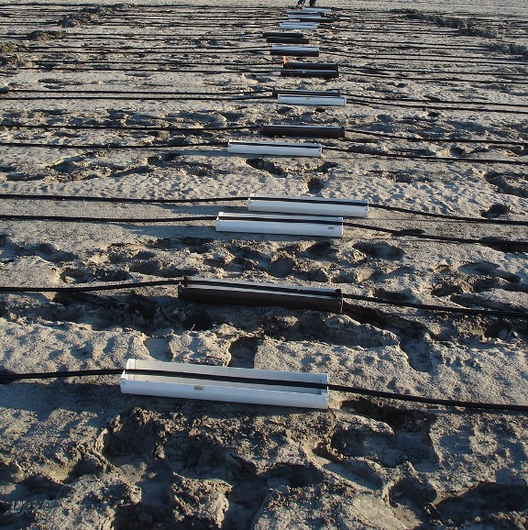
Figure 1. Volume of water from two emitters were collected using catch cans so as to estimate flow rates for three drip tapes laid flat on the ground without bed and mulch.

Slide 2
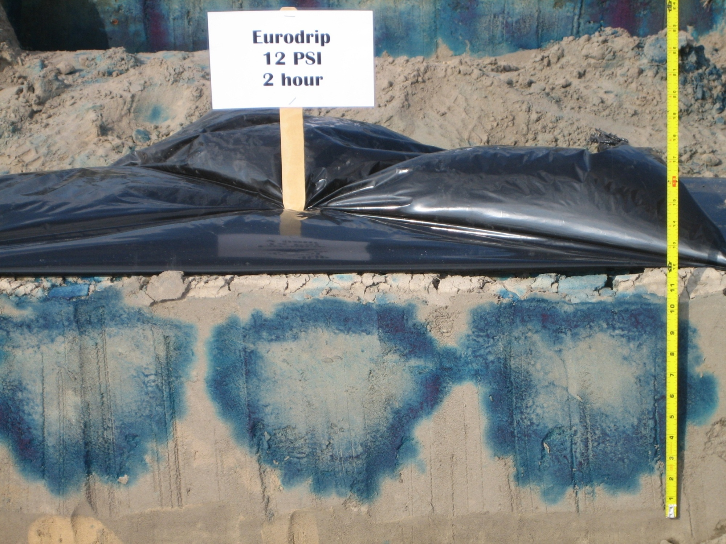
Depth (D) = vertical length from the top of the bed to the bottom of the blue ring
Width (W) = Horizontal length perpendicular to the bed axis at the widest point of the wetting bulb
W
D
Figure 2. Blue dye pattern of wetted zone in an Alpin-Blanton-Foxworth fine sand after 2 hours of irrigation for measurements of depth and width.

Slide 3
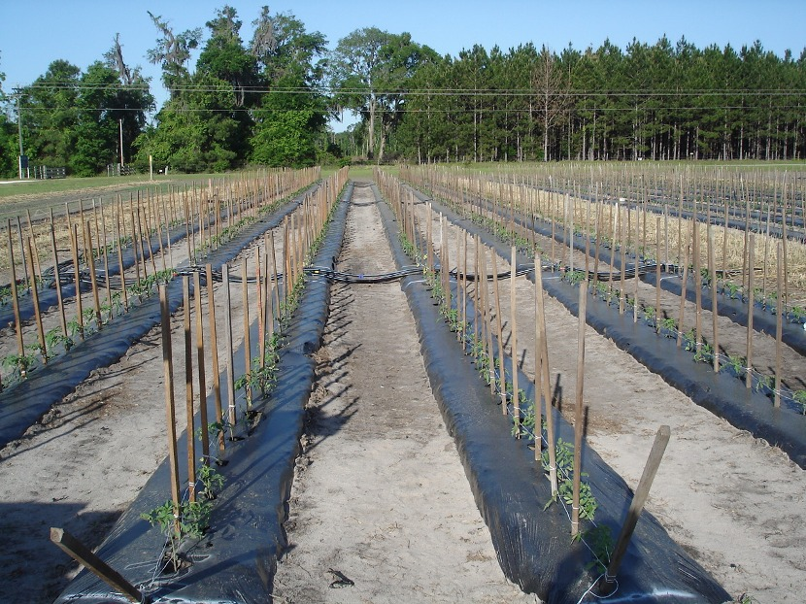
Figure 3. Tomato plants at 3 weeks after transplanting with staking and first string tied, in an Alpin-Blanton-Foxworth fine sand, on 28-inch wide mulched beds, using drip tape with 0.24gph flow rate, 12-inch emitter spacing.

