Slide 1
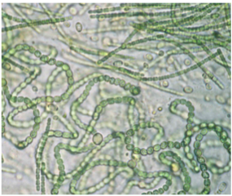
Figure 1
Example of the diverse morphology represented in one environmental culture.

