Slide 1
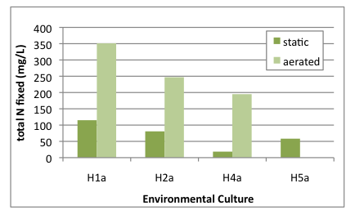
Figure 2
Comparison of the total nitrogen fixed in static vs. aerated cultures. (ND: no data available).

