Slide 1
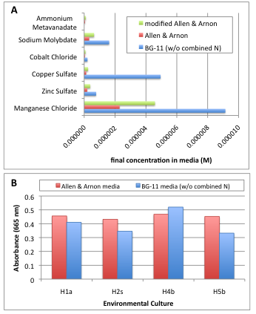
Figure 3
(A) Micronutrient composition of various media. (B) Comparison of biomass production in Allen and Arnon media vs. BG-11 media (without combined nitrogen).

