Slide 1
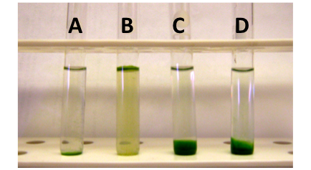
Figure 4
Demonstration of natural ability of cyanobacteria cultures to settle (A,C,D) or float (B).

