Slide 1
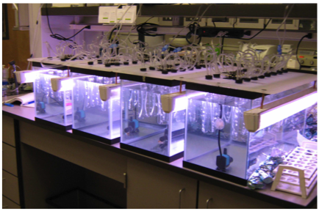
Figure 5
Culture tank reactors.

