Slide 1
Kaw Permaculture Collaborative
SARE Farmer/Rancher Project
Steve Moring, Maryam Hjersted and Charles NovoGradac

Slide 2
Kaw Permaculture Collaborative
An association of local organic farms, community gardeners and urban gardeners.
Individuals engaged in community education, information and resource networking.
Individuals and groups supporting each other in design and implementation of permaculture activities and projects.
Building local food systems for a sustainable future.

Slide 3
What is Permaculture?
A New Paradigm of Agriculture
  A biognostic epistemology
  Sustainability ethics
  Ecological mimicry (Biomimicry)
A Design Science that uses natural systems as the model for creating productive systems with resilience, diversity and stability of natural ecosystems”
A Revolution Disguised as “Organic Agriculture”
“Consciously designed landscapes which mimic the patterns and relationships found in nature, while yielding an abundance of food, fiber and energy for provision of local needs.” (D. Holmgren)

Slide 4
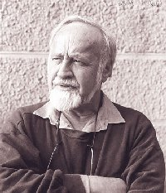
Permaculture
(Bill Mollison)
Design system for creating sustainable human environments
System of ecologically sustainable agriculture
Permanently sustainable agriculture
= sustainable agriculture base and land use ethic
“The systems by which we live today are simply,
non-sustainable.”

Slide 5
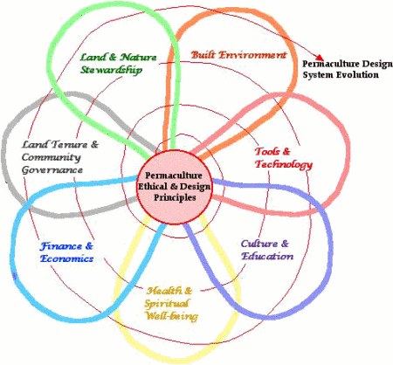
An Evolving Culture
Starting with ethics and principles focused in the critical domain of land and nature stewardship, permaculture is evolving by progressive application of principles to the integration of all seven domains necessary to sustain humanity through energy descent. - David Holmgren

Slide 6
KPC – SARE Project Goals
Establish 3 Demonstrations sites for training farm interns and permaculture students
  Early, mid & late succession forest polyculture gardens
Support on-going education in permaculture ethics, design and practice
Demonstrate permaculture food production by creating sustainable soils and biologically diverse crop systems using organic no-till & integrated vegetable, fruit and nut tree polyculture crop systems

Slide 7
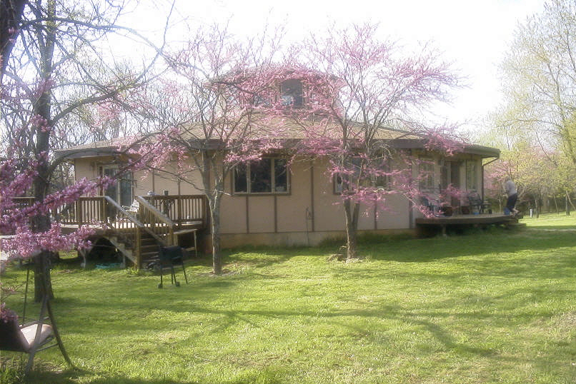
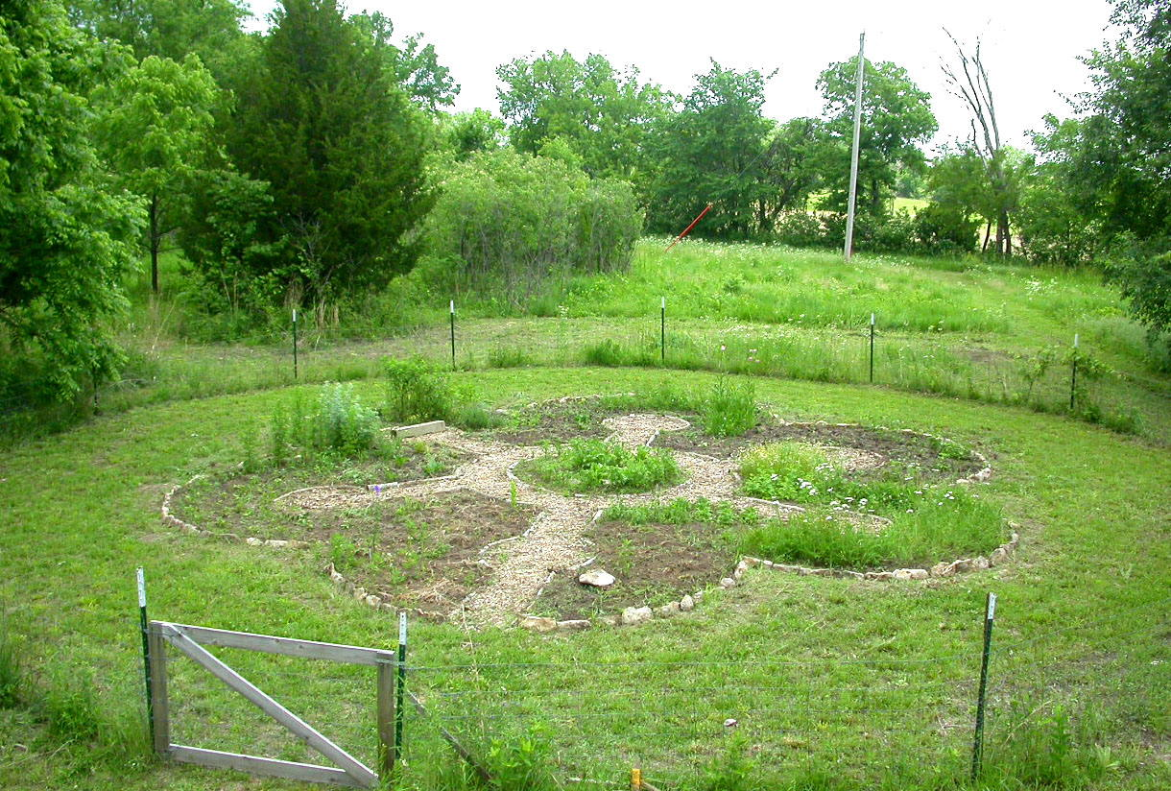
Vajra Farm
Steve Moring

Slide 8
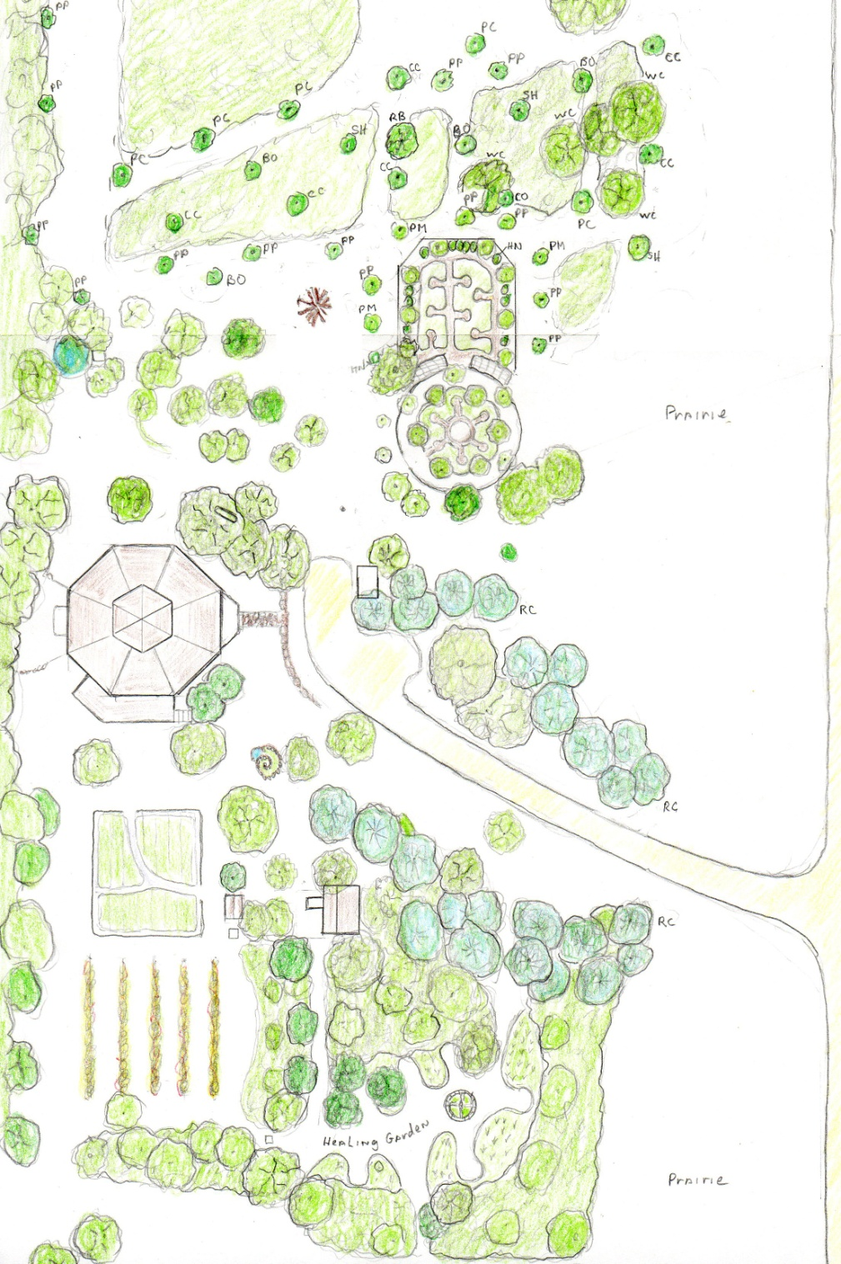
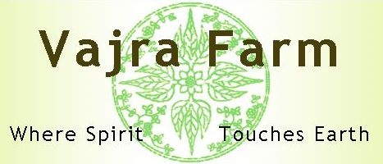
Farm Layout
Food Forest
Berry Trellises
Mandala & Suntrap Gardens
zone 1
Farm House
zone 2
Vegetable Garden
Vineyard
Healing Garden

Slide 9
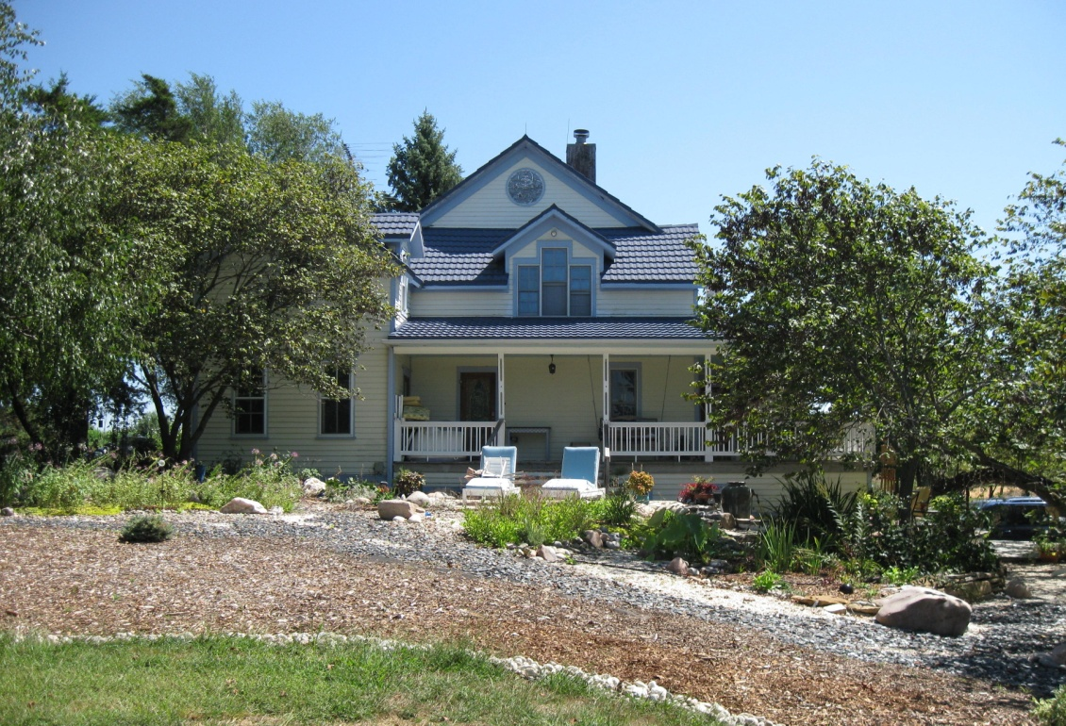
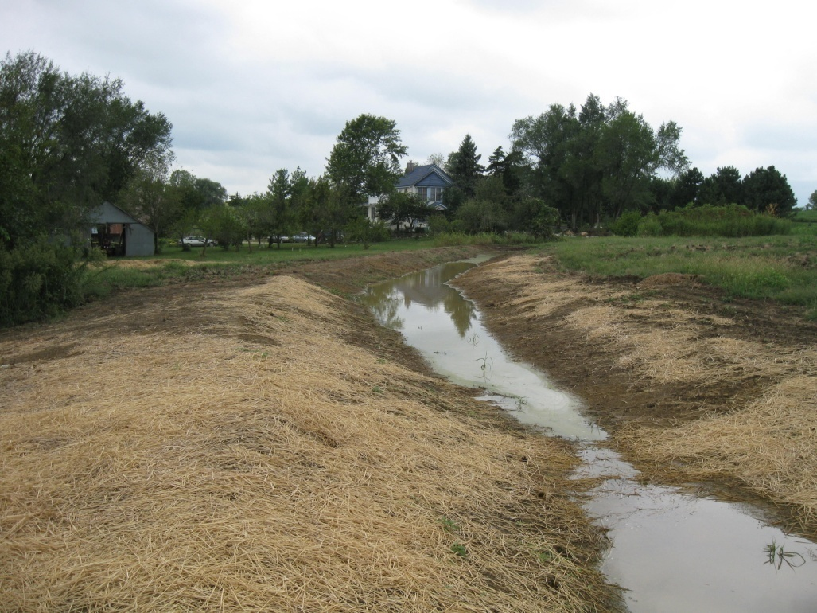
Prairie Lovesong Farm
Maryam Hjersted

Slide 10
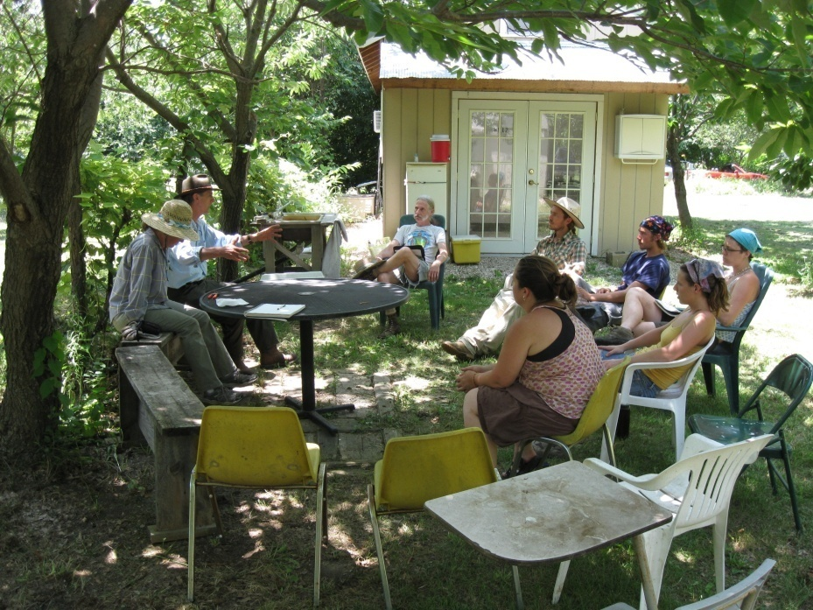
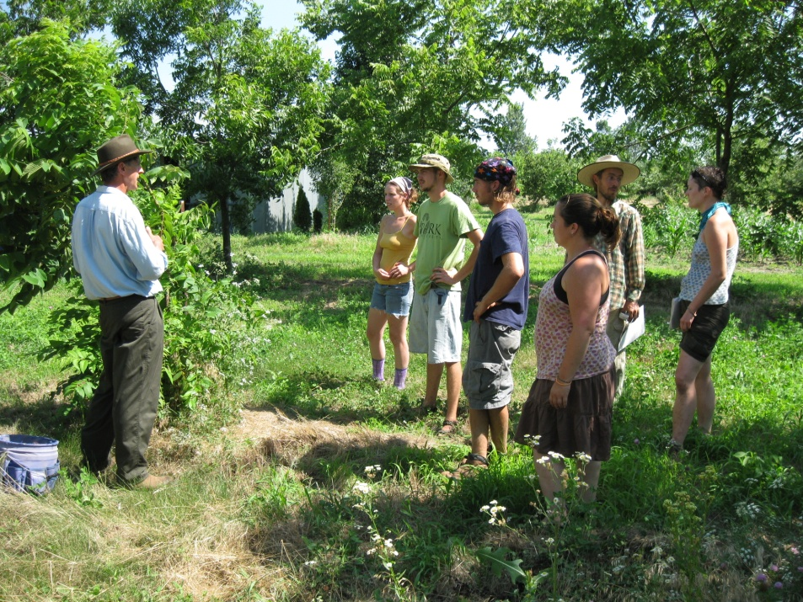
Chestnut Charlie’s Orchard

Slide 11
Designing a Forest Garden
Location on the landscape, zone 3 or 4
Purpose: - fruit & nut crops
  - mixed polyculture, food, forage and timber
  - education, demonstration garden
Species selection, crop & support species
Earthwork preparation
Managed succession, 5 – 20 years

Slide 12
Selected Forest Garden Species
Canopy Species Height Spacing
  Burr Oak 80’ 40’
  Chinkapin Oak 40 30
  Black Walnut 80’ 30’
  Carpathian Walnut 50’ 25’
  Shellbark Hickory 85’ 30’
  Pecan 80’ 35’
  Black Locust 70’ 35’
  Chestnut 35’ 20’
Mid-canopy Trees
  Redbud 15’ 10’
  Mulberry 20 – 50’ 20’
  Paw Paw 15’ 8 – 10’
  Persimmon 15 – 25’ 15 – 25’
  Service berry 24’ 5 – 10’
  Autumn Olive 15’ 10’
Copyright Vajrafarm, LLC

Slide 13
Selected Forest Garden Species
Understory shrubs Height Spacing
  Hazelnut 10 – 15’ 8’ or BDL
  Elderberry 6 – 12’ 1 - 2’ or BDL
  Juneberry 6 – 10’’ running
  Gooseberry 2 – 5’ 2 – 4’
  Jostaberry ~6’ 2 – 6’
  Black Current ~5’ 2 – 4’
  Raspberry 2 – 4’ 2 – 6’
  Lowbush Blueberry 2 – 4’ 2 – 4’
Understory Herbs
  Comfrey 1 – 3’
  Chammomile 1 – 2’
  Groundnut ~1’ running
  American Ginseng ~1’ 1 – 2’
  Wild Ginger GC spreading
  Goldenseal ~1’ spreading
Copyright Vajrafarm, LLC
Notes:
BDL = beyond the drip line

Slide 14
Supporting Species
Nitrogen Fixers
  Bristly Locust
  Russian Pea Shrub
  Goumi/ Autumn Olive
  Bush Clover
  American Senna
Dynamic Accumulators
  Basswood
  Comfrey
  Nettle
  New Jersey Tea
  Yellow Wild Indigo
  Ground Nut
  Chickling Vetch
  Red Clover
  Curly Dock
  Chickweed

Slide 15
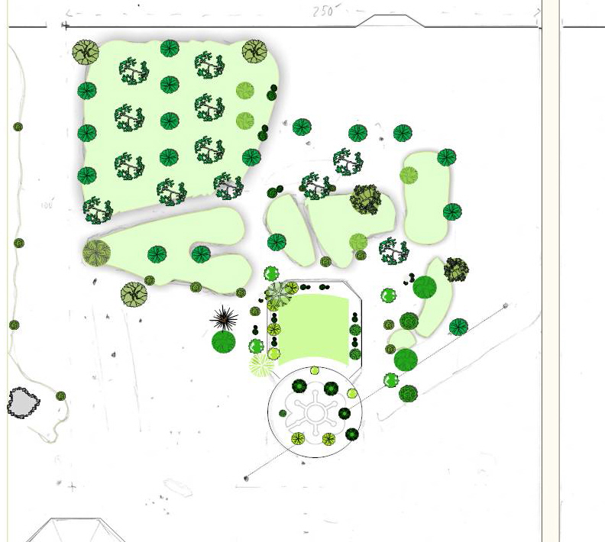
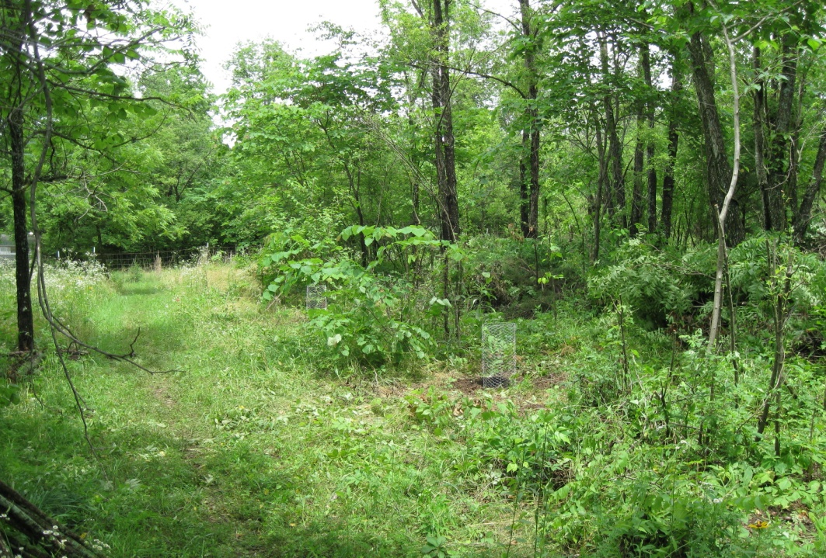
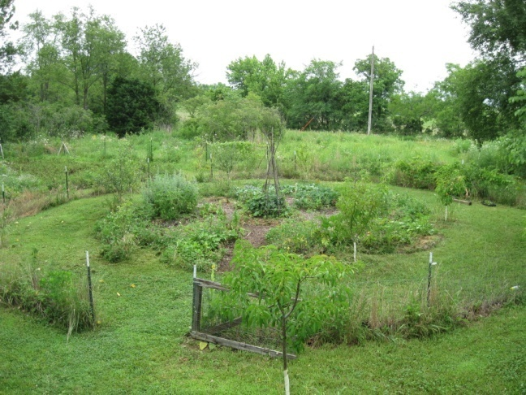
Creating Forest Gardens
Garden Layout at Vajra Farm

Slide 16
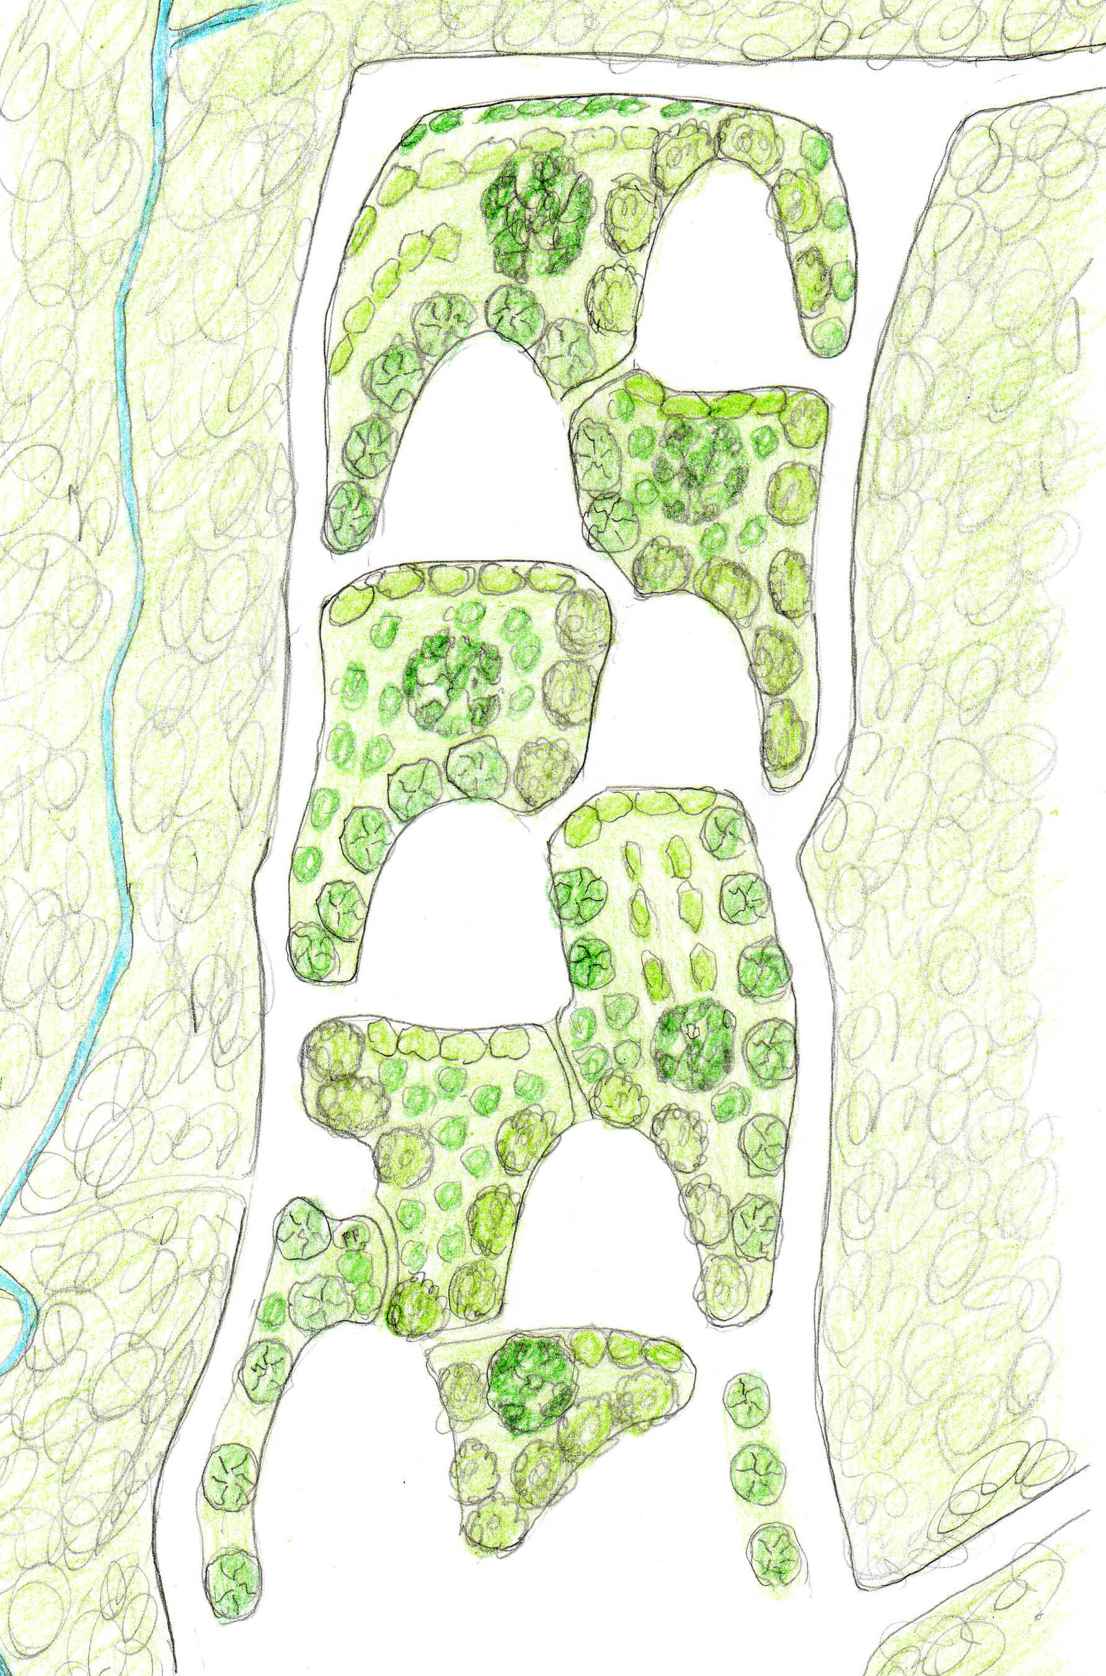
Design for the Future
Zone 5 Woodland
Suntrap Meadow
Access Corridors
Copyright Vajrafarm, LLC

Slide 17
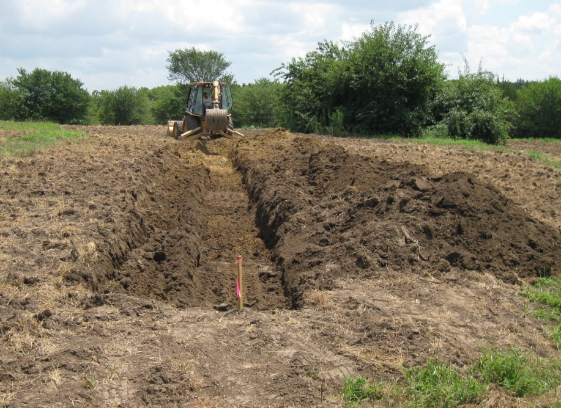
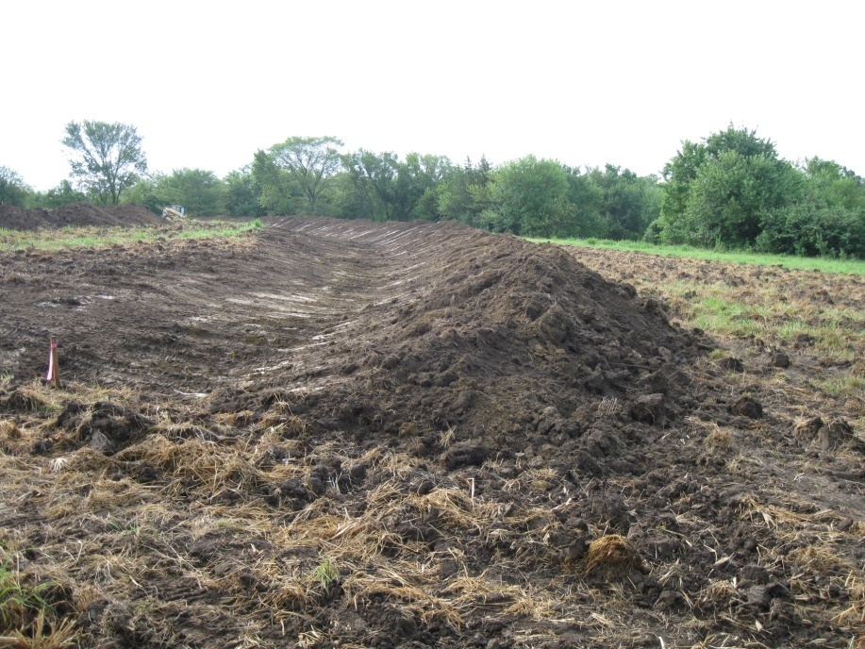
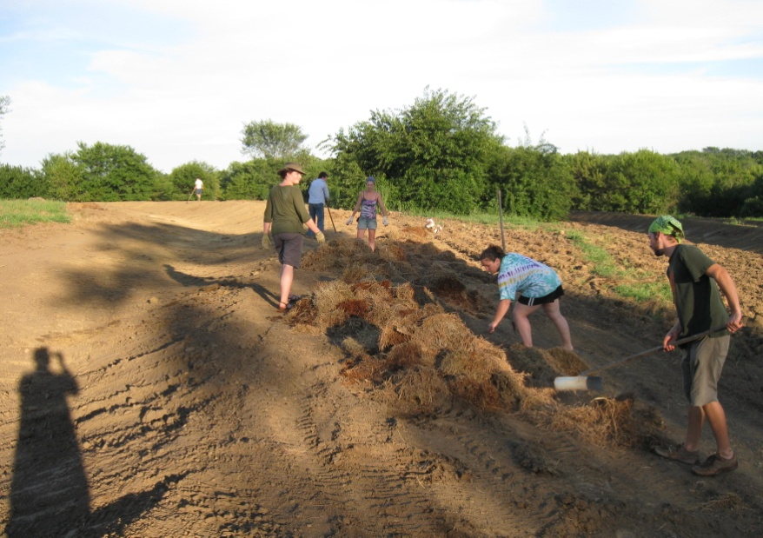
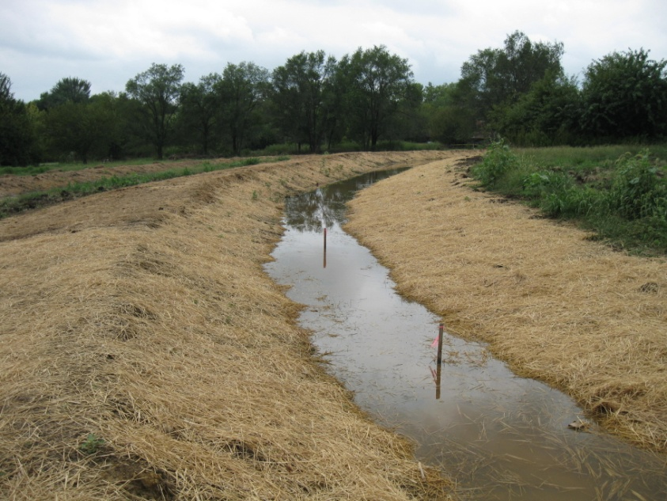
Earthworks: Creating Swales
Hjersted Farm

Slide 18
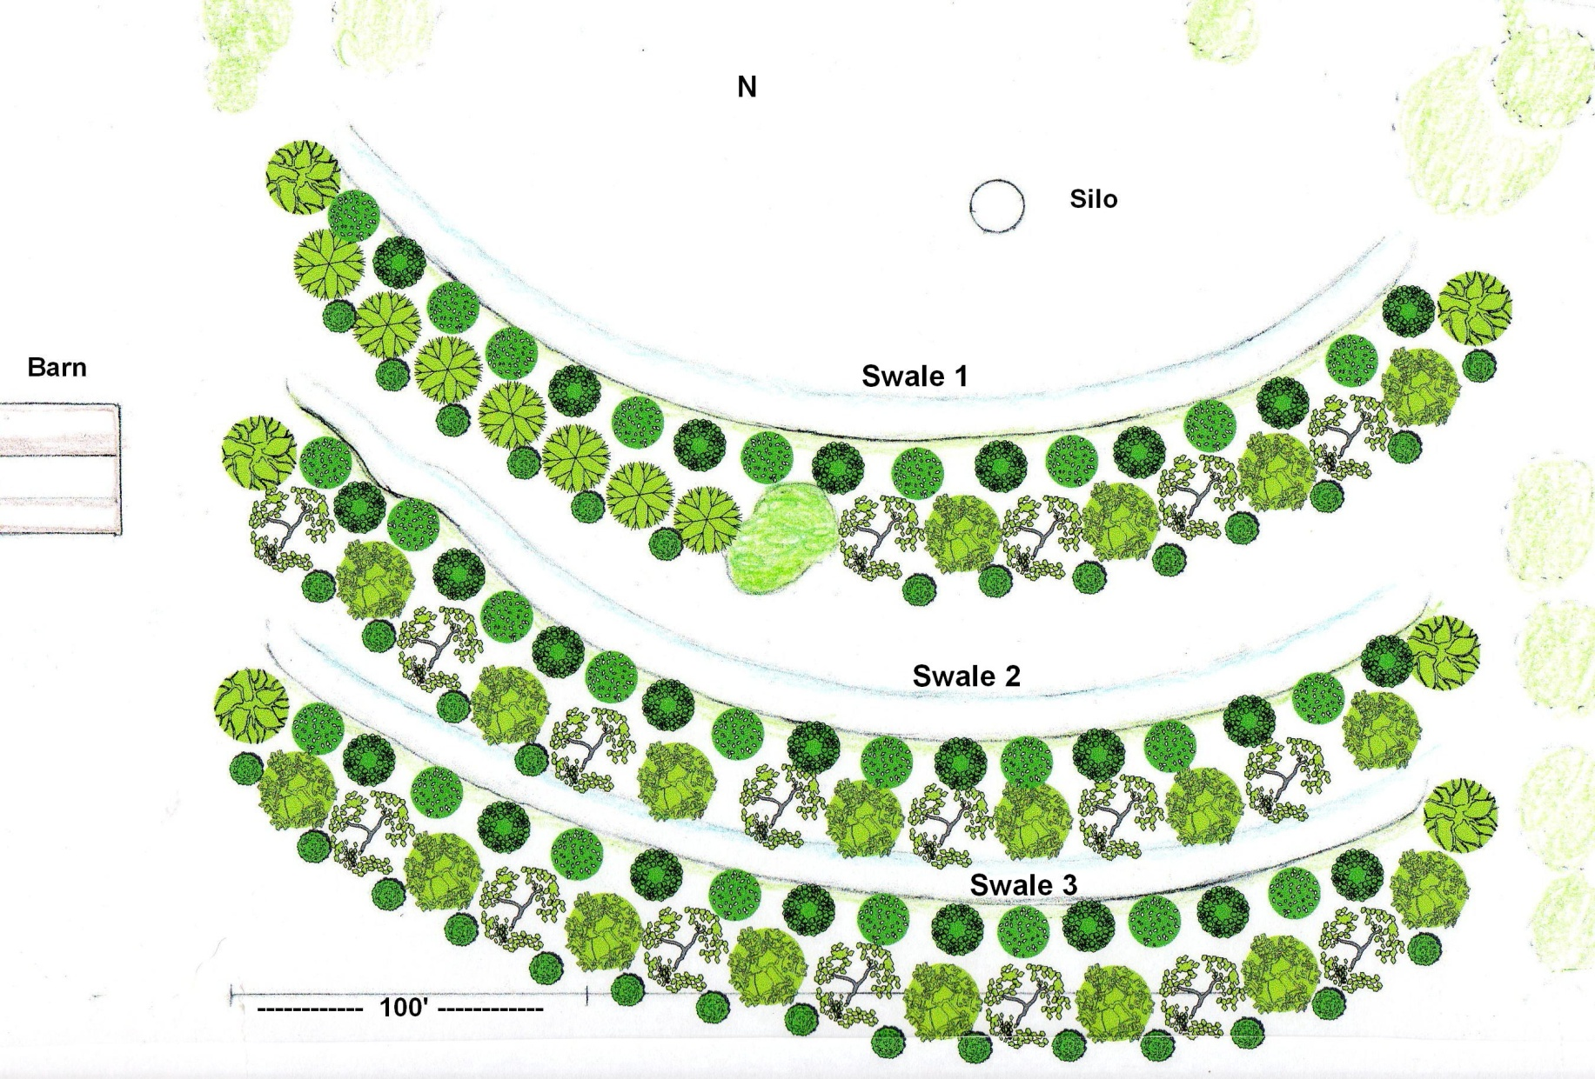
Food Forest Layout
Design for Hjersted Farm

Slide 19
Outreach 2010
Spring permaculture certification course
Permaculture farm & garden tour
Permaculture practicum sessions
  Almon Urban garden & Chestnut Charlie’s Orchard
  Vajra Farm permaculture project
  Hjersted swale project, layout & mulching
Fall agroforestry workshop at Chestnut Charlie’s
Fall permaculture lecture series
LJ World news story

