Slide 1
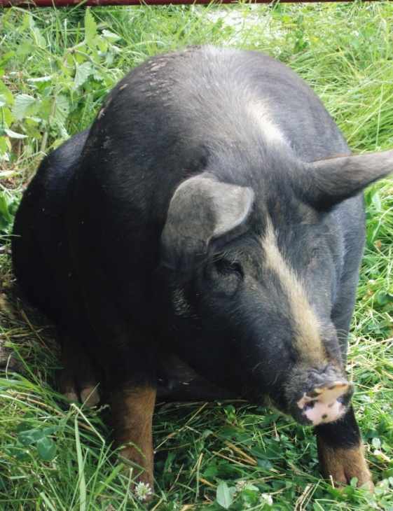
Jerusalem Artichokes as Hog Forage
Andrew Rider
Thistle Byre Farm
Burnettsville, IN

Slide 2
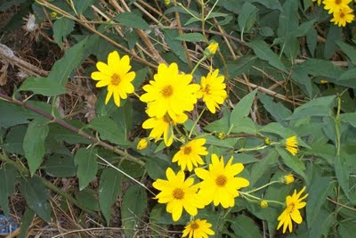
Notes:
Sunchokes are also called Jerusalem Artichokes…I have a few pictures of them.

Slide 3
Project Goals:
Add forage diversity to my free range hog pasture
Measure the impact they had on 1 group of hogs weight gain
Evaluate as a pasture forage on a larger scale

Slide 4
WHY Helianthus tuberosus?
Notes:
Sunchokes and Jerusalem Artichokes they are in the daisy and aster family

Slide 5
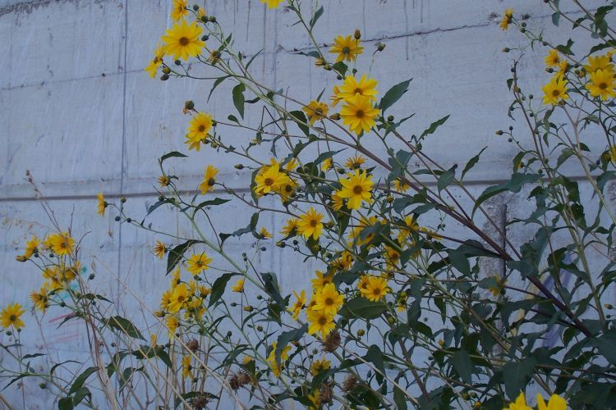
Jerusalem Artichokes:
Native to North America
Perennials
Easy to Grow
Prefer loose, moderately drained soil
Propagate easy
Thrives in full sun to partial shade
Tolerant of dry periods
Hardiness zones 3-9
Starchy root
Notes:
Energy is stored as inulin
In Europe it has been used as forage for sheep, cattle and swine

Slide 6
Planting
3-6 “ deep
18 “ a part
Yield: 2-5 pounds/plant
Notes:
I choose 50 pounds of organic Sunchokes from Johnneys..they were hard to get and they dug them especially for my SARE grant. They hadn’t cured well and on arrival they were damp…in two paper bags..we openned them and waited for the rain to break in order to plant…May 30th I was able to get them in.

Slide 7
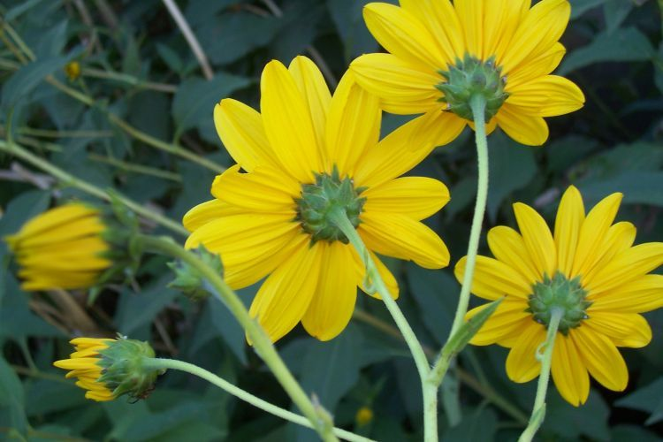

Slide 8
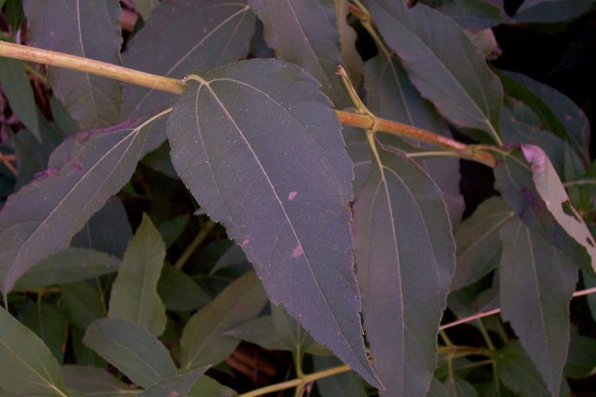
Notes:
Member of the family Asteraceae or the
Aster and Daisy family

Slide 9
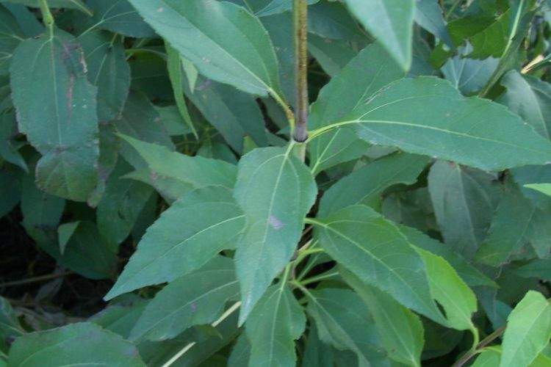

Slide 10
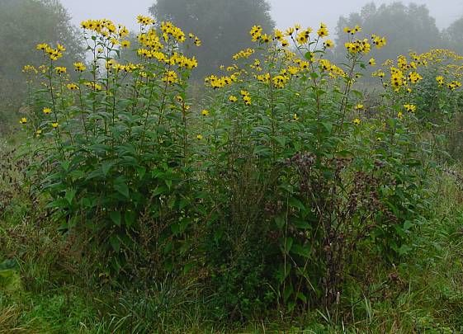

Slide 11
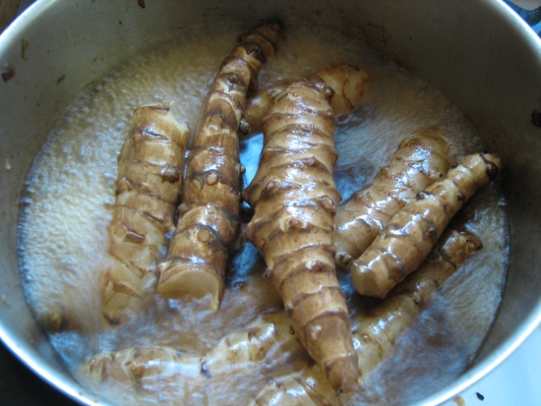
Notes:
The tubers in cooking pot. Some say they are crunchy with a sweet nutty flavor….others like John Goodyer express it differently. The inulin isn’t digested well by humans and causes flatulence.

Slide 12
Previous Research:
Purdue University Center for New Crops and Plant Products: Helianthus tuberosus. James A. Duke. 1983 Handbook of Energy Crops. Unpublished

Slide 13
John Goodyer, 1621, printed in Gerard’s Herbal about Sunchokes:
“…which way soever they be dressed and eaten, they stir and cause a filthy loathsome stinking wind with the body, there by causing the belly to be pained and tormented, and are a meat more fit for swine than for men….”
Notes:
Some folks don’t think they make great people food

Slide 14
Notes:
Greg Gunthorp peeked my interest. He is a northern Indiana hog, duck, and chicken farm who also got a SARE grant a few years ago. He butchers some of our pastured poultry and gave me a few artichokes a few years ago..telling me he was trying them as forage for hogs.

Slide 15
Thistle Byre Farm
Beef
Pork
Lamb
Chicken and Eggs
Turkey
Herbs
Veggies
Fruit
CSA and Farmer’s Market Sales

Slide 16
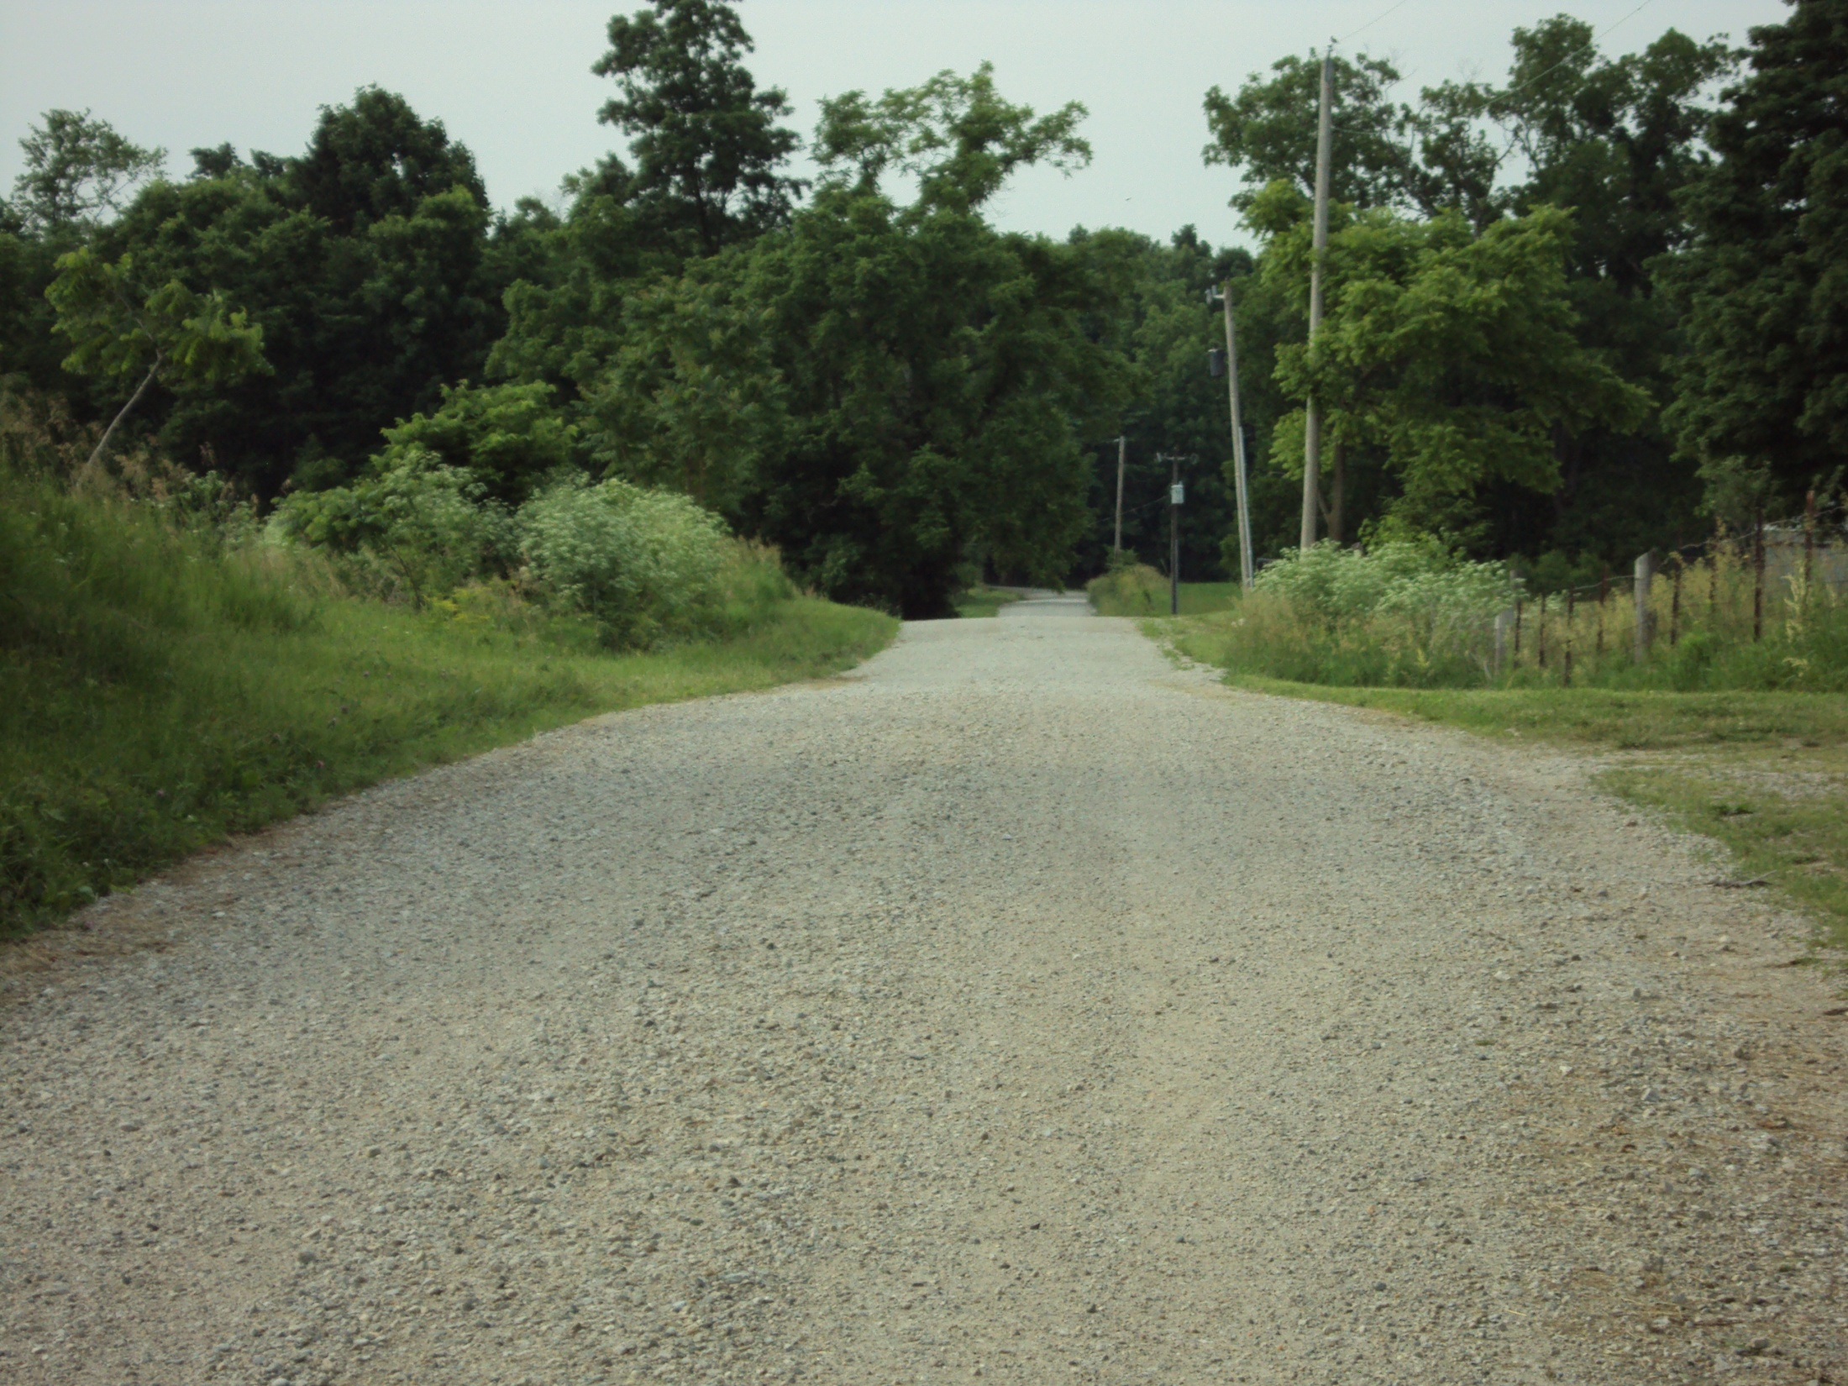
Notes:
Our road in front of the pasture that housed my hogs. We have 75 acres of certified organic crop ground.

Slide 17
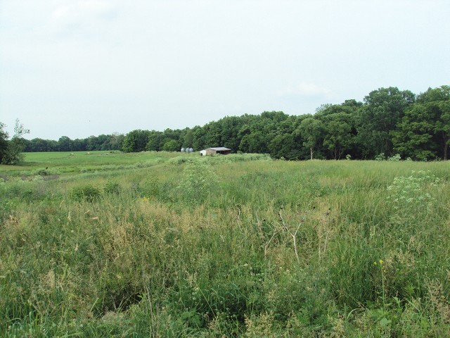
Notes:
A view across the hog pasture to the rest of the farm. It is gentlely rolling and surrounded by classified forest.

Slide 18
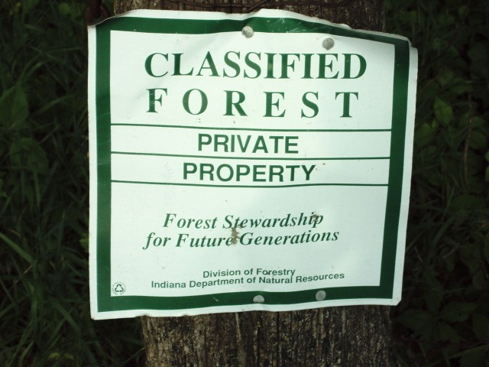

Slide 19
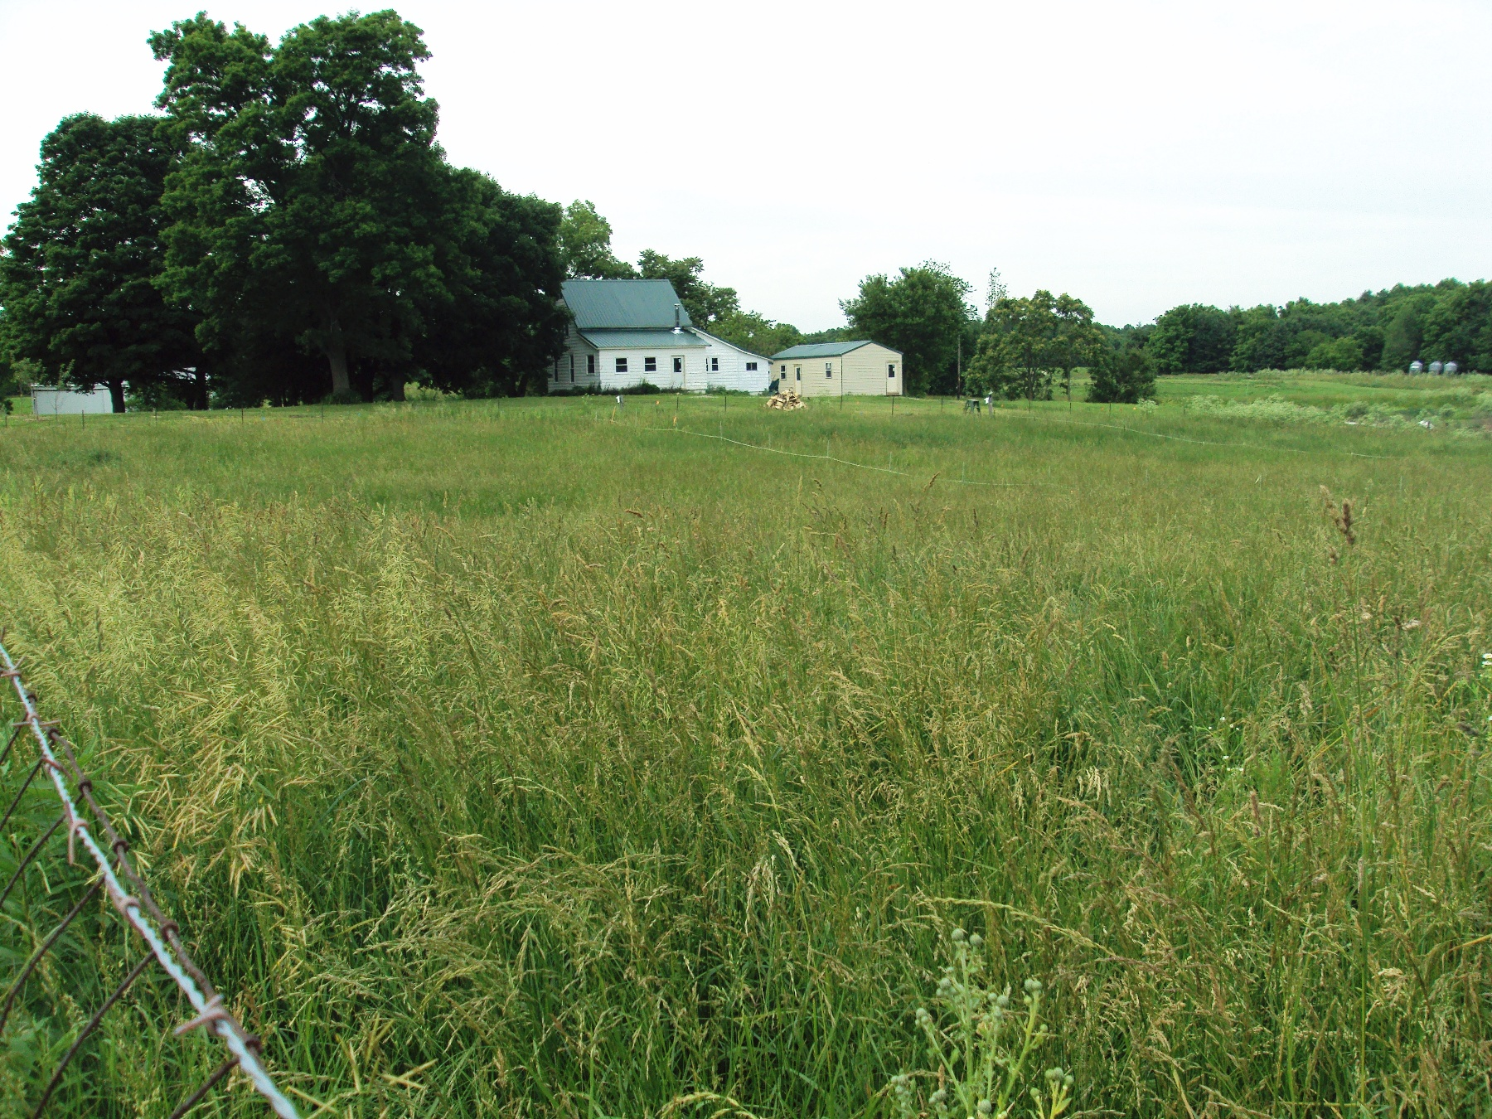
Notes:
This is the pasture’s front end where my brother has his rotational grazing paddocks laid out.

Slide 20
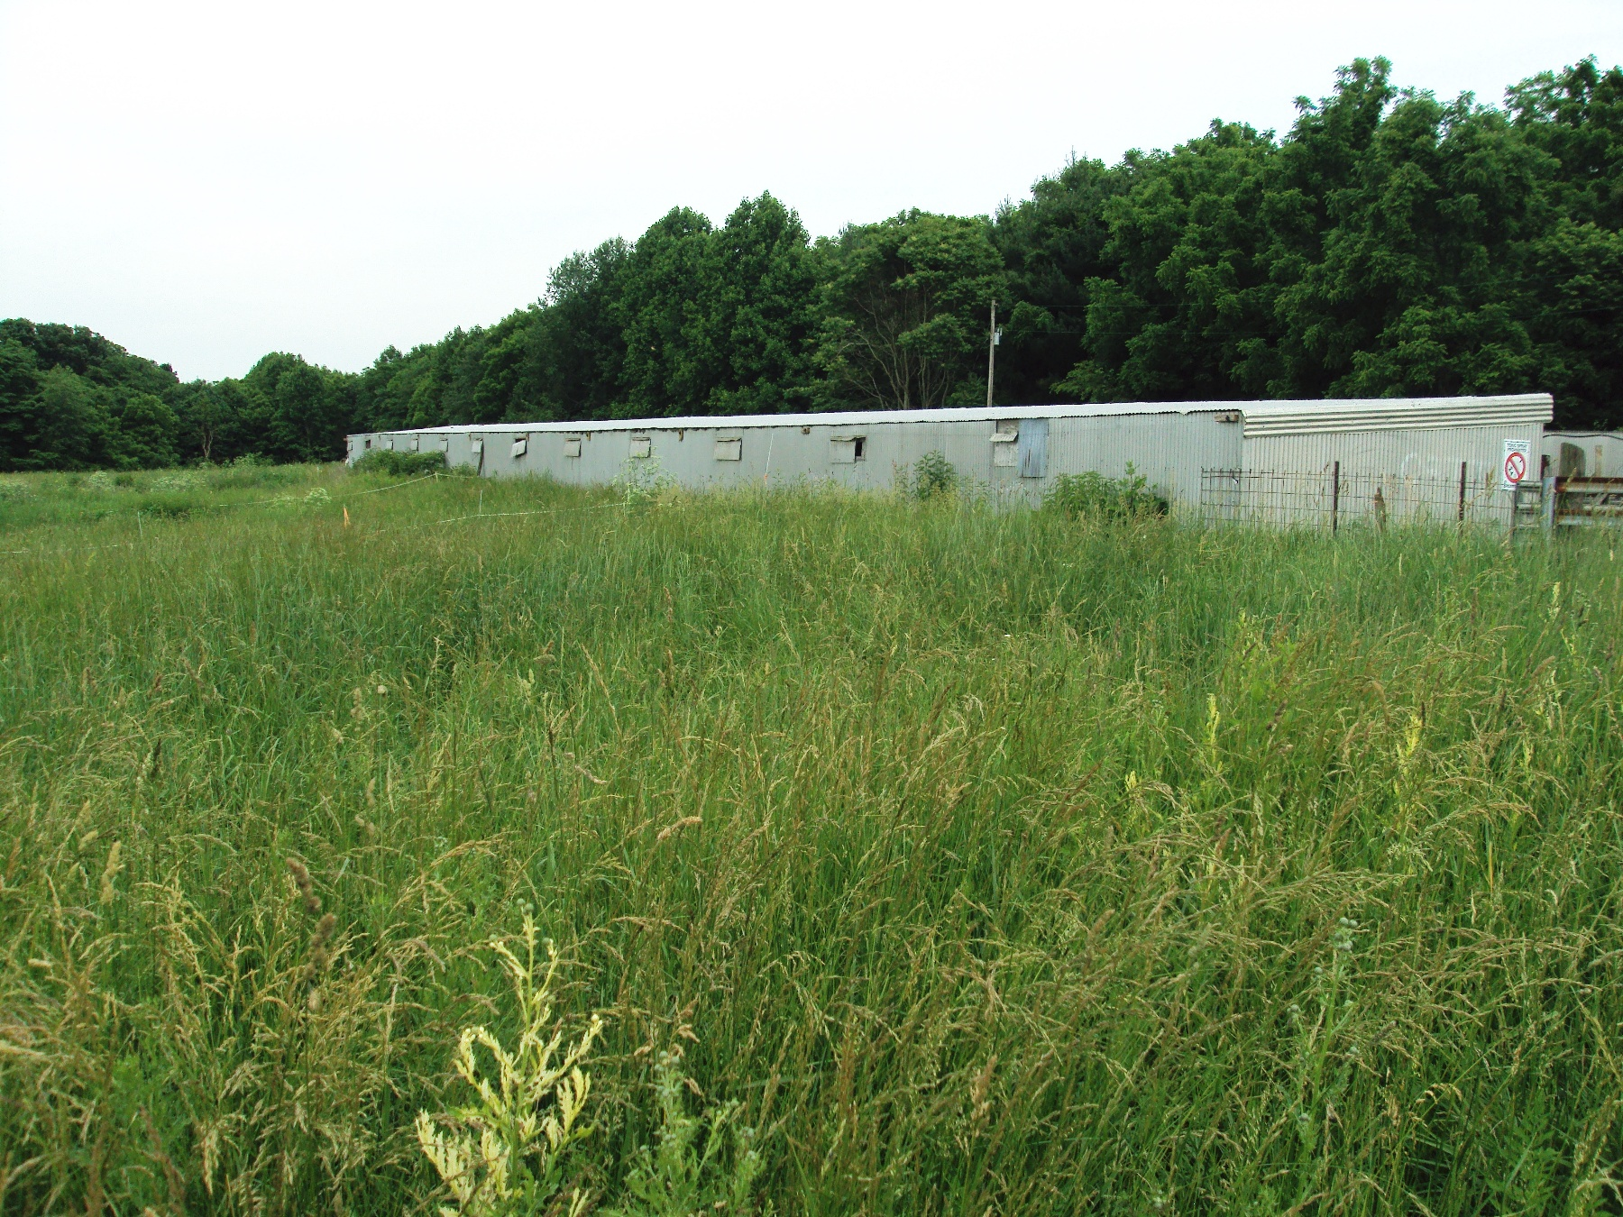
Notes:
The hog barns. The farm was in my father’s family about three owner’s ago…we have spent a great amount of time cleaning up and getting it ready for animals in the last year and a half of our ownership. A 78 year old Amish man helped me make some of the structural changes to accommodate my hogs.

Slide 21
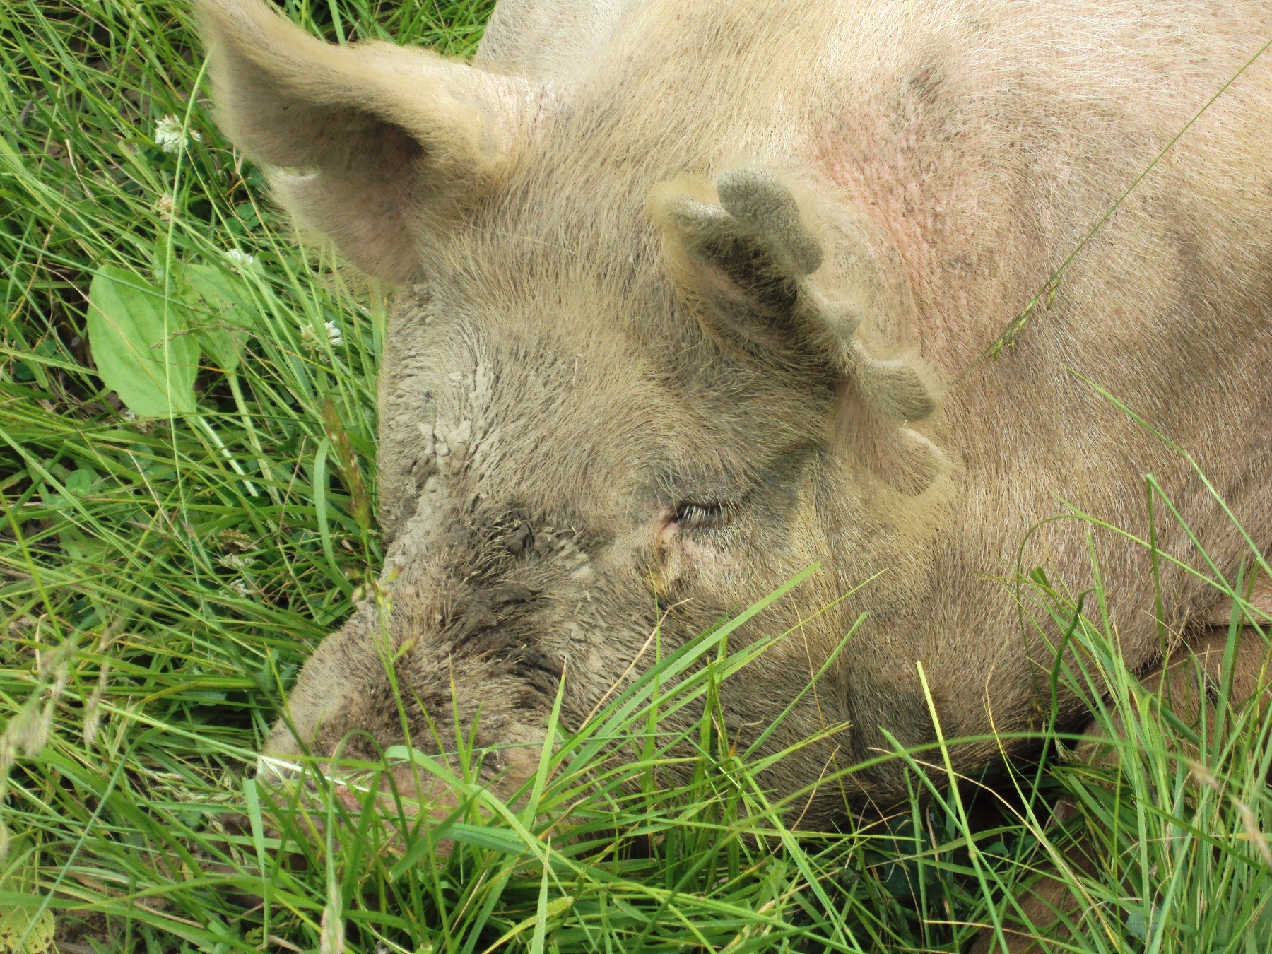
Notes:
Charolotte my first hog had 14 live babies in the pasture.

Slide 22
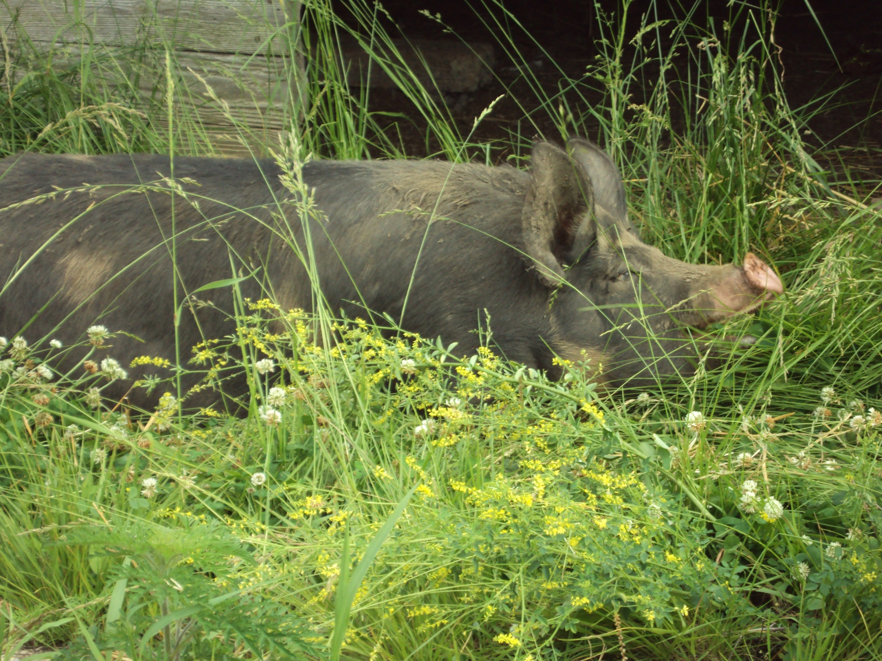
Notes:
Most of my hogs are Berkshire crosses. This is Lily, Violet and Dandelion.

Slide 23
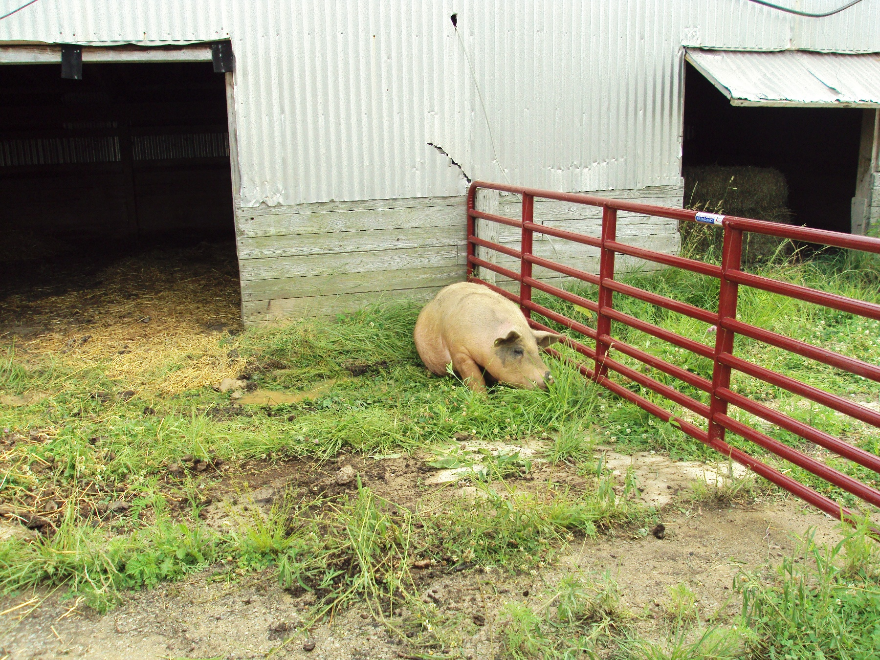
Notes:
Tulip…in her farrowing quarters.

Slide 24
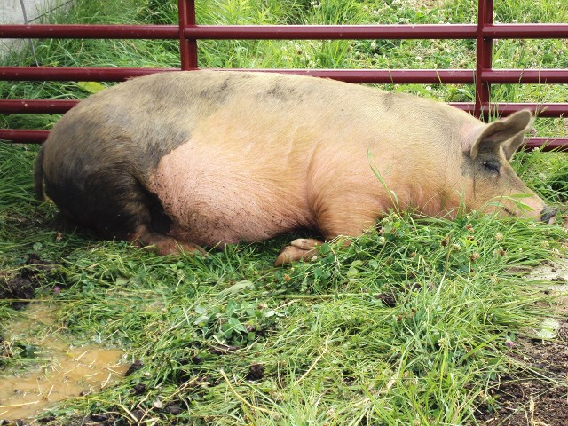
Notes:
Tulip lounging after a rain.

Slide 25
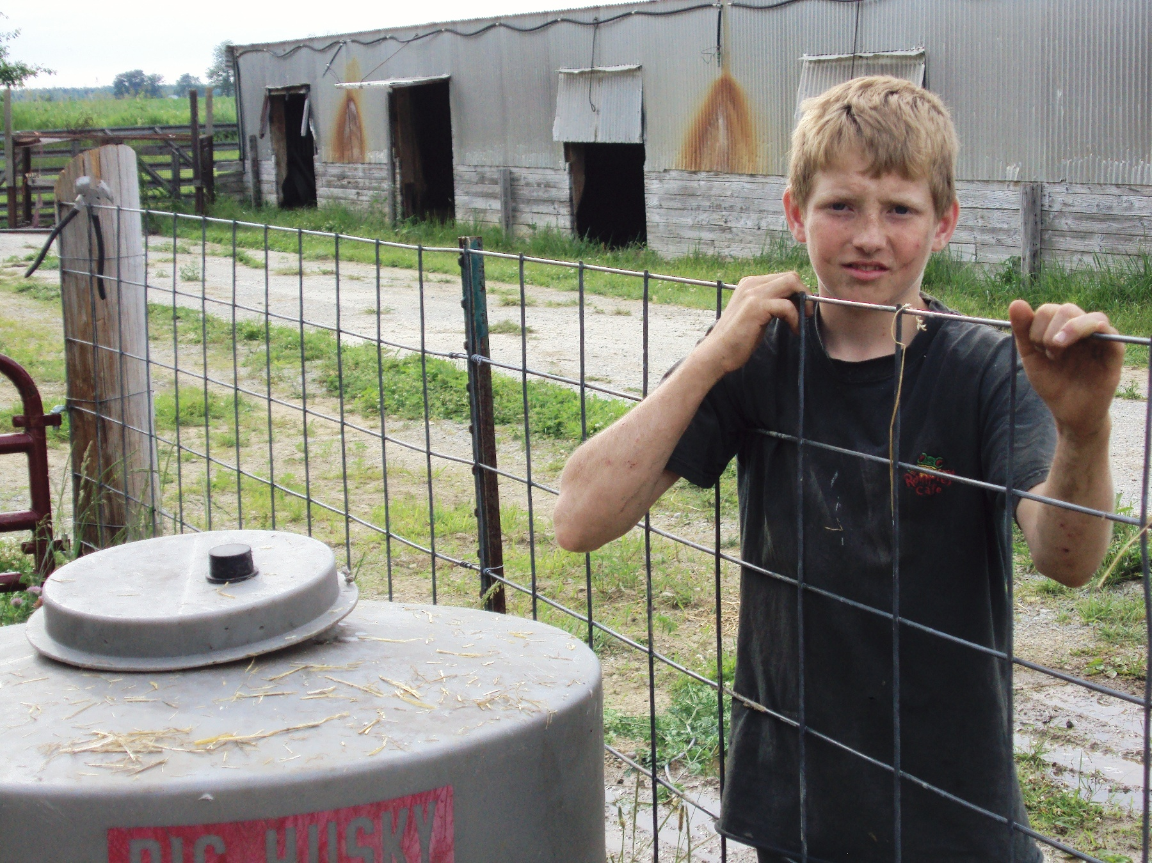
Notes:
Here I am doing chores.

Slide 26
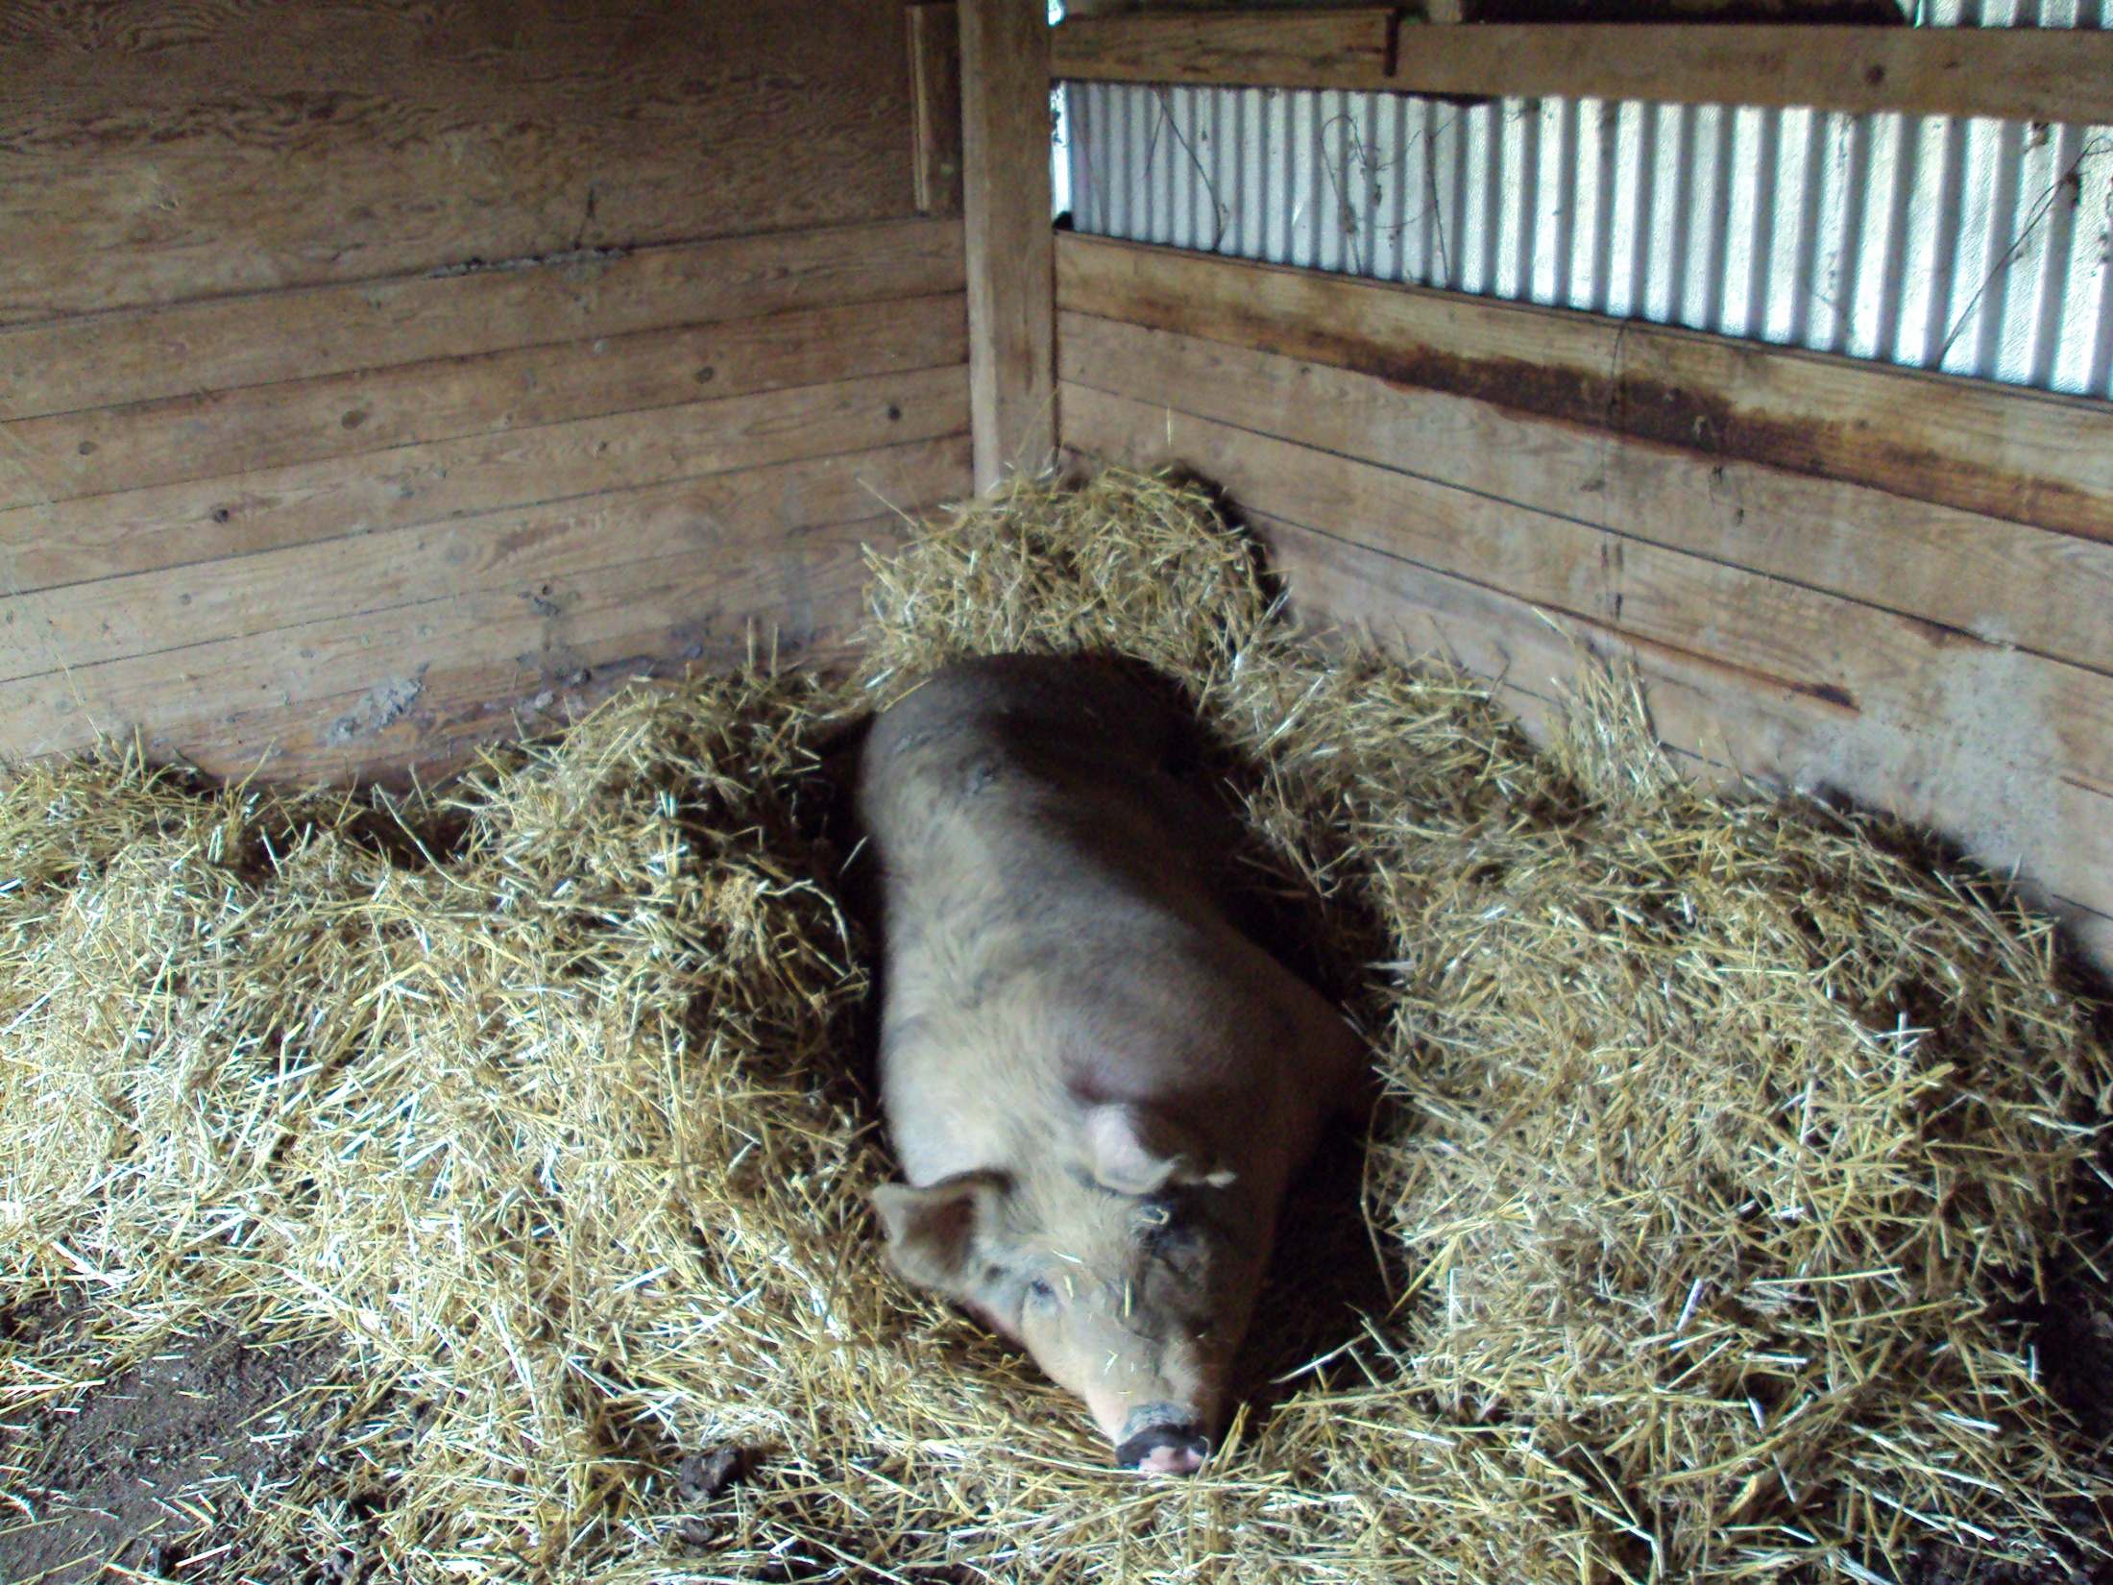
Notes:
Tulip inside her farrowing quarters.

Slide 27
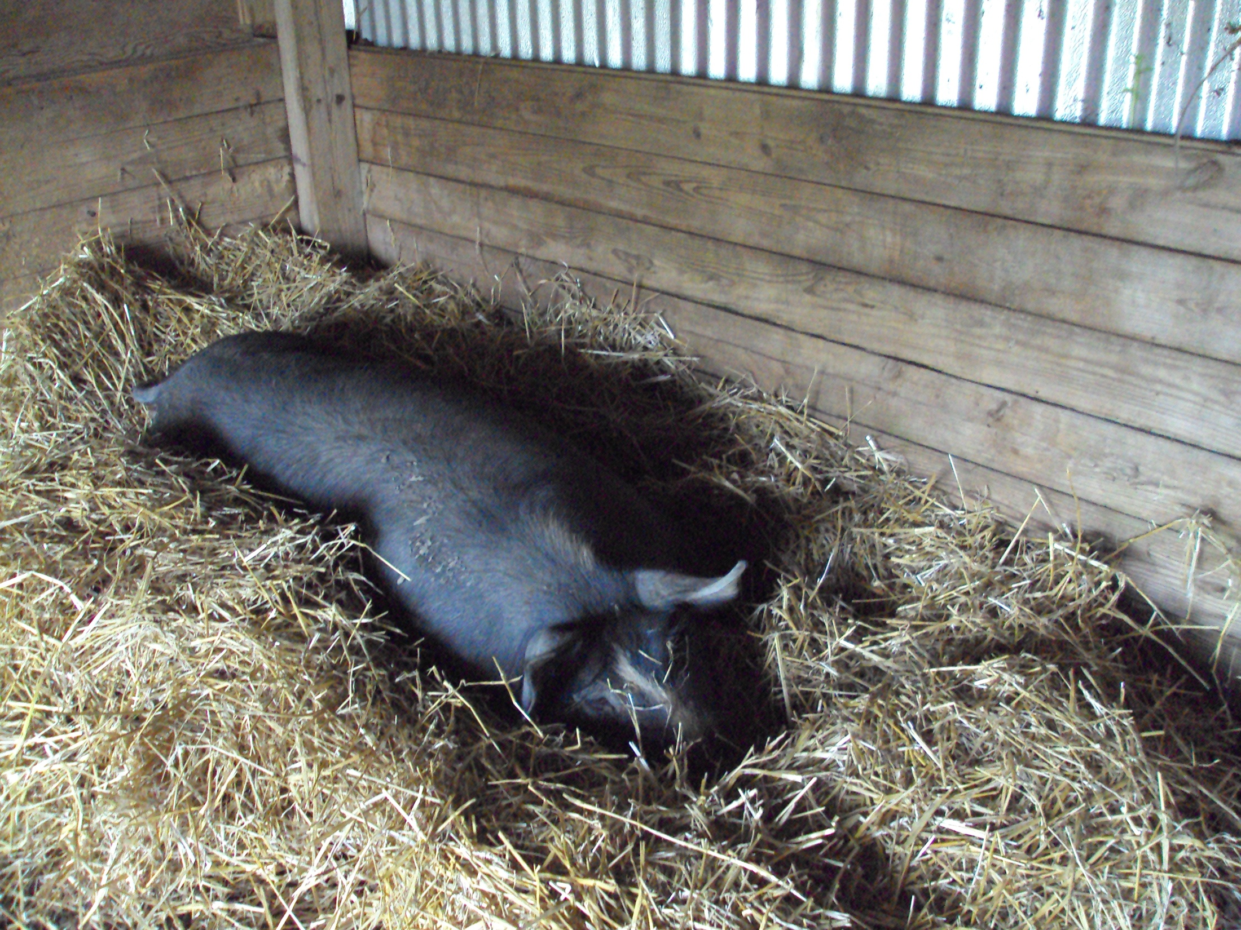
Notes:
Lily in here nest.

Slide 28
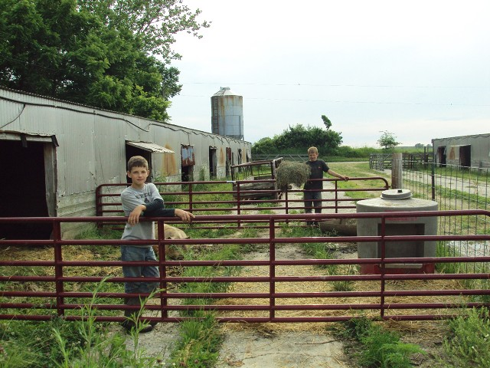
Notes:
We feed hay to our hogs all year….my brother has helped me with chores.

Slide 29
Fencing
Challenging
Hot Wire
Woven wire & hot wire … 6“ above the ground.
Cattle & hog panels
We changed charger …NO improvement

Slide 30
Hogs
Farrowed June and July
Weaned 9 wks.
3 litters … 29 live piglets…
Birth wts. ….. 2-3.5 pounds
Average litter size……. 8.6 piglets
O died before weaning
2 died from hunters
Notes:
I wanted to farrow them when I applied in April. My first and last farrowing were 1 month apart. This created a size difference in my piglets.

Slide 31
Weaning at 9 weeks
Weighed, castrated, noses ringed & put on pasture
12-15 pounds
Fencing …..problem the 1st day

Slide 32
Supplemental Ration
No antibiotics or hormones
Locally milled
No blood meal
Natural Redmond salt and minerals free choice
Finished on nonGMO corn feed

Slide 33
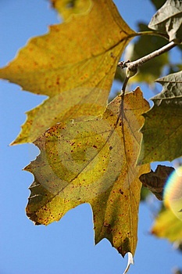
November 2009
November …… 90-200#
Finished on non GMO corn feed without antibiotics at a friends….with better fences…
Ready for market by February 2010
December …..130-250#

Slide 34
Marketing
Market weight 300-320 pounds … fatter is tastier
Locally sold …by the piece or $2.99/pound hanging wt.
Sale in January and February … $2.59/pound hanging wt ..(butchering, wrapping, delivery & cutting to customer specifications)
Notes:
I may need to lower my price although there are folks getting pork sold at $3.25/pound near us.

Slide 35
Confounding Variables:
Small plot
Difficulty obtaining organic
Wet Spring
90 days to maturity
Fencing
Pig litters more spread
1 group of pictures lost
Notes:
This is 20-20 hindsight and things I would have liked to have worked out differently. I think I know how to correct these problems and will work to improve the system..next year.

Slide 36
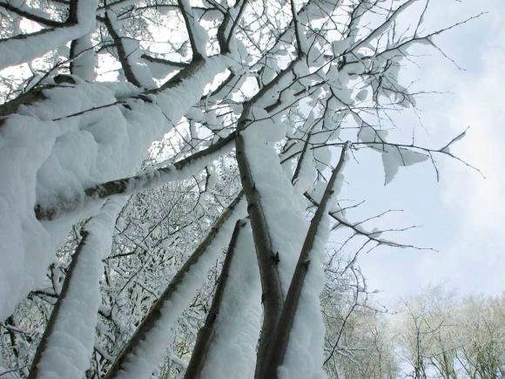
Future Goals
2 litters per sow/yr.
All heritage breeds
Buy Berkshire or Tamworth boar
Build better fence … into the woods…
Forage peas & radishes next yr.
Market more
Consistently feed nonGMO corn …grinding our own
Notes:
I think being at our farm one more year will make a lot of difference..we did a lot this summer. I have plans for a better chute and handling system, a better marking system with ear tags…our clients don’t like notching, I think I may have access to a Berkshire boar to buy which will give me better access to more effective use of my sows. We bought a tractor so could grind our own grain..we watch auctions…

Slide 37
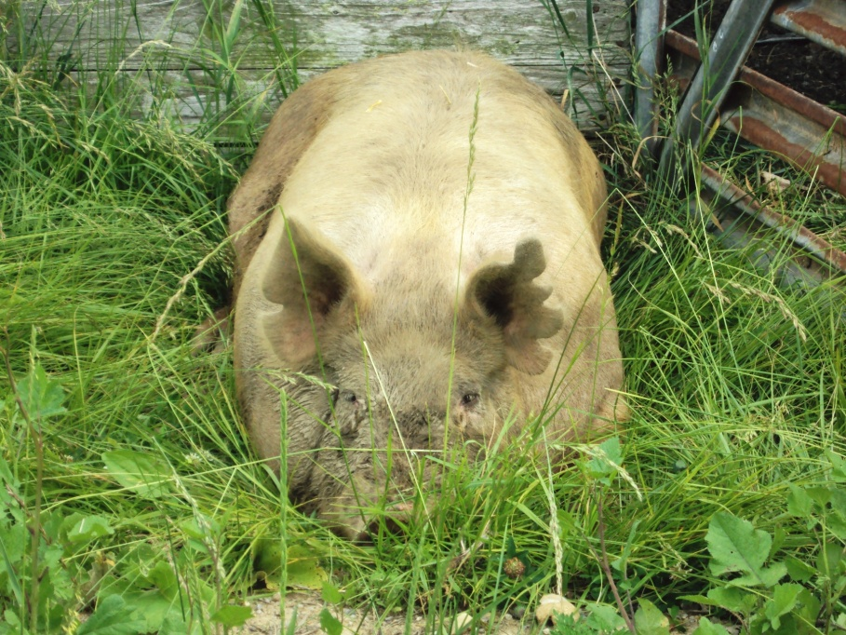
Interesting Hog Facts:
Source of 40 drugs, heart valves, skin for grafting, brain cells & insulin
Ethanol raised corn prices ….. alternative ways to feed hogs economically sought
Pork’s 3 Eras: lard, meat & bacon, lean white meat …

Slide 38
Interesting Hog History:
Christopher Columbus brought 8 hogs- 1493
Herando de Soto brought 13 hogs to Tampa Bay, Florida - 1539. 3 yrs. Later there were 700
Sir Walter Raleigh brought sows to Jamestown.
Wall Street named from the wall colonists used to keep free range hogs out of the grain fields on Manhattan.

Slide 39
Jerusalem Artichokes as forage for hogs…. Thanks for funding me!
Notes:
I really thank you for funding me and helping me learn about this idea.

