Slide 1
The Impact of a 21 Day Rotational Grazing Cycle on the Species Composition of a Square Foot Plot
Benjamin “Graham” Rider
Thistle Byre Farm
www.thistlebyrefarm.com
2009 SARE Youth Grant

Slide 3
What’s the Fuss?
Why Graze?

Slide 4
Why is grass fed better?
Environmentally Friendly
Healthy, Natural Habitat for Animals
Higher Conjugated Linoleic Acid or CLA Levels and Better Omega Fatty Acid Ratios for Consumers
Economical for the Farmer

Slide 5
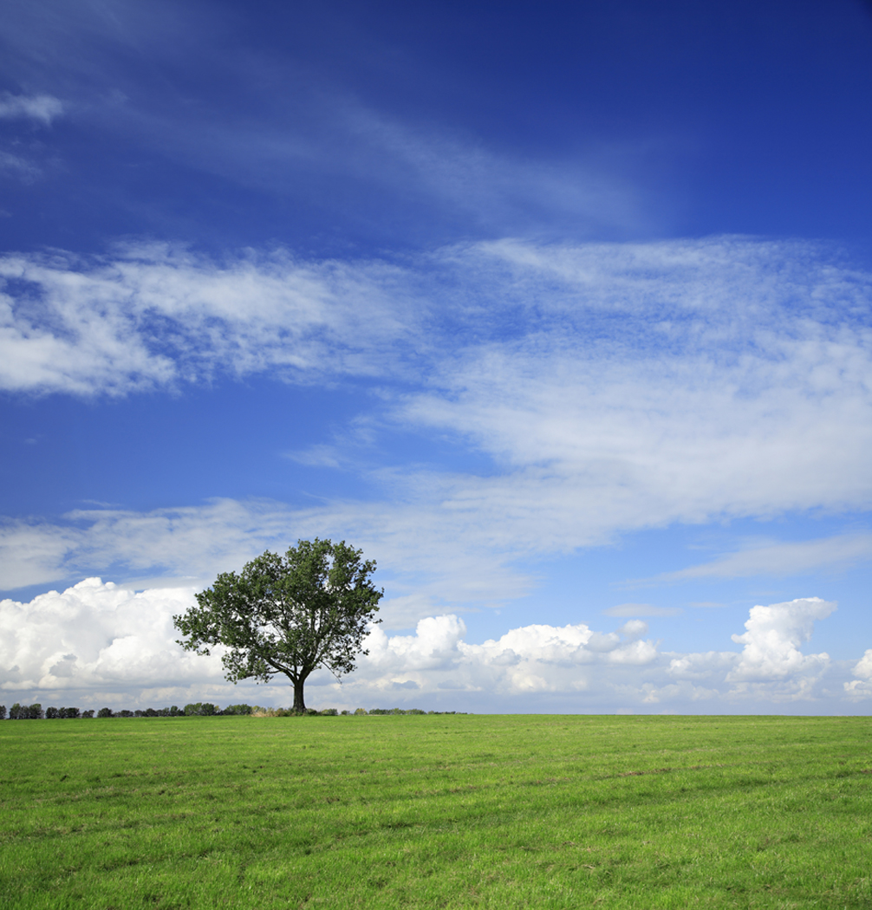
Goals
Read About Grazing
Obtain Grazing Resources
Attend ACRES Conference
Monitor 3 Plots’ Species Composition

Slide 6
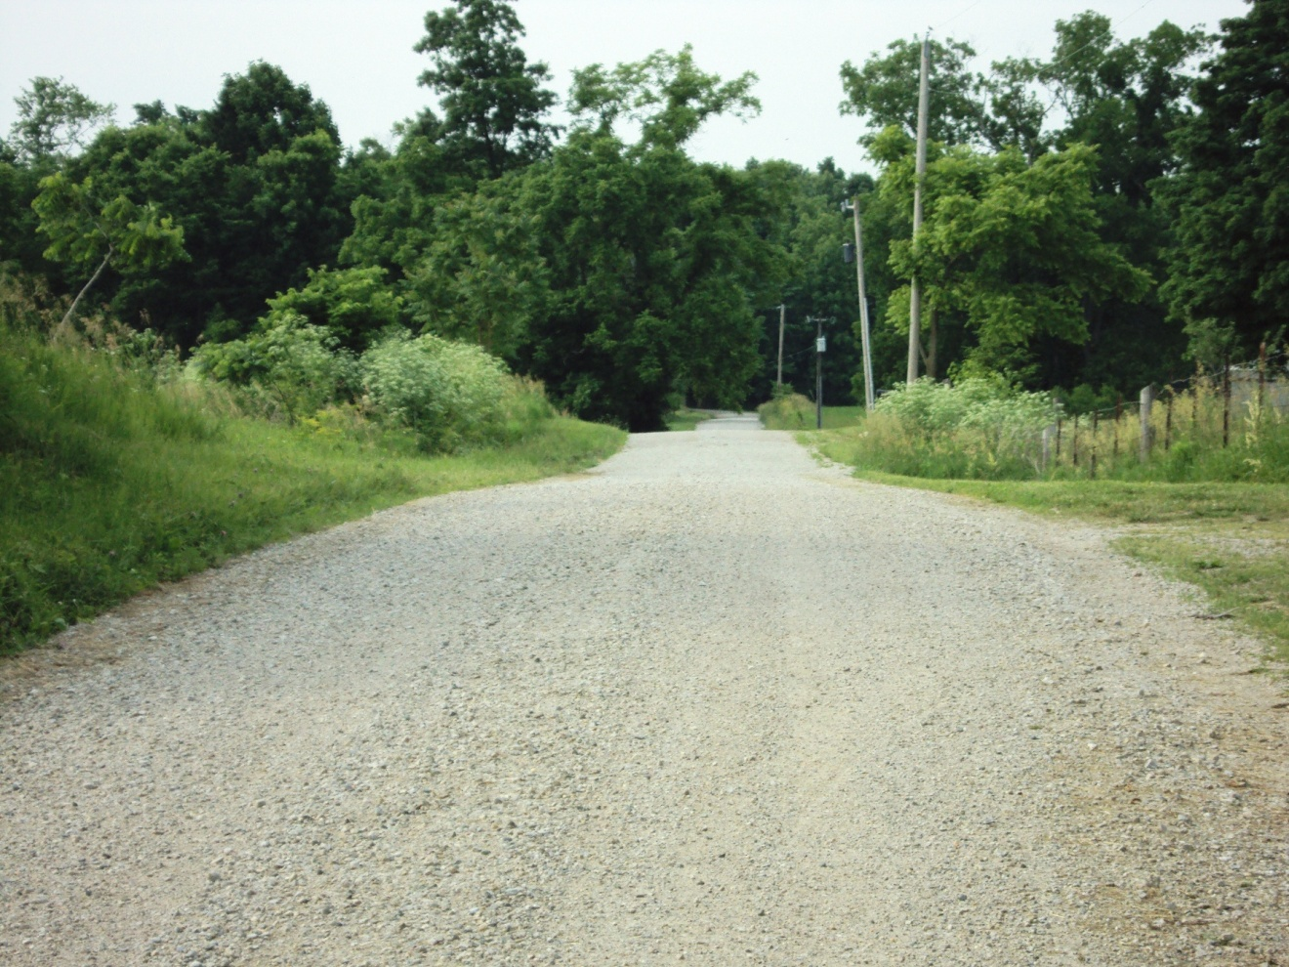
Background…
Thistle Byre Farm
Burnettsville, Indiana

Slide 7
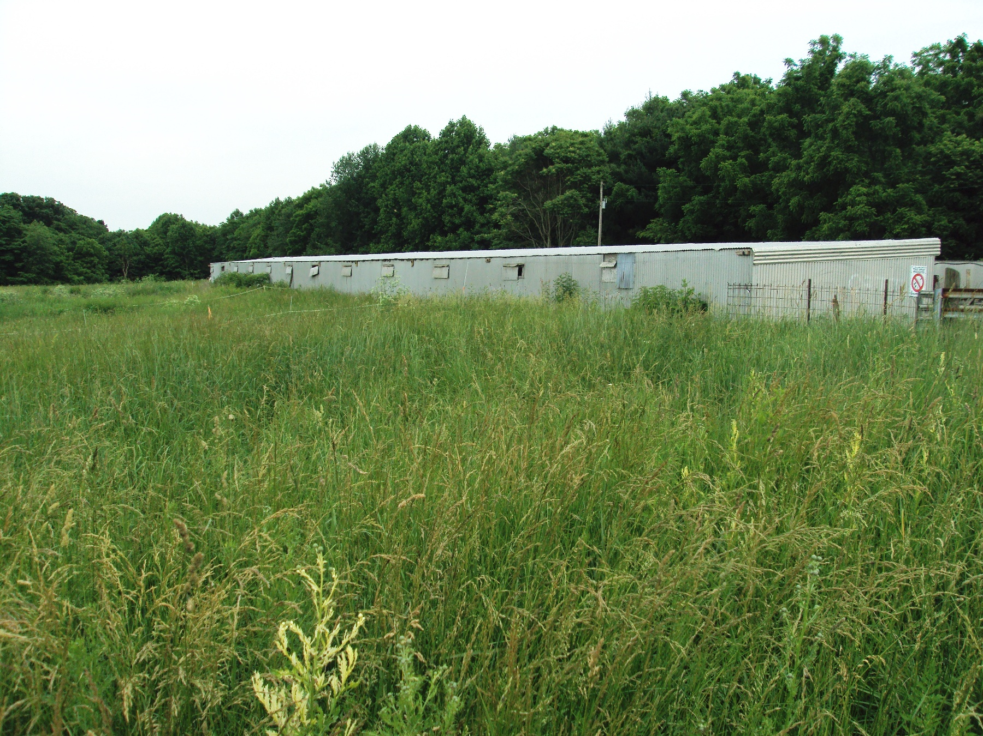

Slide 8
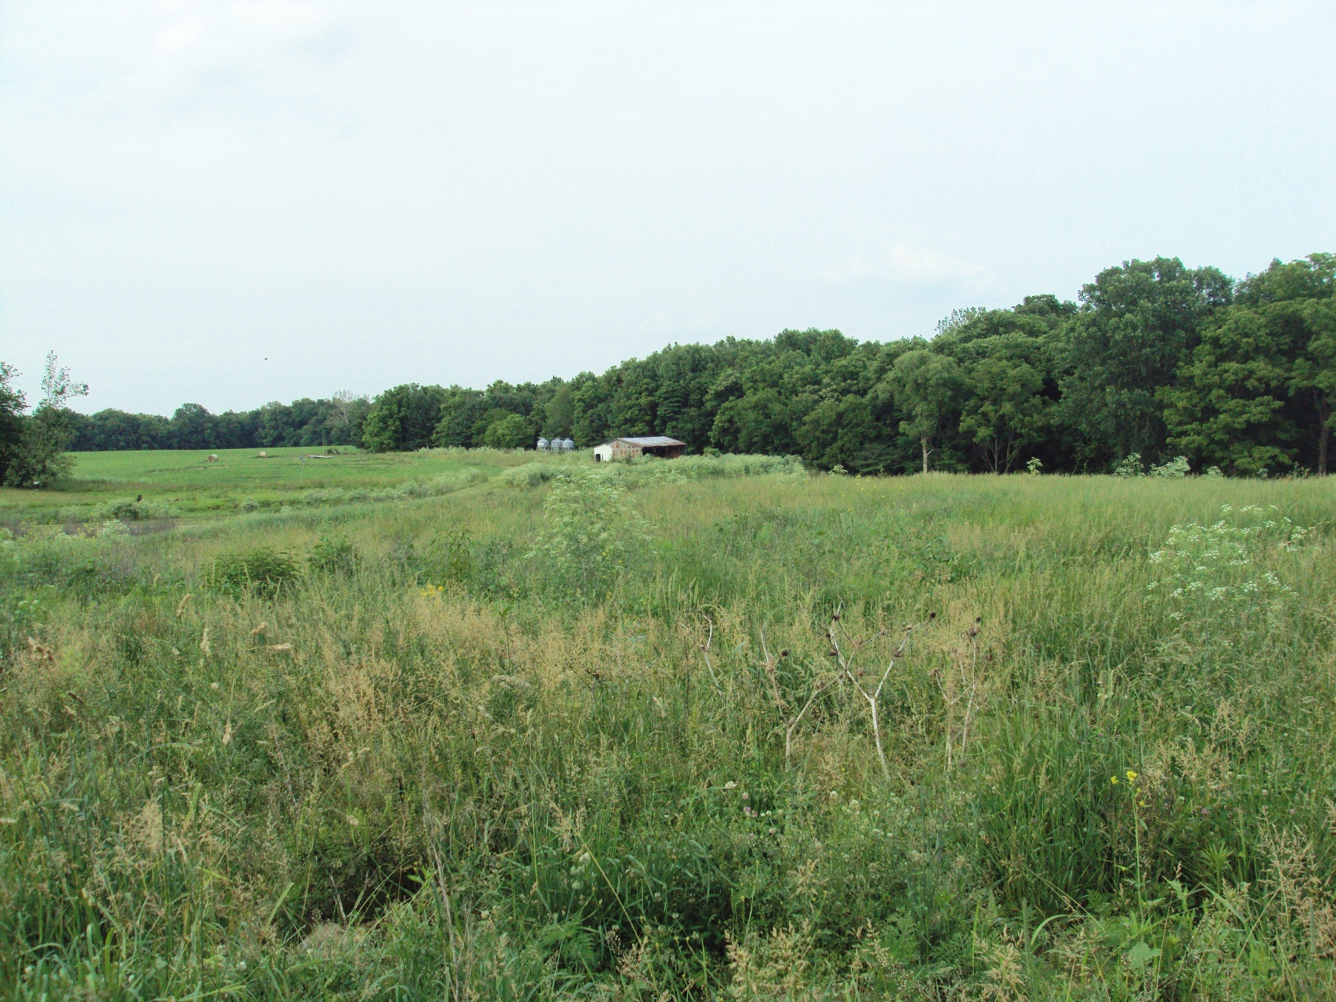

Slide 9
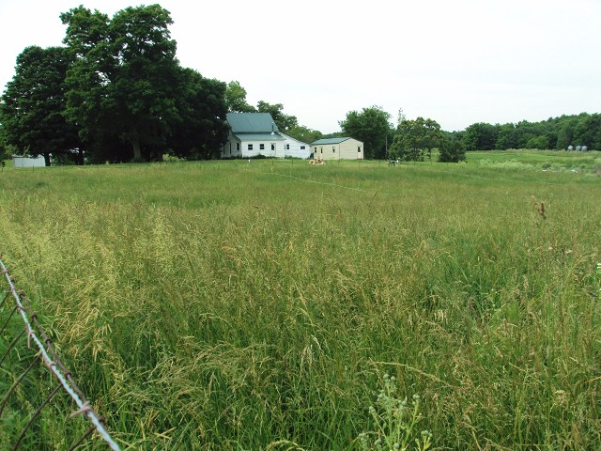

Slide 10
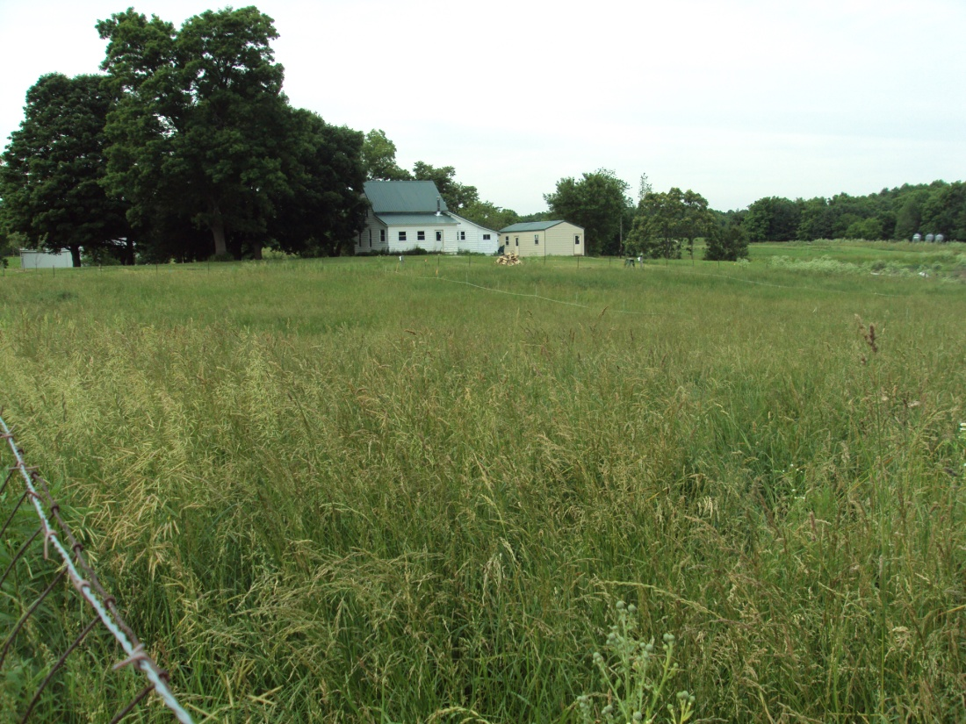
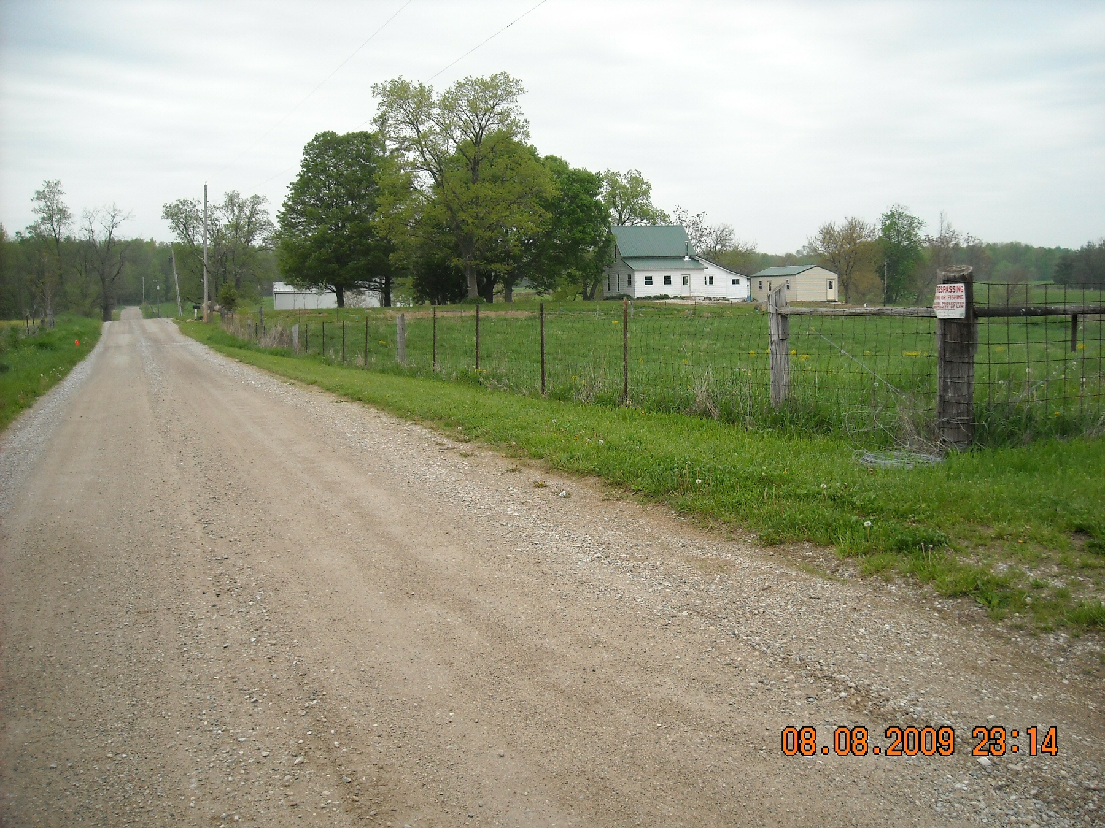

Slide 11
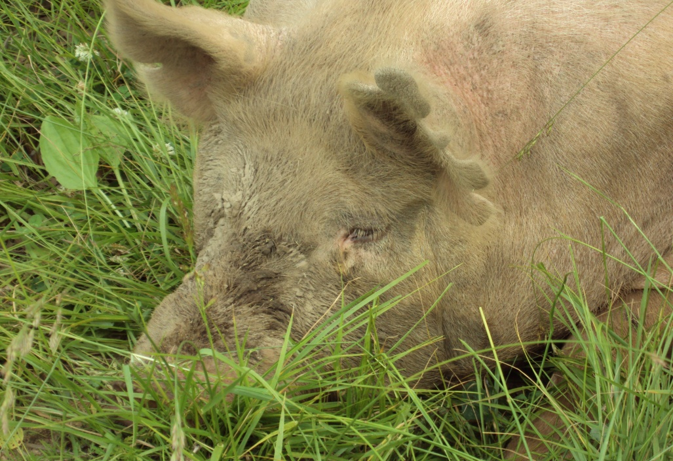
Thistle Byre Farm
Products:
CSA
Veggies
Herbs
Flowers
Pastured Beef, Lamb, Pork, and Poultry

Slide 12
Marketing
Farmer’s Market
CSA
Word of Mouth
Website
Farm Newsletter
Newspaper Ads

Slide 13
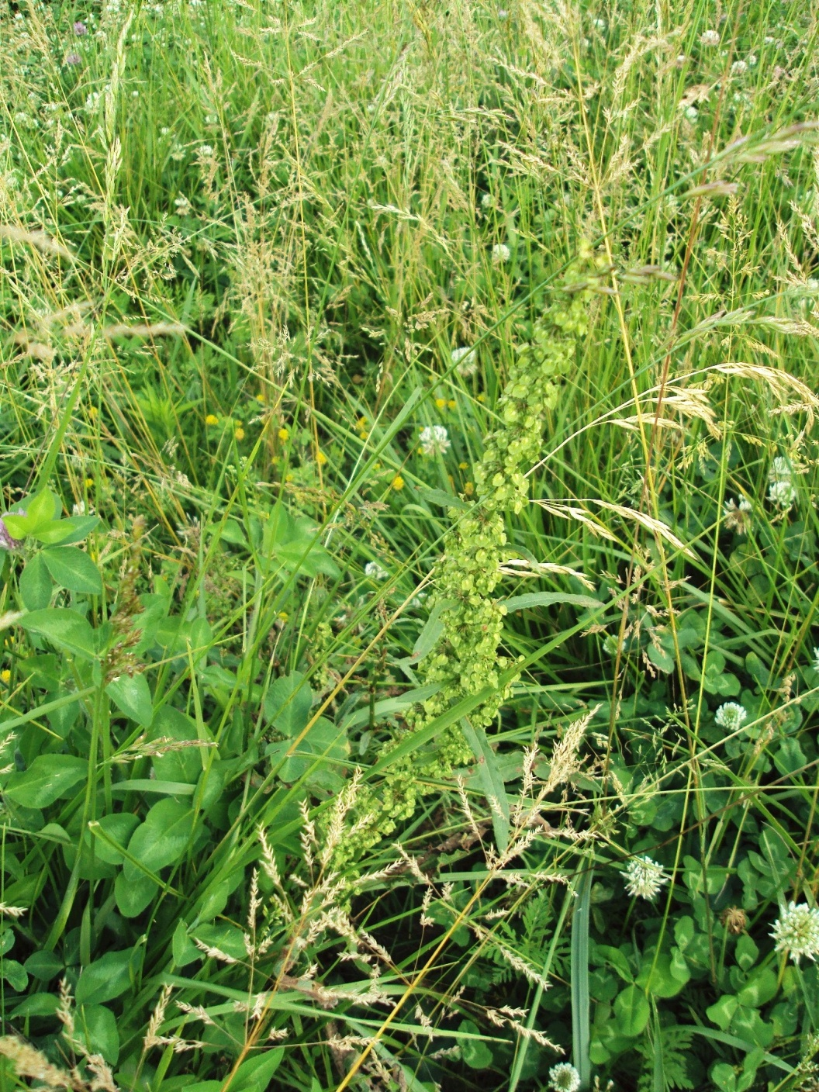
Good Pasture…
“…Cows need to graze at least 100 species a week…”
Dr. Paul Detloff, biological vet

Slide 14
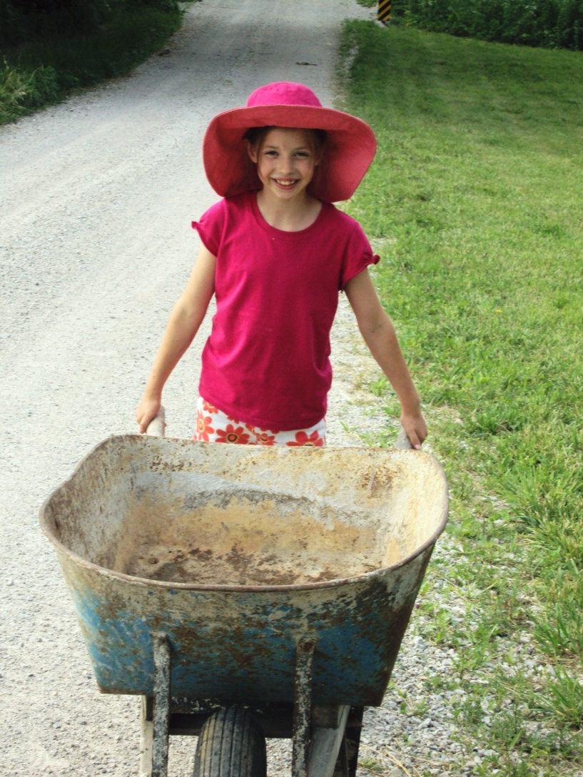
Rebuilding this old farm one building and pasture at a time…

Slide 15
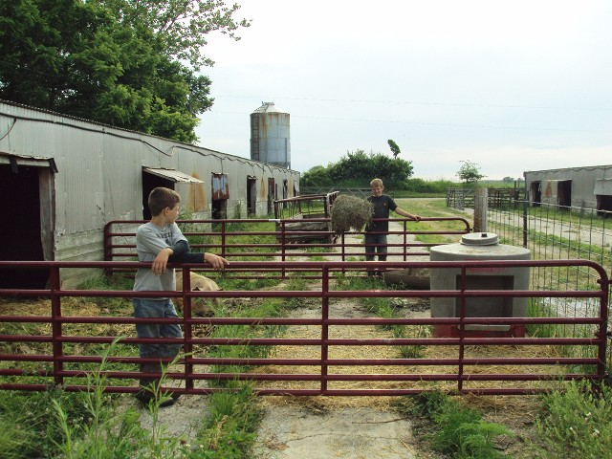

Slide 16
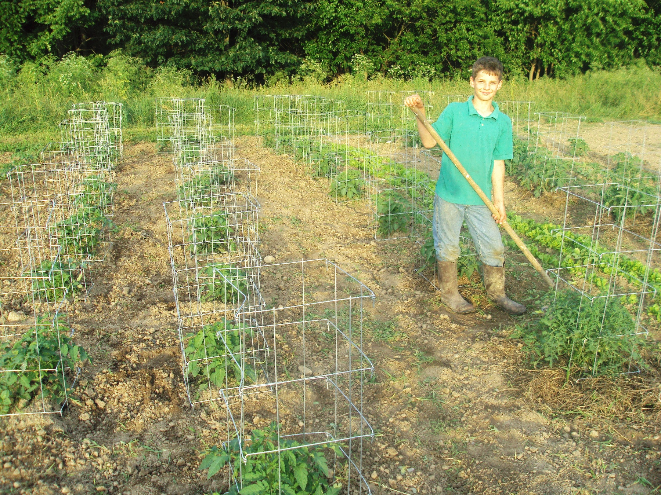

Slide 17
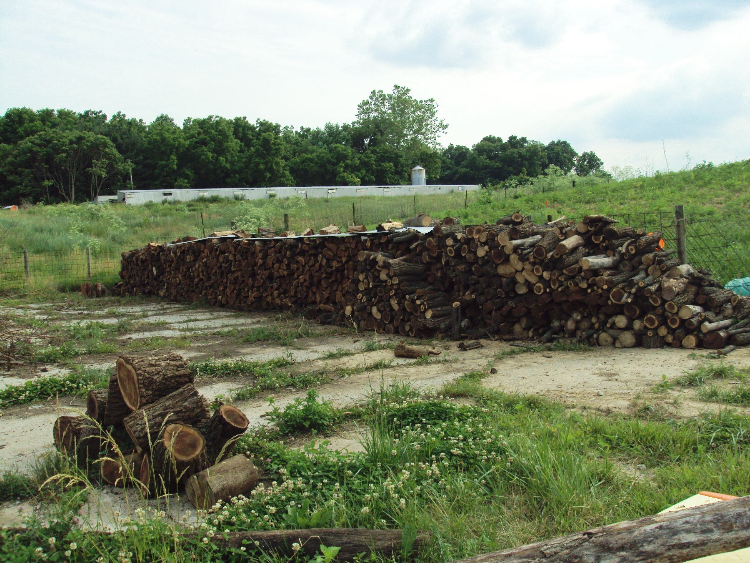

Slide 18
Vegetation in My Area:
Forbs
Legumes
Grasses

Slide 19
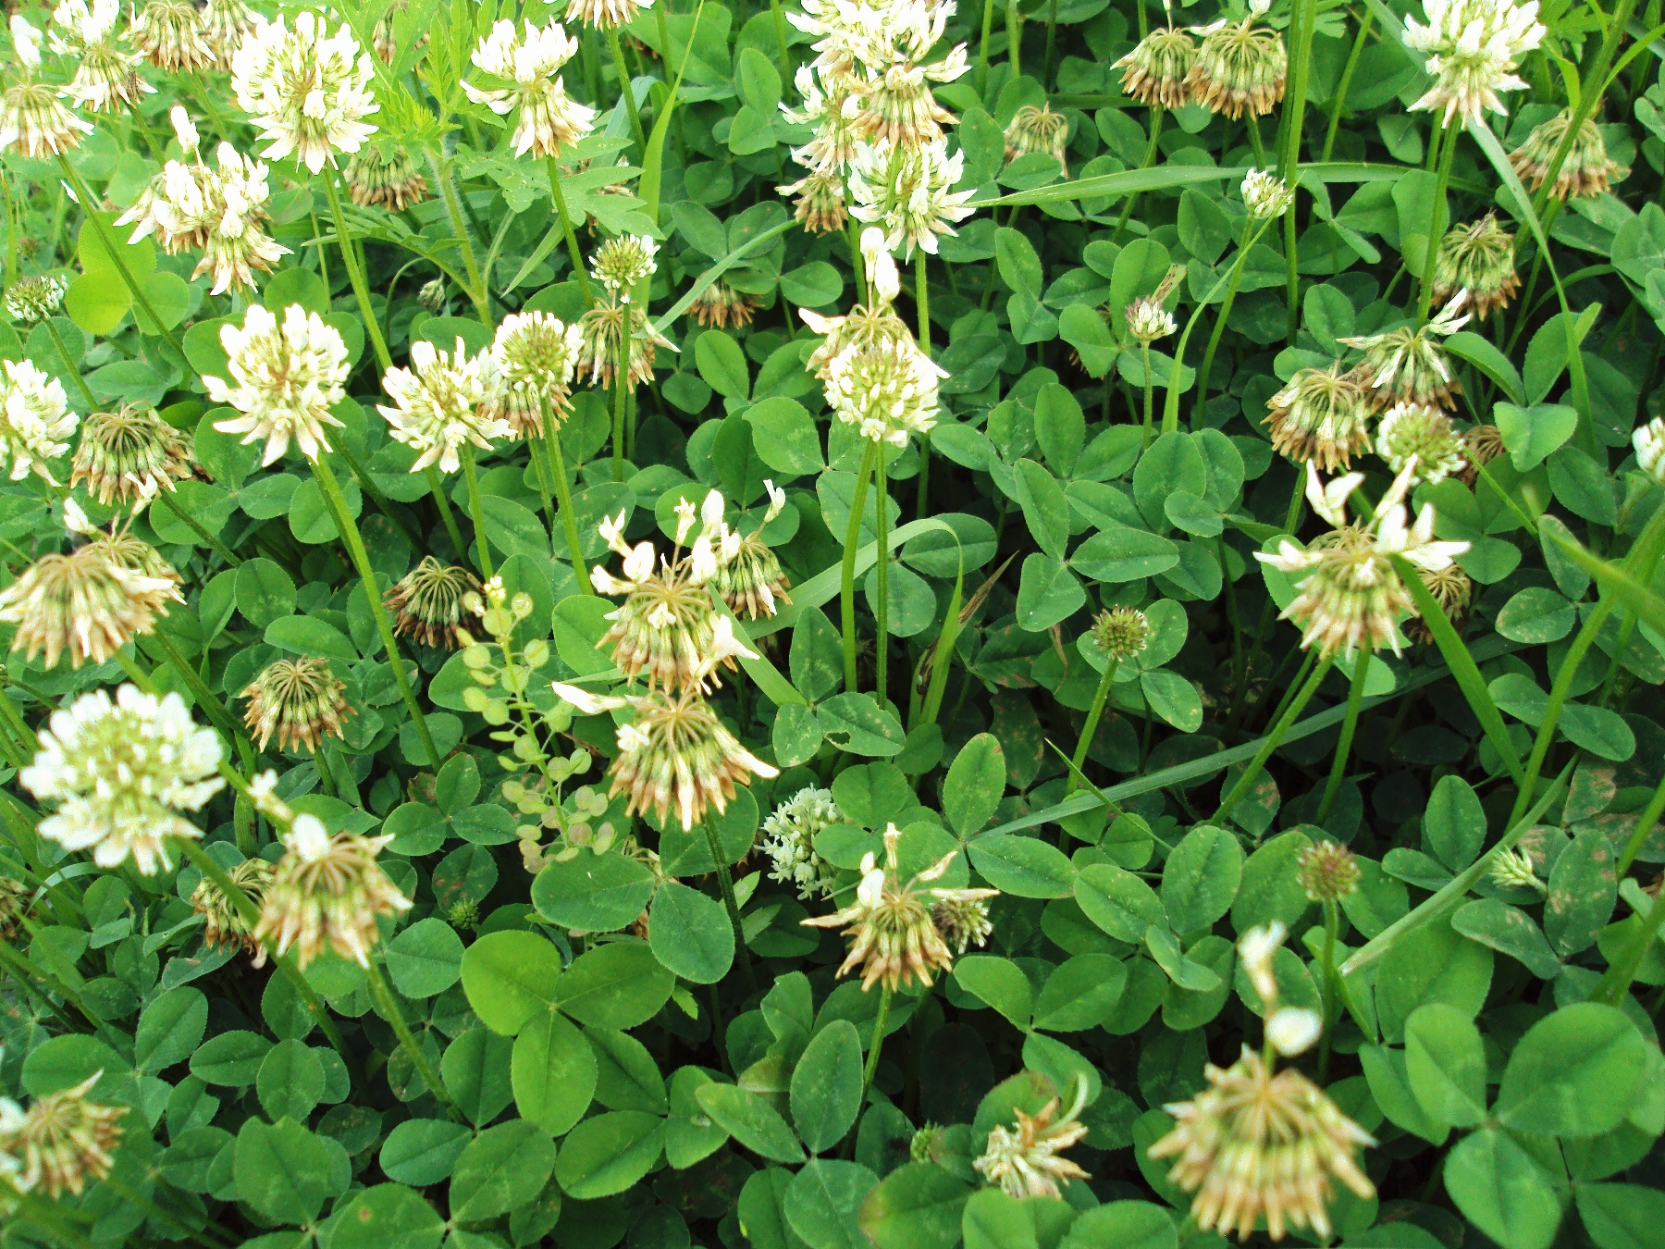
Notes:
Legume, white clover

Slide 20
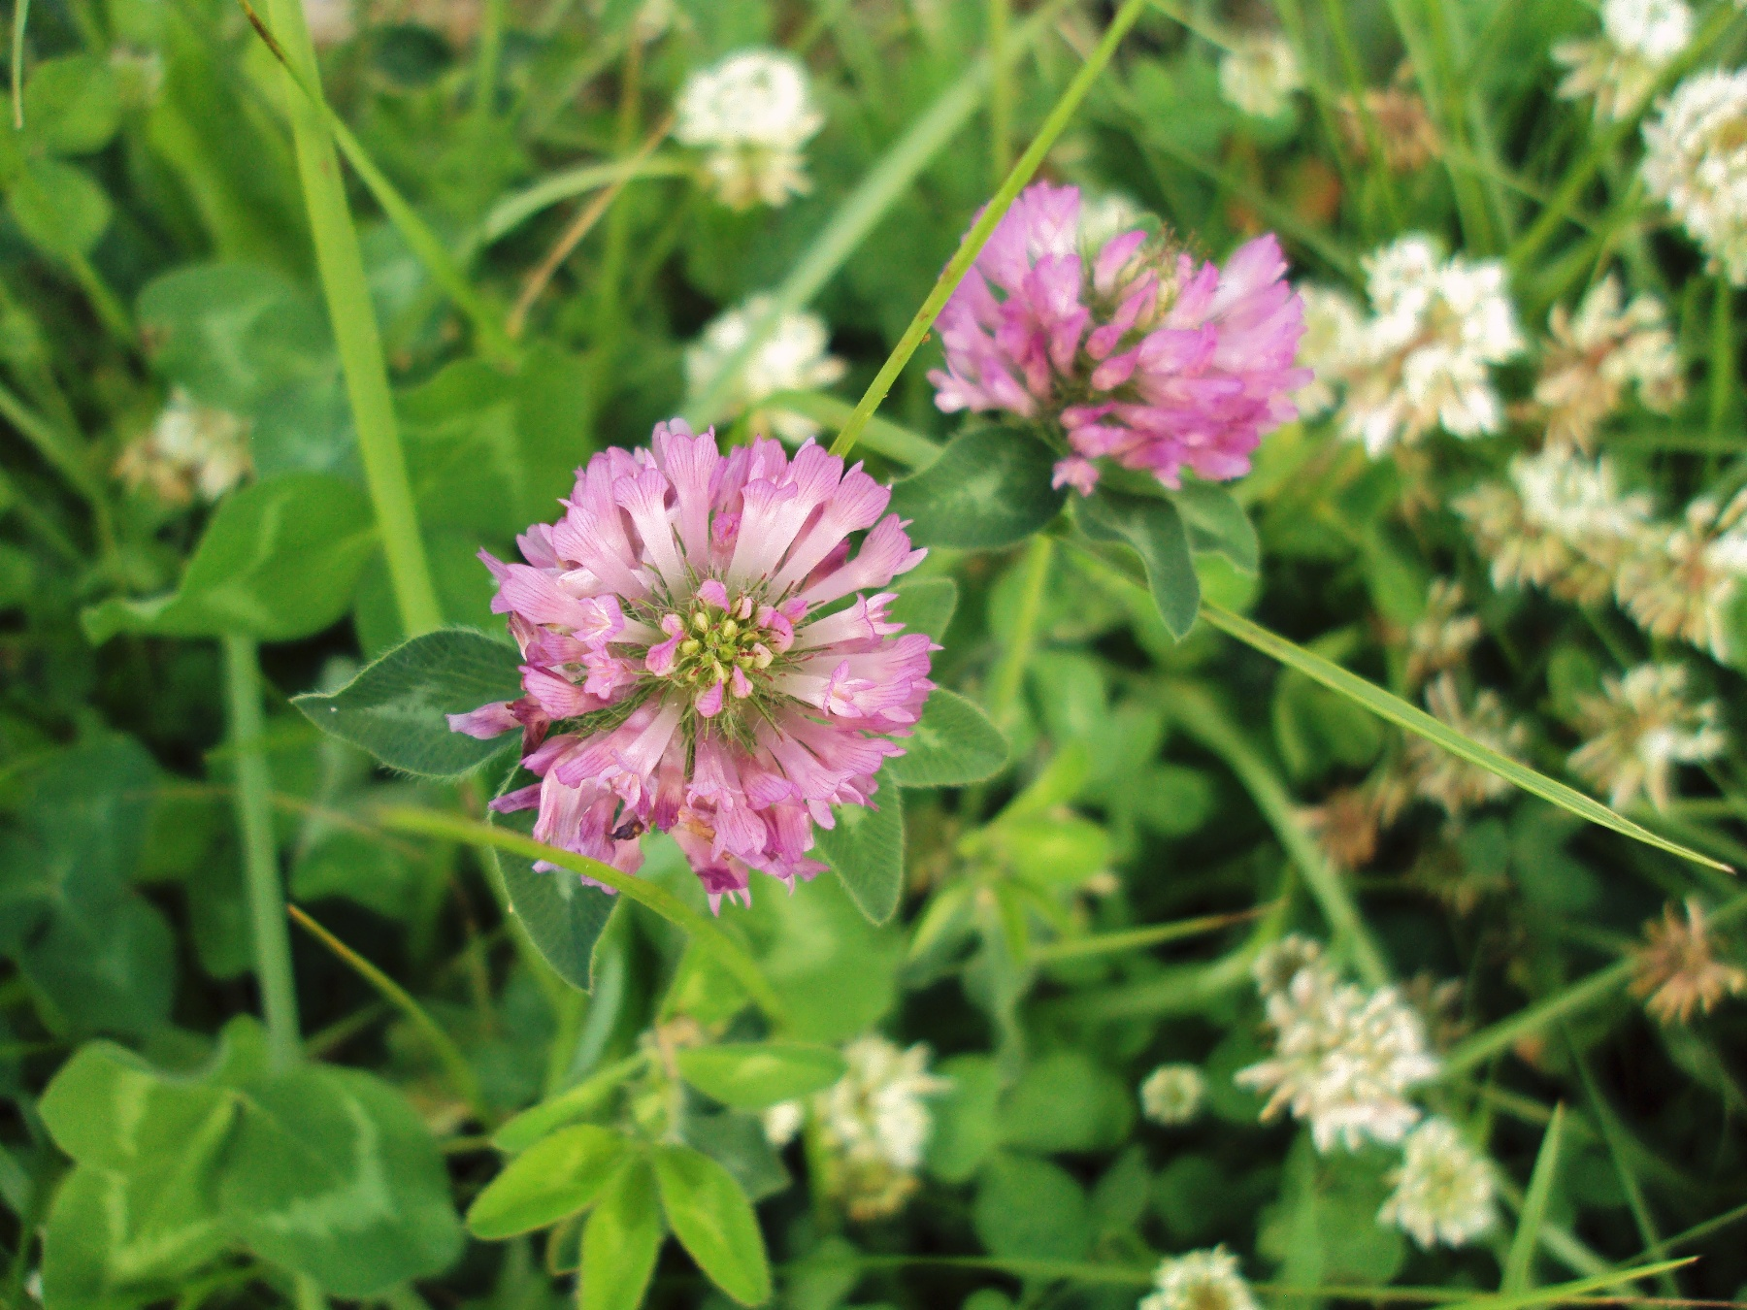
Notes:
Clover, Legume

Slide 21
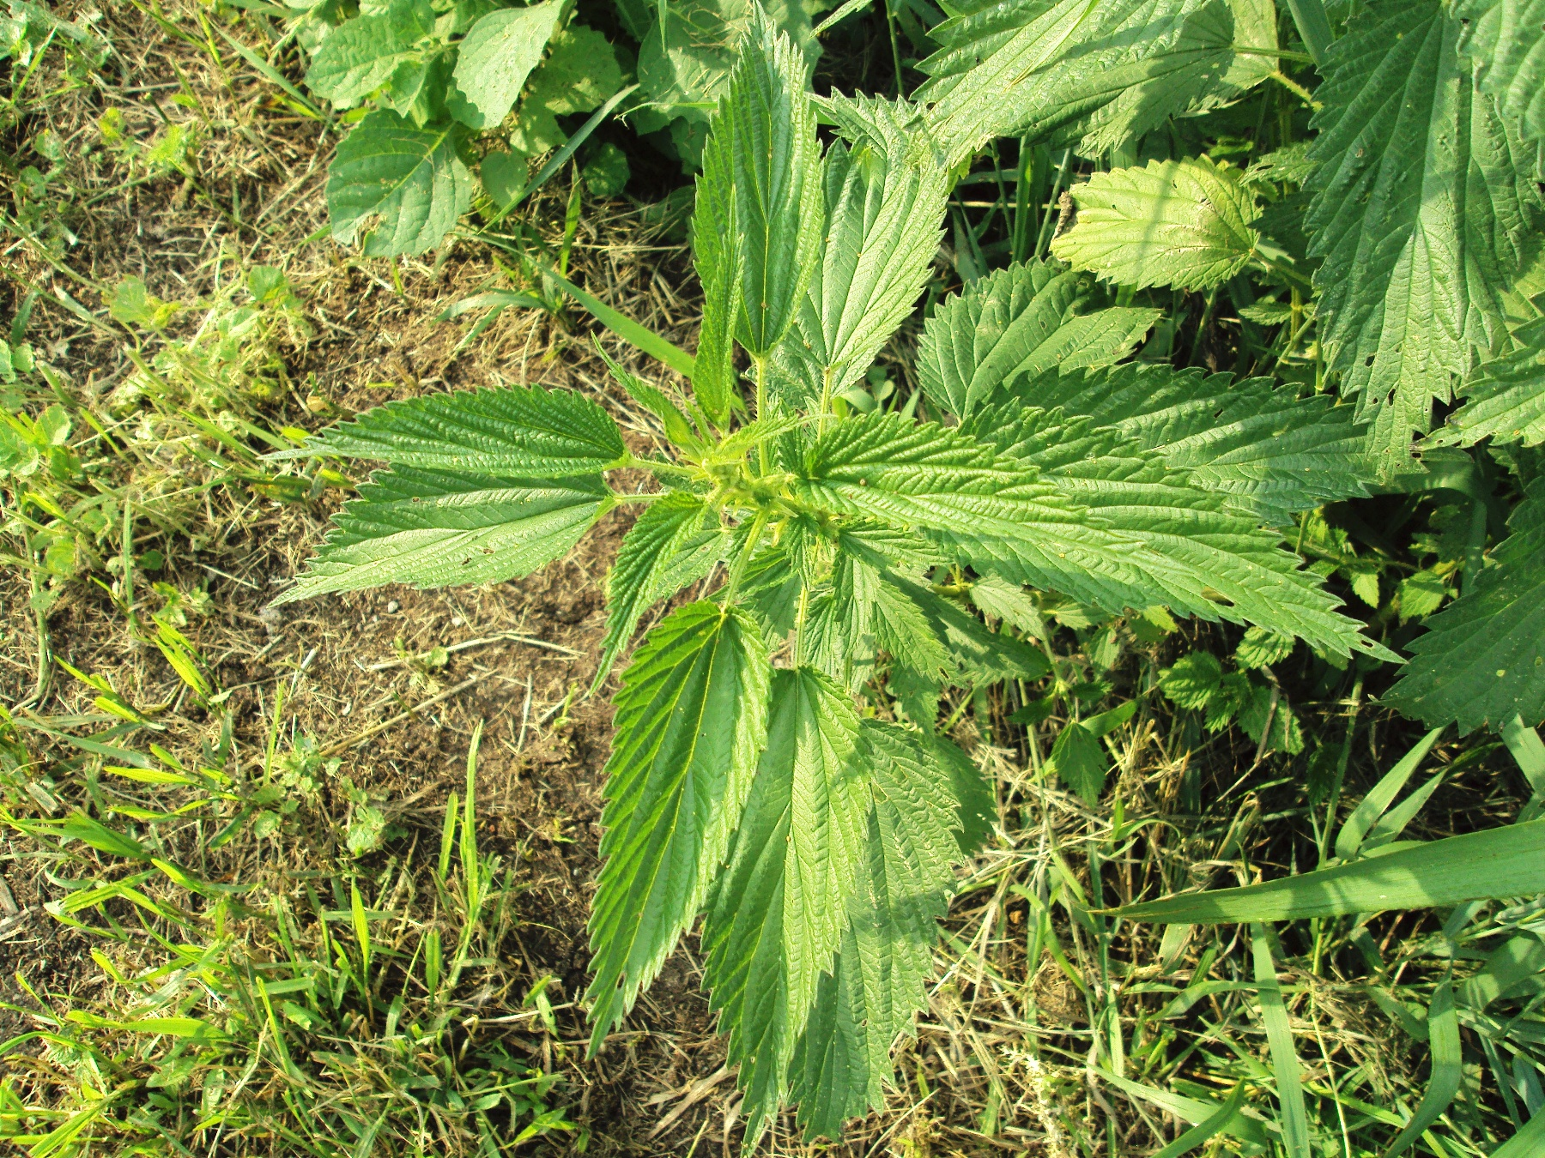
Notes:
Nettle, Forb

Slide 22
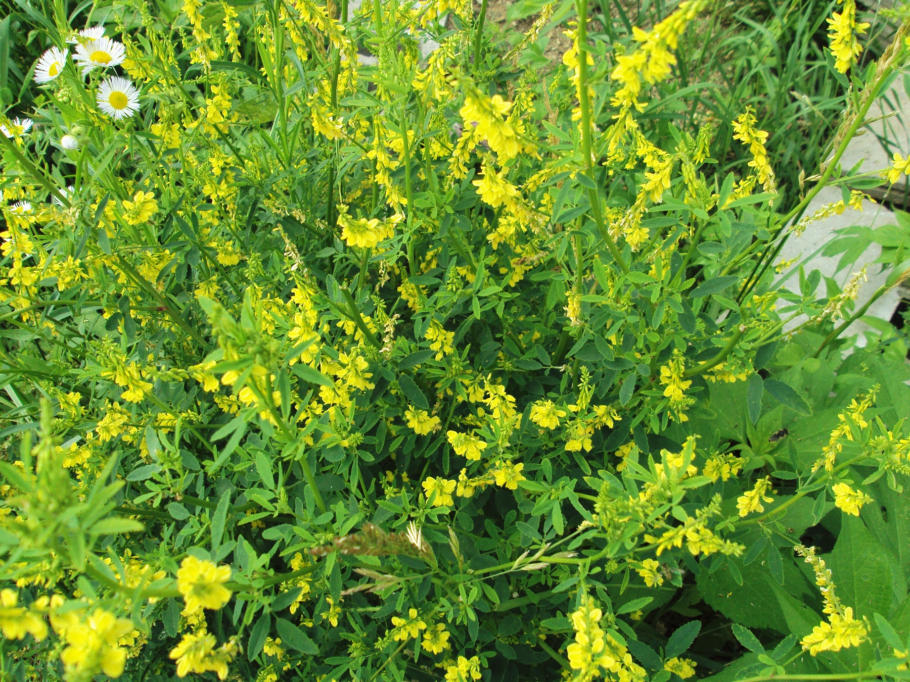
Notes:
Legume

Slide 23
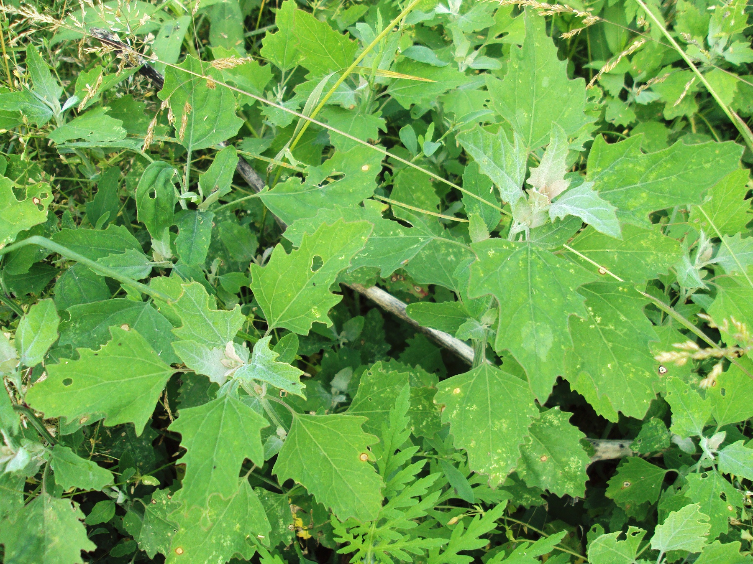
Notes:
Pig Weed, Forb

Slide 24
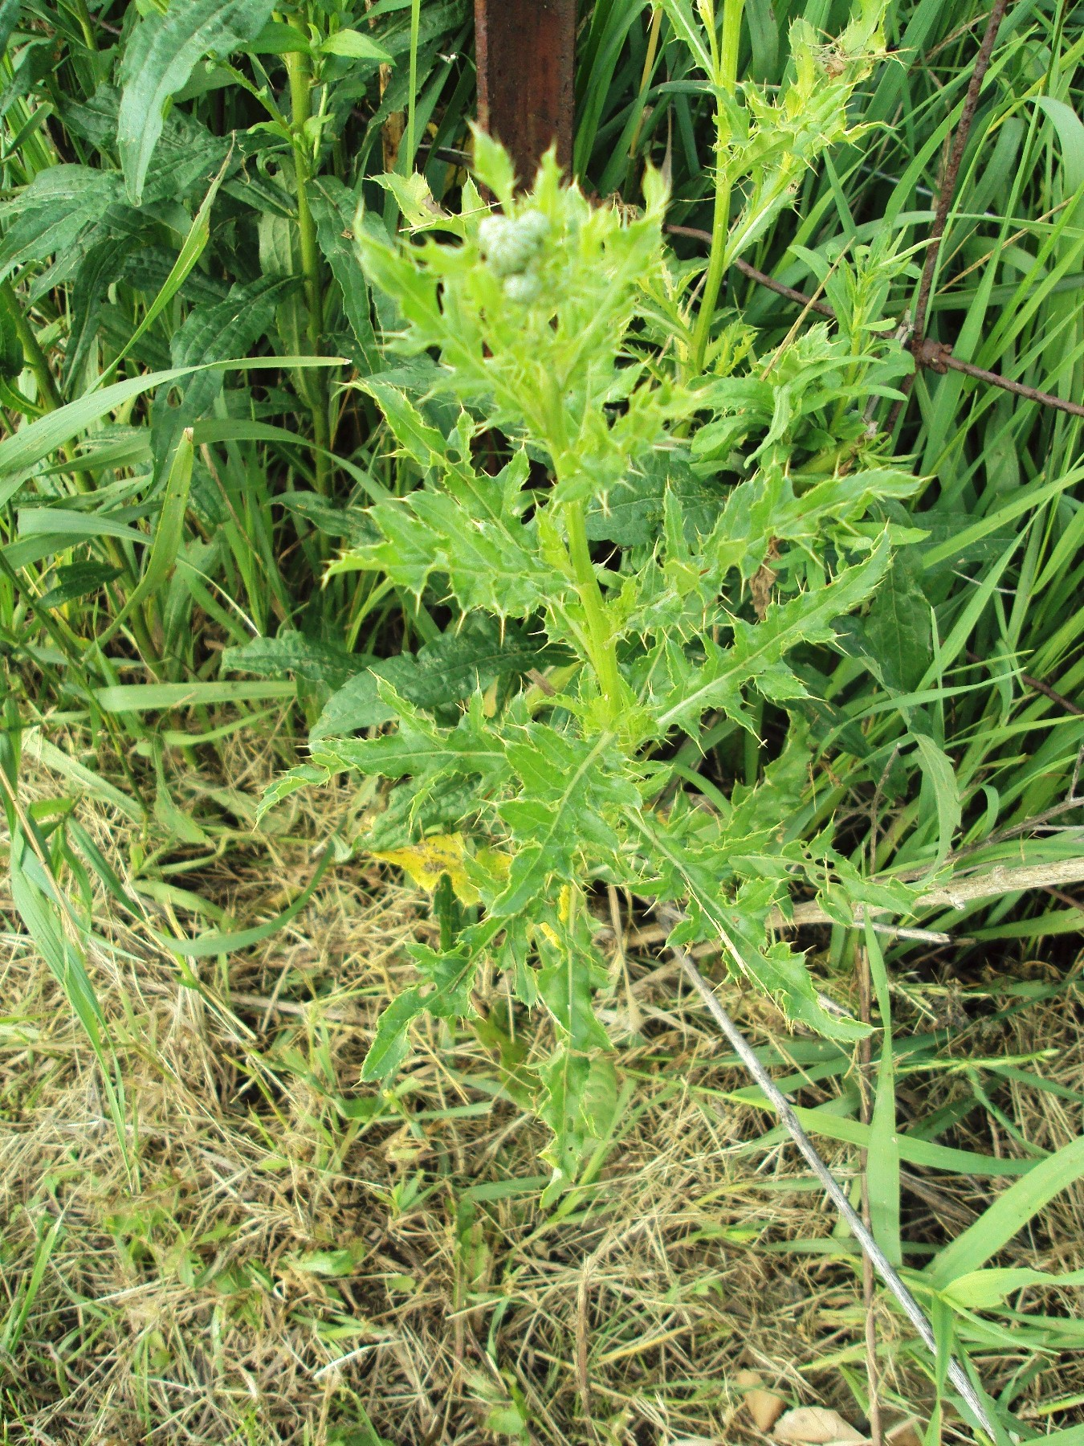
Notes:
Canadian Thistle, Forb

Slide 25
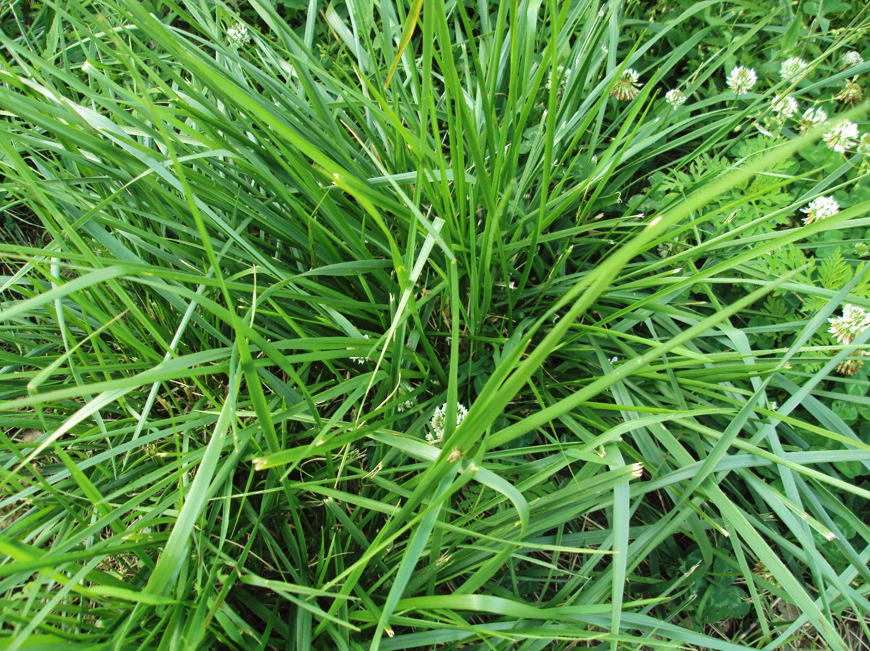
Notes:
Grass. Fescue

Slide 26
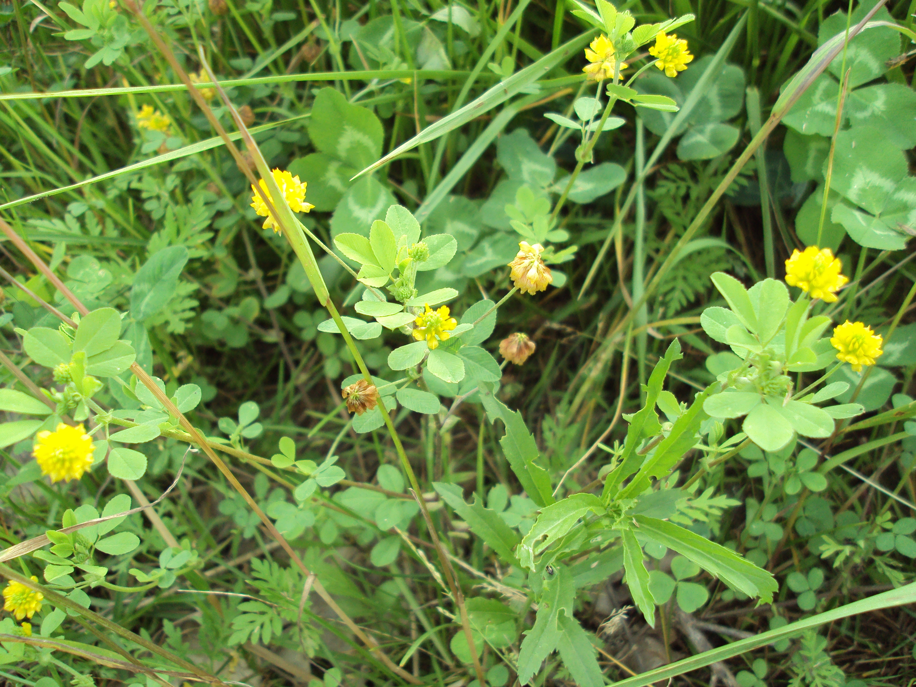
Notes:
Clover. legume

Slide 27

Notes:
Dandelion, Forb

Slide 28
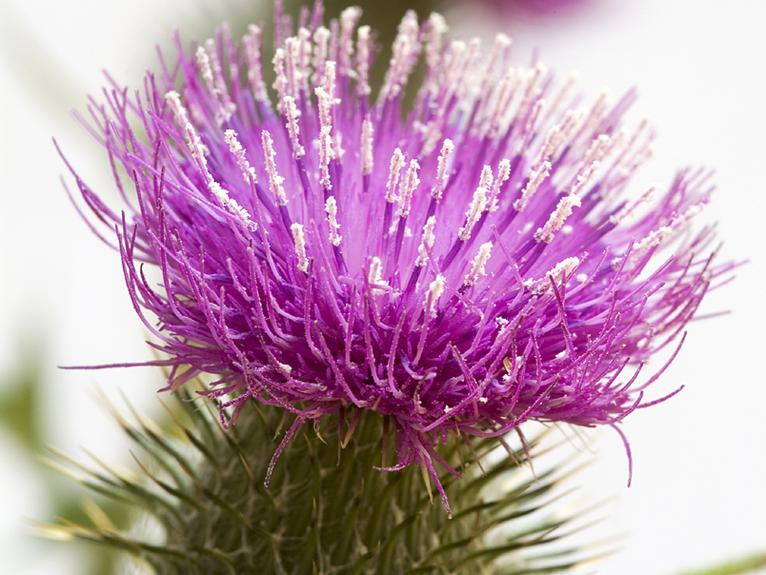
Canadian Thistle
Our farm’s namesake….

Slide 29
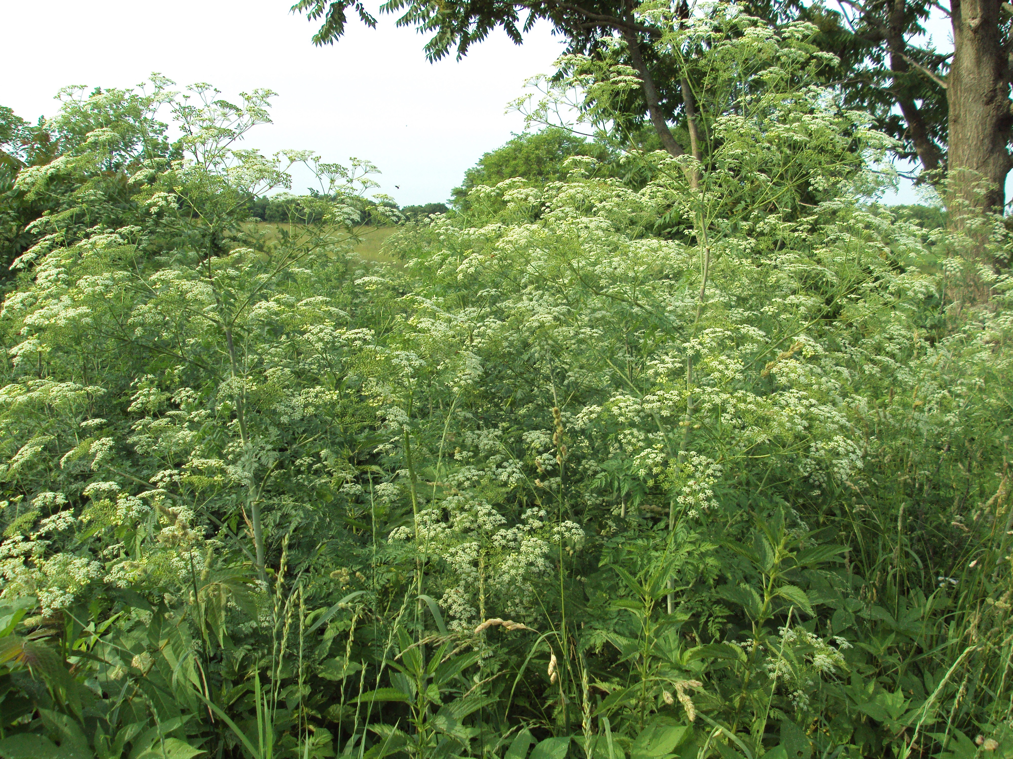
Notes:
Poison Hemlock

Slide 30
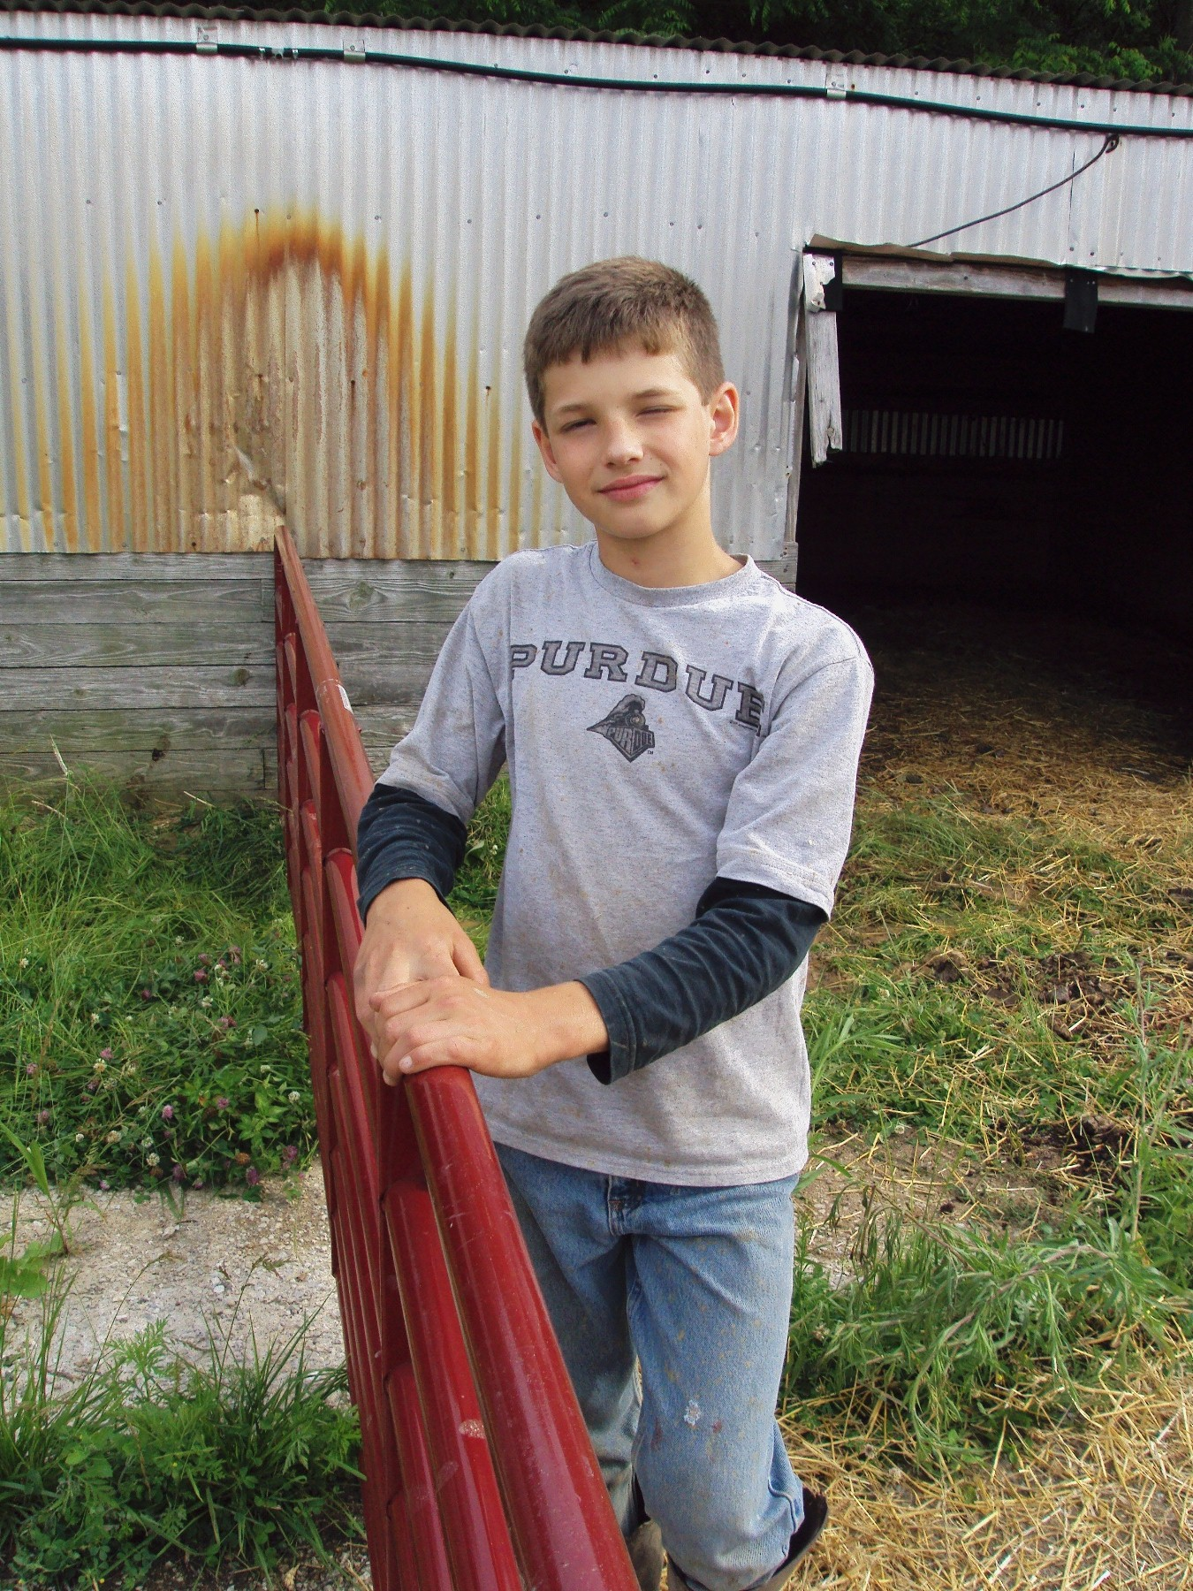
Notes:
Working at the farm

Slide 31
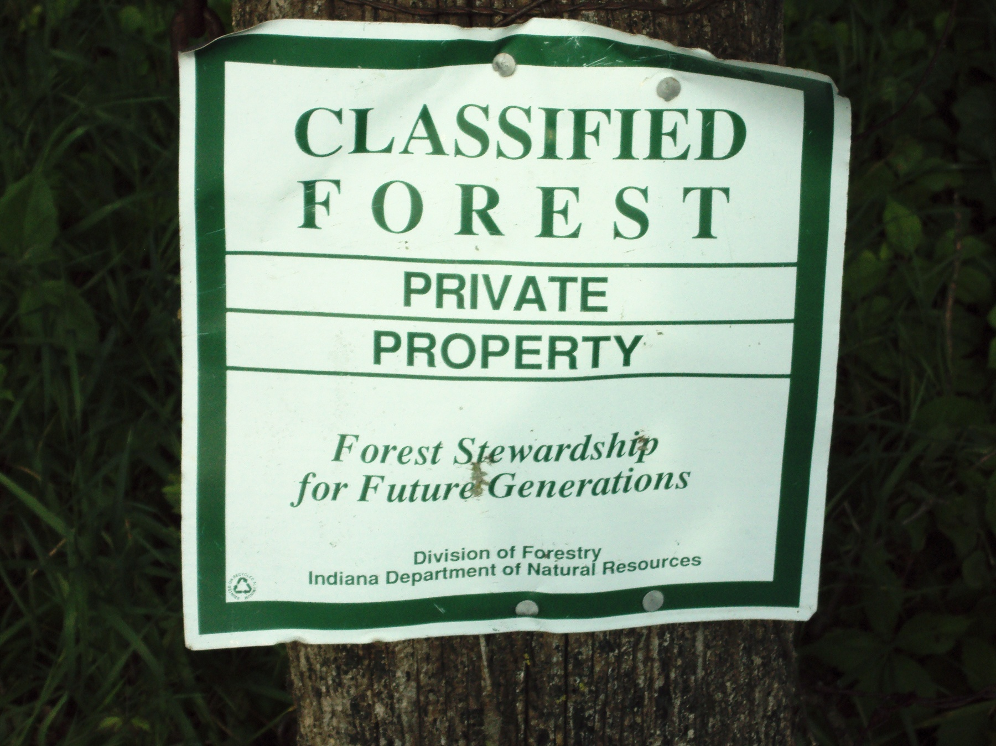
Notes:
We are surrounded on three sides by classified forest

Slide 32
People and Resources For My Project….
Salad Bar Beef…..Joel Salatin
Greener Pastures on Your Side of the Fence ….Bill Murphy
Management-Intensive Grazing…Jim Gerrish

Slide 33
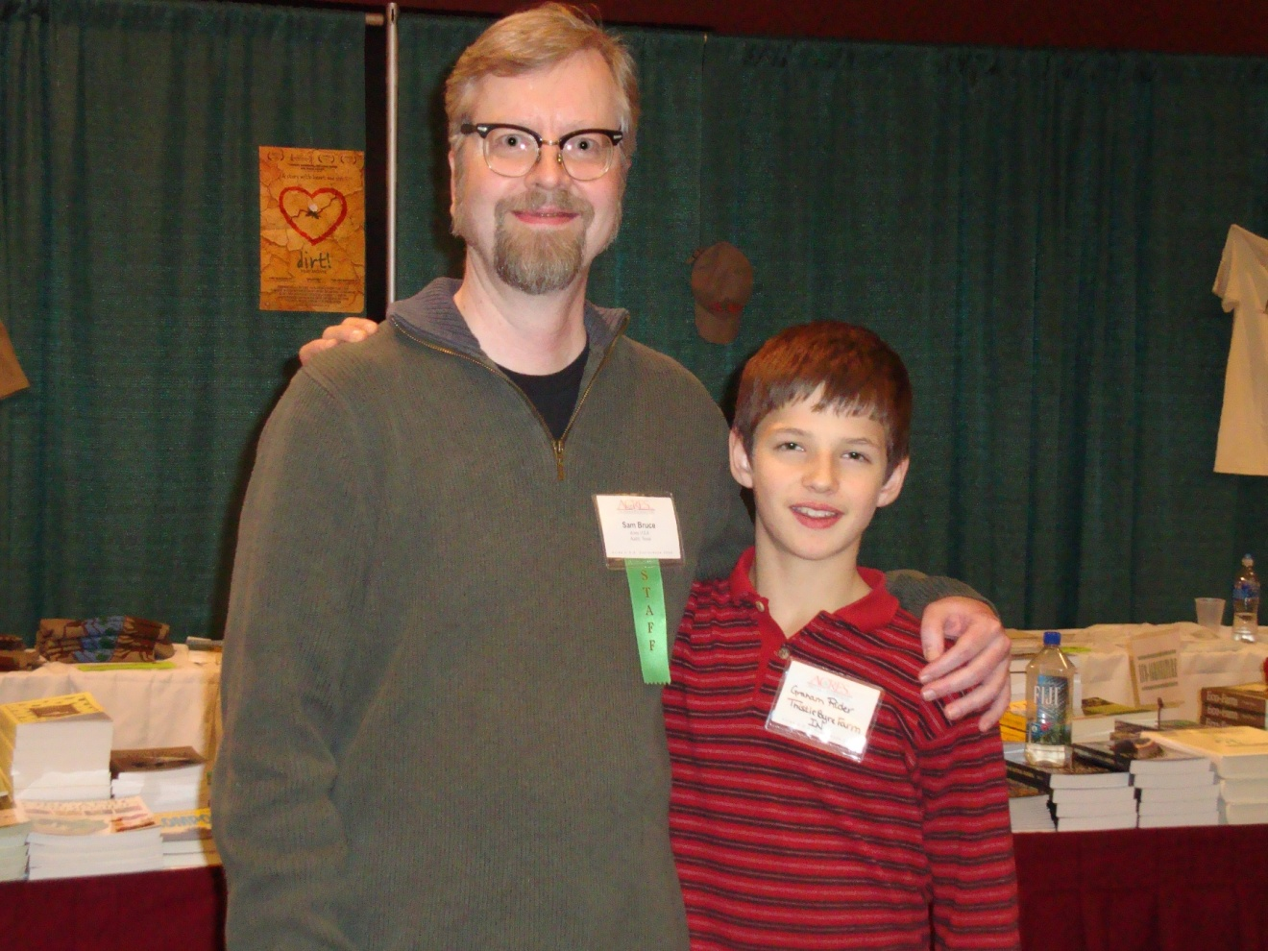
People-
Acres Managing Editor , Samuel Bruce, with me at the Conference
“To be economical, agriculture must be ecological”

Slide 34
Other Resources… Joel Salatin, Greg Judy and Dr. Paul Detloff, DVM

Slide 35
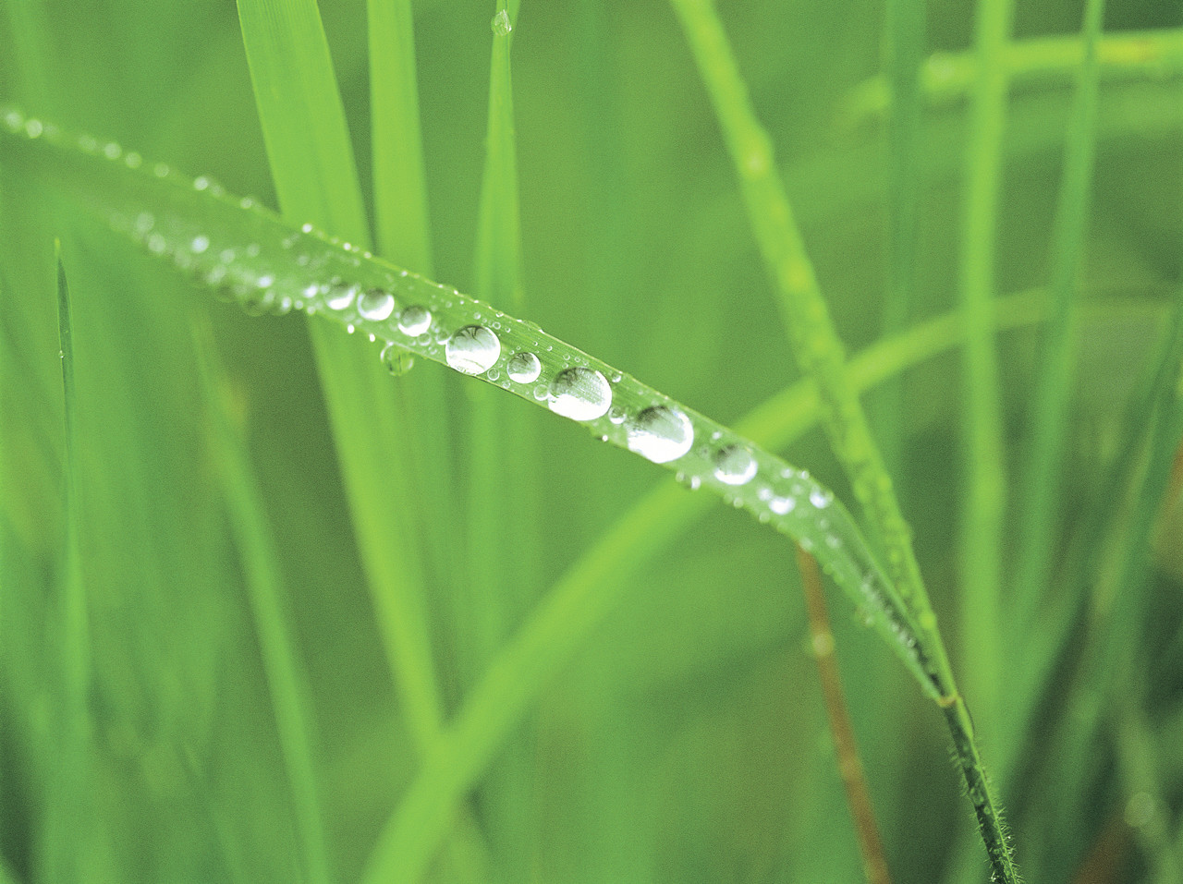
Results
Plot Changes:
Increase in Forbs as the Season Progressed
No Noticeable Change in Legume Levels
Grasses Stayed Strong with a Small Decline

Slide 36
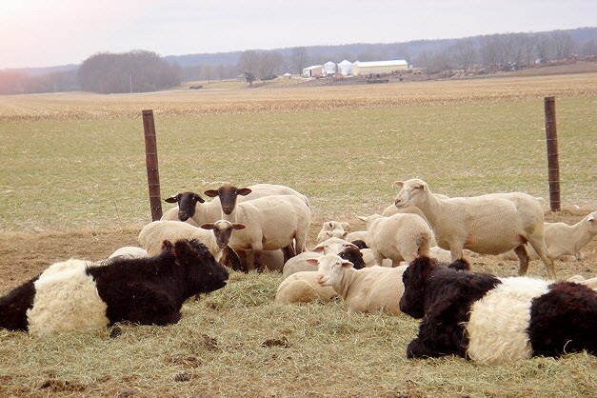
Discussion
Expectations-
Grasses - decrease
Forbs - increase
Overall Pasture Diversity - increase

Slide 37
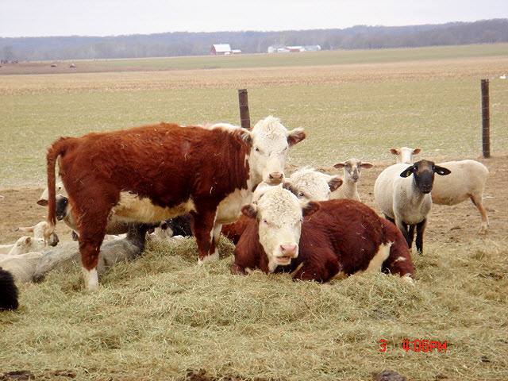
Confounding Variables….
Challenges:
Fences Not Always Respected by My Cows
Andrew’s Hogs Rooted Up One of My Plots

Slide 38
Future Goals:
Buy 5 More Brood Cows
Read More About Grazing
Build Better Fences
Stockpile Hay to Extend Grazing
Overseed Legumes and Herbal Pasture Mix
Renovate EQIP Acreage

Slide 39
Project Impact
Farm Website
Farm Newsletter
CSA Picnic
Farmer’s Market
Local Health Food Store

Slide 40
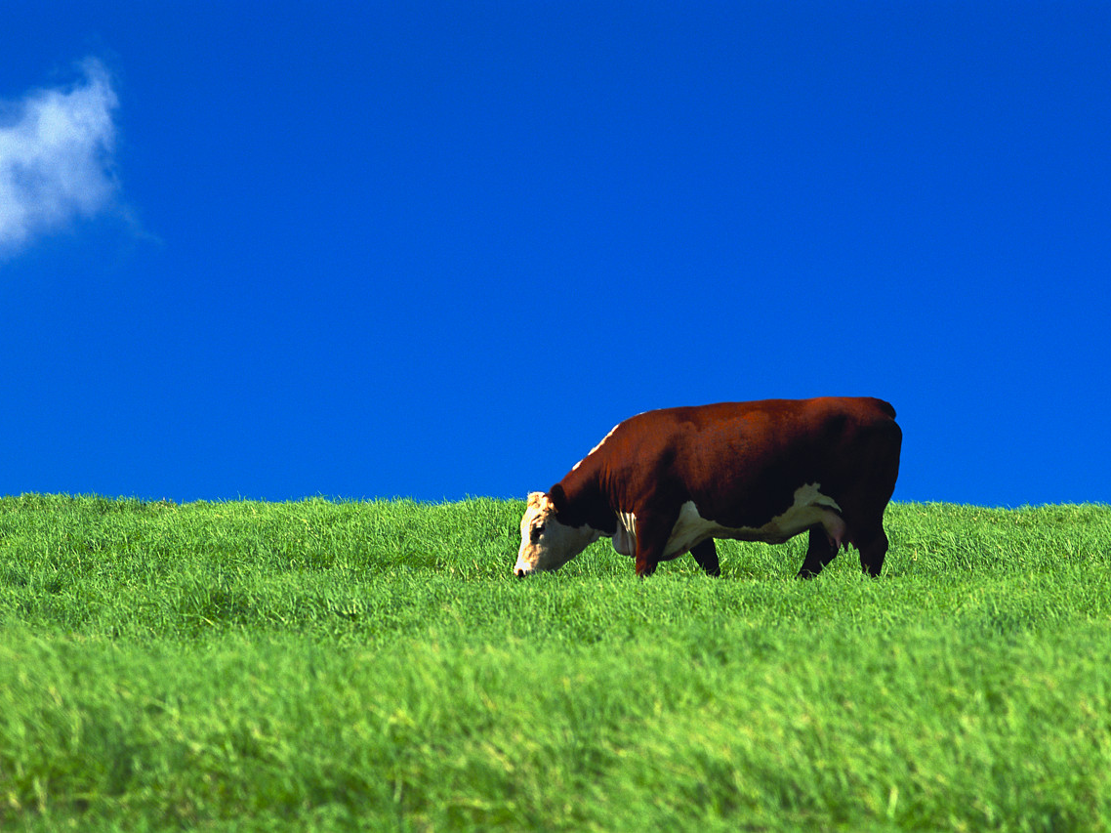
“All flesh is grass…..”
100% grass fed

Slide 41
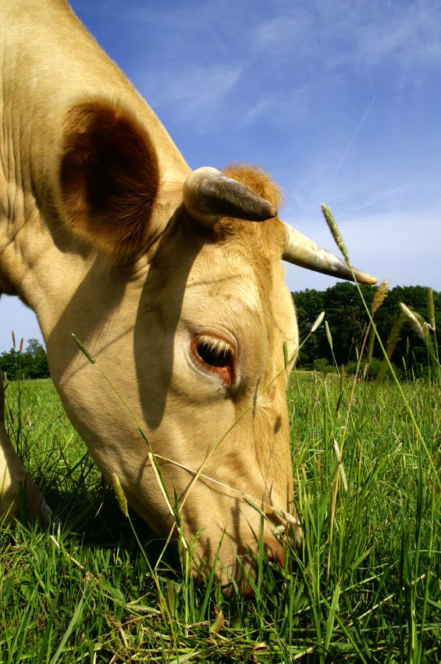
2009 SARE Youth Grant
Thank you for funding me!

