Slide 1
The ‘Black Pearl’ Pepper banker plant for Biological Control of Thrips in Commercial Greenhouses
Sarah Wong, Steve Frank
North Carolina State University
Notes:
Today I’ll be talking about the Black Pearl Pepper Banker Plant for Biological Control of Thrips in Commerical Greenhouses

Slide 2
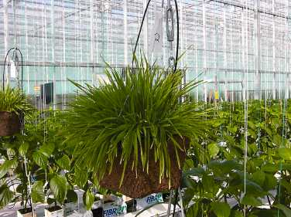
Banker Plant
A plant that directly or indirectly provides resources, such as food, prey, or hosts, to natural enemies that are deliberately released within a cropping system
Frank, S. D. (2010) Biological Control 52 8-16
http://www.omafra.gov.on.ca/english/crops/facts/06-081.htm
Notes:
To answer these problems, we’re looking at new ways to improve current Biological Control methods.
One of these ways is to use a “banker plant system”
What is a banker plant?
READ FROM SLIDE
This means they provide alternative hosts for parasitoids and pollen for omnivorous predators.
The plant shown in this picture is used in what is currently the most popular banker plant system which is using [INSERT PLANTS] which have been infested with parasitized bird-cherry-oat aphids to control pest aphids in greenhouses
MAYBE THERE IS BETTER WORDING FOR THIS

Slide 3
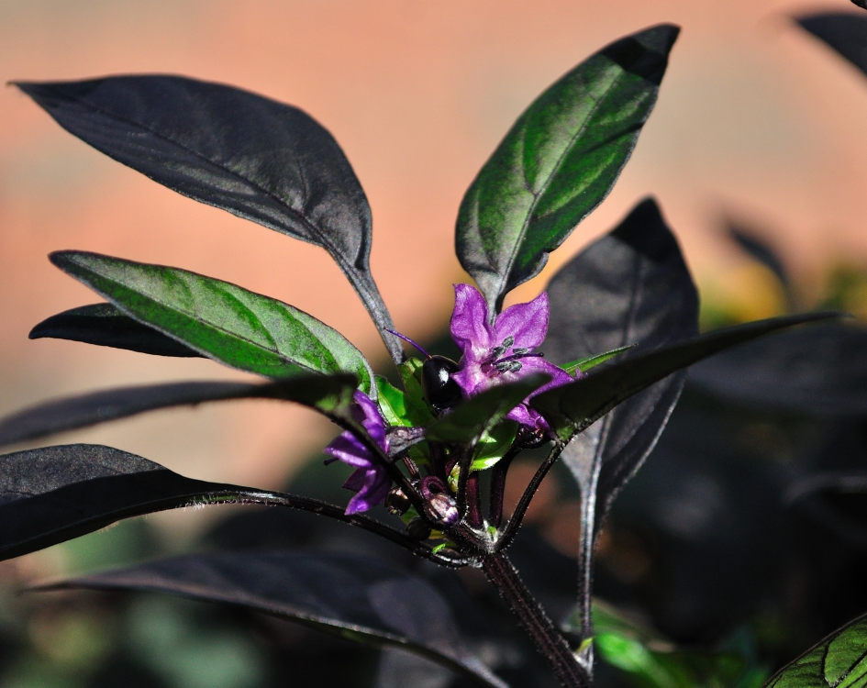
Black Pearl Pepper
http://www.eric.5596.org/photoblog/?cat=8
Notes:
The banker plant system that I will be investigating provides pollen for the omnivorous Orius insidiosus
This is a picture of the Black Pearl Pepper, which is an ornamental pepper plant that has generated interest among growers as a possible banker plant and is the reason why we chose it for my research.

Slide 4
Overall Objective
To optimize implementation of the ‘Black Pearl’ Pepper banker plant system for controlling thrips in commercial greenhouses
Notes:
Overall Objective: To optimize implementation of the black pearl pepper banker plant system for controlling Thrips in commercial greenhouses

Slide 5
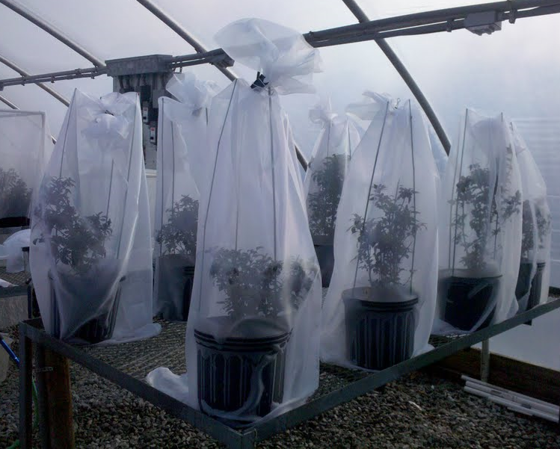
First Question
How does pollen from the ‘Black Pearl’ Pepper Banker Plant affect O. insidiosus abundance?
Measured O. insidiosus adult and nymphal abundance when flowers were present and absent
Notes:
My first question, which surprisingly no one has investigated so far, was how does pollen from the ‘Black Pearl’ Pepper banker plant affect O. insidiosus abundance?
I set up 20 individual banker plants in organza bags with two treatments, plants that were allowed to flower and plants that had flowers continuously picked off. I innoculated each plant with 30 O. insidiosus each and sampled once a week for six weeks to count O. insidiosus adults and nymphs.

Slide 6
Average O. insidiosus adult abundance in the presence and absence of flowers over six weeks
Notes:
Here we have a graph showing the average O. insidiosus adult abundance in the presence and absence of flowers. Average abundance is represented on the Y-axis and the week number is represented on the X-axis.
The flowers treatment is shown in purple, and the no flowers treatment is shown in green.
For both treatments, week zero shows the 30 adult O. insidiosus that were deliberately placed on each plant in the experiment. Both treatments saw a decrease in adult abundance by the first and second weeks.
In the flowering treatment, shown in purple, you can see that after week 2 we started to see an increase in the presence of adults until week five and six when adult abundance decreased again. Average abundance in the flowers treatment peaked at about 25 adults per plant.
In the no flowers treatment, shown in green, adult abundance remained lower than the abundance in the flowers treatment through the full six weeks. Average abundance in the no flowers treatment peaked at less than five adults per plant.

Slide 7
Average O. insidiosus nymphal abundance in the presence and absence of flowers over six weeks
Notes:
My next graph is virtually the same but represents nymphal abundance. Again, abundance is plotted on the Y-axis and week is plotted on the X-axis.
Week zero shows no nymphs because we started with O. insidiosus free plants.
The first two weeks showed an increase in nymphal abundance for both treatments.
Abundance peaked at week two around 43 nymphs per plant in the flowering treatment, but decreased to less than 10 nymphs in week four. Abundance increased again throughout weeks five and six in this treatment.
Again, in the no flowers treatment, nymphal abundance remained lower than in the flowers treatment throughout the six weeks and peaked at around 4 nymphs per plant.

Slide 8
O. insidiosus adults and nymphal abundance in the presence of flowers over six weeks
Notes:
To better express these fluctuations in adult and nymphal abundance, this graph displays only O. insidiosus abundance in the flowering treatment.
Average abundance is still on the Y-axis and week number is still on the X-axis. Adults are shown in dark purple and nymphs are shown in light purple.
The adults and nymphal abundance each are oscillating alternatively, so that during week four, those nymphs that were present in week two are now adults and then we have reproduction happening to increase nymphal abundance in week 6. Perhaps if we drew this experiment out longer or conducted it in a larger, closed arena, we might see the average abundance in adults and nymphs equal out or increase and decrease together.

Slide 9
Average thrips abundance in the presence and absence of flowers over six weeks
Notes:
We didn’t intend to have thrips on our plants I also monitored other pests on the banker plants, including thrips. The plants were relatively clean, however, they still had thrips on them at the start of the experiment, as shown in this graph where thrips abundance is plotted on the Y-axis and week number is plotted on the x-axis.
As to be expected, given that thrips are known to benefit from the presence of pollen, the plants in the flowers treatment (represented in purple) started with a greater abundance than plants in the no flowers treatment (represented in green).
By week three, the average abundance of thrips in either treatment were virtually the same. After week three, thrips abundance in the flowers treatment remained lower than thrips abundance in the no flowers treatment.

Slide 10
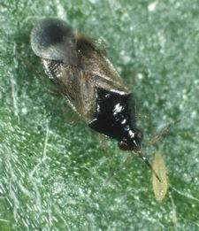
First Question Summary
Increased adult abundance
Increased nutrition
Reduced cannibalism
Increased nymphal abundance
Flowers increase fertility
Better nutrition for nymphs
Reduced cannibalism
http://www.fargro.co.uk/biologicals/gt-thrip.htm
Notes:
From this experiment, we saw that the availability of pollen from the black pearl pepper increased adult abundance in comparison to the no flowers treatment. This could be for a couple of reasons:
Pollen increased nutrition and therefore increased survival of adults and
The availability of pollen may have reduced cannibalism.
We saw similar results in nymphal abundance which may be a result
Pollen has also increased reproduction
Overall: this banker plan has shown the ability to increase and sustain Orius populations in greenhouses
This study shows that the Black Pearl Pepper Banker Plant can increase the survival and reproduction of Orius which no one has done in the context of this system. we have shown that BppBp do increase oi survival and reproduction which no one has done before in the context of this system. This is an encouraging result for the potential of bppbp to improve bc and incrase implementation of this sustainable management strategy.

Slide 11
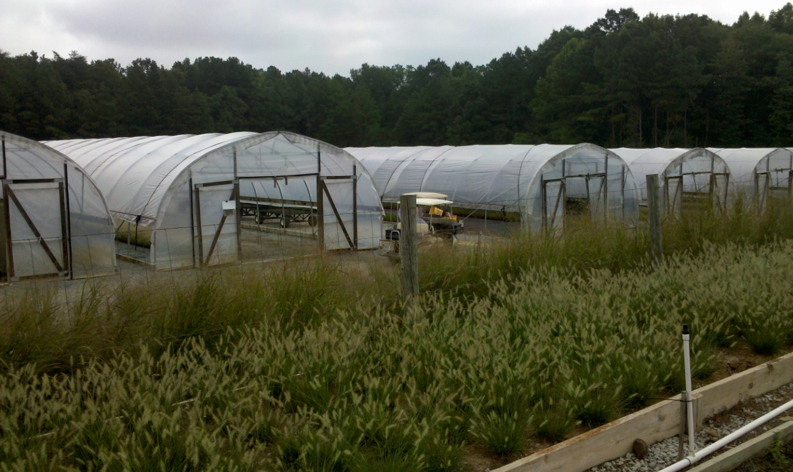
Second Question
How does the ‘Black Pearl’ Pepper banker plant system work in commercial greenhouses?
Commercial Greenhouse: Ornamental Grasses Nursery
~120x20’
Hoop houses with plastic covering
Notes:
This is Hoffman
Growers Perception of Biological Control:
Fear of time and cost
Unclear expected efficacy
Lack of understanding

Slide 12
Treatments
CONTROL | AUGMENTATION | BANKER
No insecticides | No insecticides | No insecticides
No release | Release O. insidiosus | Release O. insidiosus
No banker plants | No banker plants | Banker plants
Notes:
Control Treatment

Slide 13
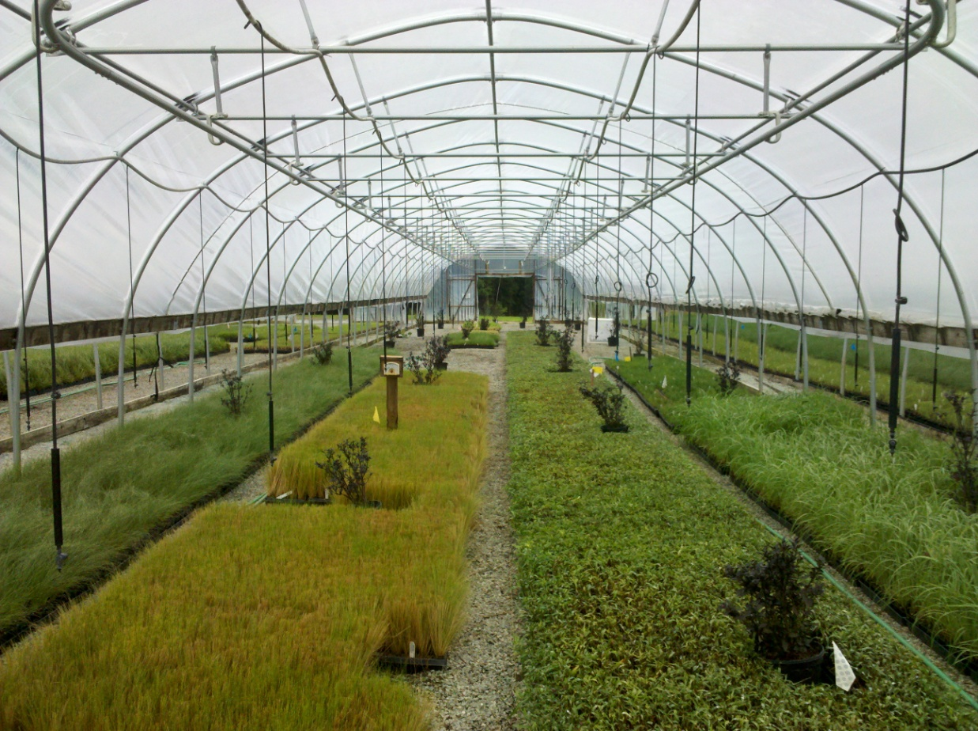
Banker Plant Treatment
4 rows in each house
6 plants in each row
24 plants per house

Slide 14
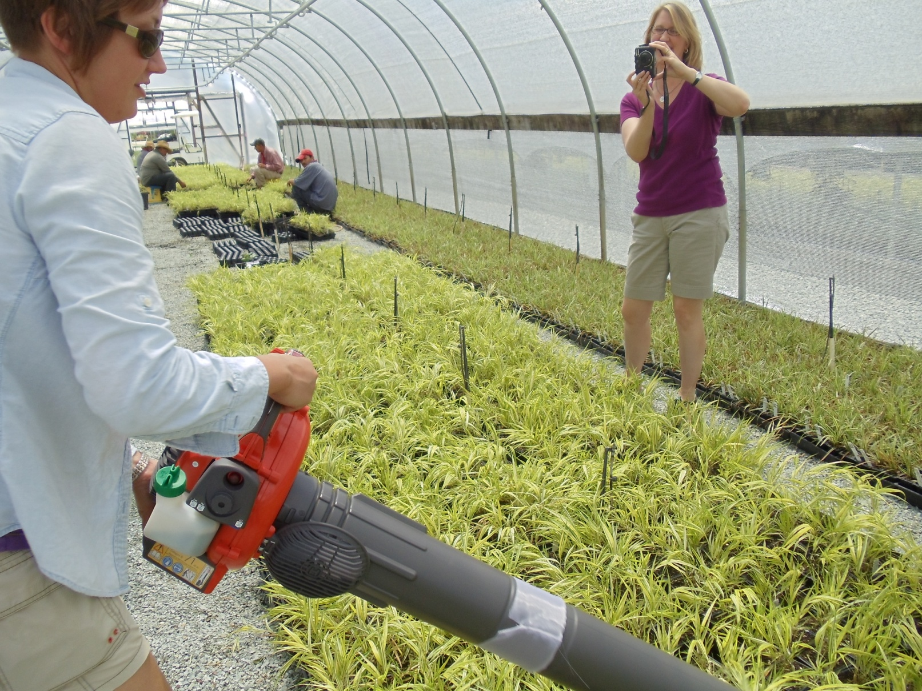
Sampling with a ‘Bug Vacuum’
Notes:
This is a picture of our sampling method used in this experiment
We used a leaf blower-vac to sample 2 square meters from each row, a total of 8 square meters
(POINT) fine mesh organza bags to capture insects
Placed all samples in jars of alcohol until sorted

Slide 15
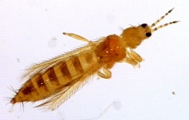
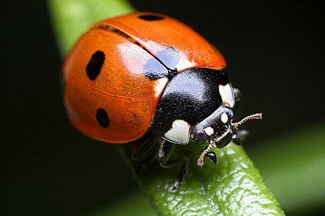
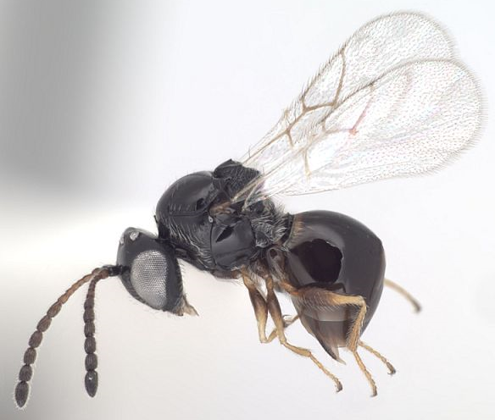
Insects found in vacuum samples
http://www.ipm.iastate.edu/ipm/icm/node/595
http://www.agroatlas.ru/pests/Rhopalosiphum_padi_en.htm
http://trmom.com/wp-content/uploads/2010/05/ladybug.jpg
http://hymenoptera.tamu.edu/paroffit/?taxcpl=tax&taxcpl_id=7472
Notes:
This shows the variety of insects and arthropods we were capturing in our vaccum samples
We captured thrips, predatory mites, spider mitdes…
Other beneficials

Slide 16
Thrips Abundance in Greenhouses Over Nine Weeks
Treatment: p = 0.007
Date: p = 0.014
Trt*Date: p = 0.755
480
158.6
224.2
Notes:
We had a significant main affect of treatment such that the banker plant and augmentation treatments had significantly fewer thrips than the control treatment

Slide 17
Spider Mite Abundance in Greenhouses Over Nine Weeks
50
25.1
7.8
Notes:
Mite popns generally inc over the summer
But the two biocon treatments were able to sustain popns at low levels
Control levels climbed

Slide 18
Discussion
Reduced thrips and spider mite abundance
Notes:
From this experiment we witnessed biological control by orius insidiosus significantly reducing thrips in the augmentation and banker treatments in comparison to the control treatment
HOWEVER

Slide 19
Discussion
Banker Plants vs. Augmentation?
http://go.ipublisher.nl/index.php?file_id=299
Notes:
This experiment did not show a significant difference in thrips abundance between the augmentation and banker plant treatments
This could be for several reasons:

Slide 20
Emigration
Notes:
The hoop-houses at Hoffman are such that in the summertime the sides of the houses are raised to help cool the houses. Because of this we may have been experiencing significant emigration of O. insidiosus
Hoffman Nursery is very interested in a wide variety of Biological Control Methods and not only practice the release of natural enemies but also have set up beds of dense flowering plants to recruit natural beneficials. The benefit of these beds is unknown. These plots were in front and flanking our experiment houses. There was also a forest flanking another side of our experiment houses which may have been interesting to our beneficials.

Slide 21
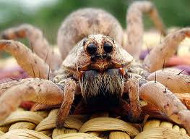
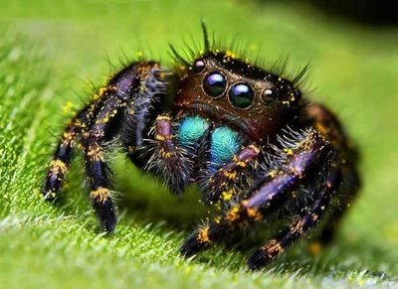
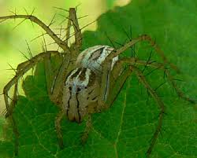
Intraguild Predation
Spiders present in grasses
Especially on the banker plants
http://tolweb.org/Lycosidae/2746
http://uglyoverload.blogspot.com/2009/01/jumping-spider-eyes.html
http://greennature.com/gallery/spider-pictures/lynx-spiders.html
Notes:
Intraguild predation may have also played a role in complications of this study. Spiders were often found in the grasses in every house as well as on the banker plants themselves.
Some of the more common spider families that were found were the Salticids (picture), wolf spiders (lycosidae??) and lynx spiders. All of which are known to stalk and consume small insects such as beneficials.

Slide 22
Alternative Food Source
Notes:
Lastly, by providing O. insidiosus an abundant and nutritious food source in the banker plant houses, we may have not increased O. insidiosus abundance enough to compensate for their reduced per capita consumption of thrips in these houses.

Slide 23
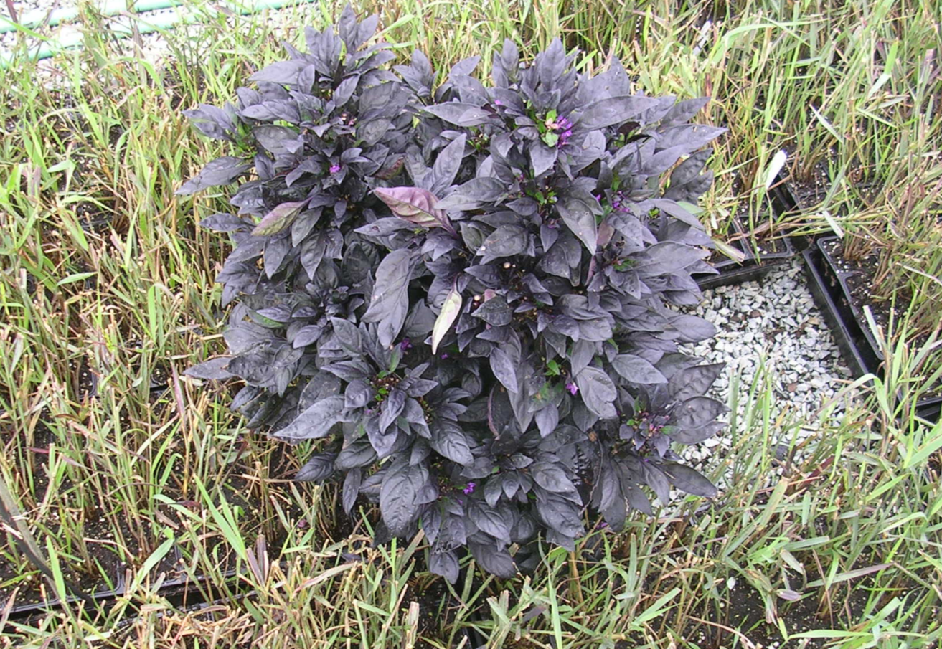
The Future of Banker Plants
Notes:
Follow-up experiments will aim to disentangle these hypotheses as to why banker plant efficacy in this system was not significantly different from the augmentation treatments.
The results from the larger Hoffman greenhouse experiments are contradictory of the first small greenhouse experiments with single banker plants and may be remedied by using the banker plant system in a more conventional closed-greenhouse situation. In a closed greenhouse, the effects of emigration are lessened as the natural enemies and pest insects are both captive audiences. Also, the effect of intraguild predation is lessened for the same reason, fewer predators and competitors are able to immigrate into the house.

Slide 24
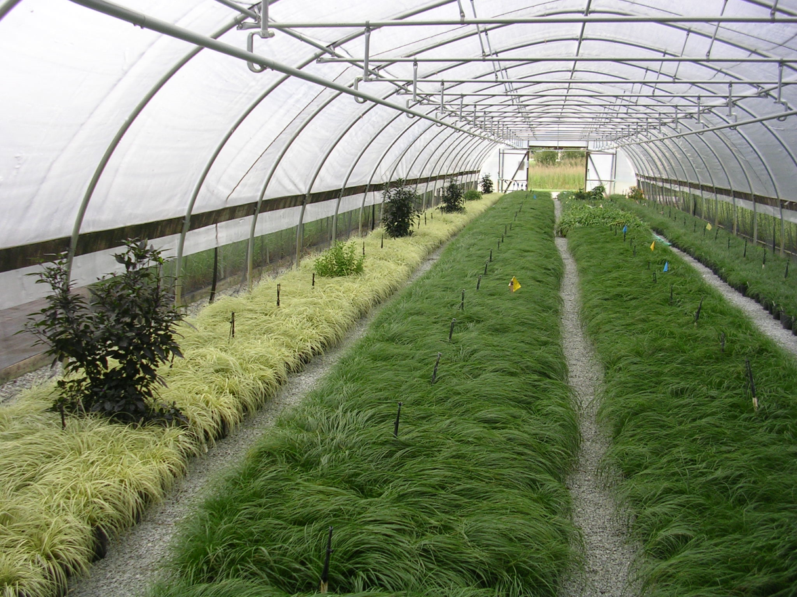
Acknowledgements
SARE On Farm Research Grant to Steve Frank
SARE Graduate Student Grant to Sarah K. Wong & Steven D. Frank
Sally Taylor
Alan Stephenson
Amy Bader
C. Raker and Sons, Inc.
Van Wingerden International
Hoffman Nursery
Notes:
In future work we hope to understand this system even better to help folks like this grower who are trying to use the bppbp as part of their IPM. (OR who are using bppbp to improve their current bc programs)
This picture is taken from an ornamental grasses grower, Hoffman Nursery in Durham, NC. They have already expressed interest in using a banker plant system and tried it in their greenhouses last growing season.
This is an exciting new facet of Biological Control and we are anxious to learn more about how banker plant systems can influence existing pest management strategies.
With that I will take any questions

