Slide 1
Low input Pasture Renovation through multi species intensive grazing.
Low input renovation of a long fallow pasture by intensively grazing feeder lambs and goat kids as well as pastured poultry. Document improvement in forage quality gained with no other inputs.

Slide 2
SARE Farmer Rancher Grant
Applied in December 2008
Notified late March 2009
http://www.sare.org/ncrsare/prod.htm
for farmers and ranchers to carry out Sustainable Agriculture research, demonstration, and education projects on their farms.
Current Deadline – December 2, 2010

Slide 3
Management Intensive Grazing (MIG)
Advantages
  Increases forage production and quality
  Improves diversity of forage species
  Permits harvesting of excess forage in spring
  Permits stockpiling of forage to extend grazing season
  Maintain benefits from pasture improvement efforts such as legume establishment
  Limits selectivity by grazing animals
  Provides better manure distribution and nutrient recycling
  Allows for frequent animal-human contact, which makes animals easier to handle and monitor
From: Pasture Management Guide for Livestock Producers, Iowa State Univ. Extension

Slide 4
Management Intensive Grazing (MIG)
Disadvantages
  Requires initial investment in fencing and watering equipment
  Requires slightly greater labor commitment
  Requires commitment to management for success
From: Pasture Management Guide for Livestock Producers, Iowa State Univ. Extention

Slide 5
Our Project: Low input Pasture Renovation through multi species intensive grazing.
  Pasture in need of renovation
  Prefer not to plow up sod
  Previously cut and left to lay
  Recent years - cut for hay and for pastured poultry access
  Prefer animal husbandry over machine operation and repair
  Wish to document improvements gained through intensive multispecies rotation grazing
  No rotational grazing previously conducted (can create baseline data)

Slide 6
  Sheep select 60% forage, 30% weeds, 10% woody material
  Goats select 60% woody material, 20% weeds, 20% forage
  Chickens utilize forage and insects. Also add nutrients to the soil through conversion of grain (~18/bird)
  2009 – 6 goat kids, 18 lambs – feeders, 200 cornish cross broilers and 14 laying hens
  2010 – 5 goat kids, 34 lambs – feeders, 300 broilers (6 breeds) and 17 laying hens
  2011 – 6 goat kids, 35 lambs – feeders, 200 broilers and 20 laying hens (anticipated)

Slide 7
  6.5 acres pasture

Slide 8
Research Techniques
  Soil Testing
  Forage nutrient analysis
  Photos
  Forage/forb surveys.
  Exclosure fencing
  Pasture condition score
  Livestock records

Slide 9
Soil Tests – April 2009

Slide 10
Forage Analysis – Summer 2009

Slide 11
Forage/forb surveys
Notes:
I plan to divide the pasture into 12 paddocks. The ATTRA A3667 Pasture Condition Score sheet will be used to initially evaluate the overall condition of each of these paddocks. I will document the previous inputs to each of the paddocks. Each paddock will have soil tests completed before grazing begins (April, 2009) and at the end of the research period (October, 2010). Each paddock will have the plant material documented using the transect method (record the plant found at prescribed measurements along a line strung across the paddock) and by weighing the plant material gathered and dried from a uniform size area in each paddock. Exclosures will be constructed in 6 random locations throughout the pasture to act as controls and the plant material in these will also be recorded. Forage will be analyzed at the lab for nutrient values as well.
I will document the starting weight and weight at sale for each of the lambs and kids involved in order to compare their weight gain on this pasture to average anticipated rates of gain. I will also use photos to document the overall pasture quality as well as for recording the plant materials found in specific locations in each paddock.

Slide 12
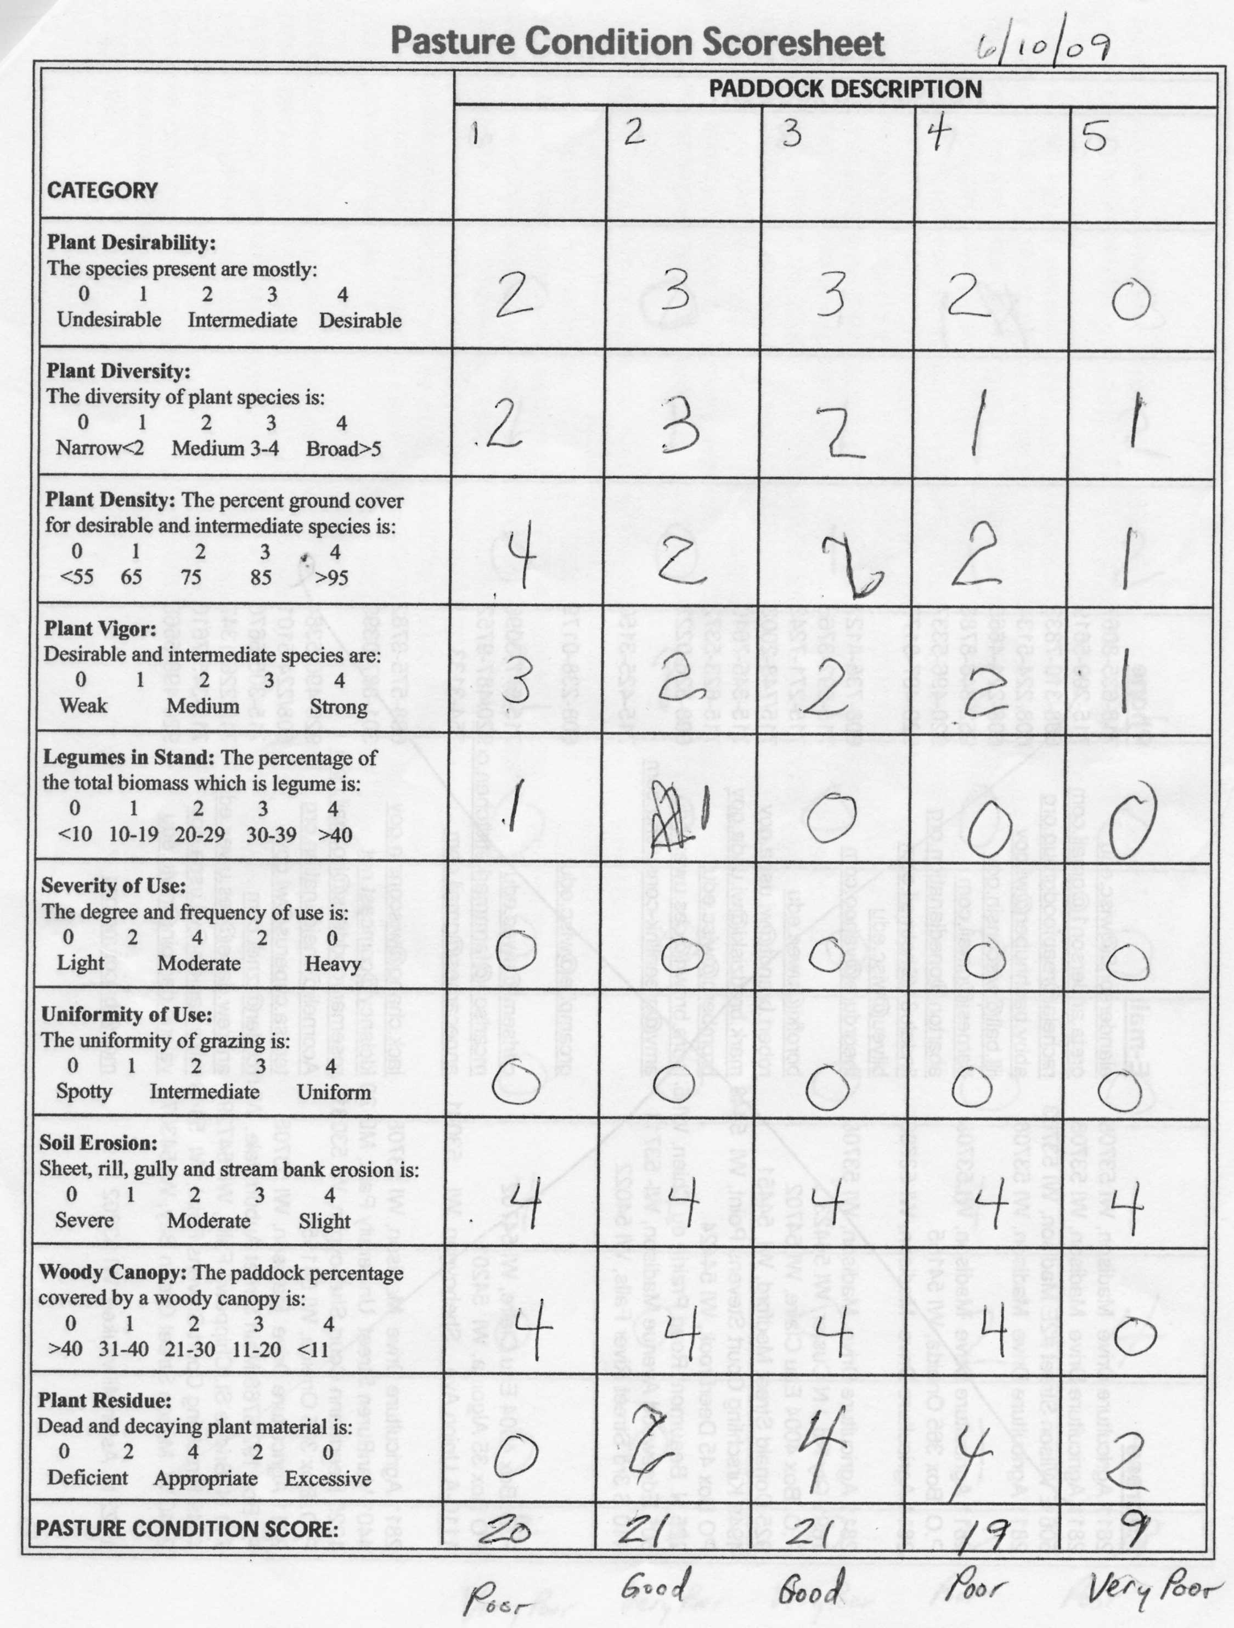
Pasture Condition Score
Notes:
Grazing livestock on this land means that we are providing food for animals that has not been transported long distances. The animals travel across the pasture to gather their food and at the same time they also travel across the pasture distributing fertilizer. By intensive grazing we will be improving the forage quality on our farm and we will be minimizing our dependence on non-renewable resources.
Renovating this pasture will allow us to increase the potential earning power of our farm. We will keep records of the costs involved in acquiring our flocks, raising them and then the income realized when we sell them. The renovation should allow us to take non productive land and convert it to a higher income and more sustainable use with relatively low monetary investment.
In past days, this area was a strong and thriving farming community. Much of that quality of life has since been lost. If we can illustrate a low input method for renovating former pastures, more potential farmers may be encouraged to return these lands to greater productivity. In addition, converting the fallow land and improving the pasture here at our farm will allow us to provide high quality and sustainable food to our local community.
We want to farm without the stress of owning and operating expensive and dangerous equipment. Raising these relatively small livestock animals will be an enjoyable enterprise for us and compatible with the other enterprises we already pursue here.

Slide 13
Livestock/Grazing Records
Inputs
Daily gain
Income or loss

Slide 14
Paddock 8 - ~.49 acres
2000 | Cut
2001 | Cut
2002 | Cut
2003 | Soil test – pH=5.2, O.M.=7.8%, Phosphorus=47ppm, Potassium=130ppm
 | Cut
2004 | Cut
2005 | Lime – 2.75 tons/acre
 | Cut
2006 | Cut
2007 | Hay baled – one crop
2008 | Hay baled – one crop
2009 | Red Clover 4#/acre frost seeded
 | Soil test – pH=5.3, O.M.=9.5%, Phosphorus=28ppm, Potassium=97ppm, 60-69 Lime Req.=7.9 T/a
 | Texture Code=2, Sample Density=.66, Buffer pH=5.9
 | 6/10 - pasture condition score - 10 (very poor)
 | 6/26 hay baled – one crop
 | Acres | Livestock |  | Date In |  | Date Out
 |  | Type | Number
 | 0.49 | lambs | 10 | 06/22/09 |  | 06/25/09
 |  | goats | 6
 |  | broilers | 100 | 06/28/09 |  | 07/17/09
 |  | broilers | 100 | 07/24/09 |  | 07/25/09
 |  | lambs | 18 | 08/10/09 |  | 08/15/09

Slide 15
Publications
ATTRA – www.attra.ncat.org
  Small Ruminant Sustainability Checklist
  Multispecies Grazing
  Pasture: Sustainable Management
  Small Ruminant Resources List
UWEX - http://learningstore.uwex.edu
  Determining Pasture Condition
SARE - /www.sare.org/
  Bulletins
    How to Conduct Research on Your Farm or Ranch
    Marketing Strategies for Farmers and Ranchers

