Slide 1
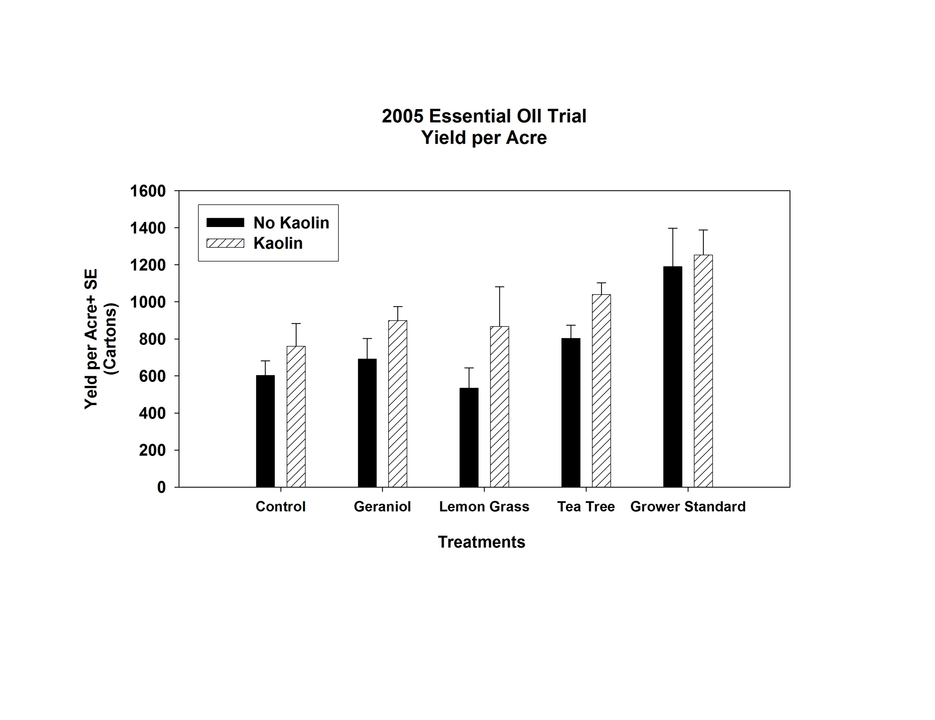
Essential Oil Trial
Yield per Acre
Year 1

