Slide 1
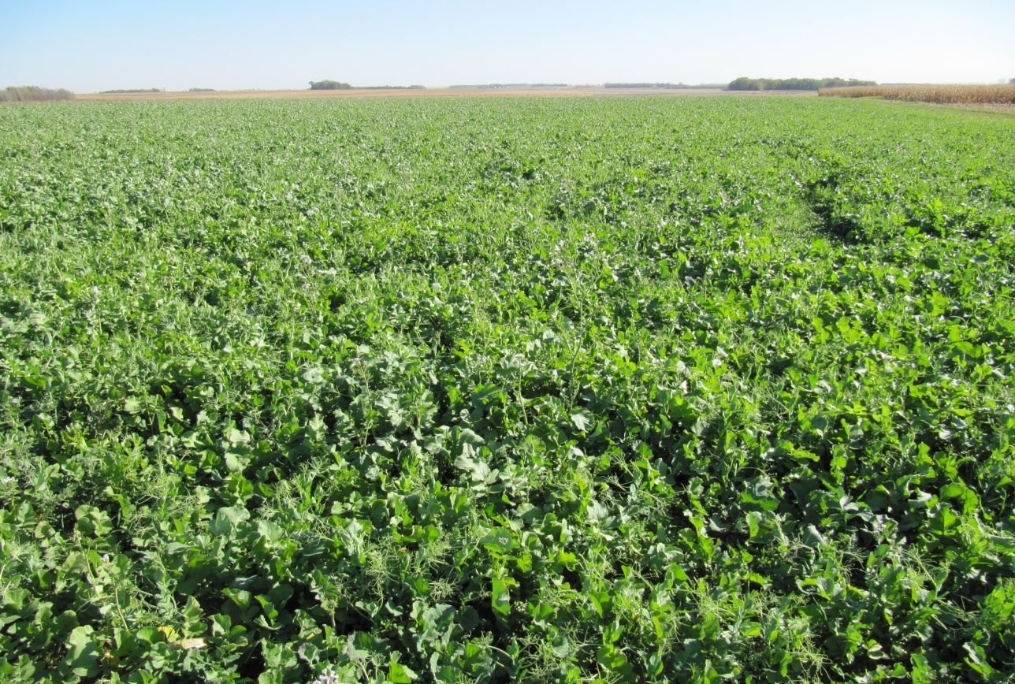
Using forage quality testing to determine cover crop N credits
Greg DeRynck
Peter Sexton
Shannon Osborne
South Dakota State University
Support provided by:
SARE-Sustainable Agriculture Research and Education

Slide 2
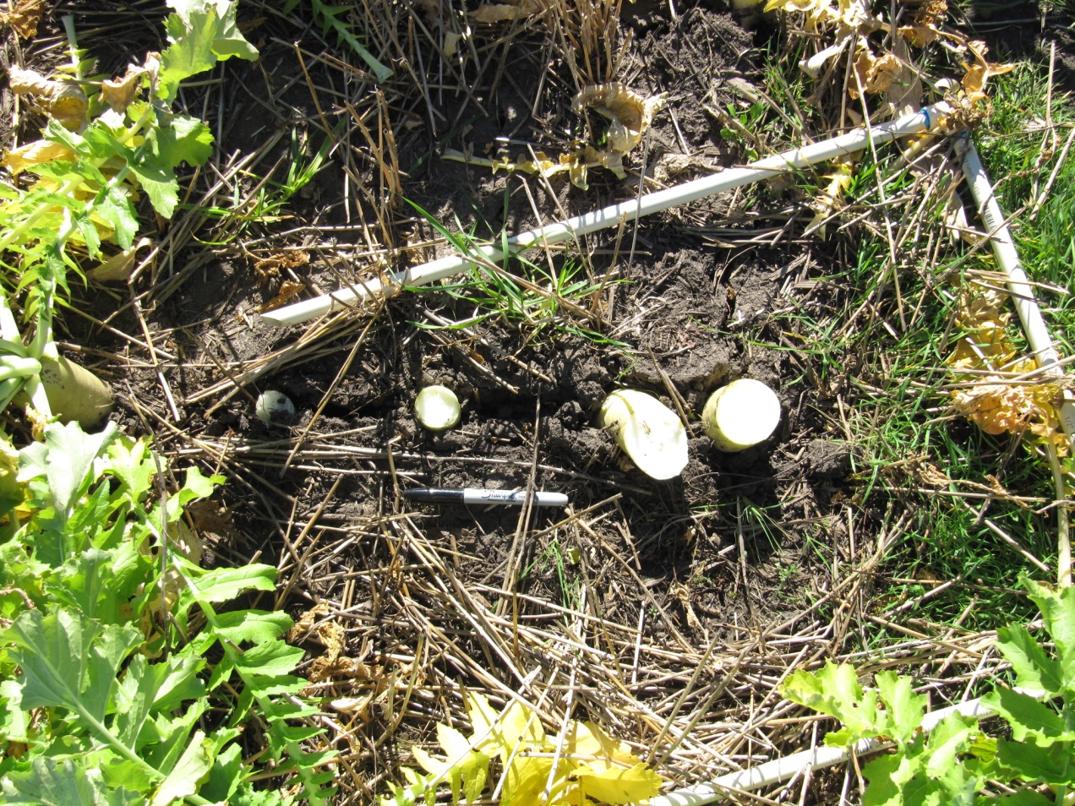
Importance of cover crops
Combat soil compaction
Control erosion
Build organic matter
Scavenge nutrients from the soil
Manage soil moisture
Provide forage
Suppress pests

Slide 3
N-Credit
An N credit is the amount Nitrogen fertilizer considered to be supplied by previous activity in the field.
N credits have been established for some situations
Cover crops are often grown as a blend of two or more crops and are subject to highly variable amounts of growth, making prediction of N mineralization difficult.

Slide 4
Rational and Objective
It is postulated that the rate of degradation will be related to the fiber content of the plant residues.
The objective is to measure the N loss from materials varying in fiber content, testing the hypothesis that the rate of N release will be related to fiber content.

Slide 5
Selected crop residues for study
Crop Residue | NDF- neutral detergent fiber
kale | 24
alfalfa hay | 39
grass hay | 62
oat straw | 69
wood chips | 83

Slide 6
Part 1: Residue breakdown
Mesh bag study
Crop residues left in the field in a mesh bag and collected over course of 10 weeks

Slide 7
Material interacting with field environment

Slide 8
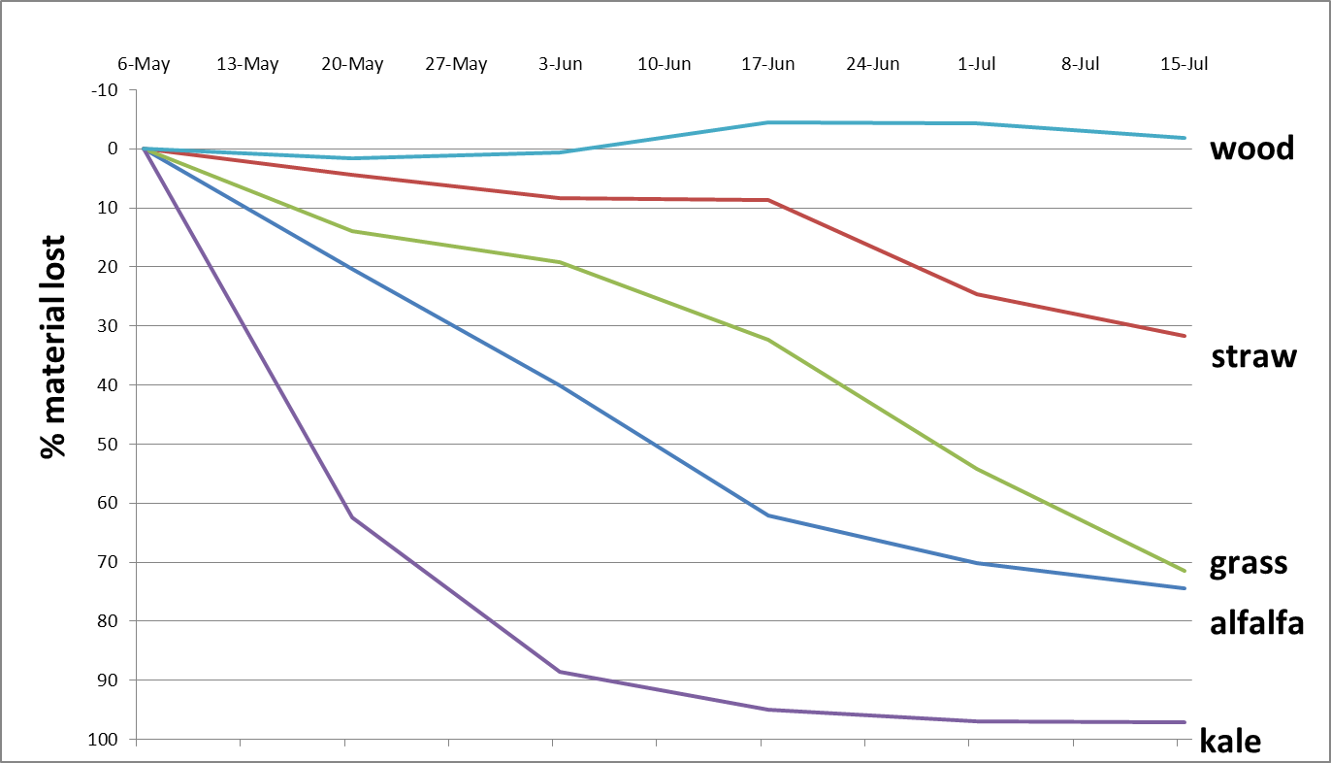
Loss from mesh bags: Spring
wood
% material lost
grass
alfalfa
kale

Slide 9
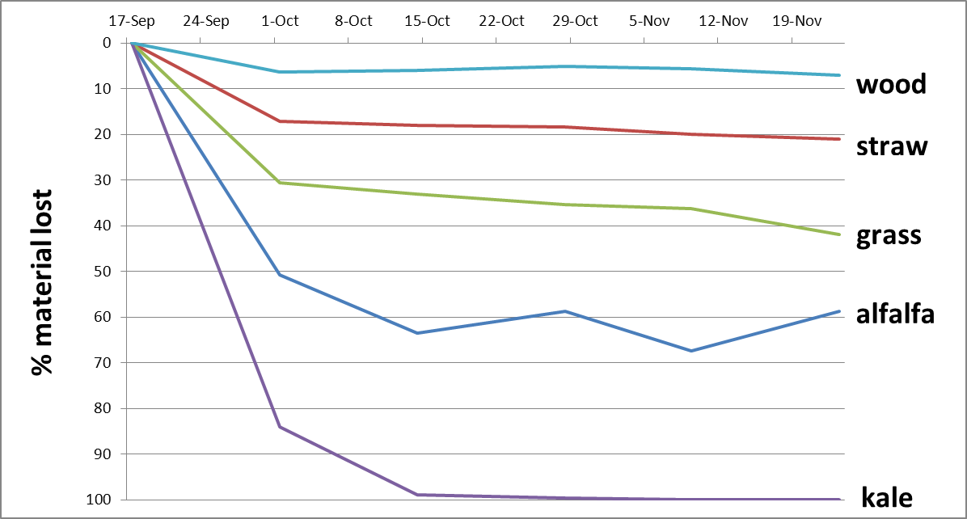
Loss from mesh bags: Fall
Notes:
NPK data in progress

Slide 10
Part 2: Cone-tainer
Soil mixed with the 5 crop residues held in a temperature controlled chamber and sampled at 10 day intervals.

Slide 11
Cone-tainer results
NO3- ppm
Notes:
At 55 degrees

Slide 12
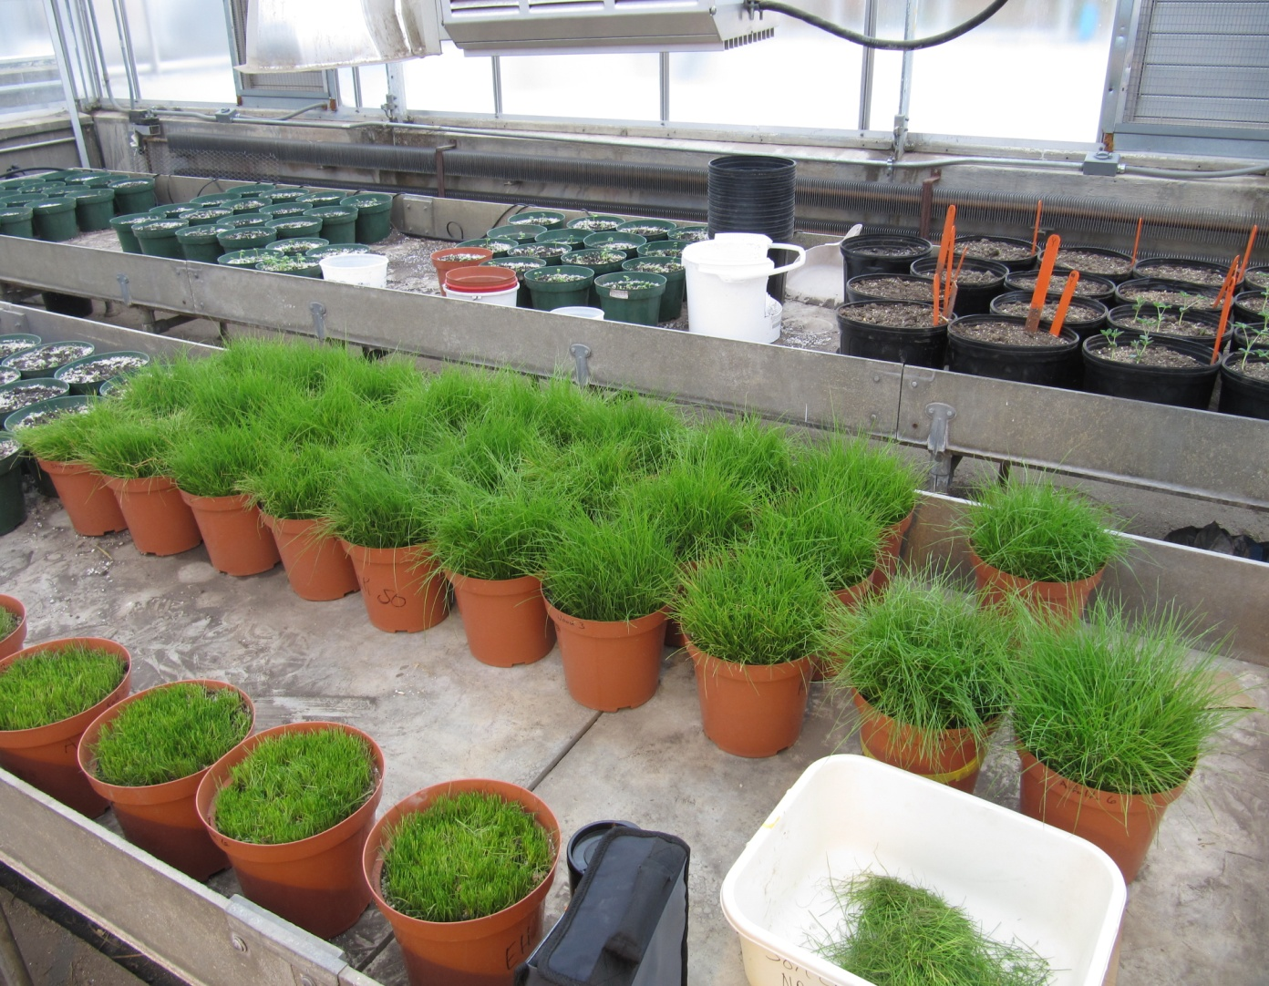
Part 3: Bioassay
Pots containing soil and the 5 residues were prepared.
A grass mix consisting of annual ryegrass and tall fescue was planted in the pots.
At two week intervals the height of the grass was recorded. The grass was harvested and weighed to measure biomass produced.

Slide 13
Grass regrowth 2 d after 1st cutting

Slide 14
Grass regrowth at 2nd cutting
Control
Grass
Straw
Alfalfa
Kale
Wood

Slide 15
Total grams of grass harvested after 18 weeks
Notes:
The study and N analysis in progress

Slide 16
Greg DeRynck
Peter Sexton
Shannon Osborne
South Dakota State University
Support provided by:
SARE-Sustainable Agriculture Research and Education

