Slide 1
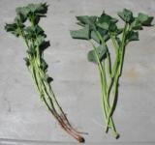
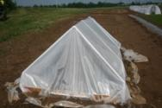
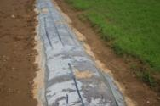
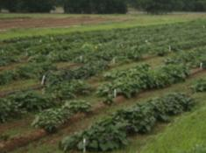
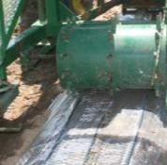
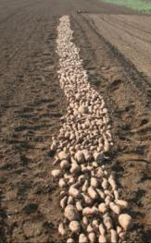
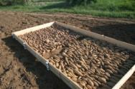
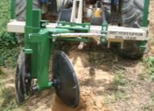
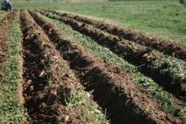
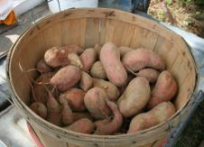
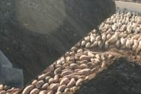
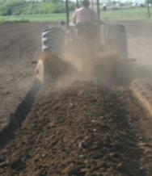
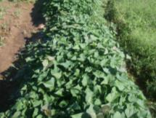
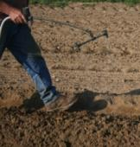
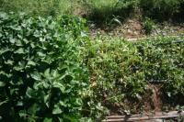
So You Want to Grow Sweetpotatoes…..
Sweetpotatoes start off as slips or cuttings from actively growing vines. Slips are usually the biggest expense in sweetpotato production
Slips can be planted using a tobacco setter. Planting into ridges makes digging easier, but dry out quicker in drought years
Use clear plastic with drip irrigation to heat soil and spur vine growth. After a week or so punch some holes in the plastic to promote air exchange and reduce the temperature. Under the plastic
Sweetpotatoes are often dug using a flip plow. After digging cure for 7 days .
Start with disease free sweetpotatoes harvested the previous fall and lay them out in the field or in a premade raised bed/stucture
When plants begin to emerge cut the plastic from the ground bed to prevent damage. Plastic can remain over the raised bed system.
After about three more weeks plants should be ready for cutting. Plants were ready a few days earlier in the raised bed/structure
Project Funded By: Sweetpotatoes: A profitable, low-input crop for small farms in rural Eastern Kentucky. Southern SARE On Farm Research Program, T. Coolong, T. Woods and S. Fannin with matching funds from the Morgan County Cooperative Extension Service
Cover the seed potatoes with dirt or sand and apply napropamide to prevent weed emergence

