Slide 1
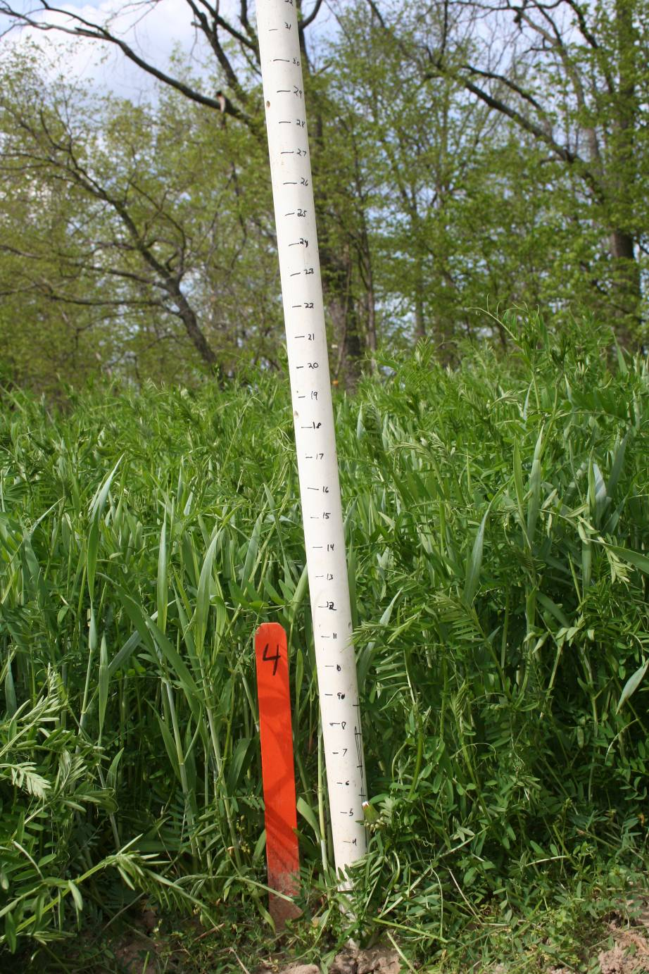
lbs/ac | Fixed N | Soil N | Total N
Vetch | 45 | 9 | 54
Rye |  | 38 | 38
Total | 45 | 47 | 92
Figure 5. A second vetch/rye mixture that resulted in moderate growth (~20” stand height) and fixed nitrogen (45 pounds/acre). The stand showed fairly good weed suppression despite a late seeding date. Seeded in early Oct. 2008, with a seeding rate of 15lbs/ 250ft bed at 20-25% legume and 75-80% rye. This is equivalent to over 500 lbs of cover crop seed/acre; a very high seeding rate. Picture was taken 5/11/09.

