Slide 1
Enhanced Pheromone-based Trapping Method for Banana Root Borer Cosmopolites sordidus (Coleoptera: Curculionidae)

Slide 2
INTRODUCTION
Banana root borer is one of the main pests of banana plantations throughout the world.
It is native to Malaysia and Indonesia but spread all over the world.
This borer has become a serious problem in commercial banana farms in Guam and other parts of Micronesia.
Yield loss can be up to 100% if the attack is uncontrolled.

Slide 3
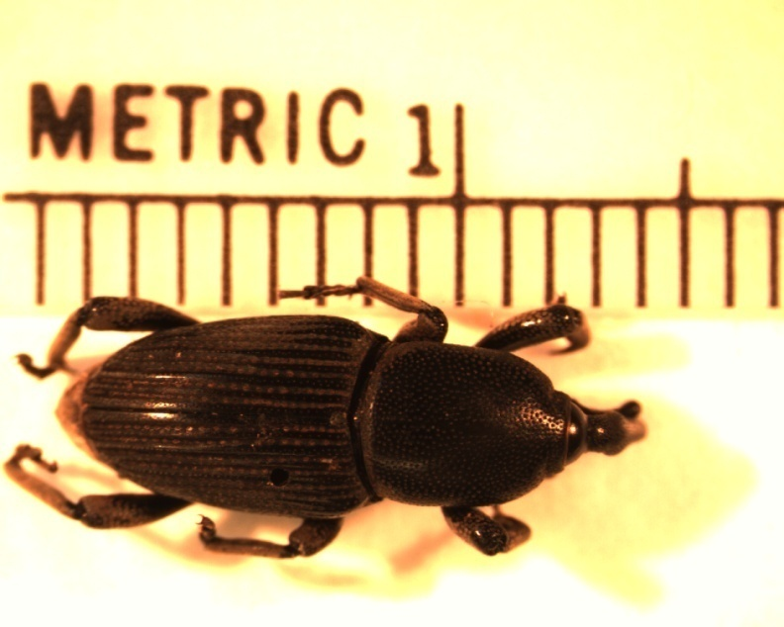
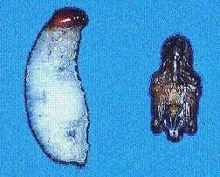
B a n a n a B o r e r

Slide 4
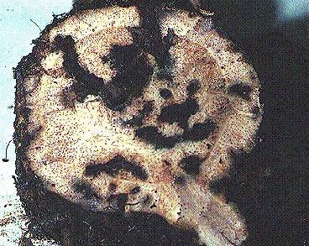
B a n a n a B o r e r
Damage to Corms

Slide 5
Existing control methods and chemical application is both undesirable and expensive.
Biological control is so far limited.
Pheromone-based trapping method using pitfall or ramp traps baited with pheromone lures results low capture rates (Tinzaara et al. 2005).
Therefore, the need is urgent for an efficient pheromone-based trapping method.

Slide 6
Objectives
Effect of Trap Type on Capture Efficiency.
Effect of Trap Size.
Effect of Trap Color.
Effect of Shade of Brown.
Relative Effects of Visual and Olfactory Cues, and
Effect of Sunlight or Shade on the Trap Catches.

Slide 7
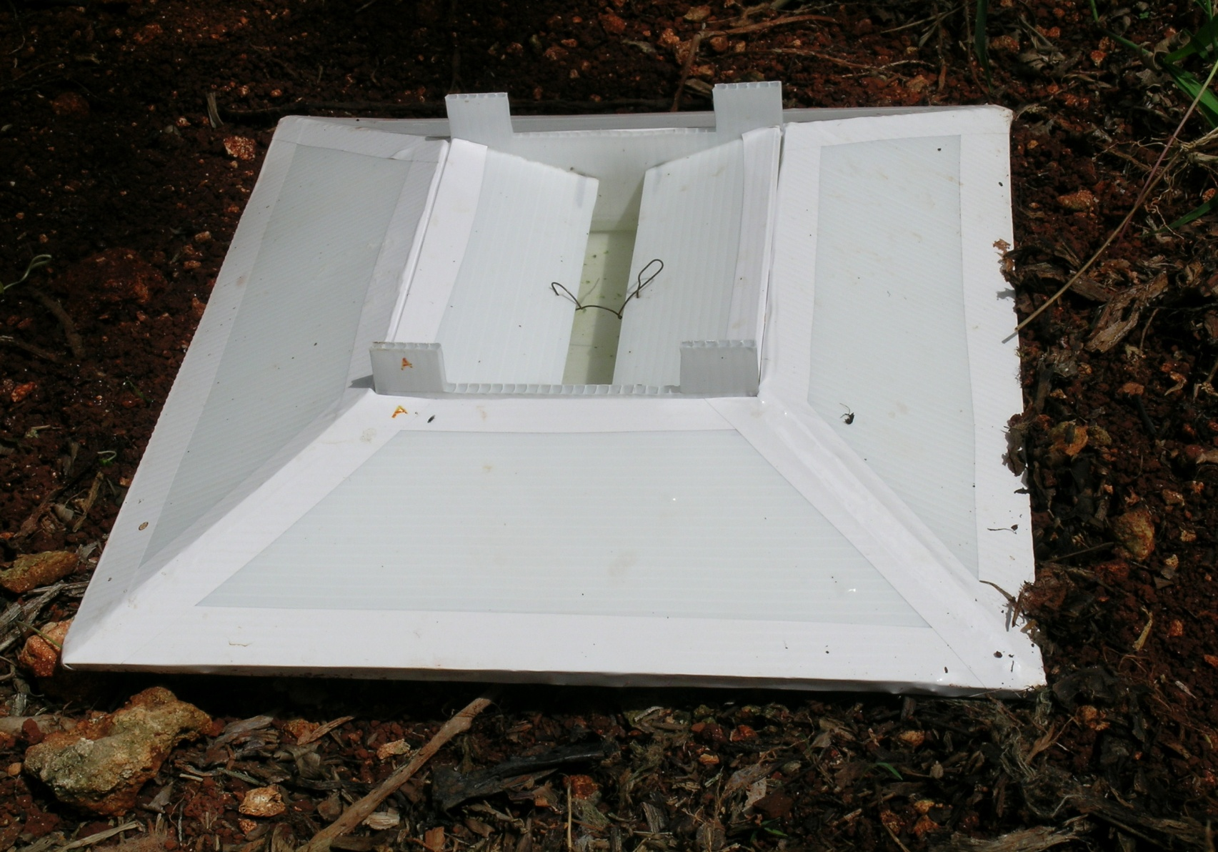
Ground Trap
50 cm
120 cm
Reddy et al. 2005. J. Chem. Ecol. 31: 2169-2177.
8 cm
60 cm

Slide 8
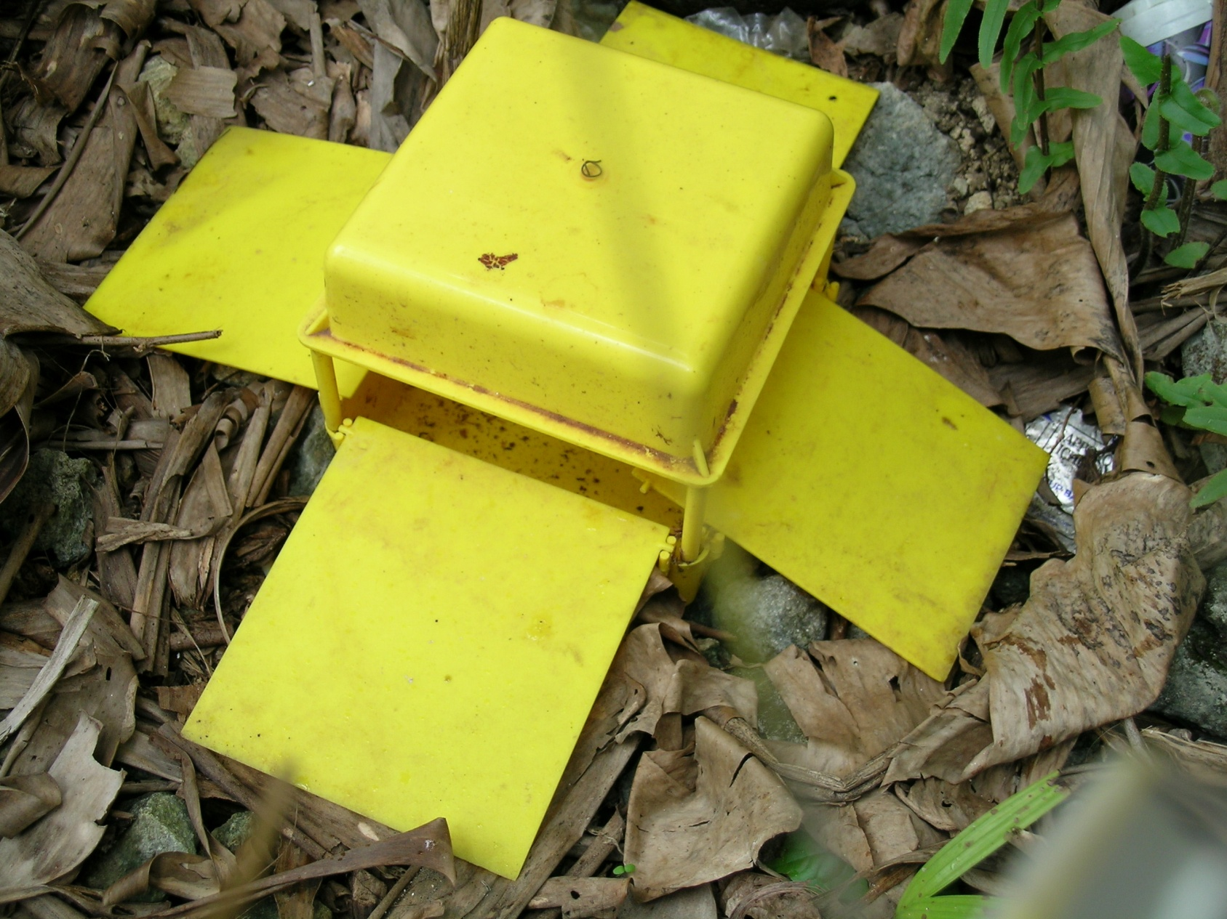
Ramp Trap
14 cm
4 cm
12 cm
13 cm

Slide 9
Pitfall Trap
10 cm diameter
1.5-liter

Slide 10
Pheromone Lure
Lures (Cosmolure) sealed in a polymer membrane release devised optimized for C. sorididus
ChemTica Internacional S.A. (San José, Costa Rica).
The lure packs, each containing 90 mg of pheromone and having a release rate of 3 mg/day
Water mixed with a dishwashing liquid detergent (1-3%) was used to retain adults.

Slide 11
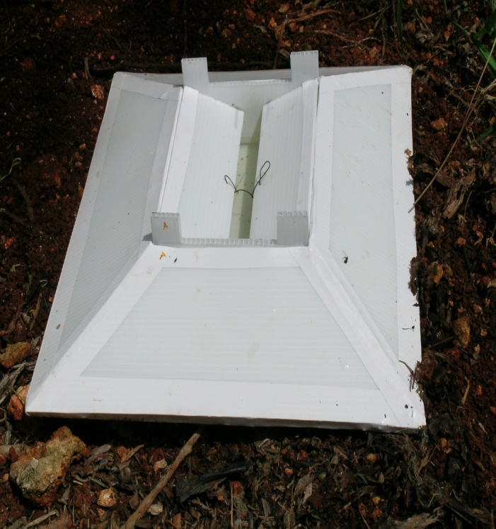
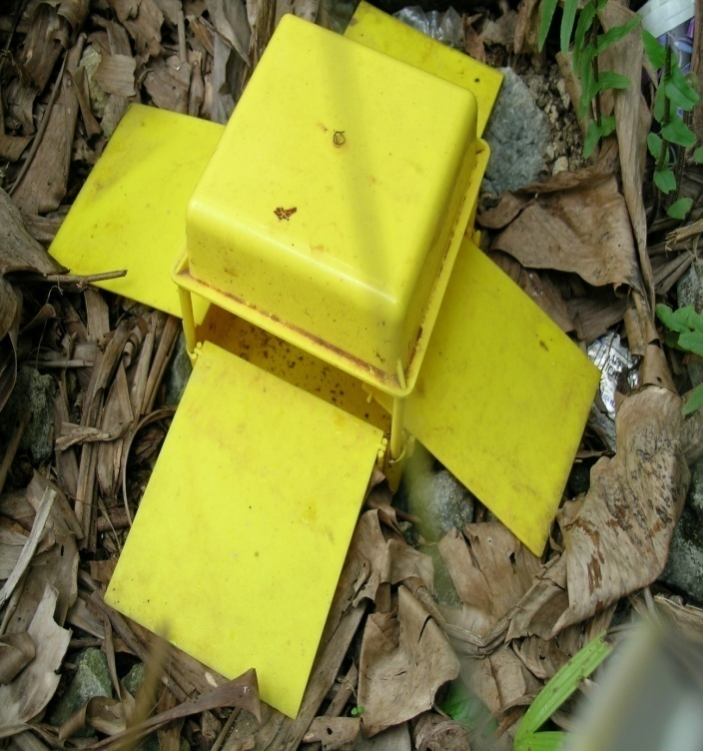
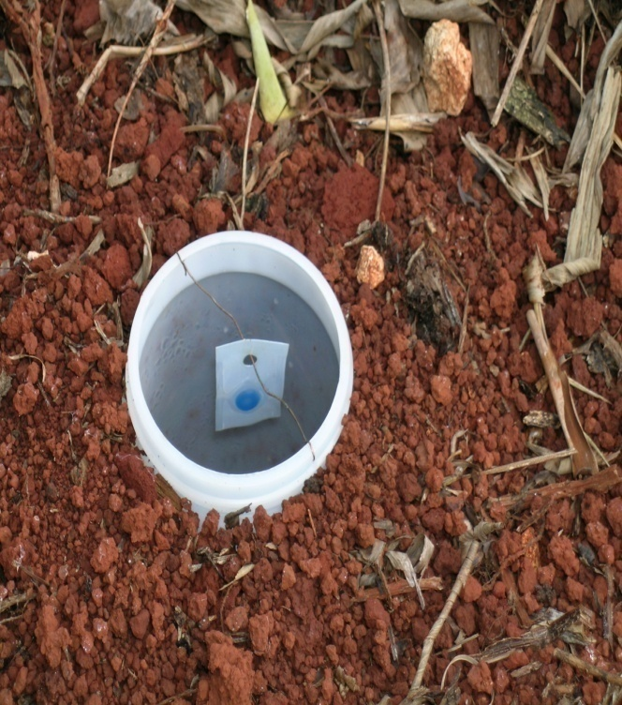
The Three Traps
A. Ground trap
B. Ramp trap
C. Pitfall trap

Slide 13
Mean (± SE) numbers of adult Cosmopolites sordidus caught by ground, pitfall and ramp trap with & without pheromone
GTWL: ground trap with lure
RTWL: ramp trap with lure
PTWL: pitfall trap with lure
GTNL: ground trap without lure
RTNL: ramp trap without lure
PTNL: pitfall trap without lure
Different lower-case letters indicate significant differences between treatments (one-way ANOVA using Poisson model, Least Square Means,
P < 0.0001). Means were generated from four replications.

Slide 14
Mean (± SE) numbers of adult C. sordidus caught in pheromone-baited ground traps of different sizes
Different lower-case letters indicate significant differences between treatments (one-way ANOVA using Poisson model, Least Square Means, P < 0.05). Bars represent means of four replicates.

Slide 15
TABLE 1. COLOR MEASUREMENTS OF TRAPS USED IN THE PRESENT STUDYª
Trap color | L* | a* | b* | Chroma (C) | angle (hº)
Black | 30.44 ± 0.06 | 0.42 ± 0.03 | -1.08 ± 0.04 | 1.16 ± 0.05 | -
Brown | 35.26 ± 0.18 | 3.98 ± 0.03 | 3.94 ± 0.02 | 5.60 ± 0.03 | 44.66 ± 0.11
Gray | 39.83 ± 0.11 | -0.17 ± 0.02 | -2.23 ± 0.01 | 2.24 ± 0.01 | 85.64 ± 0.47
Yellow | 82.57 ± 0.02 | -2.92 ± 0.03 | 84.02 ± 0.27 | 84.07 ± 0.27 | 91.99 ± 0.02
Red | 42.84 ± 0.11 | 49.88 ± 0.28 | 19.44 ± 0.20 | 53.54 ± 0.34 | 21.29 ± 0.09
White | 92.29 ± 0.03 | 1.34 ± 0.01 | -2.59 ± 0.04 | 2.91 ± 0.03 | -
Green | 43.50 ± 0.08 | -27.32± 0.03 | 1.72 ± 0.09 | 27.37 ± 0.03 | 176.39 ± 0.19
Blue | 36.02 ± 0.10 | 15.19 ± 0.10 | -35.82 ± 0.12 | 38.91 ± 0.14 | 292.98 ± 0.08
ª Data represent means of three observations

Slide 16
Mean (± SE) numbers of adult C. sordidus caught in pheromone-baited ground traps of different colors.
Different lower-case letters indicate significant differences between treatments (one-way ANOVA using Poisson model, Least Square Means, P < 0.0001). Bars represent means of four replicates.

Slide 17
TABLE 2. COLOR MEASUREMENTS OF THE DIFFERENT SHADES OF BROWN TESTEDª
Trap color | L* | a* | b* | Chroma (C) | angle (hº)
Dark brown | 35.26 ± 0.18 | 3.98 ± 0.03 | 3.94 ± 0.02 | 5.60 ± 0.03 | 44.66 ± 0.06
Mahogany brown | 35.91 ± 0.01 | 5.44 ± 0.02 | 4.35 ± 0.03 | 6.97 ± 0.03 | 38.65 ± 0.13
Russet brown | 38.99 ± 0.03 | 11.37 ± 0.05 | 9.00 ± 0.01 | 14.51 ± 0.03 | 38.37 ± 0.07
Saddle brown | 48.37 ± 0.01 | 9.25 ± 0.06 | 20.62 ± 0.05 | 22.60 ± 0.03 | 65.83 ± 0.10
Light brown | 61.13 ± 0.03 | 4.50 ± 0.02 | 21.87 ± 0.02 | 22.33 ± 0.01 | 78.38 ± 0.03
ª Data represent means of three observations

Slide 18
Mean (± SE) numbers of adult C. sordidus caught in pheromone-baited ground traps of different shades of brown.
Different lower-case letters indicate significant differences between treatments (one-way ANOVA using Poisson model, Least Square Means, P < 0.0001). Bars represent means of four replicates.

Slide 19
Mean (± SE) numbers of adult C. sordidus caught in mahogany-brown ground traps with and without pheromone lures.
Different lower-case letters indicate significant differences between treatments (one-way ANOVA using Poisson model, Least Square Means, P < 0.0001). Bars represent means of four replicates.

Slide 20
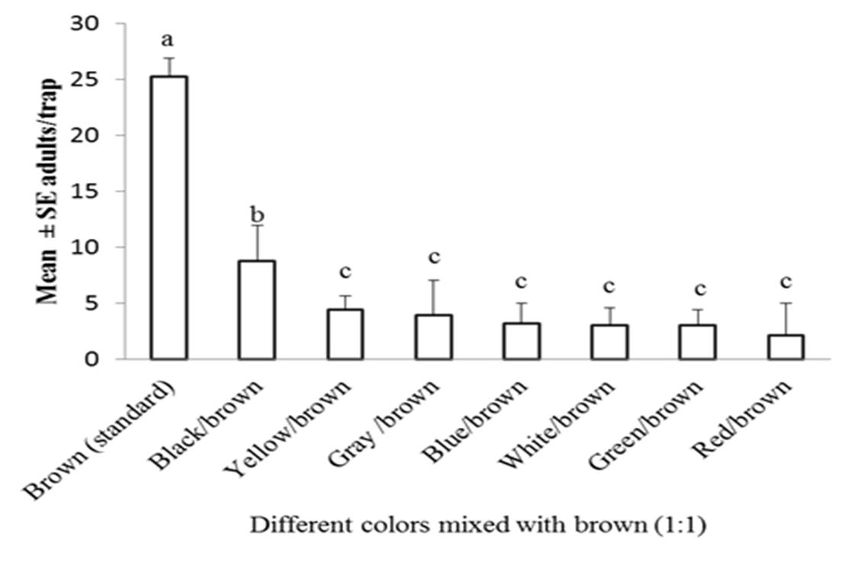

Slide 21
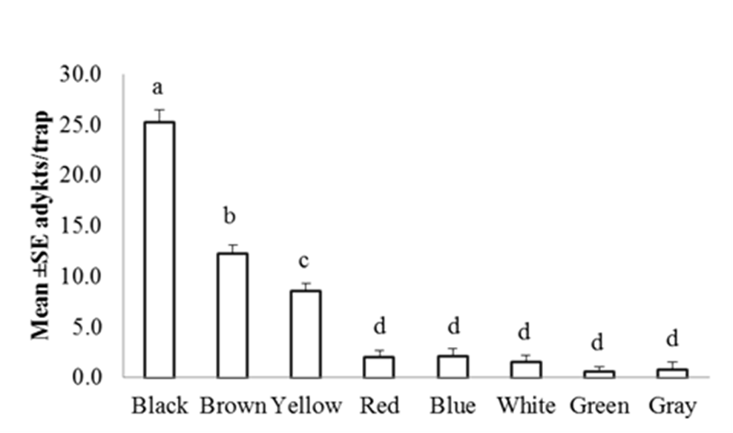

Slide 22
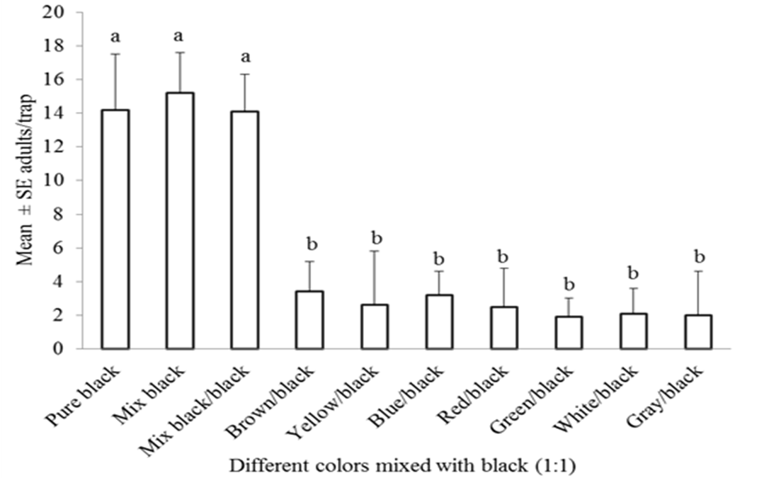
Mean (± SE) numbers of adult C. sordidus caught in semiochemical-baited ground traps of different colors mixed with black color (1:1) in a laboratory. Different lower-case letters indicate significant differences between treatments (one-way ANOVA using Poisson model, Least Square Means, P < 0.01). Bars represent means of four replicates.

Slide 23
Mean (± SE) numbers of adult C. sordidus caught in pheromone-baited ground traps placed in shade and in sunlight.
Different lower-case letters indicate significant differences between treatments (one-way ANOVA using Poisson model, Least Square Means, P < 0.05). Bars represent means of four replicates.

Slide 24
Conclusions
In summary, 40-25-cm mahogany brown ground traps baited with pheromone lures and placed in shaded areas of the banana plantations are an efficient tool for catching adult banana borers.

