Slide 1
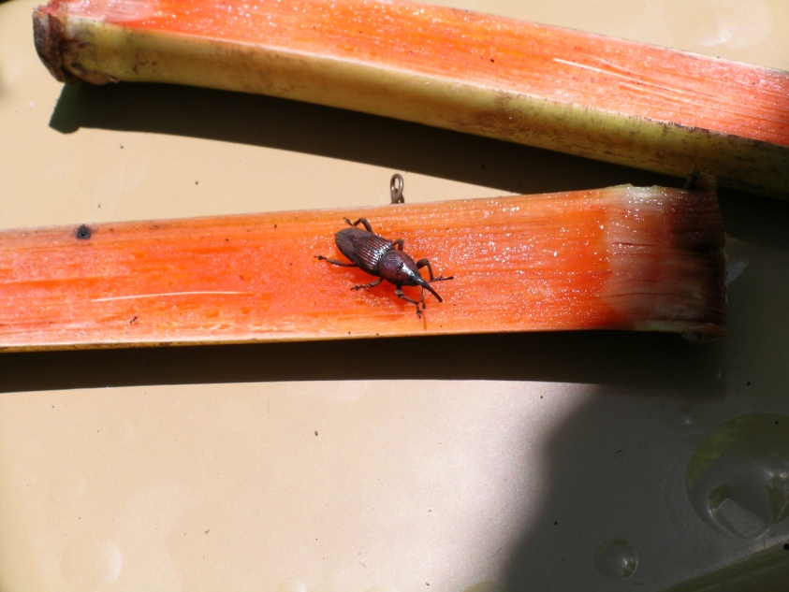
Effect of trap type, size, color, and trapping location on the capture of the New Guinea Sugarcane weevil, Rhabdocelus obscurus (Coleoptera: Curculionidae)

Slide 2
Introduction
Originally, the New Guinea Sugarcane Weevil, (Rhabdoscelus obscurus)belongs to the family Curculionidae, order Coleoptera, is from New Ireland, Papua New Guinea.
Because of the cultivation and trading of sugarcane, the sugarcane weevil made its eventual spread to Australia, Indonesia, Hawaii, and various islands in the Marianas and the Pacific.

Slide 3
Host Plants
Sugarcane (Saccharum officinarum)
Betel nut (Areca catechu)
Coconut palm (Cocos nucifera)
Champagne palm (Hyophorbe lagenicaulis)
Pritchardia palm (Pritchardia martii)
Pygmy date palm (Phoenix roebelenii)
Alexander palm (Archontophoenix alexandrae)
Royal palm (Roystonea regia)
Date palm (Phoenix canariensis)

Slide 4
Problems in Guam
Betel nut (Areca catechu).
Ornamental (palms) nursery.
Recently, R. obscurus started attacking coconut trees.
Because of the withdrawal of the ban on entry of betel nut into the US mainland from Guam by the Food and Drug Administration, commercial cultivation of betel nut on Guam has been encouraged.
Therefore, the number of weevils has increased.

Slide 6
How Weevils Damage Plants
Adults chew a 3-mm-deep hole into the sugarcane stalk and lay their eggs on the stem and in the petiole.
After that, the larvae bore into the tissue and produce frass, to let in fungal and bacterial pathogens.

Slide 7
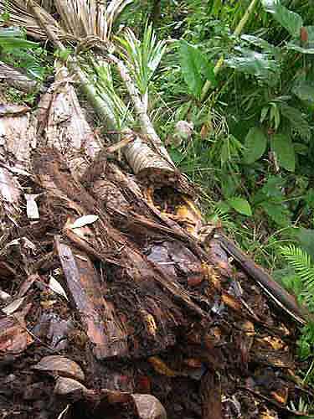
Rhabdoscelus obscurus damage on Sago palm

Slide 8
Pheromone compounds
Giblin-Davis et al. (2000) identified the pheromone of Hawaiian R. obscurus as 2-methyl-4-octanol.
Pheromone compounds for Australian R. obscurus population are 2-methyl-4-octanol (E2)-6-methyl-2-hepten-4-ol (rhynchophorol) and 2-methyl-4-heptanol.
It was determined from previous experiments that the Guam population of R. obscurus is similar to the Australian population rather than the Hawaiian population.

Slide 9
Current trapping method
Ethyl acetate (Weevil Magnet® (Chem Tica International), 40 ml of attractant, 95% purity, release rate of 200-400 mg/day
Lures of the Australian R. obscurus population: 2-methyl-4-octanol (E2)-6-methyl-2-hepten-4-ol (rhynchophorol) and 2-methyl-4-heptanol
Reddy et al. (2005) Journal of Applied Entomology129: 65-69.

Slide 10
Reddy et al. (2004) Journal of Applied Entomology, 129 (2): 65-69.
Notes:
The weevil has two aggregation pheromone compounds ((E2)-6-methyl-2-hepten-4-ol (rhychophorol) and 2-methyl-4-heptanol), which were identified by Giblin-Davis from Florida. Lures containing this pheromone were obtained from Costa Rica. Using bucket type traps, formulations containing mixtures of pheromone, food volatiles and cut sugarcane caught significantly higher number of weevils than the individual components or binary combinations of the same. Addition of an insecticide (permethrin at a rate of 0.75 ml/1 liter) to the traps prevented the weevils to escape from the traps, improving the efficiency of the formulation.

Slide 11
Existing control methods and chemical application is both undesirable and expensive.
A parasitoid of R. obscurus, Lixophaga sphenophori (Diptera: Tachinidae) was introduced to Guam from Hawaii in 2004. To date, L. sphenophori has not established.
Pheromone-based trapping method using bucket traps baited with pheromone lures results low capture rates (Reddy et al. 2005).
Therefore, the need is urgent for an efficient pheromone-based trapping method.

Slide 12
Objectives
Effect of Trap Type on Capture Efficiency.
Effect of Trap Size.
Effect of Trap Color.
Effect of Shade of Brown.
Relative Effects of Visual and Olfactory Cues, and
Effect of Trap Location.

Slide 13
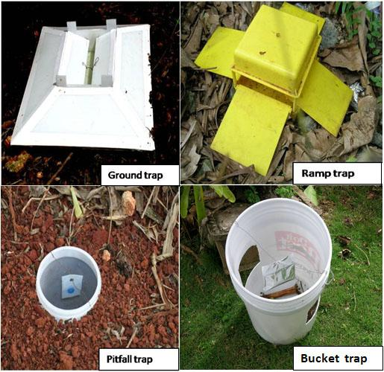
Trap types

Slide 15
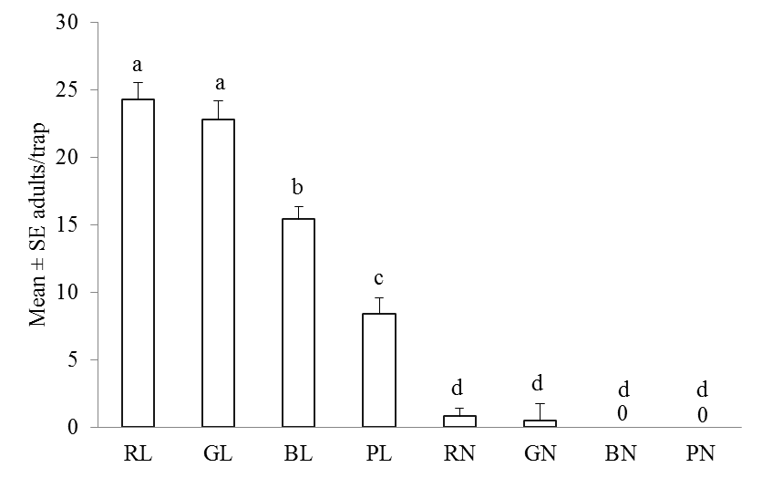
Mean (± SE) numbers of adult R. obscurus caught by ramp, bucket, ground and pitfall trap with & without pheromone
RL: ramp trap with lure
GL: ground trap with lure
BL: bucket trap with lure
PL: pitfall trap with lure
RN: ramp trap without lure
GN: ground trap without lure
BN: bucket trap without lure
PN: pitfall trap without lure
Different lower-case letters indicate significant differences between treatments (one-way ANOVA using Poisson model, Least Square Means, P < 0.0001). Means were generated from four replications.

Slide 16
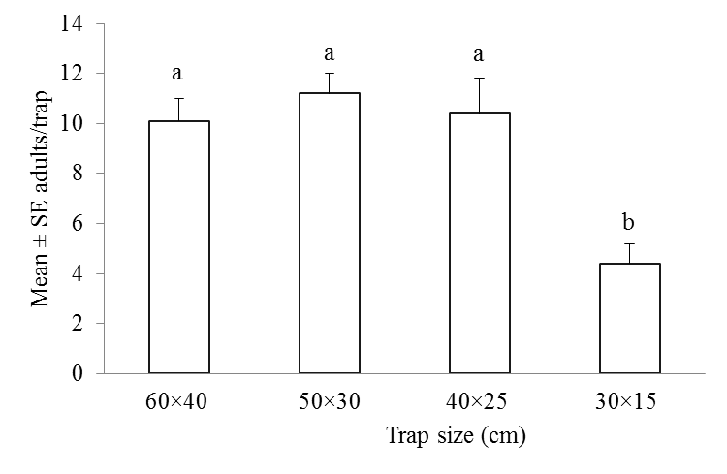
Mean (± SE) numbers of adult R. obscurus caught in pheromone-baited ground traps of different sizes
Different lower-case letters indicate significant differences between treatments (one-way ANOVA using Poisson model, Least Square Means, P < 0.05). Bars represent means of four replicates.

Slide 17
TABLE 1. Color measurements of traps used in the present study
Trap color | L* | a* | b* | Chroma (C) | angle (hº)
Black | 30.44 ± 0.06 | 0.42 ± 0.03 | -1.08 ± 0.04 | 1.16 ± 0.05 | -
Brown | 35.26 ± 0.18 | 3.98 ± 0.03 | 3.94 ± 0.02 | 5.60 ± 0.03 | 44.66 ± 0.11
Gray | 39.83 ± 0.11 | -0.17 ± 0.02 | -2.23 ± 0.01 | 2.24 ± 0.01 | 85.64 ± 0.47
Yellow | 82.57 ± 0.02 | -2.92 ± 0.03 | 84.02 ± 0.27 | 84.07 ± 0.27 | 91.99 ± 0.02
Red | 42.84 ± 0.11 | 49.88 ± 0.28 | 19.44 ± 0.20 | 53.54 ± 0.34 | 21.29 ± 0.09
White | 92.29 ± 0.03 | 1.34 ± 0.01 | -2.59 ± 0.04 | 2.91 ± 0.03 | -
Green | 43.50 ± 0.08 | -27.32± 0.03 | 1.72 ± 0.09 | 27.37 ± 0.03 | 176.39 ± 0.19
Blue | 36.02 ± 0.10 | 15.19 ± 0.10 | -35.82 ± 0.12 | 38.91 ± 0.14 | 292.98 ± 0.08
Data represent means of three observations

Slide 18
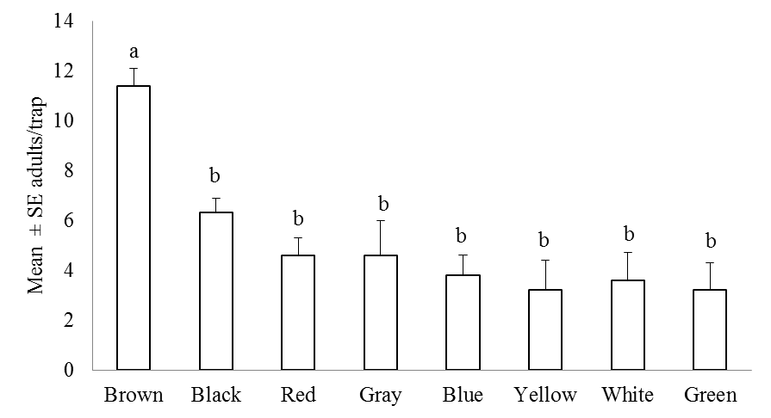
Mean (± SE) numbers of adult R. obscurus caught in pheromone-baited ground traps of different colors in the field.
Different lower-case letters indicate significant differences between treatments (one-way ANOVA using Poisson model, Least Square Means, P < 0.0001). Bars represent means of four replicates.

Slide 19
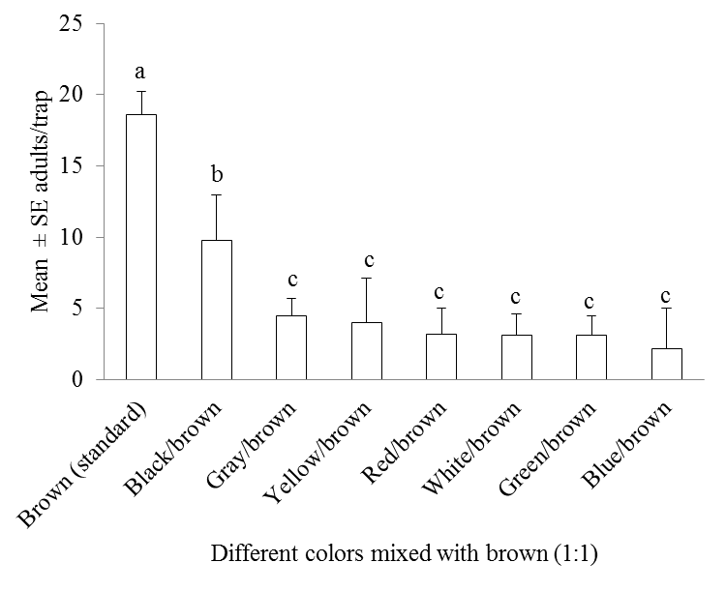
Mean (± SE) numbers of adult R. obscurus caught in pheromone-baited ground traps of different colors mixed 1:1 with brown in the field.
Different lower-case letters indicate significant differences between treatments (one-way ANOVA using Poisson model, Least Square Means, P < 0.0001). Bars represent means of four replicates.

Slide 20
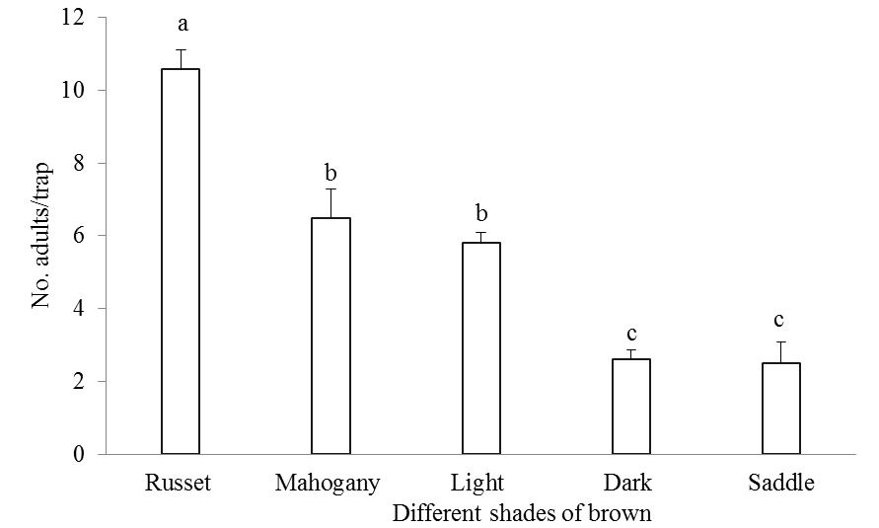
Mean (± SE) numbers of adult R. obscurus caught in pheromone-baited ground traps of different shades of brown in the field.
Mean (± SE) numbers of adult R. obscurus caught in pheromone-baited ground traps of different shades of brown in the field.

Slide 21
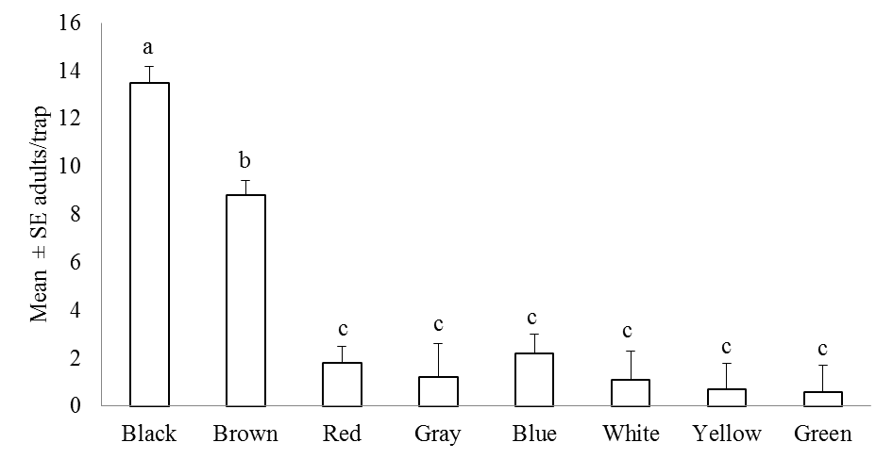
Mean (± SE) numbers of adult R. obscurus caught in pheromone-baited ground traps of different colors in the laboratory.
Different lower-case letters indicate significant differences between treatments (one-way ANOVA using Poisson model, least square means, P < 0.001). The means were generated from eight tests each using 30 insects. Black traps outperformed all others.

Slide 22
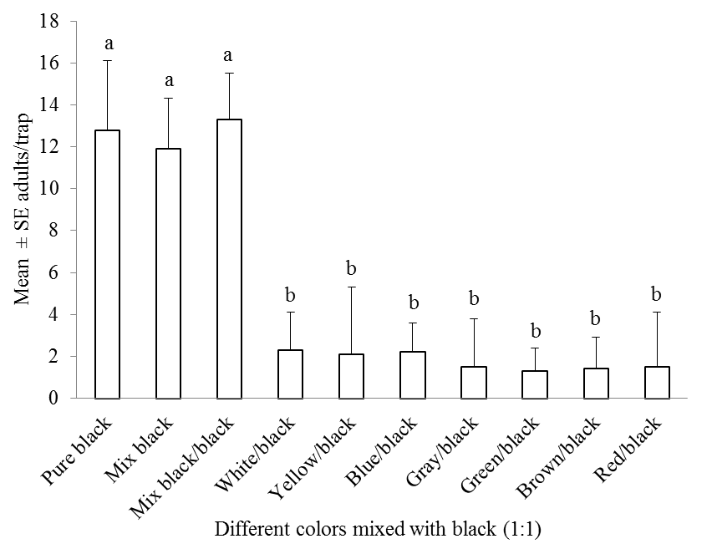
Mean (± SE) numbers of adult R. obscurus caught in pheromone-baited ground traps of different colors mixed 1:1 with black in the laboratory.
Different lower-case letters indicate significant differences between treatments (one-way ANOVA using Poisson model, least square means, P < 0.01). Adding black to the other colors did not improve their performance. Bars represent means of four replicates.

Slide 23
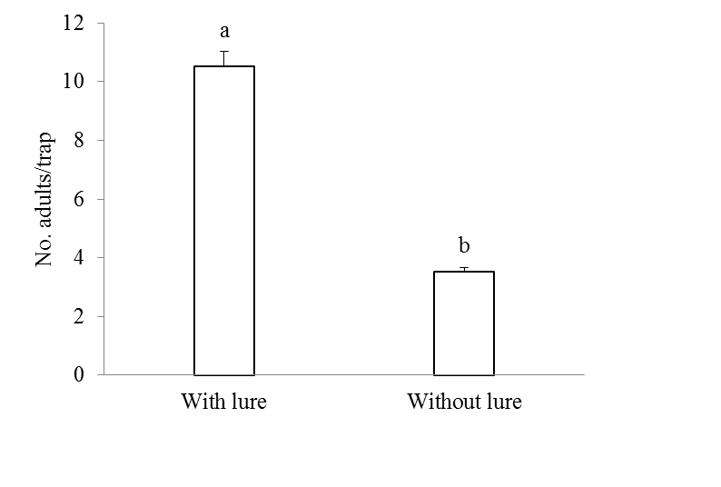
Mean (± SE) numbers of adult R. obscurus caught in russet-brown ground traps with and without pheromone lures in the field.
Different lower-case letters indicate significant differences between treatments (one-way ANOVA using Poisson model, least square means, P < 0.0001). Traps with lures outperformed identical traps without lures. Bars represent means of four replicates.

Slide 24
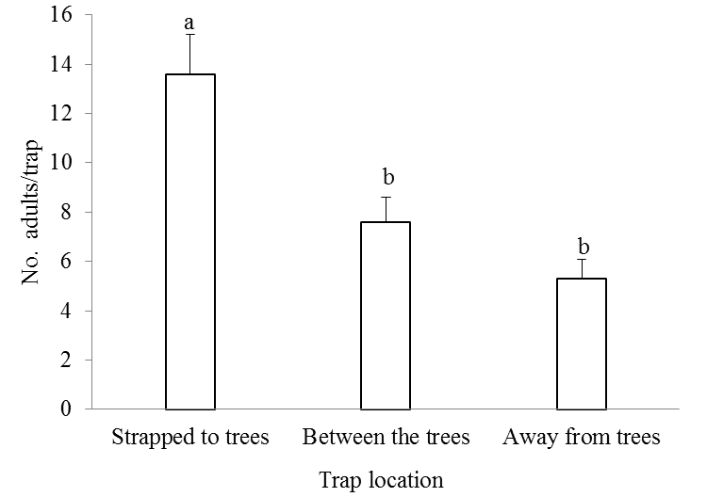
Mean (± SE) numbers of adult R. obscurus caught in pheromone-baited ground traps placed in different locations.
Different lower-case letters indicate significant differences between treatments (one-way ANOVA using Poisson model, Least Square Means, P < 0.05). Bars represent means of four replicates.

Slide 25
Conclusions
In summary, 40-25-cm russet brown ground traps baited with semiochemical lures and strapped to the host plants are an efficient tool for catching adult New Guinea Sugarcane weevil in the field.
I think it would be interesting to find out why these weevils are attracted to black colored traps in indoors and russet brown colored traps in the field.

Slide 26
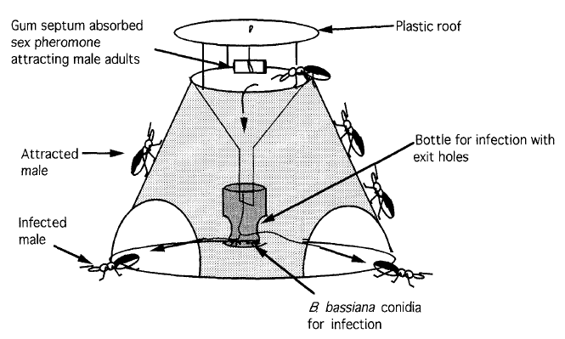
Further studies
Integrated control tactics for the New Guinea Sugarcane Weevil Rhabdoscelus obscures
Development of a trap for auto dissemination of fungal spores of Beauveria bassiana and Metarhizium anisopliae.
Implementation and evaluation of a mass trapping experiment.
Evaluation of comparative performance of pheromone traps with and without B. bassiana and M. anisopliae.
Train growers, stakeholders and ornamental nursery firms about new integrated control tactics.
Trap for Auto-infection system
USDA- Natural Resources Conservation Service

