Slide 1
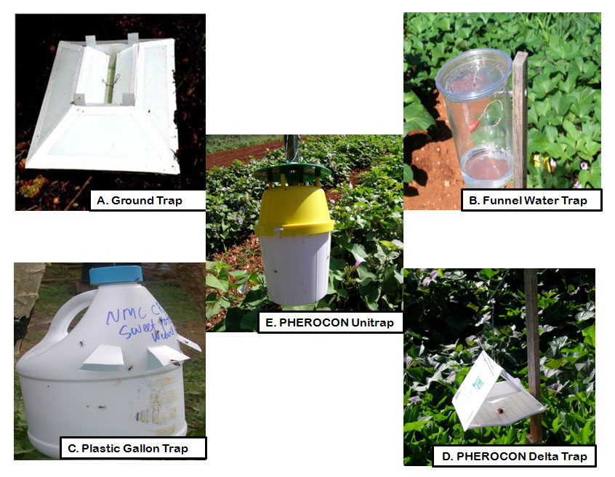
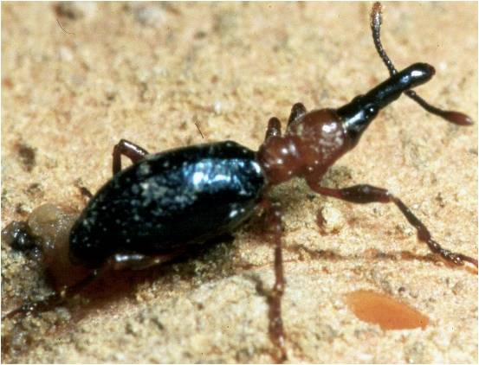
Control of Sweet Potato Weevil Cylas formicarius (Coleoptera: Curculionidae)

Slide 2
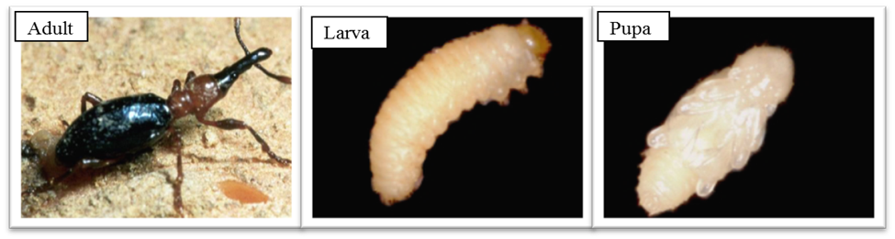
Different life stages of the sweetpotato weevil, Cylas formicarius

Slide 3
Sweetpotato damage and Weevil entry hole by Cylas formicarius

Slide 4
Mean (± SE) numbers of adult Cylas formicarius caught by different traps with & without pheromone
PUL: Pherocon unitrap with lure
FWL: funnel water trap with lure
GTL: Ground trap with lure
PDL: Pherocon delta trap with lure
PUN: Pherocon unitrap without lure
FWN: funnel water trap without lure
GTN: ground trap without lure
PDN: Pherocon delta trap without lure

Slide 5
Mean (± SE) numbers of adult Cylas formicarius caught in pheromone-baited ground traps of different sizes

Slide 6
Mean (± SE) numbers of adult Cylas formicarius caught in pheromone-baited ground traps of different colors in the field

