Slide 1
Prairie Grass Mulch in Vegetable Farming
A 2-year USDA SARE Producer Grant comparison with small grains straw at Scotch Hill Farm, Brodhead, Wis.
With Rock County UW Extension Service & Wisconsin Department of Natural Resources
Contact: Tony Ends, tony@scotchhillfarm.com /608 897-4288

Slide 2
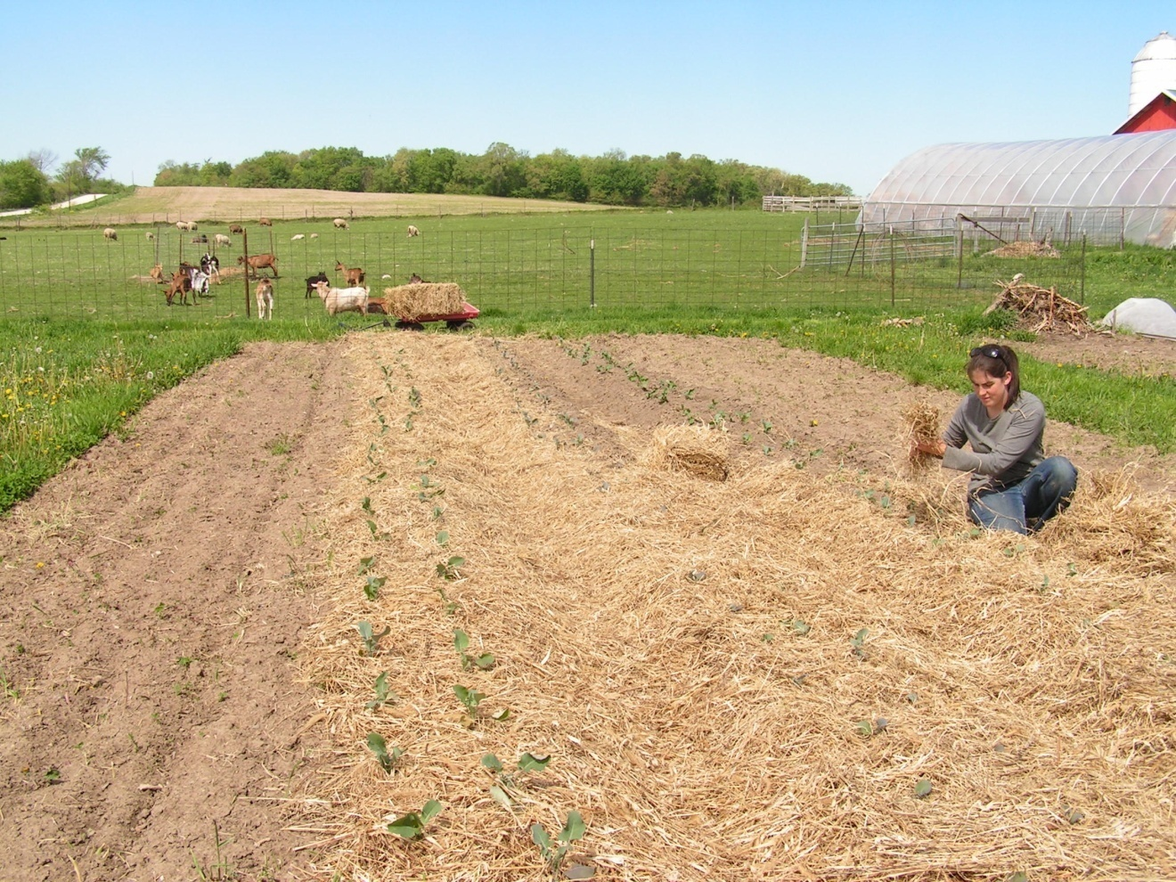
Why is straw mulch important?
Why should all specialty crop farmers use it, try it, experiment with it?

Slide 3
Your Pocketbook
  2011 forecasts for specialty crop growers expect average net cash income will decline. Receipts will increase 4 percent; expenses will rise 9 percent.
Your sustainability
  Global oil production has peaked. Fuel prices – and everything dependent on fossil fuel – are only going to rise. Farm fuel and fertilizer costs this year rose 24 percent each.
Your legacy
  Rolled plastic from polyethylene film to mulch vegetables and fruits has helped control weeds since the 1950s. By 1999, it spread globally to more than 30 million acres. Much of it ends up in landfills, which are closing. Consumers worry black plastic mulch leaches.
Your model
  About 18,000 U.S. vegetable and melon farms direct market, a 97 percent increase over 10 years. The number of CSA vegetable growers has risen from 2 in the 1980s to more than 4,000 today. Local food production is a permanent trend, and these growers are going to need sustainable methods that do not depend on non-renewable energy.

Slide 4
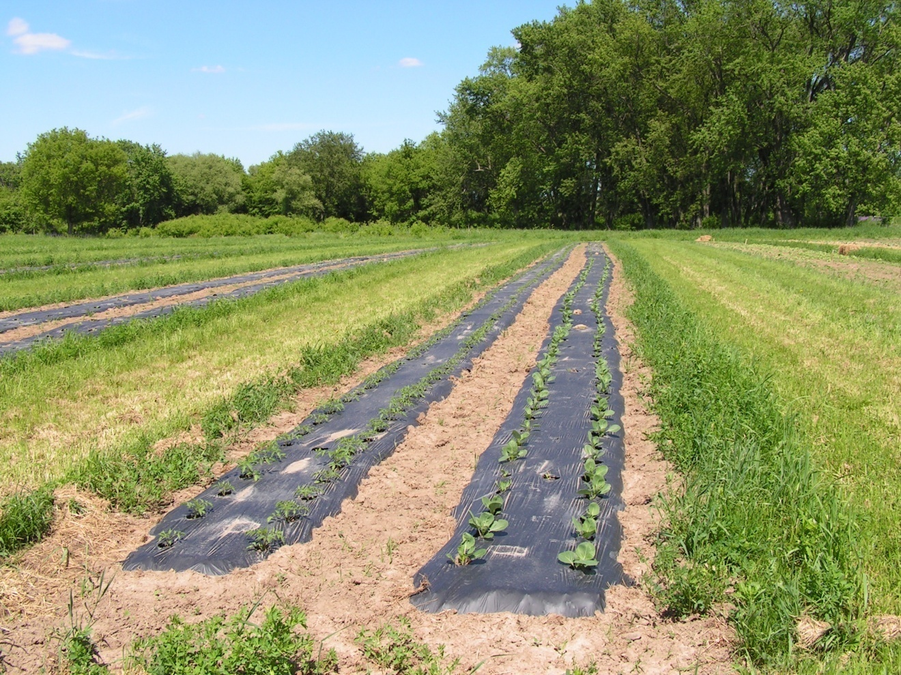
Black Plastic Mulch – Pros and Cons
Easy to lay with a used $450 machine in spring; a long, cold tiresome process to remove in late fall, early winter

Slide 5
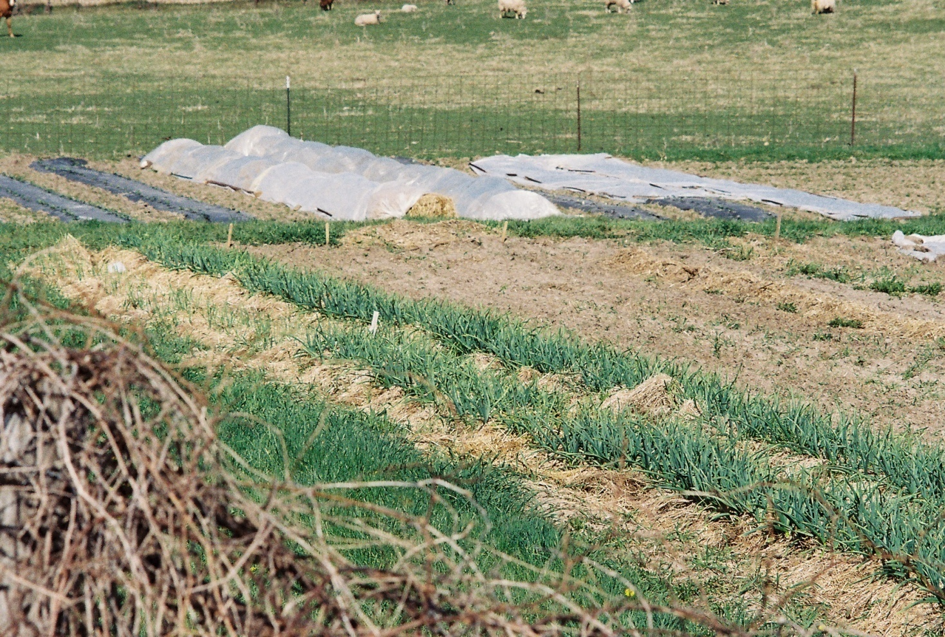
Small Grains Straw Mulch – Pros and Cons

Slide 6
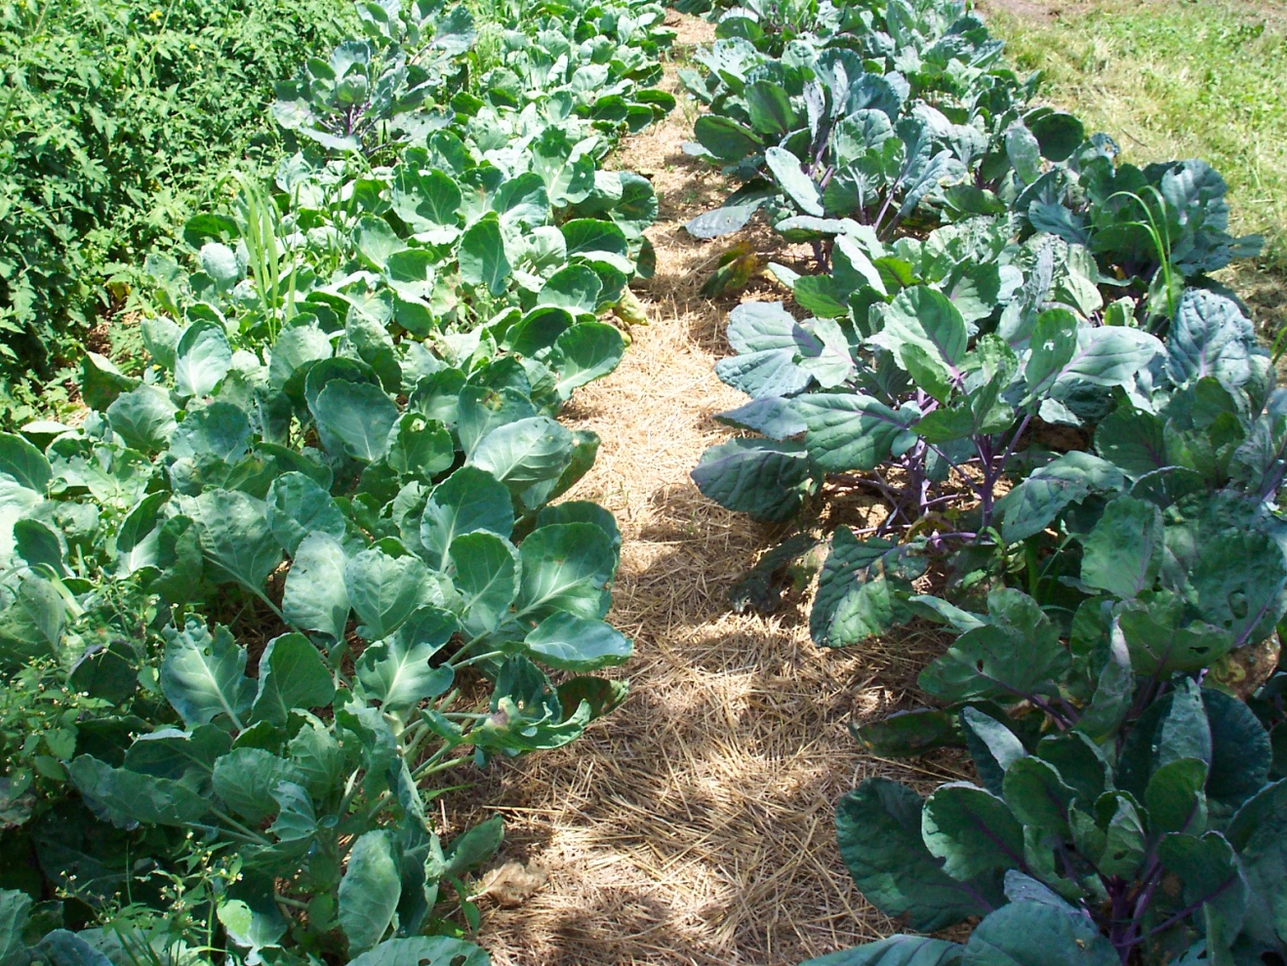
Brussels Sprouts in switch grass mulch
No incidence of plant disease in prairie grass mulch; both wheat and oat straw hosted some plant disease

Slide 7
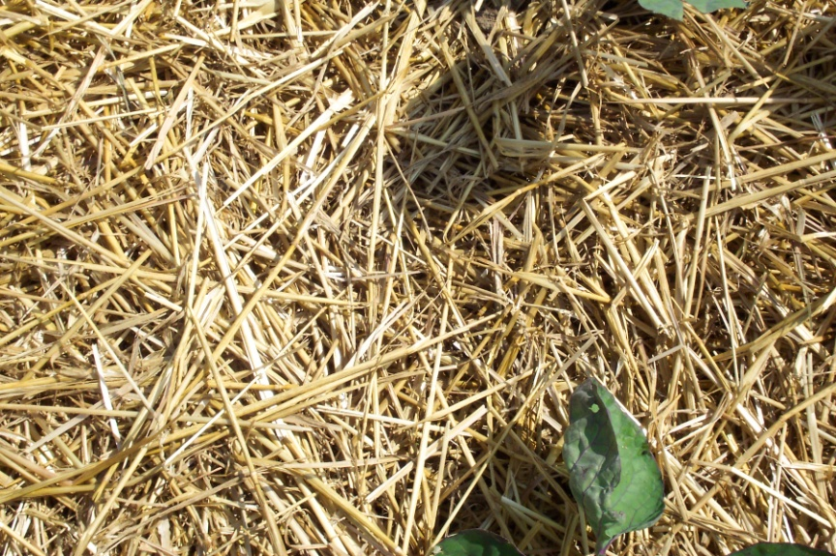
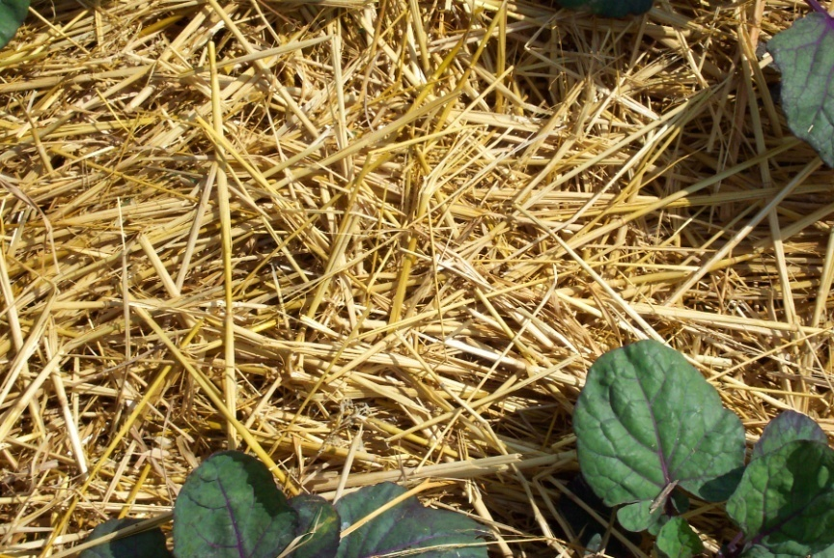
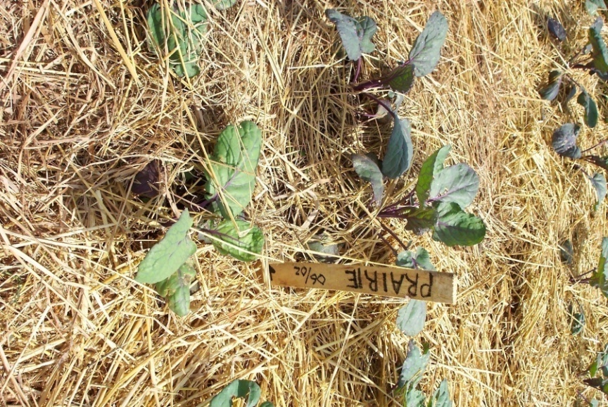
Field Trial Comparison
at Scotch Hill Farm
Mulch materials at application, June 2, 2010.
Top Left: Wheat straw
Bottom Left: Oat straw
Right: Prairie grass

Slide 10
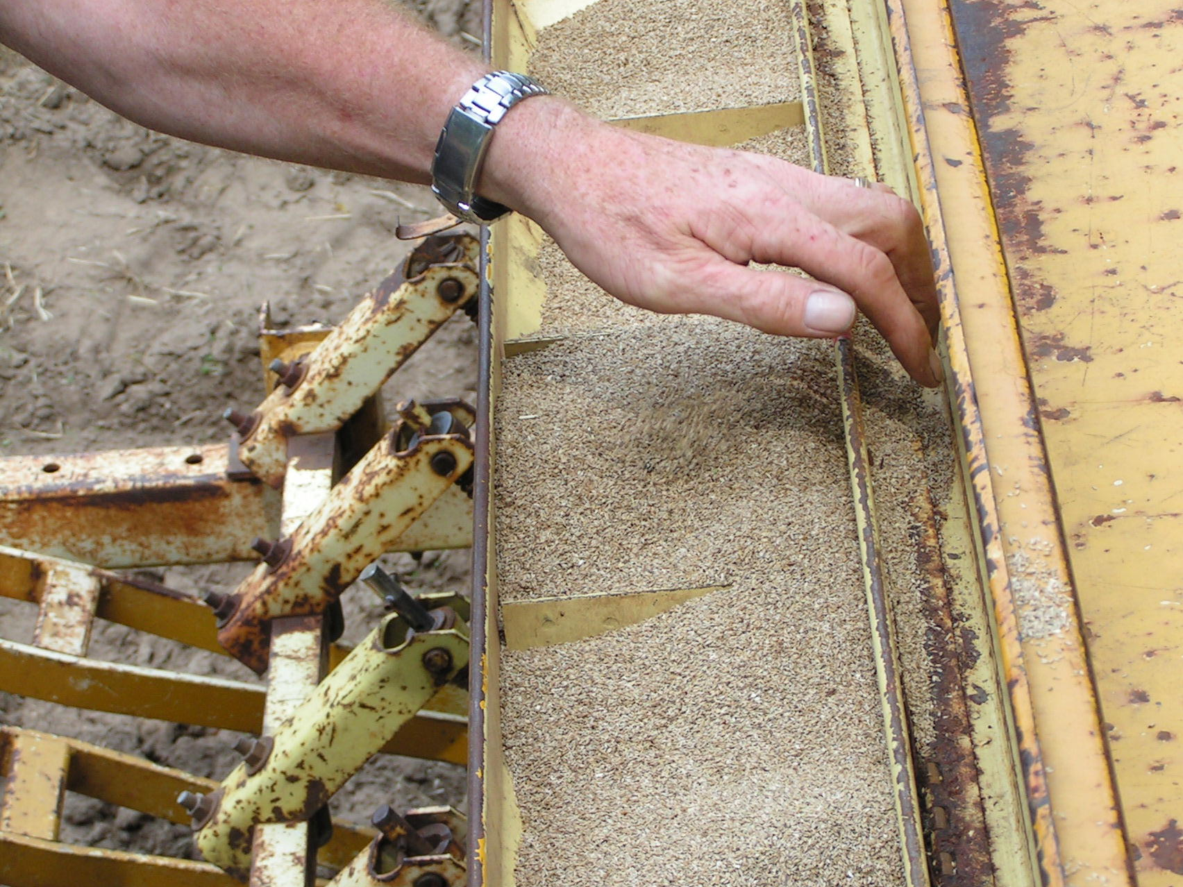
Prairie (switch grass) Mulch – Pros and Cons
Seed sown 5 lbs. to the acre; takes 2 to 3 years to establish; must be managed (mowing several times first seasons, controlled burn in fall to increase vigor and suppress weeds)

Slide 11
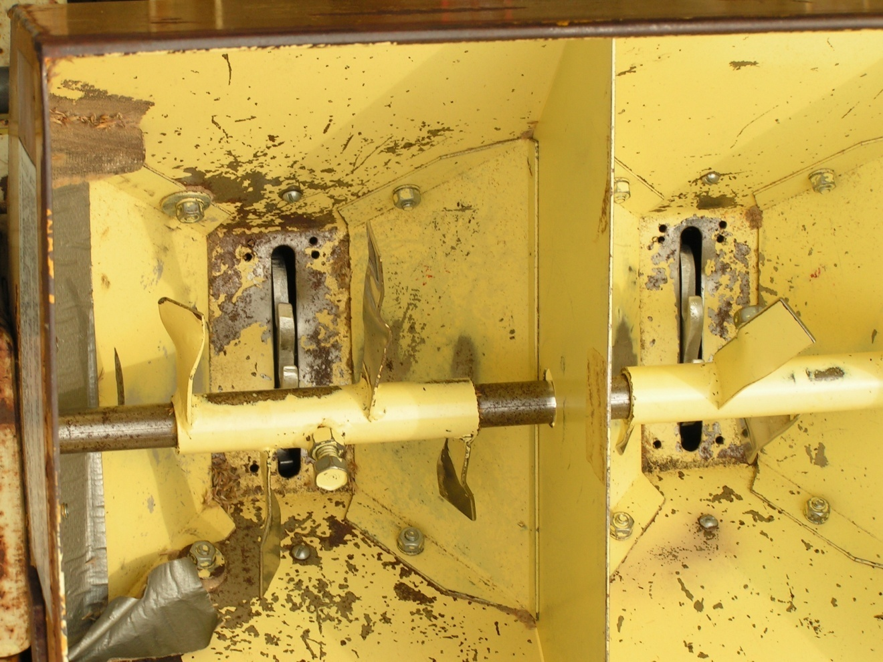
Specialized Equipment for Switch Grass
Truax812 planter, Circa 1978 for fine native species seed varieties

Slide 12
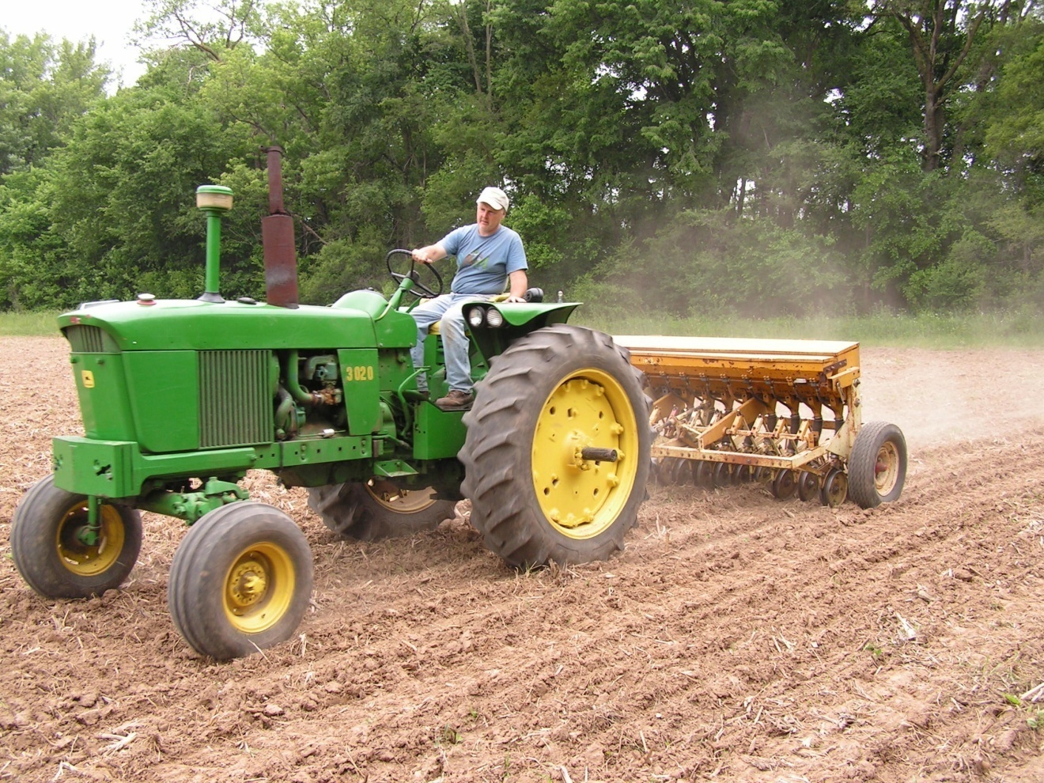
Establishing a field of switch grass
Seed drill on loan from Wisconsin Department of Natural Resources

Slide 13
Two-year Comparison
Used all 3 mulch types in 12 crops
Conduced field trial with tomatoes (high traffic) and Brussels sprouts
Observed weed suppression
Estimated organic matter rate of decomposition and availability to soil
Watched for incidence of plant disease and tendency to volunteer

Slide 14
Resources
Native Species Seed - Applied Ecological Services / Taylor Creek Restorations, Brodhead, Wis.
Organic Small Grains - Albert Lea Seed Co., Albert Lea, Minn.
Using Hay for Mulch - Organic Vegetable Seed Trials, UW Madison
Testing Biodegradable Mulches - ARS National Center for Agricultural Utilization Research, Peoria, Ill.

